Slide 1
Intel Projects

Slide 2
Additional Meetings
Additional meetings for this class will be on Thursdays 5pm in Conference room FAB 155
They will be changed on popular demand of this class students to another day and time.

Slide 3
BME Seminar
Thursday, October 8, 2015
3:00 – 4:00 pm
Center for Health & Healing
Conference Room 1A, 3rd Floor
3303 SW Bond Avenue
Portland, OR 97239
Speaker: Yiğit Mengüç, PhD
Assistant Professor of Robotics and Mechanical Engineering
Oregon State University, Corvallis
Title: Biologically inspired soft devices in robotics
Abstract: Title: "Biologically inspired soft devices in robotics"
Talk abstract: Incredible biological mechanisms have emerged through evolution, and can provide a wellspring of inspiration for engineers. One promising area emerging from biological inspiration is the design of devices and robots made of compliant materials, as part of a larger field of research in “soft robotics.” In this talk, the topics of designing soft, biologically inspired mechanisms will be presented in two case studies: controllable adhesives and soft wearable sensors. Additionally, the talk will cover the methods of fabricating soft devices through 3D printing, soft lithography, and laser micromachining. Surfaces covered in arrays of micro-fibers, inspired by the toes of a gecko, rely on compliance to repeatedly and controllably adhere to almost any surface while simultaneously shedding dirt. Sensors made of liquid metal encapsulated in rubber as soft as skin can track motion of the human body while naturally moving with its kinematics. However, these exciting soft mechanisms have certain challenges. The biological mechanisms that serve as a source of inspirations are made of materials that are vastly more compliant than the metal and plastic that engineers and roboticists normally use. To imitate and improve on nature’s design, we must create mechanisms with materials like fabric and rubber. It is difficult to characterize these hyperelastic, viscoelastic, and generally nonlinear materials, and it is difficult to integrate them into traditional fabrication techniques, but the development of such soft robotic devices promises to bring robots more and more into our daily lives.

Slide 4
Plan for class
Today:
I will explain Homework 1 in more detail and answer your questions.
We will discuss your ideas for Intel Projects.
I will talk about my ideas for Intel Projects.
I will assign “additional Homework 0”, which is just to write your realistic plans for Intel Projects. This is individual assignment, graded.
Normal lecture, if time allows.
Next Tuesday:
I will collect your “Homework 0” about ideas for Intel projects
Tony Muilenberg from Intel will talk about setting KINECT, vision with OpenCV and theatre scripts.
You read lectures posted for weeks 1 and 2 and ask me questions.

Slide 5
My ideas for Intel Projects
Intel is clearly interested in your ideas.
Young people are supposed to be very creative, innovative and with new ideas and “a better feel for new technology”
They seem to be interested more in software, vision, new sensors and Machine Learning, AI than in mechanical hardware design.
We need to increase the percent of this type of projects or project components for this quarter.
I want to propose, in addition to those presented, few more robots:
Jimmie – HR-OS1. Small biped.
InMoov large biped.
Countess Quanta will be redesigned to make it compatible with Loki.
We will steal all good Loki ideas.
Many of these ideas are compatible with what we have on Countess Quanta.
We need to improve the head and arms.
We will use more advanced vision and learning theories on top of their and our software.

Slide 6
Jimmie – HR-OS1
Intel supported Jimmie.
They have an older brother of Jimmie, but our Jimmie is cheap.
Mechanical assembly will be done by other students.
You will need to 3D print the shell
Jimmie has a camera and sensors.
It allows for many new projects in software, vision, new sensors and Machine Learning and Artificial Intelligence.
This team will be from one to three people. Leader?
It is an improved “actor-puppet” so we can re-use many pieces of software that we already developed:
Obstacle avoidance.
Face recognition
Facial emotions recognition
Control by gestures.
Dancing and singing.
Question-answering.
YOUR IDEAS.

Slide 7
InMoov large biped
This project has three aspects: hardware, theory and software.
Intel is interested in vision and deep learning – they will be used in this project
Mister Melih Erdogan is the Leader of this team.
Hardware: (this quarter)
3D print the head and neck.
Mount Intel cameras in eyes.
Check and improve if necessary neck design to allow the robot to have wide vision with head motions.
3D print arms (models exist)
3D print legs (to discuss)
Sensors: take ideas from previous projects. Re-use software. Find new advanced sensors of interest to Intel.
Theory: (this quarter)
Theory of passive walking for biped robots.
ZMP theory
Generator theory.
Approaches based on Machine Learning, especially Support Vector Machines and Support Vector Regression
Approaches based on sensor integration using Kalman Filters and Particle Filters
Approaches based on Neuro-fuzzy theories.
Software (this and next quarter)
Animation of head and arms (this quarter). Software exists to large extent.
Control of legs for simple walking (next quarters). No software available. Some software may be adapted but not sure.

Slide 8
Countess Quanta
A lot of software exists and was tested on this robot. Most was integrated. Integrate with more our software and Loki software.
Mr. Dan Petre will be the project leader. Project may be for many people. At least 3.
Making Quanta compatible with Loki will allow us to synchronize our efforts with Intel.
Loki and Quanta should be able to talk one to another and interact.
Hardware:
Mount Kinect. It will be rotated vertically.
Mount Tablet IPOD.
Mount the music instrument differently. They robot still should be able to play it with new arms.
Raise head allowing to have more space for IPOD. Move head to front.
Add head sensors.
Mount cameras in eyes.
Add more degrees of freedom to neck, it should allow looking to arms on the floor like in Loki.
Build one arm similar or identical to one in Loki. Location outside the red box.
Build another arm using components from existing arms. Use metal palm with fingers.
(possible addition). Mount floor observing sensors that we used in past.
Mount a tray in back to store items (similar to LOKI).
Fix the upper sonar ring.
Software:
Demonstrate behaviors that have been developed and tested last year.
Add new behaviors created by previous classes at PSU
Integrate behaviors developed for LOKI
(when new arms will be available). Integrate LOKI behaviors related to arms and vision.
Theory: Any new theory of interest to Intel.
For instance:
emotion recognition,
Gesture recognition,
Deep learning
Natural language,
New sensors.

Slide 9
Intel’s Robot Jimmie

Slide 10
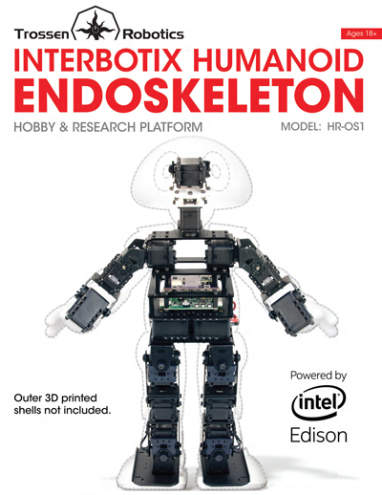

Slide 11
Trossen Robotics is proud to announce our new humanoid kit in partnership with21st Century Robot.
The HR-OS1 is an open source metal frame high tech humanoid which can be customized with 3D printable shells and connects to apps on your smart phone or tablet.
20 AX-12A Robot Actuators
On Board Gyro, Accelerometer
Intel Edison ® Processor
Wifi and Bluetooth Wireless built in, optional XBee connectivity
3-cell 11.1 2000 mAH LiPo Battery
42 cm Tall
1.85 kg
Open Source C++ framework based on the DARwin-OP software with integrated REST based API
5052 Aluminum Metal Brackets

Slide 12
When launched, the endoskeleton frame, subcontroller, and 3D shelling files will be released open source so that the HR-OS1 skeleton, electronics, and shells can be customized, modified, and personalized. Every robot should be unique!
The HR-OS1 has Intel inside! The Intel® Edison is a brand new system-on-a-chip (SoC) packing an Intel Atom dual-core CPU on a chip the size of an SD card. The Edison has integrated Wi-Fi, Bluetooth* LE, memory, and storage allowing for high level development and connectivity on small mobile robot platforms.
Paired with the Intel® Edison HR-OS1 will also have the Arbotix Pro subcontroller which boasts a 32-bit ARM Cortex-M3 72mhz CPU and is packed with features - 51 total I/O (16 x 12-bit analog inputs), ACC/Gyro combo, Dynamixel power control with TTL & RS-485 comm, Xbee/TTL/USB communication, battery voltage monitoring, & speaker output.
The HR-OS1 runs an expanded version of the DARwin-OP software framework built on top of Yocto OpenEmbedded Linux.
Framework functions are exposed through a node.js API allowing developers to build programs and apps from many different languages to deploy and share on tablets and smartphones.
Default apps will be available for users to get up and running quickly giving their robot life right after assembly.

Slide 13
Optional 3D printed Armor and add-ons not included *
Interbotix Labs is proud to announce the new HR-OS1 Humanoid Endoskeleton Robot, an open source humanoid platform that you can build yourself.
The HR-OS1 is powered by an onboard Linux computer giving you all the processing power you need to run your robot.
This robot can be customized with 3D printed armor and components to change the form and function of the robot.
The HR-OS1 is a hackable, modular, humanoid robot development platform designed from the ground up with customization and modification in mind.
A node.js interface and API have been created to enable apps and other computers on the network to interface with the robot via wifi.
We also offer full support of the Playstation DS3 Sixaxis Bluetooth Gamepad for remote control demos.

Slide 14
Kit Contents
20 AX-12A Robot Actuators
Arbotix-Pro Robocontroller (CM-730 compatible)
Intel Edison ® Processor
Raspberry Pi 2 CPU with SD card, Wifi Dongle and Bluetooth Dongle
Playstation DS3 Sixaxis Bluetooth Gamepad Controller
3-cell 11.1v 2200 mAH LiPo Battery and Battery Monitor
USB Webcam
Imax LiPo Charger
12v10A SMPS
Metal Brackets and Frames
Lasercut Delrin Torso
3D Printed Pan/Tilt Head Assembly
Assembly Hardware and Tools
Power and Data Cables

Slide 16
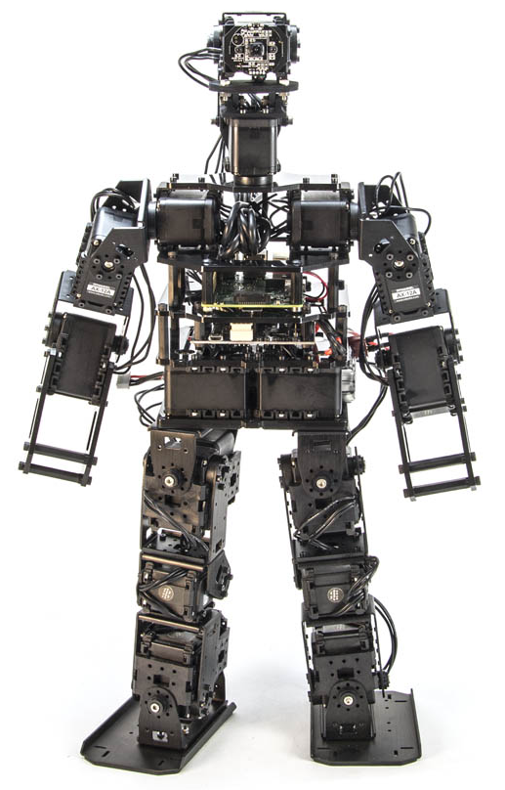

Slide 17
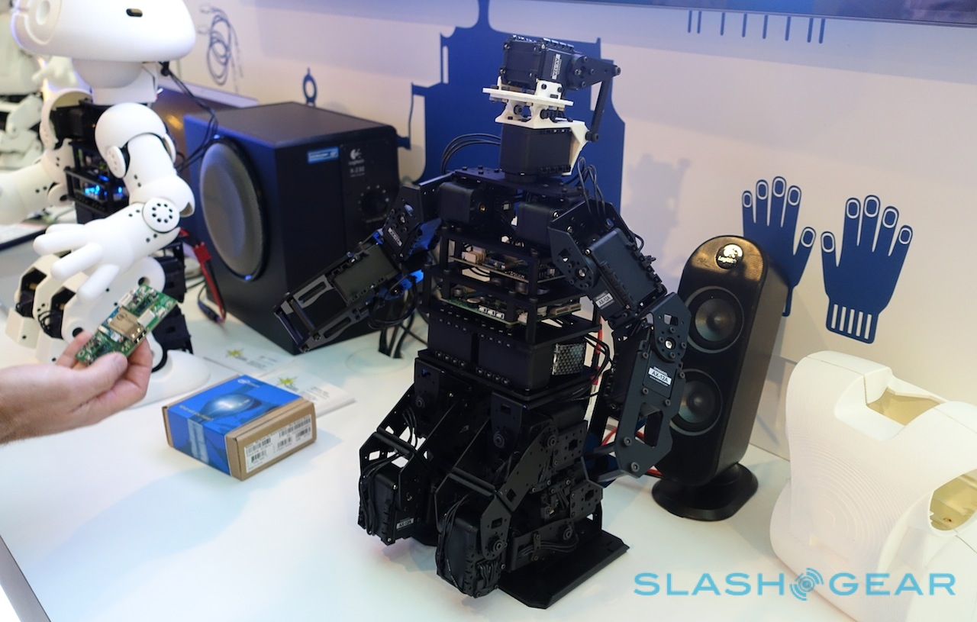

Slide 18
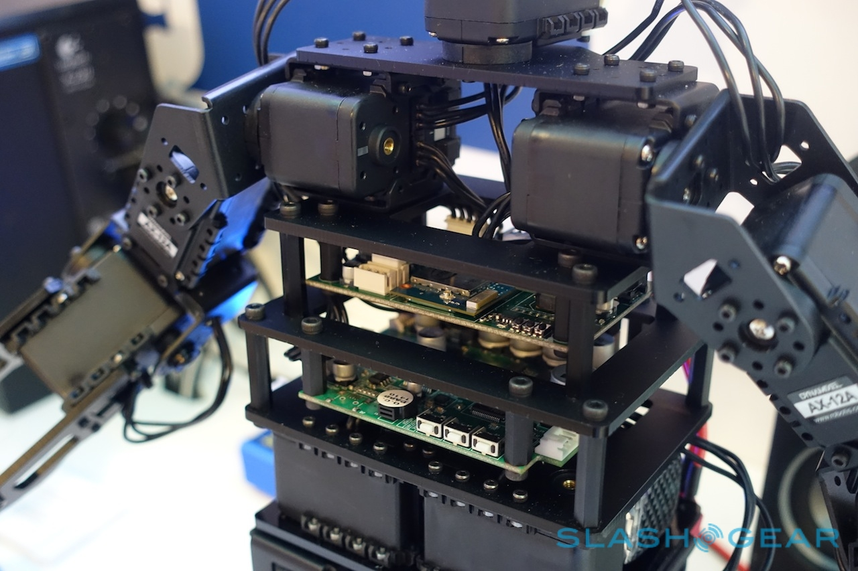

Slide 19
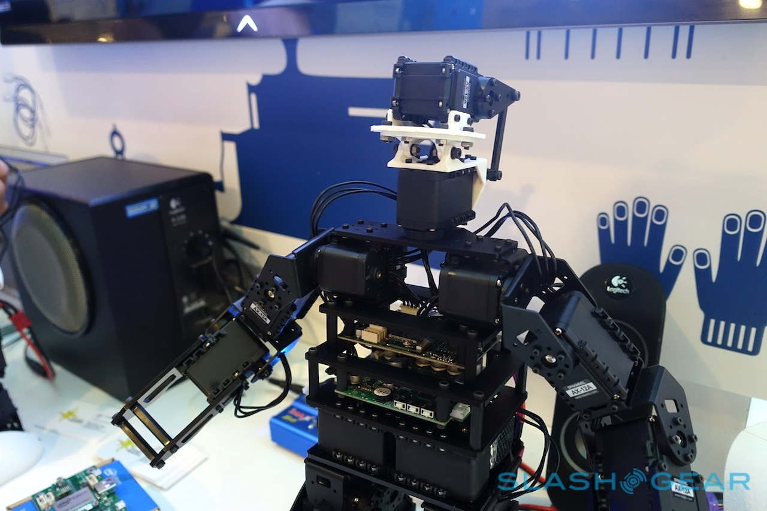

Slide 20
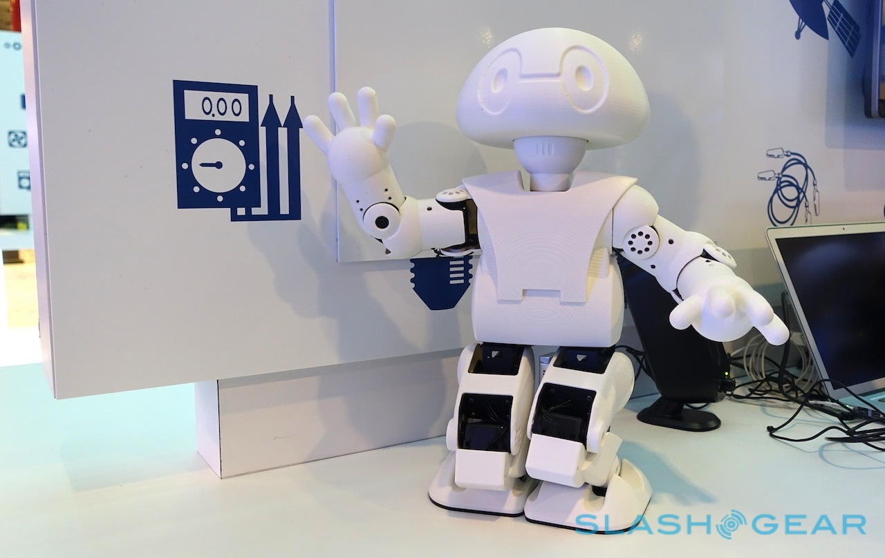

Slide 21
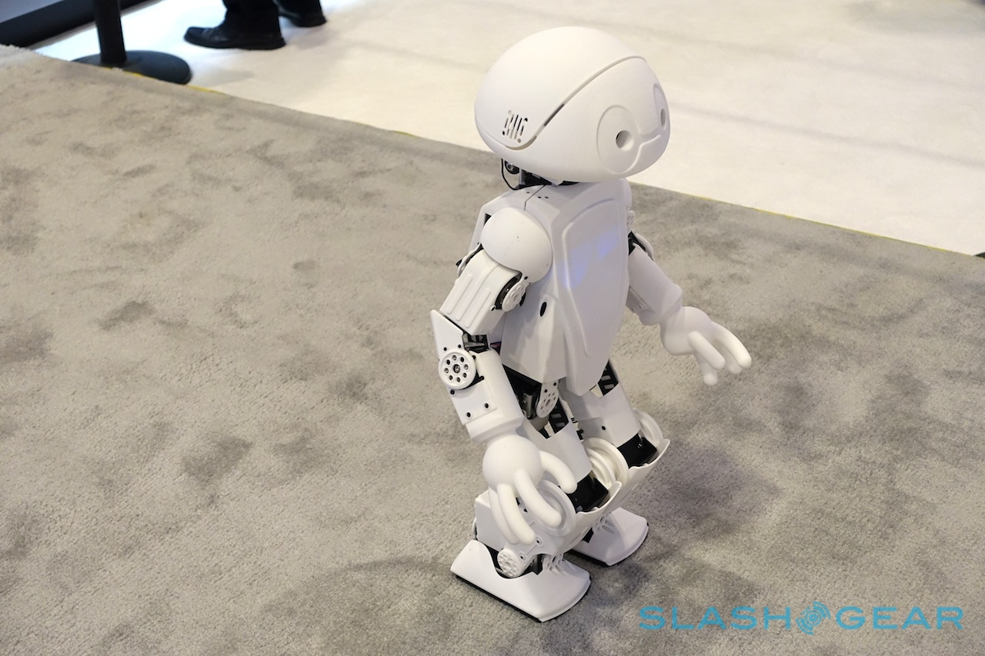

Slide 22
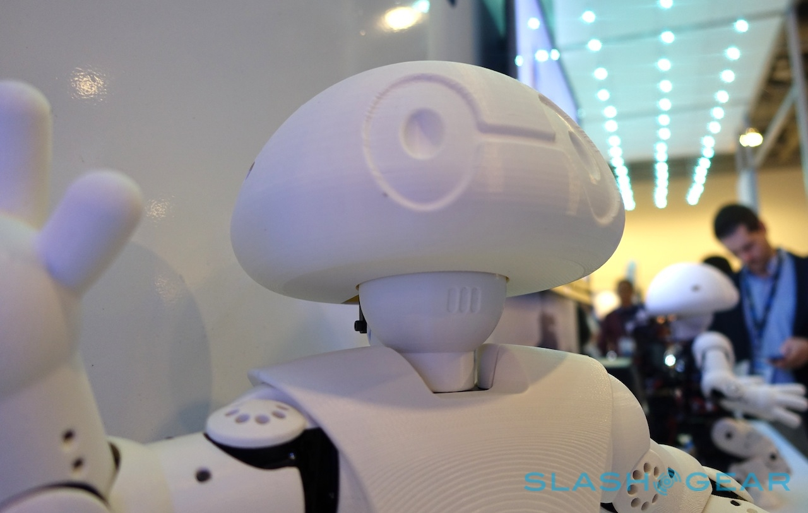

Slide 23
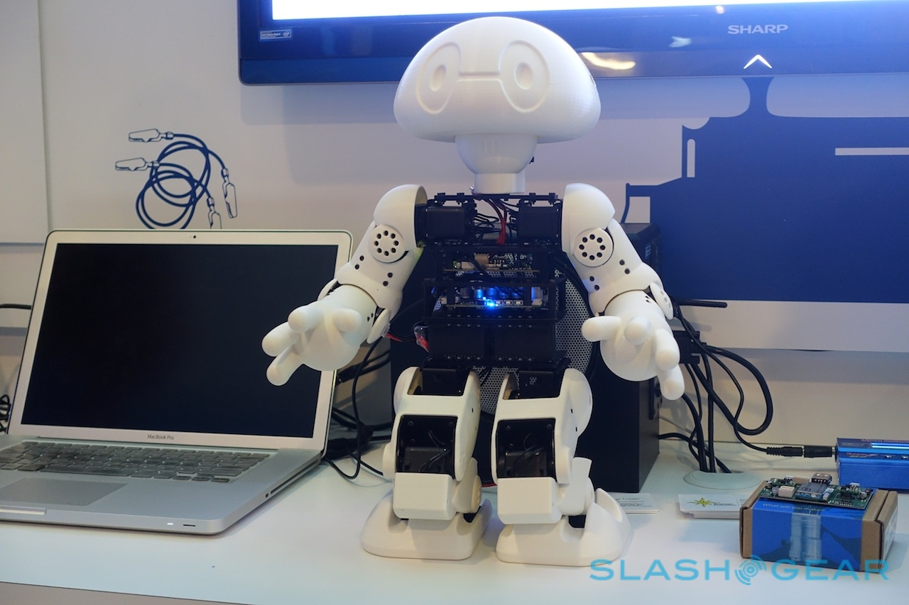

Slide 24
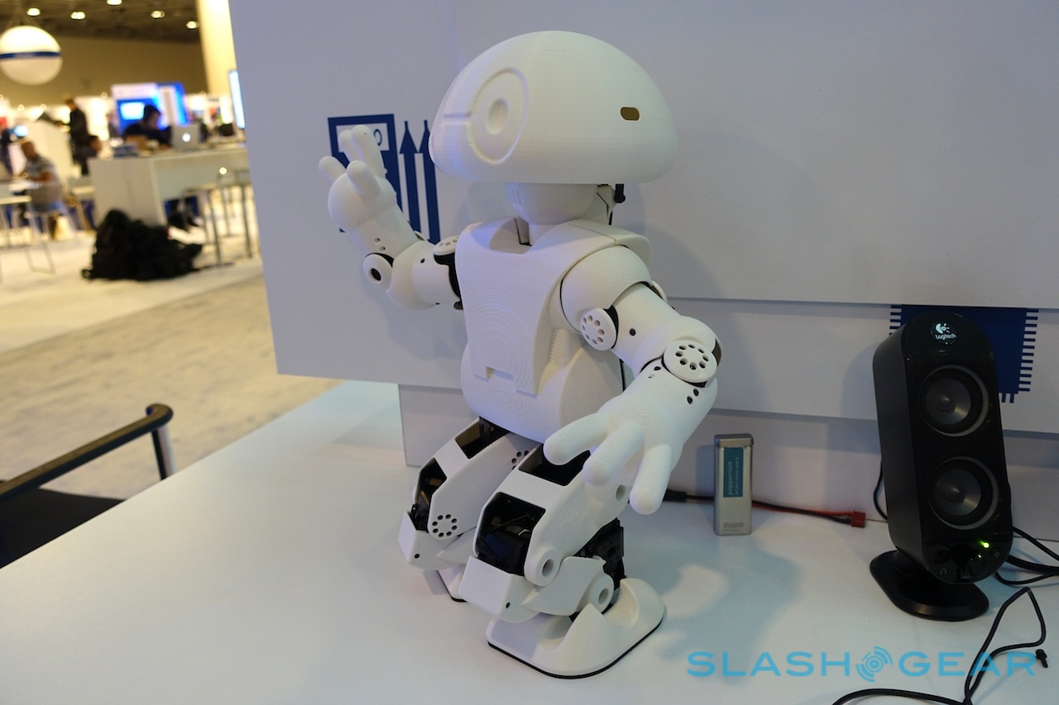

Slide 25
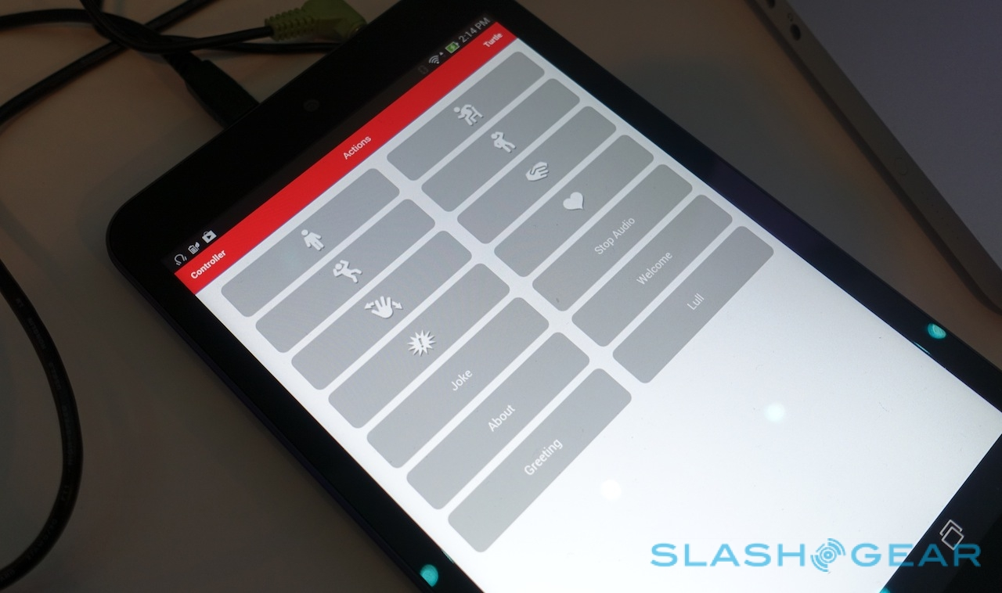

Slide 26
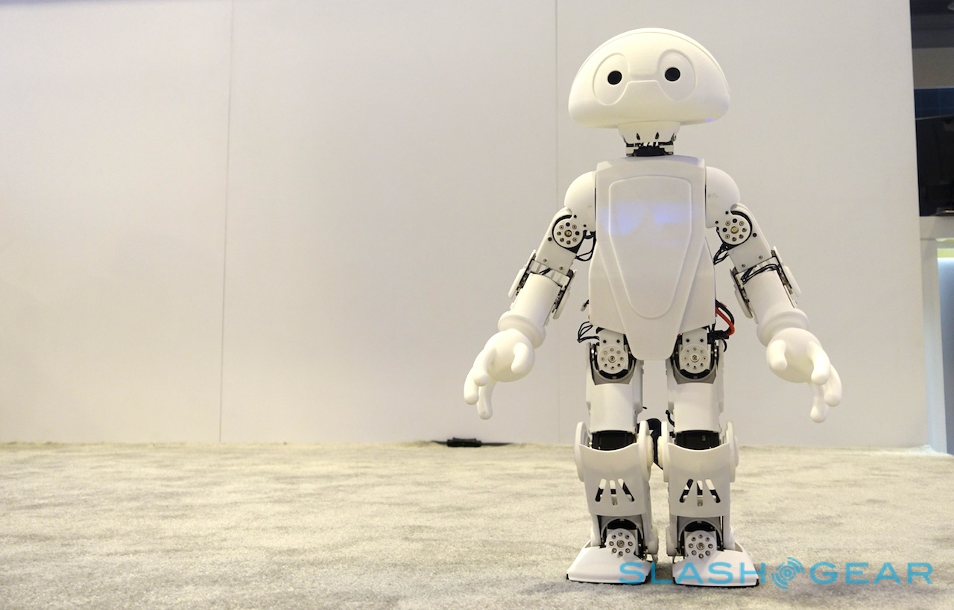

Slide 27
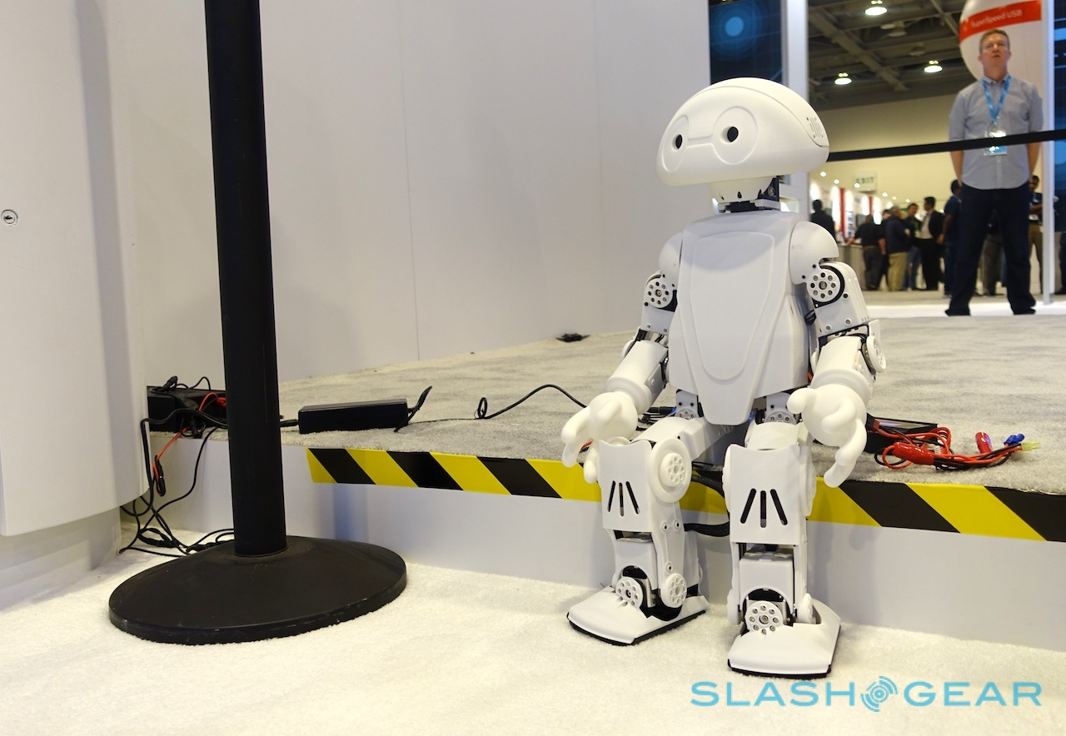

Slide 28
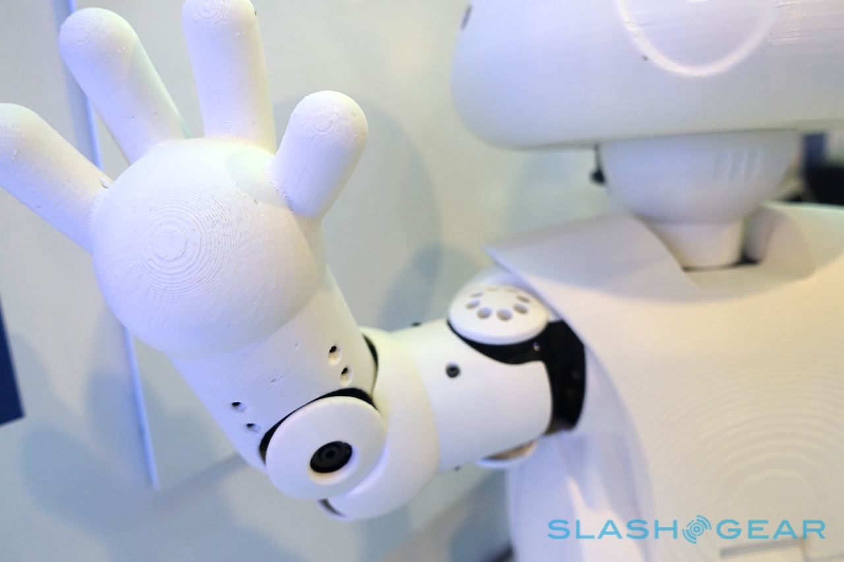

Slide 31
