Slide 1

Design of Seals

Slide 2
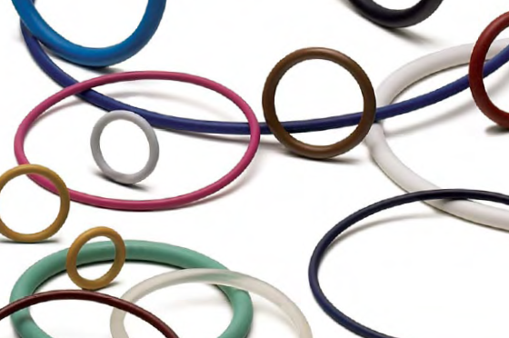




Design of O-Ring Seals
Primary Source of information

Slide 3
Why O-Rings?
  Static and dynamic applications
  Compact
  Easy to use
  Simple design rules
  Easy to install or remove
  Easy to service
  Available in many standard sizes, materials

Slide 4
Why O-Rings?
  Wide range of operating temperatures
  Wide range of operating pressures
  Good durability and abrasion resistance
  Materials for a wide range of chemicals
  Deterioration is gradual
  Inexpensive

Slide 5
Limitations of O-rings
Temperature (Typically -40 and 400 degrees F)
Rotary speeds ( not to exceeding 1500 feet per minute)
  For a 2 inch shaft, it is 3000 rpm
Vulnerable to sharp edges

Slide 6

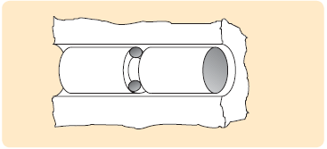
O-Rings

Slide 7
Popular O-ring materials
Nitrile (Buna-N)
  Variety of trade names
  Copolymer of butadiene and acrylonitrile
  Most widely used and economical elastomer
  Temperature Range: -40° to +257°F
  Hardness (Shore A): 40 to 90

Slide 8
Popular O-ring materials
Nitrile (Buna-N)
Excellent resistance to
  petroleum-based oils and fuels
  silicone greases
  hydraulic fluids
  water and alcohol
High tensile strength
High abrasion resistance

Slide 9
Popular O-ring materials
Nitrile (Buna-N)
Applications
  Oil resistant applications
  Low temperature uses
  Off-road equipment
  Automotive, marine, aircraft fuel systems

Slide 10
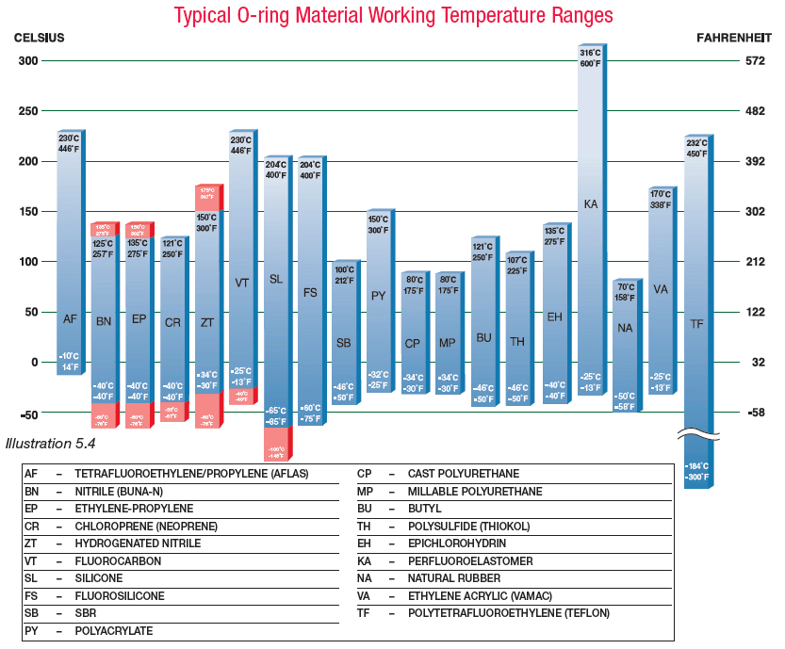

Slide 11
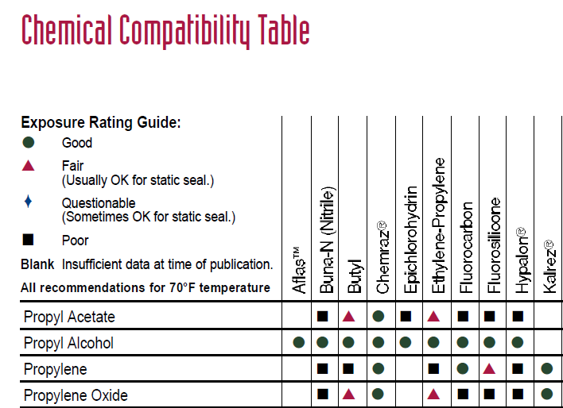

Slide 12
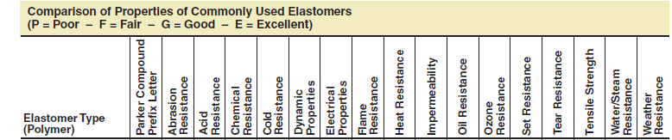


Slide 13
O-Ring Seal Design
The O-ring Specifications
  Size (inside diameter)
    1/32 to 26 inches
  CS (Cross-Section)
    1/32 to ¼ inch
  Rigidity (Hardness)
  Material

Slide 14
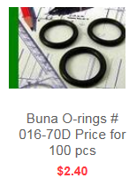
O-ring Standards
Standard
  AS568
  ISO 3601
Example
  AS016-70N Nitrile O-ring
  (AS568-016 Size 0.070 CS x 0.614 ID)

Slide 15
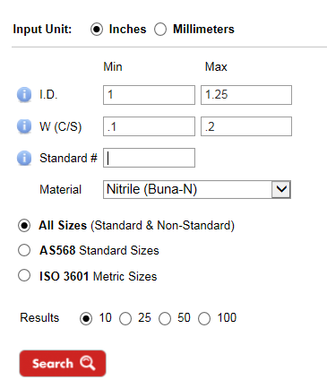
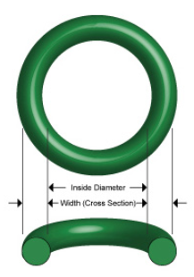
O-ring Search Tools

Slide 16
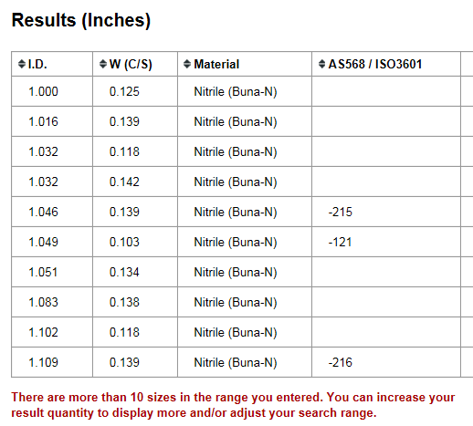

Slide 17
O-Ring Hardness
Measured on Shore-A hardness index
  Shore 20A = Rubber Band
  Shore 40A = Pencil Eraser
  Shore 60A = Car Tire Tread
  Shore 70A* = Running Shoe Sole
  Shore 80A = Leather Belt
  Shore 100A = Shopping Cart Wheel

Slide 18
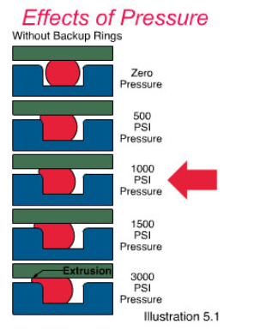

Slide 19
O-Ring Properties
Fluid resistance
Hardness
Toughness
Volume change (swell / shrinkage)
Compression set
Thermal effects
Resilience
Deterioration
Corrosion
Permeability
Coefficient of friction
Coefficient of thermal expansion
Compression set relaxation
Tensile strength
Elongation
Tear resistance / Abrasion resistance

Slide 20
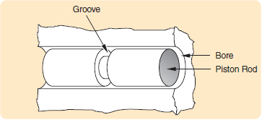
O-ring Seal Design
The Gland (Groove + Spacing)
  Depth of groove
  Width of groove
  Diameter of bore and piston
  Surface finish
  Tolerances

Slide 21
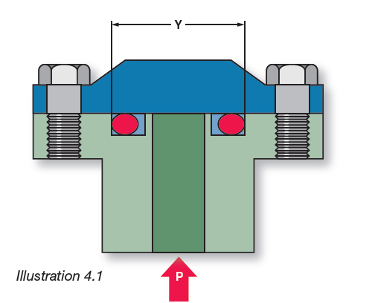
Static Seals
Static Axial Seal
(Face Seal)

Slide 22
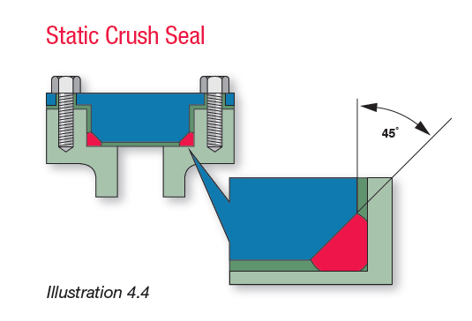
Static Seals
Static Crush Seal

Slide 23
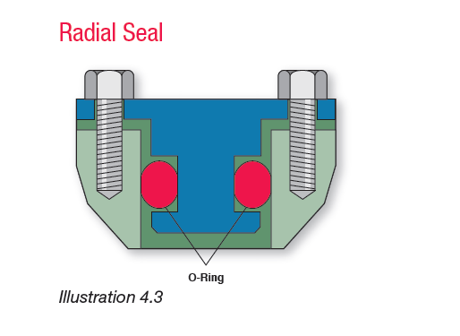
Static Seals
Static Radial Seal
(Piston Seal)

Slide 24
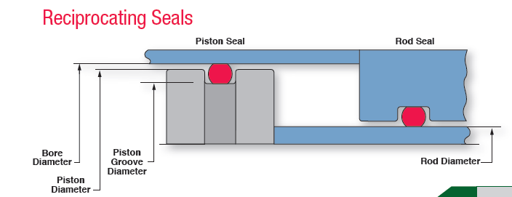
Dynamic Seals
Reciprocating Seals

Slide 25
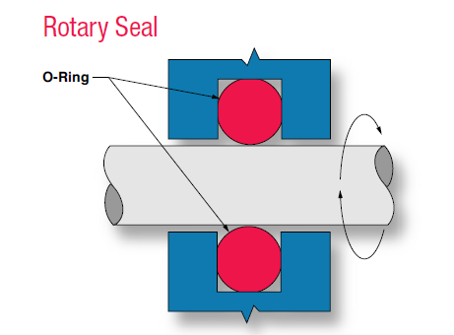
Dynamic Seals
Rotary Seals

Slide 26
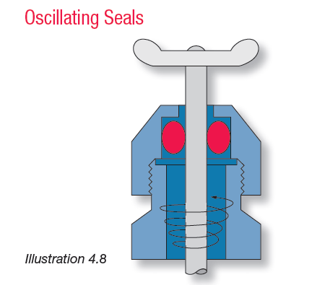
Dynamic Seals

Slide 27
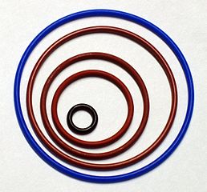
General Design Guidelines
Stretch should be less than 5% on the O-ring I.D.

Slide 28
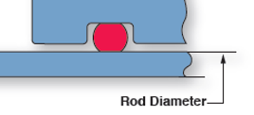
Design Guidelines
Groove depth must be smaller than the O-ring CS

Slide 29
Design Guidelines
O-ring should not completely fill the gland
  Between 75% and 90%
Static seal CS should be compressed from 10% to 40%
Dynamic seals should be compressed from 10% to 30%

Slide 30
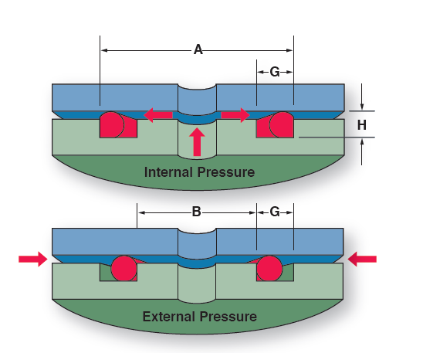
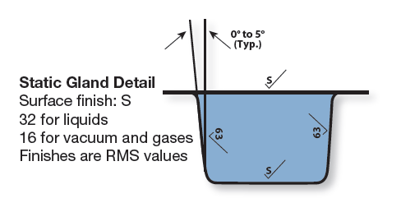
Design of Axial Seal
Axial Seal

Slide 31
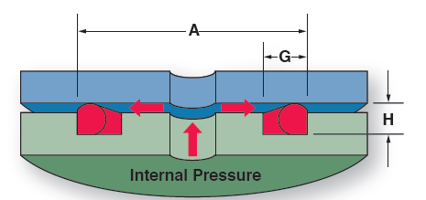
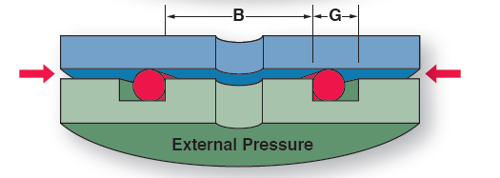
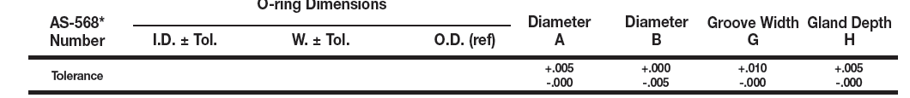
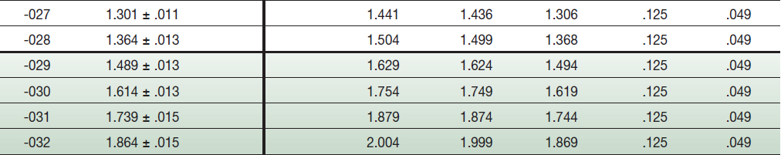

Slide 32
Example Design
Design a groove for a 1.5 inch diameter Internal pressure O-ring
  O-ring : -029 (ID: 1.489 +/- .013) (W: .07 +/- .003)
  Material: Buna-N
  Hardness: 70 Shore-A
  A: 1.624 (-0 , + .005)
  G: .125 (-0, + .01)
  H: .049 (-0,+.005)

Slide 33
Example Design
Checking resulting compression
  Compression (squeeze) = W - H
  Min. Comp. = 0.013 in (18.5%)
  Max. Comp. = 0.024 in (34.3%)

Slide 34
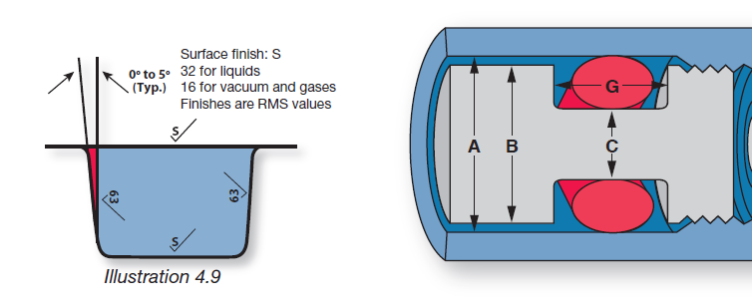
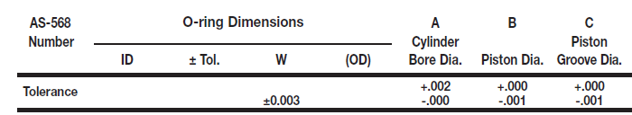

Radial Seal
Radial Static
Piston Seal

Slide 35
Example Design
Design a groove for a 0.7 inch diameter piston ring
  O-ring : -029 (ID: .614 +/- .009) (W: .07 +/- .003)
  Material: Buna-N
  Hardness: 70 Shore-A
  A: .746 (-0 , + .002)
  B: .745 (-.001, + 0)
  C: .638 (-.001,+ 0)

Slide 36
Example Design
Checking compression
  Comp = W – 0.5(A - C)
  Min. Comp. = 17.1%
  Max. Comp. = 26.0%
Also check
  Extrusion gap
  Stretch

Slide 37
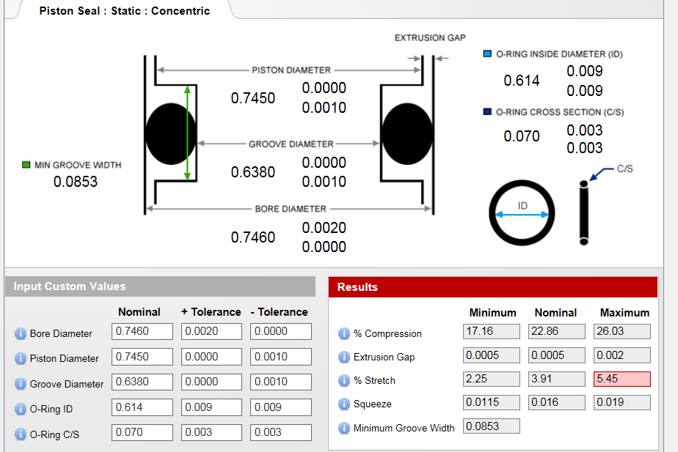

Slide 38
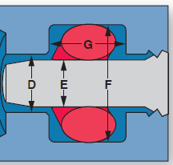
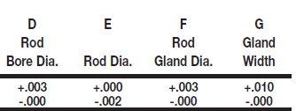
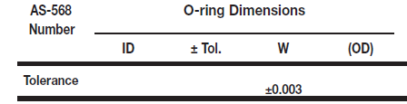


Radial Static
Rod Seal

Slide 39
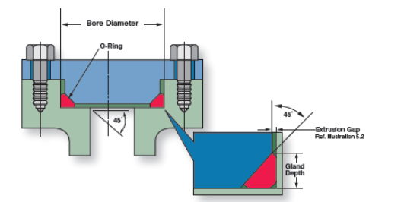
Static Crush Seal

Slide 40
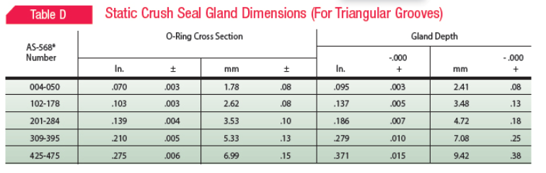
Static Crush Seal

Slide 41
Dynamic Seals

Slide 42
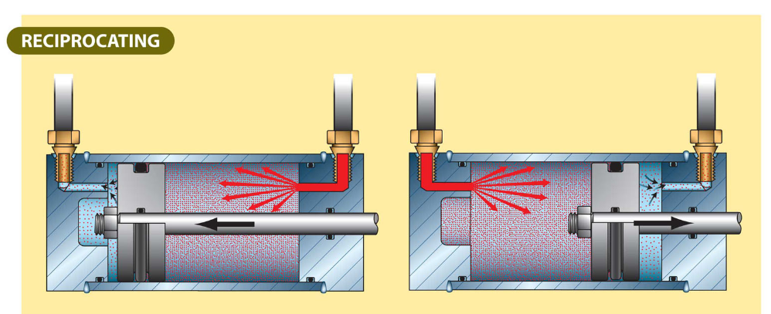
Reciprocating Motion

Slide 43
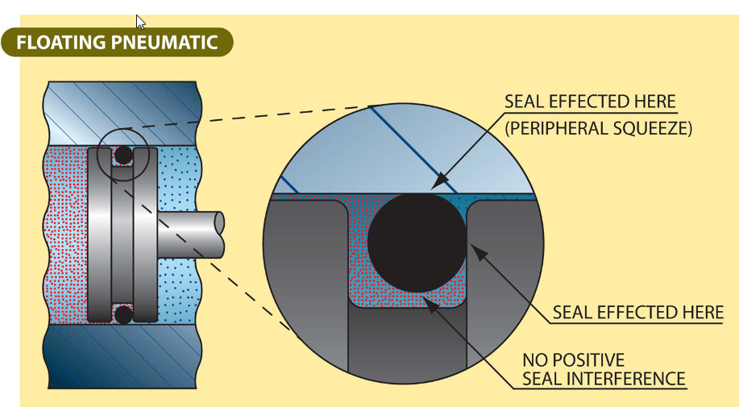

Slide 44
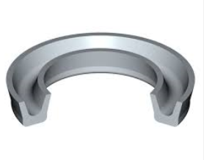
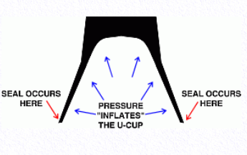
Alternatives to O-Rings
U-cup Seals
O-rings have a tendency to roll and move in reciprocating motions
U-cups create more sealing as the pressure increases
U-cups require less precision for the associated hardware

Slide 45
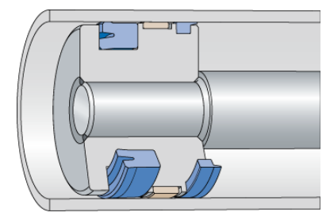
Alternatives to O-Rings
U-cup Seals

Slide 46
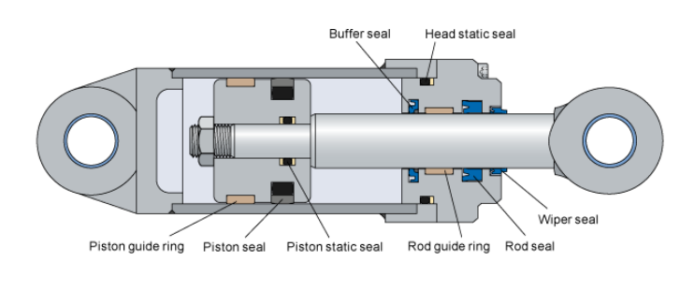
Typical Applications

Slide 47
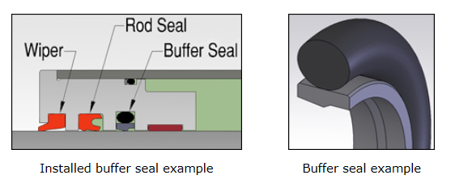
Buffer Seal
  Buffer seals are one-way seals that protect rod seals from pressure spikes yet allow fluid (lubricant) to reach the main seal

Slide 48
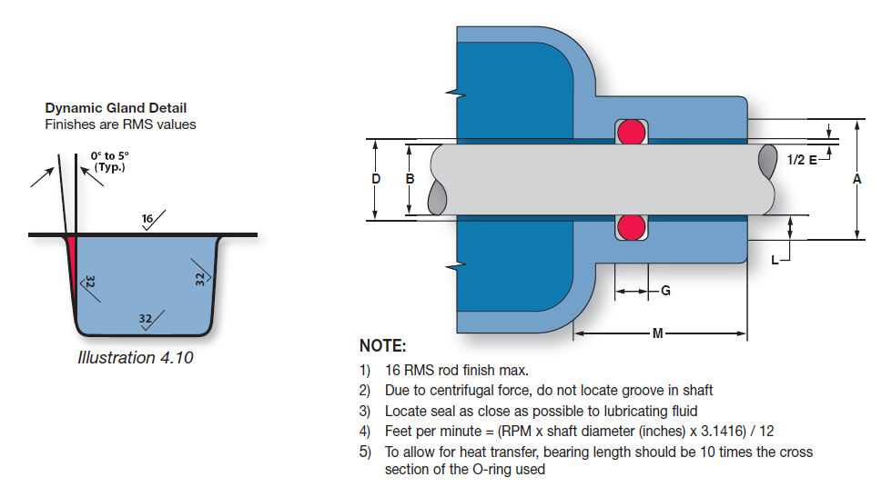
Rotary Seals

Slide 49
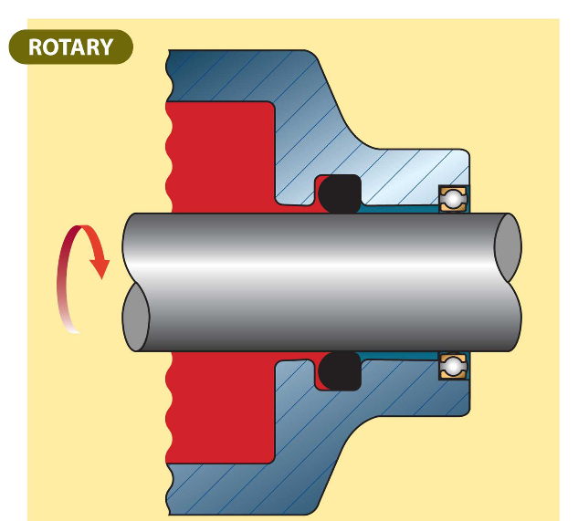
Due to centrifugal force and Gough-Joule effect rotary O-rings are only installed in the housing not on the shaft

Slide 50
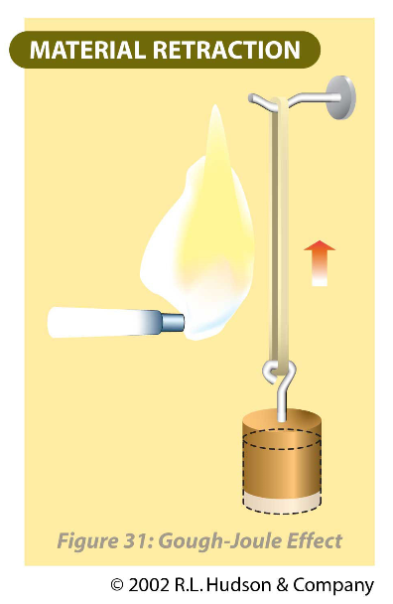
Gough-Joule effect
When an elastomer is stretched and heated, it will contract.

Slide 51
Rotary O-Ring Limitations
O-ring seals are NOT recommended for rotary applications under the following conditions:
  Pressures exceeding 900 psi
  Temperatures lower than -40° F or higher than 225° F
  Surface speeds exceeding 600 feet per minute (fpm).
        2300 rpm for 1 inch diameter shaft
        1150 rpm for 2 inch diameter shaft

Slide 52
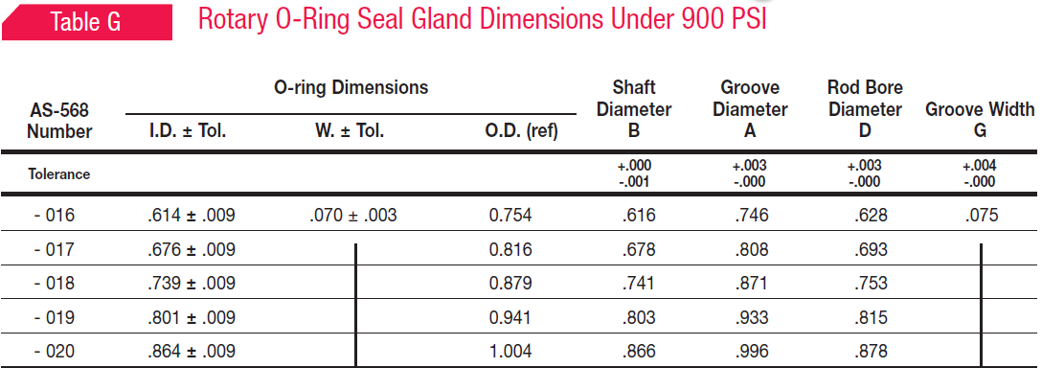
Rotary Seals

Slide 53
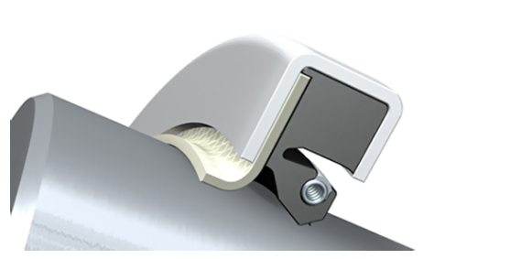
Lip Seals
Lip seals work well in high speed low pressure rotating shafts

Slide 54
Main Application of Lip Seals
Ball and roller bearing protection
  As little as 0.002% water in lubrication oil can reduce ball bearing life by 50%
  Solid particles cause rapid damage to the bearing races.

Slide 55
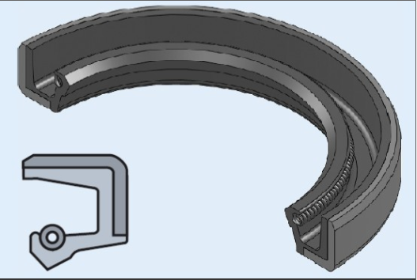

Slide 56
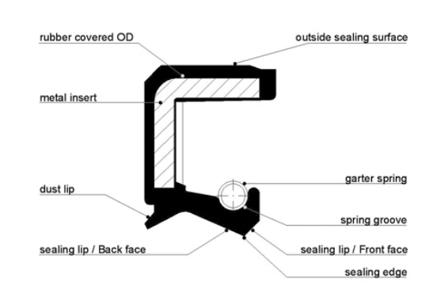

Slide 57
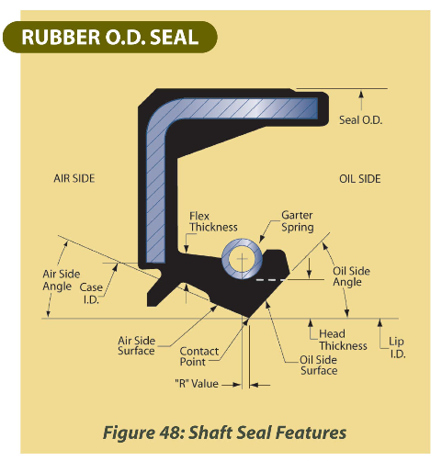
The purpose of the spring is to provide a uniform load on the lip
Also overcomes compression set and wear of the lip material.

Slide 58
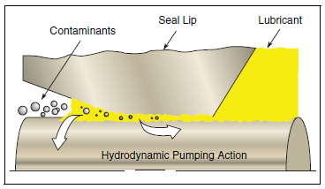
There is a tendency for liquids to be pumped from the low angle side towards the high angle side. Underneath the flattened area a thin fluid film is formed. Its thickness must be between 1 and 3 µm to avoid leakage

Slide 59
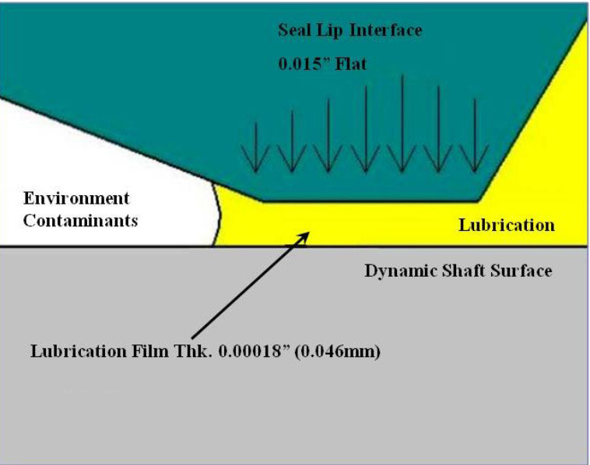

Slide 60

Primary function is retention
Primary function is exclusion

Slide 61



Slide 62



Slide 63
Lip Seals
To minimize wear
  The contact pressure should be as low as possible.
  Shaft surface should be smooth to 0.25- 0.5 µm.
  There must be enough fluid to form a hydrodynamic film
  Fluid pressure must be low (0-3 psi )

Slide 64


V-Seals

Slide 65

Flexi-Lip Rotary Seals
Speeds up to 5000 fps
Pressures up to 150 psi
Material: PTFE, graphite

Slide 66


Slide 67



Slide 68


Slide 69



Slide 70




Slide 71
Metallic Seals
Metallic seals go where polymers cannot
  High temperatures (Above 400 to 1800 Degree F)
  Cryogenic temperatures (below −238 °F)
  High pressures (3000 psi to 60000 psi)
  High speeds

Slide 72


Metal Seals

Slide 73



C-Ring and Energized C-Ring

Slide 74


E-Ring and O-Ring

Slide 75


U-Ring and Metal Wire

Slide 76

Labyrinth Seals

Slide 77

Labyrinth Seal

Slide 78

Labyrinth Seal

Slide 79


Mechanical Seals
Rotating Elements

Slide 80


