Slide 1


Online Learning Based Server Selection in Peer-to-Peer Content Delivery Networks
Hadi Hosseini
Portland State University
Sam Shippey
Portland State University
Alireza Keshavarz-Haddad
Shiraz University
Ehsan Aryafar
Portland State University
IEEE AIIoT
May 21 2026

Slide 2
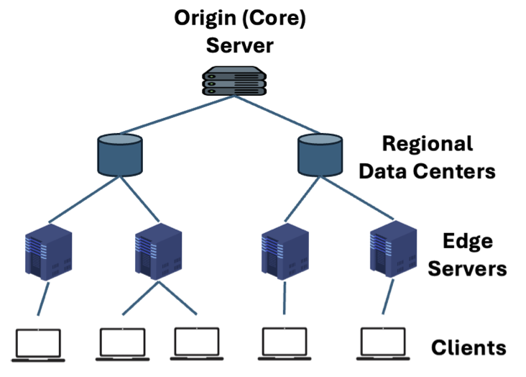
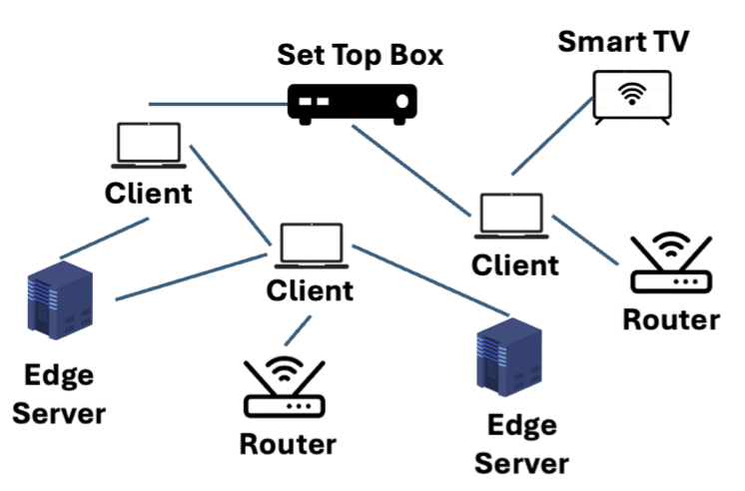
Background: CDN and PCDN
CDN (Content Delivery Network)
Hierarchical architecture
Deliver content quickly and reliably
High cost to deploy and maintain
PCDN (Peer-to-Peer CDN)
Use edge devices (smart TVs, routers) to store and send data
Storage and connectivity issues
Solution: Each client is concurrently served by multiple servers
Notes:
A Content Delivery Network, or CDN, is a strategy to lower latency and improve reliability by distributing the network load over a hierarchical and geographically widely distributed set of regional datacenters and edge servers. So it improves latency by physically shortening the distance to content, and improves reliability by offering multiple fallback options in case the nearest edge server doesn’t have the content.
However, CDNs are expensive and difficult to both deploy and maintain. So there’s interest in anything that can reduce that cost.
The Peer-to-Peer CDN (or PCDN) concept is designed to reduce the cost of running a CDN by incorporating edge devices, such as Smart TVs, routers, and set top boxes, as nodes to deliver content from. They’re mostly used to augment an existing CDN, providing extra bandwidth. This extra bandwidth is sort of hard to manage, though, edge devices aren’t usually designed expecting that you’ll try to use them as CDN nodes, so PCDNs need to be designed around managing the storage and connectivity limits that edge devices tend to suffer from.
In practice, that usually means you need to use multiple connections per client to get the bandwidth you need.

Slide 3
PCDN History
P2P File sharing: E.g. Napster (1999) and BitTorrent (2001)
First gen P2P to support video streaming (2005-2012)
Second generation PCDN (2012-2018)
  WebRTC (real-time browser-based P2P) opened new doors
  Netflix and others experimented for Video-On-Demand
Recent renewed interest in PCDN
  ByteDance (TikTok) using PCDNs to serve short video
  USENIX ATC 2024 and P-Scheduler INFOCOM 2024
  MPRD (ICDCS 2025): Multipath parallel downloading
Multipath aspects are well explored, but state of the art solutions rely on centralized peer selection
We investigate decentralized peer selection: Each client selects its own peers without a central coordinator
Notes:
This idea goes back further than you think. The most famous example is probably still the P2P file sharing networks of the early Web, like Napster and Bittorrent.
There also was a period in the late 2000s where people experimented with using these for video streaming, so if two users who were close by were watching the same video, maybe one could serve parts of the video to the other. This never achieved widespread popularity but it did lead to…
WebRTC! And the rest of the 2010s P2P boom. WebRTC enables a lot of big services like Zoom and Teams and Discord.
Perhaps even more impactfully, Netflix started some experiments using PCDNs for Video-On-Demand, which is an enormous amount of traffic.
There’s lately been renewed interest in PCDN, most notably from ByteDance, which runs TikTok. They’ve been looking at using PCDNs for short video content. In 2024 they published 2 papers, one at USENIX ATC and the other at INFOCOM.
One of these, P-Scheduler is about multipath downloading, using multiple servers to download something at the sum of their rates. This concept has been even further explored in papers in like MPRD from last year.
So the multipath part of PCDNs is pretty well explored, but…

Slide 4
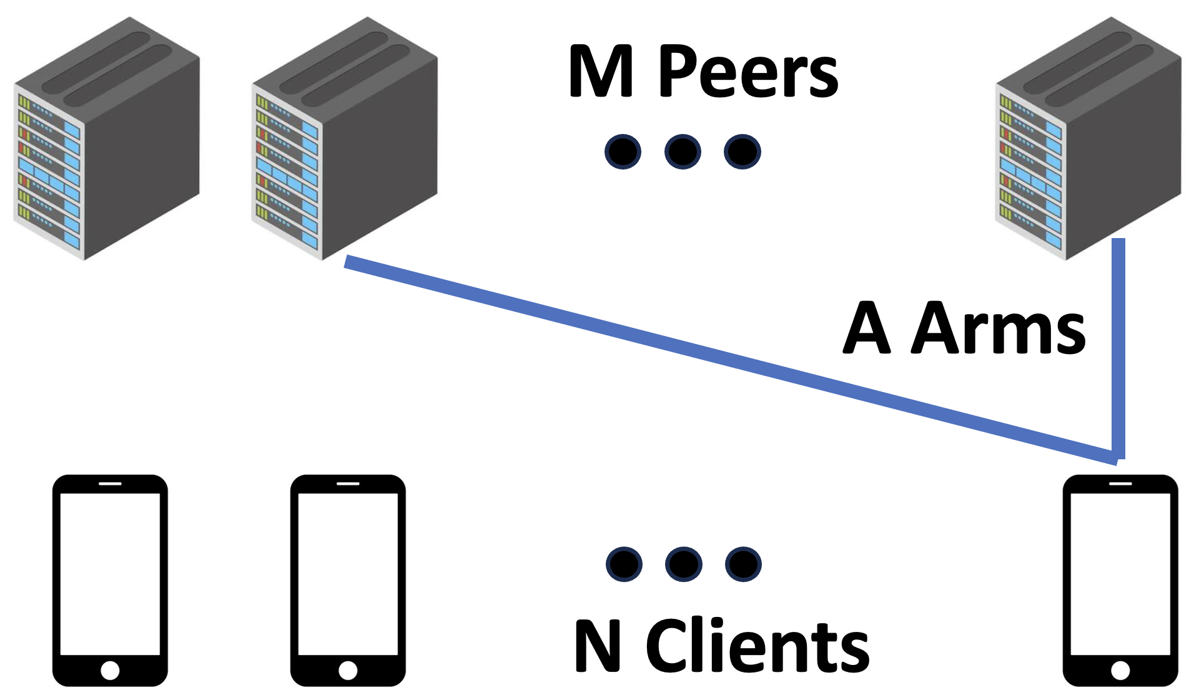
Problem Formulation
Scenario: Chunked file download for each client
  At each chunk, each client selects a set of A peers and downloads the chunk from them
  At end of chunk, get bandwidth estimate only for picked peers
  Clients don’t know bandwidths for unselected peers
  Corresponds to Multi-Armed Bandit (MAB) problem
Can MAB algorithms do as well as a centralized solver?

Slide 5
Multi-Armed Bandit Algorithms
Choose subset of available peers
Learn bandwidth for those peers (but not others)
Update internal model, repeat
Evaluate 3 Multi-Armed Bandit algorithms
EXP3
  Pick peers randomly over weighted options vector
  Update proportional to bandwidth and renormalize
BROAD
  Like EXP3 but with more complex regularization step
Thompson Sampling
  Pick by randomly sampling distributions proportional to the bandwidth of each peer
Baselines: Random selection and centralized Nash equilibrium solver
Notes:
Explain MAB framework
There are many algorithms to do this task...
Ours are from well-performing algorithms in the “singleplayer” version of this scenario

Slide 6
Performance Evaluation
Develop a simulator in Python to explore algorithm performance
Scenario: Clients trying to download the same file from several peers
  More clients (20) than peers (6)
  Two bandwidth capacity distribution scenarios
    Heterogeneous: Peer capacities differ over orders of magnitude
    Near-homogeneous: Peer capacities very similar to each other
Evaluate algorithms in terms of collective throughput properties
  Can MAB algorithms achieve high throughput for all clients?
  Do they converge to steady states?
  Is throughput smooth or does it vary over time?

Slide 7
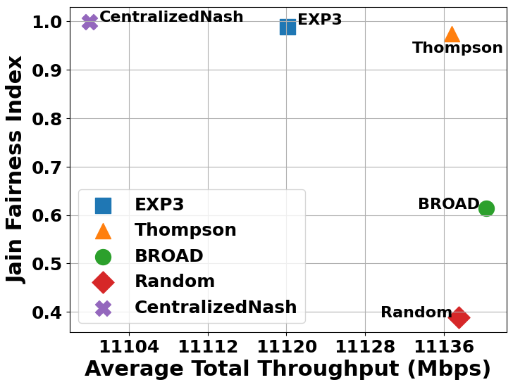
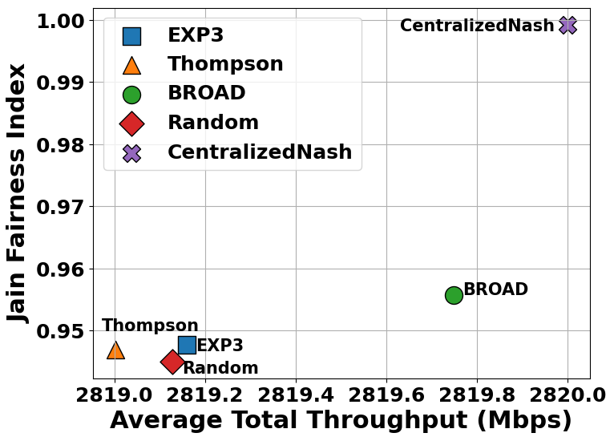
Performance Evaluation: Throughput and Fairness
Fairness
Fairness
Heterogeneous
Near-Homogeneous
Large fairness/throughput tradeoff present in heterogeneous scenario
EXP3 still achieves performance close to centralized solution
Same tradeoff does not appear in near-homogeneous scenario

Slide 8
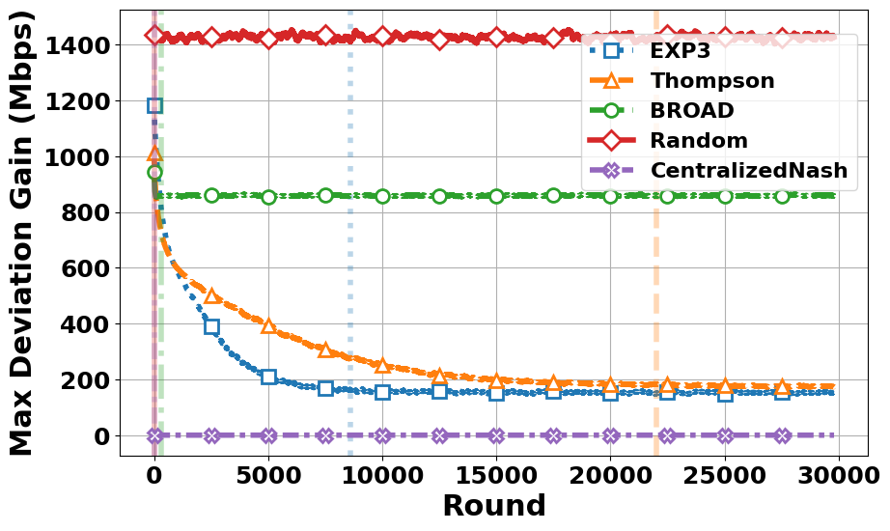
Performance Evaluation: Convergence
Max Deviation Gain: Largest improvement in throughput if all clients were assigned to the optimal peer
EXP3 and Thompson both converge eventually
BROAD converges to a poor outcome (high max deviation gain)
Notes:
- “If you’re converged, then clients can no longer improve by changing any of their choices”, you can see that the centralized solver is always sitting at zero over there

Slide 9
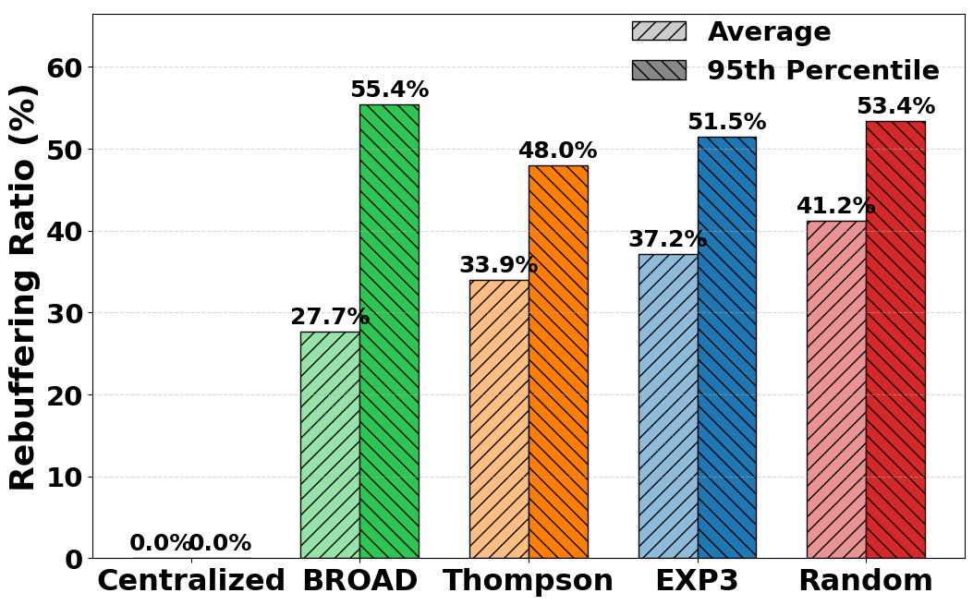
Video Streaming Evaluation
Evaluate video streaming performance in addition to raw throughput
Examine rebuffering ratio: Portion of streaming time spent waiting for video to load
High tail rebuffering indicates issues with consistent throughput

Slide 10
Summary
Peer-to-Peer CDN seeks to reduce cost compared to traditional CDN strategy by using edge devices, but relies on centralized peer selection for each client
Evaluate Multi-Armed Bandit algorithms for decentralized peer selection through simulation
EXP3 achieves near-centralized performance in terms of throughput and fairness without central coordination
Future work in improving throughput stability to improve performance in video streaming across all algorithms (EXP3, BROAD, and Thompson Sampling)

Slide 11
Email me!
Sam Shippey
sshippey@pdx.edu
Portland State University
Notes:
Peer-to-Peer CDNs, or PCDNs, offer a cost-effective alternative by leveraging the resources of end-user devices to distribute content. PCNDs turn edge users such as routers and smart TVs into active participants in content delivery, offloading traffic from centralized servers, and improve scalability. PCDNs may also be used to mostly replace CDNs for content delivery. The key challenge with PCDNs is that edge devices could have reliability issues in terms of their availability and quality of Internet links

