Slide 1
C and assembly (motivation)

Slide 2
Why C?
Compared to other high-level languages
  Maps almost directly into hardware instructions making code potentially more efficient
    Provides minimal set of abstractions compared to other HLLs
    HLLs often make programming simpler at the expense of efficiency
Compared to assembly programming
  Abstracts out hardware (i.e. registers, memory addresses) to make code portable and easier to write
  Provides variables, functions, arrays, complex arithmetic and boolean expressions

Slide 3
Why C?
Used prevalently in critical applications
  Operating systems (e.g. Windows, Linux, FreeBSD/OS X)‏
  Web servers (apache, Google’s front-end)‏
  Web browsers (firefox, chrome)‏
  Mail servers (sendmail, postfix)‏
  DNS servers (bind)‏
  Video games (any FPS)‏
  Office apps (Word, Excel, PowerPoint, Adobe)
  Graphics card programming (OpenCL GPGPU programming)
Notes:
http://www.techworm.net/2016/10/programming-language-code-used-develop-facebook-google-windows-apples-os-linux-others.html

Slide 4
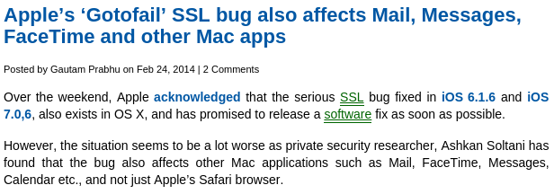
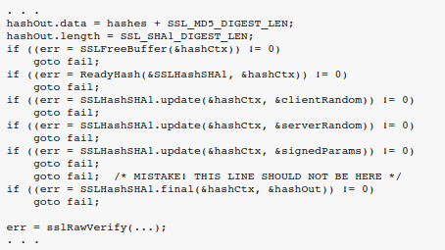
Example
2/2014

Slide 5
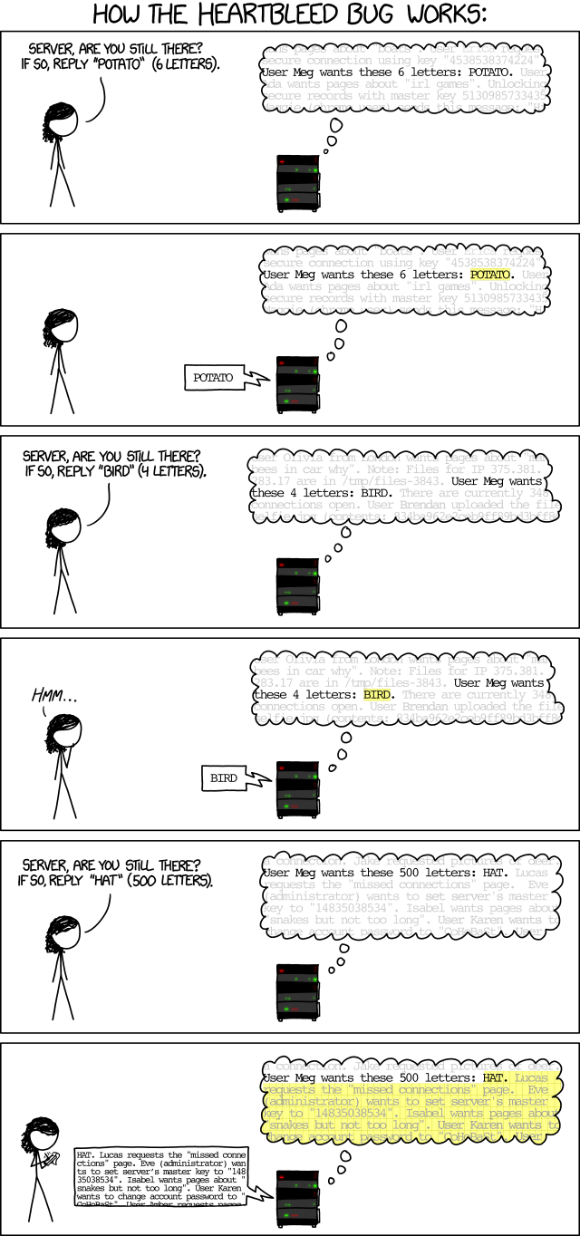

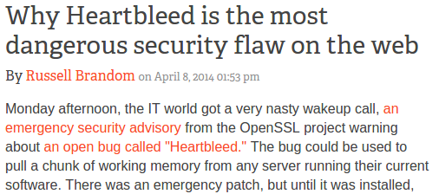
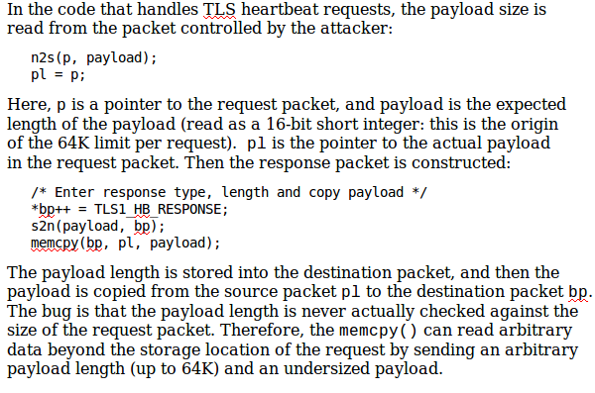
Example
Heartbleed (4/2014)

Slide 6
Why assembly?
Learn how programs map onto underlying hardware
  Allows programmers to write efficient code
  Allows one to identify security problems caused by programming language and CPU architecture
Enable platform-specific tasks
  Access and manipulate hardware-specific registers
  Utilize latest CPU instructions
  Interface with hardware devices
Reverse-engineer unknown binary code
  Identify what viruses, spyware, rootkits, and other malware are doing
  Understand how cheating in on-line games work

Slide 7
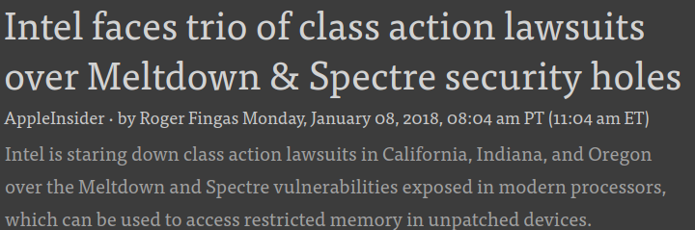
Example
Meltdown and Spectre

Slide 8
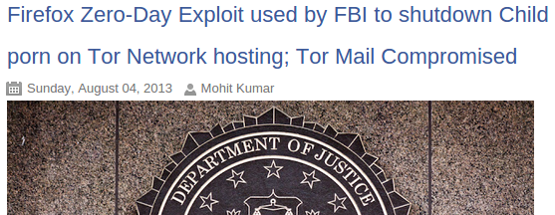
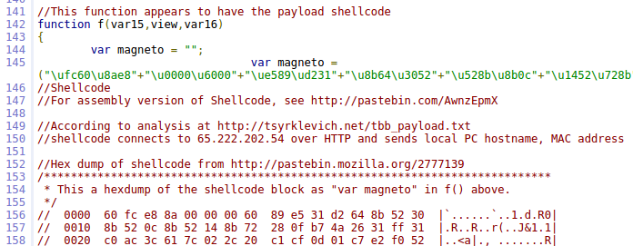
Example
FBI Tor Exploit (Playpen) (8/2013)
8/2014

Slide 9
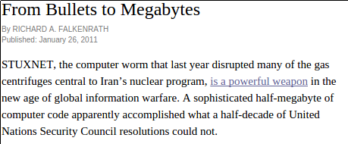
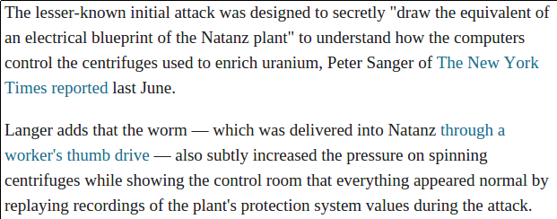
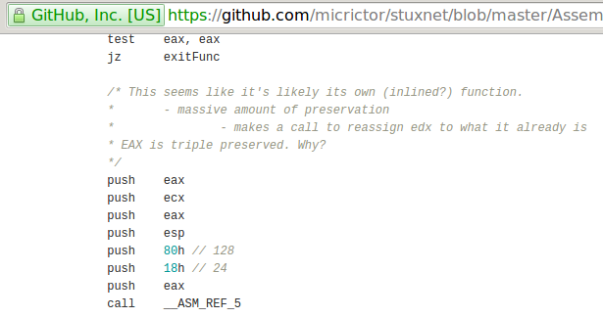
Example

Slide 10
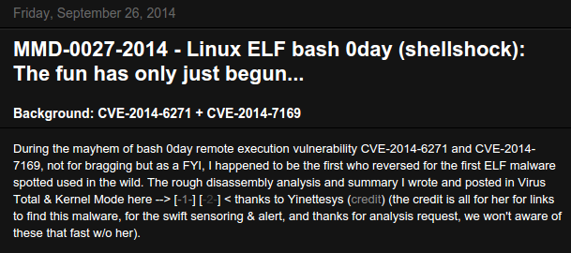
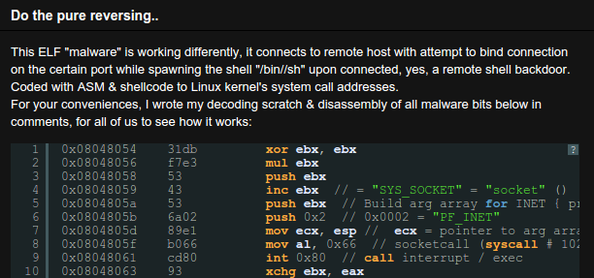
Example
Shellshock

Slide 11
C

Slide 12
The C Programming Language
One of many programming languages
C is an imperative, procedural programming language
Imperative
  Computation consisting of statements that change program state
  Language makes explicit references to state (i.e. variables)‏
Procedural
  Computation broken into modular components (“procedures” or “functions”) that can be called from any point
Contrast to declarative programming languages
  Describes what something is like, rather than how to create it (e.g. HTML, SQL)
  Implementation left to other components (e.g. a web browser or database server)

Slide 13
The C Programming Language
Simpler than higher-level languages such as C++, C#, Java
  No support for
    Objects
    Managed memory (e.g. garbage collection)
    Array bounds checking
    Name spaces
  Simple support for
    Typing
    Structures
  Basic utility functions supplied by libraries linked in at compile-time or run-time
    libc, libpthread, libm
  Low-level, direct access to machine memory (pointers)‏
  Easier to write bugs, harder to write safe programs, typically faster
Language features updated with ANSI-C standard

Slide 14
The C Programming Language
Compilation down to machine code as in C++
  Compiled, assembled, linked via gcc
Compared to interpreted languages…
  Python/JavaScript
    Commands executed by run-time interpreter
    Interpreter runs natively
  Java
    Compilation to virtual machine “byte code”
    Byte code interpreted by virtual machine software
    Virtual machine runs natively

Slide 15
C variables
Named using letters, numbers, some special characters
  By convention, not all capitals
Must be declared before use
  C is statically typed
  Contrast to typical dynamically typed scripting languages (Python, PHP, JavaScript)
Variable declaration format
  <type> <variable_name>;
  Optional initialization using assignment operator (=)
C statements end with ‘;’
Examples
int foo = 34;
float ff = 34.99;

Slide 16
Integer data types and sizes
char – single byte integer
  8-bit character, hence the name
  Strings implemented as arrays of char and referenced via a pointer to the first char of the array
short – short integer
  16-bit (2 bytes) not used much
int – integer
  32-bit (4 bytes) used in IA32
long – long integer
  64-bit (8 bytes) in x64 (x86-64)

Slide 17
Floating point types and sizes
float – single precision floating point
  32-bit (4 bytes)
double – double precision floating point
  64 bit (8 bytes)

Slide 18
Data Type Ranges for x86-64
Type Size Range
char 1 -128 to 127
short 2 -32,768 to 32,767
int 4 -2,147,483,648 to 2,147,483,647
long 8 -2⁶³ to 2⁶³-1
(-9,223,372,036,854,775,808 to …)
float 4 3.4E+/-38
double 8 1.7E+/-308

Slide 19
Constants
Integer literals (constants)
  Decimal constants directly expressed (1234, 512)
  Hexadecimal constants preceded by '0x' (0xFE , 0xab78)
Character constants
  Single quotes to denote ( 'a' )
  Corresponds to ASCII numeric value of character 'a'
String Literals
  Double quotes to denote ("I am a string")
  "" is the empty string

Slide 20
Arrays
char foo[80];
  An array of 80 characters (stored contiguously in memory)
  sizeof(foo) = 80 × sizeof(char)= 80 × 1 = 80 bytes
int bar[40];
  An array of 40 integers (stored contiguously in memory)
  sizeof(bar)= 40 × sizeof(int)= 40 × 4 = 160 bytes

Slide 21
Structures
Aggregate and organize related data of arbitrary types
typedef unsigned long time_t;
typedef unsigned long suseconds_t;
struct timeval {
time_t tv_sec;
suseconds_t tv_usec;
}; /* <== DO NOT FORGET the semicolon */
struct timeval curtime;
curtime.tv_sec = 100;
curtime.tv_usec = 0;

Slide 22
C operators
Logical relation operators (return 0 or 1)
  < > <= >= == != && || !
Bit-wise boolean operators
  & | ~ ^
Arithmetic operators
  + - * / % (modulus)
  int foo = 30;
  int bar = 20;
  foo = foo + bar;
  Equivalent shortened form
  foo += bar;

Slide 23
Increment and Decrement
Comes in prefix and postfix flavors
  i++ ++i
  i-- --i
Makes a difference in evaluating complex statements
  A major source of bugs
  Prefix: increment happens before evaluation
  Postfix: increment happens after evaluation
When the actual increment/decrement occurs is important to know about
  What are the values of these expressions for i = 3 ?
  i++*2
  ++i*2

Slide 24
C control flow
Conditional execution
Expression delineated by ( )
  if (x == 4)‏
  y = 3; /* sets y to 3 if x is 4 */
Code blocks delineated by curly braces { }
  For blocks consisting of more than one C statement
      if ( ) { } else { }
      while ( ) { }
      do { } while ( );
      for(i=1; i <= 100; i++) { }
      switch ( ) {case 1: … }

Slide 25
Other control-flow statements
Keywords and their semantics
  continue; control passed to next iteration of do/for/while
  break; pass control out of code block
  return; exits function it is used in immediately and returns value specified

Slide 26
Function calls (static)
Function or its prototype must be declared before its use
Calls to functions typically static (resolved at compile-time)
void print_ints(int a, int b)‏ {
printf("%d %d\n",a,b);
}
int main(int argc, char* argv[]) {
  int i=3;
  int j=4;
  print_ints(i,j);
}

Slide 27
Example 1
#include <stdio.h>
int main(int argc, char* argv[])‏
{
/* print a greeting */
printf("Hello world!\n");
return 0;
}
$ gcc -o hello hello.c
$ ./hello
Hello world!
$

Slide 28
Breaking down the code
#include <stdio.h>
  Include the contents of the file stdio.h
    Case sensitive – lower case only
  No semicolon at the end of line
  Required in order to supply function definition for printf call
int main(…)‏
  The OS calls this function when the program starts running.
printf(format_string, arg1, …)‏
  Call function from libc library
  Prints out a string, specified by the format string and the arguments.

Slide 29
Passing arguments
main has two arguments from the command line
int main(int argc, char* argv[])‏
argc
  Number of arguments (including program name)‏
argv
  Pointer to an array of string pointers
    argv[0]: = program name
    argv[1]: = first argument
    argv[argc-1]: last argument
Example: find . –print
  argc = 3
  argv[0] = "find"
  argv[1] = "."
  argv[2] = "-print"

Slide 30
Example 2
#include <stdio.h>
int main(int argc, char* argv[])‏
{
int i;
printf("%d arguments\n", argc);
for(i = 0; i < argc; i++)‏
printf(" %d: %s\n", i, argv[i]);
return 0;
}

Slide 31
Example 2
$ ./cmdline The Class That Gives CS Its Zip
8 arguments
0: ./cmdline
1: The
2: Class
3: That
4: Gives
5: CS
6: Its
7: Zip
$

Slide 32
C quirks

Slide 33
Pointers
Unique to C
  Variable that holds an address in memory.
  Address in memory contains another variable.
  All pointers are 8 bytes (64-bits) for x86-64
Every pointer has a type
  Type of data at the address (char, int, long, float, double)

Slide 34
Pointer operators
Declared via the * operator in C variable declarations
Assigned via the & operator
  Valid on all lvalues
  Anything that can appear on the left-hand side of an assignment

Slide 35
Pointer operators
Dereferenced via the * operator in C statements
  Returns the data that is stored in the memory location specified by the pointer
  Type of pointer determines what is returned when "dereferenced"
  Example
int x = 1, y = 2;
int *ip = &x;
y = *ip; // y is now 1
*ip = 0; // x is now 0
Dereferencing uninitialized pointers:
  What happens?
  int *ip;
  *ip = 3;
  Segmentation fault
  Pointers must always be pointing to allocated memory space!

Slide 36
Using Pointers‏
long i; /* data variable */
long *i_addr; /* pointer variable */
i_addr = &i; /* & = address operator */
i
i_addr
?
?
0x4300
0x4308
i
i_addr
?
4300
0x4300
0x4308

Slide 37
Using Pointers‏
*i_addr = 32; /* dereference operator */
long j = *i_addr; /* dereference: j is now 32 */
i
i_addr
32
4300
0x4300
0x4308
i
i_addr
j
32
4300
32
0x4300
0x4308
0x4310

Slide 38
Using Pointers‏
i = 13; /* but j is still 32 */
i
i_addr
j
13
4300
32
0x4300
0x4308
0x4310

Slide 39
Pointers and arrays in C
Assume array z[10]
  z[i] returns i^{th} element of array z
  &z[i] returns the address of the i^{th} element of array z
  z alone returns address the array begins at or the address of the 0th element of array z (&z[0])
    int* ip;
    int z[10];
    ip = z; /* equivalent to ip = &z[0]; */

Slide 40
Pointer arithmetic
Done based on type of pointer
    char* cp1;
    int* ip1;
    cp1++; // Increments address by 1
    ip1++; // Increments address by 4
Often used to sequence arrays
    int* ip;
    int z[10];
    ip = z;
    ip += 3;
    *ip = 100
How much larger is ip than z?
Which element of z is set to 100?
12
z[3] = 100

Slide 41
Function call parameters
Function arguments are passed “by value”.
What is “pass by value”?
  The called function (callee) is given a copy of the arguments.
What does this imply?
  The callee can’t alter a variable in the caller function, only its copy given through arguments.

Slide 42
Example 1: swap_1
void swap_1(int a, int b)‏
{
int temp;
temp = a;
a = b;
b = temp;
}
If x=3,y=4, then
after swap_1(x,y);
A1: x=4; y=3;
A2: x=3; y=4;

Slide 43
Example 2: swap_2
void swap_2(int *a, int *b)‏
{
int temp;
temp = *a;
*a = *b;
*b = temp;
}
If x=3,y=4, then
after swap_2(&x,&y);
A1: x=3; y=4;
A2: x=4; y=3;

Slide 44
Call by value vs. reference in C
Call by reference implemented via pointer passing
  void swap(int *px, int *py) {
  int tmp;
  tmp = *px;
  *px = *py;
  *py = tmp;
  }
  Swaps the values of the variables x and y if px is &x and py is &y
  Uses integer pointers instead of integers
Otherwise, call by value...
void swap(int x, int y) {
  int tmp;
  tmp = x;
  x = y;
  y = tmp;
  }

Slide 45
Assignments and expressions
In C, assignment is an expression
  x = 4 has the value 4
if (x == 4)‏
y = 3; /* sets y to 3 if x is 4 */
if (x = 4)‏
y = 3; /* always sets y to 3 */
while ((c=getchar()) != EOF)‏

Slide 46
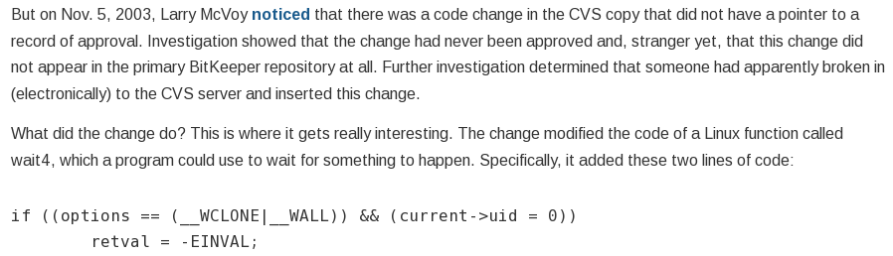
Tricky expressions
https://freedom-to-tinker.com/blog/felten/the-linux-backdoor-attempt-of-2003/

Slide 47
JPL’s Power of Ten rules
C is difficult to code securely in
For safety-critical, embedded applications (IoT, driverless cars, etc), use these rules to improve safety of code
Rule #1
  Restrict all code to very simple control flow constructs
  Avoid using goto statements, setjmp or longjmp constructs, and recursion
  Easier to verify, better code clarity, acyclic call graph for integrity checks
Rule #2
  Ensure loops have a fixed upper bound that can be statically proven to prevent runaway code
Rule #3
  Do not use dynamic memory allocation after initialization
  Predictability in performance, avoidance of memory leaks and memory corruption bugs in allocation/deallocation code

Slide 48
JPL’s Power of Ten rules
Rule #4
  No function should be longer than what can be printed on a single sheet of paper (60 lines)
  Each function should be a logical unit that is understandable and verifiable as a unit
Rule #5
  Code should average a minimum of two assertions per function to check for anomalous conditions that should never happen
  Verify pre- and post-conditions of functions, parameters, return values and loop invariants
  Assertion failures should return error conditions to caller
  Defect rate of 1 every 10-100 lines of code. Assertions help catch them

Slide 49
JPL’s Power of Ten rules
Rule #6
  Data objects should be declared at the smallest possible level of scope
  Data-hiding keeps values from being referenced or corrupted from elsewhere
  Allows easier diagnosis of errors
Rule #7
  Return value of non-void functions should be checked by calling function
  Validity of parameters should be checked inside each function
  Common to ignore return value checks on many C library calls
  Exceptions should be justified

Slide 50
JPL’s Power of Ten rules
Rule #8
  Limit preprocessor use to inclusion of header files and simple macros. Macros should expand into complete syntactic units
  Limit the use of conditional compilation directives to one or two to limit number of versions of code that need to be tested
  Reduce obfuscated code
Rule #9
  Restrict the use of pointers with no more than one level of dereferencing. Function pointers should be avoided
  Pointers easily misused, are hard to follow and analyze for static analyzers
  Must have clear flow of control and function call hierarchies to reason about safety of code
Rule #10
  Compile all code with all compiler warnings enabled -Wpedantic
  Code should pass with no warnings
  Modern, static source code analyzers can catch a large percentage of errors with few false positives

Slide 51
Extra
https://sayat.me/wu4f

Slide 52
Constant pointers
Used for static arrays
  Square brackets used to denote arrays
  Symbol that points to a fixed location in memory
  Can change characters in string ( amsg[3] = 'x'; )
  Can not reassign amsg to point elsewhere (i.e. amsg = p)
char amsg[ ] = “This is a test”;
This is a test\0

