Slide 1

CS510 Concurrent Systems
Jonathan Walpole

Slide 2
Transactional Memory: Architectural Support for Lock-Free Data Structures
By Maurice Herlihy and J. Eliot B. Moss
1993

Slide 3
Outline
Review of synchronization approaches
Transactional memory (TM) concept
A hardware-based TM implementation
  Core additions
  ISA additions
  Transactional cache
  Cache coherence protocol changes
Validation and results
Conclusions

Slide 4
Locking
A pessimistic approach based on mutual exclusion and blocking
  Easy to understand and use
  Does not scale well
  Not composable
Proc A
Proc B
Proc C
Lo-priority
Holds Lock X
Pre-emption
Hi-priority
Can’t proceed
Med-priority
Priority Inversion
Get Lock X
Holds Lock X
De-scheduled
Can’t proceed
Convoying
Get Lock X
Ex: Quantum expiration,
Page Fault, other interrupts
High context switch overhead
Can’t proceed
Can’t proceed
Deadlock
Holds Lock Y
Holds Lock X
Get Lock X
Get Lock Y

Slide 5
Lock-Free Synchronization
  Non-Blocking, optimistic approach
    Uses atomic operations such as CAS, LL&SC
    Limited to operations on single-word or double-words
Avoids common problems seen with locking
  - no priority inversion, no convoying, no deadlock
Difficult programming logic makes it hard to use

Slide 6
Wish List
Simple programming logic (easy to use)
No priority inversion, convoying or deadlock
Equivalent or better performance than locking
  Less data copying
No restrictions on data set size or contiguity
Composable
Wait-free
. . .
. . . Enter Transactional Memory (TM) …

Slide 7
What is a Transaction?
Transaction: a finite sequence of revocable operations, executed by a process, that satisfies two properties:
  Serializability
    the steps of one transaction are not seen to be interleaved with the steps of another transaction
    all processes agree on the order of transaction execution
  2. Atomicity
    Each transaction either aborts or commits
    Abort: all tentative changes of the transaction are discarded
    Commit: all tentative changes of the transaction take effect immediately
This paper assumes that a process executes one transaction at a time
  Transactions do not nest (ie. not composable)
  Transactions do not overlap

Slide 8
What is Transactional Memory?
Transactional Memory (TM) is a lock-free, non-blocking concurrency control mechanism based on transactions
TM allows programmers to define customized atomic operations that apply to multiple, independently chosen memory locations
TM is non-blocking
  - Multiple transactions execute optimistically, in parallel, on different CPU’s
  - If a conflict occurs only one can succeed, others can retry

Slide 9
Basic Transaction Concept
Proc A
Proc B
beginTx:
[A]=1;
[B]=2;
[C]=3;
x=_VALIDATE();
Optimistic execution
beginTx:
z=[A];
y=[B];
[C]=y;
x=_VALIDATE();
True concurrency
Changes must be revocable!
How is validity determined?
IF (x)
_COMMIT();
ELSE
_ABORT();
GOTO beginTx;
IF (x)
_COMMIT();
ELSE
_ABORT();
GOTO beginTx;
How to COMMIT?
How to ABORT?
// _COMMIT - instantaneously make all above changes visible to all Proc’s
Atomicity
// _ABORT - discard all above changes, may try again
ALL
or NOTHING
Serialization is ensured if only one transaction commits and others abort
Linearization is ensured by atomicity of validate, commit, and abort operations

Slide 10
TM Primitives
LT - Load Transactional
LTX - Load Transactional Exclusive
ST - Store Transactional
Validate
Commit
Abort

Slide 11
TM vs. Non-Blocking Algorithm
// TM
While (1) {
curCnt = LTX(&cnt);
if (Validate()) {
int c = curCnt+1;
ST(&cnt, c);
if (Commit())
return;
}
}
// Non-Block
While (1) {
curCnt = LL(&cnt);
// Copy object
if (Validate(&cnt)) {
int c = curCnt + 1;
if (SC(&cnt, c))
return;
}
}
LT or LTX
// READ set of locations
Fail
VALIDATE
// CHECK consistency of READ values
Critical Section
Succeed
// Do work
ST
// MODIFY set of locations
Fail
COMMIT
Pass
// HW makes changes PERMANENT

Slide 12
Hardware or Software TM?
TM may be implemented in hardware or software
  Many SW TM library packages exist (C++, C#, Java, Haskell, Python, etc.)
  2-3 orders of magnitude slower than other synchronization approaches
This paper focuses on a hardware implementation of TM
  better performance than SW for reasonable cost
  Minor tweaks to CPUs
    core, instruction set, caches, bus and cache coherency protocols ...
  Uses cache-coherency protocol to maintain transactional memory consistency
  Hardware implementation without software cache overflow handling is problematical

Slide 13
Core Changes
Each CPU maintains two additional Status Register bits
  TACTIVE
    flag set if a transaction is in progress on this CPU
  TSTATUS
    - flag set if the active transaction has conflicted with another transaction
TACTIVE | TSTATUS | MEANING
False | DC | No tx active
True | False | Orphan tx - executing, conflict detected, will abort
True | True | Active tx - executing, no conflict yet detected

Slide 14
Instruction Set Changes
LT: load from shared memory to register
ST: tentative write of register to shared memory
becomes visible upon successful COMMIT
LTX: LT + intent to write to same location later
A performance optimization for early conflict detection
VALIDATE: Verify consistency of read set
  ABORT: Unconditionally discard all updates
COMMIT: Attempt to make tentative updates permanent

Slide 15
TM Conflict Detection
Tx Abort Condition Diagram*
Tx Dependencies Definition
LOAD reg, [MEM]
STORE[MEM], reg
(as in Reader/Writer paradigm)
// non-Tx READ
// non-Tx WRITE - careful!
Y
DATA-SET
Updated?
READ-SET
LT reg, [MEM]
N
// pure Tx READ
Y
WRITE-SET
Read by any other Tx?
ABORT
//Discard changes
to WRITE-SET
DATA
SET
WRITE-SET
LTX reg, [MEM]
ST [MEM], reg
N
// Tx READ with intent to WRITE later
// Tx WRITE to local cache, value globally
// visible only after COMMIT
COMMIT
//WRITE-SET visible
to other processes
*Subject to arbitration
LOAD and STORE are supported but do not affect tx’s READ or WRITE set
  Semantics are left to implementation
  Interaction between tx and non-tx operations to same address is generally a programming error
  If LOAD/STORE are not viewed as committed transactions, with conflict potential, non-linearizable outcomes are possible.

Slide 16
TM Cache Architecture
1st level Cache
2nd level … 3rd level
Main Mem
L1D
Direct-mapped
Exclusive
2048 lines x 8B
Core
L2D
L3D
Core
L2D
L3D
Tx Cache
Fully-associative
Exclusive
64 lines x 8B
1 Clk
4 Clk
Tx Cache
  - Fully-associative, otherwise how would address collisions be handled?
  - Single-cycle COMMIT and ABORT
  - Small - size is implementation dependent
  - Holds all tentative writes without propagating to other caches or memory
  - Upon ABORT modified lines set to INVALID state
  - Upon COMMIT, lines can be snooped by other processors, lines written back to memory upon replacement

Slide 17
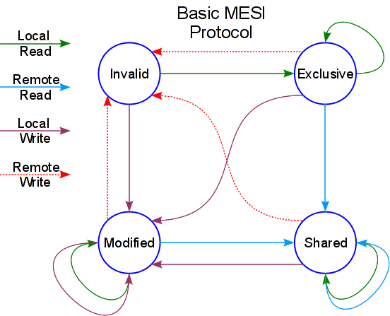
HW TM Leverages Cache Protocol
M - cache line only in current cache and is modified
E - cache line only in current cache and is not modified
S - cache line in current cache and possibly other caches and is not modified
I - invalid cache line
Tx commit logic detects the following events (akin to R/W locking):
  Local read, remote write
      S -> I
      E -> I
  Local write, remote write
      M -> I
  Local write, remote read
    M, snoop read, write back -> S
Works with bus-based (snoopy cache) or network-based (directory) architectures

Slide 18
Protocol Changes: Cache States
Tx Cache Line Entry, States and Replacement
Tx Op Allocation
COMMIT
ABORT
CL Entry & States
2 lines
XCOMMIT
Old value
EMPTY
Old value
NORMAL
Old value
XABORT
New Value
NORMAL
New Value
EMPTY
New Value
CL Replacement
search
EMPTY
No
NORMAL
No
XCOMMIT
No
ABORT Tx/Trap to SW
Yes
Yes
Yes
replace
replace
WB if DIRTY then replace
Every transactional operation allocates 2 cache line entries

Slide 19
ISA: TM Verification Operations
VALIDATE [Mem]
ABORT
COMMIT
Return TRUE
TSTATUS
For ALL entries
1. Drop XABORT
2. Set XCOMMIT
to NORMAL
Return FALSE
ABORT
TSTATUS
FALSE
TRUE
Return FALSE
TSTATUS=TRUE
TACTIVE=FALSE
TSTATUS=TRUE
TACTIVE=FALSE
For ALL entries
1. Drop XCOMMIT
2. Set XABORT
to NORMAL
Orphan = TACTIVE==TRUE && TSTATUS==FALSE
  Tx continues to execute, but will fail at commit
Commit does not force write back to memory
  Memory written only when CL is evicted or invalidated
Conditions for calling ABORT
  Interrupts
  Tx cache overflow
Return TRUE
TSTATUS=TRUE
TACTIVE=FALSE

Slide 20
TM Memory Access
Tx requests REFUSED by BUSY response
  Tx aborts and retries (after exponential backoff?)
  Prevents deadlock or continual mutual aborts
Exponential backoff not implemented in HW
  Performance is parameter sensitive
  Benchmarks appear not to be optimized
For reference
Tx Op Allocation
XCOMMIT
Old value
XABORT
New Value
LT reg, [Mem]
//search Tx cache
LTX reg, [Mem]
//search Tx cache
ST [Mem], reg
Return DATA
Y
Is
XABORT DATA?
Return DATA
Y
Is
XABORT DATA?
XCOMMIT DATA
XABORT NEW DATA
Y
Is
XABORT DATA?
XABORT NORMAL DATA
XCOMMIT DATA
Y
Is
NORMAL DATA?
XABORT NORMAL DATA
XCOMMIT DATA
Y
Is
NORMAL DATA?
XCOMMIT NORMAL DATA
XABORT NEW DATA
Y
Is
NORMAL DATA?
//Tx cache miss
//Tx cache miss
//Tx cache miss
XABORT DATA
XCOMMIT DATA
OK
T_READ cycle
XABORT DATA
XCOMMIT DATA
OK
T_RFO cycle
XCOMMIT DATA
XABORT NEW DATA
OK
T_RFO cycle
BUSY
BUSY
BUSY
Return arbitrary DATA
//ABORT Tx
For ALL entries
1. Drop XABORT
2. Set XCOMMIT to NORMAL
TSTATUS=FALSE
Return arbitrary DATA
//ABORT Tx
For ALL entries
1. Drop XABORT
2. Set XCOMMIT to NORMAL
TSTATUS=FALSE
Return arbitrary DATA
//ABORT Tx
For ALL entries
1. Drop XABORT
2. Set XCOMMIT to NORMAL
TSTATUS=FALSE
CL State as Goodman’s protocol for LOAD (Valid)
CL State as Goodman’s protocol for LOAD (Reserved)
CL State as Goodman’s protocol for STORE (Dirty)
ST to Tx cache only!!!

Slide 21
TM – Snoopy Cache Actions
Both Regular and Tx Cache snoop on the bus
Main memory responds to all L1 read misses
Main memory responds to cache line replacement WRITE ‘s
If TSTATUS==FALSE, Tx cache acts as Regular cache (for NORMAL entries)

Slide 22
Experimental Platform
Implemented in Proetus - execution driven simulator from MIT
  - Two versions of TM implemented
    - Goodman’s snoopy protocol for bus-based architectures
    - Chaiken directory protocol for (simulated) Alewife machine
  - 32 Processors
    - memory latency of 4 clock cycles
    - 1st level cache latency of 1 clock cycles
      2048x8B Direct-mapped regular cache
      64x8B fully-associative Tx cache
  - Strong Memory Consistency Model

Slide 23
Comparisons
Compare TM to 4 alternative approaches
  - Software
    - TTS (test-and-test-and-set) spinlock with exponential backoff [TTS Lock]
    - SW queuing [MCS Lock]
      Process unable to lock puts itself in the queue, eliminating poll time
  - Hardware
    - LOAD_LINKED/STORE_COND with exponential backoff [LL/SC Direct/Lock]
    - Hardware queuing [QOSB]
      Queue maintenance incorporated into cache-coherency protocol
      Goodman’s QOSB protocol - head in memory elements in unused CL’s

Slide 24
Test Methodology
Benchmarks
  - Counting
    - LL/SC directly used on the single-word counter variable
  - Producer & Consumer
  - Doubly-Linked List
All benchmarks do a fixed amount of work

Slide 25
Counting Benchmark
N processes increment shared counter 2^16/n times, n=1 to 32
Short CS with 2 shared-mem accesses, high contention
In absence of contention, TTS makes 5 references to mem for each increment
  RD + test-and-set to acquire lock + RD and WR in CS + release lock
TM requires only 3 mem accesses
  RD & WR to counter and then COMMIT (no bus traffic)

Slide 26
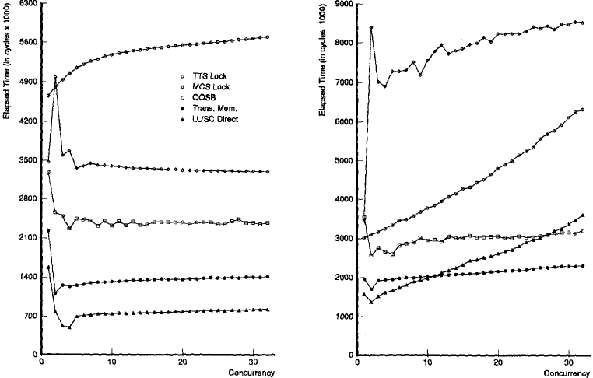
Counting Benchmark Results
Total cycles needed to complete the benchmark
MCS Lock - SWQ
TTS Lock
SOURCE: Figure copied from paper
MCS Lock - SWQ
TTS Lock
QOSB - HWQ
QOSB - HWQ
TM
TM
LL/SC Direct
LL/SC Direct
Concurrent Processes
BUS
NW
LL/SC outperforms TM
  - LL/SC applied directly to counter variable, no explicit commit required
  - For other benchmarks, adv lost as shared object spans multiple words – only way to use LL/SC is as a spin lock
TM has higher throughput than all other mechanisms at most levels of concurrency
  - TM uses no explicit locks and so fewer accesses to memory (LL/SC -2, TM-3,TTS-5)

Slide 27
Producer/Consumer Benchmark
N/2 producers and N/2 consumers share a bounded buffer, initially empty
Benchmark finishes when 2^16 operations have completed

Slide 28
Producer/Consumer Results
Cycles needed to complete the Benchmark
MCS Lock - SWQ
MCS Lock - SWQ
LL/SC Direct
TTS Lock
LL/SC Direct
QOSB - HWQ
TTS Lock
SOURCE: Figure copied from paper
QOSB - HWQ
TM
TM
Concurrent Processes
BUS
NW
N

Slide 29
Doubly-Linked List Benchmark
N processes share a doubly linked list
  Head & Tail pointers anchor the list
  Process Dequeues an item by removing the item pointed by tail and then Enqueues it by adding it at head
  Removing the last item sets both Head & Tail to NULL
  Inserting the first item into an empty list set’s both Head & Tail to point to the new item
Benchmark finishes when 2^16 operations have completed

Slide 30
Doubly-Linked List Benchmark
Concurrency difficult to exploit by conventional means
State dependent concurrency is not simple to recognize using locks
  - Enquerers don’t know if they must lock tail-ptr until after they have locked head-ptr & vice-versa for dequeuers
  - Queue non-empty: each Tx modifies head or tail but not both, so enqueuers can (in principle) execute without interference from dequeuers and vice-versa
  - Queue Empty: Tx must modify both pointers and enqueuers and dequeuers conflict
Locking techniques use only single lock
  - Lower throughput as single lock prohibits overlapping of enqueues and dequeues
TM naturally permits this kind of parallelism

Slide 31
Doubly-Linked List Benchmark

Slide 32
Doubly-Linked List Results
Cycles needed to complete the Benchmark
TTS Lock
MCS Lock - SWQ
LL/SC Direct
MCS Lock - SWQ
TTS Lock
LL/SC Direct
SOURCE: Figure copied from paper
QOSB - HWQ
QOSB - HWQ
TM
TM
BUS
NW
Concurrent Processes
Concurrency difficult to exploit by conventional means
  State dependent concurrency is not simple to recognize using locks
    Enquerers don’t know if it must lock tail-ptr until after it has locked head-ptr & vice-versa for dequeuers
    Queue non-empty: each Tx modifies head or tail but not both, so enqueuers can (in principle) execute without interference from dequeuers and vice-versa
    Queue Empty: Tx must modify both pointers and enqueuers and dequeuers conflict
  Locking techniques uses only single lock
    Lower thruput as single lock prohibits overlapping of enqueues and dequeues
TM naturally permits this kind of parallelism

Slide 33
Advantages of TM
TM matches or outperforms atomic update locking techniques for simple benchmarks
TM uses no locks and thus has fewer memory accesses
TM avoids priority inversion, convoying and deadlock
TM’s programming semantics are fairly easy
Complex non-blocking algorithms, such as doubly-linked list, are more realizable usingTM
Allows true concurrency?
  It allows disjoint access concurrency
  Should be scalable (for small transaction sizes)

Slide 34
Disadvantages of TM
TM can not perform undoable operations such as I/O
Single cycle commit and abort restrict size of 1st level cache and hence Tx size
Portability is restricted by transactional cache size
Algorithm tuning benefits from SW based adaptive backoff and transactional cache overflow handling
Long transactions have high risk of being aborted by an interrupt, scheduling conflict or transactional conflict
Weaker consistency models require explicit barriers at start and end, impacting performance

Slide 35
Disadvantages of TM
Complications that make it more difficult to implement in hardware:
  Multi-level caches
  Nested Transactions (required for composability)
  Cache coherency complexity on many-core SMP and NUMA architectures
Theoretically subject to starvation
  - Adaptive backoff strategy suggested fix - authors used exponential backoff
Poor debugger support

Slide 36
Summary
Wish | Granted? | Comment
Simple programming model | Yes | Very elegant
Avoids priority inversion, convoying and deadlock | Yes | Inherent in NB approach
Equivalent or better performance than lock-based approach | Yes | Only for very small and short tx’s
No restrictions on data set size or contiguity | No | Limited by practical considerations
Composable | No | Possible but would add significant HW complexity
Wait-free | No | Possible but would add significant HW complexity

Slide 37
Summary
TM is a novel multi-processor architecture which allows easy lock-free multi-word synchronization in hardware
TM is losely based on the concept of Database Transactions
TM overcomes the single/double-word limitation of CAS and LL/SC
TM implementation exploits cache-coherency mechanisms

