Slide 1
Relativistic Red Black Trees

Slide 2
Relativistic Programming
Concurrent reading and writing improves performance and scalability
concurrent readers may disagree on the order of concurrent updates
orders may be non-linearizable
is this OK?
Relativistic programming provides tools for enforcing the order that is necessary for correctness
linearizability is not always necessary!

Slide 3
The Natural World is Relativistic

Slide 4
Implications for Parallel Computing
Communication over distance takes time
recipients at different distances will receive information/results at different times
potential to receive information out of order
Forcing all recipients to agree on the order can only be done by delaying receipt
i.e. nobody gets it until the slowest has received it
delays slow down computation
the approach is inherently non-scalable

Slide 5
The Natural World is also Causal

Slide 6
Implications for Parallel Computing
Scalability is all about allowing local computation to proceed unhindered
but violations of causality are confusing
Delays can be introduced to preserve causality
i.e., if two updates are causally related, we can ensure that all readers see them in their correct order (the order the programmer specified)
if they are unrelated, then don’t force all to agree on an order: its unnecessary and expensive

Slide 7
Simple (atomic) Operations
List delete operation
- readers either see it or they don't
- no ordering problems
- no incoherency

Slide 8
Complex (non-atomic) Operations
List move operation
- readers might see before state,
after state, or two during states

Slide 9
Dealing with Complex Operations
What options do we have for list move?
do we add new before removing old?
do we remove old before adding new?
What can concurrent readers observe?
both old and new?
neither old nor new?
old but not new?
new but not old?
Which options are OK, and how can we enforce them?

Slide 10
Hiding Incorrect States
If its OK to see either old, or new, or both, then we must hide the “neither” state
any reader that fails to find the old must find the new
is it enough to insert the new before removing the old?
if the new appears earlier in the list than the old then we need to wait for readers before we delete the old!
If we must only see the before or after state then we need atomic transactions (later)

Slide 11
Relativistic Programming Primitives
Generalization of RCU primitives
write-lock, write-unlock
for synchronization among writers
start-read, end-read
to delimit read sections
wait-for-readers
to wait for all pre-existing readers
deferred-free
to safely reclaim memory
publish, read
to remove reordering problems

Slide 12
Rules for Relativistic Programming
Writers must keep data in a continually consistent state
a reader must be able to safely traverse a data structure at any time
individual updates must take effect at a well-defined point with respect to a concurrent reader
this is like linearizability
but it does not necessarily imply that all readers must agree on the order of unrelated updates!

Slide 13
Rules for Relativistic Programming
When updates must be seen in order, writers must insert the appropriate delay
wait-for-readers
sometimes rp-read is enough
Readers must delimit their read sections and not hold references between read sections
just like conventional locking rules
To simplify CPU and compiler reordering issues
readers must use the rp-read to access shared data
writers update shared data using the rp-publish

Slide 14
Rules for Relativistic Programming
Sometimes writers can reason about read traversal order and avoid using wait-for-readers
readers will naturally see updates in order even without it
example: moving an element from earlier to later in a singly linked list, by copying then removing, guarantees that all readers will see one or the other or both

Slide 15
But How Generally Useful is This?
We have some primitives and a few simple rules
They work well for simple list operations
They also work well for hash-tables
But is this enough for more complex data structures?

Slide 16
Red Black Trees
RB-trees store sorted <key,value> pairs
They guarantee O(log(N)) performance for inserts, deletes, and lookups
they limit the depth of the tree (partially balanced)
updates require restructuring of the tree
They are very difficult to parallelize
difficult to avoid deadlock with per-node locking
most implementations use a single global lock
they are a stiff challenge for Relativistic Programming!

Slide 17
Red Black Tree Properties
All nodes on the left branch of a subtree have a key less than that of the root of the subtree
All nodes on the right branch of a subtree have a key greater or equal to that of the root
Each node has a color (red or black)
Both children of a red node are black
The black depth of every leaf is the same
this is the balance property

Slide 18
Rebalancing
Updates potentially require the tree to be restructured to maintain its balance properties
changes can affect any node between the update and root
locking requires a lock for each affected node
acquiring locks on the way up can deadlock with readers that are descending
acquiring all possible locks ahead of time degenerates to coarse grain locking
conventional approaches use a single lock for the tree
no concurrency

Slide 19
Restructuring is also a concern for RP
A thread searching for B could fail to find it

Slide 20
Restructuring is also a concern for RP
A thread searching for B could fail to find it

Slide 21
Lookups
Readers ignore color and do not access parent pointers
Readers stop searching when they find a key that matches
Updates can change colors and place multiple copies in the tree so long as they appear in valid sort positions, without affecting readers
Relativistic lookups are essentially sequential code!

Slide 22
Inserts
A new node is always inserted as a leaf
Concurrent readers will see it if they dereference its pointer before the update publishes the pointer
If the insert breaks the tree’s color or balance properties it must be recolored or rebalanced
that's the! tricky part

Slide 23
Deletes
Nodes only deleted from the bottom of the tree
this may require some restructuring (called a swap)
Readers will either see the deleted node, or they will not, depending on when they dereference its pointer
The node's memory must not be reclaimed while readers are still accessing it
use rp-free
If the delete leaves the tree unbalanced it must be restructured

Slide 24
Swap and Deletion of Node B
Before
During
After
Move B's next node (C) to B's position
- create new copy of C (C')
- assign B's children to C'
- give C' B's parent (B is now unreachable)
- defer free of B's memory
Defer deletion of C
- wait for readers, then reassign C's children to C's parent (E)
Defer free of C's memory

Slide 25
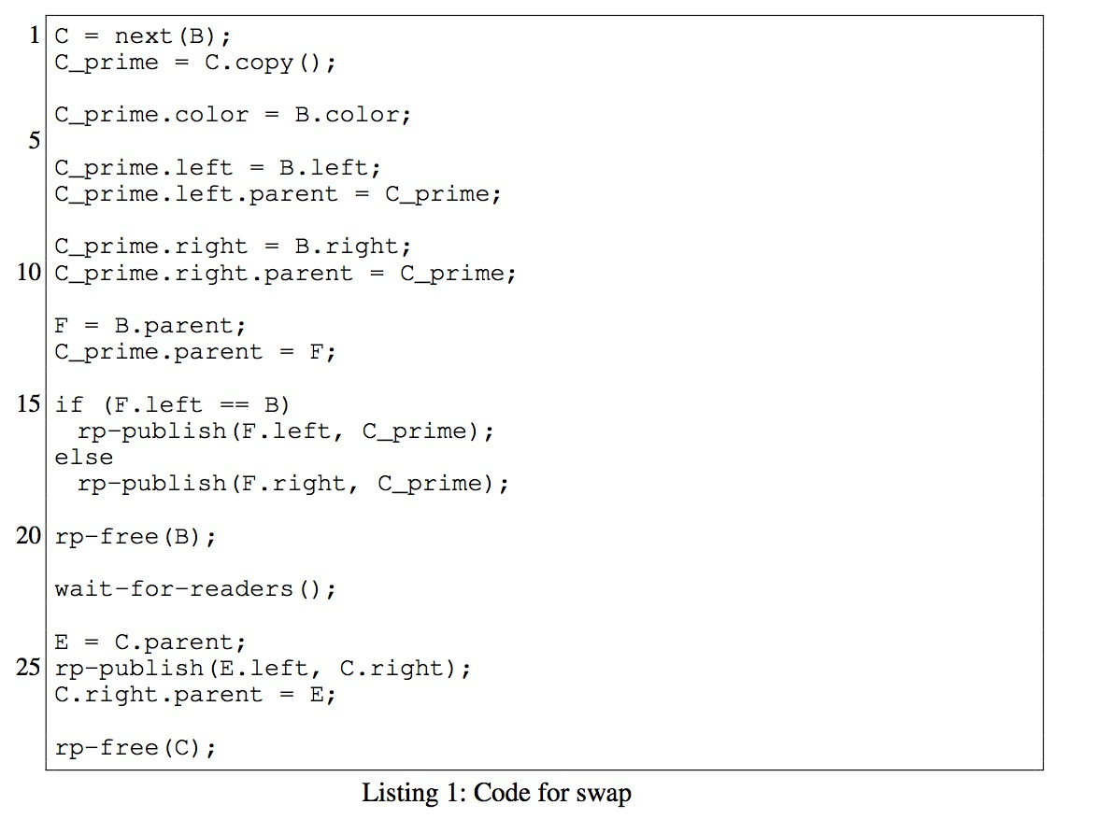
Code for Swap

Slide 26
Special Case Swap
No copy is necessary
C adopts B's left child (A)
A appears twice in the tree (its temporarily a DAG)
- this does not affect readers
Defer free of B

Slide 27
Code for Special Case Swap

Slide 28
Diagonal Restructure

Slide 29
Code for Diagonal Restructure

Slide 30
Zig Restructure

Slide 31
Code for Zig Restructure

Slide 32
Read (lookup) Performance

Slide 33
Sequential Write (insert/delete) Performance

Slide 34
Write-side Synchronization
Global locking
no concurrent writes
Fine-grain locking
deadlock
CCAVL
concurrent, but different data structure
STM - transactional memory
disjoint access parallelism (to be discussed later)

Slide 35
Concurrent Write (insert/delete) Performance

Slide 36
Concurrent Read (lookup) Performance

Slide 37
Linearizability
Lookup, insert and delete operations are linearizable
there is a well defined point at which they take effect
they are primitive operations with only one update (can’t be seen out of order!)

Slide 38
Linearizability
Lookups
last rp-read is the linearization point
Inserts
rp-publish is the linearization point
Deletes
store is the linearization point
Traversals are not necessarily linearizable

Slide 39
Traversals
Traversals visit the nodes in order
they make use of the next operation
Traversals are challenging for RP because they read more than one location
restructures might cause nodes to be missed or duplicated

Slide 40
Traversals
Three approaches explored:
treat a traversal as a single indivisible operation
acquire a lock and hold it for the duration
replace the write lock with a reader-writer lock
O (N log (N)) relativistic traversals
can't use parent pointers
use relativistic lookups to construct the traversal (traversal take O (N log (N)))
updates only wait for lookups
traversal is non-linearizable

Slide 41
Traversals
Third approach: O(N) relativistic traversal
requires modification of update operations to allow readers to use parent pointers
requires additional node copies to preserve the parent pointers

Slide 42
Traversals

Slide 43
Traversals

Slide 44
Conclusions
Relativistic programming can be applied to a data structure as complex as a Red-Black Tree with excellent performance and scalability results

Slide 45
Spare Slides

Slide 46
Reader-visible States in Swap

Slide 47
Reader-visible States in Swap

Slide 48
Reader-visible States in Diagonal Restructure

Slide 49
Reader-visible States in Diagonal Restructure

Slide 50
Reader-visible States in Zig Restructure

Slide 51
Reader-visible States in Zig Restructure

