Slide 1
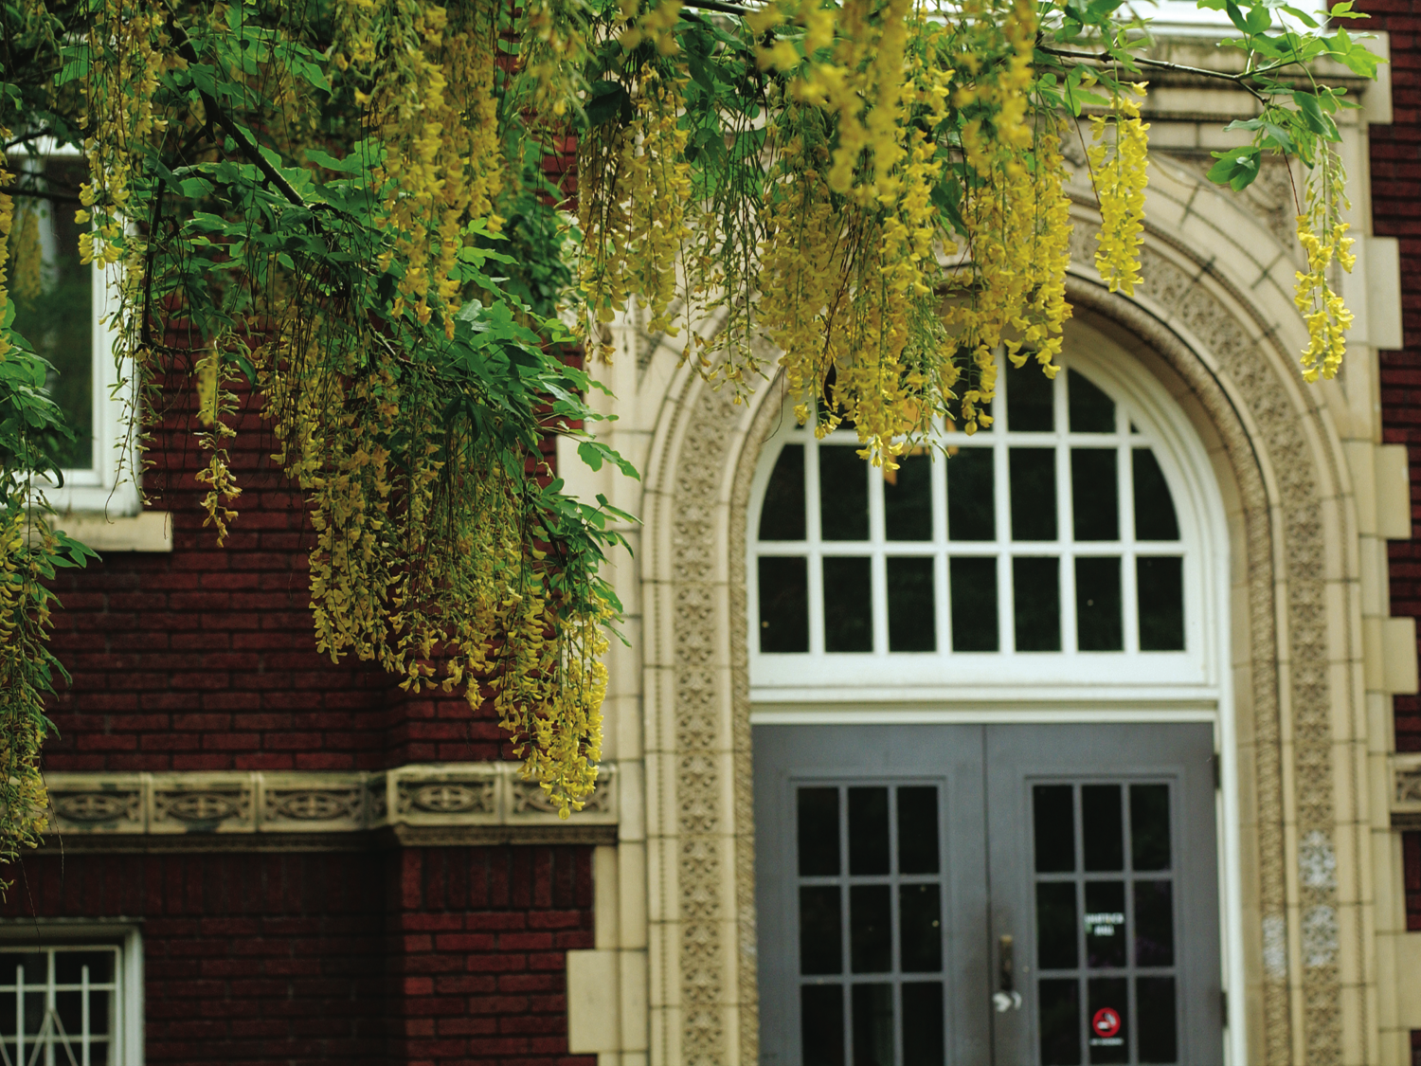
CS510 Concurrent Systems
Jonathan Walpole

Slide 2
Shared Memory Consistency Models: A Tutorial

Slide 3
Outline
Concurrent programming on a uniprocessor
The effect of optimizations on a uniprocessor
The effect of the same optimizations on a multiprocessor
Methods for restoring sequential consistency
Conclusion

Slide 4
Outline
Concurrent programming on a uniprocessor
The effect of optimizations on a uniprocessor
The effect of the same optimizations on a multiprocessor
Methods for restoring sequential consistency
Conclusion

Slide 5
Dekker’s Algorithm
Process 1::
Flag1 = 1
If (Flag2 == 0)
critical section
Process 2::
Flag2 = 1
If (Flag1 == 0)
critical section
Flag1 = 1
Flag2 = 0

Slide 6
Dekker’s Algorithm
Process 1::
Flag1 = 1
If (Flag2 == 0)
critical section
Process 2::
Flag2 = 1
If (Flag1 == 0)
critical section
Flag1 = 1
Flag2 = 0

Slide 7
Dekker’s Algorithm
Process 1::
Flag1 = 1
If (Flag2 == 0)
critical section
Process 2::
Flag2 = 1
If (Flag1 == 0)
critical section
Flag1 = 1
Flag2 = 0

Slide 8
Dekker’s Algorithm
Process 1::
Flag1 = 1
If (Flag2 == 0)
critical section
Process 2::
Flag2 = 1
If (Flag1 == 0)
critical section
Flag1 = 1
Flag2 = 1

Slide 9
Dekker’s Algorithm
Process 1::
Flag1 = 1
If (Flag2 == 0)
critical section
Process 2::
Flag2 = 1
If (Flag1 == 0)
critical section
Flag1 = 1
Flag2 = 1

Slide 10
Dekker’s Algorithm
Process 1::
Flag1 = 1
If (Flag2 == 0)
critical section
Process 2::
Flag2 = 1
If (Flag1 == 0)
critical section
Critical section is protected!

Slide 11
Dekker’s Algorithm
Process 1::
Flag1 = 1
If (Flag2 == 0)
critical section
Process 2::
Flag2 = 1
If (Flag1 == 0)
critical section
Flag1 = 1
Flag2 = 0

Slide 12
Dekker’s Algorithm
Process 1::
Flag1 = 1
If (Flag2 == 0)
critical section
Process 2::
Flag2 = 1
If (Flag1 == 0)
critical section
Flag1 = 1
Flag2 = 1

Slide 13
Dekker’s Algorithm
Process 1::
Flag1 = 1
If (Flag2 == 0)
critical section
Process 2::
Flag2 = 1
If (Flag1 == 0)
critical section
Flag1 = 1
Flag2 = 1

Slide 14
Dekker’s Algorithm
Process 1::
Flag1 = 1
If (Flag2 == 0)
critical section
Process 2::
Flag2 = 1
If (Flag1 == 0)
critical section
Flag1 = 1
Flag2 = 1

Slide 15
Dekker’s Algorithm
Process 1::
Flag1 = 1
If (Flag2 == 0)
critical section
Process 2::
Flag2 = 1
If (Flag1 == 0)
critical section
Both processes can block, but the
critical section is still protected!

Slide 16
Outline
Concurrent programming on a uniprocessor
The effect of optimizations on a uniprocessor
The effect of the same optimizations on a multiprocessor
Methods for restoring sequential consistency
Conclusion

Slide 17
Write Buffer With Bypass
SpeedUp:
- Write takes 100 cycles
- Buffering takes 1 cycle
- So Buffer and keep going!
Problem: Read from a location with a buffered write pending?

Slide 18
Dekker’s Algorithm
Process 1::
Flag1 = 1
If (Flag2 == 0)
critical section
Process 2::
Flag2 = 1
If (Flag1 == 0)
critical section
Flag1 = 0
Flag1 = 1
Flag2 = 0

Slide 19
Dekker’s Algorithm
Process 1::
Flag1 = 1
If (Flag2 == 0)
critical section
Process 2::
Flag2 = 1
If (Flag1 == 0)
critical section
Flag1 = 0
Flag1 = 1
Flag2 = 0
Flag2 = 1

Slide 20
Dekker’s Algorithm
Process 1::
Flag1 = 1
If (Flag2 == 0)
critical section
Process 2::
Flag2 = 1
If (Flag1 == 0)
critical section
Flag1 = 0
Flag1 = 1
Flag2 = 0
Flag2 = 1

Slide 21
Dekker’s Algorithm
Process 1::
Flag1 = 1
If (Flag2 == 0)
critical section
Process 2::
Flag2 = 1
If (Flag1 == 0)
critical section
Flag1 = 0
Flag1 = 1
Flag2 = 0
Flag2 = 1

Slide 22
Dekker’s Algorithm
Process 1::
Flag1 = 1
If (Flag2 == 0)
critical section
Process 2::
Flag2 = 1
If (Flag1 == 0)
critical section
Flag1 = 0
Flag1 = 1
Flag2 = 0
Flag2 = 1
Critical section is not protected!

Slide 23
Write Buffer With Bypass
Rule:
- If a write is issued, buffer it and keep executing
Unless: there is a read from the same location (subsequent writes don't matter), then wait for the write to complete

Slide 24
Dekker’s Algorithm
Process 1::
Flag1 = 1
If (Flag2 == 0)
critical section
Process 2::
Flag2 = 1
If (Flag1 == 0)
critical section
Flag1 = 0
Flag1 = 1
Flag2 = 0

Slide 25
Dekker’s Algorithm
Process 1::
Flag1 = 1
If (Flag2 == 0)
critical section
Process 2::
Flag2 = 1
If (Flag1 == 0)
critical section
Flag1 = 0
Flag1 = 1
Flag2 = 0
Flag2 = 1

Slide 26
Dekker’s Algorithm
Process 1::
Flag1 = 1
If (Flag2 == 0)
critical section
Process 2::
Flag2 = 1
If (Flag1 == 0)
critical section
Stall!
Flag1 = 0
Flag1 = 1
Flag2 = 0
Flag2 = 1

Slide 27
Dekker’s Algorithm
Process 1::
Flag1 = 1
If (Flag2 == 0)
critical section
Process 2::
Flag2 = 1
If (Flag1 == 0)
critical section
Flag1 = 1
Flag2 = 0
Flag2 = 1

Slide 28
Dekker’s Algorithm
Process 1::
Flag1 = 1
If (Flag2 == 0)
critical section
Process 2::
Flag2 = 1
If (Flag1 == 0)
critical section
Flag1 = 1
Flag2 = 1

Slide 29
Is This a General Solution ?
- If each CPU has a write buffer with bypass, and follows the rules, will the algorithm still work correctly?

Slide 30
Outline
Concurrent programming on a uniprocessor
The effect of optimizations on a uniprocessor
The effect of the same optimizations on a multiprocessor
Methods for restoring sequential consistency
Conclusion

Slide 31
Dekker’s Algorithm
Process 1::
Flag1 = 1
If (Flag2 == 0)
critical section
Process 2::
Flag2 = 1
If (Flag1 == 0)
critical section
Flag1 = 0
Flag2 = 0

Slide 32
Dekker’s Algorithm
Process 1::
Flag1 = 1
If (Flag2 == 0)
critical section
Process 2::
Flag2 = 1
If (Flag1 == 0)
critical section
Flag1 = 1
Flag1 = 0
Flag2 = 0

Slide 33
Dekker’s Algorithm
Process 1::
Flag1 = 1
If (Flag2 == 0)
critical section
Process 2::
Flag2 = 1
If (Flag1 == 0)
critical section
Flag1 = 1
Flag1 = 0
Flag2 = 1
Flag2 = 0

Slide 34
Dekker’s Algorithm
Process 1::
Flag1 = 1
If (Flag2 == 0)
critical section
Process 2::
Flag2 = 1
If (Flag1 == 0)
critical section
Flag1 = 1
Flag1 = 0
Flag2 = 1
Flag2 = 0

Slide 35
Dekker’s Algorithm
Process 1::
Flag1 = 1
If (Flag2 == 0)
critical section
Process 2::
Flag2 = 1
If (Flag1 == 0)
critical section
Flag1 = 1
Flag1 = 0
Flag2 = 1
Flag2 = 0

Slide 36
Its Broken!
How did that happen?
- write buffers are processor specific
- writes are not visible to other processors until they hit memory

Slide 37
Generalization of the Problem
Dekker’s algorithm has the form:
WX WY
RY RX
The write buffer delays the writes until after the reads!
It reorders the reads and writes
Both processes can read the value prior to the other’s write!

Slide 38
1
2
3
4
5
6
7
8
9
10
11
12
13
14
15
16
17
18
19
20
21
22
23
24
WX
WX
WX
WX
WX
WX
RY
RY
WY
RX
WY
RX
RY
RY
WY
RX
WY
RX
RY
RY
WY
RX
WY
RX
RY
RY
WY
RX
WY
RX
WX
WX
WX
WX
WX
WX
WY
RX
RY
RY
RX
WY
WY
RX
RY
RY
RX
WY
WY
RX
RY
RY
RX
WY
WY
RX
RY
RY
RX
WY
WX
WX
WX
WX
WX
WX
RX
WY
RX
WY
RY
RY
RX
WY
RX
WY
RY
RY
RX
WY
RX
WY
RY
RY
RX
WY
RX
WY
RY
RY
WX
WX
WX
WX
WX
WX
There are 4! or 24 possible orderings.
If either WX<RX or WY<RY
Then the Critical Section is protected (Correct Behavior).

Slide 39
1
2
3
4
5
6
7
8
9
10
11
12
13
14
15
16
17
18
19
20
21
22
23
24
WX
WX
WX
WX
WX
WX
RY
RY
WY
RX
WY
RX
RY
RY
WY
RX
WY
RX
RY
RY
WY
RX
WY
RX
RY
RY
WY
RX
WY
RX
WX
WX
WX
WX
WX
WX
WY
RX
RY
RY
RX
WY
WY
RX
RY
RY
RX
WY
WY
RX
RY
RY
RX
WY
WY
RX
RY
RY
RX
WY
WX
WX
WX
WX
WX
WX
RX
WY
RX
WY
RY
RY
RX
WY
RX
WY
RY
RY
RX
WY
RX
WY
RY
RY
RX
WY
RX
WY
RY
RY
WX
WX
WX
WX
WX
WX
There are 4! or 24 possible orderings.
If either WX<RX or WY<RY
Then the Critical Section is protected (Correct Behavior).
18 of the 24 orderings are OK.
But the other 6 are trouble!

Slide 40
Another Example
What happens if reads and writes can be delayed by the interconnect?
non-uniform memory access time
cache misses
complex interconnects

Slide 41
Non-Uniform Write Delays
Process 1::
Data = 2000;
Head = 1;
Process 2::
While (Head == 0) {;}
LocalValue = Data
Memory Interconnect
Head = 0
Data = 0

Slide 42
Non-Uniform Write Delays
Process 1::
Data = 2000;
Head = 1;
Process 2::
While (Head == 0) {;}
LocalValue = Data
Memory Interconnect
Head = 0
Data = 0

Slide 43
Non-Uniform Write Delays
Process 1::
Data = 2000;
Head = 1;
Process 2::
While (Head == 0) {;}
LocalValue = Data
Memory Interconnect
Head = 0
Data = 0

Slide 44
Non-Uniform Write Delays
Process 1::
Data = 2000;
Head = 1;
Process 2::
While (Head == 0) {;}
LocalValue = Data
Memory Interconnect
Head = 1
Data = 0

Slide 45
Non-Uniform Write Delays
Process 1::
Data = 2000;
Head = 1;
Process 2::
While (Head == 0) {;}
LocalValue = Data
Memory Interconnect
Head = 1
Data = 0

Slide 46
Non-Uniform Write Delays
Process 1::
Data = 2000;
Head = 1;
Process 2::
While (Head == 0) {;}
LocalValue = Data
Memory Interconnect
Head = 1
Data = 0
WRONG
DATA !

Slide 47
Non-Uniform Write Delays
Process 1::
Data = 2000;
Head = 1;
Process 2::
While (Head == 0) {;}
LocalValue = Data
Memory Interconnect
Head = 1
Data = 2000

Slide 48
What Went Wrong?
Maybe we need to acknowledge each write before proceeding to the next?

Slide 49
Write Acknowledgement?
But what about reordering of reads?
- Non-Blocking Reads
Lockup-free Caches
Speculative execution
Dynamic scheduling
... all allow execution to proceed past a read
Acknowledging writes may not help!

Slide 50
General Interconnect Delays
Process 1::
Data = 2000;
Head = 1;
Process 2::
While (Head == 0) {;}
LocalValue = Data
Memory Interconnect
Head = 0
Data = 0

Slide 51
General Interconnect Delays
Process 1::
Data = 2000;
Head = 1;
Process 2::
While (Head == 0) {;}
LocalValue = Data (0)
Memory Interconnect
Head = 0
Data = 0

Slide 52
General Interconnect Delays
Process 1::
Data = 2000;
Head = 1;
Process 2::
While (Head == 0) {;}
LocalValue = Data (0)
Memory Interconnect
Head = 0
Data = 2000

Slide 53
General Interconnect Delays
Process 1::
Data = 2000;
Head = 1;
Process 2::
While (Head == 0) {;}
LocalValue = Data
Memory Interconnect
Head = 1
Data = 2000

Slide 54
General Interconnect Delays
Process 1::
Data = 2000;
Head = 1;
Process 2::
While (Head == 0) {;}
LocalValue = Data (0)
Memory Interconnect
Head = 1
Data = 2000
WRONG
DATA !

Slide 55
Generalization of the Problem
This algorithm has the form:
WX RY
WY RX
The interconnect reorders reads and writes

Slide 56
1
2
3
4
5
6
7
8
9
10
11
12
13
14
15
16
17
18
19
20
21
22
23
24
WX
WX
WX
WX
WX
WX
RY
RY
WY
RX
WY
RX
RY
RY
WY
RX
WY
RX
RY
RY
WY
RX
WY
RX
RY
RY
WY
RX
WY
RX
WX
WX
WX
WX
WX
WX
WY
RX
RY
RY
RX
WY
WY
RX
RY
RY
RX
WY
WY
RX
RY
RY
RX
WY
WY
RX
RY
RY
RX
WY
WX
WX
WX
WX
WX
WX
RX
WY
RX
WY
RY
RY
RX
WY
RX
WY
RY
RY
RX
WY
RX
WY
RY
RY
RX
WY
RX
WY
RY
RY
WX
WX
WX
WX
WX
WX
Correct behavior requires WX<RX, WY<RY. Program requires WY<RX.
=> 6 correct orders out of 24.

Slide 57
1
2
3
4
5
6
7
8
9
10
11
12
13
14
15
16
17
18
19
20
21
22
23
24
WX
WX
WX
WX
WX
WX
RY
RY
WY
RX
WY
RX
RY
RY
WY
RX
WY
RX
RY
RY
WY
RX
WY
RX
RY
RY
WY
RX
WY
RX
WX
WX
WX
WX
WX
WX
WY
RX
RY
RY
RX
WY
WY
RX
RY
RY
RX
WY
WY
RX
RY
RY
RX
WY
WY
RX
RY
RY
RX
WY
WX
WX
WX
WX
WX
WX
RX
WY
RX
WY
RY
RY
RX
WY
RX
WY
RY
RY
RX
WY
RX
WY
RY
RY
RX
WY
RX
WY
RY
RY
WX
WX
WX
WX
WX
WX
Correct behavior requires WX<RX, WY<RY. Program requires WY<RX.
=> 6 correct orders out of 24.
Write Acknowledgment means WX < WY. Does that Help?
Disallows only 12 out of 24.
9 still incorrect!

Slide 58
Outline
Concurrent programming on a uniprocessor
The effect of optimizations on a uniprocessor
The effect of the same optimizations on a multiprocessor
Methods for restoring sequential consistency
Conclusion

Slide 59
Sequential Consistency for MPs
Why is it surprising that these code examples break on a multi-processor?
What ordering property are we assuming (incorrectly!) that multiprocessors support?
We are assuming they are sequentially consistent!

Slide 60
Sequential Consistency
Sequential Consistency requires that the result of any execution be the same as if the memory accesses executed by each processor were kept in order and the accesses among different processors were interleaved arbitrarily.
...appears as if a memory operation executes atomically or instantaneously with respect to other memory operations
(Hennessy and Patterson, 4th ed.)

Slide 61
Understanding Ordering
Program Order
Compiled Order
Interleaving Order
Execution Order

Slide 62
Reordering
Writes reach memory, and reads see memory, in an order different than that in the program!
- Caused by Processor
- Caused by Multiprocessors (and Cache)
- Caused by Compilers

Slide 63
What Are the Choices?
If we want our results to be the same as those of a Sequentially Consistent Model. Do we:
- Enforce Sequential Consistency at the memory level?
- Use Coherent (Consistent) Cache ?
- Or what ?

Slide 64
Enforce Sequential Consistency?
Removes virtually all optimizations
Too slow!

Slide 65
What Are the Choices?
If we want our results to be the same as those of a Sequentially Consistent Model. Do we:
- Enforce Sequential Consistency at the memory level?
- Use Coherent (Consistent) Cache ?
- Or what ?

Slide 66
Cache Coherence
Multiple processors have a consistent view of memory (i.e. MESI protocol)
But this does not say when a processor must see a value updated by another processor.
Cache coherency does not guarantee Sequential Consistency!
Example: a write-through cache acts just like a write buffer with bypass.

Slide 67
What Are the Choices?
If we want our results to be the same as those of a Sequentially Consistent Model. Do we:
- Enforce Sequential Consistency at the memory level?
- Use Coherent (Consistent) Cache ?
- Or what ?

Slide 68
Involve the Programmer
Someone’s got to tell your CPU about concurrency!
Use memory barrier / fence instructions when order really matters!

Slide 69
Memory Barrier Instructions
A way to prevent reordering
- Also known as a safety net
Require previous instructions to complete before allowing further execution on that CPU
Not cheap, but perhaps not often needed?
- Must be placed by the programmer
- Memory consistency model for processor tells you what reordering is possible

Slide 70
Using Memory Barriers
Process 1::
Flag1 = 1
>>Mem_Bar<<
If (Flag2 == 0)
critical section
Process 2::
Flag2 = 1
>>Mem_Bar<<
If (Flag1 == 0)
critical section
WX
WY
>>Fence<<
>>Fence<<
RY
RX
Fence: WX < RY
Fence: WY < RX

Slide 71
1
2
3
4
5
6
7
8
9
10
11
12
13
14
15
16
17
18
19
20
21
22
23
24
WX
WX
WX
WX
WX
WX
RY
RY
WY
RX
WY
RX
RY
RY
WY
RX
WY
RX
RY
RY
WY
RX
WY
RX
RY
RY
WY
RX
WY
RX
WX
WX
WX
WX
WX
WX
WY
RX
RY
RY
RX
WY
WY
RX
RY
RY
RX
WY
WY
RX
RY
RY
RX
WY
WY
RX
RY
RY
RX
WY
WX
WX
WX
WX
WX
WX
RX
WY
RX
WY
RY
RY
RX
WY
RX
WY
RY
RY
RX
WY
RX
WY
RY
RY
RX
WY
RX
WY
RY
RY
WX
WX
WX
WX
WX
WX
There are 4! or 24 possible orderings.
If either WX<RX or WY<RY
Then the Critical Section is protected (Correct Behavior)
18 of the 24 orderings are OK.
But the other 6 are trouble!
Enforce WX<RY and WY<RX.
Only 6 of the 18 good orderings are allowed OK.
But the 6 bad ones are still forbidden!

Slide 72
Example 2
Process 1::
Data = 2000;
>>Mem_Bar<<
Head = 1;
Process 2::
While (Head == 0) {;}
>>Mem_Bar<<
LocalValue = Data
WX
RY
>>Fence<<
>>Fence<<
WY
RX
Fence: WX < WY
Fence: RY < RX

Slide 73
1
2
3
4
5
6
7
8
9
10
11
12
13
14
15
16
17
18
19
20
21
22
23
24
WX
WX
WX
WX
WX
WX
RY
RY
WY
RX
WY
RX
RY
RY
WY
RX
WY
RX
RY
RY
WY
RX
WY
RX
RY
RY
WY
RX
WY
RX
WX
WX
WX
WX
WX
WX
WY
RX
RY
RY
RX
WY
WY
RX
RY
RY
RX
WY
WY
RX
RY
RY
RX
WY
WY
RX
RY
RY
RX
WY
WX
WX
WX
WX
WX
WX
RX
WY
RX
WY
RY
RY
RX
WY
RX
WY
RY
RY
RX
WY
RX
WY
RY
RY
RX
WY
RX
WY
RY
RY
WX
WX
WX
WX
WX
WX
Correct behavior requires WX<RX, WY<RY. Program requires WY<RX.
=> 6 correct orders out of 24.
We can require WX<WY and RY<RX. Is that enough?
Program requires WY<RX.
Thus, WX<WY<RY<RX; hence WX<RX and WY<RY.
Only 2 of the 6 good orderings are allowed -
But all 18 incorrect orderings are forbidden.

Slide 74
Memory Consistency Models
Every CPU architecture has one!
- It explains what reordering of memory operations that CPU can do
The CPUs instruction set contains memory barrier instructions of various kinds
- These can be used to constrain reordering where necessary
- The programmer must understand both the memory consistency model and the memory barrier instruction semantics!!

Slide 75
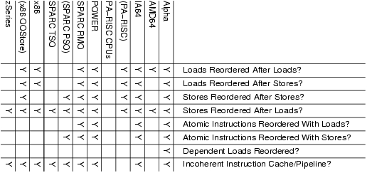
Memory Consistency Models

Slide 76
Code Portability?
Linux provides a carefully chosen set of memory-barrier primitives, as follows:
- smp_mb(): “memory barrier” that orders both loads and stores. This means loads and stores preceding the memory barrier are committed to memory before any loads and stores following the memory barrier.
- smp_rmb(): “read memory barrier” that orders only loads.
- smp_wmb(): “write memory barrier” that orders only stores.

Slide 77
Words of Advice
- “The difficult problem is identifying the ordering constraints that are necessary for correctness.”
- “...the programmer must still resort to reasoning with low level reordering optimizations to determine whether sufficient orders are enforced.”
- “...deep knowledge of each CPU's memory-consistency model can be helpful when debugging, to say nothing of writing architecture-specific code or synchronization primitives.”

Slide 78
Programmer's View
- What does a programmer need to do?
- How do they know when to do it?
- Compilers & Libraries can help, but still need to use primitives in truly concurrent programs
Assuming the worst and synchronizing everything results in sequential consistency
- Too slow, but may be a good way to start

Slide 79
Outline
Concurrent programming on a uniprocessor
The effect of optimizations on a uniprocessor
The effect of the same optimizations on a multiprocessor
Methods for restoring sequential consistency
Conclusion

Slide 80
Conclusion
- Parallel programming on a multiprocessor that relaxes the sequentially consistent memory model presents new challenges
- Know the memory consistency models for the processors you use
- Use barrier (fence) instructions to allow optimizations while protecting your code
- Simple examples were used, there are others much more subtle.

Slide 81
References
- Shared Memory Consistency Models: A Tutorial By Sarita Adve & Kourosh Gharachorloo
- Memory Ordering in Modern Microprocessors, Part I, Paul E. McKenney, Linux Journel, June, 2005
- Computer Architecture, Hennessy and Patterson, 4th Ed., 2007

