Slide 1
CS510 Concurrent Systems
Jonathan Walpole

Slide 2
A Methodology for Implementing Highly Concurrent Data Objects

Slide 3
Concurrent Object
A data structure shared by concurrent processes
Traditionally implemented using locks
Problem: in asynchronous systems slow/failed processes impede fast processes
Alternative approaches include non-blocking and wait-free concurrent objects
... but these are hard to write!
... and hard to understand!

Slide 4
Goals
Make it easy to write concurrent objects (automatable method)
Make them as easy to reason about as sequential objects (linearizability)
Preserve as much performance as possible

Slide 5
The Plan
Write sequential object first
Transform it to a concurrent one (automatically)
Ensure it is linearizable
Use load-linked, store conditional for non-blocking
Transform non-blocking implementation to wait-free implementation when necessary

Slide 6
Non-Blocking Concurrency
Non-blocking: after a finite number of steps at least one process must complete
Wait-free: every process must complete after a finite number of steps
A system that is merely non-blocking is prone to starvation
A wait-free system protects against starvation

Slide 7
The Methodology
Sequential objects must be total, i.e., well defined on all valid states of the data
It must also have no side effects
Why?

Slide 8
Load-Linked Store Conditional
Load-linked copies a memory location
Store conditional stores to a memory location, only if the location load-linked has not been accessed
No ABA, but it can suffer from spurious failures!
- for example, due to cache line replacement
- or execution of a new load-linked on a different location

Slide 9
Small Object Method
Reads memory pointer using load_linked
On failure retry
Copies version into another block
On success transformation complete
Calls store_conditional to swing the pointer from the old to the new
Applies sequential operation to the copy

Slide 10
Is This Safe?
What if one thread reads while another is modifying, can the copy be corrupted?
to prevent access to incomplete state, two version counters are used (check[0] and check[1])
Updates: a thread updates check[0], then does the modification, then updates check[1]
Copies: a thread reads check[1], copies the version, then reads check[0]

Slide 11
Small Objects Cont. - Code
int Pqueue_deq(Pqueue_type **Q){
...
while(1){
old_pqueue = load_linked(Q);
old_version = &old_pqueue->version;
new_version = &new_pqueue->version;
new_pqueue->check[0] = new_pqueue->check[1] + 1;
first = old_pqueue->check[1];
copy(old_version, new_version);
last = old_pqueue->check[0];
if (first == last){
result = pqueue_deq(new_version);
new_pqueue->check[1] = new_pqueue->check[0] + 1;
if (store_conditional(Q, new_version))break;
}
}
new_pqueue = old_pqueue;
return result;
}
If the check values DO match, now we can perform our dequeue operation!
Try to publicize the new heap via store_conditional, which could fail and we loop back.
Reclaim the memory!
Return our priority queue result.
Preventing the race condition!
Copy the old, new data.
If the check values do not match, loop again. We failed.

Slide 12
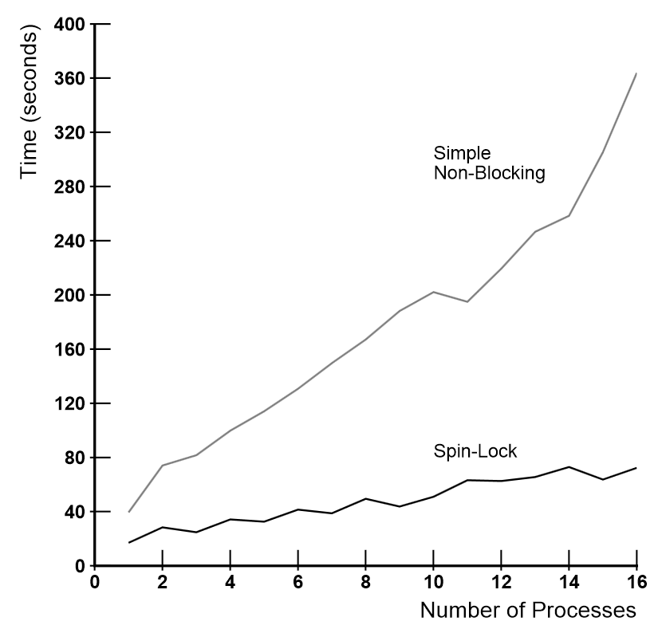
Simple Non-Blocking Algorithm vs. Spin-Lock

Slide 13
Why Does It Perform So Poorly?

Slide 14
Small Objects Cont. – Back Off
...
if (first == last)
{
result = pqueue_deq(new_version);
if (store_conditional(Q, new_version )) break;
}
if (max_delay < DELAY_LIMIT) max_delay = 2 * max_delay;
delay = random() % max_delay;
for (i = 0; i < delay; i++);
} /* end while*/
new_pqueue = old_pqueue;
return result;
}
When the consistency check or the store_conditional fails, introduce back-off for a random amount of time!

Slide 15
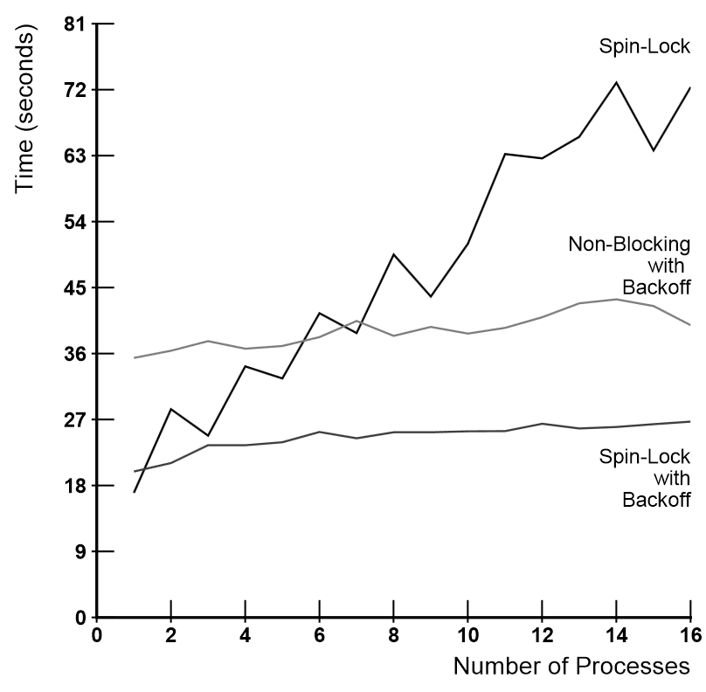
Effect of Adding Backoff

Slide 16
Why Does It Still Perform Poorly?

Slide 17
Other Problems
Long operations struggle to finish
They are repeatedly forced to retry by short operations
The approach is subject to starvation!
How can we fix this?

Slide 18
Small Objects – Wait Free
Each process declares its intended operations ahead of time, using an invocation structure
- name, arguments, and toggle bit to determine if invocation is old or new
The results of each operation are recorded in a response structure
- result value, toggle bit
Every process tries to do every other processes operations before doing its own!!!!
- but only one succeeds (exactly one succeeds!)

Slide 19
Small Objects – Wait Free
...
announce[P].op_name = DEQ_CODE;
new_toggle = announce[P].toggle = !announce[P].toggle;
if (max_delay> 1) max_delay = max_delay >> 1;
while(((*Q)->responses[P].toggle != new_toggle)
|| ((*Q)->responses[P].toggle != new_toggle)){
old_pqueue = load_linked(Q);
old_version = &old_pqueue->version;
new_version = &new_pqueue->version;
first = old_pqueue->check[1];
memcopy(old_version, new_version, sizeof(pqueue_type));
last = old_pqueue->check[0];
if (first == last){
result = pqueue_deq(new_version);
apply(announce, Q);
if (store_conditional(Q, new_version )) break;
}
if (max_delay < DELAY_LIMIT) max_delay = 2 * max_delay;
delay = random() % max_delay;
for (i = 0; i < delay; i++);
}
new_pqueue = old_pqueue;
return result;
}
Record your operation
Flip the toggle bit
?
apply all pending operations to the NEW version
Commit the new version

Slide 20
Doing The Work of Others
void apply (inv_type announce[MAX_PROCS], pqueue_type *object){
int i;
for (i = 0; i < MAX_PROCS; i++){
if(announce[i].toggle != object->res_types[i].toggle){
switch(announce[i].op_name){
case ENG_CODE:
object->res_type[i].value =
pqueue_enq(&ojbect->version, announce[i].arg);
break;
case DEQ_CODE:
object->res_type[i].value =
pqueue_deq(&ojbect->version, announce[i].arg);
break;
default:
fprintf(stderr, “Unknown operation code \n”);
exit(1);
};
object->res_types[i].toggle = announce[i].toggle;
}
}
}

Slide 21
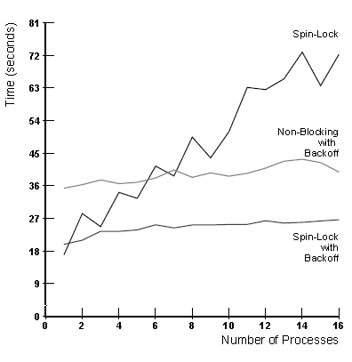
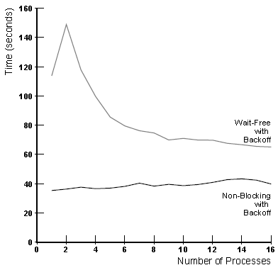
Small Objects Cont. – Wait Free
Small Object, Non-Blocking (back-off)
Small Object, Wait Free (back-off)
Notes:
Wait Free guarantees no starvation

Slide 22
Wait-Free Performance Sucks! Why?

Slide 23
Large Concurrent Objects
- Cannot be copied in a single block
- Represented by a set of blocks linked by pointers
- The programmer is responsible for determining which blocks of the object to copy
- The less copying the better the performance

Slide 24
Summary & Contributions
Foundation for transforming sequential implementations to concurrent ones
uses LL and SC
simplifies programming complexity
could be performed by a compiler
maintains a “reasonable” level of performance?

