Slide 1
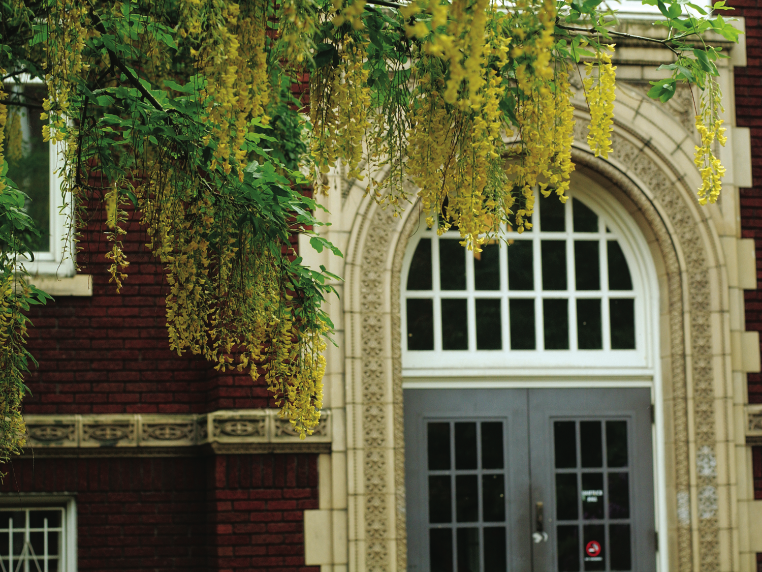
CS510 Concurrent Systems
Jonathan Walpole

Slide 2
A Lock-Free Multiprocessor OS Kernel

Slide 3
The Synthesis Kernel
A research project at Columbia University
Synthesis V.0
Uniprocessor (Motorola 68020)‏
No virtual memory
1991 - Synthesis V.1
Dual 68030s
virtual memory, threads, etc
Lock-free kernel

Slide 4
Locking
Why do kernels normally use locks?
Locks support a concurrent programming style based on mutual exclusion
Acquire lock on entry to critical sections
Release lock on exit
Block or spin if lock is held
Only one thread at a time executes the critical section
Locks prevent concurrent access and enable sequential reasoning about critical section code

Slide 5
Why Not Use Locking?
Granularity decisions
Simplicity vs performance
Increasingly poor performance (superscalar CPUs)
Complicates composition
Need to know the locks I’m holding before calling a function
Need to know if its safe to call while holding those locks?
Risk of deadlock
Propagates thread failures to other threads
What if I crash while holding a lock?

Slide 6
Is There an Alternative?
Use lock-free, “optimistic” synchronization
Execute the critical section unconstrained, and check at the end to see if you were the only one
If so, continue. If not roll back and retry
Synthesis uses no locks at all!
Goal: Show that Lock-Free synchronization is...
Sufficient for all OS synchronization needs
Practical
High performance

Slide 7
Locking is Pessimistic
Murphy's law:
- “If it can go wrong, it will...”
In concurrent programming:
“If we can have a race condition, we will...”
“If another thread could mess us up, it will...”
Solution:
Hide the resources behind locked doors
Make everyone wait until we're done
That is...if there was anyone at all
We pay the same cost either way

Slide 8
Optimistic Synchronization
The common case is often little or no contention
Or at least it should be!
Do we really need to shut out the whole world?
Why not proceed optimistically and only incur cost if we encounter contention?
If there's little contention, there's no starvation
So we don’t need to be “wait-free” which guarantees no starvation
Lock-free is easier and cheaper than wait-free
Small critical sections really help performance

Slide 9
How Does It Work?
Copy
Write down any state we need in order to retry
Do the work
Perform the computation
Atomically “test and commit” or retry
Compare saved assumptions with the actual state of the world
If different, undo work, and start over with new state
If preconditions still hold, commit the results and continue
This is where the work becomes visible to the world (ideally)

Slide 10
Example – Stack Pop
Pop() {
retry:
old_SP = SP;
new_SP = old_SP + 1;
elem = *old_SP;
if (CAS(old_SP, new_SP, &SP) == FAIL)
goto retry;
return elem;
}

Slide 11
Example – Stack Pop
Pop() {
retry:
old_SP = SP;
new_SP = old_SP + 1;
elem = *old_SP;
if (CAS(old_SP, new_SP, &SP) == FAIL)
goto retry;
return elem;
}
loop

Slide 12
Example – Stack Pop
Pop() {
retry:
old_SP = SP;
new_SP = old_SP + 1;
elem = *old_SP;
if (CAS(old_SP, new_SP, &SP) == FAIL)
goto retry;
return elem;
}
Global - may change any time!
Locals -
won’t change!
“Atomic”
read-modify-write
instruction

Slide 13
CAS
CAS – single word Compare and Swap
An atomic read-modify-write instruction
Semantics of the single atomic instruction are:
CAS(copy, update, mem_addr)
{
if (*mem_addr == copy) {
*mem_addr = update;
return SUCCESS;
} else
return FAIL;
}

Slide 14
Example – Stack Pop
Pop() {
retry:
old_SP = SP;
new_SP = old_SP + 1;
elem = *old_SP;
if (CAS(old_SP, new_SP, &SP) == FAIL)
goto retry;
return elem;
}
Copy
global
to local

Slide 15
Example – Stack Pop
Pop() {
retry:
old_SP = SP;
new_SP = old_SP + 1;
elem = *old_SP;
if (CAS(old_SP, new_SP, &SP) == FAIL)
goto retry;
return elem;
}
Do Work

Slide 16
Example – Stack Pop
Pop() {
retry:
old_SP = SP;
new_SP = old_SP + 1;
elem = *old_SP;
if (CAS(old_SP, new_SP, &SP) == FAIL)
goto retry;
return elem;
}
Test

Slide 17
Example – Stack Pop
Pop() {
retry:
old_SP = SP;
new_SP = old_SP + 1;
elem = *old_SP;
if (CAS(old_SP, new_SP, &SP) == FAIL)
goto retry;
return elem;
}
Copy
Do Work
Test

Slide 18
What Made It Work?
It works because we can atomically commit the new stack pointer value and compare the old stack pointer with the one at commit time
This allows us to verify no other thread has accessed the stack concurrently with our operation
i.e. since we took the copy
Well, at least we know the address in the stack pointer is the same as it was when we started
Does this guarantee there was no concurrent activity?
Does it matter?
We have to be careful !

Slide 19
Stack Push
Push(elem) {
retry:
old_SP = SP;
new_SP = old_SP – 1;
old_val = *new_SP;
if(CAS2(old_SP, old_val, new_SP, elem, &SP, new_SP)
== FAIL)‏ goto retry;
}

Slide 20
Stack Push
Push(elem) {
retry:
old_SP = SP;
new_SP = old_SP – 1;
old_val = *new_SP;
if(CAS2(old_SP, old_val, new_SP, elem, &SP, new_SP)
== FAIL)‏ goto retry;
}
Copy

Slide 21
Stack Push
Push(elem) {
retry:
old_SP = SP;
new_SP = old_SP – 1;
old_val = *new_SP;
if(CAS2(old_SP, old_val, new_SP, elem, &SP, new_SP)
== FAIL)‏ goto retry;
}
Do Work

Slide 22
Stack Push
Push(elem) {
retry:
old_SP = SP;
new_SP = old_SP – 1;
old_val = *new_SP;
if(CAS2(old_SP, old_val, new_SP, elem, &SP, new_SP)
== FAIL)‏ goto retry;
}
Test and
commit

Slide 23
Stack Push
Push(elem) {
retry:
old_SP = SP;
new_SP = old_SP – 1;
old_val = *new_SP;
if(CAS2(old_SP, old_val, new_SP, elem, &SP, new_SP)
== FAIL)‏ goto retry;
}
Compare
Unnecessary
Note: this is a double compare and swap!
Its needed to atomically update both the
new item and the new stack pointer

Slide 24
CAS2
CAS2 = double compare and swap
- Sometimes referred to as DCAS
CAS2(copy1, copy2, update1, update2, addr1, addr2)
{
if(addr1 == copy1 && addr2 == copy2) {
*addr1 = update1;
*addr2 = update2;
return SUCCEED;
} else
return FAIL;
}

Slide 25
Stack Push
Push(elem) {
retry:
old_SP = SP;
new_SP = old_SP – 1;
old_val = *new_SP;
if(CAS2(old_SP, old_val, new_SP, elem, &SP, new_SP)
== FAIL)‏ goto retry;
}
Copy
Do Work
Test

Slide 26
Synchronization in Synthesis
Saved state is only one or two words
Commit is done via
- Compare-and-Swap (CAS), or
- Double-Compare-and-Swap (CAS2 or DCAS)
Can we really do everything in only two words?
- Every synchronization problem in the Synthesis kernel is reduced to only needing to atomically touch two words at a time!
- Requires some very clever kernel architecture

Slide 27
Approach
Build data structures that work concurrently
- Stacks
- Queues (array-based to avoid allocations)
- Linked lists
Then build the OS around these data structures
Concurrency is a first-class concern

Slide 28
Its Trickier Than It Seems
List operations show insert and delete at the head
This is the easy case
What about insert and delete of interior nodes?
Next pointers of deletable nodes are not safe to traverse, even the first time!
Need reference counts and DCAS to atomically compare and update the count and pointer values
This is expensive, so we may choose to defer deletes instead (more on this later in the course)
Specialized list and queue implementations can reduce the overheads

Slide 29
The Fall-Back Position
If you can’t reduce the work such that it requires atomic updates to two or less words:
Create a single server thread and do the work sequentially on a single CPU
Why is this faster than letting multiple CPUs try to do it concurrently?
Callers pack the requested operation into a message
Send it to the server (using lock-free queues!)
Wait for a response/callback/...
The queue effectively serializes the operations

Slide 30
Lock vs Lock-Free Critical Sections
Lock_based_Pop() {
spin_lock(&lock);
elem = *SP;
SP = SP + 1;
spin_unlock(&lock);
return elem;
}
Lock_free_Pop() {
retry:
old_SP = SP;
new_SP = old_SP + 1;
elem = *old_SP;
if (CAS(old_SP, new_SP, &SP) == FAIL)‏
goto retry;
return elem;
}

Slide 31
Conclusions
This is really intriguing!
Its possible to build an entire OS without locks!
But do you really want to?
Does it add or remove complexity?
What if hardware only gives you CAS and no DCAS?
What if critical sections are large or long lived?
What if contention is high?
What if we can’t undo the work?
… ?

