Slide 1
Fixing Broken Programs

Slide 2
How do you figure out what’s wrong?
Look carefully at the error message.
Locate the error
Most messages have line numbers
Comment out the part of the program where you think the error may be. Then add in little bits at a time, until it breaks again.
Try and fix it yourself
Ask some one for help.

Slide 3
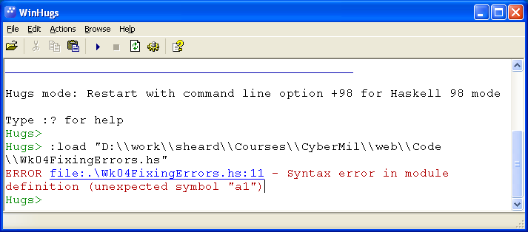
Where is the error
It also tells what it thinks is wrong. It is not always correct.
The error message tells the file and the line number

Slide 4
Line number analysis
Errors are some times on the line indicated
Many times the errors are in the last non-whitespace before the line number listed. This can be several lines above the line number indicated.

Slide 5
Num class errors
When you write a numeral
5
22
1567 etc
The system classifies this a value in the Num class
This means it could be Int, Integer, Double, Float , or many other types.
An error that mentions (Num x) could mean you have a numeral without an exact type. Use a type declaration to fix this
r = row [5]
Broken program
x::Integer
r = row [x]
r = row [5:: Integer]
Fix #2
Fix #1

Slide 6
Constructor errors
Constructors start with a capital letter
We know of at least two- True and False
Types also start with a capital letter: Bool, Integer, Double, etc.
You cannot use a name that starts with a capital letter.
If you see “unexpected Constructor” look for a name that starts with a capital letter.

