Slide 1
Computer Graphics 11: 3D Object Representations – Octrees & Fractals

Slide 2
Contents
In today’s lecture we would like to continue on from the last day and look at some more modelling techniques
Octrees
Fractals

Slide 3
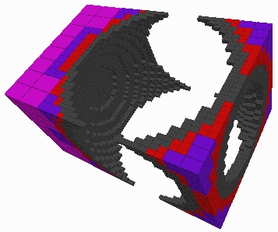
Octrees
Octrees are hierarchical tree structures used to represent solid objects
Octrees are particularly useful in applications that require cross sectional views – for example medical applications
Octrees are typically used when the interior of objects is important

Slide 4
Octrees & Quadtrees
Octrees are based on a two-dimensional representation scheme called quadtree encoding
Quadtree encoding divides a square region of space into four equal areas until homogeneous regions are found
These regions can then be arranged in a tree

Slide 5
Quadtree Example 1

Slide 6
Quadtree Example 2
Images taken from Hearn & Baker, “Computer Graphics with OpenGL” (2004)

Slide 7
Octrees
Quadtree encodings provide considerable savings in storage when large colour areas exist in a region of space
An octree takes the same approach as quadtrees, but divides a cube region of 3D space into octants
Each region within an octree is referred to as a volume element or voxel
Division is continued until homogeneous regions are discovered

Slide 8
Octrees (cont…)
Images taken from Hearn & Baker, “Computer Graphics with OpenGL” (2004)

Slide 9
Octrees (cont…)
In 3 dimensions regions can be considered to be homogeneous in terms of colour, material type, density or any other physical characteristics
Voxels also have the unique possibility of being empty

Slide 10
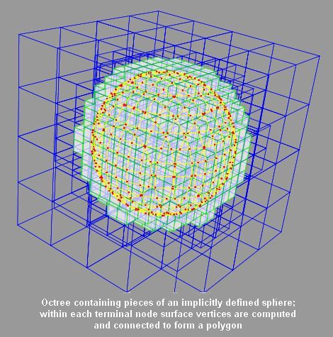
Octree Examples
Taken from http://www.unchainedgeometry.com/jbloom/images.html

Slide 11
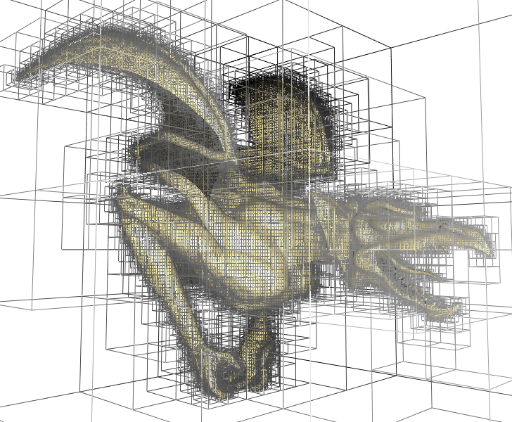
Octree Examples (cont…)
Taken from http://www-evasion.inrialpes.fr/Membres/Sylvain.Lefebvre/these/

Slide 12
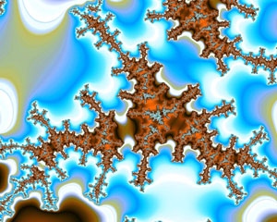
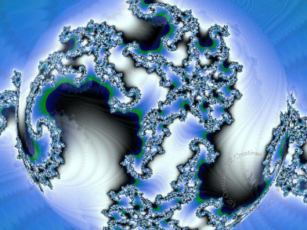
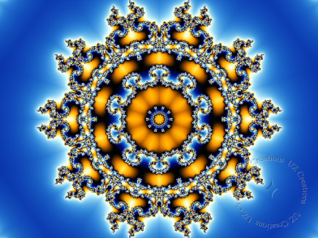
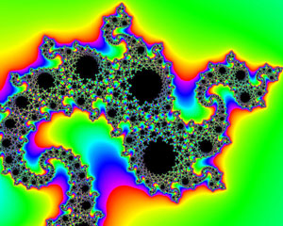
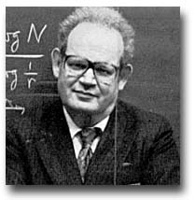
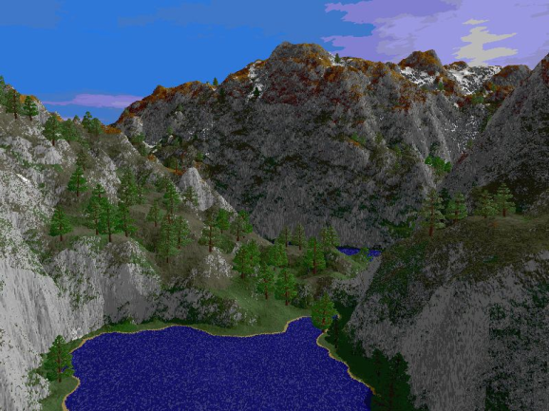
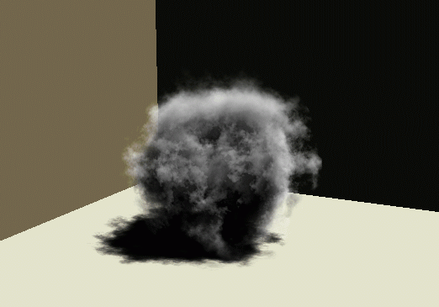
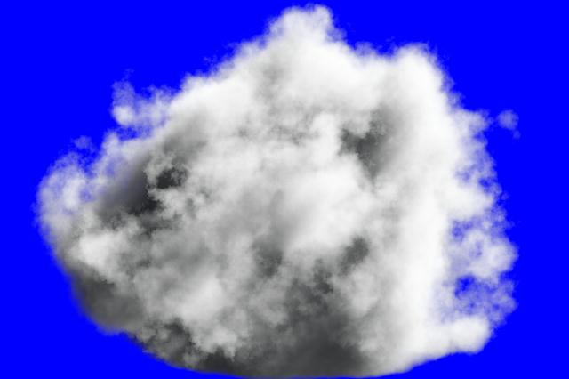
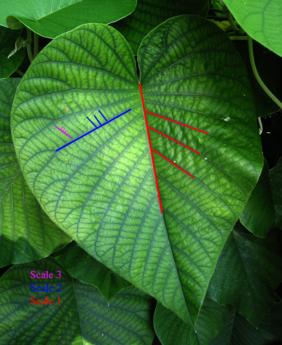
Fractals
All of the modelling techniques covered so far use Euclidean geometry methods
Objects were described using equations
This is fine for manufactured objects
But what about natural objects that have irregular or fragmented features?
Mountains, clouds, coral…
“Clouds are not spheres, mountains are not cones, coastlines are not circles and bark is not smooth, nor does lightning travel in a straight line.”
Benoit Mandelbrot

Slide 13
Fractal Geometry Methods & Procedural Modelling
Natural objects can be realistically described using fractal geometry methods
Fractal methods use procedures rather than equations to model objects - procedural modelling
The major characteristic of any procedural model is that the model is not based on data, but rather on the implementation of a procedure following a particular set of rules
Modelling On The Fly!

Slide 14
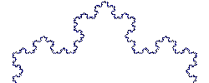
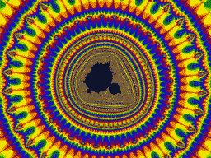
Fractals
A fractal object has two basic characteristics:
Infinite detail at every point
A certain self similarity between object parts and the overall features of the object
Mandelbrot Set Video From: http://www.fractal-animation.net/ufvp.htm
The Koch Curve

Slide 15
Generating Fractals
A fractal object is generated by repeatedly applying a specified transform function to points in a region of space
If P₀ = (x₀, y₀, z₀) is a selected initial position, each iteration of a transformation function F generates successive levels of detail with the calculations:
In general the transformation is applied to a specified point set, or to a set of primitives (e.g. lines, curves, surfaces)

Slide 16
Generating Fractals (cont…)
Although fractal objects, by definition have infinite detail, we only apply the transformation a finite number of times
Obviously objects we display have finite dimension – they fit on a page or a screen
A procedural representation approaches a true representation as we increase the number of iterations
The amount of detail is limited by the resolution of the display device, but we can always zoom in for further detail

Slide 17
Example: The Koch Snowflake
Images taken from Hearn & Baker, “Computer Graphics with OpenGL” (2004)

Slide 18
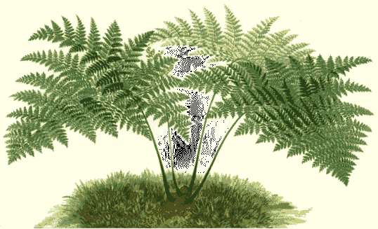
Example: Ferns
Very similar techniques can be used to generate vegetation

Slide 19
Fractal Dimension
The amount of variation in the structure of a fractal object is described as the fractal dimension, D
More jagged looking objects have larger fractal dimensions
Calculating the fractal dimension can be difficult, especially for particularly complex fractals
We won’t look at the details of these calculations

Slide 20
Types Of Fractals
Fractals can be classified into three groups
Self similar fractals
These have parts that are scaled down versions of the entire object
Commonly used to model trees, shrubs etc
Self affine fractals
Have parts that are formed with different scaling parameters in each dimension
Typically used for terrain, water and clouds
Invariant fractal sets
Fractals formed with non-linear transformations
Mandelbrot set, Julia set – generally not so useful

Slide 21
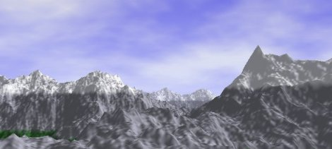
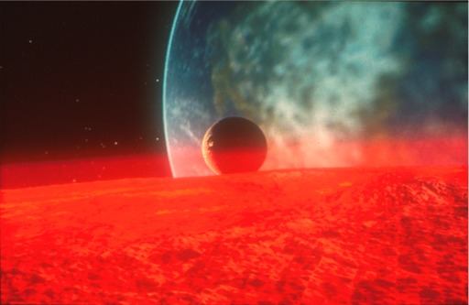
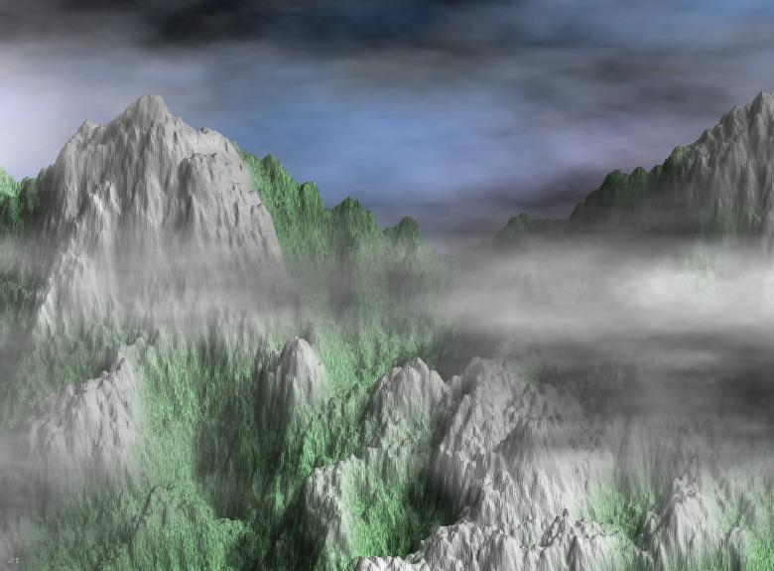
Random Midpoint Displacement Methods For Topography
One of the most successful uses of fractal techniques in graphics is the generation of landscapes
One efficient method for doing this is random midpoint displacement

Slide 22
Random Midpoint Displacement Methods For Topography (cont…)
Easy to do in two dimensions
Easily expanded to three dimensions to generate terrain
Can introduce a roughness factor H to control terrain appearance
Control surfaces can be used to start with a general terrain shape
Terrain generation demo:
http://world.std.com/~bgw/applets/1.02/MtFractal/MtFractal.html

Slide 23
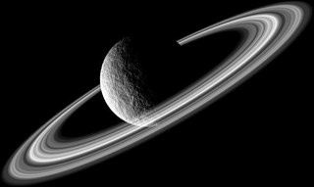
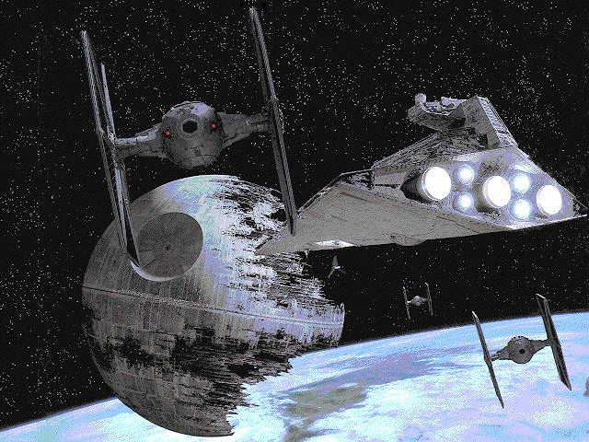
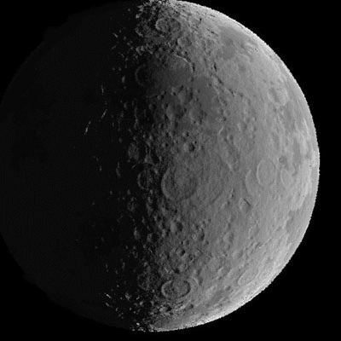
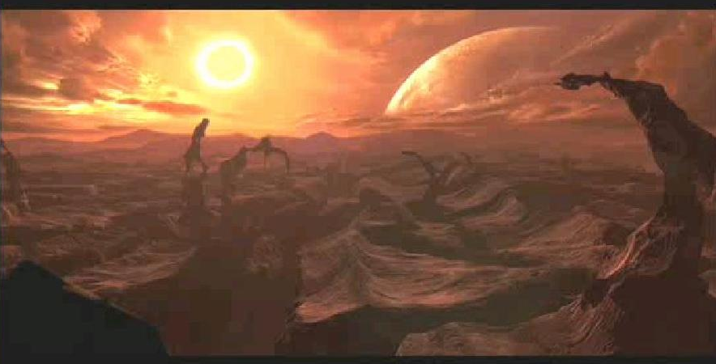
Fractals In Film Special Effects

Slide 24
Summary
In today’s lecture we looked at how octrees and fractals are used in modelling
Fractals in particular are a fairly exotic modelling technique, but can be extremely effective
Next time we will look at curved surfaces which are extremely important

