Slide 1
Triangular Sorter
(Memristor-Parallel)
Shri Kavya Alaparthy
PSU ID:923357905
Boddireddy Sindhu
PSU ID:951176634

Slide 2
Overview:
Sorter
Min-max cell
Memristor
FPGA
Results

Slide 3
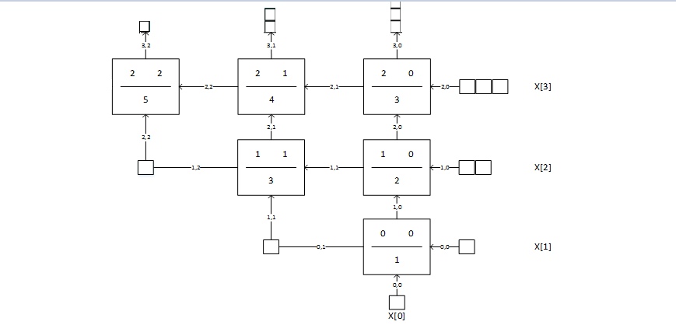
Sorter:

Slide 4
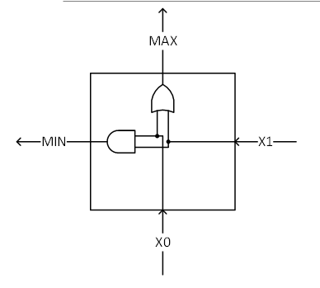
Min-Max Cell:
Inputs are given in thermometric code.
The drawback of this thermometric code is we need more number of bits per input.

Slide 5
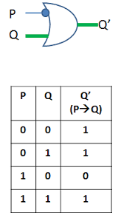
Gate and its truth table:

Slide 6
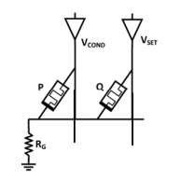
Realization with two memristors:

Slide 7
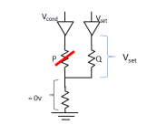
Circuit when p=0:

Slide 8
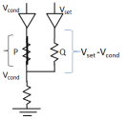
Circuit when p not equal to 0:

Slide 9

Realization of OR gate:

Slide 10
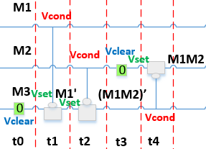
AND gate space-time notation:

Slide 11
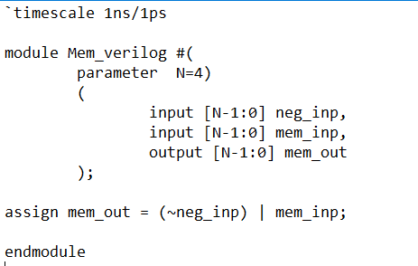
Memristor Module:
Memristor module is written separately.
Called twice for OR gate operation.
Called thrice for AND gate operation.

Slide 12
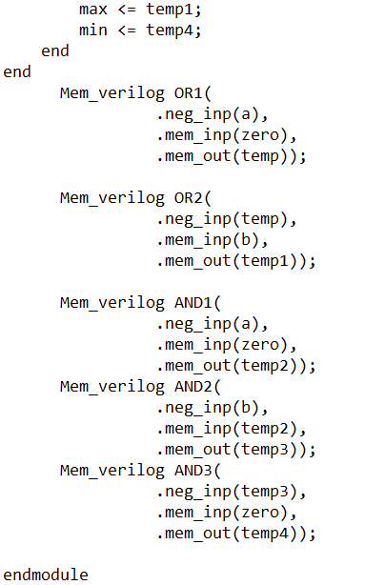
Min Max Module:
This is the module where memristor_module is called for the AND and OR operation.
For OR gate,
X = mem (mem (a, 0), B).
For AND gate,
X = mem(mem(mem (b,0),a),0)

Slide 13
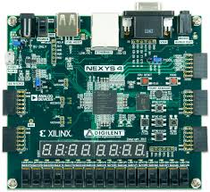
FPGA Board:
NEXYS 4 DDR
Inputs: Slider switches
Output: 7 segment display

Slide 14
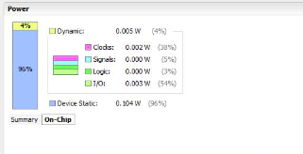
Power:

Slide 15
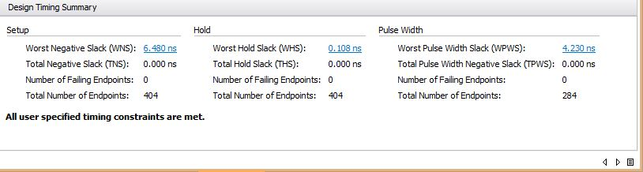
Timing:

Slide 16
Comparision:
 | Delay(ns) |  |  |  | Area(mm² ) | Power
 |  | Logic | Net | Total
Memristor | Setup | 0.632 | 3.020 | 3.652 | 0.255 | 0.104
 | Hold | 0.186 | 0.053 | 0.239
CMOS | Setup | 1.056 | 2.838 | 3.894 | 0.217 | 0.104
 | Hold | 0.186 | 0.065 | 0.251

Slide 17
Results summary:
Delay is decreased in memristor when compared to cmos.
Area of the logic increased when memristor used compared to use of cmos.
Static power is almost equal in both the cases.
Dynamic power in memristor is bit high when compared to cmos.

