Slide 1

Triangular Sorter Using Memristive Architecture.
Under the Leadership and Guidance of Dr. Marek A Perkowski
ECE 590
By,
Sai Kiran Kadam
914459405

Slide 2
Contents
Introduction
Triangular Sorter
Memristor
IMPLY Gate
Min_Max Cell
Parallel Sorting vs. Serial Sorting
Thermometer Code
Pipelined Data Flow
Applications

Slide 3
Introduction
The memristive architecture is used and implemented to realize the parallel triangular sorter.
A memristor is a novel circuit produced by HP labs in the year 2008.
A parallel triangular sorting has been used rather than serial triangular sorting.
The Max_Min logic cells have been used to compare the minimum and maximum of the give input bits which is shown in the later stages.
This model can be used in computer engineering areas that deal with huge data.

Slide 4
Triangular Sorter
A triangular sorter is a technique of sorting and comparing the given m, n bit inputs that gives out the minimum and maximum values through the implementation of Imply gate logic in its imply primitive logic cell.
The triangular sorter, here, begins with the two inputs at a time and proceeds with different inputs as the time progresses.
As the sorting progresses, the number of Max_Min cells that are required is minimized and at the last, only one Max_Min cell is required to get the maximum and minimum values

Slide 5
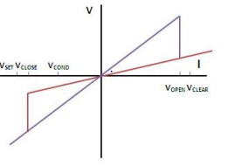

Memristor
A memristor is a two terminal fundamental passive element with non-linear Characteristic
Smaller form factor.
Memristor provides the relation between Charge and Flux.
A resistor with a memory.

Slide 6
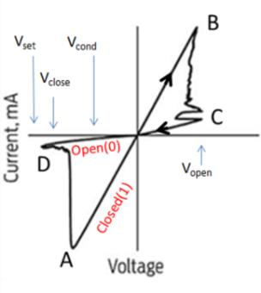
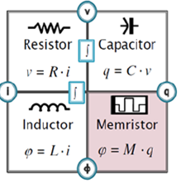
V-I Chars of a Memristor
The ‘AB’ of the graph = ON (Less Resistance)
The ‘BC’ of the graph = Closed to Open.
The ‘CD’ of the graph = OFF (High resistance)
The ‘DA’ of the graph = Open to Close.

Slide 7
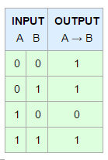
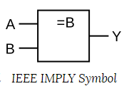
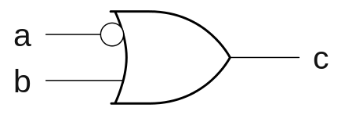
IMPLY Gate
Imply gate is a digital logic gate used to implement a logical condition.
Imply gate is considered as a virtual gate for memristors.

Slide 8
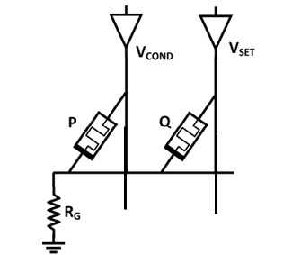
IMPLY Gate using Memristors
P is the input Memristor.
Q is the working Memristor.
Output available at Q
C – State of Memristor Q
RG – Ground Resistance.
P is varied.
Q is set to 0/1.

Slide 9
IMPLY Logic using Memristors
Working of Imply Logic:
When P = 0
Memristor P =0, implies P is open
Memristor P has high resistance
The voltage across the grounding resistance is zero.
The voltage across memristor Q becomes Vset.
From V-I characteristics, Vset is greater than Vclose causing the Vset across memristor Q high that implies Vset = 1.
The state of Q becomes 1, irrespective of the input at Q.

Slide 10
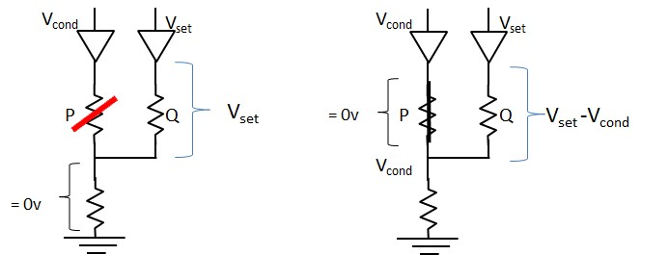
IMPLY Logic using Memristors

Slide 11
IMPLY Logic using Memristors
When P = 1
Memristor P=1, implies P is closed.
Memristor P has less resistance. P can be treated as a wire.
The voltage across the grounding resistor is same as Vcond
The voltage across memristor Q becomes Vset-Vcond.
From Figure , Vset-Vcond < Vclose, not enough to switch the state of Q irrespective of its input.
The state of Q = Previous state of Q.

Slide 12
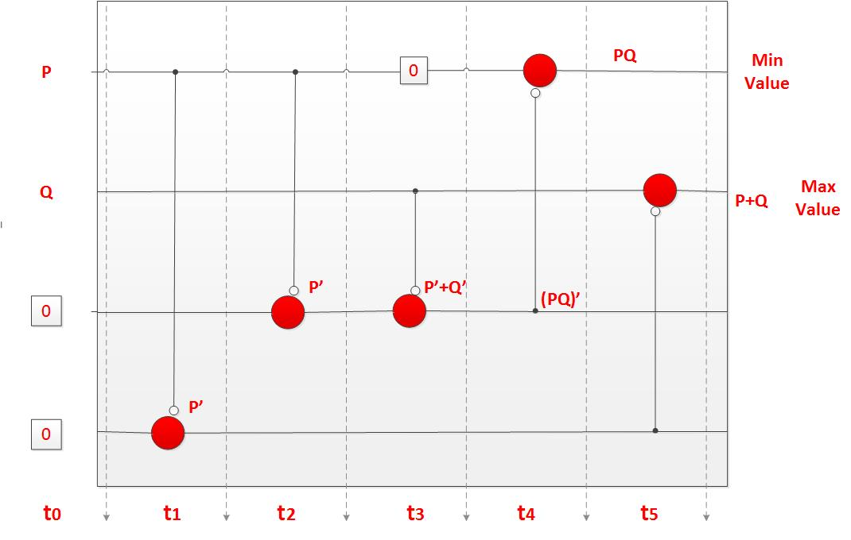
1 –bit Min_Max Cell – IMPLY Sequence

Slide 13
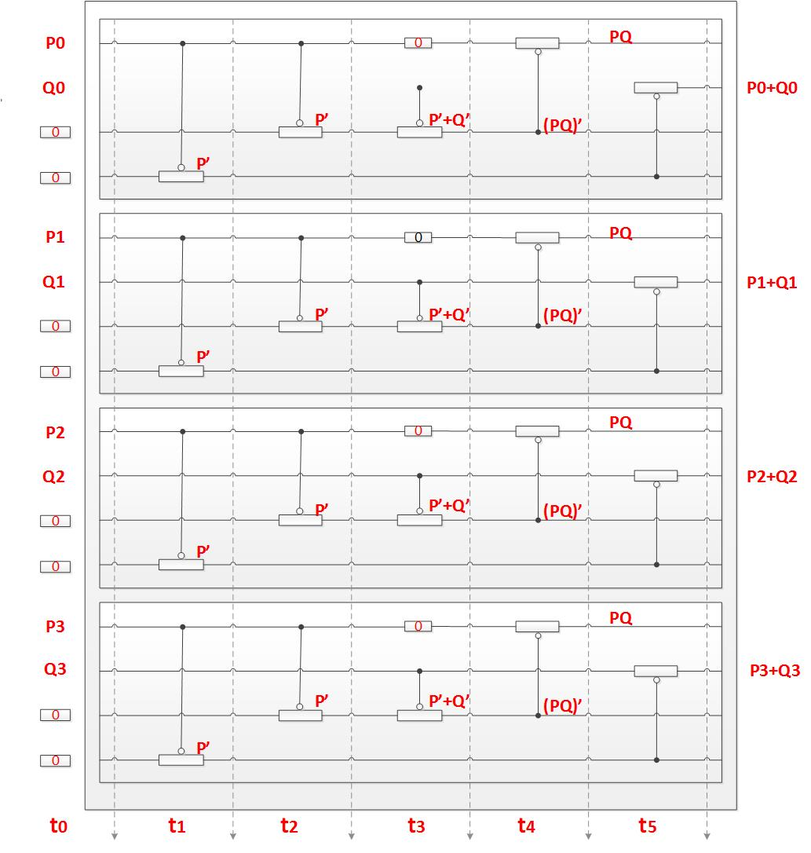
4 –bit -Min_Max Cell - Imply Sequence

Slide 14
Min_Max Cell Description
The above Min_Max cell can be described as follows:
0 represent working memristors which have value of ‘0’
P, Q are input memristors that can be ‘1’ or ‘0’
As shown above, the final output of Min and Max value is obtained after six pulses. i.e., (t0 – t5)
Max value = P+Q = P OR Q is obtained after t5. i.e., pulses after t0.
Min value = P.Q = P AND Q is obtained after t4 i.e., 5 pulses after t0.

Slide 15
Min_Max Cell Basic
Inputs are in thermometer code
This makes comparison easy
Let X₁=0011 X₂=0111
0011 0011
&0111 +0111
0011=min 0111=max
Tradeoff is more bits/input

Slide 16
Physical memristors are represented by Horizontal lines
The bottom side of this symbol is the negated input.
The left side is the non-negated input and the value of memristor before the pulse.
0 on the left side indicates an additional pulse required to reset the input state of the memristor to 0
The right side is the value of the memristor after the pulse

Slide 17
Sorting
Sorting is an important operation in engineering applications.
Different types of sorting – Serial and Parallel.
  Serial Sorting:
The input bits are forwarded one after the other.
Less architecture is required.
Waiting time or delay is high.
  Parallel Sorting:
The input bits are forwarded all the same time.
Heavy architecture (more Min_Max cells) is required.
Very less waiting time as It implements a Pipeline model.

Slide 18
Thermometer Code
Thermometer code is a type of encoding pattern in which the unsigned integer, n, is represented by n ones and the remaining zeros until the desired vector width.
The Thermometer code makes the comparison easy.
Let us take two numbers, say, 2 and 4
2 = 0011 and 4 = 1111 in Thermometer code

Slide 19
Implemented Min_Max Cells & Buffers (Hardware)
1-bit Min_Max cell = 24
4- bit Min_Max cell = 6
4-bit 6 register - FIFO Buffers = 4
4- bit 12 register – FIFO Buffer = 2
4- bit registers = 8

Slide 20
Pipelined Data Flow
The data flow of a parallel sorter requires more hardware when compared to a serial sorter.
The time required to get the output is less when compared to that of the Serial sorter.
The two 4-bit inputs are given at the first stage and it takes 6 pulses for the Max and Min values to appear at the output after comparison.
Meanwhile, the inputs at the second stage are already given and the second stage, now, requires a second input which is the Min value from the first stage of the pipeline.

Slide 21
So, In order not to occur a false comparison, the inputs given at the second stage are given to a 6 stage-FIFO Buffer which enables the inputs to reach the 4-bit Min_Max cell when the Min value from the first stage is readily available.
Hence, the parallel sorting using memristive architecture progresses from here on in the similar fashion.
During the third stage, a, 12-bit FIFO Buffer is required to keep the inputs busy till the Min value from the second stage is available.
So, the parallel triangular sorter implements a Pipeline model and works in this fashion reducing the overall throughput time of the outputs

Slide 22
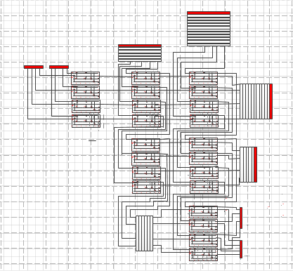
Data Flow of a 4 four-bit Parallel Sorter

Slide 23
Data Flow of a 4 four-bit Parallel Sorter.
Each Min_Max cell is labelled as (X,Y)
X – Row number;
Y- Column number.
To Maintain the delays, FIFO Buffers are placed where ever required to avoid faulty comparisons.

Slide 24
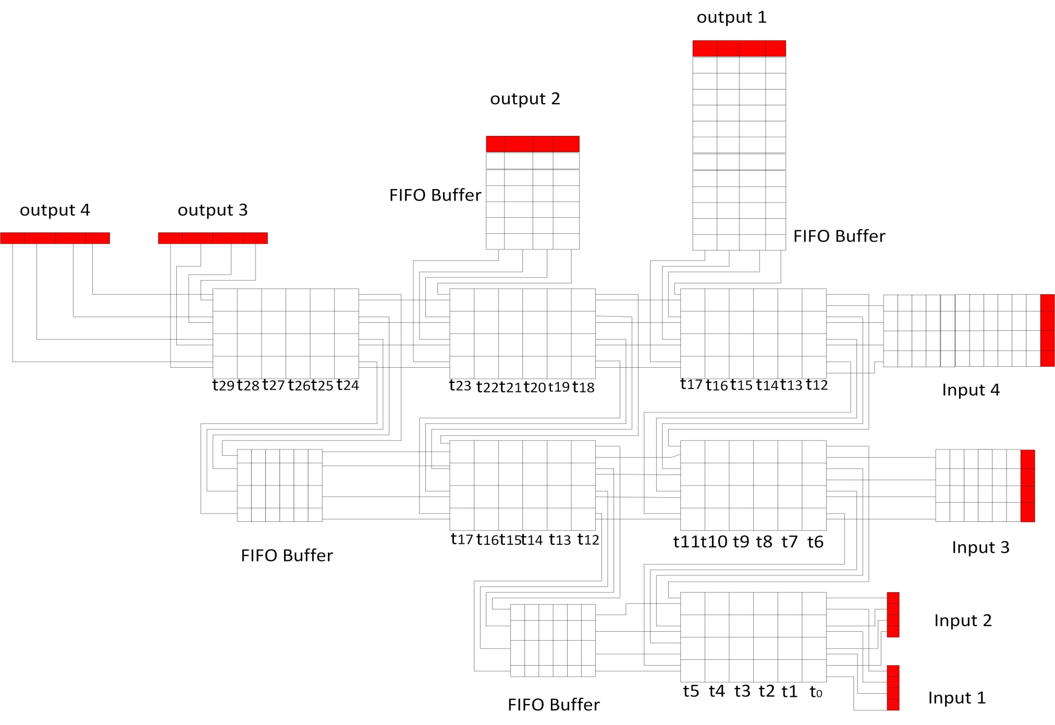
Data Flow of a 4 four-bit Parallel Sorter.

Slide 25
Color specification of Inputs
Here, the inputs 1,2,3,4 and outputs 1,2,3,4
are represented by registers colored in RED.
The Cells marked in ‘Yellow’ are the four input bits that are required to be sorted using this Parallel Triangular Sorter.
The Yellow colored inputs move as the pulse progresses and so on.

Slide 26
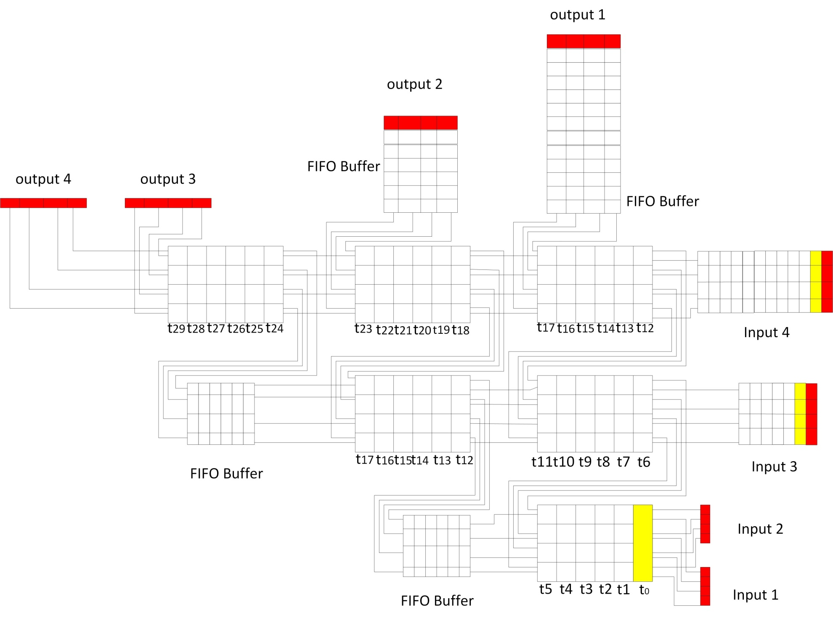
Data Flow of a 4 four-bit Parallel Sorter.

Slide 27
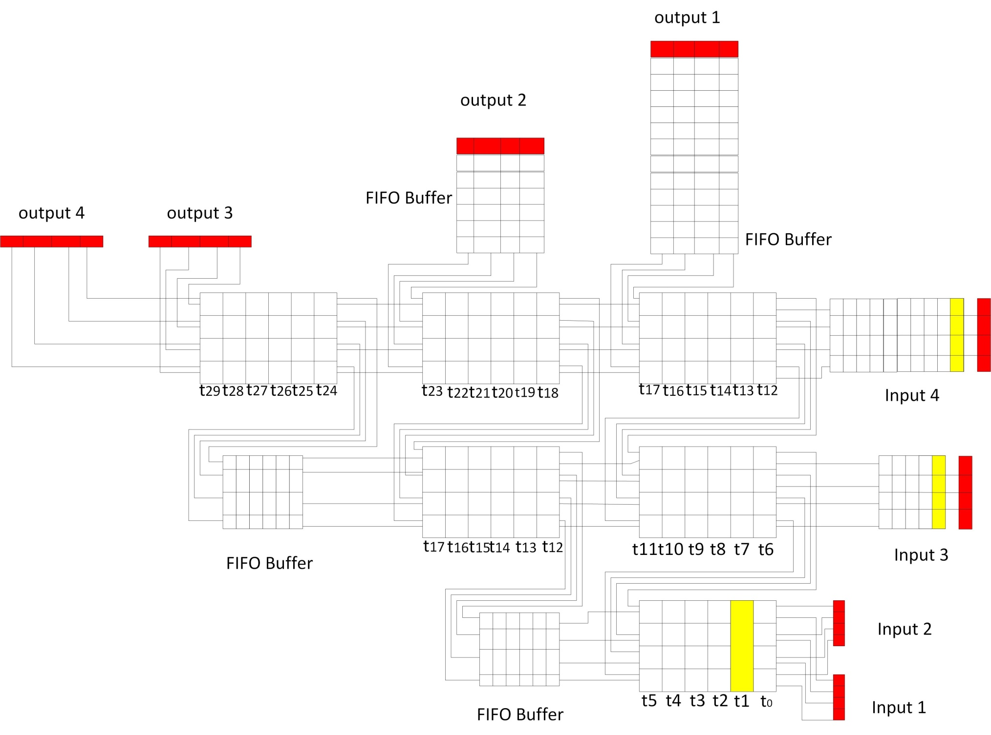

Slide 28
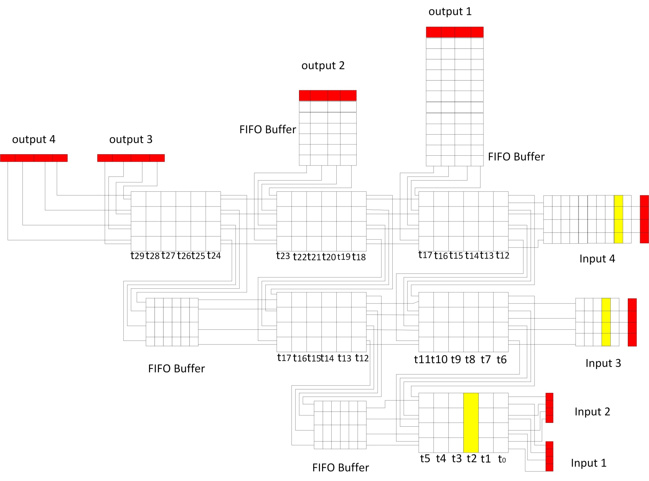

Slide 29
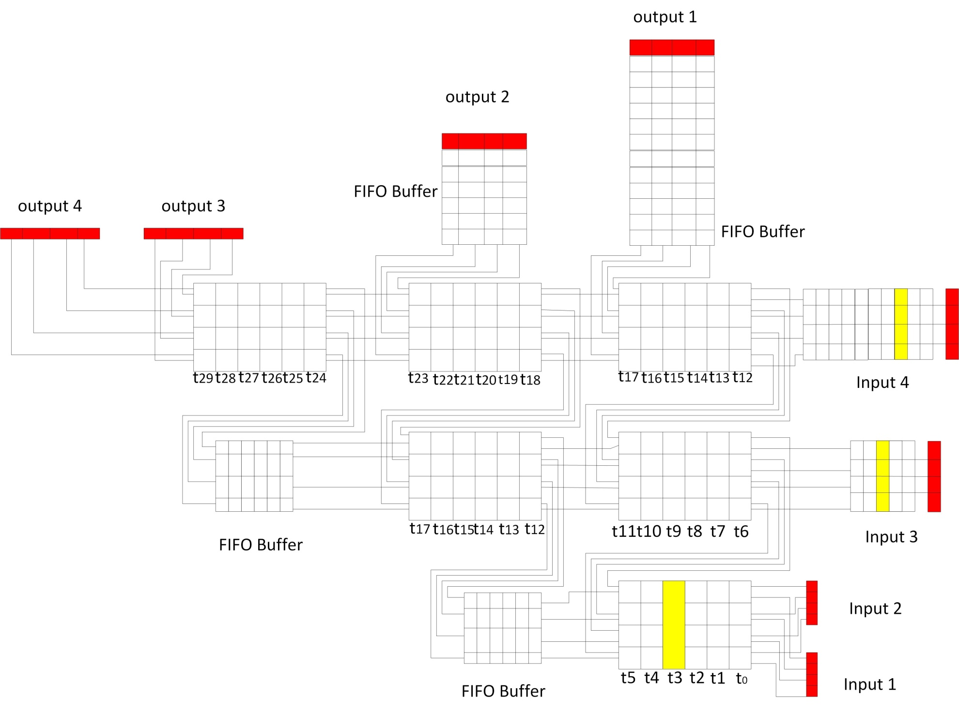

Slide 30
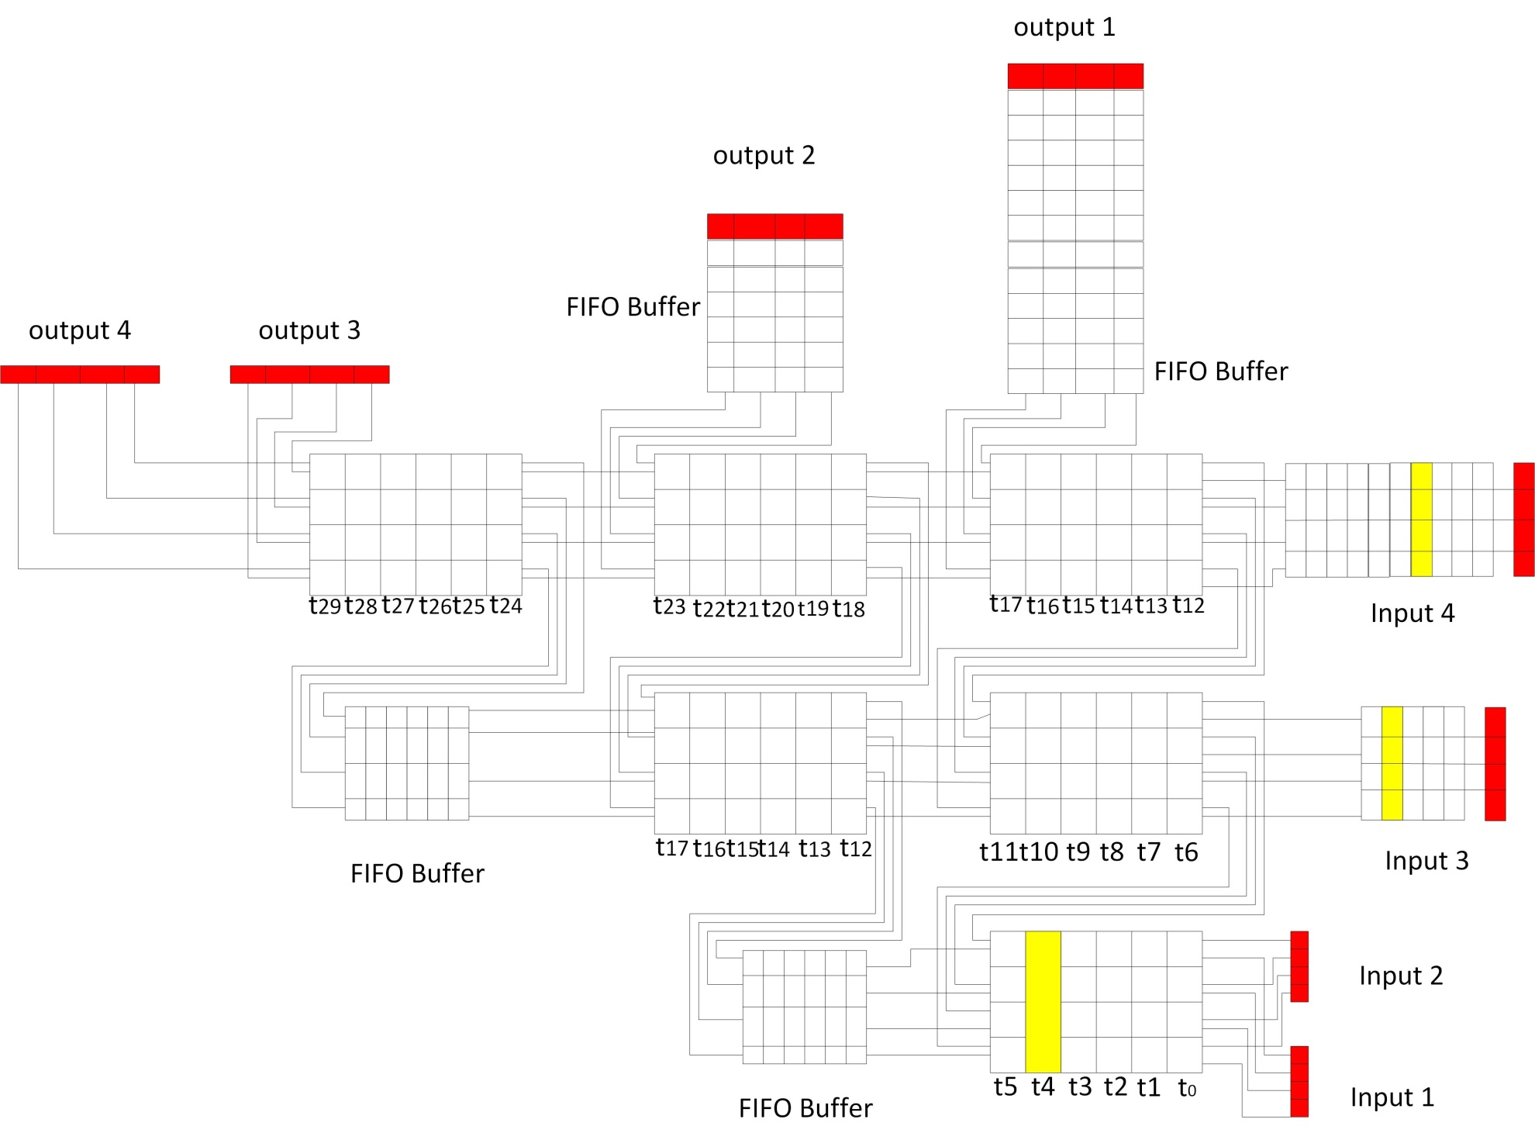

Slide 31
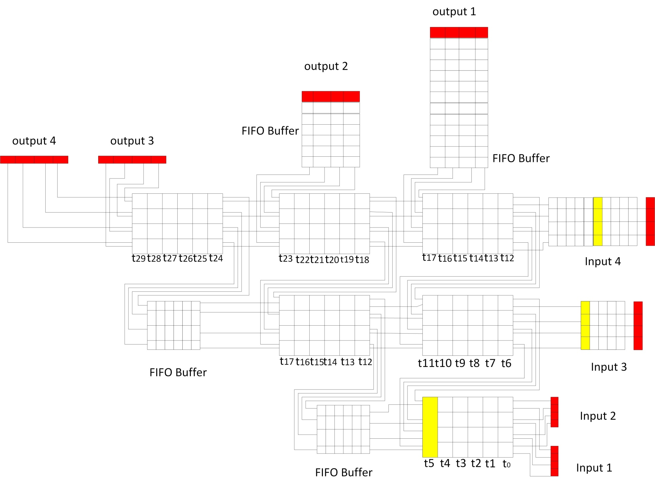

Slide 32
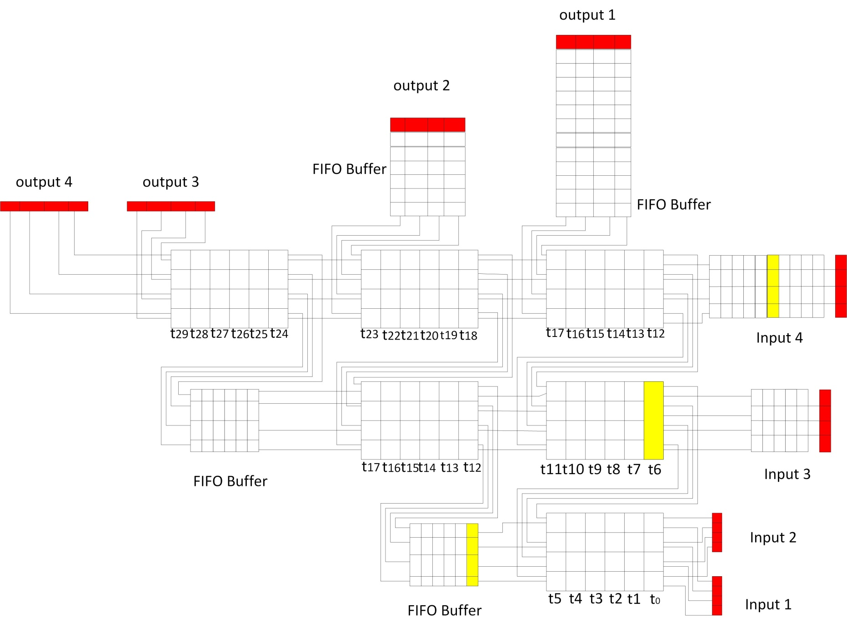

Slide 33


Slide 34
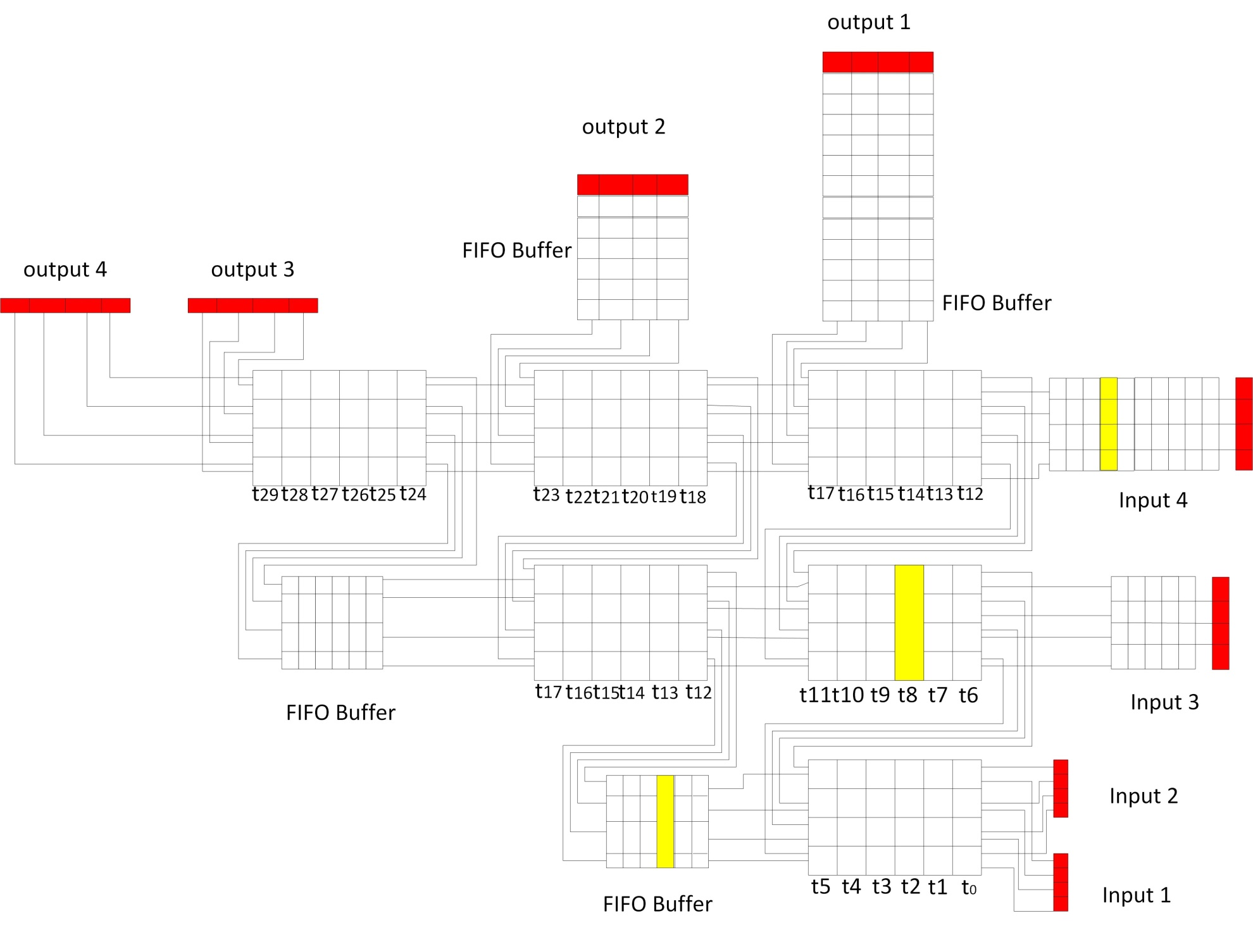

Slide 35
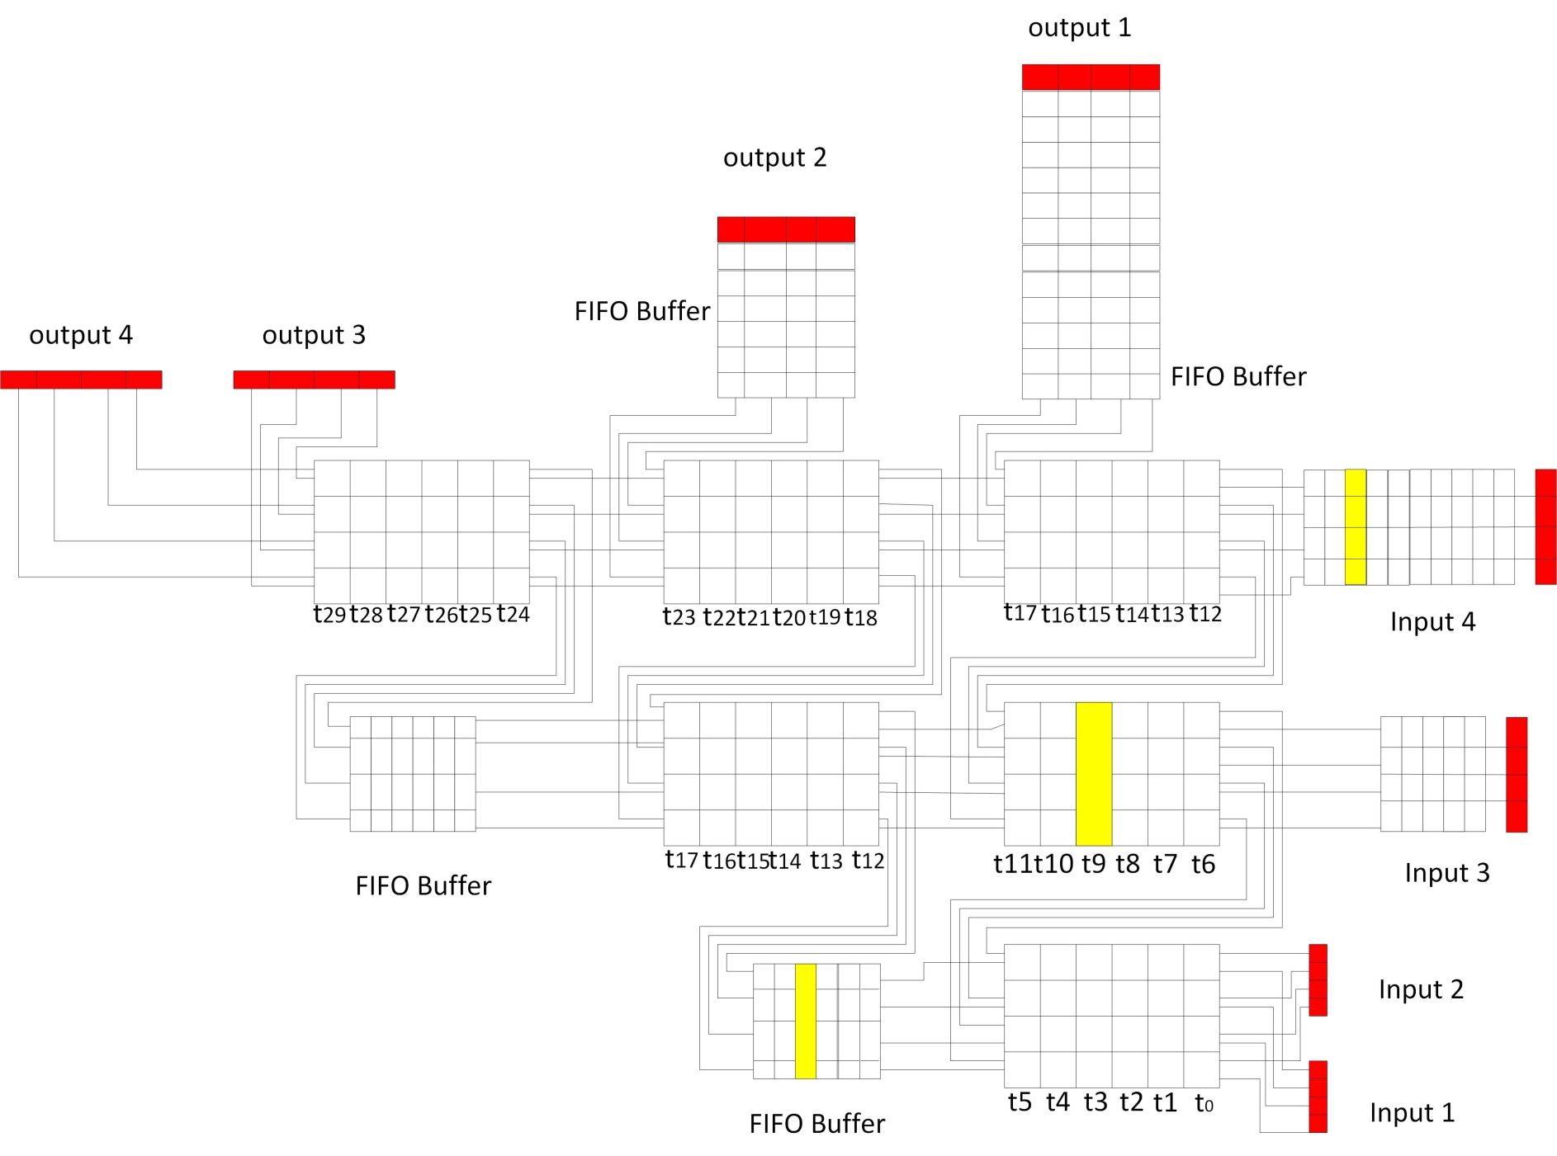

Slide 36
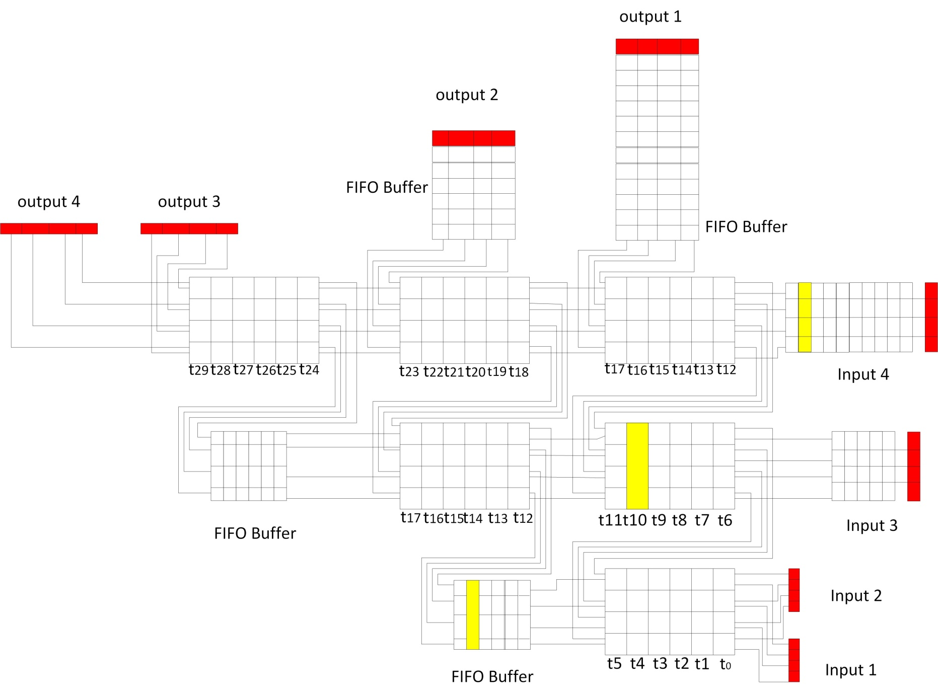

Slide 37
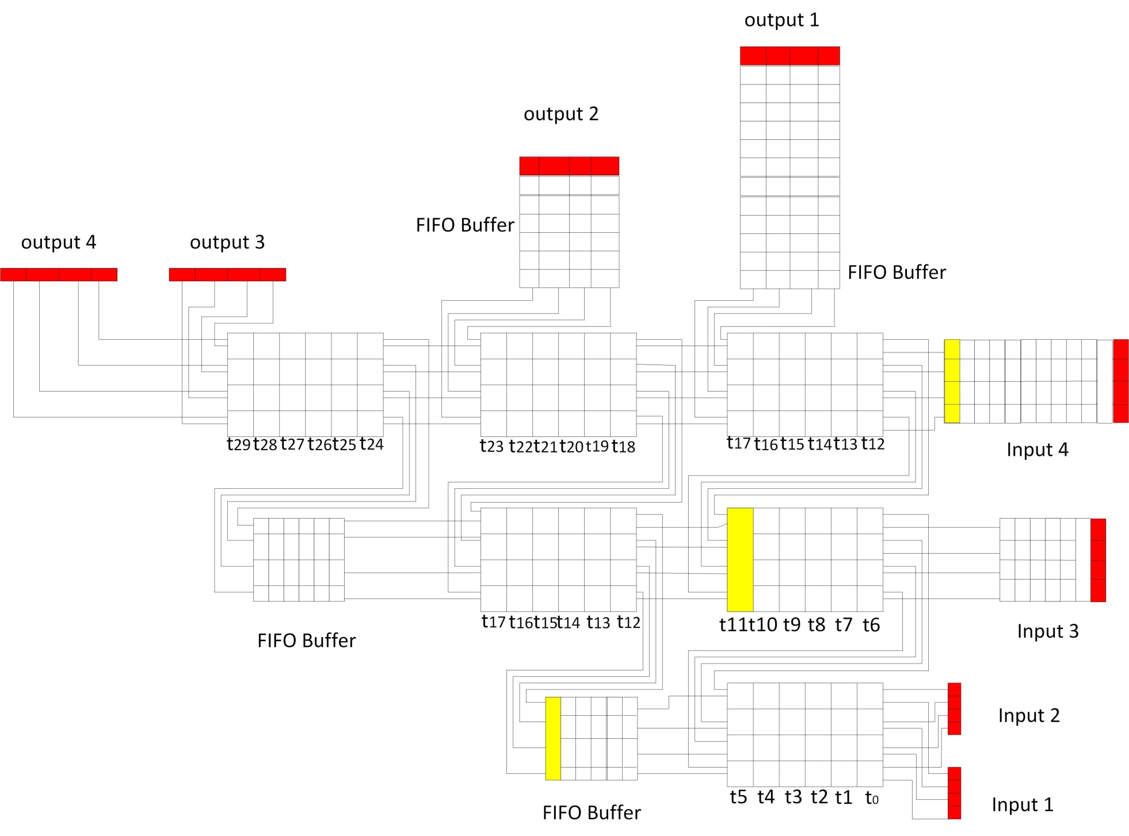

Slide 38
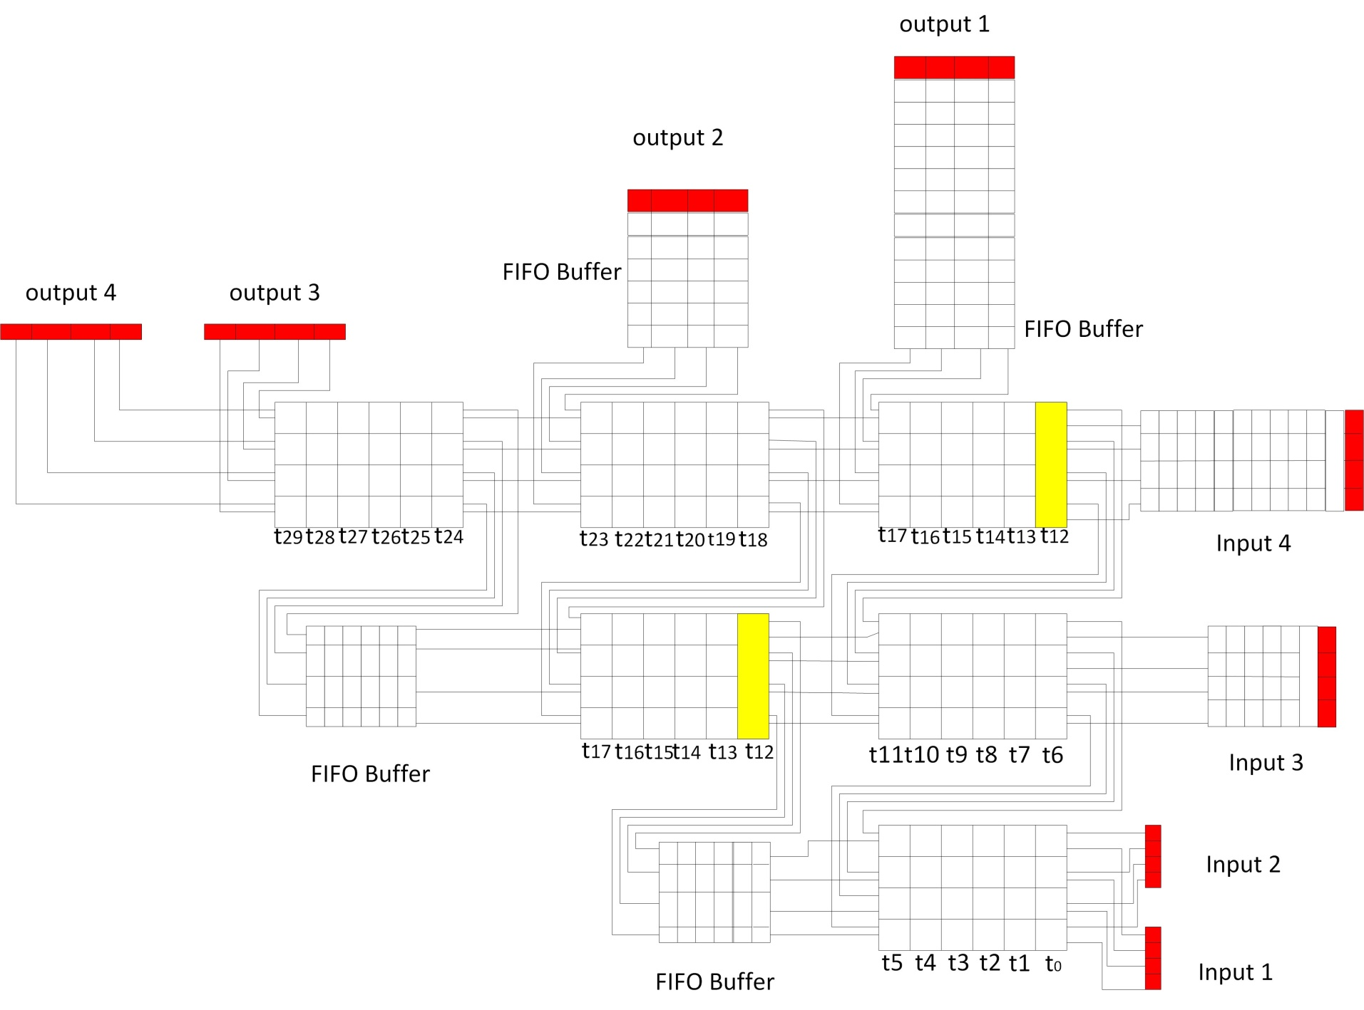

Slide 39
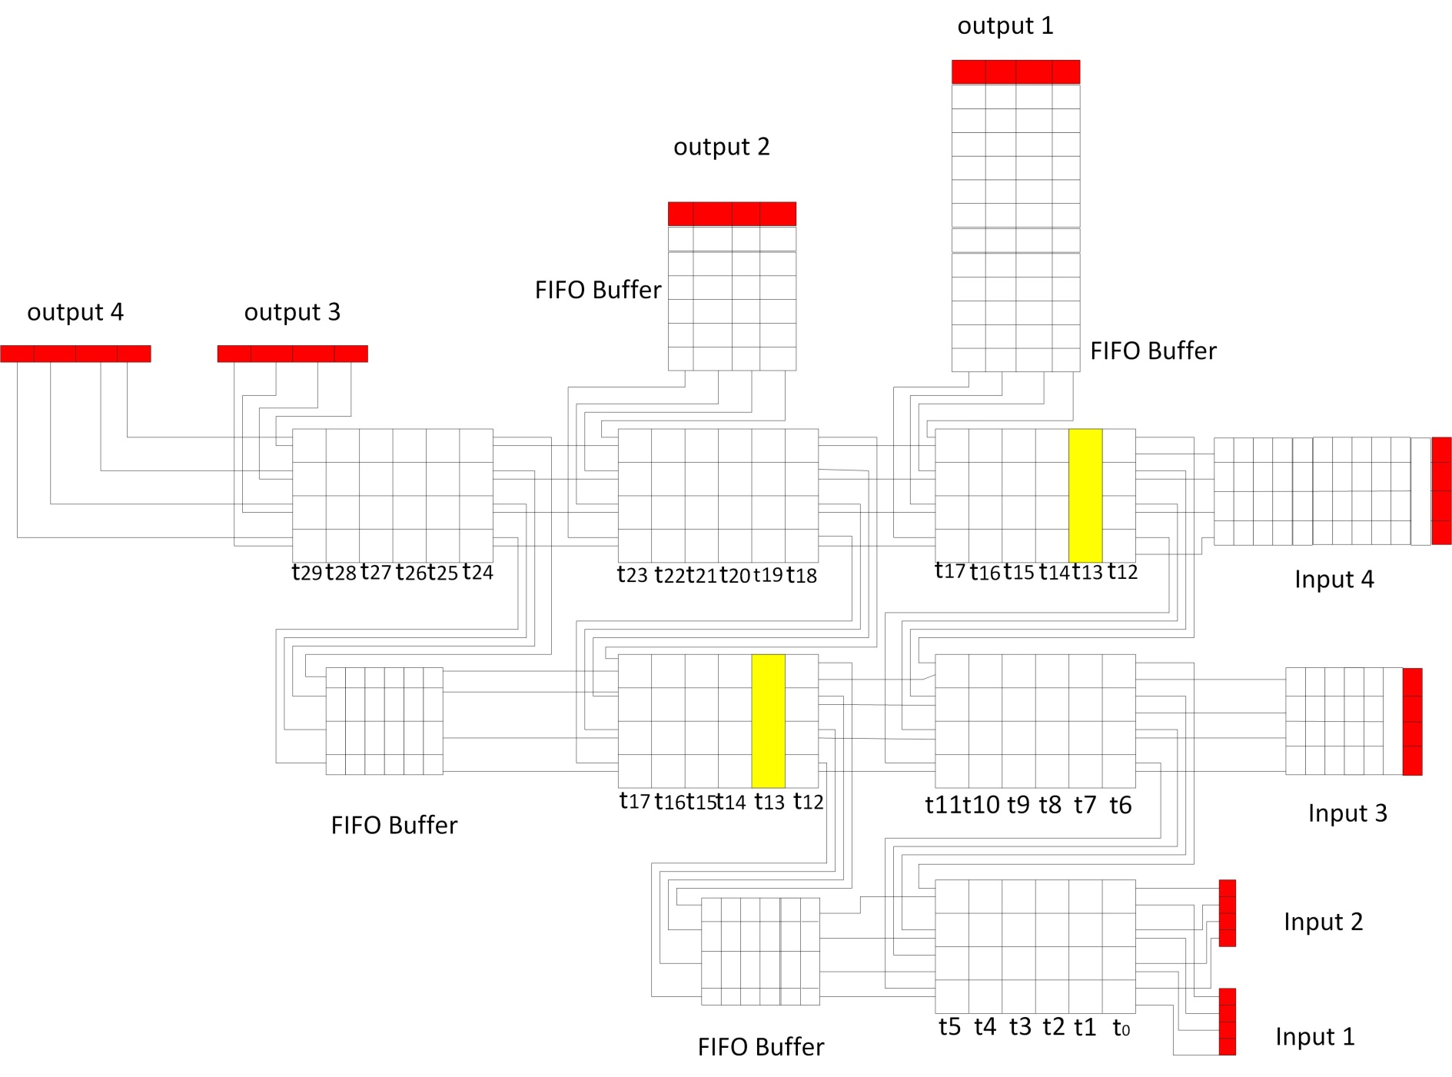

Slide 40
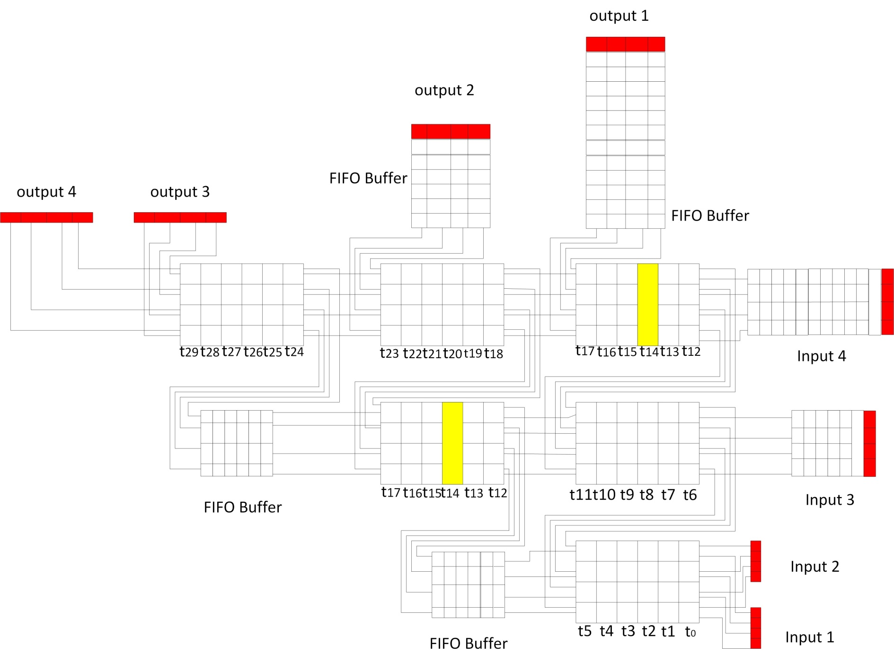

Slide 41
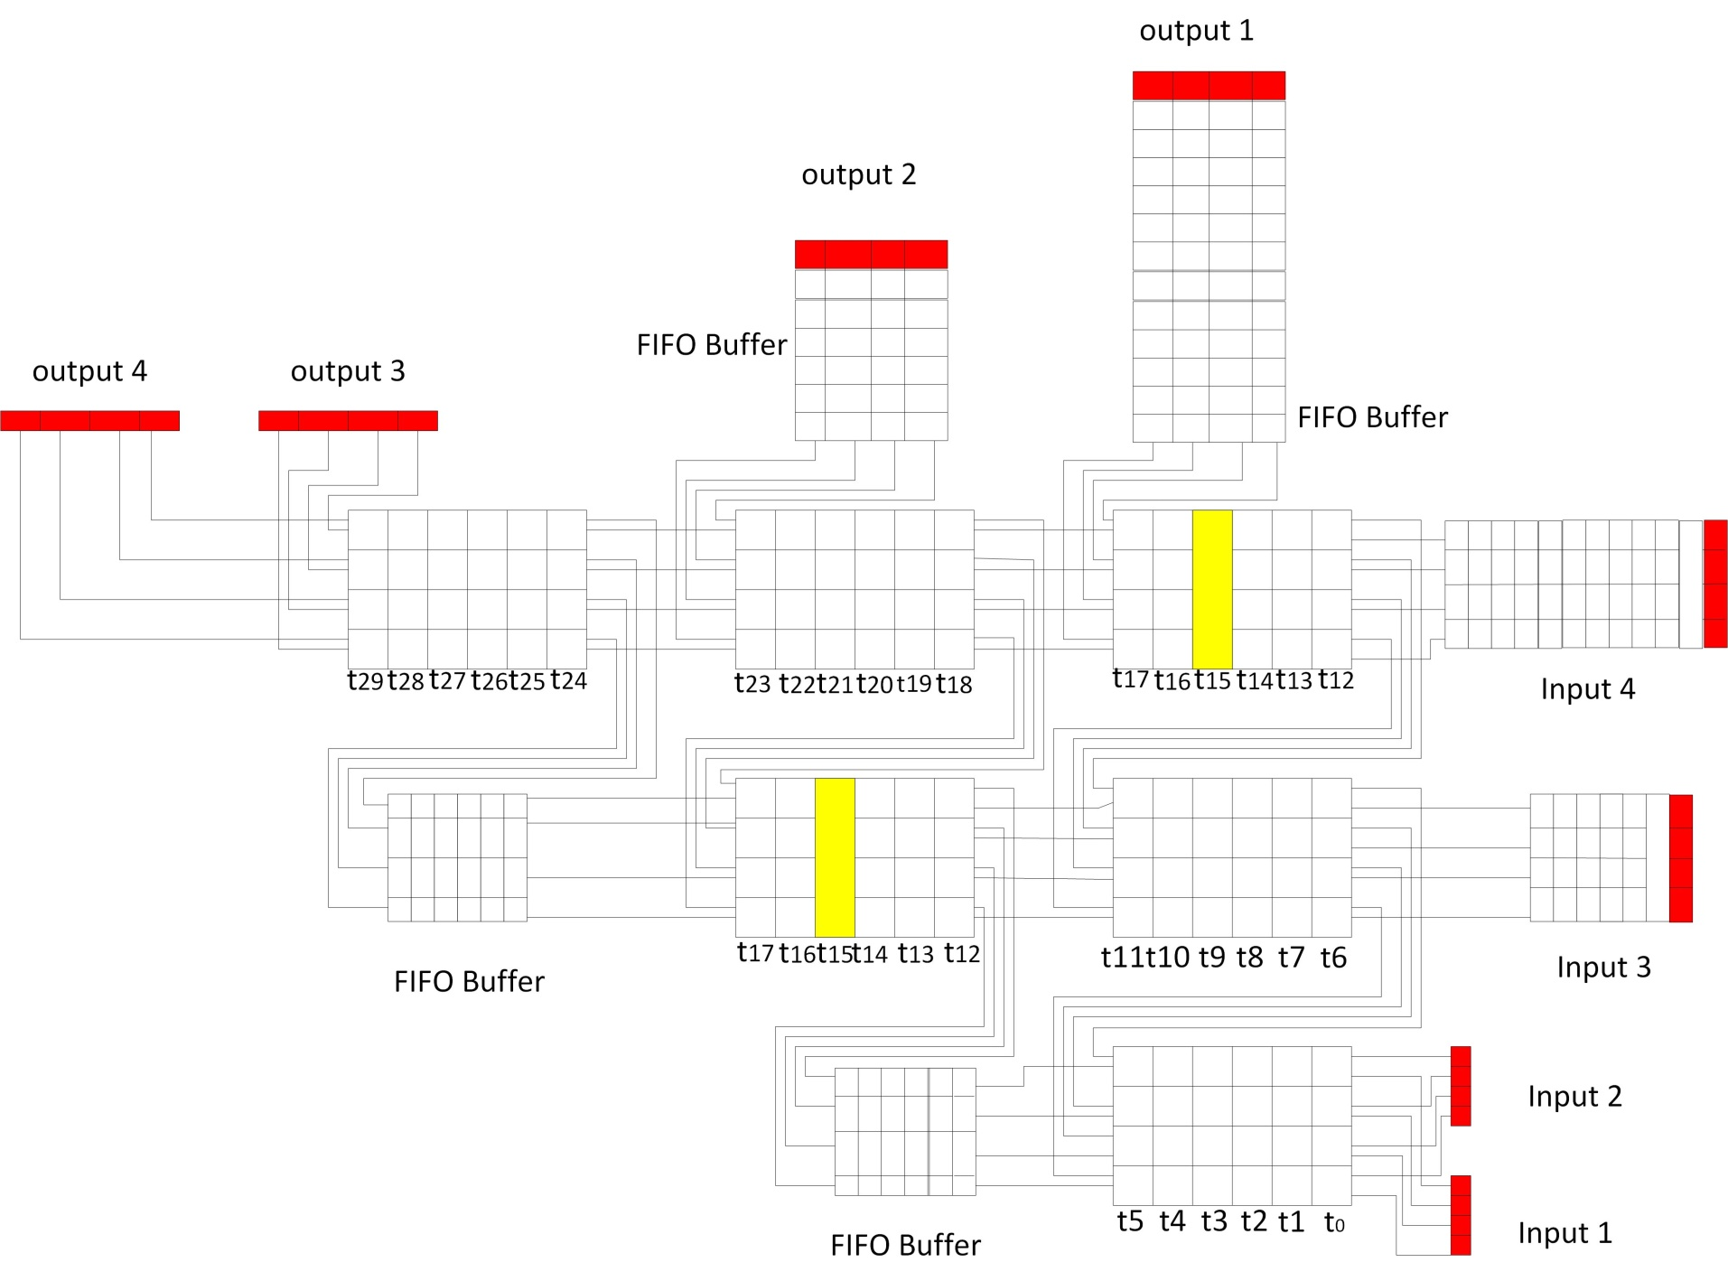

Slide 42
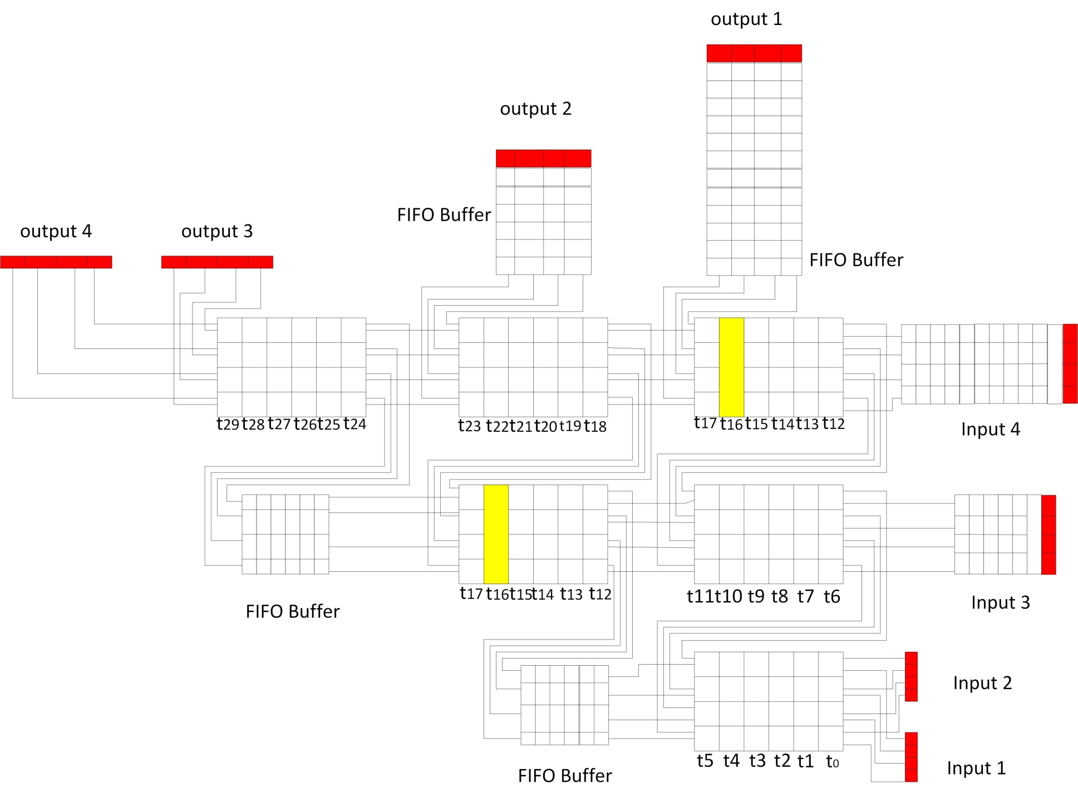

Slide 43


Slide 44
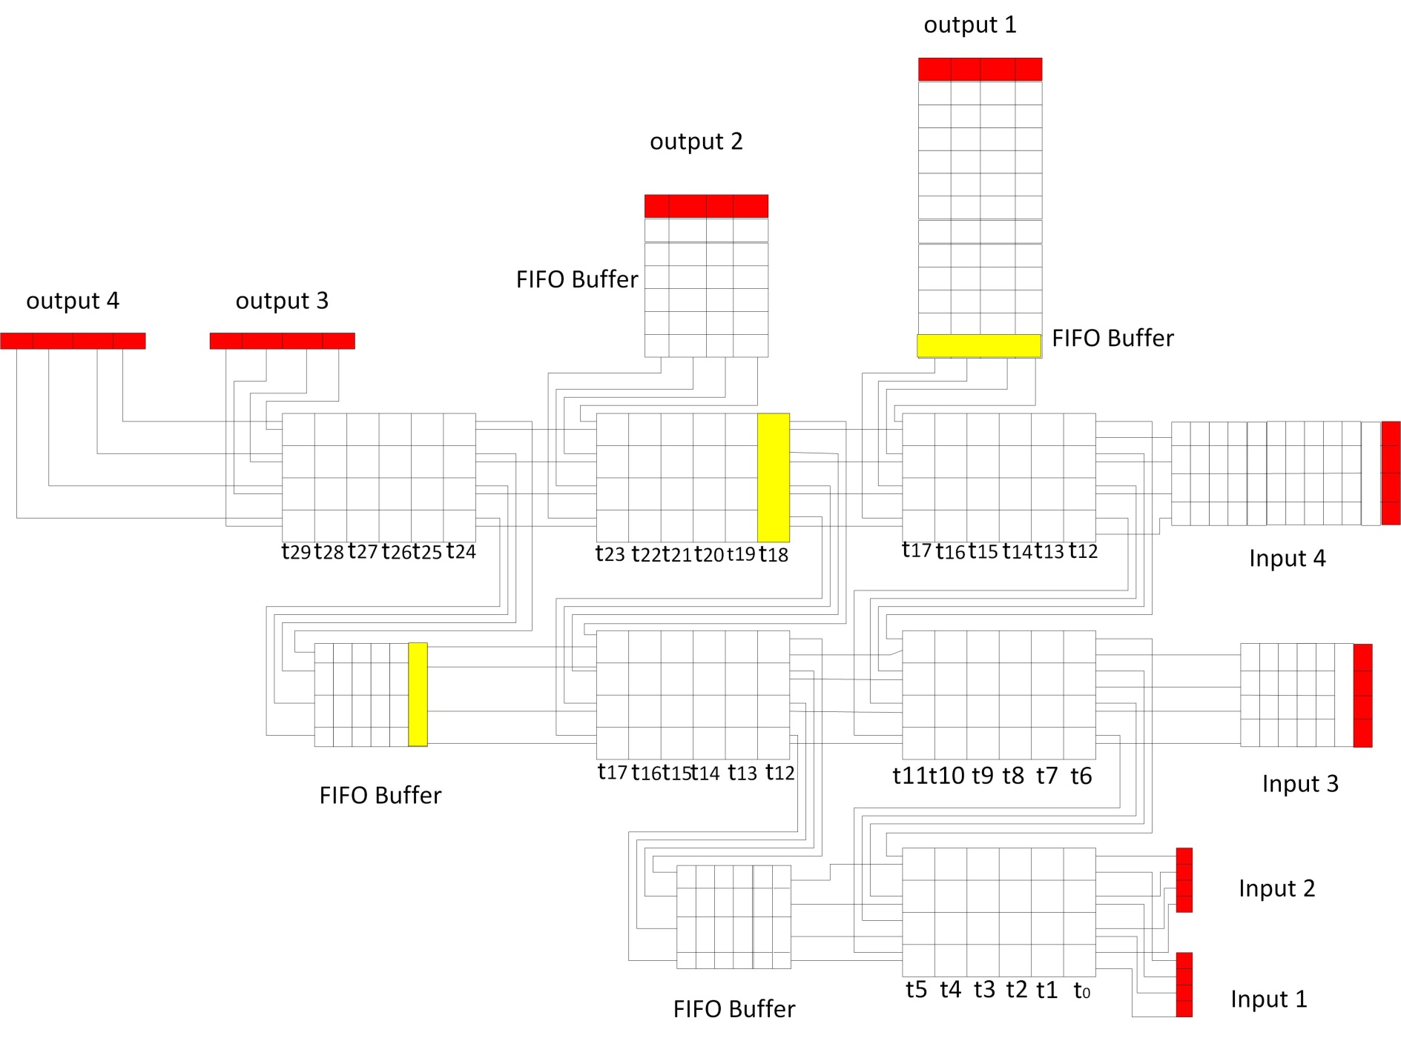

Slide 45
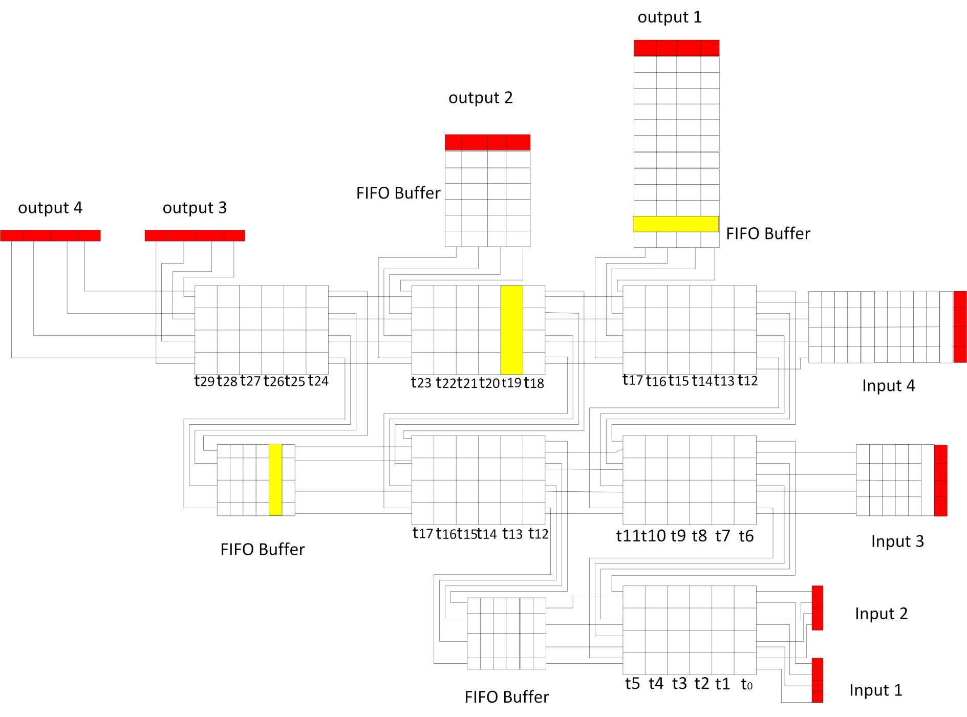

Slide 46
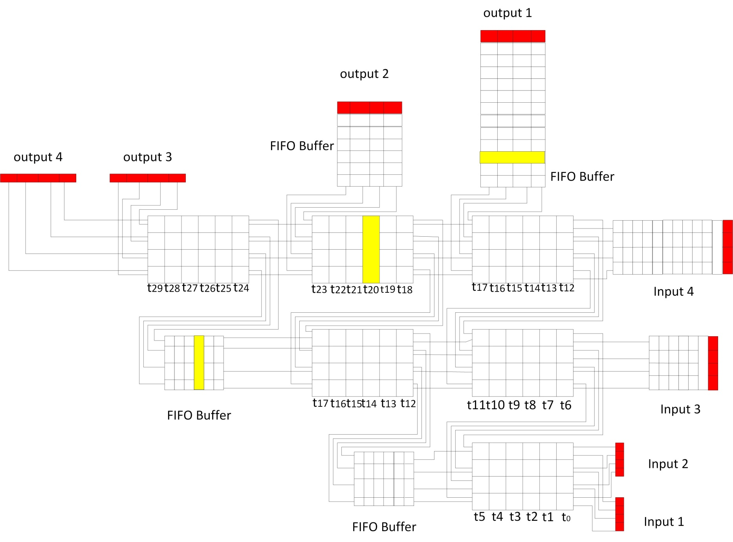

Slide 47


Slide 48
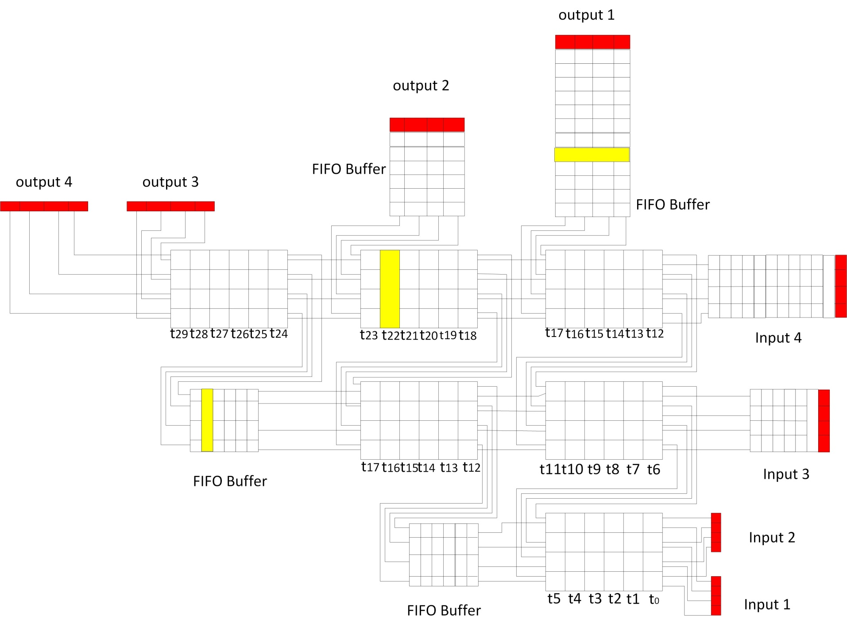

Slide 49


Slide 50
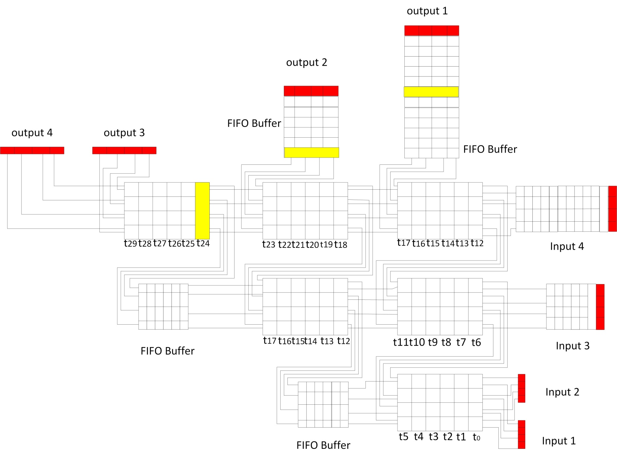

Slide 51
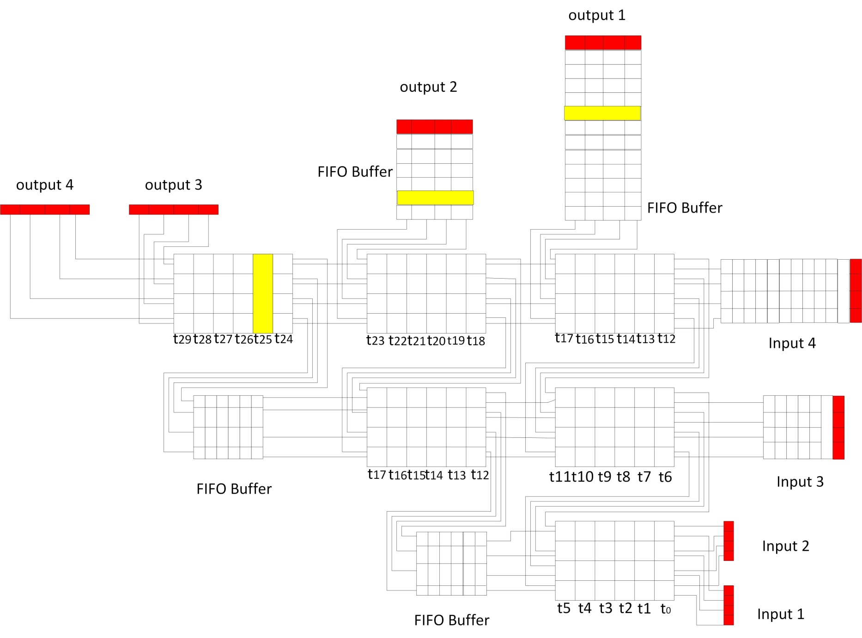

Slide 52
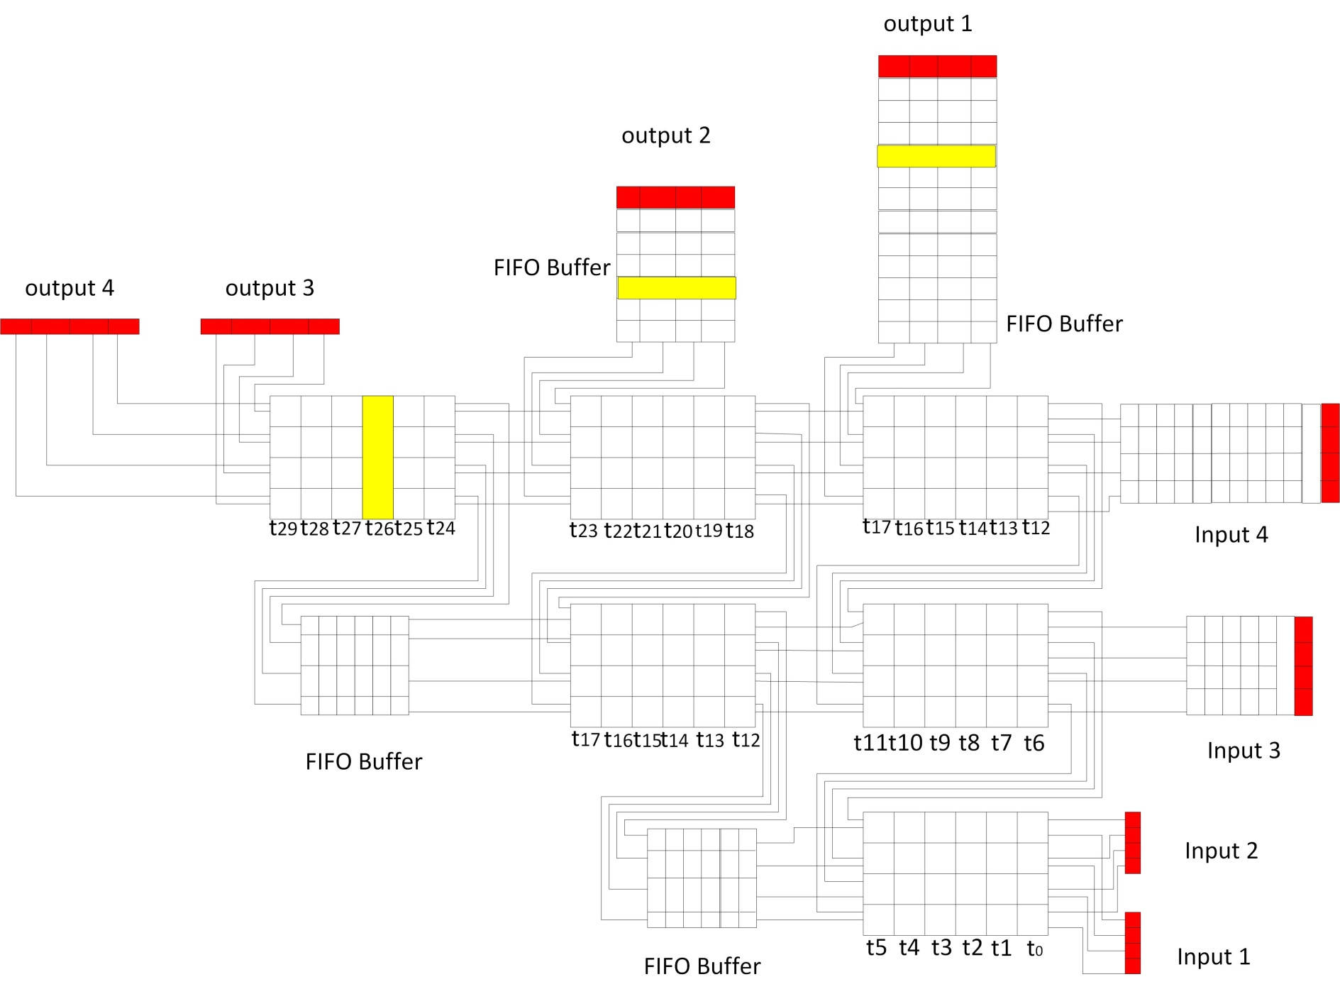

Slide 53
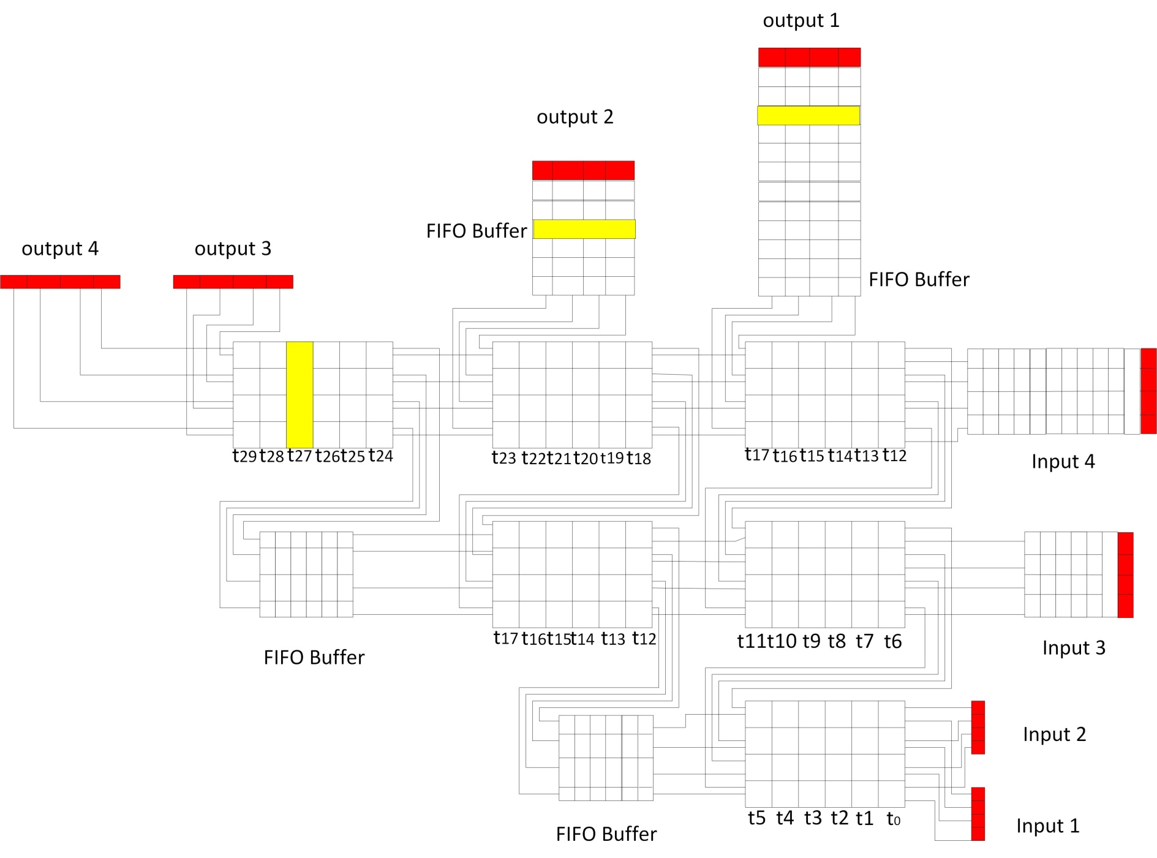

Slide 54


Slide 55
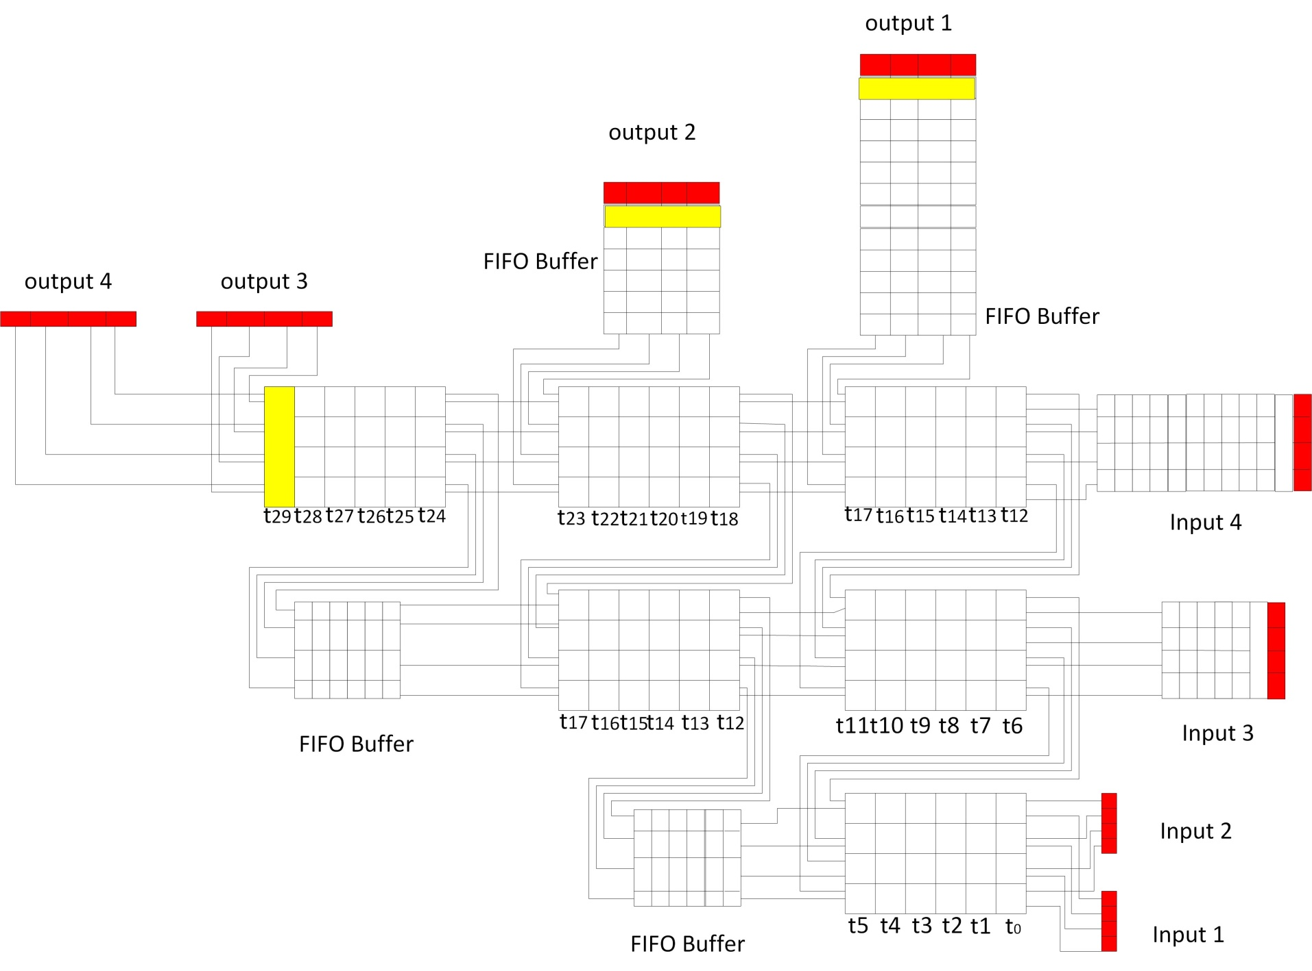

Slide 56
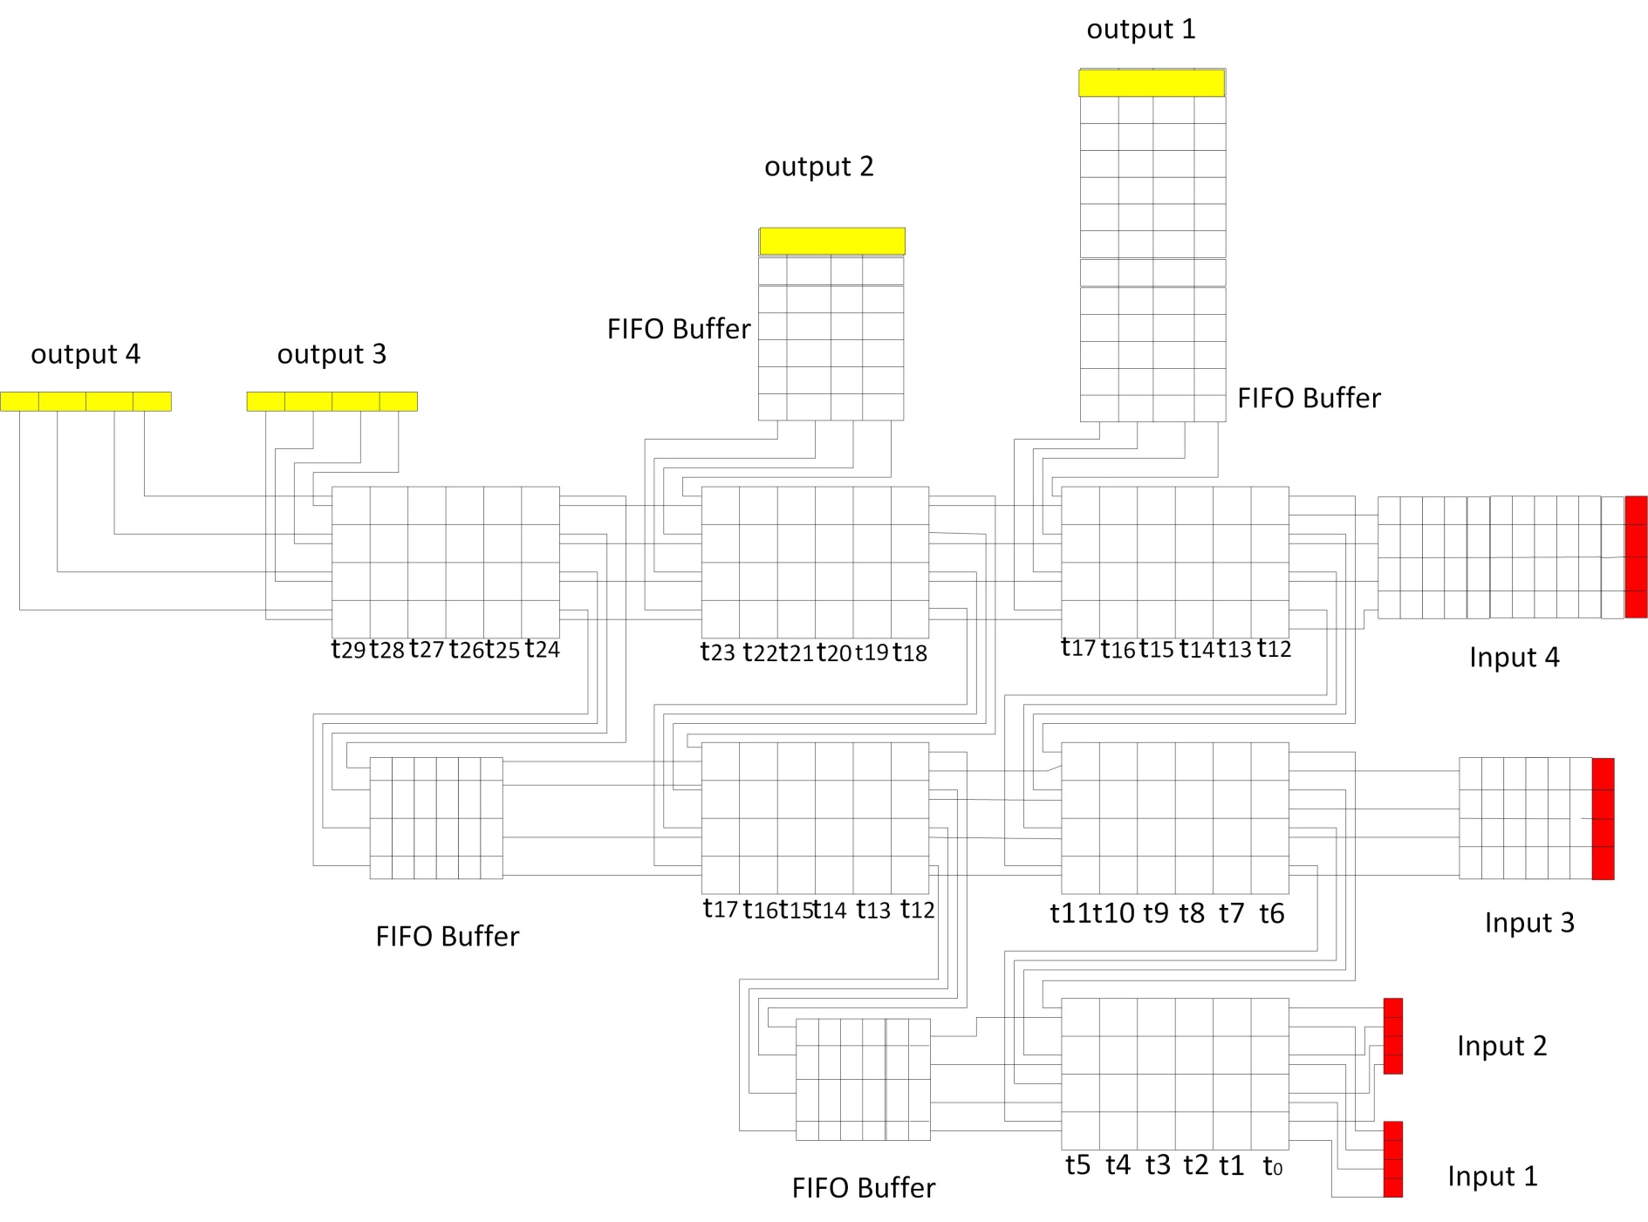
Hence , the o/p of parallel sorter is available 31st Pulse

Slide 57
Pipelined Data Flow for multiple 4-bit inputs[4]
8 registers in RED are used to represent Inputs and Outputs (1,2,3,4)
4 FIFO Buffers are used to maintain synchronicity and Delays thereby avoiding faulty comparisons.
FIFO Buffers increase the Pipeline Throughput!
6 sets of 4-bit inputs of the following color are sorted
Yellow, Green, Blue, Orange, Purple and Gold

Slide 58
Every output is available for 6 pulses as the input delay of Min_Max cell is 6 pulses.
Timing Constraints:
1. First input set given at ‘t0‘, the output
Input Set | Time at Input | Time atOutput
Set 1 | t0 | t30
Set 2 | t6 | t36
Set 3 | t12 | t42
Set 4 | t18 | t48
Set 5 | t24 | t54
Set 6 | t30 | t60

Slide 59


Slide 60
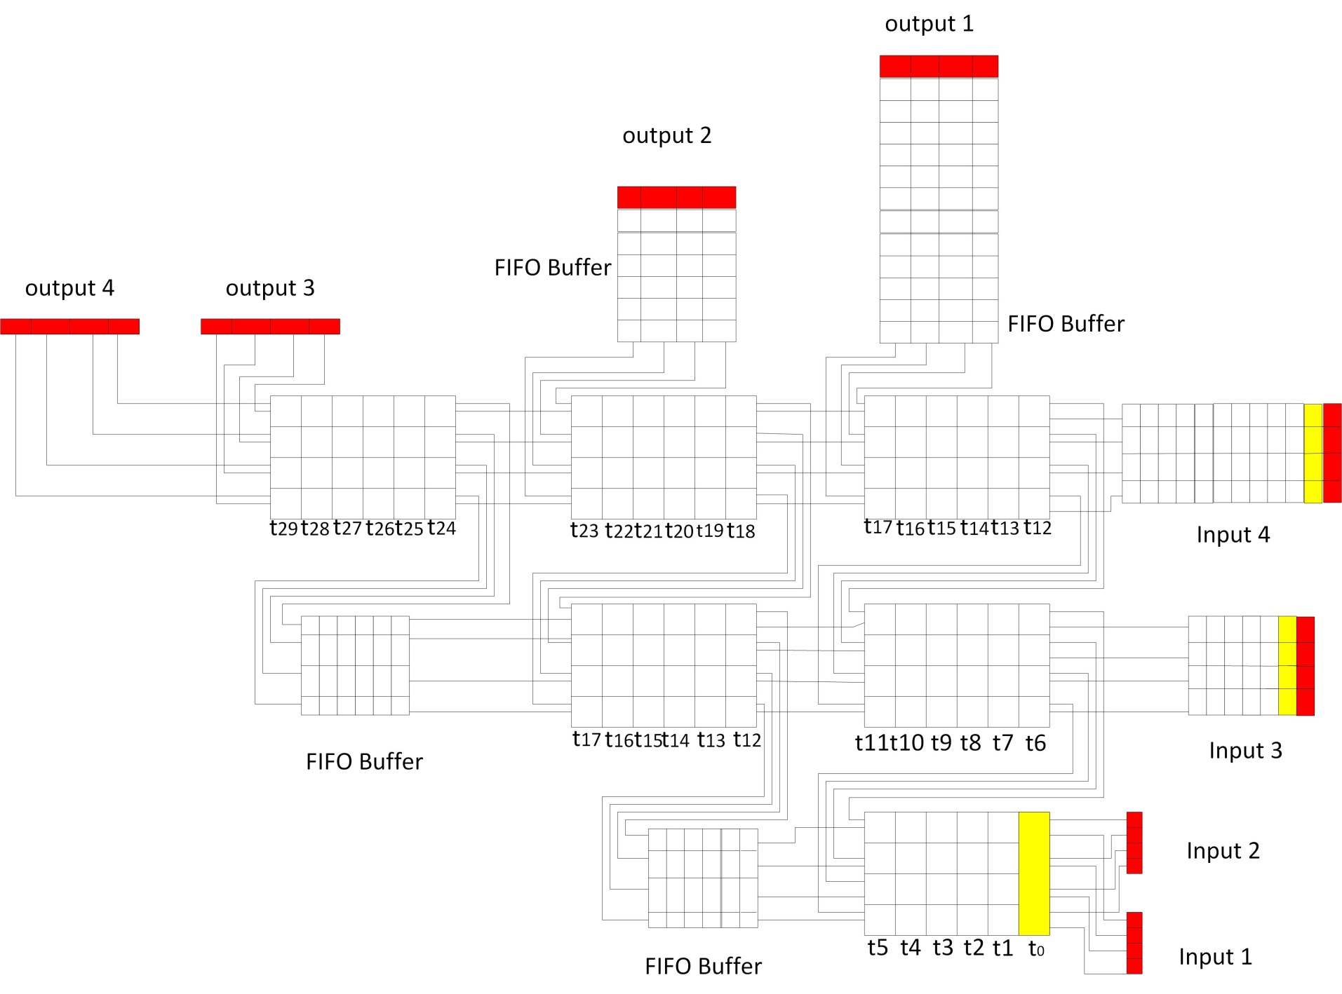

Slide 61


Slide 62


Slide 63


Slide 64


Slide 65


Slide 66
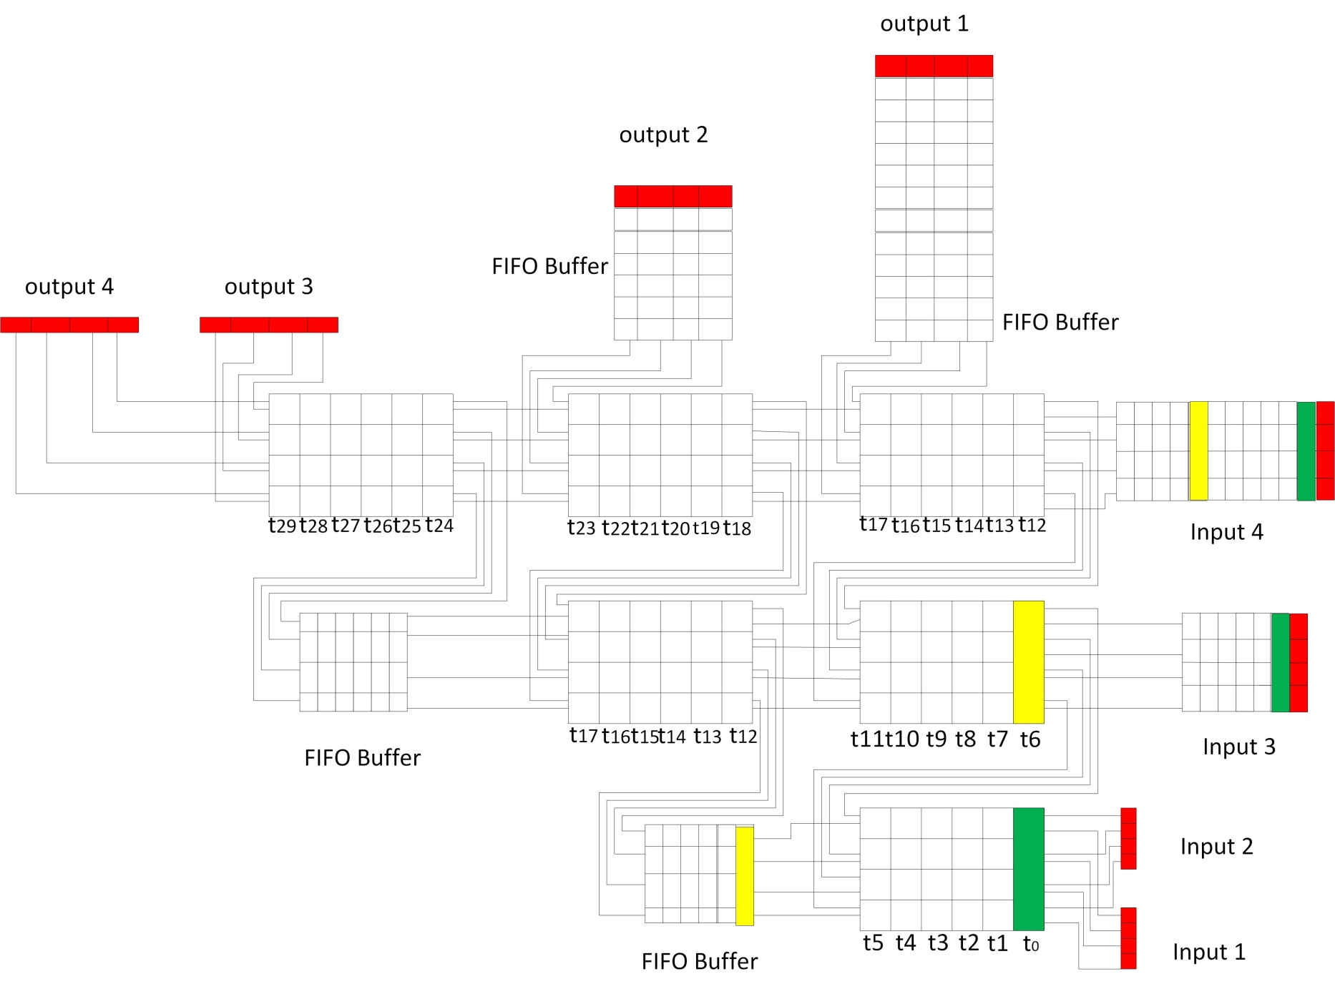

Slide 67
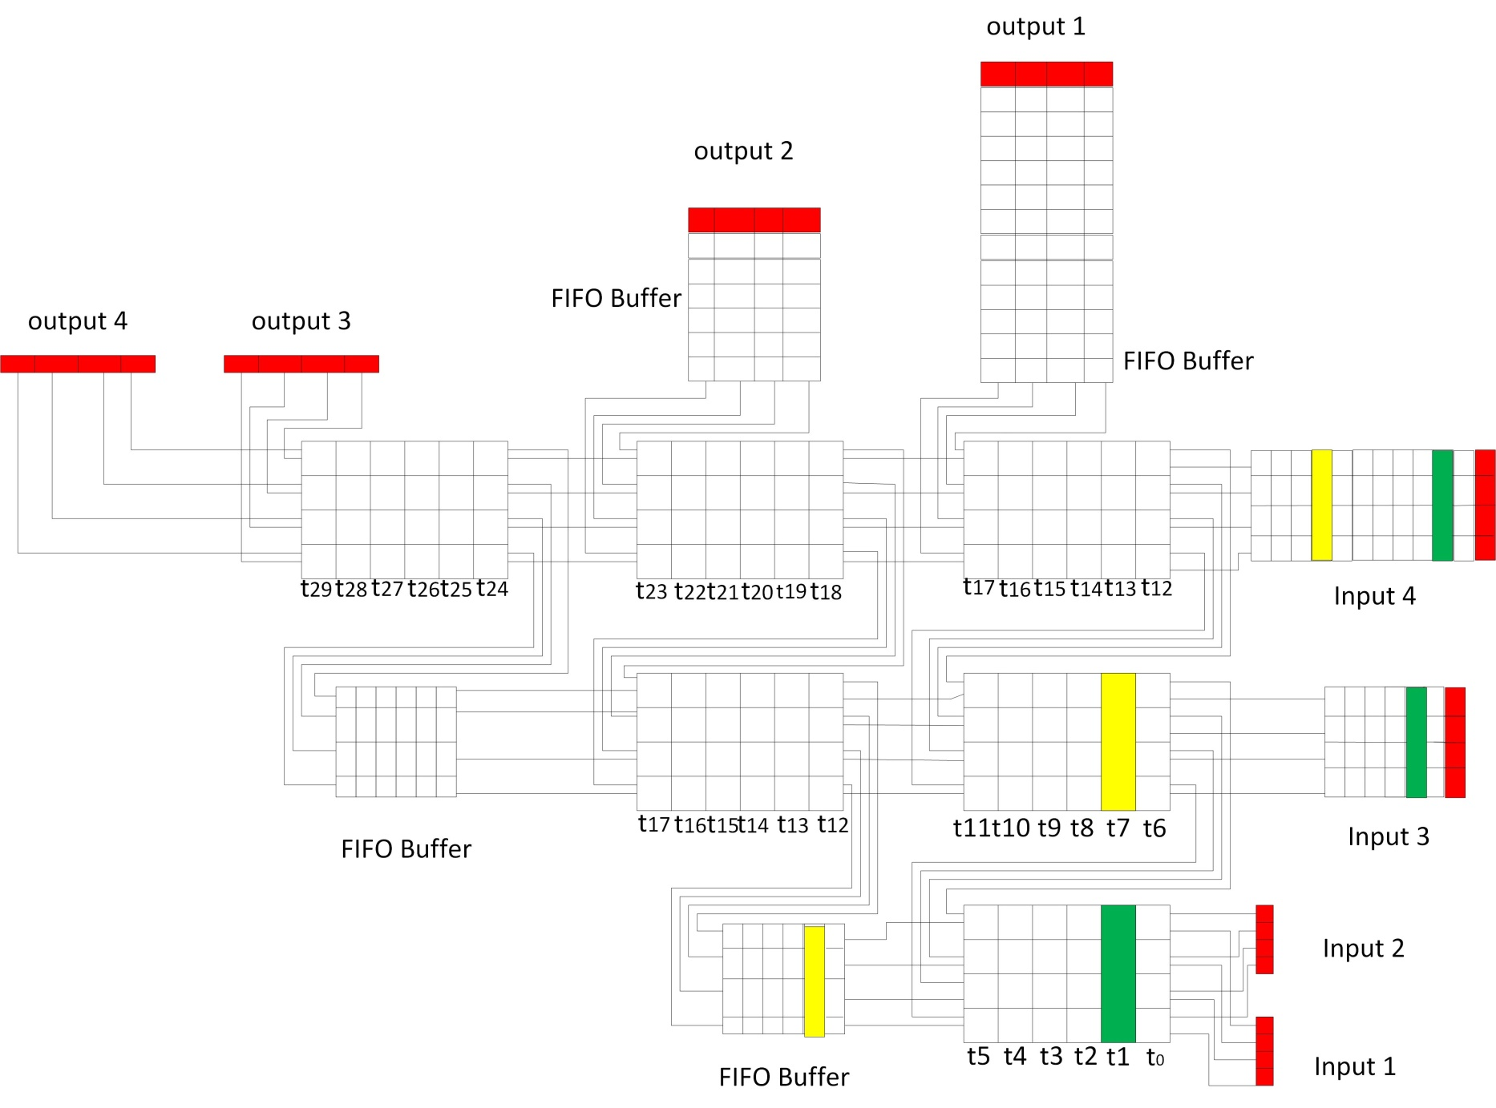

Slide 68
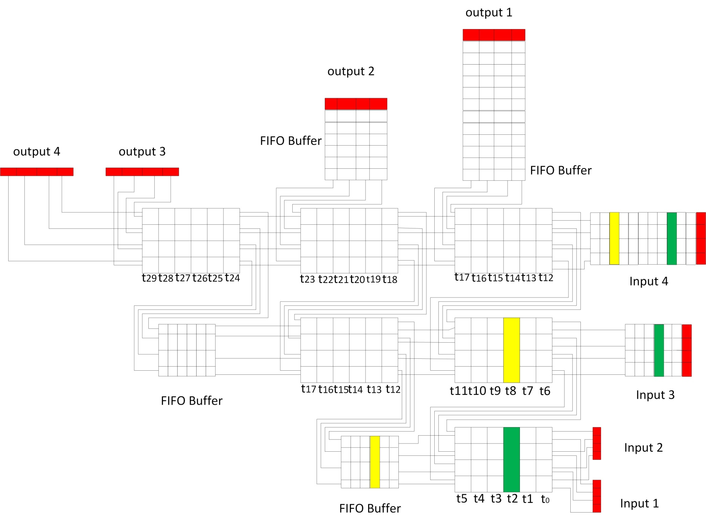

Slide 69
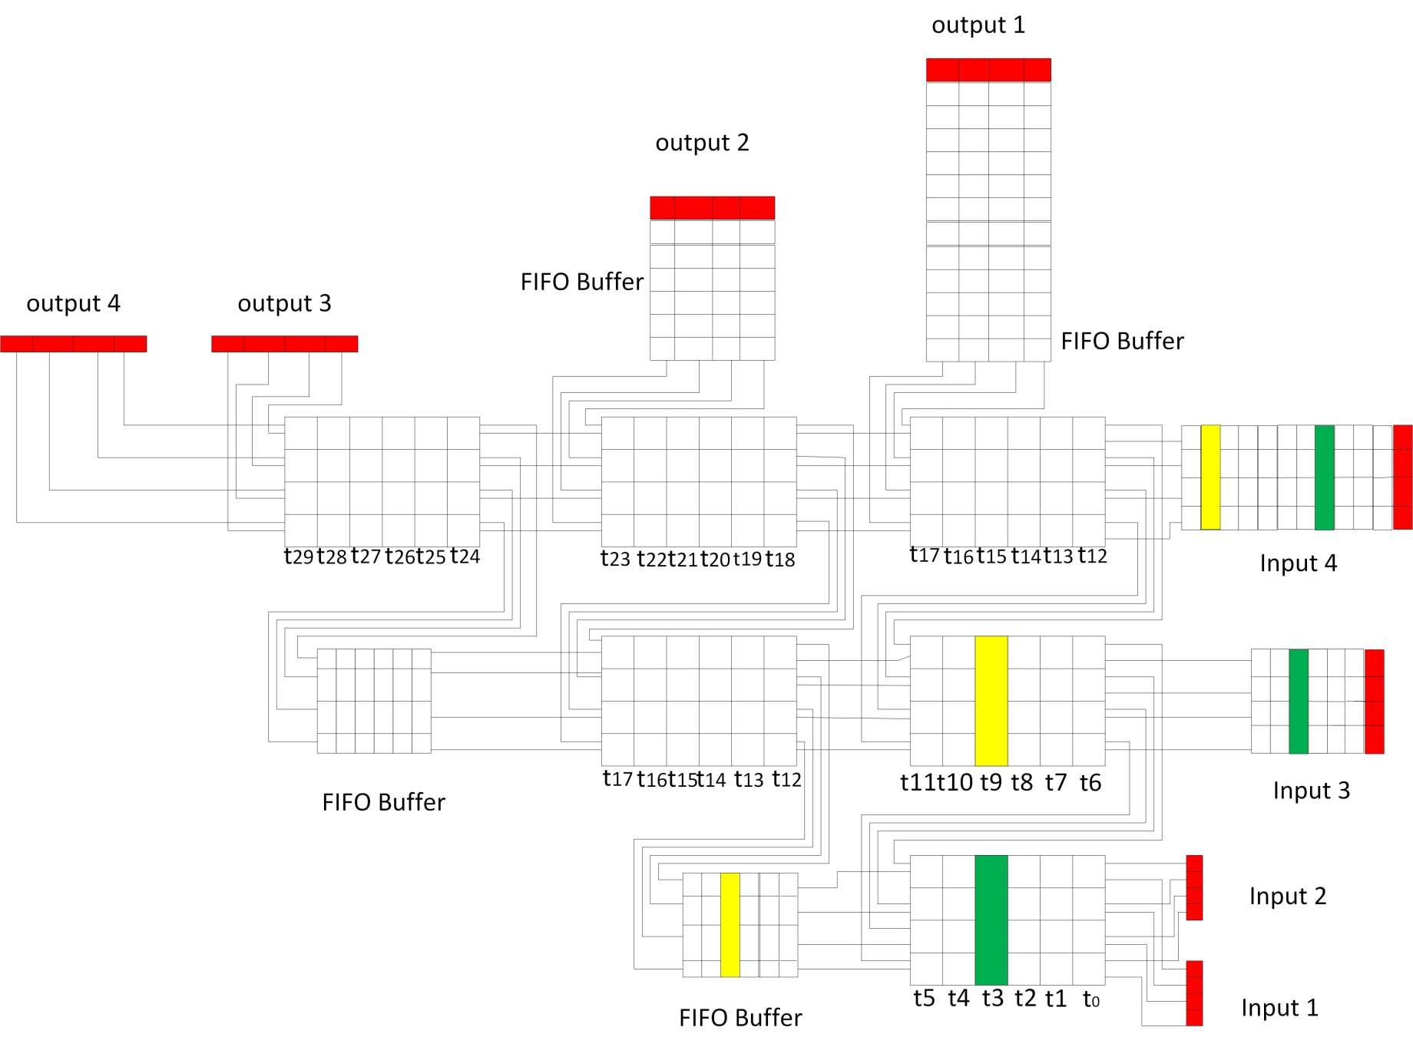

Slide 70
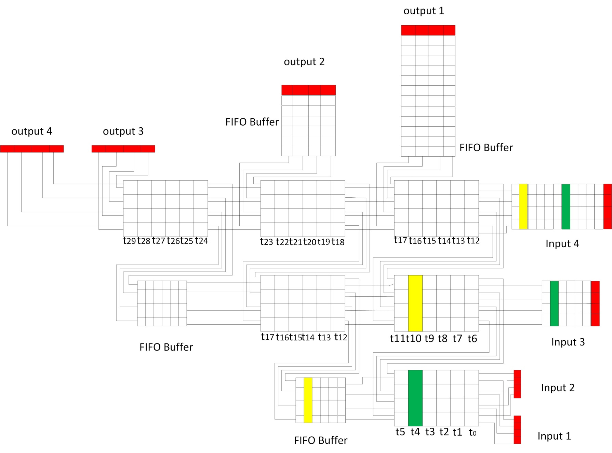

Slide 71
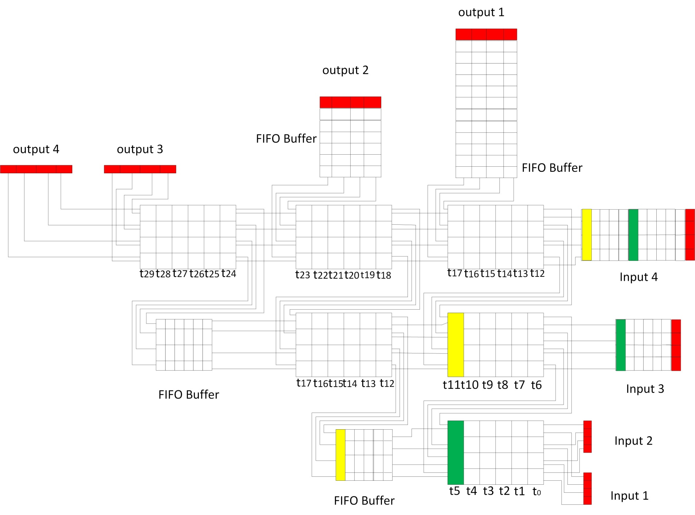

Slide 72
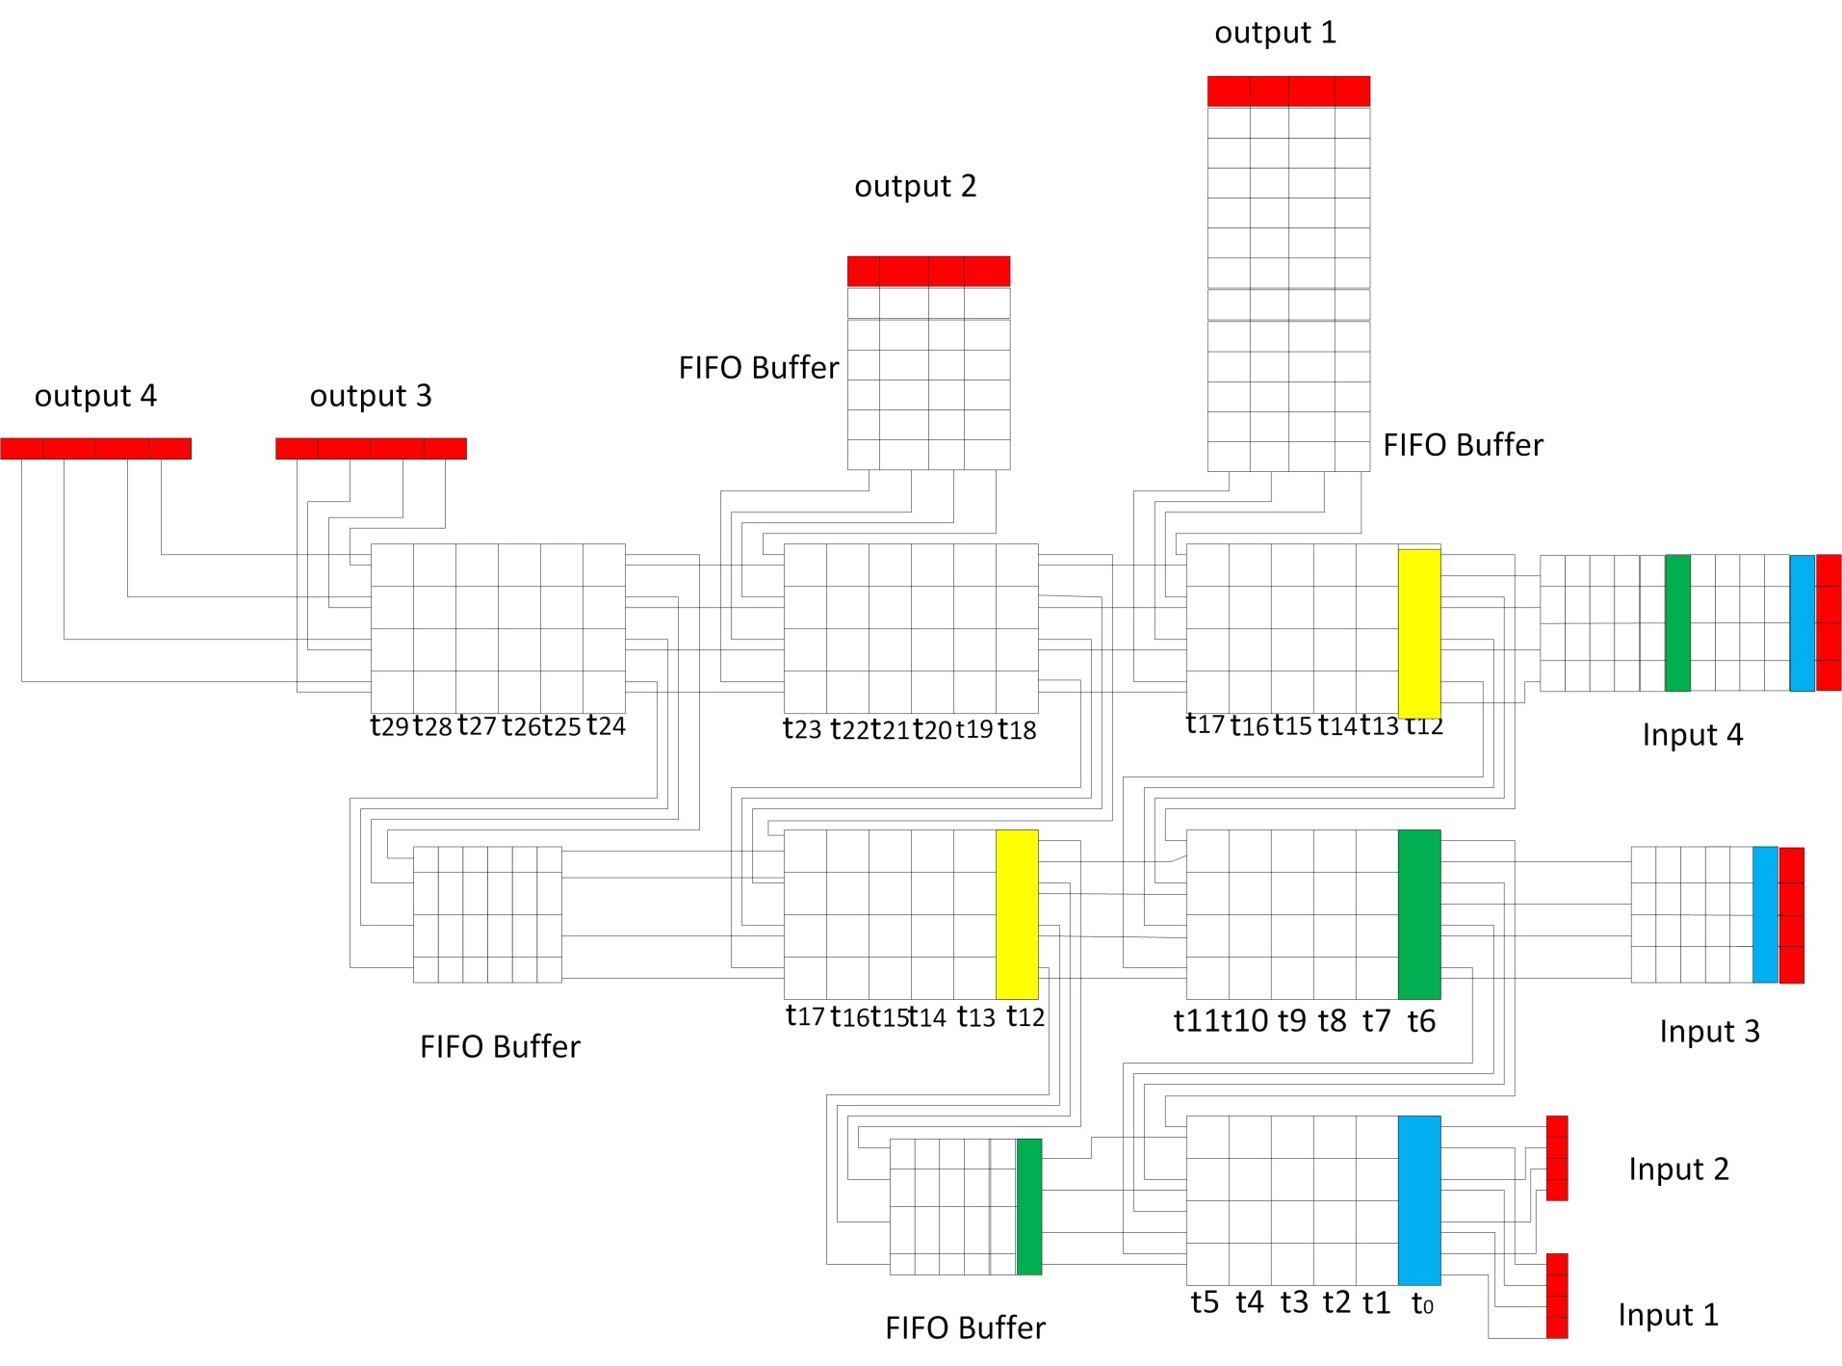

Slide 73
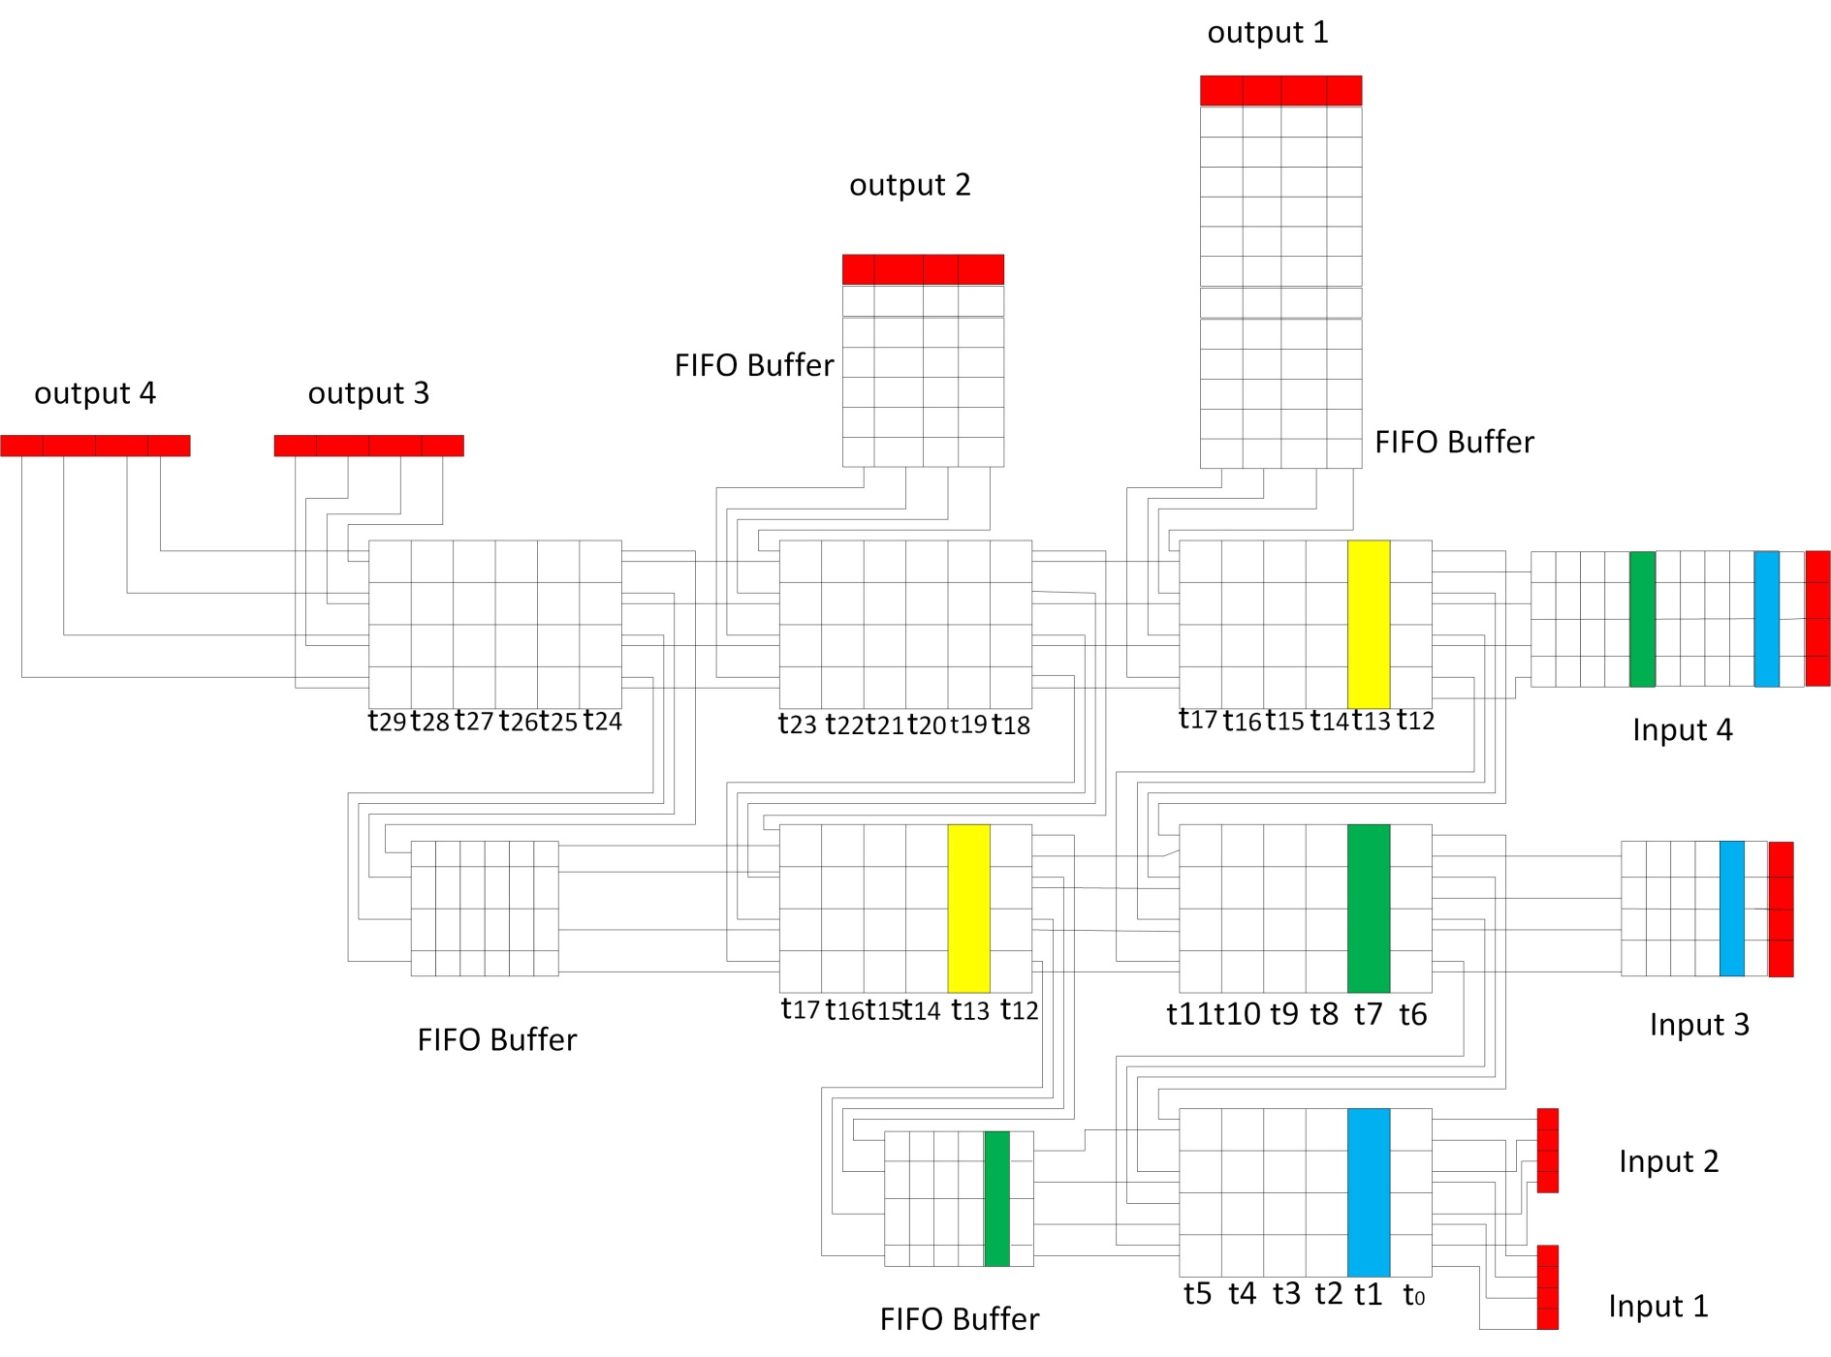

Slide 74
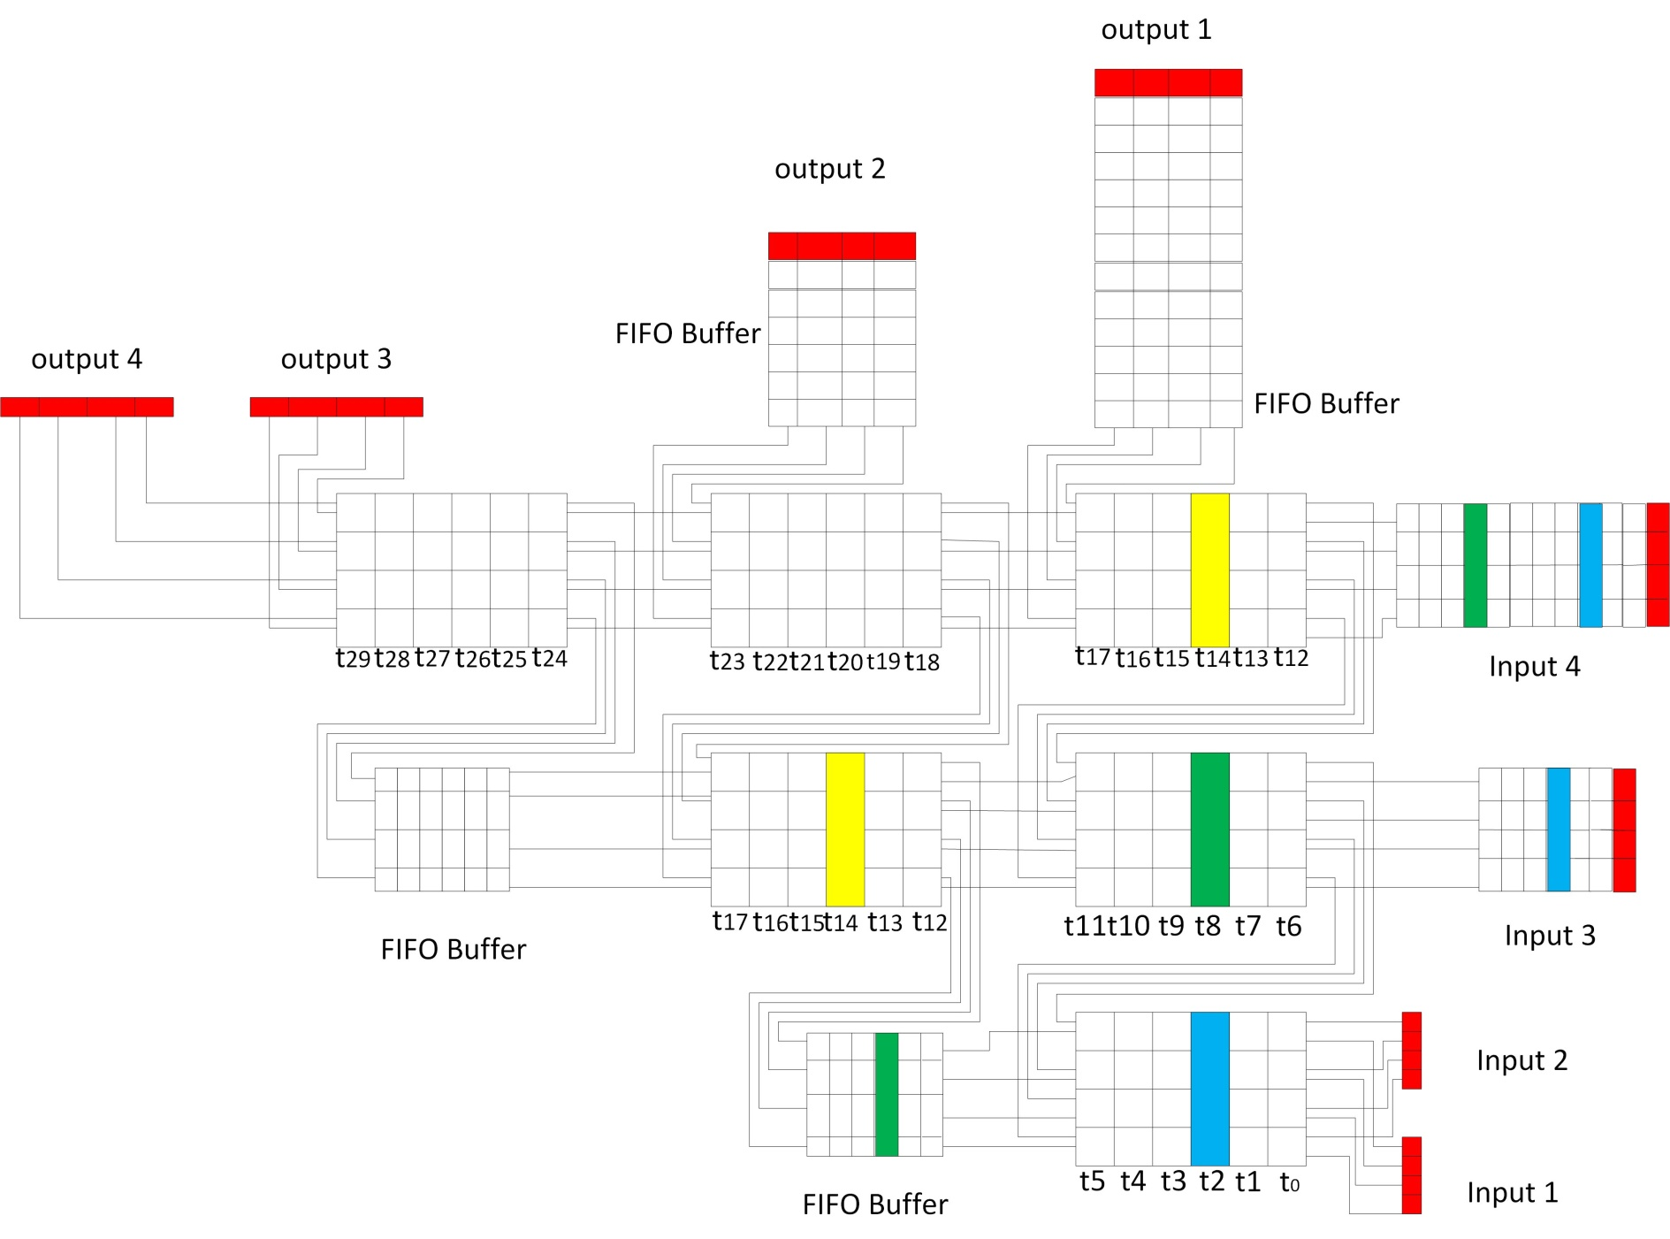

Slide 75
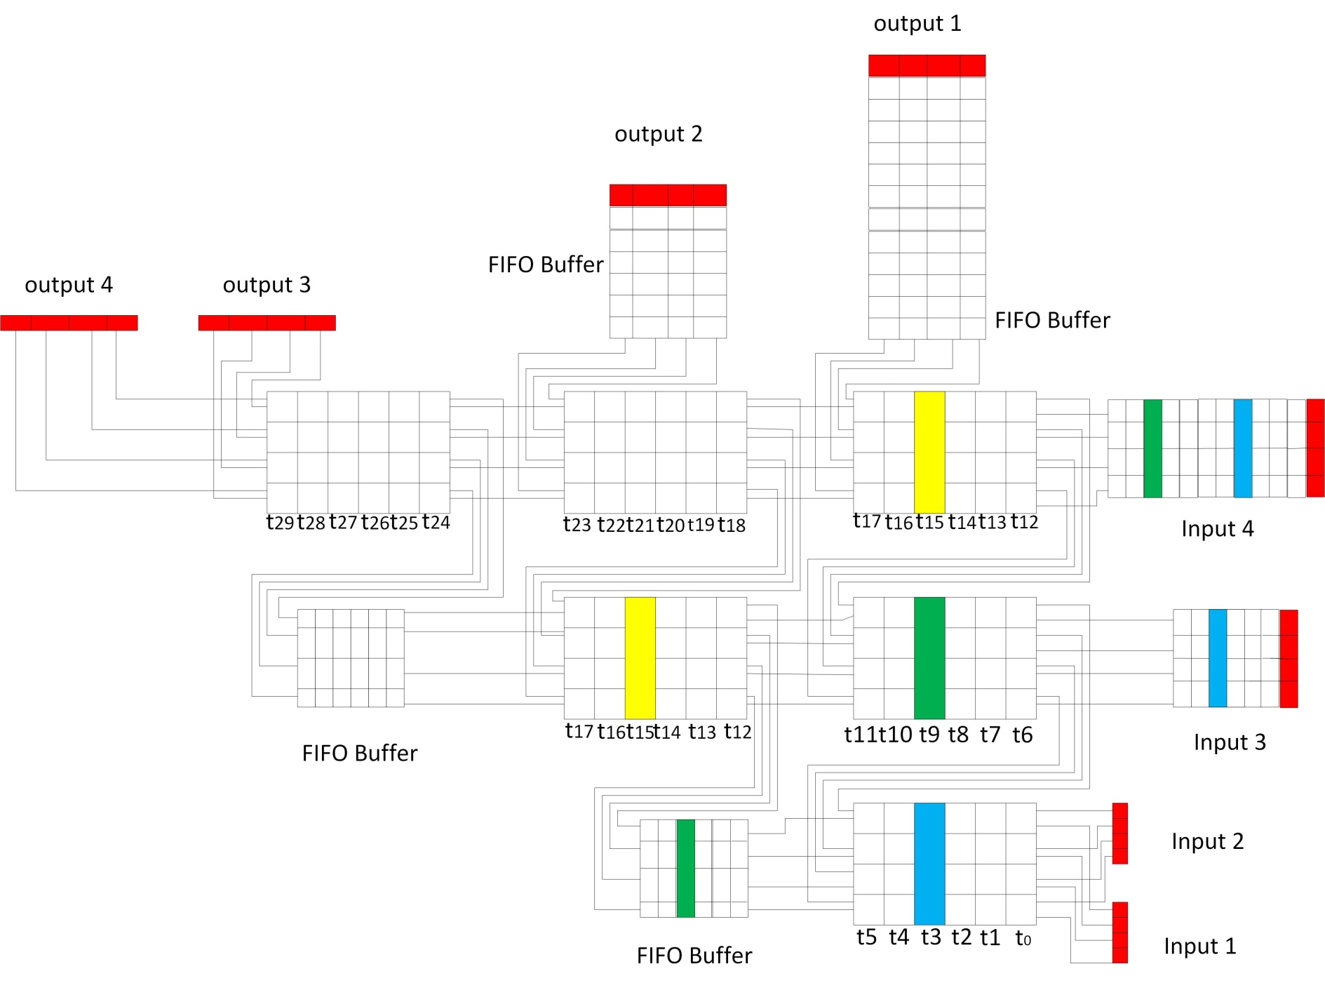

Slide 76
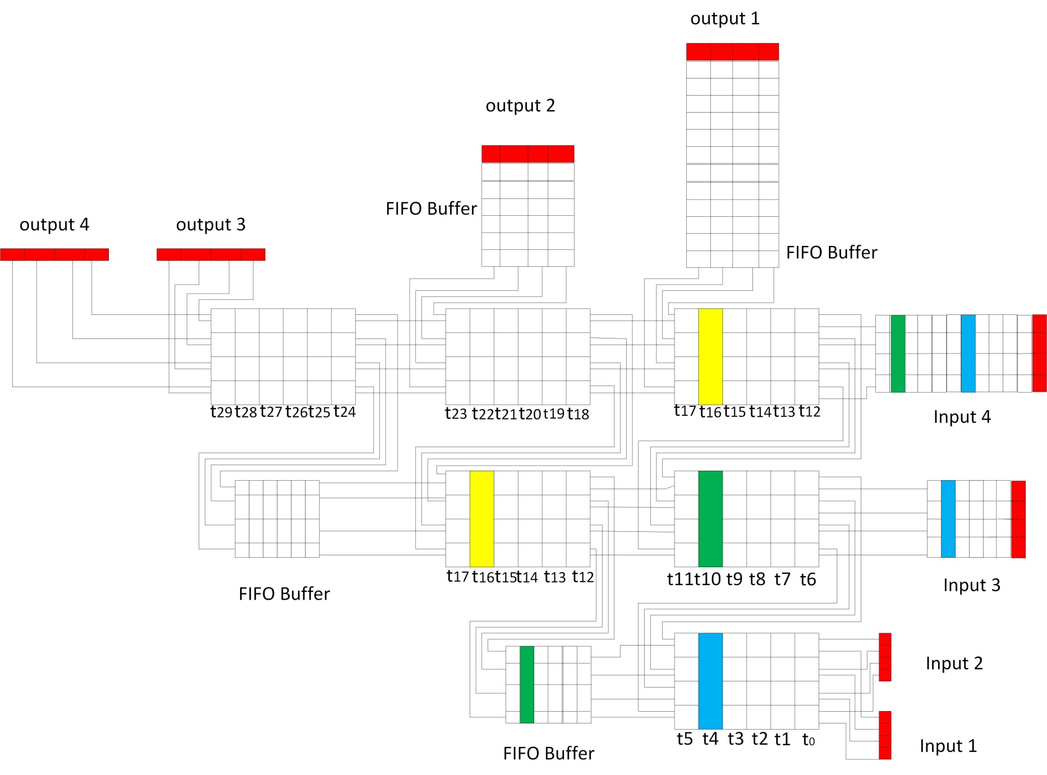

Slide 77


Slide 78


Slide 79


Slide 80


Slide 81


Slide 82


Slide 83


Slide 84


Slide 85


Slide 86


Slide 87


Slide 88


Slide 89


Slide 90


Slide 91
At the end, only one 1 Min_Max cell is required, hence the name Triangular sorter.

Slide 92
Advantages:
They are cost effective.
Array is modular i.e. adjustable to various performance goals.
Large number of processors work together.
Local communication in systolic array is advantageous for communication to be faster.
Exploit concurrency.

Slide 93
Applications
Sorter circuits find application while working with a lot of large data sets.
A sorted array or data is much easier to understand
Sorted data is useful in extracting meaningful insights from unstructured or structured data.
Sorting detects the redundancy in a large circuit with m n-bit inputs.
Very significant role and is going to be useful in the near future in the areas of Data Science, Machine Learning, etc.

Slide 94
References
http://web.cecs.pdx.edu/~mperkows/CLASS_VHDL_99/S2016/01.MEMRISTIVE_ARCHITECTURE/006.%20Anika%20davidson.pdf
http://web.cecs.pdx.edu/~mperkows/CLASS_VHDL_99/slides08.html
http://www.ijera.com/papers/Vol5_issue5/Part%20-%205/T50505105109.pdf
http://www.cs.kent.edu/~batcher/sort.pdf
http://www-bcf.usc.edu/~dkempe/CS104/10-31.pdf

