Slide 1
Complete Design Methodology of A Massively Parallel and Pipelined Memristive Stateful IMPLY Logic Based Reconfigurable Architecture
Kamela C. Rahman
Dissertation Committee:
Marek A. Perkowski, Chair
Dan Hammerstrom
Xiaoyu Song
Rolf Koenenkamp, GO Rep

Slide 2
Motivation
Biologically Inspired Associative Memory Based Modeling
Massively Parallel and Pipelined Architecture
Neuromorphic Nanoscale Circuits and Devices
Methodology Development for non-von-Neumann architectures
Notes:
By definition, any system that tries to model the architectural details of the neocortex is a biologically inspired model or neural network.
An associative memory can recall information from incomplete or noisy inputs and as such, AM has applications in pattern recognition, facial recognition, robot vision, robot motion, DSP, voice recognition, and big data analysis. Neural network based algorithms generally require massive parallelism. Single Instruction Multiple Data (SIMD), pipelining, and systolic array architecture are typical to DSP, neural network and image processing algorithms.
Finding a hardware methodology for the biologically inspired associative memory models for the application areas of big data analysis, pattern recognition, neural network etc. was the original motivation of this work. Therefore, the focus of this research was to provide a hardware methodology that is suitable for massively parallel and pipelined architecture and can be implemented with neuromorphic nanoscale technology. Memristor is a promising such new technology and as such, this dissertation proposes a methodology of designing a massively parallel reconfigurable architecture using the stateful IMPLY-memristor based nanowire crossbar.

Slide 3
Research Groundwork
Euclidean Distance
Evaluation of AM Based Algorithms
Memristor Research and memristive FPGA
Notes:
As in associative memories the information is retrieved through a search: in case of Best Match association, given an input vector one wants to obtain the stored vector that has been previously associated with the input. In a parallel hardware implementation of a large-scale associative memory the memory is searched to find the minimum distance between the new vector and the stored memory vector using the Euclidean distance formula. Therefore, Euclidean Distance calculation is a critical operation for any Associative Memory based models.
Kanerva (Furber) SDM AM model: matlab
Palm AM model: matlab
CLA, a commercial model by Numenta:
SOINN & ESOINN: for special pattern recognition by Shen & Hasegawa, coded in matlab
GAM: for spatial and temporal pattern recognition, coded in matlab.
Memristive devices [1] are electrical resistance switches that can retain a state of internal resistance based on the history of applied voltage. Leon Chua in 1971 [1] published the theoretical description of memristors. Strukov et al. [2] in 2008 established the link between the memristor theory and experimental results for the first time. Likharev and Strukov in 2005 [6] predicted the development of hybrid CMOL integrated circuits that would allow to extend Moore’s Law to the few-nm range. They listed several important future applications for such circuits, including large-scale memories, reconfigurable digital circuits, and mixed-signal neuromorphic networks with high and promising performances in delay and power. Keukes in 2008 showed that memristors themselves can perform logical operations. Two memristors can form one logical stateful IMPLY gate. Cong in 2011 proposed how to use Memristors for memory and connections only, in FPGA development, keeping cmos gates for the logic.

Slide 4
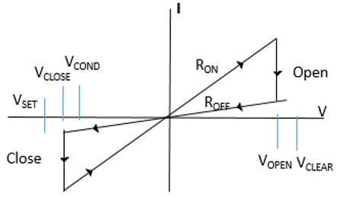
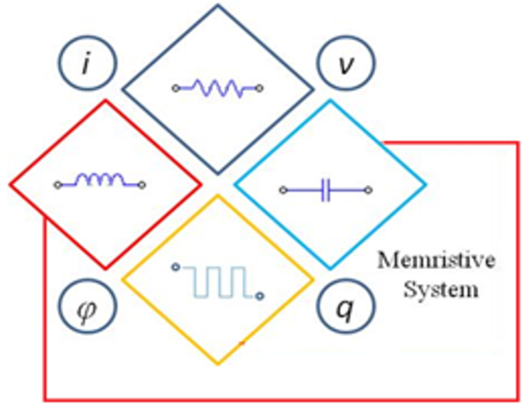

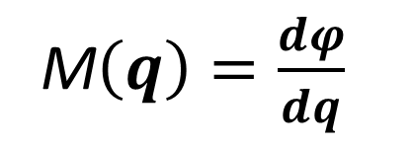
Memristors
M$\left(q\right)=\frac{dφ}{dq}$
[Kuekes]
[Kuekes]
[Chua]
Notes:
Vcond, Vset voltages are supplied as pulses.

Slide 5
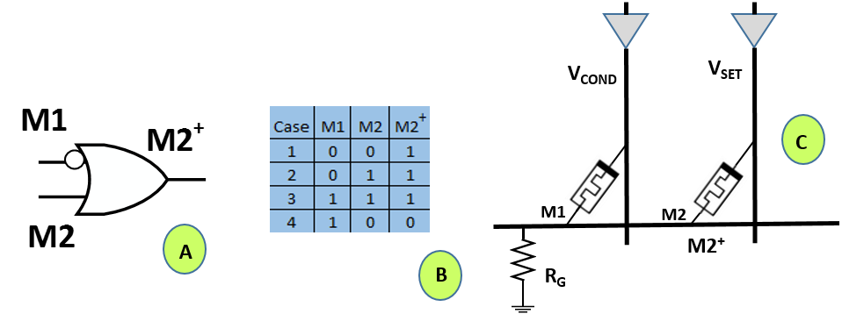
Stateful IMPLY Memristor
IMPLY Logic
A. Gate B. Truth Table C. Realization with Two memristors. [Kuekes]

Slide 6
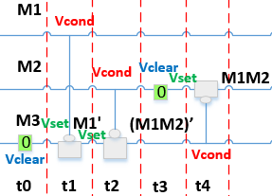
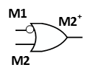

Logic Synthesis With Memristors
Space-Time Notation
Notes:
Adamatzky

Slide 7
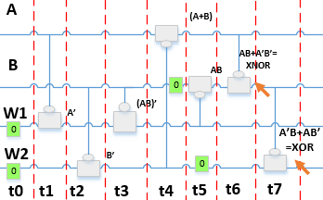
IMPLY-memristor: Proposed Optimized XOR Gate

Slide 8
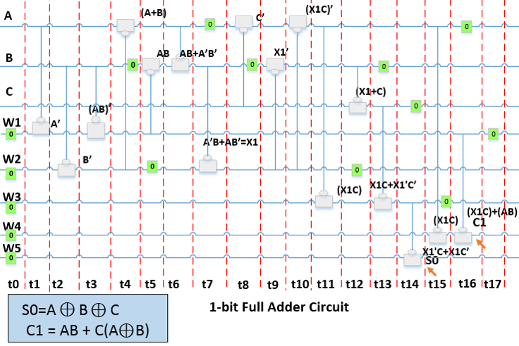
Proposed Optimized 1-bit Full Adder

Slide 9
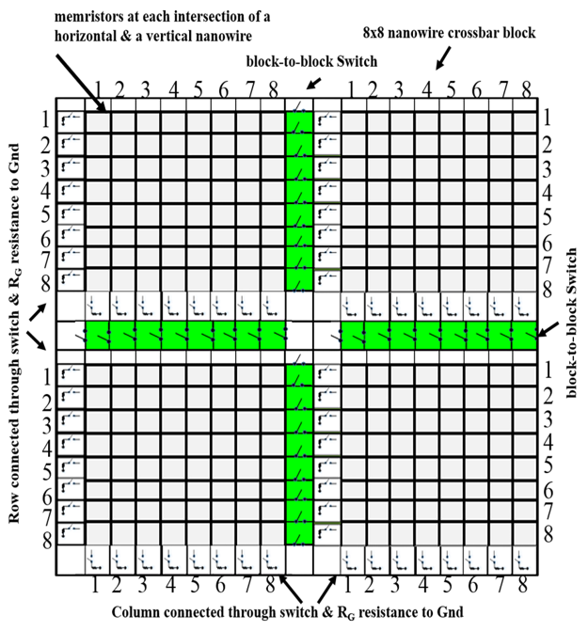
8x8 Nanowire Crossbar Blocks
1-bit Full adder in each row
8-bit in 8 rows i.e. in one 8x8 crossbar block
Proposed sneak-path protection
Proposed pipelining using array of 8x8 crossbar blocks in horizontal or in vertical direction
Massive parallelism using many pipelines running in parallel
Notes:
This is the fabric of FPGA.

Slide 10
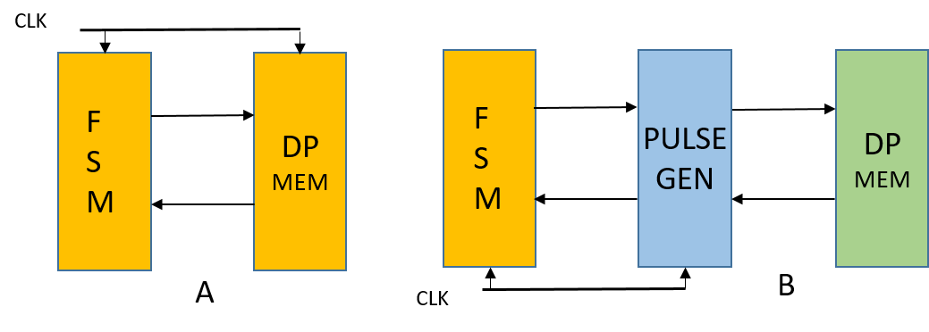
Conventional versus Proposed Architecture
A. FSMD
B. Proposed MsFSMD
Notes:
The well-known concepts of state machine with datapath design, FSMD cannot be applied to the kind of design for memristors with nanowire. So, I invented a new fundamental way of designing architecture with nanowire crossbars.

Slide 11
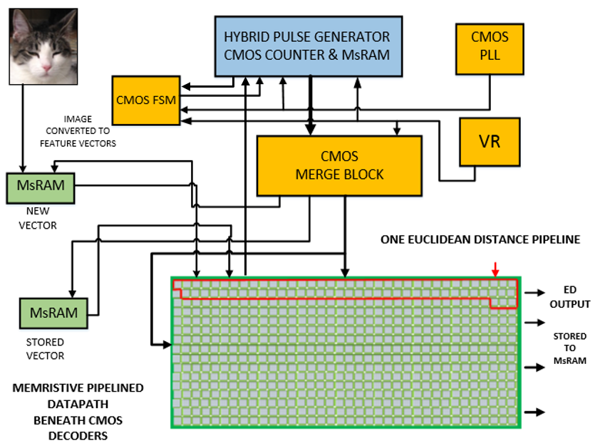
FPGA Design Using Memristors: Proposed MsFPGA
(Memristive stateful logic Field Programmable Gate Array)

Slide 12
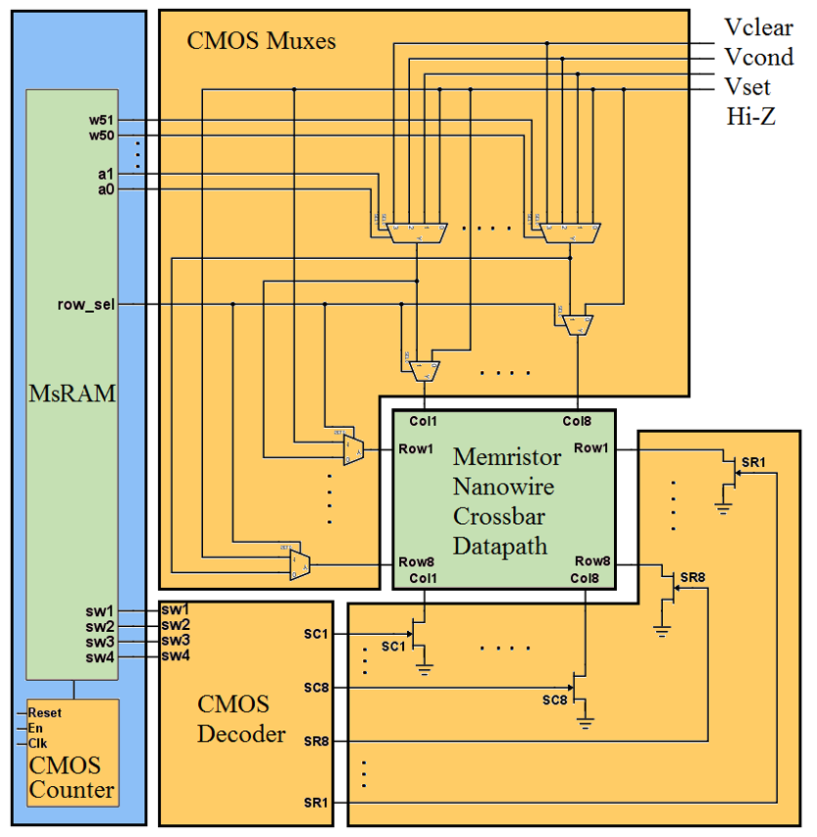
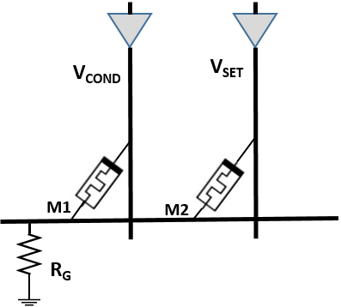
Proposed MsCMOL (Memristive stateful CMOL) Architecture
CMOL → Semiconductor transistors, CMOS/Molecular scale two-layer two-terminal nanodevices [Strukov-Likharev, 2005]
row/column select Multiplexers: row_sel signal selects either 1 row or 1 column
Voltage multiplexers: select V_{COND}, V_{SET}, V_{CLEAR}, HiZ
4-to-16 one-hot decoder to switch to Gnd selection
MsRAM contains all configuration information for the memristive nanowire crossbar datapath

Slide 13
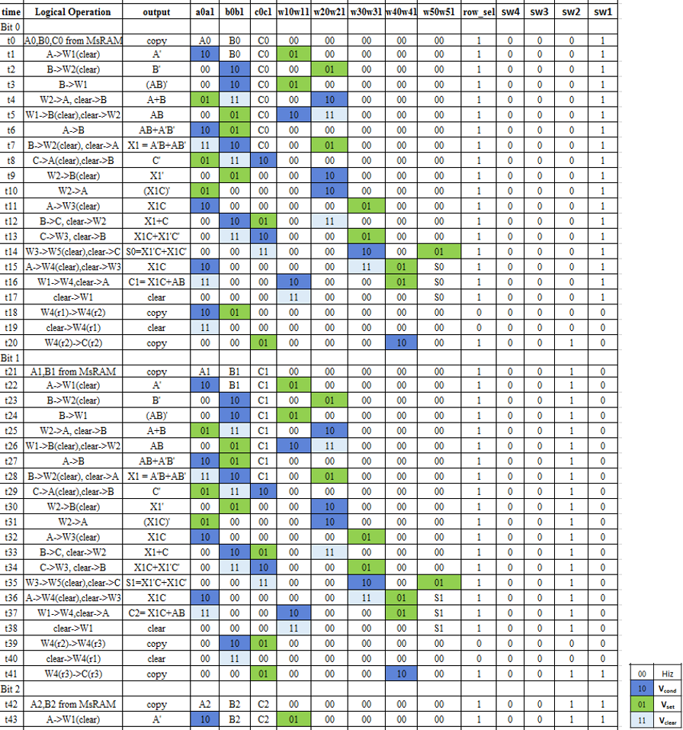
MsRAM (Memristive stateful logic Random Access Memory)

Slide 14
What is special about MsFPGA?
Published FPGA in nanotechnologies by Strukov & Likharev, S. Kang, Williams R. S., & mrFPGA by Cong.
Notes:
MsFPGA is a unique and completely different approach from published research on memristor-based FPGAs, because it allows separate programming or reconfiguration, of all- logic, memories and connections in the datapath which leads to significant gain in area, power and delay. While MrFPGA uses the combinational logic gates realized in CMOS, and therefore emphasizes connections programmability only using memristors, which plays the role of connect-disconnect switches, MsFPGA is intended for highly parallel regular architectures in which blocks are placed in abutment and in which horizontal connections are short. Also the usage of the CMOS components is insignificant compared to MrFPGA. In contrast to MrFPGA, MsFPGA methodology concentrates on logic design using stateful IMPLY gates with memristors and allows thus to build much larger logic/memory based systems for many applications. These applications include massively parallel pipelined architectures.

Slide 15
What is special about MsFPGA?
Comparison with other published memristive FPGA
iMemComp NVM logic architecture [Li et al. (2015) @Nature Scientific reports]
Notes:
The paper did not present any complete system with control, datapath and memory as MsFPGA. The iMemComp paper concentrated on a new way of reconfiguring resistance values in a crossbar to realize basic logic gates, whereas, MsFPGA concentrated on system design with stateful memristors and addressed major circuit issues. In the crossbar structure, for multiple bit logic, the methodology of this dissertation allows to move data from row to row, so it is possible to perform serial logic operation between rows. On the contrary, iMemComp architecture does not support row-to-row data transfer, rather they use CMOS circuitry to transfer data. Also, the datapath in this dissertation work is completely reconfigurable compared to the iMemComp LUT design. In general, proposed design of this dissertation provides a wider and more flexible framework for a whole programmable system design. The iMemComp focuses on the RS switch based design for the programmable logic and did not show any of the CMOS circuitry and the control of the pulses.

Slide 16
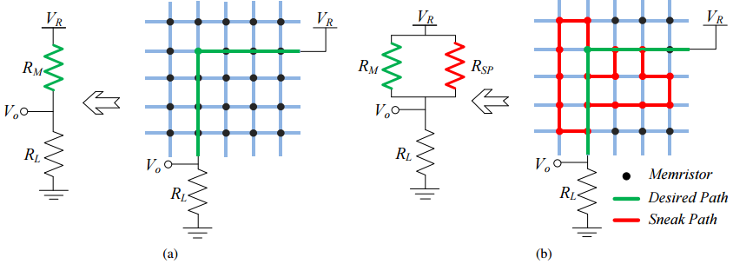
Issue with Sneak-Path Current
(a) Current Flows Through Target Cells (b) Current Flows Through Undesired Paths. [99]

Slide 17
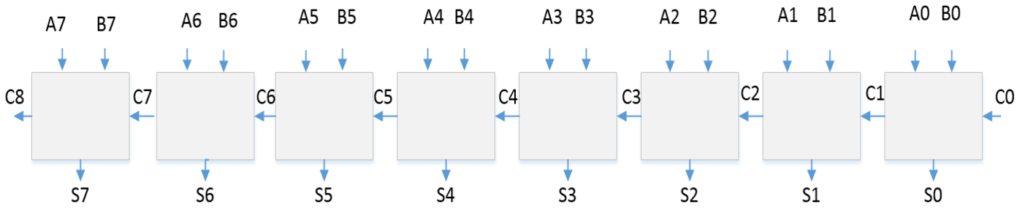
Classical 8-bit Iterative Adder

Slide 18
Proposed Sneak-path protection

Slide 19
  Step-by-Step Execution of Proposed 8-bit Iterative Adder
step1: sequences of the bit0 adder operations
I. The primary inputs (PI) -- A0, B0, C0 are copied from storage MsRAM to datapath in row1 locations to perform bit0 operations.
symbolically, (row1, col1) := A0, (row1, col2) := B0, (row1, col3) := C0.
II. Select row1, close only row1 switch to Gnd.
III. Apply V_{COND} and V_{SET} through col1 and col2 respectively for a row-wise data transfer. A stateful logic operation will take place.
1-bit adder: 18 micro pulses required, accounted for all required reset operations.
The carry and sum bits are saved in (row1, col7) and (row1, col8).
Also, col1 through col6 are cleared to state ‘0’ to avoid sneak-path currents.

Slide 20
  Step-by-Step Execution of Proposed 8-bit Iterative Adder
step2: Copying of the carry bit from the current row to the next row.
Here it is demonstrated for (row1, col7) to (row2, col7).
I. Disconnect row1 from Gnd. Select col7, close only col7 switch to Gnd.
II. Apply V_{COND} to (row1, col7) and V_{SET} to (row2, col7) for a column-wise data transfer. Stateful logic is transferred from (row1, col7) to (row2, col7).
III. Apply V_{CLEAR} to (row1, col7) for sneak-path protection.
step3: Carry bit transfer steps from one column to another in the same row. Here, voltages are applied through columns again.
I. Disconnect col7 from Gnd. Select row2, close only row2 switch to Gnd.
II. Apply V_{COND} to (row2, col7) and apply V_{SET} to (row2, col3) for a row-wise data transfer.
Location of carry-out bit C1 now is at (row2, col3).

Slide 21
  Step-by-Step Execution of Proposed 8-bit Iterative Adder
step4: This step explains the bit1 operation of the adder.
I. Values A1 and B1 are copied from storage MsRAM to datapath in row2.
symbolically, (row2, col1) := A1, (row2, col2) := B1. (row2, col3) := C1.
II. Repeat the above steps from step1 II through step3 for all eight rows in the 8×8 nanowire crossbar.
III. The final sum bits are located in the eighth column of each row respectively.
But cannot cause sneak-path issue as there is no direct current sink path available.
Total number of pulses for the 8-bit full-adder circuit operation is 165, which includes all logic, copy, and reset operations.

Slide 22
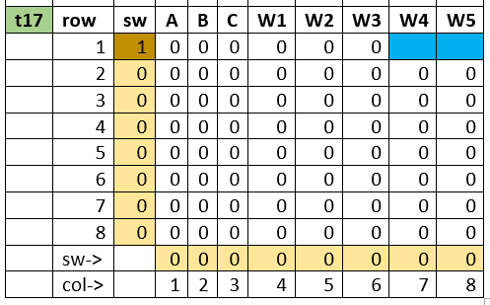
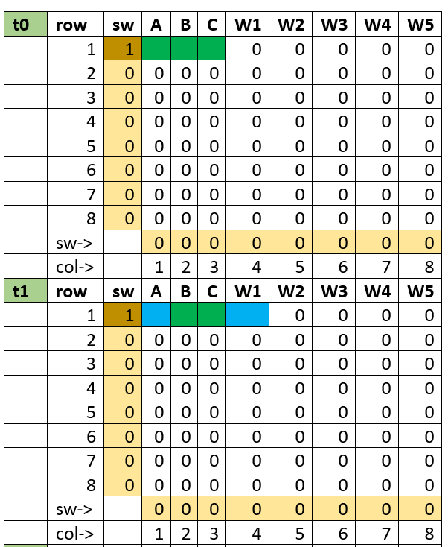
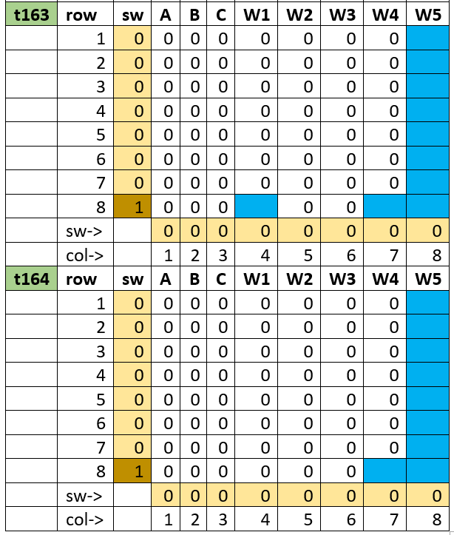
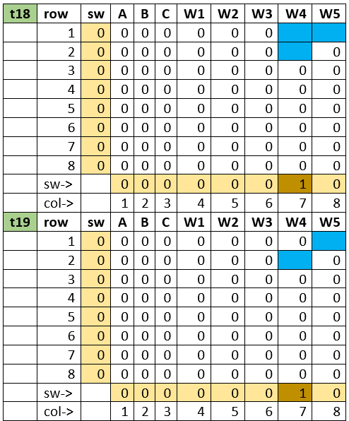
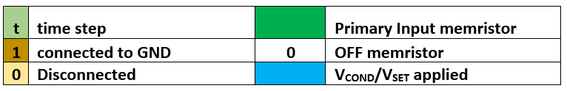
Detailed 8-bit iterative adder sneak-path free design (A portion shown)
. . .
. . .

Slide 23
Proposed Sneak-path protection methodology
Design can be faster without sneak-path current protection.
Memristor C0 will contribute to the static power P_{ON}, insignificant amount.
8-bit iterative adder design, P_{ON} = 2.38µW with 40nm half-pitch nanowire crossbar with V_{SET} = 1.0V and P_{ON} = 0.38µW with 8nm half-pitch nanowire crossbar with V_{SET} = 0.4V.
Either one row or one column connects to ground at a time, there can be only one path from V_{SET} to Gnd at a time.
Memristors are turned down to the “reset” state through the V_{CLEAR} signal in each row after operation completes.

Slide 24
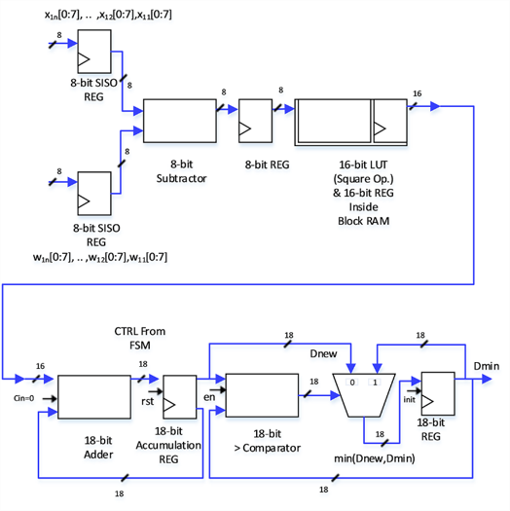

Proposed CMOS Pipelined Implementation of Euclidean Distance Calculator
$$D\left(X, Y\right)=\sqrt{{(x_{1}−y_{1})}^{2}+{(x_{2}−y_{2})}^{2}+ ∙∙∙ +{(x_{n}−y_{n})}^{2} }$$
four pipe-stages
Notes:
The direct-line distance between two points in a multi-dimensional space can be specified by using the Pythagorean formula.
My goal was to compare the distance only, so I did not do sq-roots.

Slide 25
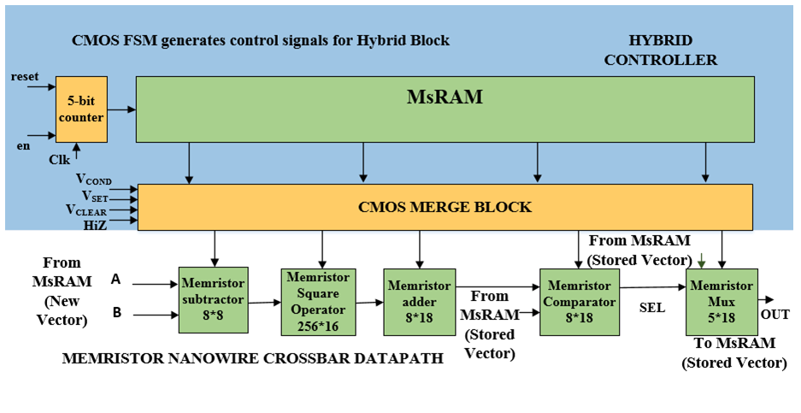
Proposed MsFPGA Pipelined Implementation of Euclidean Distance Processor

Slide 26
CMOS FPGA Design for ED Pipeline
Each element of the vector represents a pixel of an image with gray scale value between 0-255 (i.e. 2^8).
Designed for 8-bit wide vector, so arithmetic computations are based on 8-bit.
Design coded using VHDL.
Simulated for functionality evaluation and synthesized for performance measurement using Xilinx® XA Vivado-2015.2 tool with Kintex®-7 family based smallest chip xc7k70tfbg484-3
total package size of 23x23 mm²
high-performance/low-power (HPL) 28 nm high-k metal gate (HKMG) process technology
optimized for best price-performance with a 2X improvement compared to the previous Xilinx FPGA generations

Slide 27
CMOS FPGA Design
CMOS FPGA design was driven by a 134 MHz clock frequency
Subtractor used is different from the normal adder-subtractor, which always produces a positive result.

Slide 28
Area & Delay of CMOS ED Pipeline
Block | Delay (ns) |  |  | Area (mm²)
 | logic delay | net delay | Total
8-bit subtractor | 1.25 | 5.7 | 6.95 | 0.203
16-bit LUT Sq. RAM | 3.78 | 0.71 | 4.49 | 0.041
18-bit adder | 2.29 | 0.76 | 3.05 | 0.076
18-bit accumulator | 2.51 | 0.43 | 2.94 | 0.2
18-bit comparator | 3.56 | 1.06 | 4.62 | 0.042
18-bit mux | 2.98 | 0.87 | 3.85 | 0.038
Pipeline Total | 16.37 | 9.53 | 25.9 | 0.6

Slide 29
Power & Area of CMOS ED Pipeline
The estimated dynamic power for the complete design was 22.3mW and 24mW at 25% and 100% toggle rate respectively in Xilinx.
The static power of the chip remains constant because all of the blocks in the FPGA are turned on regardless of their utilization and rather depends only on a particular FPGA type selected for comparison.
Based on the total device utilization compared to the total available units in the chip, the percentage area was estimated and thus the total area was obtained; 0.904 mm² occupied by the complete ED pipeline.

Slide 30
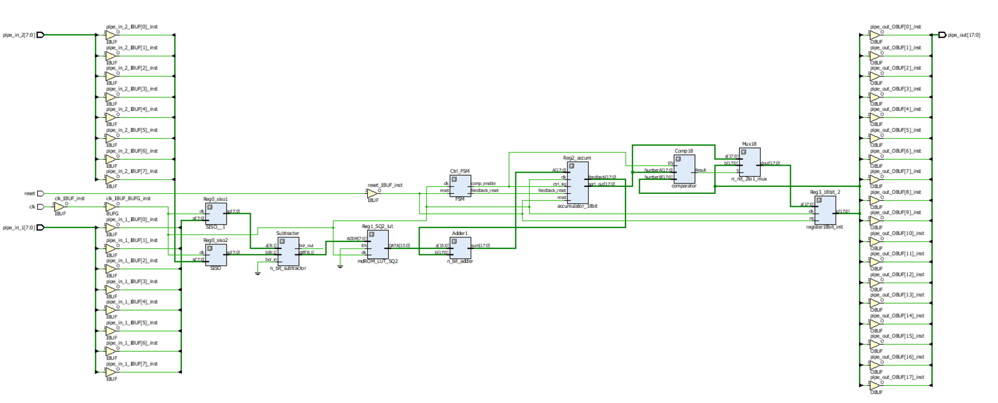
Xilinx Synthesis of CMOS ED Pipeline

Slide 31
Performance Study of Proposed MsFPGA
Memristor Device Level PSPICE Simulation
Memristor Crossbar Nanowire PSPICE Simulations
Area Estimations
Delay Measurement
Power Calculations

Slide 32
Memristor Device Level PSPICE Simulation:
The memristor model used for SPICE simulation in this dissertation work is similar to that of the Biolek model.
Biolek model is a behavioral memristor model.
The physical model was two-layer TiO₂ based, sandwiched between electrodes. One of the layers is doped with oxygen vacancies and thus it behaves as a semiconductor. The second layer, un-doped region, has an insulating property.
The memristor circuit model here was implemented by using the software OrCAD PSPICE.

Slide 33
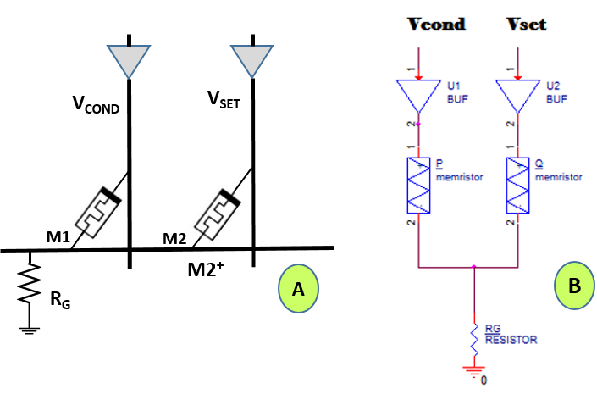
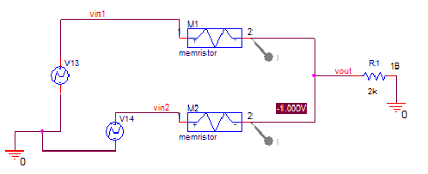
IMPLY-Memristor Simulation Model
This work used R_{ON} = 100Ω, R_{OFF} = 10KΩ, V_{SET} = 1.0V,
V_{COND} = 0.5V, and V_{CLEAR} = -1.0V in simulations.

Slide 34
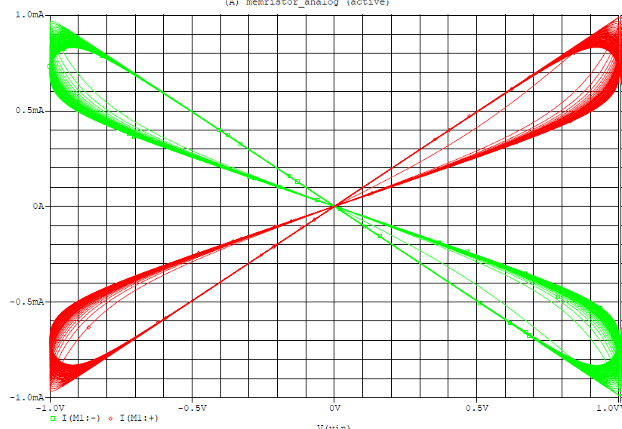
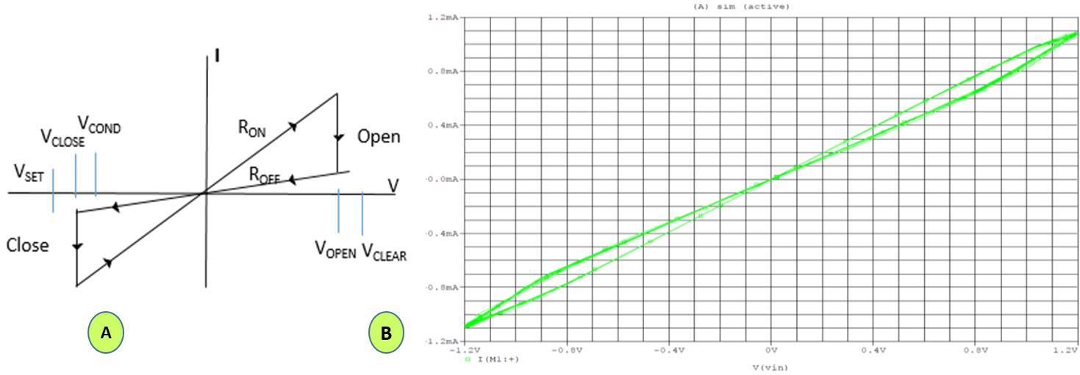
I-V Plot
I-V Plot resembles the I-V plot obtained from simulation of Biolek model.

Slide 35
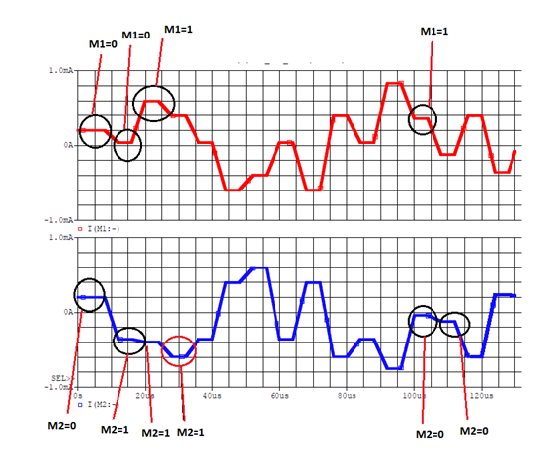
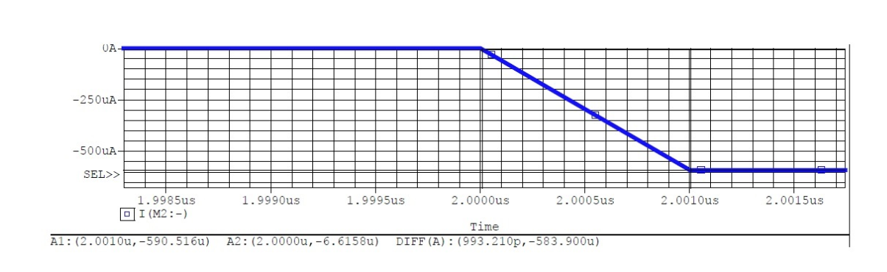
IMPLY-Memristor Logic Evaluation
TiO₂ Based Memristor Device Transition Delay
Logical Combinations of M1M2: 00, 01, 11, 10
current
Time
993.21ps

Slide 36
Various Memristor Device Delay From Literature
Behavioral models of memristive devices provide overview of expected characteristics.
Process-dependent models contain various process-dependent parameters, which can reflect actual circuit performance, and through the parameters, the devices can be tweaked to optimize the design for performance, e.g. delay reduction.
Kvatinsky reported the delay of the memristive implication gate to be 397.1ns using the ThrEshold Adaptive Memristor (TEAM) model with a TiO₂ based memristor. → Behavior Model
Torrezan showed that the set and reset operations were successfully performed in the TaO_{X} (Tantalum Oxide) memristor using pulses with durations of 105ps and 120ps, respectively. → Behavior Model
Mazady recently reported a promising work based on ZrO₂ memristors delay of 6.8ps, i.e. 147GHz CLK, which is due to a very high mobility of 370 cm2/V-s of ZrO₂ with a resistivity of 1.33×1013 Ω-cm for the insulating material. → Process Model

Slide 37
Memristor 8x8 Nanowire Crossbar PSPICE Simulations
Model was created using OrCAD PSPICE software.
wire RC segments of one row and eight columns were drawn to model 8x8 crossbar network.
The wire resistance and wire capacitance values were calculated using Strukov paper and used in the model.
Fringe capacitance for the memristor device was added in the model, which is placed between one column and one row.
V_{SET} = 1.0V, R_{G} = 5kΩ and nanowire half-pitch = 40nm.

Slide 38
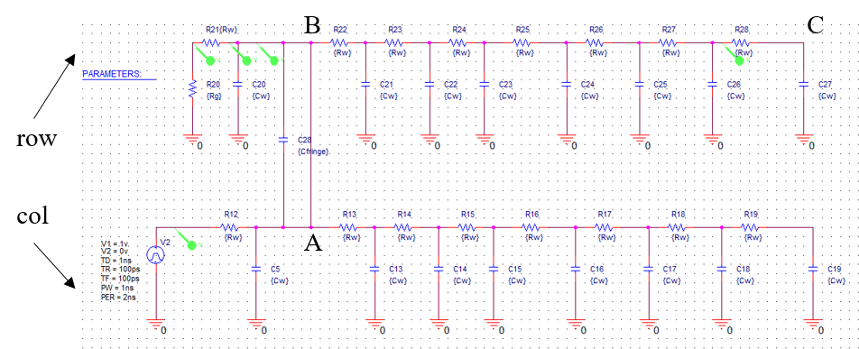
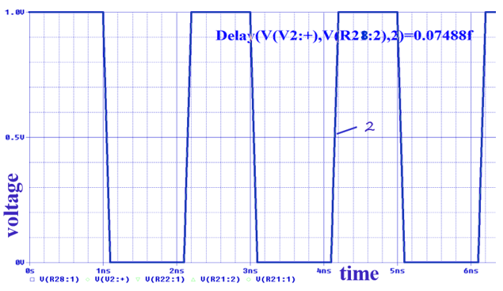
RC Delay Measurement of the 8x8 Nanowire Crossbar Model Through PSPICE Simulations
Simulation results showed negligible wire delay even for the worst case/farthest column from load resistor R_{G}, the RC delay was only ~0.075fs.

Slide 39
Before Performance Evaluation of MsFPGA
Before we can estimate the design area and delay, every memristor-based block in the MsFPGA system is designed with IMPLY-memristors using the space-time notation. Thus we know how many memristors or 8x8 crossbar block(s) and how many pulses are required for designing each component or block.
The number of memristors is used for the layout area estimation and the number of pulses is used for the delay calculation.

Slide 40
    Memristor-Nanowire Crossbar Area Estimation
Borghetti et al. of Hewlett Packard fabricated 40 nm half-pitch memristor crossbars using nanoimprint lithography on the same silicon substrate with CMOS, for fully integrated hybrid circuits.
Half-pitch is defined as half the distance between two nanowires from center to center. Therefore, the width of nanowire=40 nm, spacing of nanowire =40 nm and the center to center distance is 80nm.
Strukov [6] proposed 8 nm half-pitch for nanowire crossbars based on simulations.

Slide 41
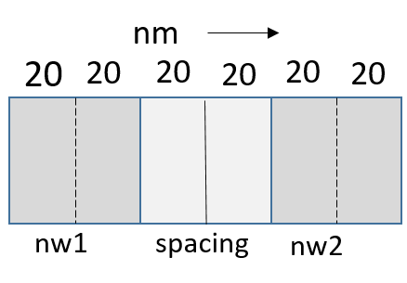
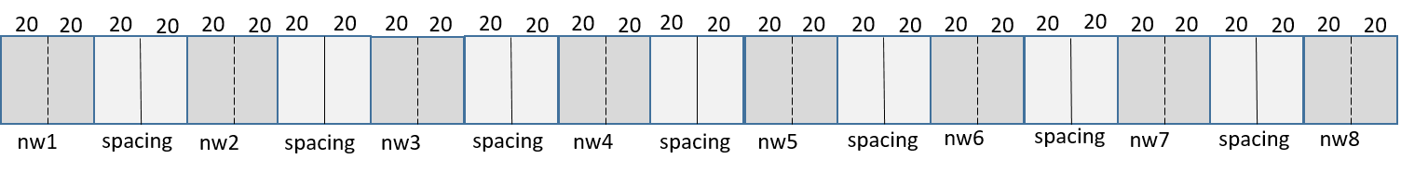
For the 40 nm half-pitch memristor crossbars
X-direction distance = (Full-pitch between nanowires * number of nanowires in the middle) + (Half of two side nanowires on both ends).
Half of each nanowire = 20nm;
X-direction distance = (80 * 7) + (20) = 600 nm;
Similarly, Y-direction distance = 600 nm;
Thus the total area of 8x8 crossbar = 0.6 * 0.6 µm² = 0.36 µm²

Slide 42
Calculated Area of Memristor Crossbar Blocks in the ED Pipeline Datapath
Component | Memristors | Area(µm²)
8-bit sub | 8x8 | 0.36
LUT | 256x16 | 23.04
18-bit adder | 8x18 | 0.81
18-bit comp | 8x18 | 0.81
18-bit mux | 5x18 | 0.51
Total |  | 25.53

Slide 43
Datapath, MsRAM and Total Area of ED Pipeline
Since the total number of micro-pulses for the complete pipeline is 1027 and the total number of control bits is 21, therefore the total MsRAM area was calculated:
MsRAM area = ((Total number of micro-pulses * Total number of control bits) * Total area for 8x8 crossbar)/Total number of memristors in an 8x8 crossbar.
Thus, the total MsRAM area for the ED pipeline is calculated as 121.31µm².
Based on 40nm half-pitch, the estimated area of the proposed ED pipeline datapath is 25.5µm², with corresponding MsRAM area in Pulse Generator is 121µm². Therefore, the total area consumed by the complete ED pipeline is 146µm².
Based on Strukov’s 8nm half-pitch nanowires, the total area requirement of the same ED pipeline is only 5.9µm².

Slide 44
Block | Micro pulse required | Delay Based on ZrO₂ memristor for each transfer = 6.8ps [17]. | Delay Based on TiO₂ memristor TEAM Model for each transfer = 397.1ns [5]. | Delay Based on TaO_{x} memristor for each transfer = 120ps [18]. | Area (µm²) Based on Ref. [20].
 |  | Realistic Process Model | Behavioral Model | Behavioral Model
8-bit Subtractor | 224 | 1.52ns | 88.95µs | 26.88ns | 0.36
16-bit LUT RAM | 35 | 0.24ns | 13.9µs | 4.2ns | 23.04
18-bit Full Adder | 369 | 2.51ns | 146.53µs | 44.28ns | 0.81
18-bit Comparator | 290 | 1.97ns | 115.16µs | 34.8ns | 0.81
18-bit Multiplexer | 109 | 0.74ns | 43.28µs | 13.08ns | 0.51
Pipeline Total | 1027 | 6.98ns | 407.82µs | 123.24ns | 25.53
PG MsRAM For 5 Blocks in Pipeline | - | - | - | - | 121.31
Calculated Delay And Area of Euclidean Distance Pipeline Using Stateful IMPLY-Memristor Nanowire Based MsFPGA Design.

Slide 45
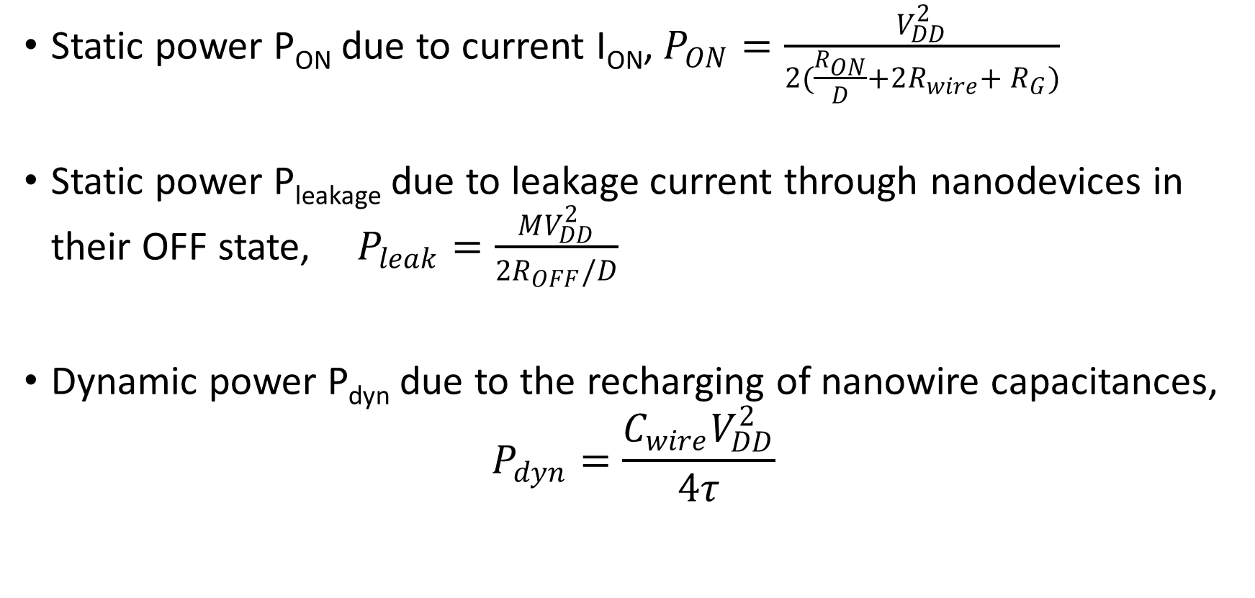
Power Consumption Sources of Memristor-Nanowire Design [Strukov]
Static power P_{ON} due to current I_{ON}, $P_{ON}=\frac{V_{DD}^{2}}{2(\frac{R_{ON}}{D}+2R_{wire}+ R_{G})}$
Static power P_{leakage} due to leakage current through nanodevices in their OFF state, $P_{leak}=\frac{MV_{DD}^{2}}{2R_{OFF}/D}$
Dynamic power P_{dyn} due to the recharging of nanowire capacitances,
$$P_{dyn}=\frac{C_{wire}V_{DD}^{2}}{4τ}$$

Slide 46
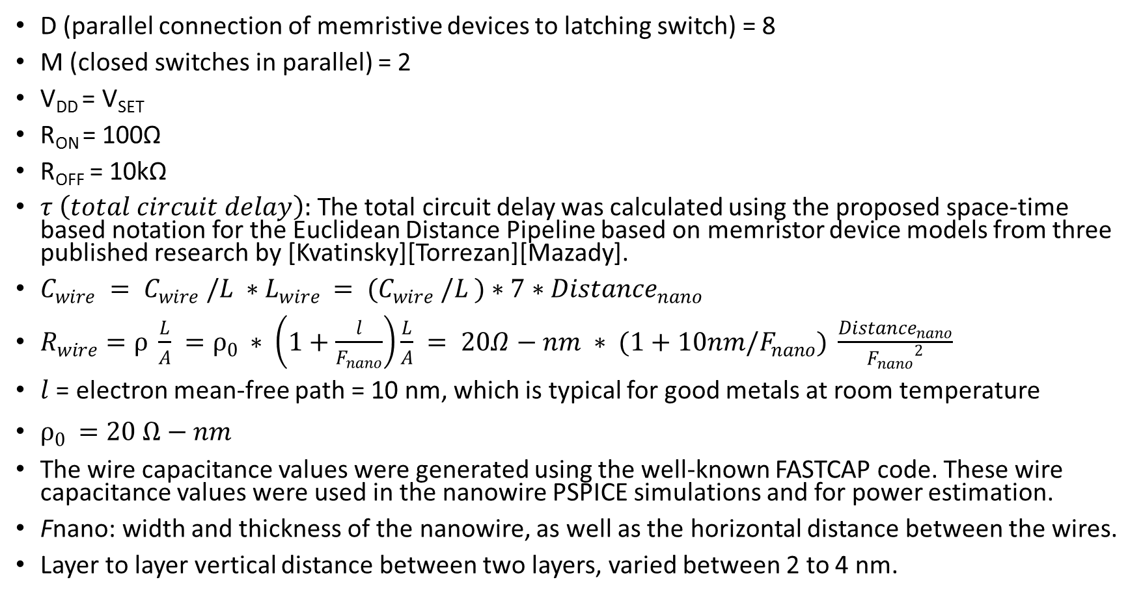
D (parallel connection of memristive devices to latching switch) = 8
M (closed switches in parallel) = 2
V_{DD} = V_{SET}
R_{ON} = 100Ω
R_{OFF} = 10kΩ
$τ \left(total circuit delay\right):$The total circuit delay was calculated using the proposed space-time based notation for the Euclidean Distance Pipeline based on memristor device models from three published research by [Kvatinsky][Torrezan][Mazady].
$C_{wire} = C_{wire} /L ∗L_{wire }= (C_{wire} /L )∗7∗{Distance}_{nano}$
$R_{wire}=ρ \frac{L}{A} =ρ_{0 }∗ \left(1+\frac{l}{F_{nano}}\right)\frac{L}{A} = 20Ω−nm ∗ (1+10nm/F_{nano}) \frac{{Distance}_{nano}}{{F_{nano}}^{2}}$
$l$ = electron mean-free path = 10 nm, which is typical for good metals at room temperature
$ρ_{0 }=20 Ω−nm$
The wire capacitance values were generated using the well-known FASTCAP code. These wire capacitance values were used in the nanowire PSPICE simulations and for power estimation.
Fnano: width and thickness of the nanowire, as well as the horizontal distance between the wires.
Layer to layer vertical distance between two layers, varied between 2 to 4 nm.

Slide 47
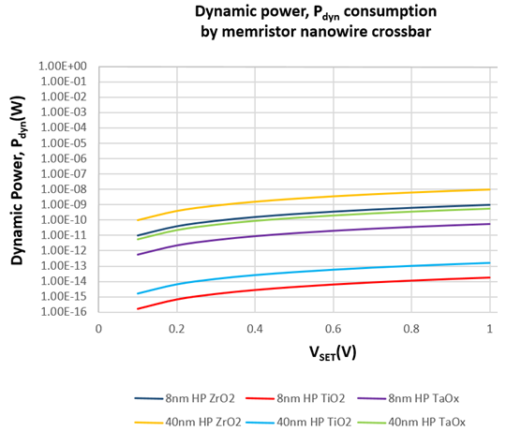
MsFPGA Pipeline P_{DYN} Calculation: Total Pipeline Delay, 𝞃 from TaO_{x}, TiO₂, ZrO₂ Models
Design cases:
40nm half-pitch, V_{SET} = 1 V
8nm half-pitch, V_{SET} = 1 V
40nm half-pitch, V_{SET} = 0.4 V
8nm half-pitch, V_{SET} = 0.4 V
Result: Worst case Pipeline P_{dyn} is 9.63nW running at a V_{SET} voltage of 1.0V for the 40nm half-pitch nanowires.

Slide 48
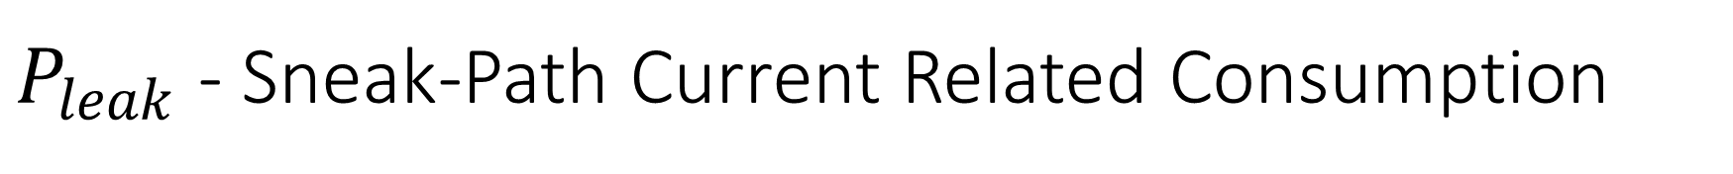
$P_{leak}$ - Sneak-Path Current Related Consumption
In this proposed design only one row or column of the 8×8 crossbar at a time can discharge through Gnd.
Moreover, memristors go through reset with the V_{CLEAR} voltage after completing the operations in each row.
In the proposed 8-bit adder design only the sum bits are preserved in the eighth column of the 8×8 nanowire crossbar, while all other memristors are cleared.
However, the memristors that are holding the sum bits cannot easily discharge as no direct path to Gnd is available for them.
Thus the claim is that the leakage power P_{leakage} is negligible in the proposed design.
Without any sneak-path protection, the worst case calculated leakage power would be 0.8mW per pipe-stage.

Slide 49
P_{ON} Consumption
In proposed methodology the primary input data is copied over from storage MsRAM to row1 of the 8×8 nanowire crossbar.
Therefore, in 1-bit FA design, the carry bit holds the memristance value for several pulses/cycles. This may cause some static power loss. However, since other protections are provided to the design, this loss is also negligible.
The calculated P_{ON} power loss is 2.38µW per pipe-stage.

Slide 50
CMOS Power Component of MsFPGA
The estimated total dynamic power consumption by CMOS circuitry per 8×8 memristive nanowire crossbar (per pipe-stage) is 2.25mW at 25% toggle rate
Thus, for four pipe-stages of the complete ED pipeline, it is approximately 9mW.
Proposed hybrid MsFPGA operating at 1.0V consumes ~9mW total dynamic power as the power components from memristor design is insignificant.

Slide 51
CMOS Area of MsFPGA
CMOS circuitry in the hybrid MsFPGA consumes 0.32mm² area as estimated.
The area of the hybrid MsFPGA design is dominated by the CMOS components.
Nanowire is fabricated on top of CMOS.
As the memristor crossbar technology matures, more components can be converted from CMOS to memristors and thus these components can be moved to the memristor layer from the CMOS layer.

Slide 52
Performance Comparison of CMOS FPGA vs. MsFPGA
Performances | CMOS FPGA | MsFPGA | CMOS Component of MsFPGA
Delay | 25.9ns | ZrO₂ Realistic Process Model: 6.98ns TaO_{x} Behavioral Model: 123.24ns TiO₂ Behavioral Model: 407.82µs | -
Datapath Area | 0.6mm² | 146µm² | n/a
Total Die Area | 0.904 mm² | n/a | 0.32mm²
Static Power | Whole FPGA is on, so not comparable. | Sneak-path protection provided. | -
Dynamic Power @25% toggle-rate | 22mW | 9.63nW | 9mW

Slide 53
Contributions: Circuit Methodology
Presented optimized design for logic blocks using IMPLY-memristor.
An innovative concept of an 8-bit iterative adder design using the Stateful IMPLY-memristor is presented.
The 8-bit iterative adder is designed in a new type of 8x8 nanowire crossbar, where, each adder bit is implemented in one row of the 8-row crossbar network.
The design is optimized for area, power and delay and has sneak-path protection for logical error.
Similarly, components of 8-bit, 16-bit, or any other order bit can be designed using one or multiple 8x8 crossbar blocks, as needed.
For this dissertation other arithmetic blocks, e.g. subtractor, comparator, multiplexer, square-operator blocks were also designed using the same design concepts.

Slide 54
Contributions: Circuit Methodology
Array of 8x8 Nanowire Crossbar Block
The innovative pipelining concept is presented for the datapath design using an array of 8x8 nanowire crossbar blocks.
This array of blocks can grow both horizontally as well as vertically and can act as a pipeline in either way.
Therefore, multiple arithmetic operations can simultaneously execute.
Improves overall design speed that can compensate for slowness in memristors devices.

Slide 55
Contributions: Circuit Methodology
Novel ideas that are valuable to the development of memristor technology.
Proposed MsCMOL: Conventional CMOL cannot be conveniently used for logic design using memristors. Proposed novel MsCMOL can be used for Logic, Memory and Connections.
Idea of data storage MsRAM: Receives the image feature vectors in the data storage MsRAM, which later copies the data over to the Datapath.
Array of 8x8 nanowire crossbar blocks: Enables pipelining and parallelism, which helps speed-up the memristor based design.
Proposed row-to-row data transfer: Voltages are applied through columns to execute operations. Once data is ready in the current row and needs to move to the next row, voltages are applied through rows to copy data from current row to the next row.

Slide 56
Contributions: Circuit Methodology
Proposed sneak-path protection: Major concern of all crossbar nanowire design for logical error and power loss.
Proposed design was presented with an example 8-bit Full iterative adder design.
This design is free of dangerous logical errors and it was minimized for possible power consumption.
The power consumption for this proposed design is reduced to the lowest possible level.
This proposed sneak-path free combinatorial circuit design methodology is much more robust and simple than any other published research on similar designs with nanowire crossbars.

Slide 57
Contributions: Architecture Methodology
Dissertation presented Innovative concepts for the memristive FPGA design.
MsFPGA (Memristive stateful logic Field Programmable Gate Array): A novel Memristor-CMOS Hybrid Reconfigurable Architecture was proposed.
MsFPGA uses memristors for memory, connections programming, and combinational logic implementation as opposed to other published memristor based FPGAs, for example mrFPGA, where memristors are reconfigured for logic connections only.
Proposes a Non-von-Neumann architecture where DP and memory does not need to be separated.
MsFPGA is intended for highly parallel regular architectures in which blocks are placed in abutment and in which horizontal connections are short.
Pipelining and Parallelism: The proposed MsFPGA is a reconfigurable system that can be designed with pipelined datapaths and massive parallelism in the datapath.
The pipelining is designed by simultaneously executing multiple operations using several 8x8 crossbar blocks.
The parallelism can be designed by simultaneously driving many such pipelines with one controller, using the SIMD (Single Instruction Multiple Data) concept.

Slide 58
Contributions: Architecture Methodology
Proposes a novel general new architecture model, Memristive stateful Finite State Machine with Datapath (MsFSMD). Like conventional FSMD, this proposed system is also a digital system that includes a finite-state machine, and a datapath, but all logic is implemented with memristors, which changes timing and design methods used.
MsFSMD model has an additional control block called the pulse generator. The pulse generator can be defined as the brain of the proposed MsFPGA.
The pulse generation block contains the Memristive stateful Random Access Memory (MsRAM). This MsRAM, another innovation of this dissertation work, contains all the configuration information required to realize the virtual logic circuit in the memristive nanowire crossbar datapath. The MsRAM is a memory while the datapath is a fabric.

Slide 59
Contributions: Hardware Realization of Euclidean Distance Calculator
Proposed the hardware implementation of the Euclidean Distance Calculator as an innovative pipelined datapath.
Presented this datapath as a CMOS FPGA design as well as a memristive FPGA design with performance analysis.
Euclidean Distance calculation used in many neural network and associative memory based software algorithms, the hardware realization of the Euclidean Distance Calculator as a pipelined datapath with memristors is an important concept.

Slide 60
Contributions: Design Execution Methodology
Presented the detailed area, power and delay measurement and calculation methods -for CMOS FPGA and proposed MsFPGA.
Performed the performance comparisons of CMOS FPGA versus Proposed MsFPGA designs using the example, Euclidean Distance pipelined datapath.
A new contribution as no other published research presented such performance comparisons between the two technologies for complete systems with simulated results.

Slide 61
Conclusions
MsFPGA
Hybrid
Reconfigurable
Memristors can be used for logic, memory and connections programming
Applications requiring massive parallelism
Massive parallelism through pipelining
Pipelining and parallelism architectures compensate for memristor device delay
Non-von-Neumann Architecture
Since a logical block can also be used for interconnect, in principle the fabric of the MsFPGA can be used for general purpose combinational and sequential functions.

Slide 62
Conclusions
MsFPGA is particularly suited to regular designs with rectangular or square blocks (8x8 nanowire crossbar blocks) executed in parallel or pipelined.
Since the blocks communicate mostly by abutting, the routing is simplified. This makes architecture specifically suitable for regular SIMD, systolic and pipelined architectures, which are typical to DSP, neural network and image processing.
Datapath is a fabric.

Slide 63
Conclusions
MsFSMD: Hybrid controller & a new type of DP-memory
MsRAM in Pulse Generator
MsCMOL

Slide 64
Conclusions
Provides Sneak-path protection
- eliminates dangerous logical error
- power loss

Slide 65
Conclusions
Euclidean Distance Calculator
Pipelined Implementation in two technology- Purely CMOS & Stateful IMPLY-memristors with CMOS, Hybrid design.
Comparative Circuit Performance analysis at a system level shows significant promise of memristors to be a viable new circuit technology.

Slide 66
Publications:
Journal Publication (conditionally accepted):
Rahman, K. C., Hammerstrom, D., Li, Y., Xiong, H., & Perkowski, M. "Methodology and Design of a Massively Parallel Memristive Stateful IMPLY Logic based Reconfigurable Architecture." Nanotechnology, IEEE Transactions on (2016): xx.
Patent:
Rahman, K. C., Perkowski, M., Hammerstrom, D., & Al-Jafar M. filed Provisional Patent Application No. 61/989,387.

Slide 67
Questions?

Slide 68
Additional Slides:

Slide 69
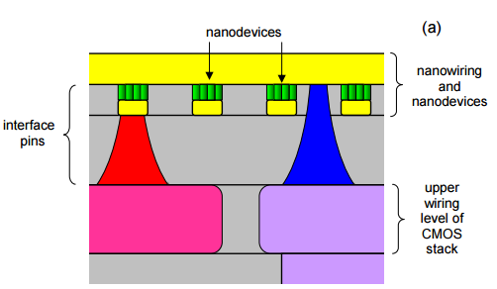
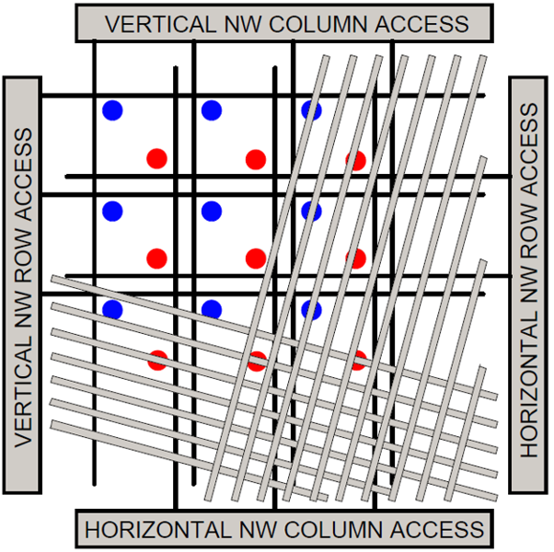
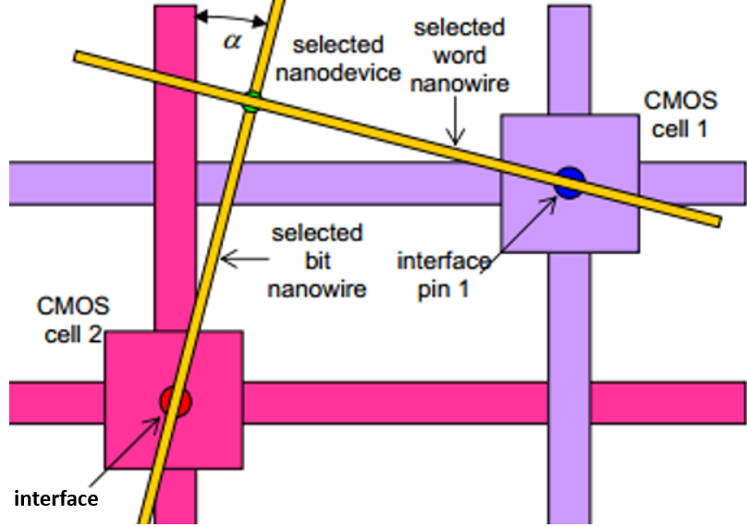
Conventional CMOL
Notes:
Observe that in this conventional CMOL architecture four CMOS decoders and one CMOS AND cell are used to select a single memristor, which plays the role of a single memory bit.

Slide 70
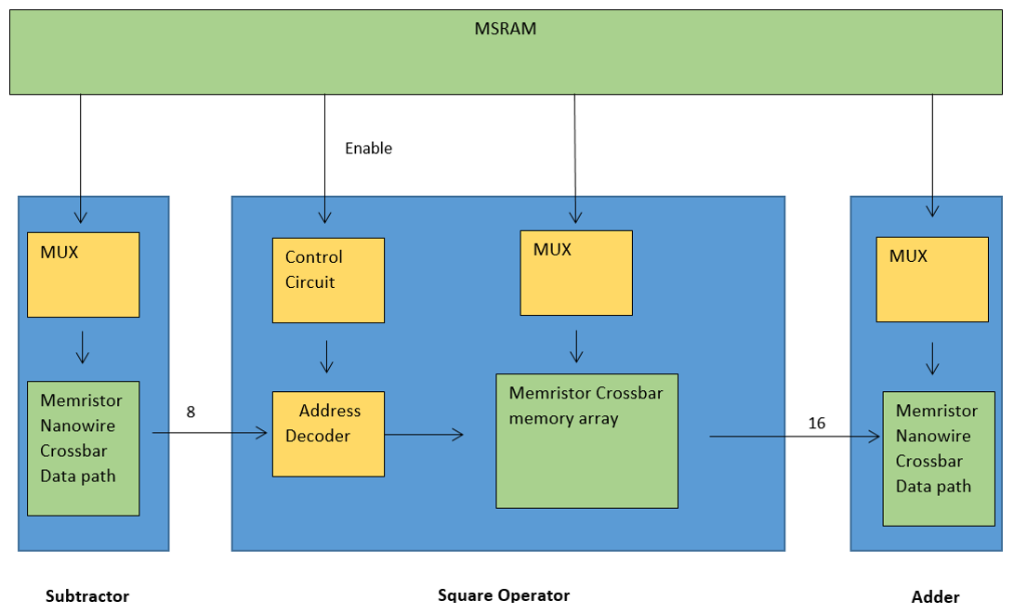
Block diagram of the square operator

Slide 71
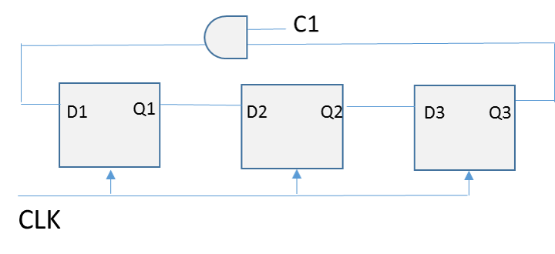
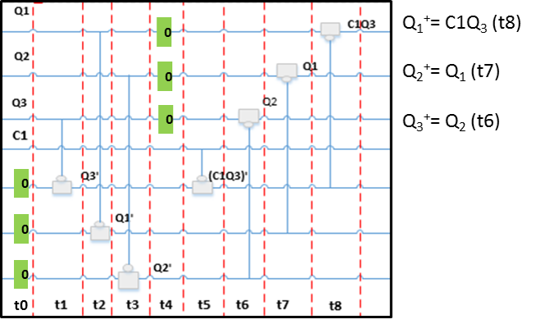
Separation between combinational and sequential logic: CMOS vs. IMPLY-memristor

