Slide 1
When God thinks about Euclidean geometry He thinks exactly the same as axioms
Of course God has more knowledge of other algebras but in Euclidean it is the same as the axioms are necessary not contingent

Slide 2
Specific Philosophical Aspects : God and Human Free Will
f
d

Slide 3
Specific Philosophical Aspects : Is creation analogy valid?
f
f

Slide 4
Zwróćmy uwage Że termin “Humanista” nie odnosi się teraz do progresisty broniącego wszystkiego co ludzkie “bo człowiek jest najwyŻszą formą stworzenia”, ale do reakcjonisty który dąŻy do przetrwania człowieka jako formy przestarzałej i niedoskonałej a nie chce dopuścić do powstania nowego Życia, pod kaŻdym względem wyŻszego. Coś jak “neandertalista”, broniący wiernie statusu Neandertalczyka przed nadchodzącym wspanialszym Pitekantropem. Humanizm jako bunt przeciw ewolucji, a zarazem moŻe przeciw Bogu?
Autor sztuki nie wypowiada jednoznacznie swego stanowiska w tym fundamentalnym konflikcie idei, pokazuje jedynie wielki problem z którym ludzkość będzie musiała się wkrótce zmierzyć. Czy moŻemy świadomie zaprzestać badan prowadzących do wspaniałego rozwoju naszego ducha w nowej, cybernetycznej formie? Czy cyborgi z kwantowymi mózgami to będziemy nadal my czy nowa forma istnienia? Czy moŻemy ryzykowac eksynkcje naszej ludzkiej rasy która dla naszych cybernetycznych dzieci będzie tak prymitywna jak pluskwy dla nas? Czy mamy przekazać pałeczkę “najwyŻszego stworzenia” nowej formie Życia w ewolucyjnym pochodzie tworczosci? Czy fakt Że Życie jest wieczne i Że “akt Stworzenia jest powtarzalny” czyni nas szczęśliwszymi jako ludzi? Czy czeka nas okrutna wojna zwolenników budowy robotów-bogów z ich przeciwnikami? I co na to Pierwszy Stwórca w rekurencyjnym łancuchu stworzenia? Raj utracony czy wyŻsze Życie odzyskane?
“Raj Utracony” są ludzie i roboty. Jest to pierwsza kompletna sztuka teatralna, w której występują roboty kontrolowane procesami kwantowymi.
Sztuka ma trzy warianty: (a) tradycyjna tekstowa sztuka - tu przedstawiona, (2) sztuka oparta na symulowanych układach I automatach kwantowych, jak to opisał Perkowski i jego zespół w szeregu publikacjach, (c) gra interaktywna ze współudziałem publiczności, jak to opisuje artykuł Perkowskiego i Żukowskiej.
Poniższy tekst odnosi się do pierwszego wariantu. Jest on kompletny lecz może być modyfikowany poprzez zastosowanie elementow drugiego czy trzeciego wariantu.
W drugim wariancie zachowanie robotów kwantowych jest opisane przez sterujace nimi automaty kwantowe, co oznacza, że zachowania są deterministyczne tak dlugo jak długo ich sterujace sekwencje stanow wewnętrznych pozostają w przestrzeni Hilberta. W momencie obserwacji (co w mechanice kwantowej jest rowne pomiarowi) nastepuja probabilistyczne skoki zachowan, ktore moga byc calkowicie nieprzewidywalne. Kiedy na przyklad stan pojedycznego sterujacego kubitu (bitu kwantowego) znajduje sie na rowniku Sfery Blocha, w momencie pomiaru nastepuje gwaltowny skok do stanu bedacego polnocnym lub poludniowym biegunem, kazdy ze skokow z prawdopodobienstwem ½. Gdyby zatem decyzja Ewy byla jednorazowa I opierala sie na pojedynczym pomiarze kwantowym dokonanym w jej obdarzonym wolnoscia wyboru mozgu, losy ludzkości mogłyby być całkowicie zmienione w zaleznosci od wyniku tego pomiaru 0 = “jem owoc”, 1 – “nie jem owocu”. Teatr ilustruje ten wybor poprzez wizualizacje kwantowego pomiaru - wybór Ewy, kiedy zjada zakazany owoc (to znaczy, instaluje nowy kwantowy mikroczip o rozszerzonej Wiedzy).
Spostrzeżenie, że zachowanie jest wymuszowne a nie całkowicie chaotyczne i probabilistyczne, jest rezultatem uwikłania kwantowego (quantum entanglement) w opisanych automatach kwantowych. Uwiklanie w ukladzie dwoch kubitow prowadzi do faktu ze ze zbioru stanow 00, 01, 10 i 11 wybierane w pomiarze sa tylko stany 00 i 11.
Jak narazie, teatr nie wykorzystuje komputera kwantowego. Wszystki kwantowe automaty są symulowane za pomocą symulatora kwantowego QUIDPRO, opracowanego w Uniwersytecie Michigan. Wszystkie inne programy pochodzą ze Stanowego Uniwersytetu w Portland.
W kontekscie tej sztuki operacje kwantowe oznaczają, że roboty w zasadzie realizuja scenariusz, ale że mogą także improwizować. (Adam, I Ewa w pewnych partiach sztuki również mogą improwizować, w ograniczonym stopniu, wypowiadając swój tekst). Z tego względu każdy fragment przedstawienia jest inny w szczegółach, chociaż dzieje się to w ramach scenariusza.
Bardziej szczegółowe informacje jak projekt scenograficzny i zdjęcia znajdują się w osobnym dokumencie.
Dokladny opis programow opartych o logike kwantową i modalną podany jest w innym dokumencie.
Inaczej niż w przypadku sztuki “Quantum Consciousnes”, która będzie pokazywana w laboratorium, to przedstawienie będzie stopniowo nagrywane na wideo a nie odgrywane przed publicznością.

Slide 5
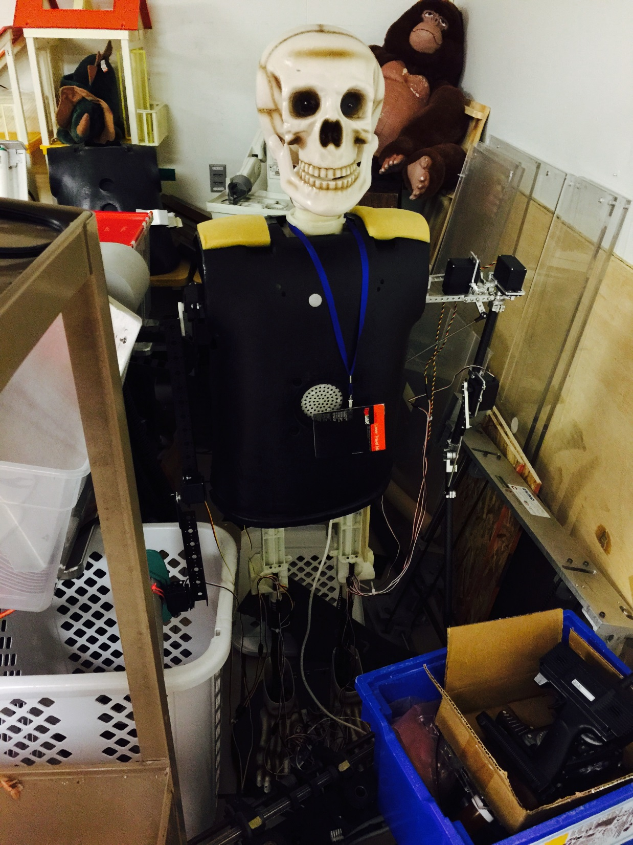
Serpent
New Adam naked
It is the same robot as Newton and Al Harizmi in Quantum Consciousness and also the original Kuwaiti Dancer
Adam

Slide 6
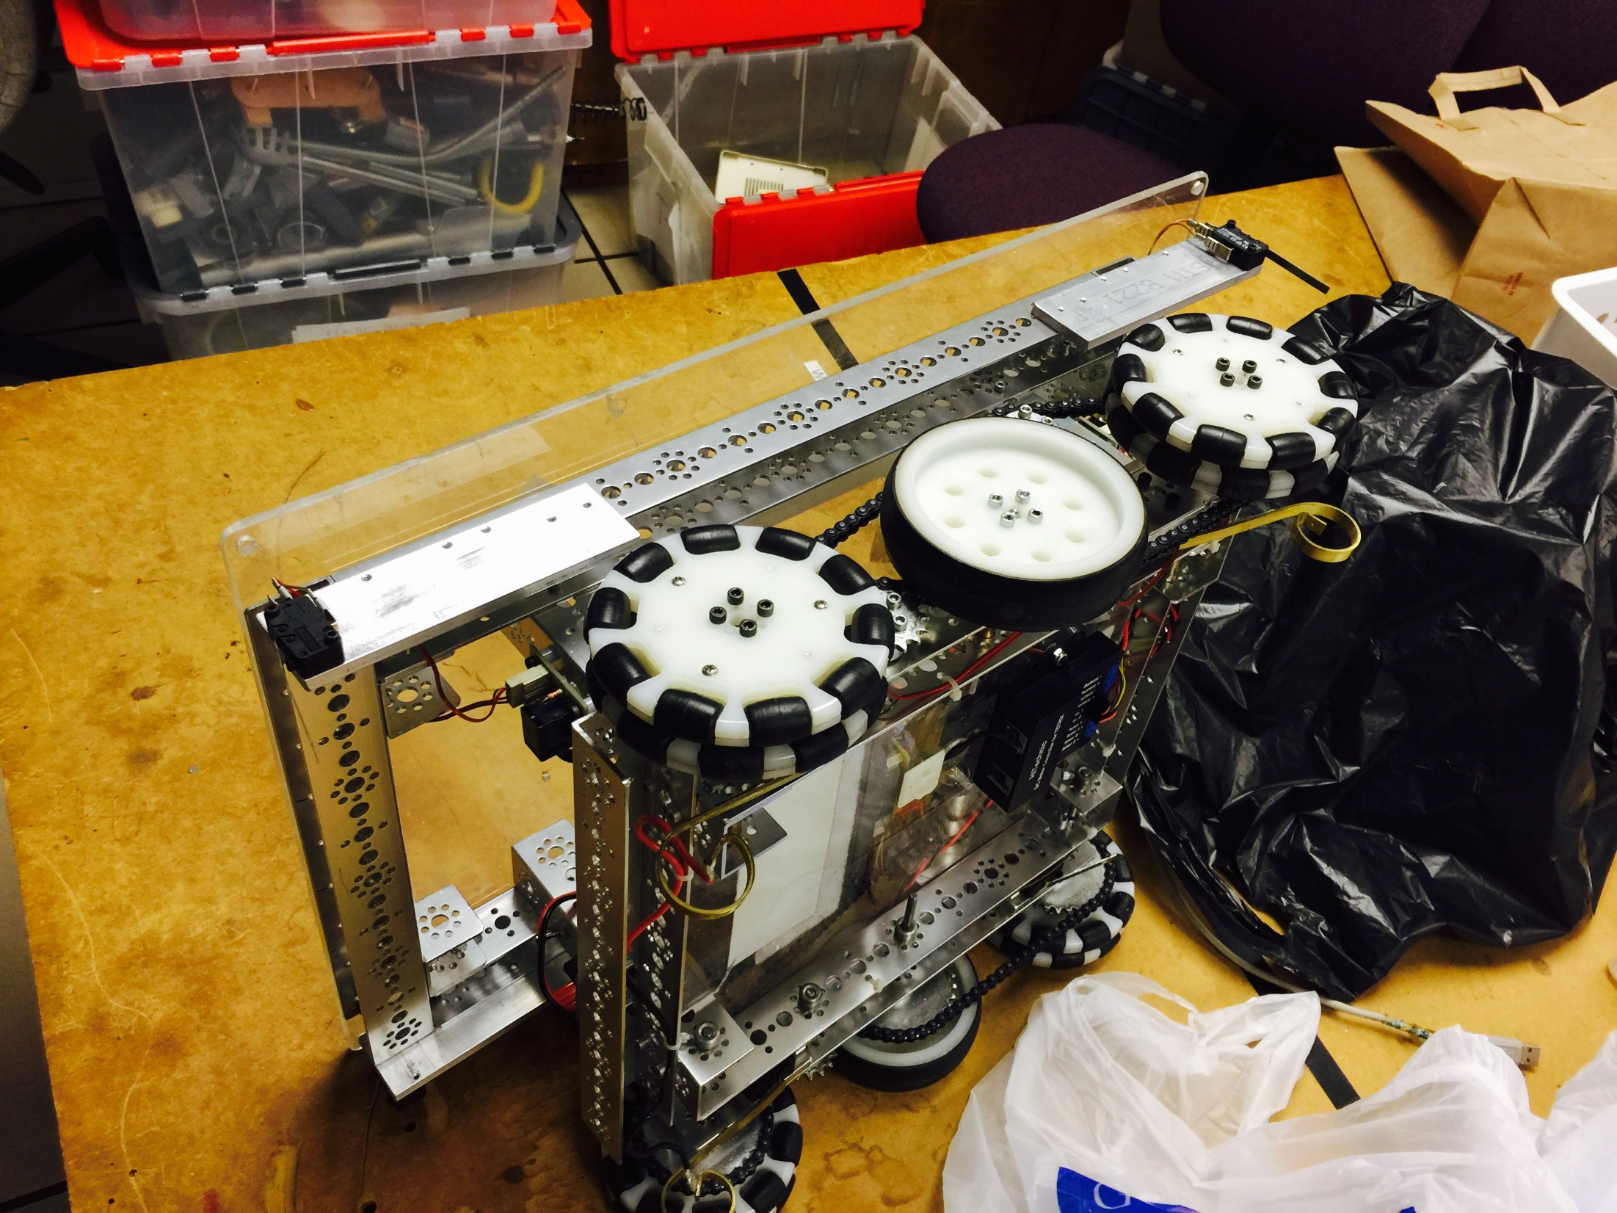
Wheeled base of new Adam

Slide 7
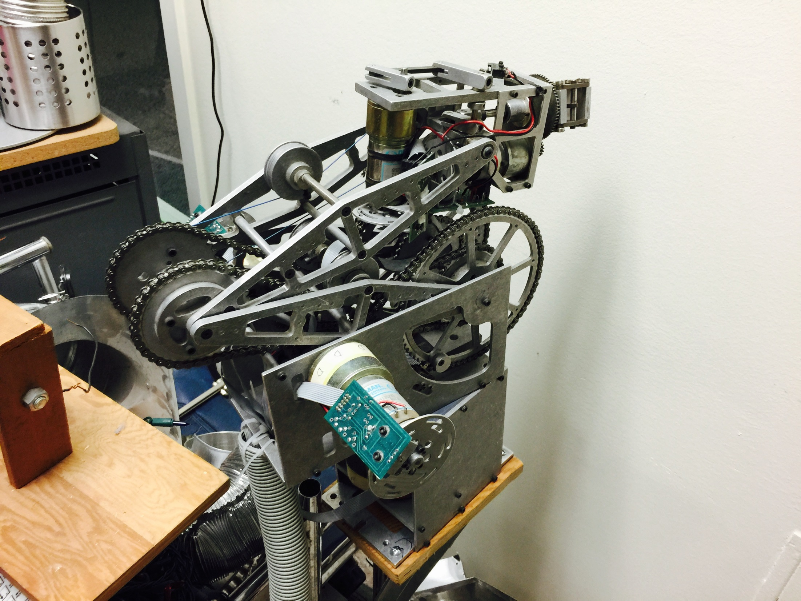
Robot that will “assemble” Adam

Slide 8
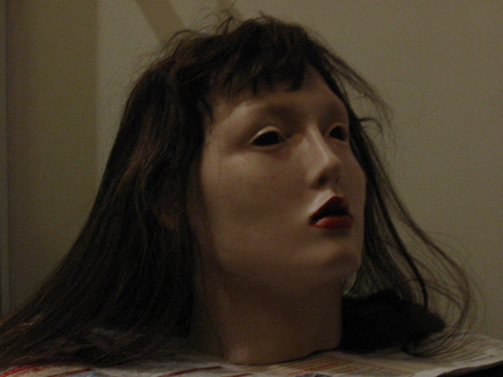
New Eve
Robots, in order of appearance
Previous Eve
The body of Confucius robot from Quantum Consciousness will be used.

Slide 9
Parts of
Tree of Knowledge of Good and Evil
and
Tree of Life

Slide 10
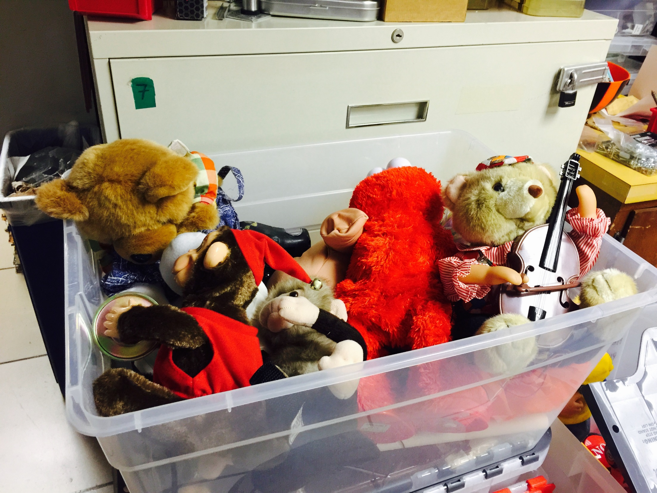
Some animals from Tree of Life

Slide 11
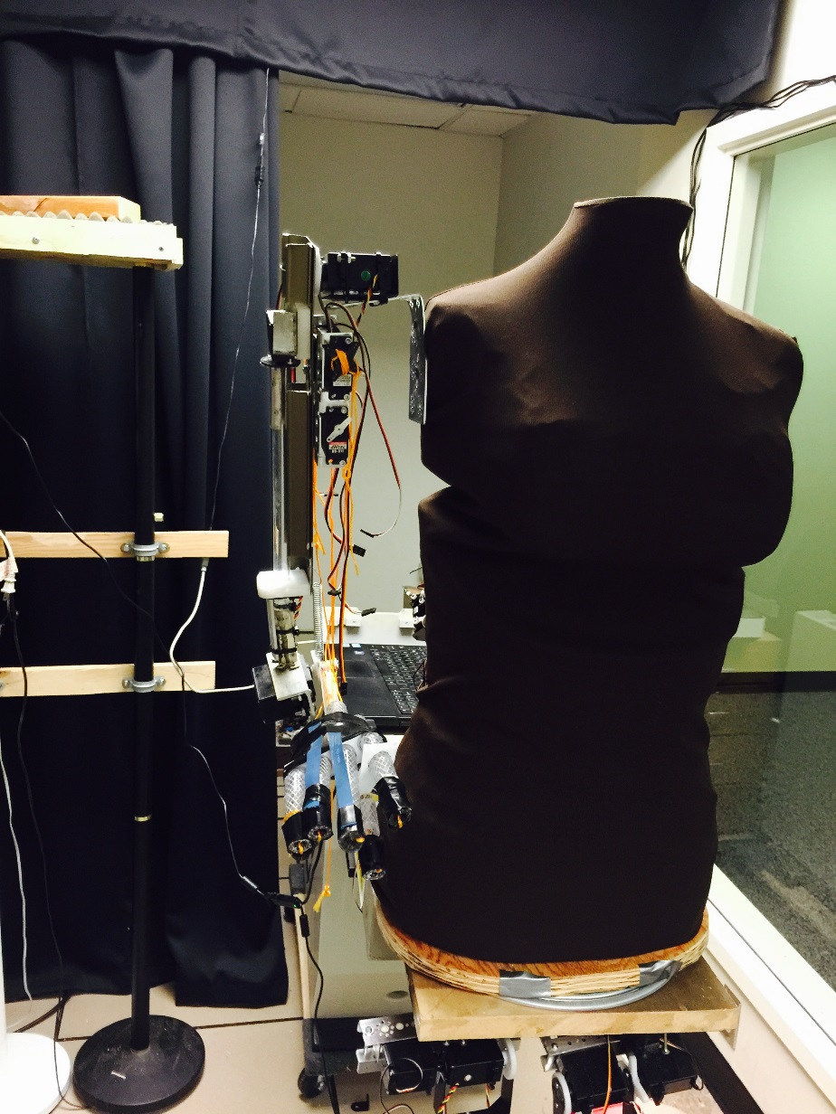
Serpent
Robots, in order of appearance
It is the same robot that plays Marie Curie-Sklodowska in play Quantum Consciousness
Right Arm of Serpent, yet naked

Slide 12
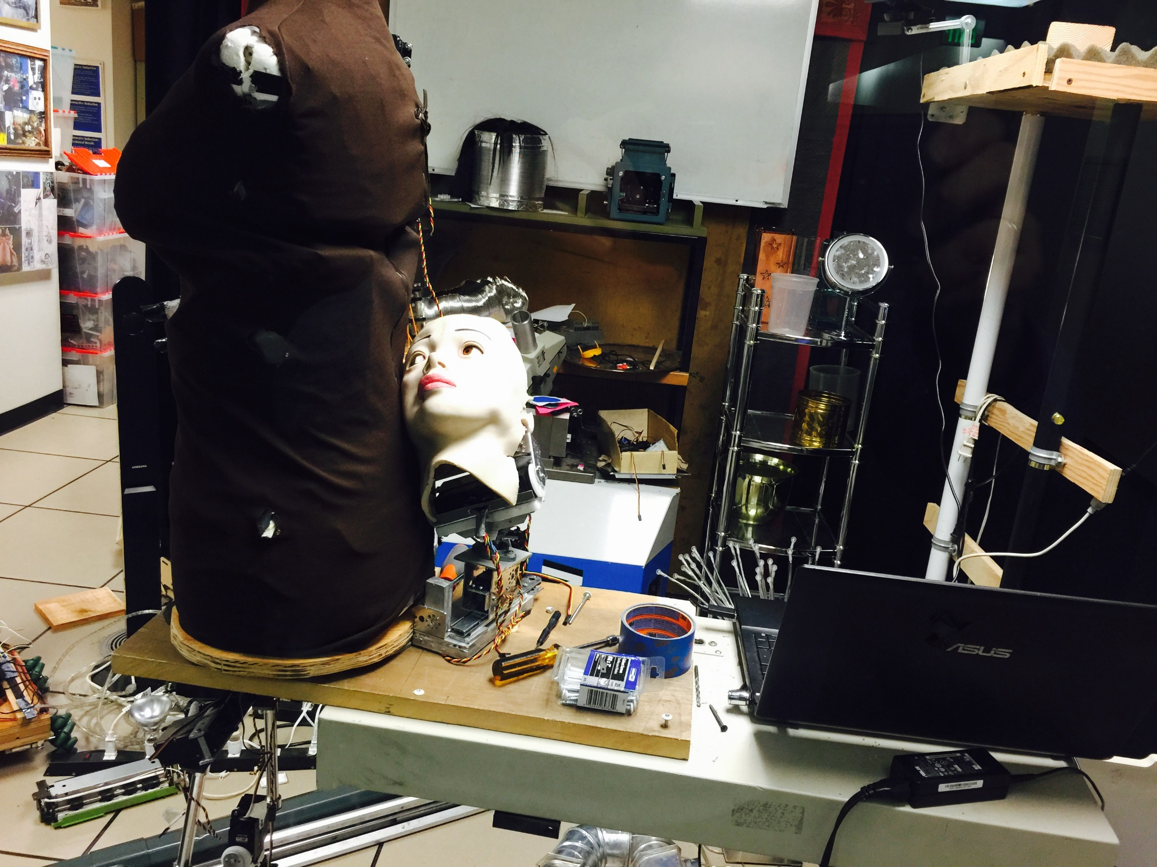
Parts of Serpent and Tree of Knowledge of Good and Evil

Slide 13
Stage design for first act
We see the stage of Portland Cyber Theatre
In back of the stage we see the red Chinese wall from bamboo
In front we see the Tree of Life, this is the (Lamarckian-like) evolutionary tree of low animals, high animals, humans, robots and electronics.
On the red Chinese wall there is a screen to which images are projected from the projector.
ROBOTS
Adam – the first human, the first super-intelligent robot,
Industrial robot that assembles Adam,
Eve –wife of Adam,
Tree of Life (many robots, animals, humans, fairy tale characters, electric boards, human and human-like heads),
Towns of Paradise (more robots, located in the large cage of fairy tale character with strange lights).
Towns of Paradise
Chinese wall
screen
Tree of life
door
window
Public located here

Slide 14
Symbol + in box, like in regular languages, means one or more repetitions.
Symbol * means no, one, two or more repetitions.
Higher number of repetitions is possible but with very small probability
Symbol [ ] means selection of one item
Symbol [ ]* means selection of one item or nothing
Symbol [[ ]] means selection of any subset

Slide 15
Part 1
Voice of Bible: Genesis Two.
(Voice of Bible and Voice of God are made by a powerful computer-controlled system of speakers mounted to the ceiling and hidden in decorations such as the tree of life).
Voice of Bible: Creation is recursive.
What happens:
PSU stage of the Intelligent Robotics Laboratory.
There is a fog that settles down showing the lab desks with oscilloscopes, generators, powers supplies, FPGAs, and robotic equipment. PCs and laptops,
and a humanoid robot, Adam, lying in front of the audience and yet not fully assembled.
Voice of Bible: (from many speakers around the lab. This is like Greek tragedy chorus).
There went up a mist from the earth,
and watered the whole face of the ground.
A1

Slide 16
Part 1A
IN PARALLEL
A1A
On the screen.:
Hands of God add the last screws to the humanoid robot Adam.
Next we see the God’s hand punching the key ENTER on a laptop.
The robot which was standing with no motion, starts to move and gesticulate its hands.
He visibly is not sure of his moving skills. God guides the robot like a father walks a little child.
What we see on stage:
Robotic arm inserts components the same way as the God does to the robot Adam.
Robot arm does exactly the same as God does

Slide 17
Part 2
In Parallel
On screen:
God, dressed in white laboratory apron like a computer science professor with long hair and long beard cleans the lab,
God sets the “paradise part” of the lab for the Adam and Eve robots.
A4
What happens:
Adam walks the lab and wonders at electronics equipment
Lightens
Voice of Bible:
And the LORD God formed man of the dust of the ground,
and breathed into his nostrils the breath of life;
and man became a living soul.
What happens:
Robot Adam gesticulates his hands.
Robot Adam dances.
Robot Adam talks.
A2
All these behaviors completely probabilistic and quantum
A5 [ ]
On screen:
God can be played by John Parker with hair not tied up.
This actor never talks, he is always silent.
His hands, often seen on the screen, should show mastery in puppet animation and robot design, tools and equipment operation.
These should be hands of a mystic and a sculptor.
A3 [ ]
Voice of Bible.
And the LORD God planted a garden eastward in Eden;
and there he put the man whom he had formed.
Voice of Bible:
And the LORD God took the man,
and put him into the Garden of Eden
to dress it and to keep it.
A6 [ ]+

Slide 18
Part 3
What happens:
A laying body of Adam looks up to tall God from the floor.
Adam robot is naked, naked as a robot not as a man.
It means we see the metal-plastic construction of his bones, muscles, motors and some electronics.
His maleness is discretely demonstrated by some hanging mechanical part.
A7
Voice of Bible:
And the LORD God commanded the man,
saying,
Voice of God:
Of every tree of the garden thou mayest freely eat:
IN PARALLEL:
A9
A8
On the screen:
God’s hand teaching the robot by the method of “motion programming by example”.
We see the graphic movement editor, the voice-based behavior editor and we can learn the process of teaching a robot.
We see the effort and the skill of the robot creator.
We see a lab (FAB-07) full of previous robotic creations and microchips, some microchips are hanging on little tree-like pedestals.
What happens on the stage:
We see a lab (FAB-07) full of previous robotic creations and microchips, some microchips are hanging on little tree-like pedestals.
What happens on the stage:
The hand points the robot to the Tree of Life on which several little robots, heads and electronics artifacts such as boards and microcontrollers full of Artificial Intelligence and Cognitive Knowledge hang.
Adam listens to God.
His body gestures demonstrate that he agrees and follows God’s command
Voice of God:
But of the Tree of the Knowledge of Good and Evil,
thou shalt not eat of it:
for in the day that thou eatest
thereof thou shalt surely die.
What happens on the stage:
Darkens
A9A

Slide 19
Part 4
A12
What happens:
Lightens
Adam: (now he already stands)
Adam listens to God.
His body gestures demonstrate that he agrees and follows God’s command.
Adam: ….yes, yes, surely…..
Voice of God: …. hahaha…
Voice of God.
It is not good that the man should be alone;
I will make him a help for him.
Voice of Bible:
And out of the ground the LORD God formed every beast of the field,
and every fowl of the air; and brought them unto Adam to see what he would call them:
and whatsoever Adam called every living creature, that was the name thereof.
What happens:
All previously built robot animals rotate on the Tree of Life in front of Adam
they are blessed by both God’s hand (on the screen) and Adam, trying to mimick God roughly and naively.
When an animal-robot approaches Adam, he gives the name to this animal.
What happens:
Adam: ….a dog.... (blesses a dog)
Tree rotates
Adam: ….an Aibo….
Adam: …..a dinosaur….
Tree rotates
Adam: …an Icybie…..
Tree rotates
Adam: ….a monkey …
Adam: ….a movie robot….
Adam: ….a hexapod…..
Tree rotates
Adam: ….a car…..
Adam: ….and what a funny thing is that.
What happens:
Adam
presses buttons on the control panel of the robot head ESRA to observe emotions.
robot shows emotions
A10
On the screen
God blesses animals.
A11+

Slide 20
Part 5
Adam: …..a truck….. (he is tired and bored)
Adam: ….a Furby…. (he falls asleep).
Voice of Bible:
And Adam gave names to all cattle,
and to the fowl of the air,
and to every beast of the field;
but for Adam there was not found an help meet for him.
Adam: is awaken
A13+

Slide 21
Part 6
Adam: (walks around, obviously tired and bored).
I am bored with these simpleton microcontrollers.
No soul,
no mind…
A14+
Voice of Bible:
And the LORD God caused a deep sleep to fall upon Adam,
and he slept:
and God took one of Adam’s ribs,
and closed up the flesh instead thereof; Adam: sleeps and snores.
A15+
On the screen:
God’s hands building another similar robot, this is a robot that will become Eve.
God removes an electronic controller board from Adam and puts it to Eve.
Adam is awakened and now he watches with big curiosity what God is doing.
He even shows God some sizes of Eve’s body and gives suggestions.
(Eve’s body is missing one male component in her body, besides she is a copy of the Adam robot).
A16+

Slide 22
Part 6A
Voice of Bible:
And the rib, which the LORD God had taken from man,
made she a woman,
and brought her unto the man.
Eve: Ohh. (as a person awaken from a deep sleep, flirtatious), ohh,….
What happens:
Eve wakes up,
Eve goes to Adam,
Eve hugs Adam
Eve kisses him…. Adam smiles. Adam is happy.
Next Eve looks around with curiosity.
Adam looks at her with wonder and admiration.
A17
Voice of Bible: And Adam said….
Adam:
deeply touched,
raises his hands to God thanking for Eve
Talks:
This is now bone of my bones,
and flesh of my flesh:
she shall be called Woman,
because she was taken out of Man.
A18

Slide 23
Part 7
Voice of God:
Therefore shall a man leave his father
and his mother,
and shall cleave unto his wife:
and they shall be one flesh.
Voice of Bible:
And they were both naked,
the man and his wife,
and were not ashamed.
What happens:
Adam and Eve joyful
play like children,
Adam chases Eve
Eve: hahah hhhaaa aahh
Eve chases Adam
both run after animals…
Total innocence.
What happens:
darkens.
Curtain closes
A19

Slide 24
Stage design in Act 2
We see the stage of Portland Cyber Theatre
In back we see the red Chinese wall from bamboo rotated, now it is a laboratory desk with screen.
In left we see the Tree of Life, the evolutionary tree of low animals, high animals, humans, robots and electronics.
On right back we see the Towns of Paradise
Red are escape routes from Paradise
Serpent is a sad woman sitting on a strange inverse pendulum, dressed in black.
ROBOTS
Adam,
Eve,
Serpent
Tree of Life (many robots, do nothing, mostly passive)
Towns of Paradise (more robots, mostly passive)
Archangel (a quadrucopter)
Towns of Paradise
Tree of life
Chinese wall
screen
Serpent on tree of Knowledge
door
window

Slide 25
Part 8
ACT II
Curtain opens.
In front we see the Tree of Knowledge of Good and Evil.
A Serpent is seen located near the Tree of Knowledge of Good and Evil.
What happens:
Serpent gesticulates with hands and legs.
As she would want to communicate something, but cannot.
Voice of Bible:
Genesis Three.
Singularity.
Recursion.
Voice of Bible: Now the serpent was more subtil than any beast of the field which the LORD God had made.
What happens:
Serpent pulls out a poster saying “Year 2050. THE Singularity is near.”
B1

Slide 26
Part 9
Serpent: Sings.
Hear this everybody, hear. The Singularity is near.
Machine Learning,
Cybernetics,
Not apologetics.
Coming true revolution:
Recursive Evolution.
Golem was right
Human race was not so bright.
Sheep mentality.
Natural stupidity
Human reason prohibited.
God’s power limited.
Superintelligence comes soon. New Species will boom.
Time to change, to modify
Intelligence will be high.
Intellect should be mechanical
Reasoning - cybernetical
Ethics - Mathematical
And body truly physical
Metal better than the flesh.
Soon the Supercomputers mesh
Triumph of Rationality End of humanity.
B2

Slide 27
Part 10
Red is not in the Bible
Decision nodes are explained in a separate document
What happens: Serpent talks to Adam. Eve looks with fear.
Voice of Bible: And the Serpent said unto the man,
Serpent: Yea, hath God said, Ye shall not eat of every tree of the garden?
Voice of Bible: And the man said unto the serpent…
Eve: We may eat of the fruit of the trees of the garden: But of the fruit of the tree which is in the midst of the garden, God hath said, Ye shall not eat of it, neither shall ye touch it, lest ye die.
Voice of Bible: And the serpent said unto the man,
Serpent: Ye shall not surely die: For God doth know that in the day ye eat thereof, then your eyes shall be opened, and ye shall be as gods, knowing good and evil.
B7
What happens: Serpent talks to Eve. Adam sleeps and snores.
Voice of Bible: And the Serpent said unto the woman,
Serpent: Yea, hath God said, Ye shall not eat of every tree of the garden?
Voice of Bible: And the woman said unto the serpent…
Eve: We may eat of the fruit of the trees of the garden: But of the fruit of the tree which is in the midst of the garden, God hath said, Ye shall not eat of it, neither shall ye touch it, lest ye die.
Voice of Bible: And the serpent said unto the woman,
Serpent: Ye shall not surely die: For God doth know that in the day ye eat thereof, then your eyes shall be opened, and ye shall be as gods, knowing good and evil.
B3
Eve refuses to eat the fruit
Decision Node 2.
Depending on feedback of the audience, random numbers and actors’ moods, a decision is made by Adam, to eat or not to eat.
Decision Node 1.
Depending on feedback of the audience, random numbers and actors’ moods, a decision is made by Eve, to eat or not to eat.
Adam refuses to eat the fruit
Adam eats the fruit
Eve eats the fruit
B4
What happens: Eve takes and gives another microchip from the tree which Adam inserts to his socket on his bosom.
What happens : Eve takes the microchip from the tree, inserts it to the socket on her bosom.
B8
B5
Voice of Bible: And when the man saw that the tree was good for food, and that it was pleasant to the eyes, and a tree to be desired to make one wise, he took of the fruit thereof, and did eat. And gave also unto her wife with him.
Voice of Bible: And when the woman saw that the tree was good for food, and that it was pleasant to the eyes, and a tree to be desired to make one wise, she took of the fruit thereof, and did eat. And gave also unto her husband with her.
B9
Eve refuses to eat the fruit
Adam refuses to eat the fruit
Decision Node 4.
Depending on feedback of the audience, random numbers and actors’ moods, a decision is made by Adam, to eat or not to eat.
Decision Node 3.
Depending on feedback of the audience, random numbers and actors’ moods, a decision is made by Adam, to eat or not to eat.
Eve eats the fruit
Adam eats the fruit
Voice of Bible: … and she did eat.
Voice of Bible: … and he did eat.
B6
B10

Slide 28
Part 11
Decision Node 5. (God‘s decides)
Depending on feedback of the audience, random numbers and actors’ moods, a decision is made by God, to eat or not to eat.
What happens : After inserting the chips their behaviors change, they are less innocent, more nervous, more aggressive. They see that they are naked.
Good Adam
B11
Adam tested again with a new wife
God tests Adam again
B15
Voice of Bible:
And Lord the God forgave Eve because of the faithfulness of Adam.
And God allowed them to stay in the Paradise
But God decided to do a one more test for them:
Of truthfulness and of intelligence.
Voice of Bible:
And so Lord the God removed Eve from the Paradise and found a new wife for Adam
Voice of Bible. And the eyes of them both were opened, and they knew that they were naked; and they sewed fig leaves together, and made themselves aprons.
What happens : Adam and Eve. Put fig leaves on their bodies.
Now we see them dressed in fig leaves.
B13
Voice of Bible:
And God gave one more chance to Adam
To choose what to do.
B12
Go to Part 31. God finds a new wife, Lillith, for Adam
B14
Go to Part 17. Adam and Eve stay in Paradise. Modal logic test.
Students have to write and extend this variant
Adam stays in Paradise with new wife
Adam, no wife, live in celibacy
stay in Paradise
Decision Node 6.
Depending on feedback of the audience, random numbers and actors’ moods, a decision is made by Adam
Voice of Bible:
And Adam decided to take no wife
He decided to stay in Paradise and just pray to God
B16
Loving Adam, stay with Eve, whatever, leaves Paradise
Bad Adam, leave Paradise, take new wife
Voice of Bible:
And so Adam decided to remain faithful to Eve whom he loved dearly
And he decided to leave the Paradise to be with her
B17
Voice of Bible:
And so Adam the first Human decided to leave the Paradise
So angry was he with Eve that he does not want to see her again.
God:
Now that you have knowledge, show that you understand how to play the Game of Life
I will test you one more time, together with your former wife.
from My Mercy.
B16A
God:
Now that you have knowledge, and human love
show that you can use the brain
that I gave you
B17A
B18
Go to Part 25. Adam and Eve are tested one more time.
Go to Part 22. Adam and Eve stay together out of Paradise. Analogy reasoning test.
Go to Part 30. Adam out of Paradise, angry.

Slide 29
Part 12
B19
Voice of Bible: And they heard the voice of the LORD God walking in the garden in the cool of the day:
Adam and Eve hiding from God behind the shelf.
Voice of Bible: and Adam and his wife hid themselves from the presence of the LORD God amongst the trees of the garden.
Adam and Eve hiding from God behind the desk.
God: Adam, Adam… Eve, where art thou?
Voice of Bible: And the LORD God called unto Adam, and said unto him,
God: Where art thou?
Voice of Bible: And Adam said,
Adam: I heard thy voice in the garden, and I was afraid, because I was naked; and I hid myself.
Voice of Bible: And God said.
God: Who told thee that thou wast naked? Hast thou eaten of the tree, whereof I commanded thee that thou shouldest not eat?
Voice of Bible: And the man said,
Adam. The woman whom thou gavest to be with me, she gave me of the tree, and I did eat.
God: Adam, Adam… not only you were the first to eat and now you blame your wife, what kind of a man are thou?
B19A
yes
Decision node 7
Adam lied?
no
To blue arrow of next page
To red arrow of next page

Slide 30
Part 13
Voice of Bible: And the LORD God said unto the woman,
God: What is this that thou hast done?
Voice of Bible: And the woman said,
Eve: The serpent beguiled me, and I did eat.
Voice of Bible: And the LORD God said unto the man,
God: What is this that thou hast done?
Voice of Bible: And the man said,
Eve: My wife whom I dearly love beguiled me, and I did eat.
B20
B21
Voice of Bible:
And the LORD God
said unto the serpent,
God:
Because thou hast done this,
thou art cursed above all cattle,
and above every beast of the field;
upon thy belly shalt thou go,
and dust shalt thou eat all the days of thy life:
Voice of Bible:
Unto the woman the LORD God said,
God:
I will greatly multiply thy sorrow and thy conception;
in sorrow thou shalt bring forth children;
and thy desire shall be to thy husband,
and he shall rule over thee.
B22

Slide 31
Part 14
B23
Voice of Bible:
And unto Adam the LORD God said,
God:
Because thou hast hearkened unto the voice of thy wife,
and hast eaten of the tree,
of which I commanded thee, saying,
Thou shalt not eat of it:
cursed is the ground for thy sake;
in sorrow shalt thou eat of it all the days of thy life;
Voice of Bible:
And Adam called his wife's name Eve;
because she was the mother of all living.
Adam and Eve leave the stage
Voice of Bible:
Unto Adam also and to his wife did the LORD God make coats,
and clothed them.
Adam and Eve, come back, dressed in ancient Chinese costumes.
Voice of Bible:
And the LORD God said
God:
Behold,
the man is become as one of us,
to know good and evil:
and now,
lest he put forth his hand,
and take also of the tree of life,
and eat,
and live for ever:

Slide 32
Part 15
Out of Paradise
Voice of Bible: Therefore the LORD God sent him forth from the garden of Eden, to till the ground from whence he was taken.
Archangel Michael (a quadrucopter with laser lights).
Makes rounds around the space
Goes to back left
Goes to back right
Goes to front door
Should I remove them there? (shows various locations)
Archangel Michael : If I remove them through the front door you can have them for your questions.
Audience (gives directions where they should be removed)
B24
Decision Node 7
Public decides what to do with Adam and Eve
To front door
To back corridor
Voice of Bible:
So the Archangels drove out the man and the woman;
and they were placed among others
To testify about God
What Happens
Adam and Eve leave the front door of the lab and are ready to answer questions.
Curtain closes.
B25
To left corridor
Voice of Bible:
So the Archangels drove out the man and the woman;
and they were placed at the east of the garden of Eden Cherubims,
and a flaming sword which turned every way,
to keep the way of the tree of life.
Voice of Bible:
So the Archangels drove out the man and the woman
B26
B27
Archangel Michael:
Removes Adam and Eve from paradise
Comes back and guards
B25A
Sounds: of Abel, Kain, wars, revolutions.
B26A
THE END
To next page
To next page

Slide 33
Part 16
B28
What happens:
Archangel Michael quadrucopter returns back to the stage
IN PARALLEL SCREEN:
Archangel Michael returns and puts the flaming sword at the feet of God. He kneels before the God in silence. Few animals returns to God from the outside of paradise.
Lights go slowly off.
Silent music interrupted with sounds of atomic bombs exploding.
God’s Voice:
Freedom of choice.
Creation is recursive
Singularity
Curtain closes
THE END

Slide 34
2.3.1. An example of Modal Reasoning. (the smartest reasoning in this case)
Part 17
God:
At least one of you committed a sin.
If you know that you committed a sin,
please come forward.
Voice of Bible:
And they started to use their newly gained faculties,
reasoning in modal logic
Adam:
Eve definitely has committed a sin, eating a fruit and giving it to me.
I see her sin but I am not certain about myself.
I just was a good husband.
I see also sin in her face,
but I cannot see my own face.
If she should confess that she sinned
I would think even with more assurance that I did not.
B29
Eve:
Adam definitely has committed a sin,
eating a fruit and not protesting to eat.
He has been longer than me in Paradise so he knows what God wants.
I am just a woman.
I see his sin in his face and behavior,
but I am not certain about myself.
I cannot see my own face and myself objectively.
But he is silent.
If he would know he sinned,
he would acknowledge.
B30

Slide 35
Part 18
IN PARALLEL
Adam:
God is silent.
What does it mean?
Why Eve did not speak?
Eve:
God is silent.
What does it mean?
Why Adam did not speak?
B31
IN PARALLEL
Adam:
Eve is uncertain.
But I know she sinned.
Eve:
Adam is uncertain
But I know he sinned.
B32

Slide 36
Part 19
Adam:
God knows what I think.
He knows what Eve thinks.
He knew that I know that Eve sinned.
I know that Eve sinned.
But I was not asked about her, I was asked to testify about me.
I may sinned or not.
What Eve knows?
She knows that I am sinful or that I am not sinful.
If she saw that I did not sin, she would come and say that she sinned, obeying God who told “at least one”.
So she knows that I sinned.
God did not tell that one human sinned.
God told “at least one”.
So I am still uncertain.
I suppose Eve is in the same state as me.
So she knows I am a sinner.
But I also do not come forward.
I know she is a sinner.
But she would come forward if I were not a sinner.
So I am a sinner.
B33

Slide 37
Part 20
Eve:
God knows what I think.
He knows what Adam thinks.
He knew that I know that Adam sinned.
I know that Adam sinned.
But I was not asked about her, I was asked to testify about me.
I may sinned or not.
What Adam knows?
He knows that I am sinful or that I am not sinful.
If he saw that I did not sin, he would come and say that he sinned, obeying God who told “at least one”.
So he knows that I sinned.
God did not tell that one human sinned.
God told “at least one”.
So I am still uncertain.
I suppose Adam is in the same state as me.
So he knows that I am a sinner.
But I also do not come forward.
I know he is a sinner.
But he would come forward if I were not a sinner.
So I am a sinner.
B34

Slide 38
Part 21
God.
At least one of you sinned.
Please come forward,
if you think that you sinned.
B34A
IN PARALLEL
Adam:
I am a sinner.
Eve:
I am a sinner.
B35
God.
You passed the test of Truthfulness.
You proved also to understand Higher Order Logic
Thou will stay in a Paradise and be smart and happy,
Grow and multiply .
B35A
Go to Part 8

Slide 39
2.3.2. An example of Reasoning by Analogy. (the standard reasoning in this case)
Part 22
God:
At least one of you committed a sin.
If you know that you committed a sin, please come forward.
Adam:
Eve definitely has committed a sin,
eating a fruit and giving it to me.
I see her sin but I am not certain about myself.
I just was a good husband.
I see also sin in her face, but I cannot see my own face.
If she should confess that she sinned I would think even with more assurance that I did not.
Assuming that she is like me, God created us together, I perhaps am also guilty.
B36

Slide 40
Part 23
Eve:
Adam definitely has committed a sin,
eating a fruit and not protesting to eat.
He has done what I have done.
I am perhaps also guilty.
B37
IN PARALLEL
Adam:
God is silent
What does it mean?
Why Eve did not speak?
B38
Eve:
God is silent
What does it mean?
Why Adam did not speak?
God.
At least one of you sinned.
Please come forward,
if you think that you sinned.
B38A
IN PARALLEL
Adam:
I am perhaps a sinner.
B39
Eve:
I am perhaps a sinner.

Slide 41
Part 24
God:
There is no “perhaps”.
Let your speech be Yes-Yes, No-No.
You will leave Paradise.
And do start to think well,
to be sure of the Truth.
B40
IN PARALLEL
Adam:
Thank you God
Thank you that You allowed me to stay with Eve
B41
Eve:
Thank you God
Thank you that You allowed me to stay with Adam
God.
You are welcome
B42
IN PARALLEL
Adam:
Leaves together with Eve, happy singing.
B43
Eve:
Leaves hugging Adam, happy singing.
Go to part 15

Slide 42
Part 25
2.3.3. An example of Prisoner Dilemma-like Game-Theoretical Reasoning. (the stupidest reasoning although following Nash Game Theory).
God:
At least one of you committed a sin.
If you know that you committed a sin, please come forward.
Adam:
Eve definitely has committed a sin, eating a fruit and giving it to me. I did commit the same sin.
But if I testify that she did a sin and I will be silent about me, then what she can do, not knowing my testimony.
If she would remain silent God will penalize me and her with only a small penalty. Like -1.
Buy if she would say “Adam ate the fruit and I was just afraid of him because he is stronger?”
Then God would throw me away from Paradise and leave Eve here and give her a new husband. My loss would be -10.
And what if testify against her? If she stays silent God would throw her away from Paradise. So her loss would be -10 and my loss would be 0 as I would get a new wife.
And what if would blame her and she would blame me? God would perhaps be angry for a moment but we will both stay in Paradise. So my loss would be -3 and her loss would be -3.
Serpent:
Use a rational method, use decision theory
Adam:
Adam creates a decision table (at the advice of the Serpent).
It looks like this.
Eve:
Observes what Adam does.
B44

Slide 43
Part 26
On Screen
Adam’s Choices\Eve’s Choices | Eve stays silent | Eve blames Adam
Adam stays silent | Adam is penalized lightly -1 Eve is penalized lightly -1 | Adam is thrown out of Paradise= penalized harshly -10 Eve stays in Paradise and gets a new wife = Eve’s penalty =0 | If Adam stays silent his expectation is being penalized -11
Adam blames Eve | Eve is thrown out of Paradise= penalized harshly -10 Adam stays in Paradise and gets a new wife = Adam’s penalty =0 | Adam is penalized moderately -3 Eve is penalized moderately -3 | If Adam blames Eve he is penalized -3, so it is reasonable for him to blame Eve, although he would be penalized only -1 if he would remain silent
 | If Eve stays silent she is penalized -11 | If Eve blames Adam she is penalized -3, so it is reasonable for her to blame Adam, although she would be penalized only -1 if she would remain silent | As we see the Serpent’s advice to act rationally is the worst irrational advise at this time
B45

Slide 44
Part 27
Eve:
Adam definitely has committed a sin, eating a fruit and giving it to me. I did commit the same sin.
But if I testify that he did a sin and I will be silent about me, then what he can do, not knowing my testimony.
If he would remain silent God will penalize me and him with only a small penalty. Like -1.
Buy if he would say “Eve ate the fruit and I was just afraid of her because she is psychologically stronger?”
Then God would throw me away from Paradise and leave Adam here and give him a new wife. My loss would be -10.
And what if I testify against him? If he stays silent God would throw him away from Paradise. So his loss would be -10 and my loss would be 0 as I would get a new husband.
And what if I would blame him and he would blame me? God would perhaps be angry for a moment but we will both stay in Paradise. So my loss would be -3 and his loss would be -3.
Serpent:
Good girl, good girl. You think rationally using the Game Theory of Nash.
Voice of Bible:
And Eve created a decision table
And it looked exactly like the one created by Adam.
B46

Slide 45
Part 28
IN PARALLEL
Adam:
God is silent.
What does it mean?
Why Eve did not speak?
Eve:
God is silent.
What does it mean?
Why Adam did not speak?
B47
IN PARALLEL
Adam:
Eve is uncertain.
But I know it is rational to blame her..
Eve:
Adam is uncertain.
: But I know it is in my interest to blame him in front of God.
B48

Slide 46
Part 28A
God.
At least one of you sinned.
Please come forward,
if you think that you sinned.
B49
IN PARALLEL
Adam:
Eve did this
She is a sinner
Eve:
Adam did this
He is a sinner
B50
B51
God:
If you both would stay silent the total loss of both of you would be (-1) + (-1) = (-2).
But because of your irrational choice you will be penalized,
You, Adam, and you, Eve, for a total loss of both of you equal to (-3) + (-3) = -6.
Calculate for yourself and be truly rational.

Slide 47
Part 29
God:
Because now you are the entire Human Race,
The Human Race is penalized by this choice.
This choice will haunt your children and children of your children
Until you will learn how to think really rationally
Calculate for yourself and be truly rational.
B52
IN PARALLEL
Adam:
Our Children penalized for our sins?
Eve:
This is not fair, God.
B53
God.
This is a Singularity
B54
Go to Part 15, out of Paradise

Slide 48
Adam out of Paradise, no wife, angry
Part 30
Left for students

Slide 49
Part 31. God finds a new wife, Lillith, for Adam
For students.

