Slide 1
Meccano and Omni wheeled Vehicles

Slide 2
Famous Mobile Robots

Slide 3
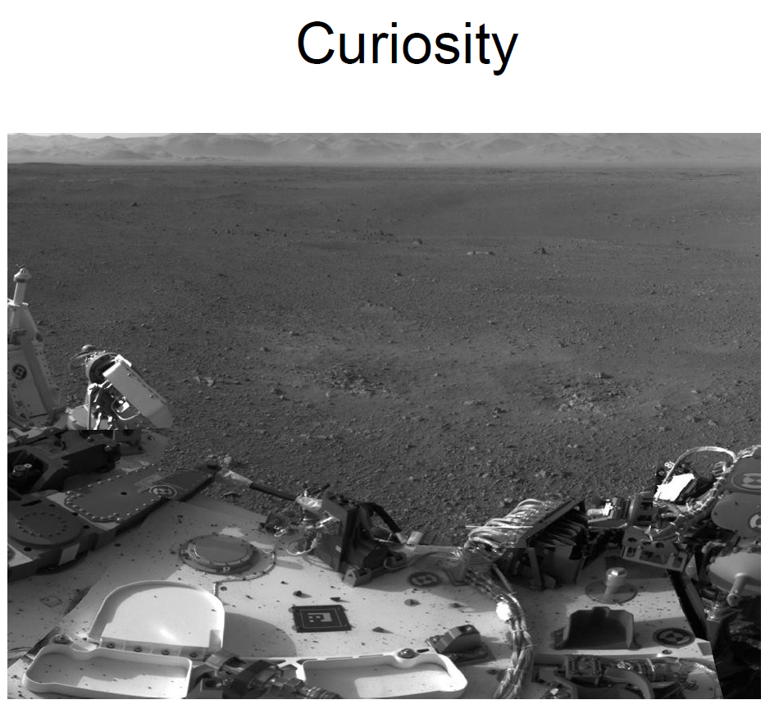

Slide 4
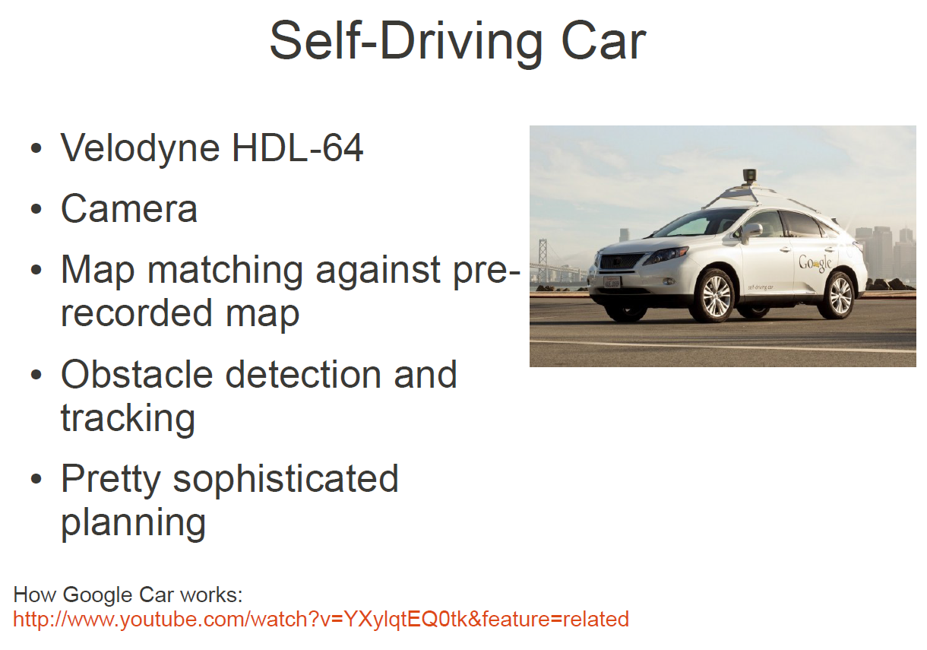

Slide 5
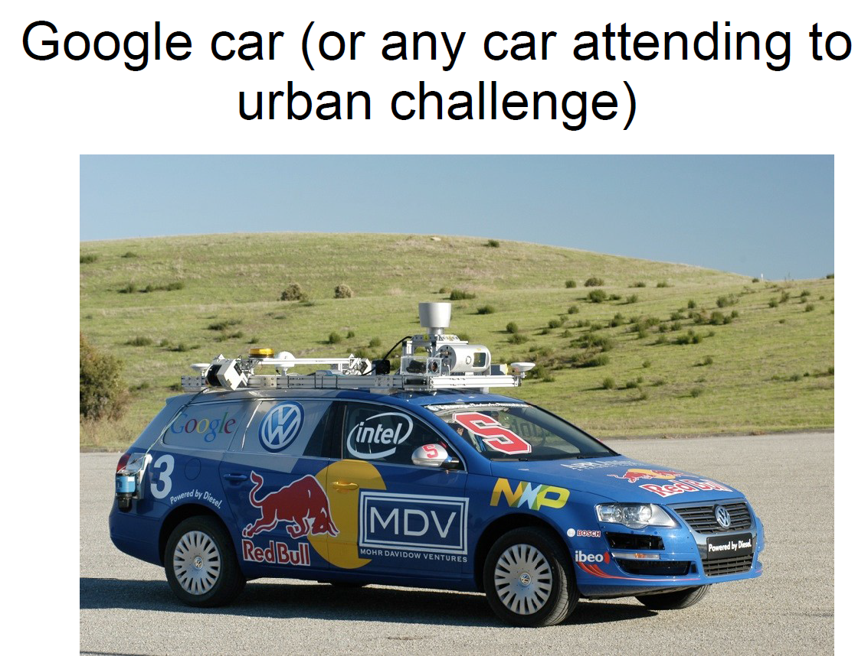

Slide 6
Driving Robots

Slide 7
Driving Robots
Driving robots can be:
  • 1. Non-Holonomic
  • 2. Holonomic (Omni-Directional)
  • 3. Wheels
  • 4. Tracks

Slide 8
Single Driven Wheel

Slide 9
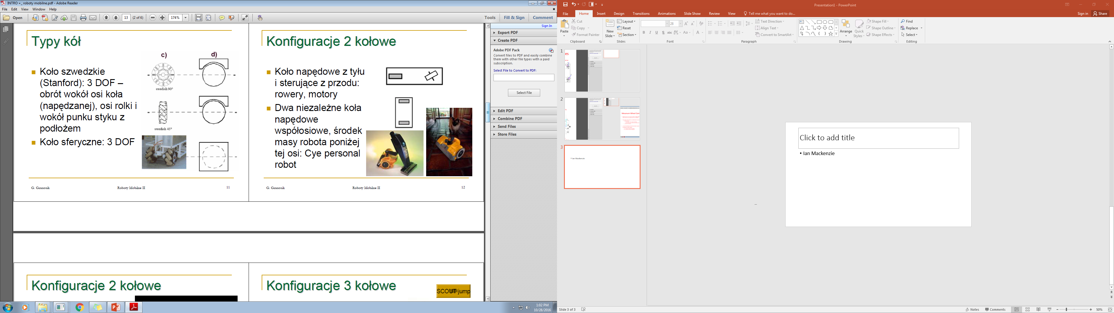
Types of wheels = vehicles with single driven wheel
Meccano Wheels

Slide 10
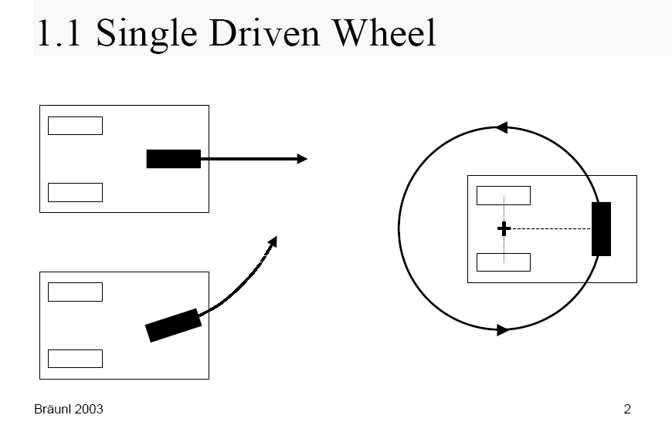
Single Driven Wheel

Slide 11
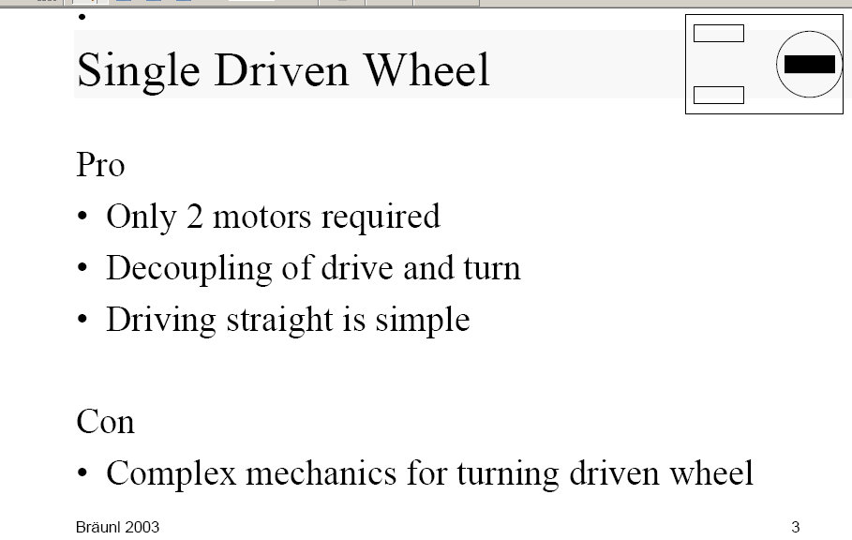
What is good and bad about this design?

Slide 12
Two Driven Wheels

Slide 13
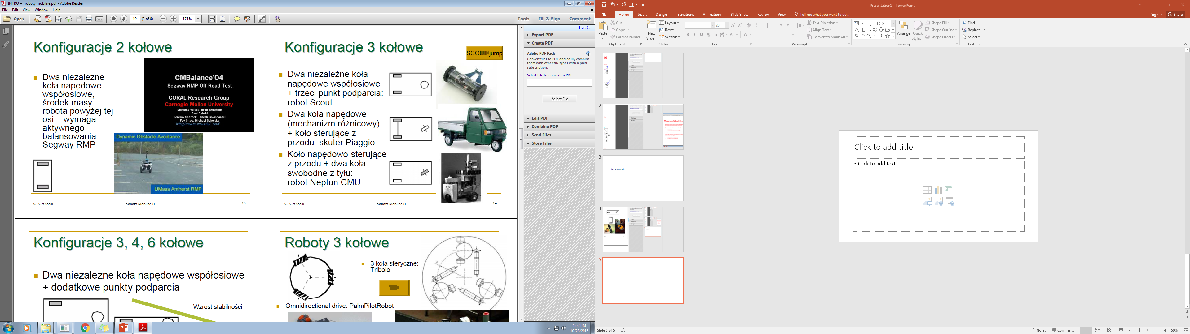
Two-Wheeled vehicles
Three-wheeled vehicles
Two-wheeled vehicles
Robot Scout
Segway RMP
Scuter Piaggio
Robot Neptun CMU

Slide 14
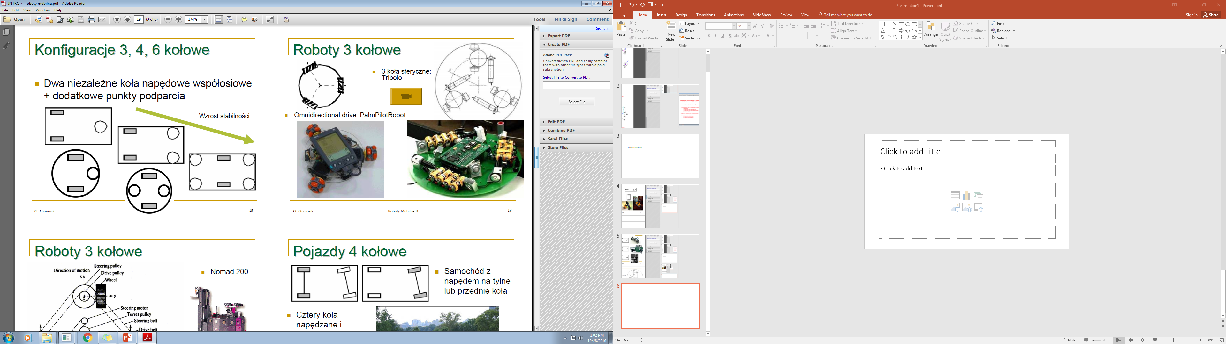
Robots with 2 wheels and additional support points
Increase of stability

Slide 15
Differential Drives

Slide 16
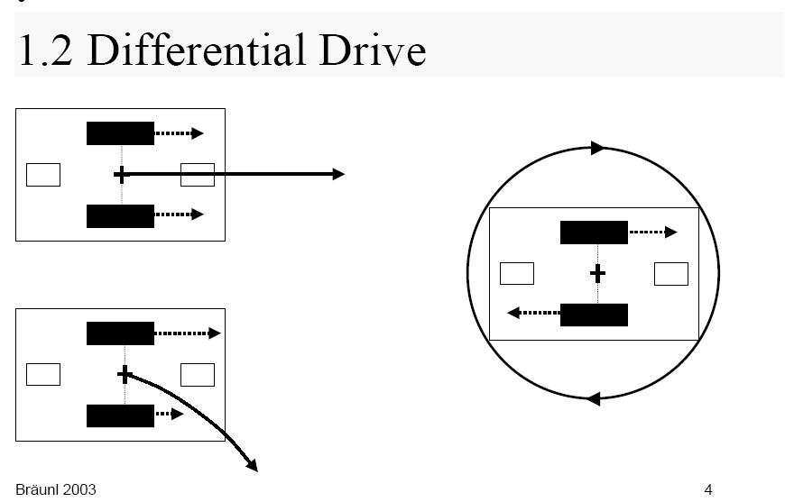
Differential Drive

Slide 17
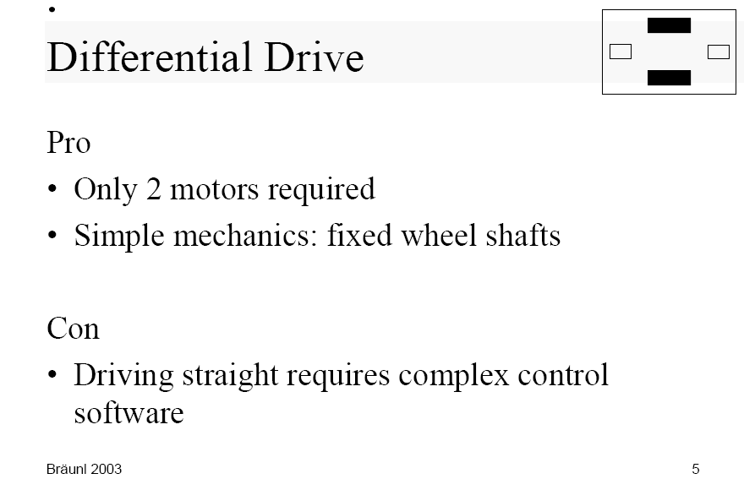
What is good and bad about this design?

Slide 18
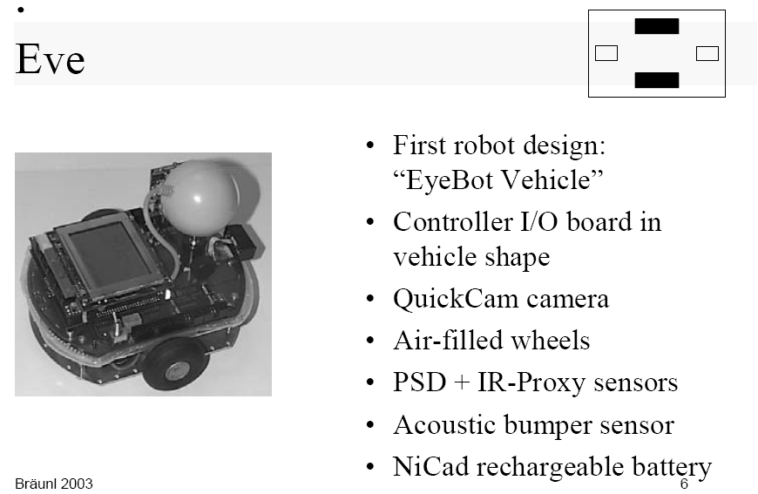
Example of Differential Drive Design: Robot Eve of Braunl

Slide 19
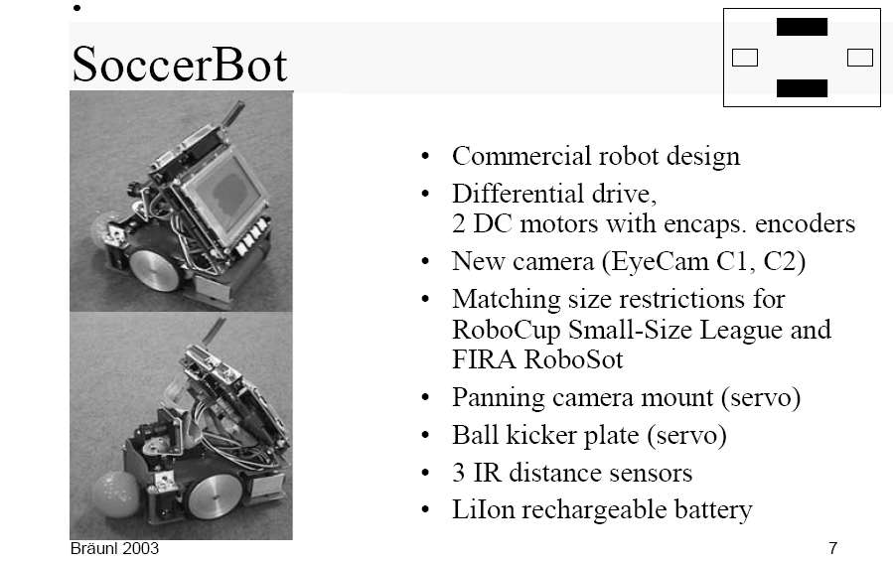
Another Example of Differential Drive Design: Robot SoccerBot for robot soccer competitions

Slide 20
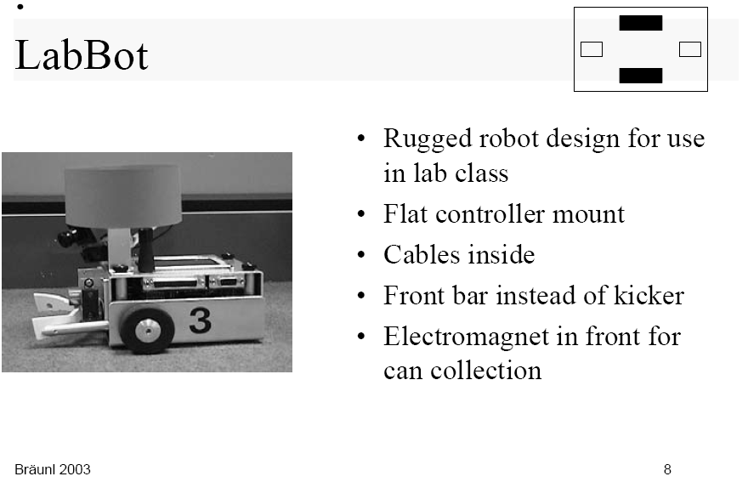
Another Example of Differential Drive Design: Laboratory wheeled robot LabBot

Slide 21
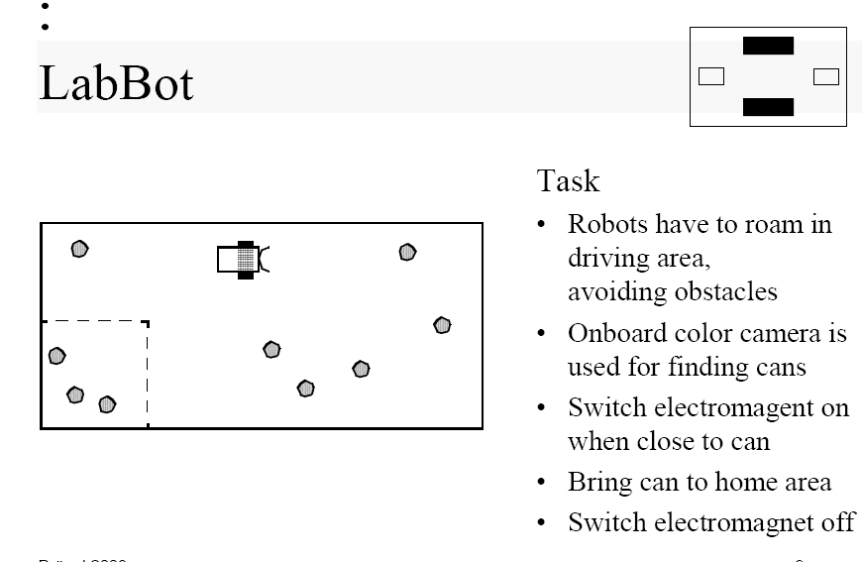

Slide 22
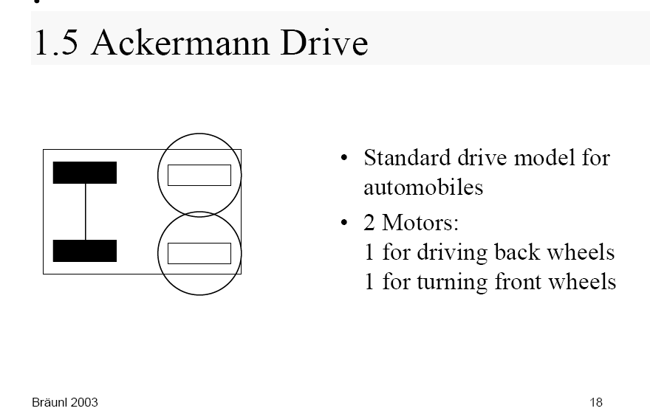
Ackermann Drive

Slide 23
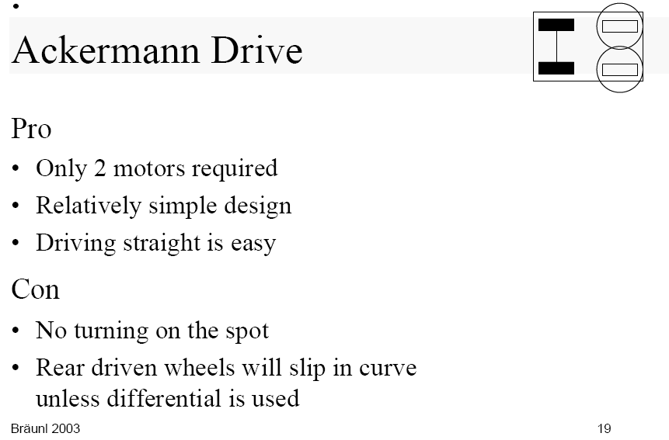

Slide 24
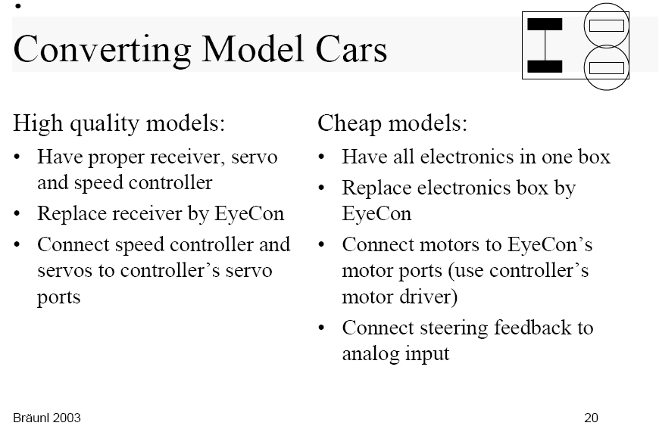
Application of Ackerman Drives

Slide 25
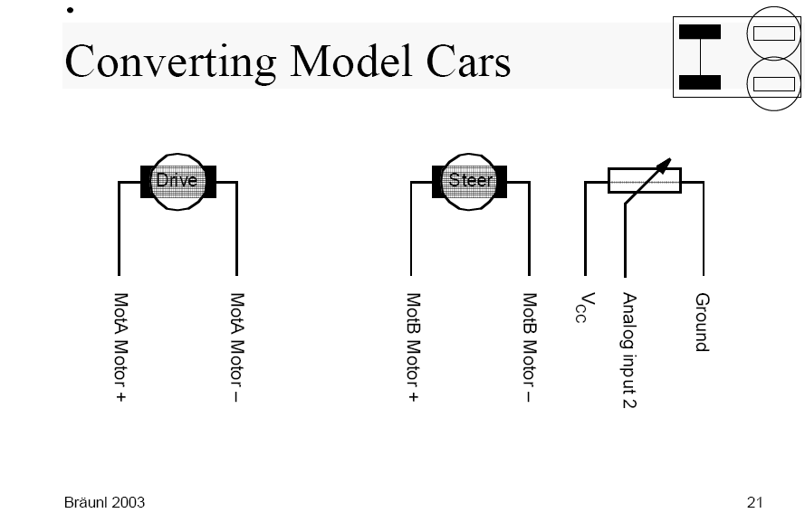
Driving motor A
Steering motor B

Slide 26
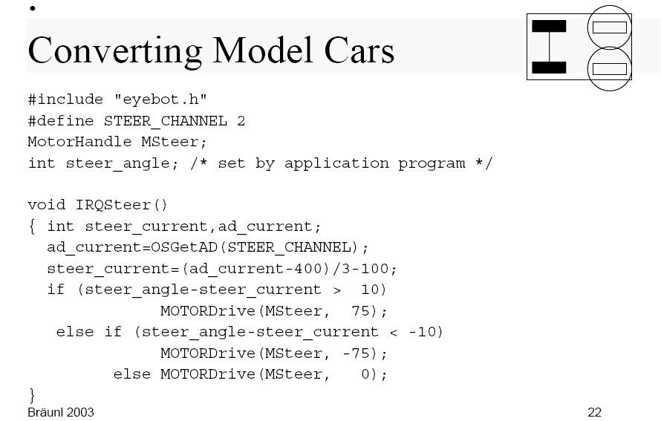
Steering motor control with respect to variable steer_angle

Slide 27
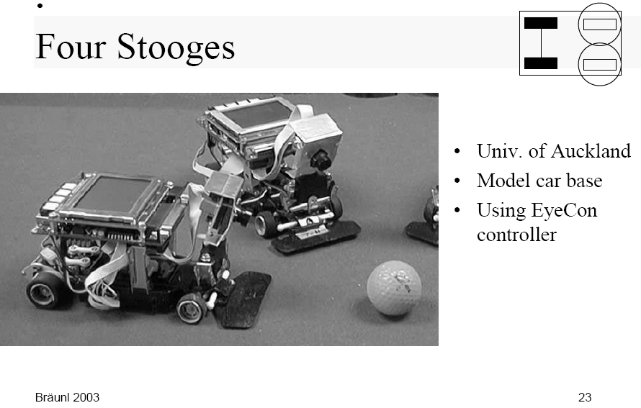
Example of Ackerman Drive Robot: Four Stooges

Slide 28
Three Driven Wheels

Slide 29
Robots with 3 wheels
3 spheric wheels Tribolo

Slide 30
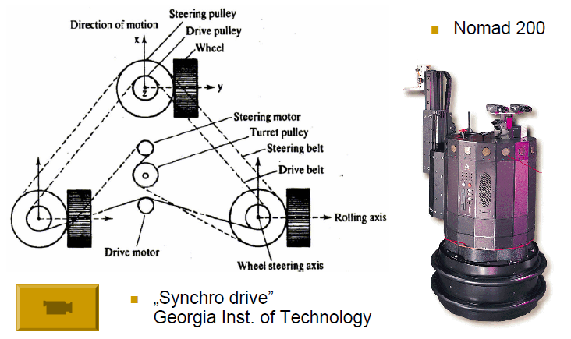
Robots with three wheels

Slide 31
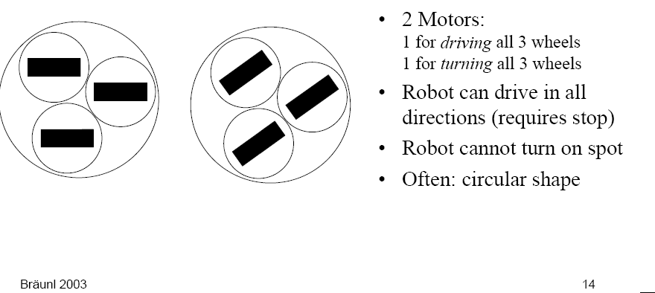
Synchro-Drive

Slide 32
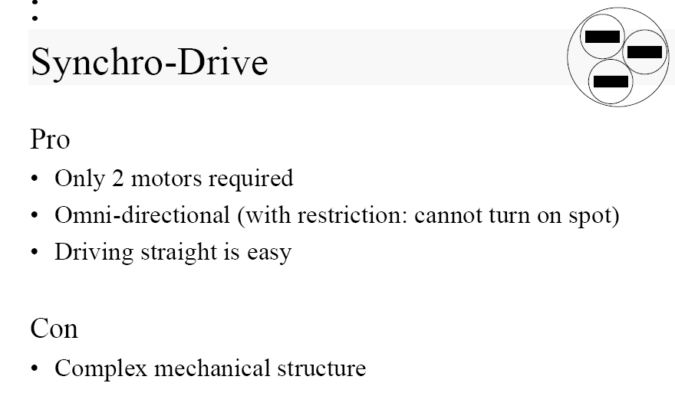
What is good and bad about Synchro-Drives?

Slide 33
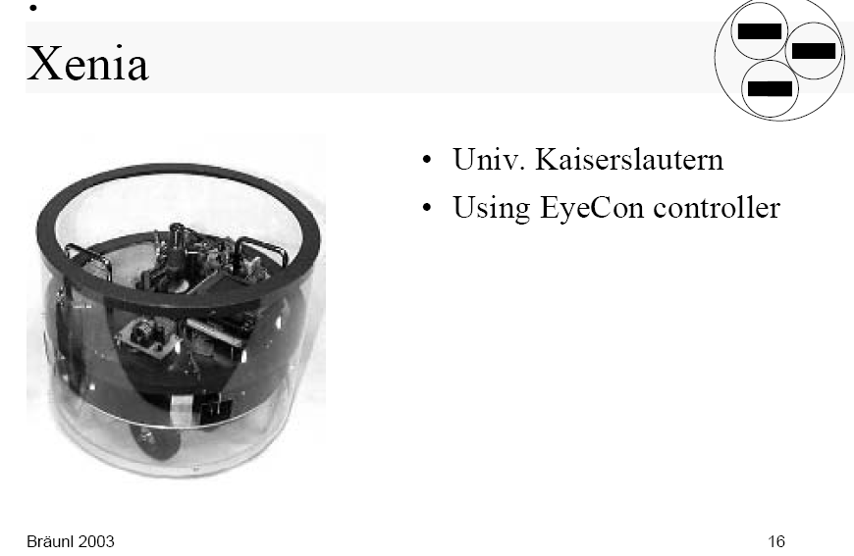
Example of Synchro-Drive robot design: XENIA

Slide 34
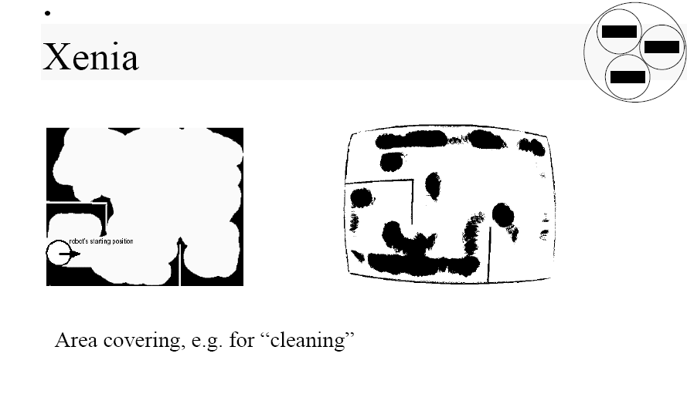

Slide 35
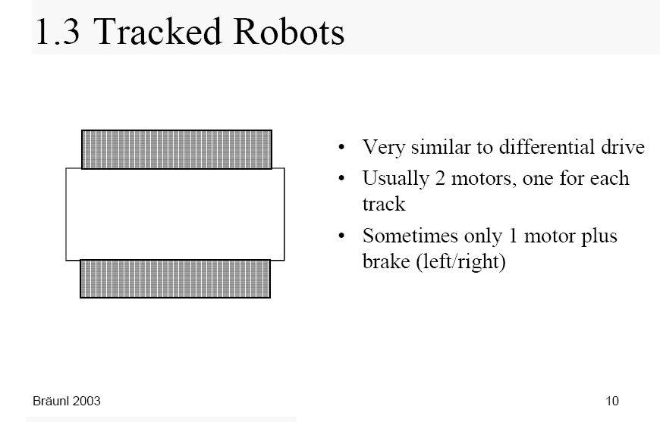
Tracked Robots

Slide 36
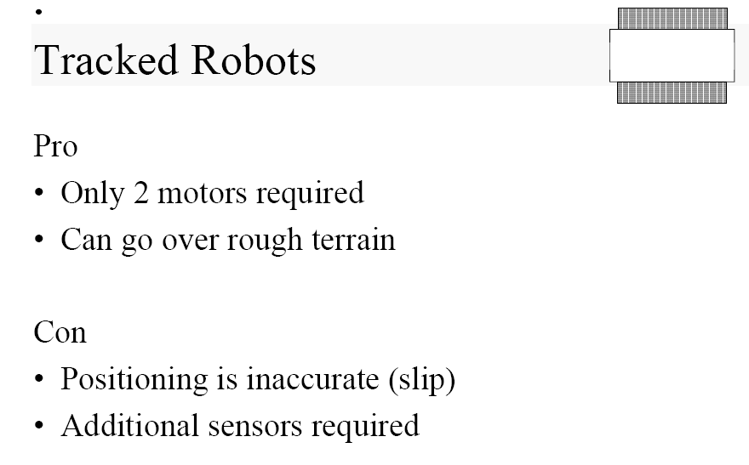
What is good and bad about Tracked Robots?

Slide 37
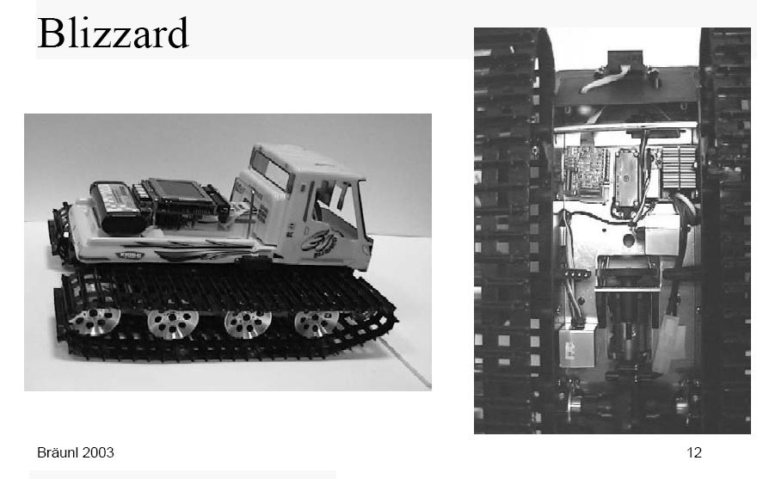
Example of Tracked robot: Blizzard
Reuse your old toys or steal from your kids

Slide 38
