Slide 1
examples
Robot Arms

Slide 2
Stationary Robot

Slide 3
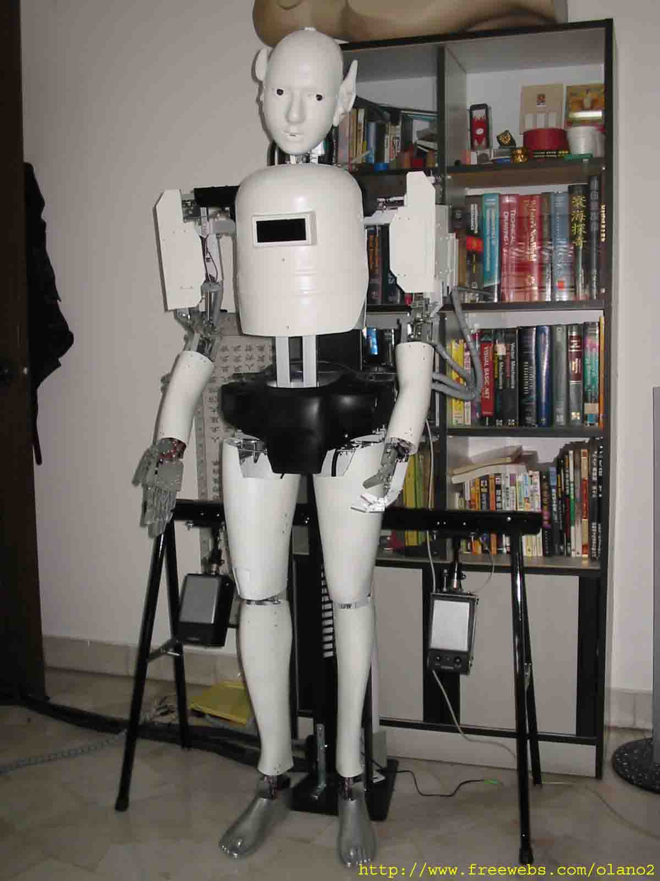
Robot actor
Does not walk
Has realistic body proportions, including legs
Hangs from behind.
Similar to our SONBI

Slide 4
PNEUMATIC ROBOTS

Slide 5
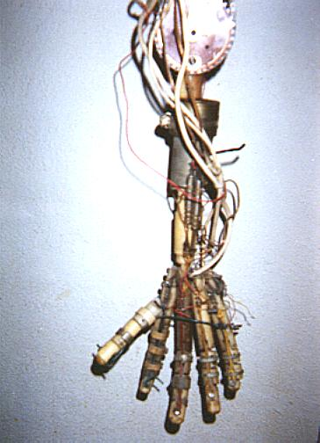
Use of pneumatics

Slide 6
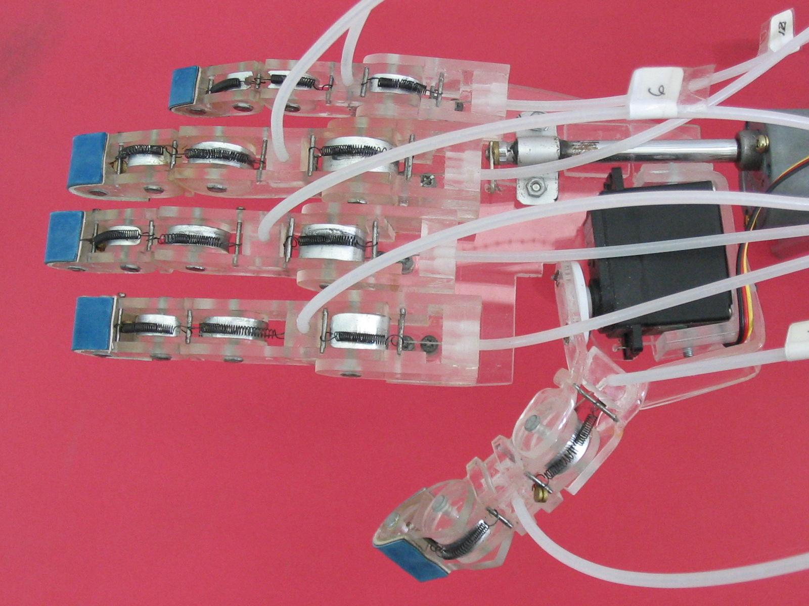
Combine pneumatics, springs and electric control

Slide 7
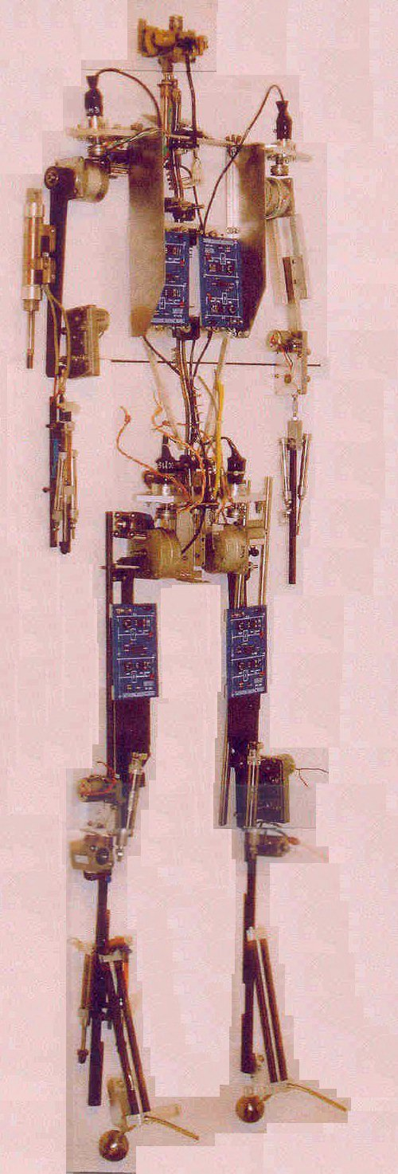
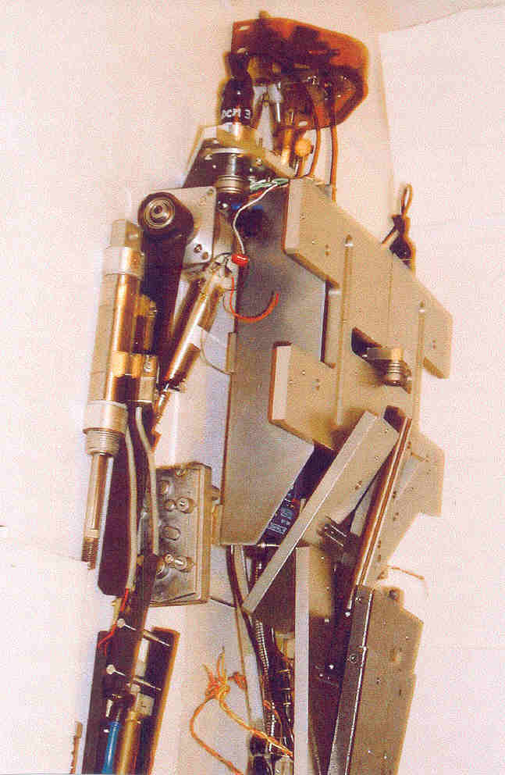

Slide 8
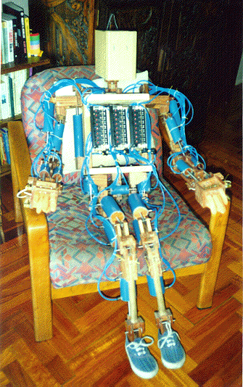

Slide 9
WOODEN ROBOTS

Slide 10
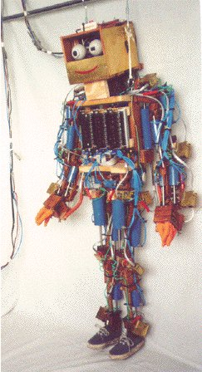
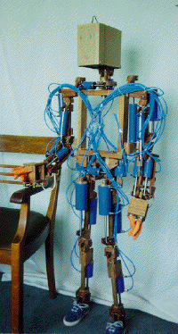
Good idea of using wood
Bad idea of using glue

Slide 11
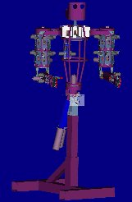
Similar to our DIM the Drummer robot

Slide 12
Heavy Duty Steel ROBOTS

Slide 13
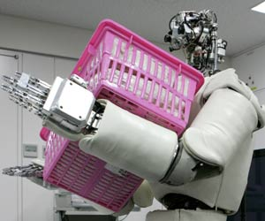

Slide 14
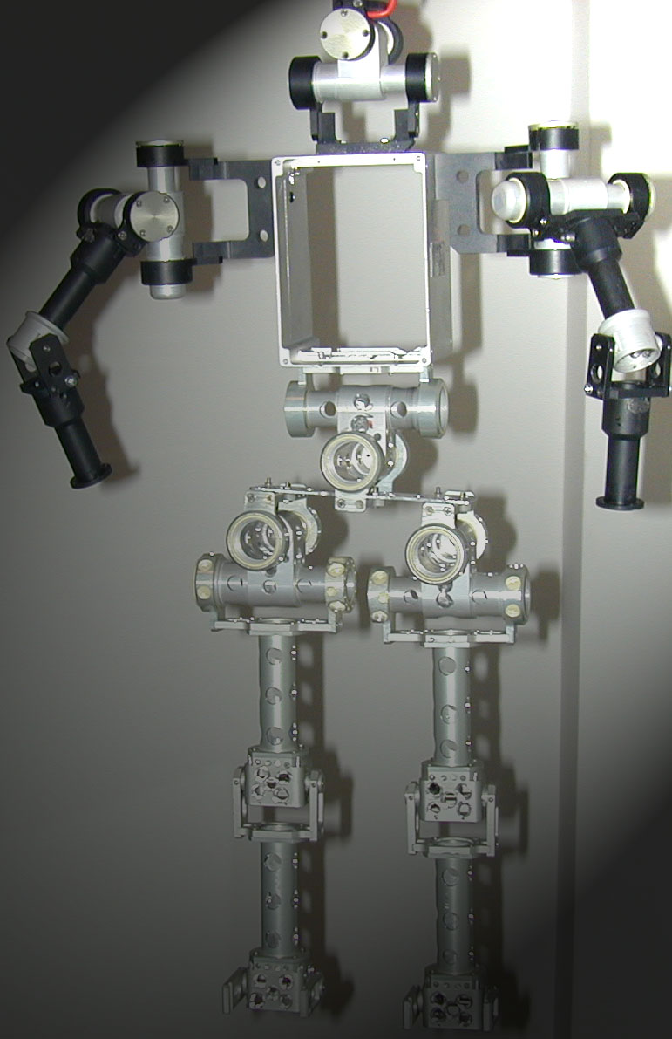
MODULAR ROBOTS
Robot built from commercial building blocks.
Many animals can be built like this.
Cheap version of this concept is available from LYNXMOTION

Slide 15
ALUMINUM ROBOTS

Slide 16
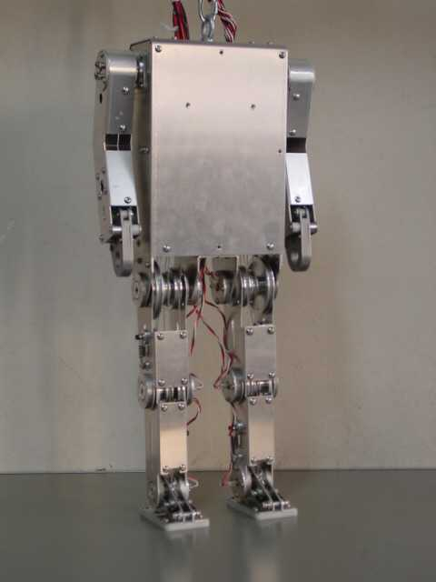
Please note use of metal screws
Please note use of pulleys

Slide 17
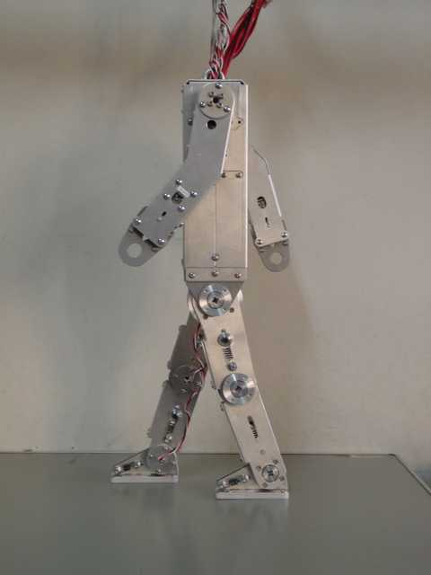

Slide 18
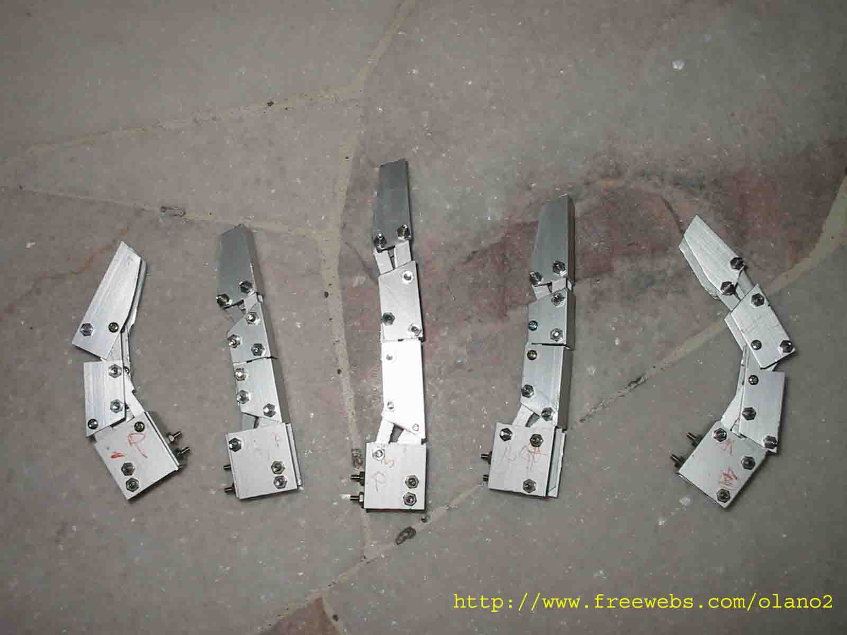
Aluminum Fingers

Slide 19
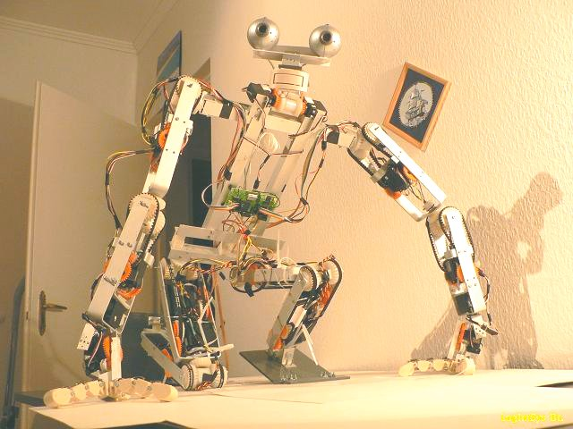

Slide 20
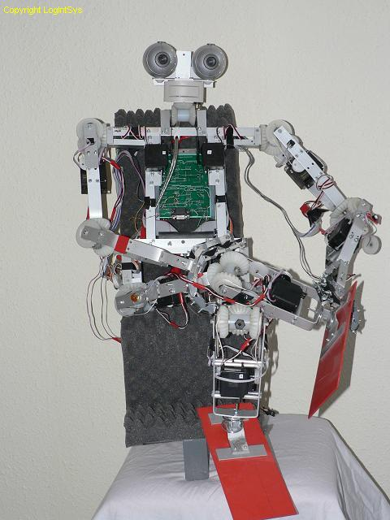
Note the use of plastic gears removed from toys
Note aluminum home-like design.

Slide 21
SMALL COMMERCIAL ROBOTS

Slide 22
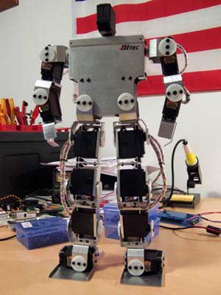
Good idea of using servos as links in arms and legs

Slide 23
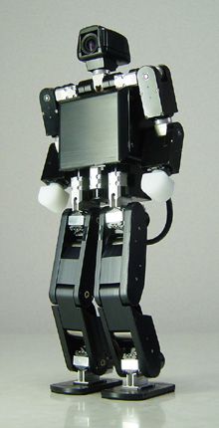
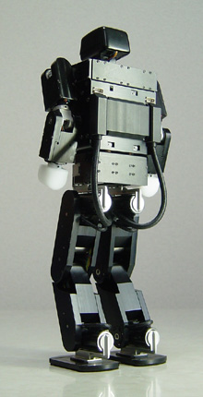
Small commercial robots

Slide 24
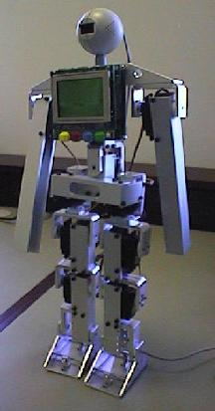
Robot built by prof. Braunl, author of our textbook
Simple robot, one degree of freedom arm, but walks.
Not a commercial robot.

Slide 25
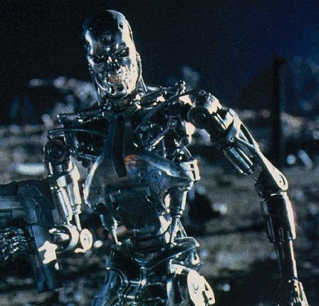
Robot from a movie

