Slide 1
Why Exercise?
Presented by Lifestyle Fitness

Slide 2
What Ongoing Exercise Can Do for You
Benefits
Programs

Slide 3
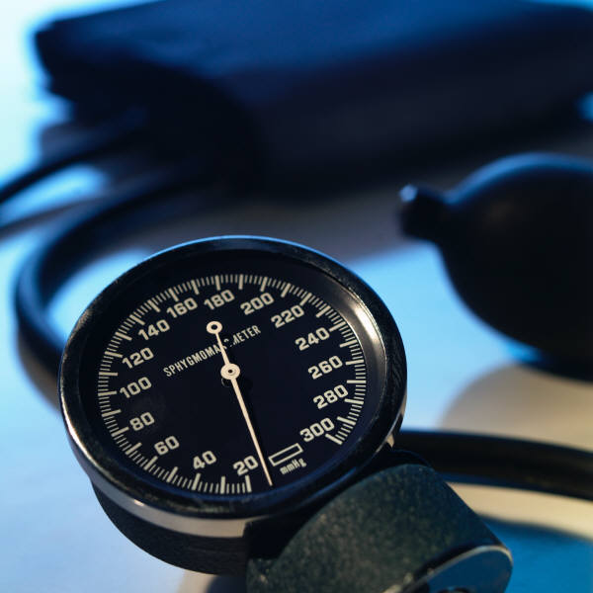
Benefits
Prevents heart disease and normalizes blood pressure
Regulates blood sugar and controls body weight
Prevents bone and tissue loss
Improves lifestyle

Slide 4
Regulate Blood Sugar and Control Body Weight
Improves body’s ability to metabolize sugar
Burns calories
Maintains weight-loss

Slide 5
Prevent Heart Disease and Normalize Blood Pressure
Slows plaque buildup in arteries
Increases “good” and decreases “bad” cholesterol
Decreases resting heart rate
Prevents obstructive blood clots
Makes heart stronger and more efficient

Slide 6
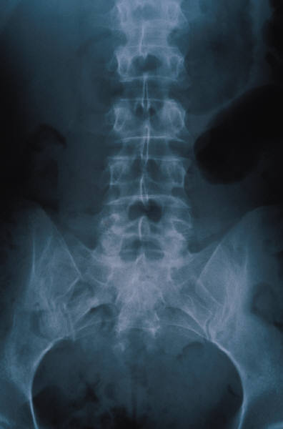
Prevent Bone and Muscle Tissue Loss
Prevents osteoporosis
Prevents loss of lean body mass
Prevents drop in metabolic rate

Slide 7
Improve Lifestyle
Makes activity easier
Increases stress resistance
Improves sleep
Encourages other healthy habits

Slide 8
Programs
Exercise
Personalized fitness programs
Group workout classes
Spinning
Kick Boxing
Step Aerobics
Yoga
Running and racquetball clubs
Nutrition
Healthy Choices
Tips

Slide 9
Lifestyle Fitness Program Schedule
 | MON | TUE | WED | THURS | FRI | SAT | SUN
9 AM | Spinning | Spinning | Spinning | Spinning | Spinning | Running Club | Running Club
Noon | Circuit Training | Basic Step | Circuit Training | Basic Step | Circuit Training | Basic Step | Squash
5 PM | Water Workout | Running Club | Water Workout | Running Club | Water Workout | Racquet-ball League | Racquet-ball League
6 PM | Kick Boxing | Tae Kwon Do | Kick Boxing | Tae Kwon Do | Kick Boxing

Slide 10
Exercise Makes Life More Fun!
Start a regular workout program today
Join a workout group and share the health
Notes:
Fat analysis done upon request. Ask at front desk.
Personal trainers available Monday through Friday from 10-5.
Special fitness workshops offered periodically. Check calendar in lobby.

Slide 11
Lifestyle Fitness
23 Wharton Drive
(650) 555-7777
www.fitlife.com
The End

