Slide 1
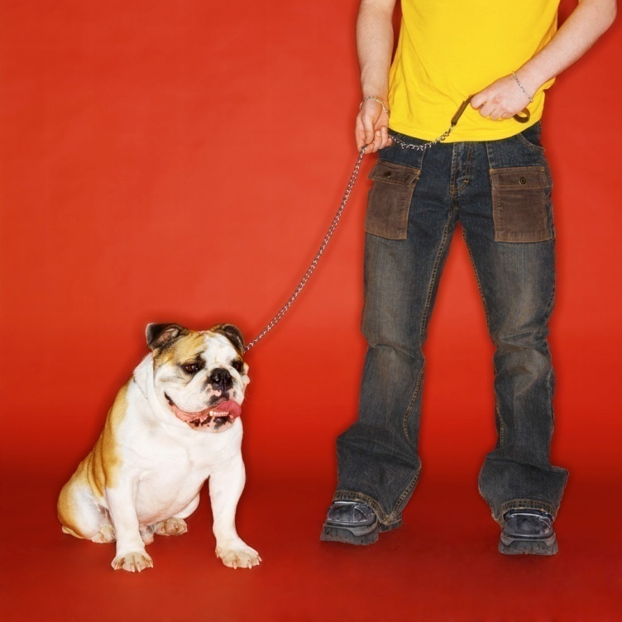
Traveling with Your Dog
Student Name

Slide 2
How Do Dogs Travel?
Mode of Travel | Percent
Auto | 76%
RV | 10%
Airline | 6%
Other | 8%

Slide 3
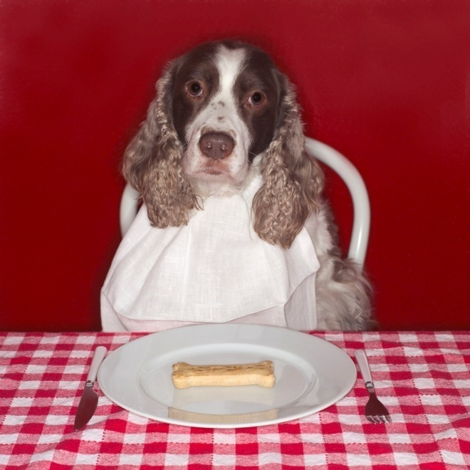
Etiquette in Public
Always keep your dog on a leash (no longer than 6') when in public and around other people.
Be careful when letting your dog make contact with other dogs on a leash.
Pick up after your dog whenever you are out in public.

Slide 4
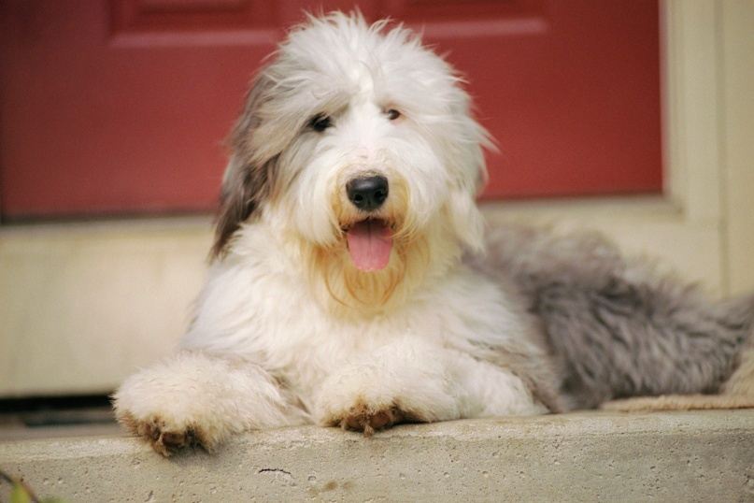
Staying in a Hotel
Take a crate.
Never leave your dog alone in the room.
Do not allow your dog on the furniture or beds.
Feed and water in the bathroom or on a tiled or hardwood floor.
Before checking out, spray the room with air freshener to eliminate any odors.

Slide 5
Traveling by Car
Get your dog used to the car by going for short rides.
Avoid car sickness by letting your dog travel on an empty stomach.
Keep the car well-ventilated.
Do not let your dog ride with his head sticking out of an open window.
Stop frequently for exercise and potty breaks.
Never, ever leave your dog unattended in a closed vehicle, particularly in the summer.

Slide 6
Pet Travel Kit
Supply of pet's regular food
Pet's food and water dishes
Blanket
Favorite toy or two
A few treats
Comb and/or brush
A mop-up towel, paper towels or a few newspapers
Flea or tick repellent if you will be in rural areas
A sedative prescribed by your veterinarian
Scooper and plastic bags to clean up after your pet
Spray-type room deodorant or air freshener

Slide 7
Trip Tips
Administer a sedative or tranquilizer if prescribed.
Do not feed or water the just before starting.
Feed only once a day, preferably by evening.
Try to keep to established walking and feeding routines.
Plan stops at regular intervals to give your pet a drink and a short run.

Slide 8
Trip Tips
Do not feed or water the just before starting.
Feed only once a day, preferably by evening.
Try to keep to established walking and feeding routines.
Plan stops at regular intervals to give your pet a drink and a short run.

Slide 9
Trip Tips
Take a container of fresh water along.
Always attach the leash before opening the car door, and detach it after the pet is back inside and the door closed.
Walk away from manicured lawns and from garden and swimming pool areas.

Slide 10
Car Checklist
Travel identification and rabies tags?
Health documents and pet's veterinary record?
Pet's travel kit packed?
Water container filled?
Stake and long leash in the car? Scooper?
Cage or carrier fixed in place so it won't tip or slide around?

