Slide 1
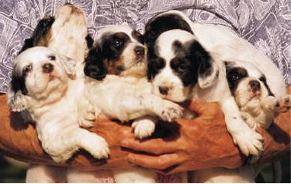
Join Animal Angels
Animal Rescue Foundation
Student Name, Volunteer Coordinator

Slide 2
Topics Of Discussion
  Why are pets abandoned?
  How does the Foundation help?
  Who are Animal Angels?
  How can you help?

Slide 3
Why Are Pets Abandoned?
Poor or deteriorating health
Maintenance expenses
  Veterinary bills
  Food
Change in lifestyle
Behavioral problems
Moving to a new location

Slide 4
How Does The Foundation Help?
Provides temporary homes
Provides obedience training
Provides veterinary care
Finds loving permanent homes

Slide 5
Animal Rescue Foundation History
1990
  Founded by Steve Dow
1991
  Built first shelter
1992
  Began volunteer program
2005
  Saved 1000 animals!

Slide 6
Who Are Animal Angels?
Believes unwanted pets deserve a home
Believes you can teach an old dog new tricks
Believes you can retrain animals to be lovable

Slide 7
How Can You Help?
Donate your time and talent
Become a foster parent
  Work at adoption fairs
Donate new or used items
  Crates and pads
  Collars, leads, and other items

Slide 8
More Ways To Help!
Provide financial support
  Send a donation
  Sponsor a foster pet
  Sponsor an adoption

Slide 9
Adoption Angels
Work at adoption fairs
Transport animals to fairs
Interview potential parents
Follow up on adoptions

Slide 10
Foster Angels
Provide a temporary home
Evaluate special needs
  Housebreaking
  Obedience training
  Socialization
Bring pet to adoption fairs

Slide 11
How Do You Become An Angel?
Sign up to volunteer
Send a check
Drop off donations

