Slide 1
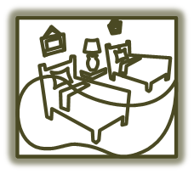
Staff Training
Sleepy Time Inn

Slide 2
Welcome and Introduction
Welcome all old and new staff members!
Learn about Sleepy Time Inn
Improve your knowledge of our services

Slide 3
Overview
Hotel amenities and services
Local attractions
Rates and discounts
Other information sources

Slide 4
Hotel Terms
Common hotel terms and their definitions

Slide 5
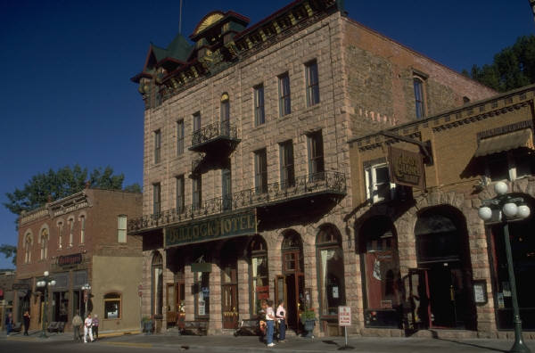
Amenities and Activities for Guests
What is there to do?
At the Inn
In the city

Slide 6
Inn Amenities and Services
Dining
Services
Special Events

Slide 7
Dining
Breakfast
Complimentary cooked-to-order breakfast
Lunch
Custom pack-lunch for outings
Build-your-own sandwich bar
Dinner
Daily chef’s special
Four course meal (salad, soup, entrée, dessert)

Slide 8
Services
Easy parking
Cable TV and HBO
High-speed internet, fax and copy services available
Direct dial phones with free local calls
Speciality shops
Easy walking to dining, entertainment and shopping

Slide 9
Special Events
Special Dining Events
Sunday champagne brunch
Saturday afternoon tea
Extras
Wine tour
Tour of haunted houses
Antique shopping

Slide 10
Local Points of Interest
Sleeepy-Oaks Bridge and Farmer’s Market
Downtown
Sleepy-Oaks Square
1877 Huose
Clock Tower

Slide 11
More to See and Do
Withiin 20 miles
Twelve Oaks Caanyon
Mt. Riverton Academy
Riverton Fashion Mall

Slide 12
Rates and Discounts
Rates
$89 to $119
King, Queen and Double beds
Suites
Discounts
GVT
Government Employee (current or retired)
US3A
AAA
SEN
Senior/AARP
LOC
Local guest, long-term, or frequent return

Slide 13
Summary
Hotel amenities and services
Things to do
Rates and discounts

Slide 14
More information
Use local event calendar
Refer questions regarding meetings and receptions to manager
Provide maps of city and points of interest
Welcome our guests as your friends

