Slide 1
the
FOOD
Pyramid
Steps to a healthier you

Slide 2
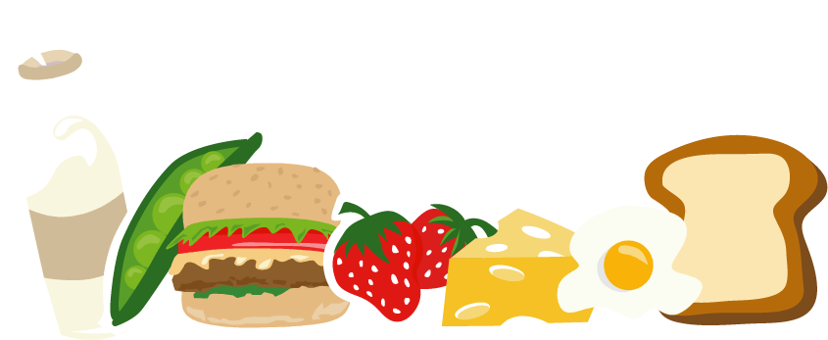
Eating Right Every Day
Briefly describe the point of this lesson, which is that the class will be learning about the relationship between good nutrition and health.

Slide 3
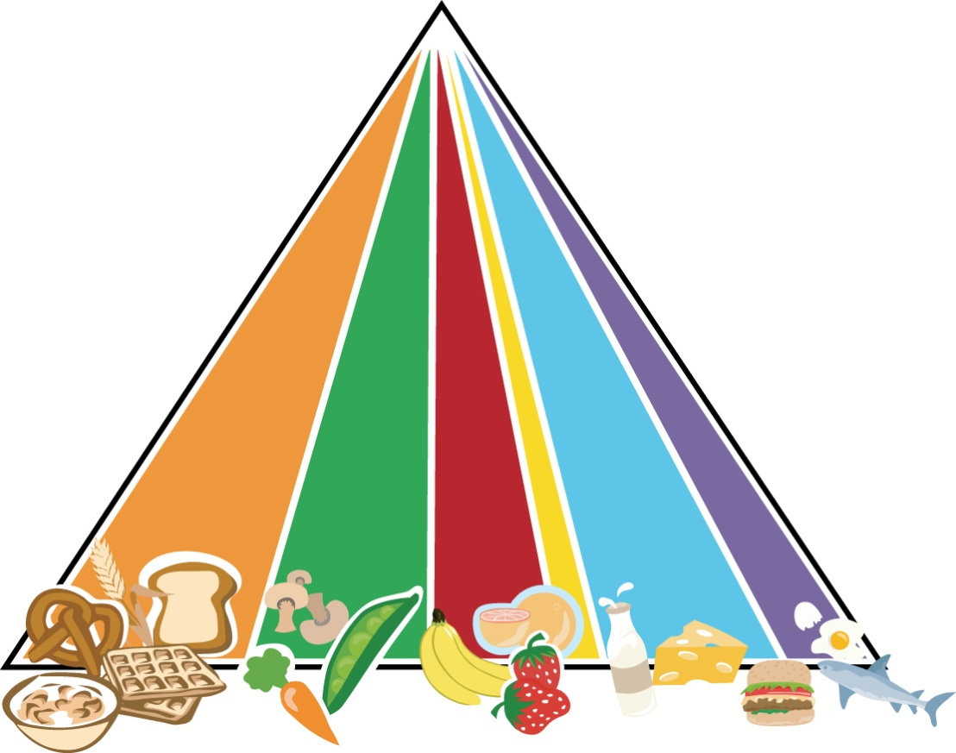
The Food Pyramid Steps to a healthier you
GRAINS
VEGETABLES
FRUITS
OILS
MILK
MEAT & BEANS

Slide 4
Grains Make half of your grains whole
List a few examples of grains that are plentiful in your area.
Disscuss how much children should eat every day and when they might have them.
Together, research and discuss the health benefits of grains.
Encourage children to list foods that they like from this food group.

Slide 5
Vegetables Vary your veggies
List a few examples of vegetables that are plentiful in your area.
Discuss how much children should eeat every day and when they might have them.
Together, research and discuss the health benefits of vegetables.
Encourage children to list foods that they like from this food group.

Slide 6
Fruits Focus on fruits
List a few examples of fruits that are plentiful in your area.
Discuss how much children should eat every day and when they might have them.
Together, research and discuss the health benefits of fruits.
Encourage children to list foods that they like from this food group.

Slide 7
Oils Know your fats
List a few examples of oils and fats.
Discuss how much children should eat daily and what foods contain oils and fats.
Together, research and discuss the health benefits associated with the different kinds of oils and fats.
Encourage children to list foods that they like from this food group.

Slide 8
Milk Get your calcium rich foods
List a few examples of milk products.
Discuss how much children should eat daily and when they might have them.
Together, research and discuss the health benefits of milk products.
Encourage children to list foods that they like from this food group.

Slide 9
Meat and Beans Go lean on protein
List a few examples of meat and bean products that are plentiful in your area.
Discuss how much children should eat daily and when they might have them.
Together, research and discuss the health benefits of meat and beans.
Encourage children to lisst foods that they like from this food group.

Slide 10
Discretionary Calories Extras for luxury foods
What are discretionary calories?
Discuss how many discretionary calories children should eat every day.
Solicit class feedback for examples of ways to use discretionary calories.

Slide 11
Physical Activity Strive for 60 minutes or more per day
What is physical activity?
Discuss moderate vs. vigorous activity.
Solicit class feebdack for examples of moderate and vigorous activities.

Slide 12
Eat Well and Stay Healthy!

Slide 13
Conclusion
Summarize the health benefits of each food group.
Encourage children to do research on any new findings about food and health.
Encourage children to continue keeping a food diary.
Encourage children to strive for 60 minutes or more of physical activity every day.
Ask your school nurse or doctor to visit the class to share facts about food and health on an ongoing basis.

