Slide 1
Coffee Talk
Downtown Internet Café

Slide 2
Introduction
What’s in a name?
Coffee terms

Slide 3
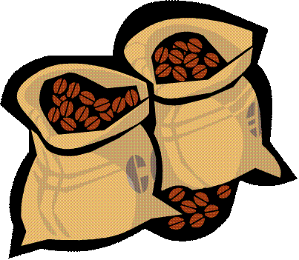
Agenda
Regular Roasts
Other Offerings

Slide 4
Regular Roasts
Central and South American
East African
Indonesian

Slide 5
Central and South American Coffees
Colombian
Distinctive, heady aroma
Clean, mellow, balanced flavor
Guatemala Antigua
Complex and slightly sweet
Gentle spice flavors
Kona
Delicately sweet aroma
Smooth, light-bodied flavor

Slide 6
East African Coffees
Arabian
Strong and sparkling
Pungent, wine flavor
Ethiopian
Floral aroma and flavor
Moderate body and acidity
Kenyan
Complex and fruity
Medium-bodied brew

Slide 7
Indonesian Coffees
Java
Unique, smoky flavor
Rich-bodied
Sumatra
Dark roasted
Heavy mellow flavor

Slide 8
Other Offerings
Blends
Dark roasts
French (dark)
Italian (darker)
Espresso (darkest)
Decaffeinated
Traditionally (solvent) processed
Water processed
Regular and dark roasts

Slide 9
Coffee Terms
Flavor
Aroma
Acidity
Body
Aroma, acidity, and body
Fragrance of brewed coffee
Sharp lively characteristic of coffee
Feel of coffee’s weight on your tongue

