Slide 1
Self-organization of Wireless SensorSelf-organization of Wireless Sensor Networks for Wildfire Detection Using Shapley Values
Self-organization of Wireless Sensor Networks for Wildfire Detection Using Shapley Values
Networks for Wildfire Detection Using Shapley Values
Garrison Greenwood
Dept. of Electrical & Computer Engineering
Portland State University
Portland, OR 97201 USA

Slide 2
Wildfires are uncontrolled and unplanned fires that destroy vegetation (forests, bushland, etc.) and animal species.
In the United States about 8 million acres, on average, burned each year in wildfires between 2017 and 2021 with an annual expenditure of $2.5 billion (in 2020 dollars) on fire suppression activities.
Although wildfires do have positive effects on many ecosystems, their high economic costs and adverse human health effects can be staggering.

Slide 3
Early detection of wildfires can help minimize those negative effects.
Environmental monitoring should be effective, yet non-intrusive, non-toxic and as inexpensive as possible.
Unfortunately, monitoring in remote, limited-access areas is difficult…
Wireless sensor networks (WSNs) can meet those requirements.

Slide 4
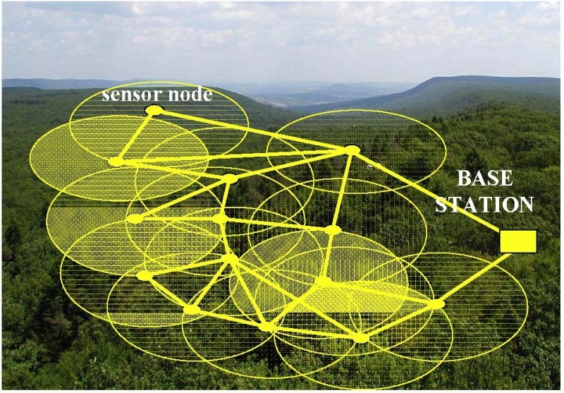
Wireless Sensor Networks (WSNs)
Multiple sensors (100s or 1000s) cooperatively collect data about a physical environment.
Data is wirelessly sent to a base station.
The base station can locally use the data or serve as a gateway that sends the collected data to other networks (e.g., the internet)
Sensor nodes are randomly distributed (for example by air) in remote areas.

Slide 5
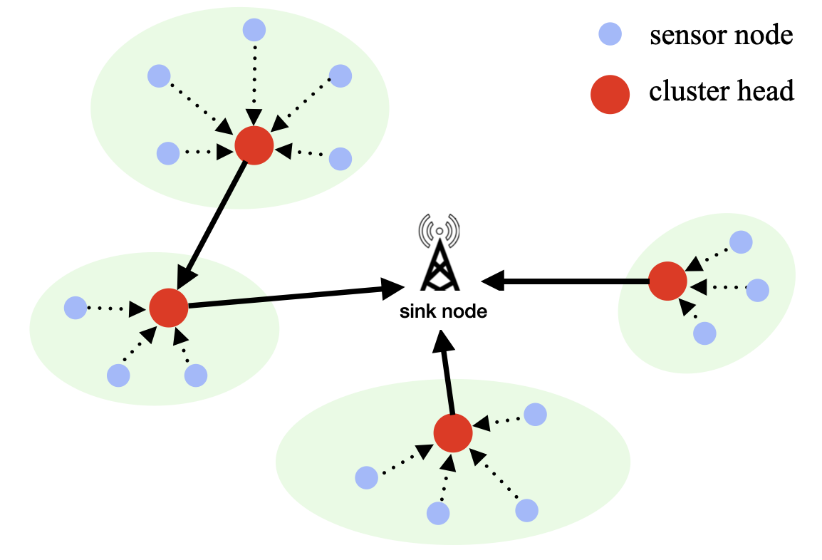
The network model
Sensor nodes are low cost by design and have a limited transmitter power output.
Consequently, most sensor nodes do not have a 1-hop communication with the sink node.
One solution is to organize nodes into clusters

Slide 6
The sink node is located at a known location and is not energy limited. It communicates with all nodes within R0 meters.
For sensor nodes we assume
- sensor batteries have finite capacity and are not rechargeable.
- sensor locations are not known (randomly dispersed by air)
- sensors can communicate with neighbor nodes located within R1 meters (R1 < R0).
- sensors can adjust their transmitter output power.
- all nodes are homogeneous so they can act as sensors or cluster heads.

Slide 7
After deployment, the sensors must self-organize, that is, organize itself into clusters autonomously.
Self-organization creates the WSN.

Slide 8

Shapley’s Problem
Lloyd Shapley* was interested in the following coalition problem:
Problem Statement
A coalition C ⊂ N cooperates to complete some activity.
When the activity is finished, there is a profit to distribute among the | C |
coalition members.
What a fair distribution of the profit among the coalition members?
*2012 recipient of the Nobel prize in economics sciences
12

Slide 9

What is a fair distribution?
Intuitively, a fair distribution would be an equal payoff to everyone.
Example
Three people want to build a house, sell it, and split the profit.
·one person does all of the plumbing and internal wiring
· one person installs the doors and windows
· one person lays the foundation, puts up the walls and roof and connects all utilities (water, sewer, etc.)
Question: How would you determine a fair distribution of the profit in this
example?

Slide 10
Shapley Values
Shapley believed a fair distribution must consider the marginal contribution
of an individual—i.e., the value that individual adds to a coalition by joining it.
The marginal contribution of an individual joining a coalition C can be
positive, negative, or zero depending on whether the larger C has more,
less, or the same value.
A weighted sum of marginal contributions for an individual over all possible
coalitions is called the Shapley value for that individual.

Slide 11

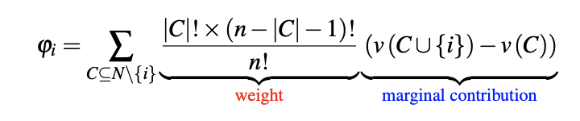
Shapley Value (cont.)
The Shapley value for an individual is a weighted sum of the marginal
contributions over all possible coalitions.
Let C ⊆ N be a coalition with n = | N | .
Definition
The Shapley value $φ_{i}$ of individual i ∈ C is
$v(C)$ is a characteristic function which gives the value of the coalition C
(problem dependent).
18

Slide 12
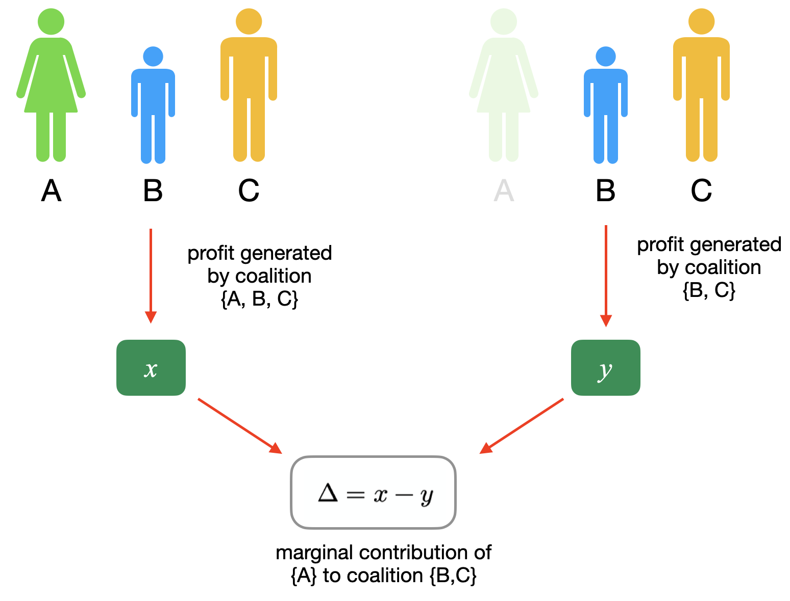

Slide 13
Unmark all nodes
Sink node broadcasts alert message; all nodes within distance d < R0 respond
Sink nodes selects subset of responding nodes as cluster heads (CHs)
CHs broadcasts alert message; unmarked all nodes within distance d < R1 < R0 respond
Nodes responding to CH(k) are marked and join the cluster
Marked cluster nodes broadcast alert message; all marked nodes within distance d < R1 respond. Nodes record ID numbers of responders.
Shapley values (SVs) are computed for each node in the cluster
Node with the smallest SV re-designated as a CH that will form a new cluster
If not all nodes in a cluster, go to step 4.

Slide 14
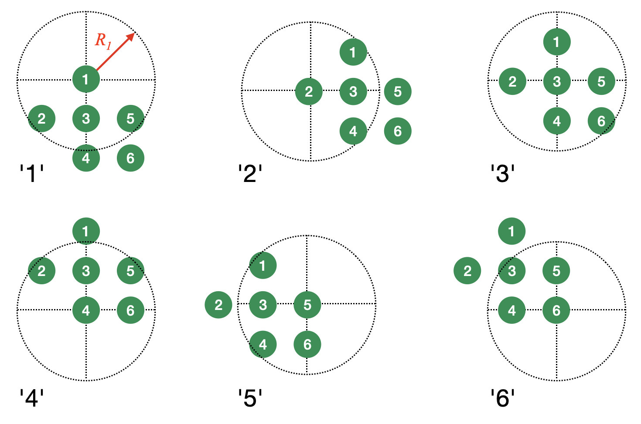
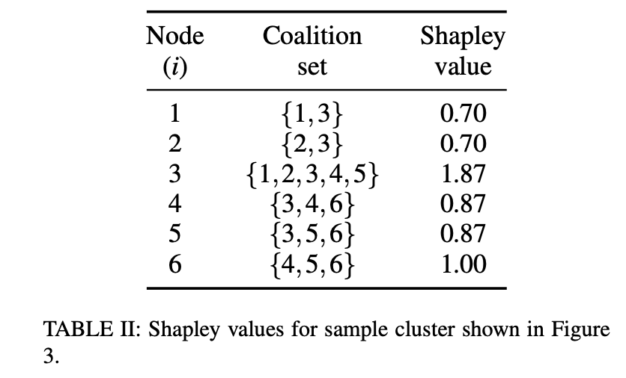


,
$$v($$
$$)$$
is the cardinality of its coalition set = 2
$$v($$
,
$$)$$
is the cardinality of union of the coalition sets = 4

Slide 15
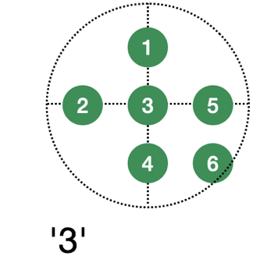
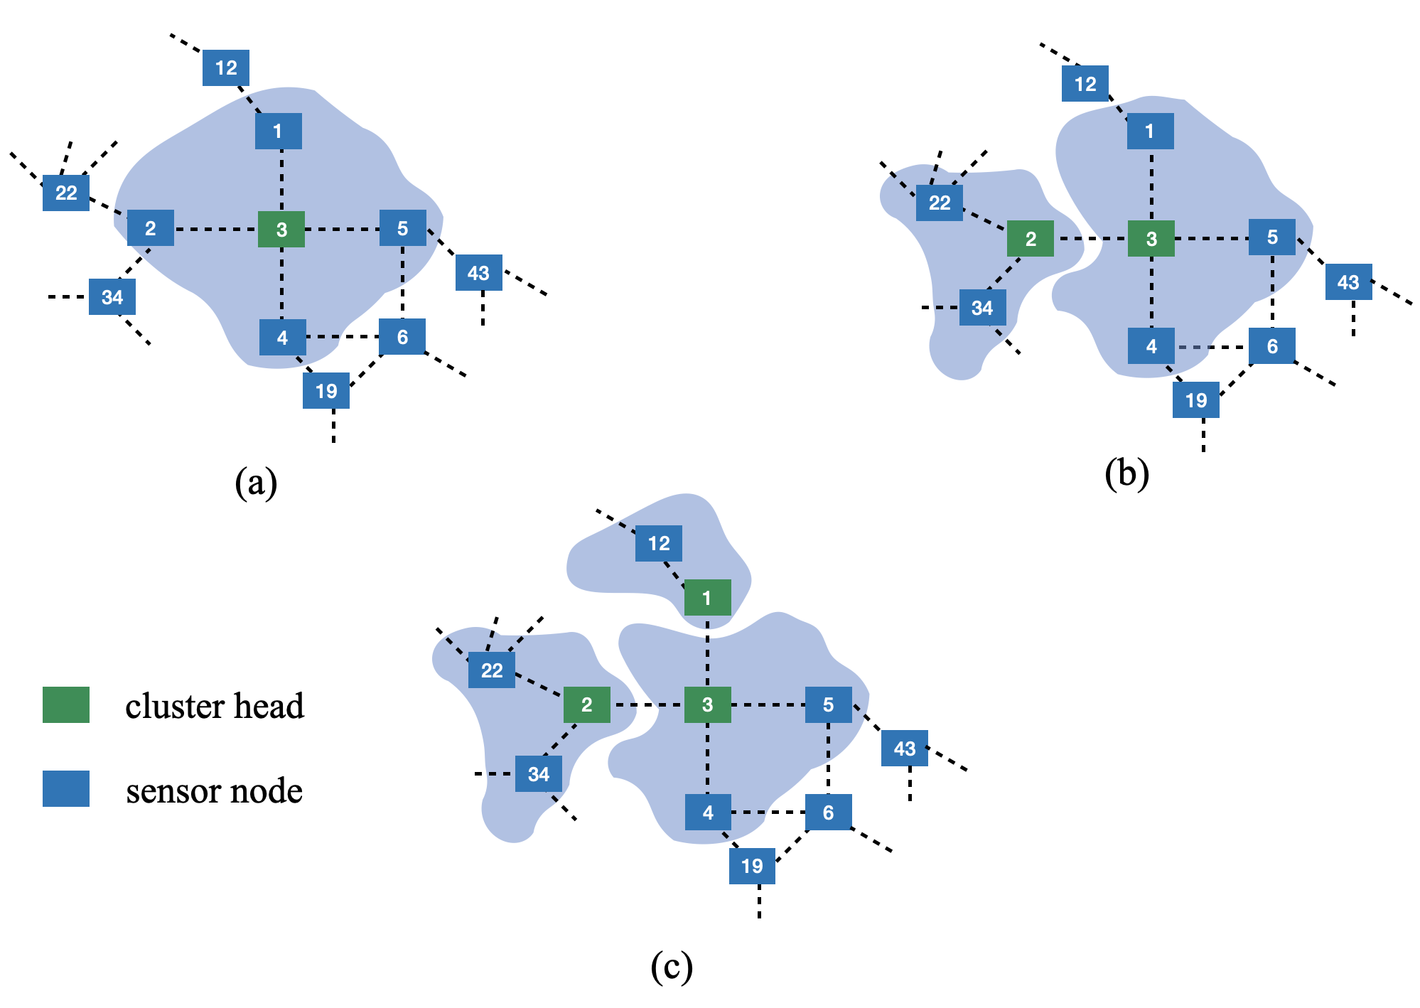
Nodes 1 and 2 had the same lowest Shapley values

Slide 16
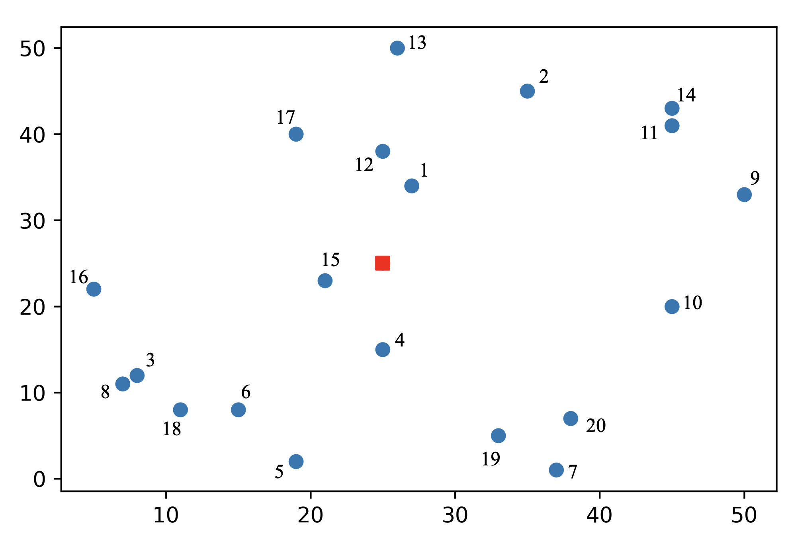

Slide 17
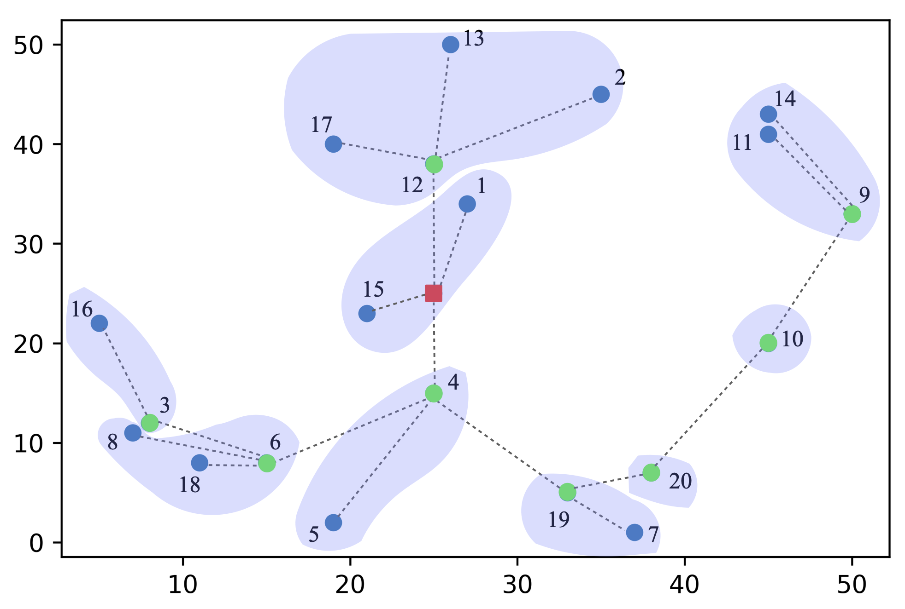
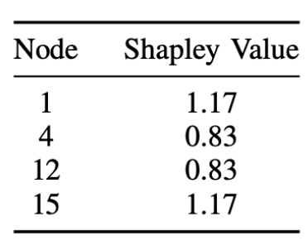

Slide 18

Summary
This paper presents a self-organization method for WSNs. Method is well suited wild-fire detection (or any other application) in remote, inaccessible areas.
No sensor node localization is required; nodes determine neighbors by ability to communicate.
All comunication between clusters is 1-hop
Shapley values determine suitable cluster heads for forming new clusters
Routing paths from clusters to the sink node are defined when the clusters are created.

Slide 19

Questions

