Slide 1
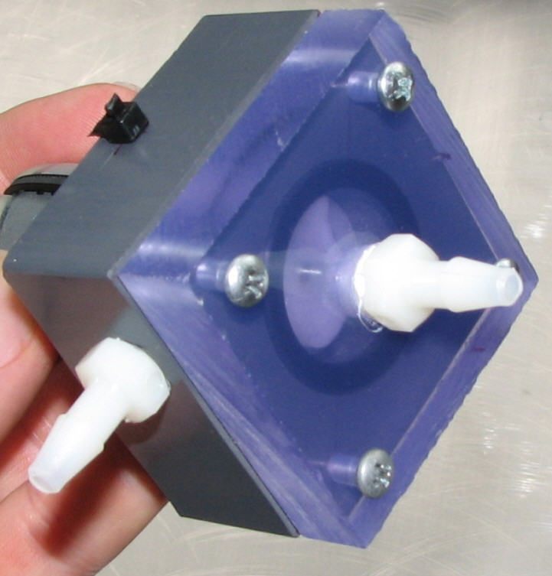
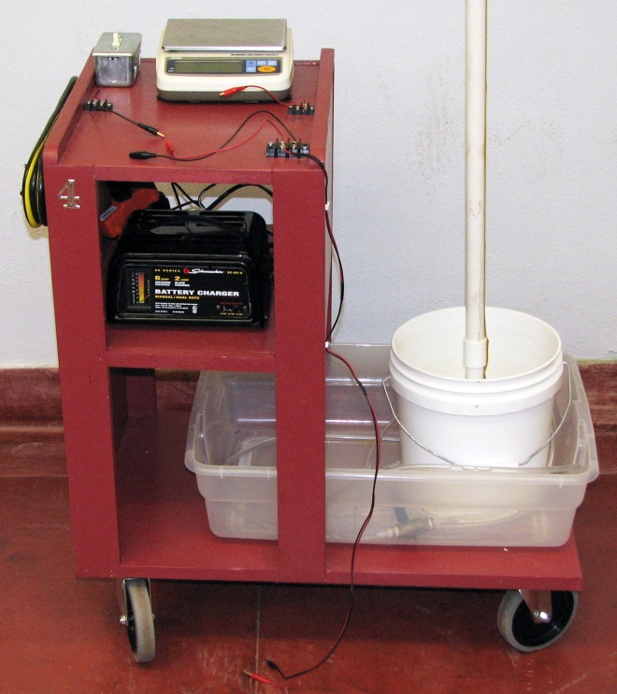
Fabrication and testing of a centrifugal pump
living with the lab

Slide 2
living with the lab
DISCLAIMER
The content of this presentation is for informational purposes only and is intended only for students attending Louisiana Tech University.
The author of this information does not make any claims as to the validity or accuracy of the information or methods presented.
The procedures demonstrated here are potentially dangerous and could result in injury or damage.
Louisiana Tech University and the State of Louisiana, their officers, employees, agents or volunteers, are not liable or responsible for any injuries, illness, damage or losses which may result from your using the materials or ideas, or from your performing the experiments or procedures depicted in this presentation.
If you do not agree, then do not view this content.

Slide 3
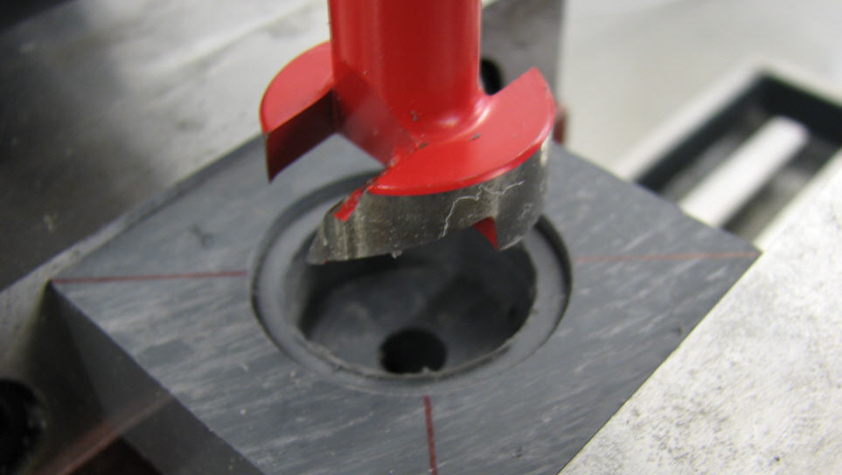
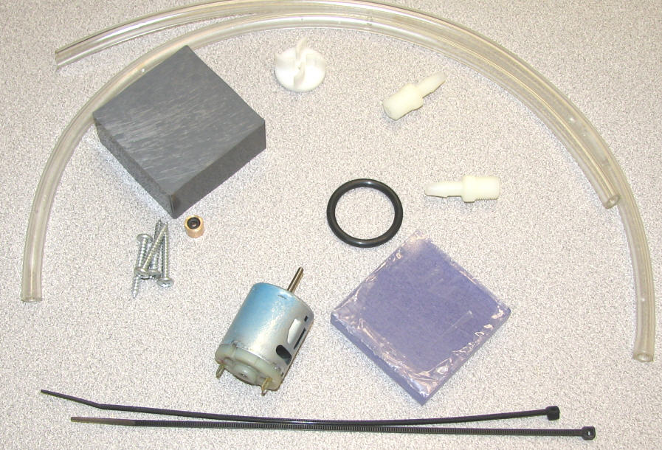
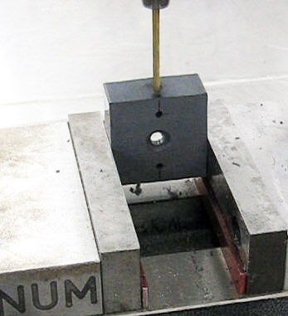
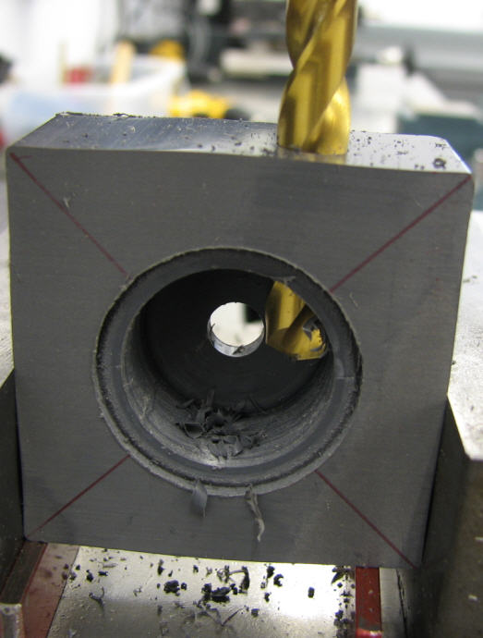
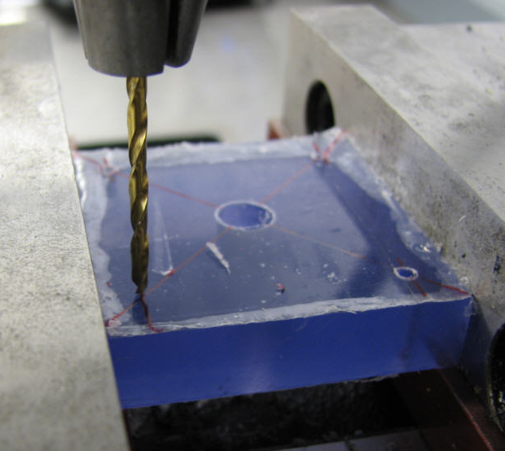
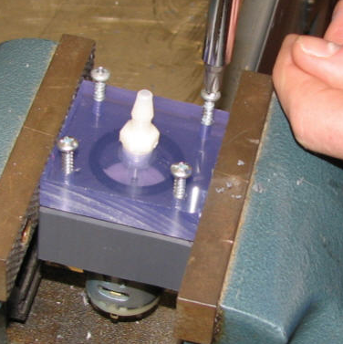
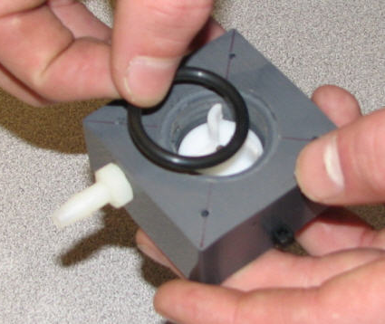
living with the lab
mostly involves drilling holes
Pump fabrication
teams of two students

Slide 4
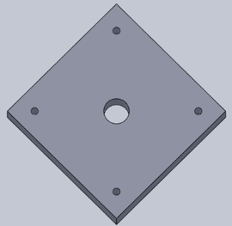
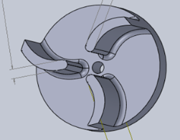
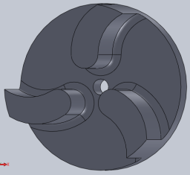
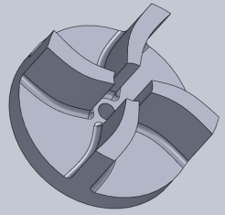
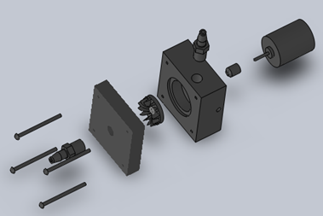
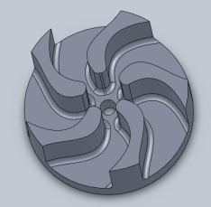
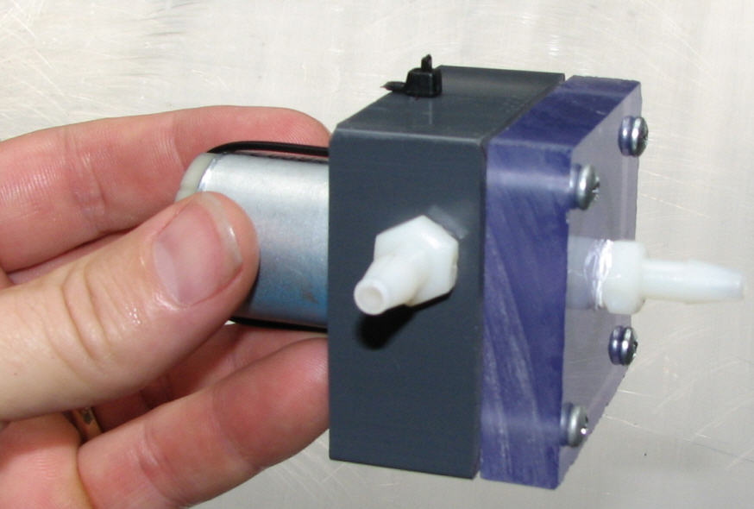
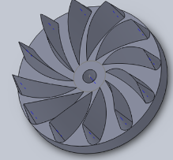
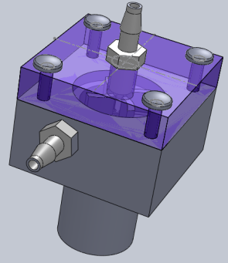
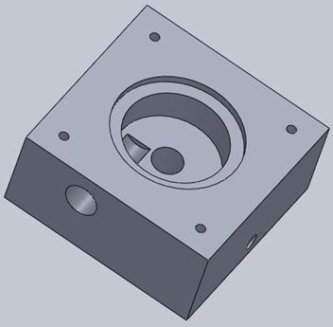
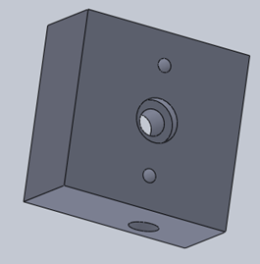
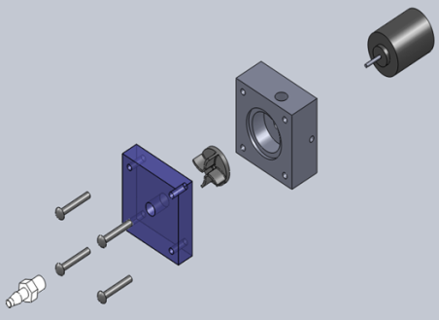
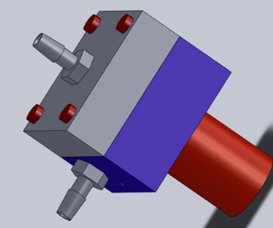
living with the lab
faceplate
impeller (your own design)
SolidWorks models
other parts &
pump assembly
pump body

Slide 5
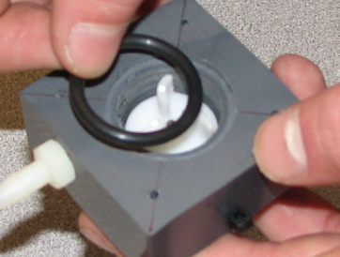
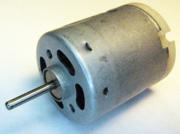
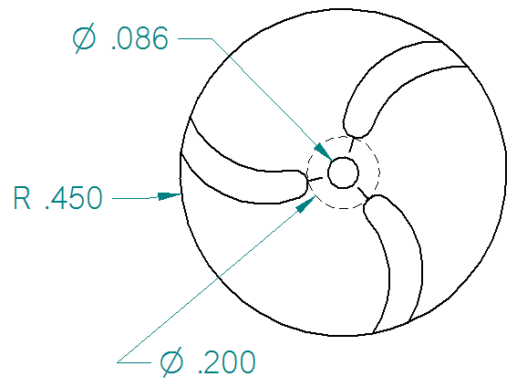
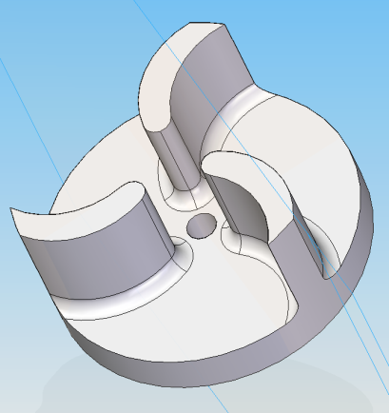
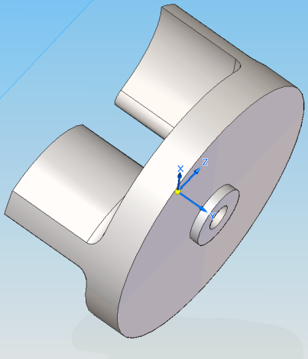
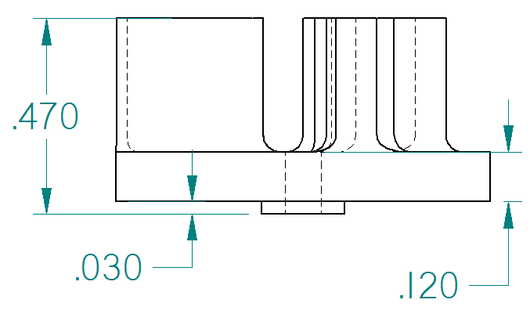
living with the lab
impeller cavity in pump body
Impeller must fit in
pump body
slightly smaller than motor
shaft to allow a press fit
inside radius of impeller cavity is 0.50 inch; making the
impeller radius 0.45 inch leaves a 0.05 inch clearance
the target depth of the impeller cavity is
0.5 inches; if this dimension is too large,
the impeller will rub on the face plate
making a little offset here keeps the impeller from
rubbing against the bottom of the impeller cavity

Slide 6
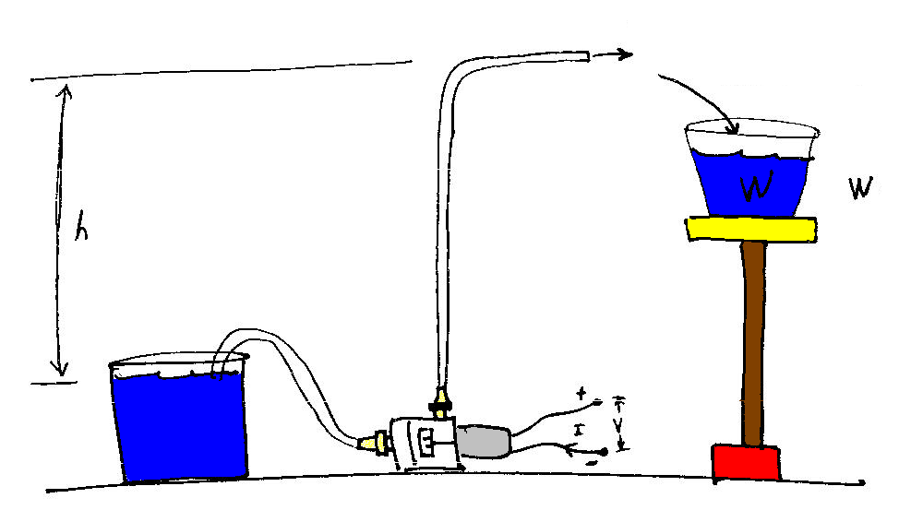
living with the lab
Pump testing
See how high your pump can pump water
Measure electrical current and voltage as well as the mass of water collected at several more heights (or pump heads) up to a maximum of 72 inches
Generate a plot of pump head versus flow rate
Generate a plot of pump efficiency versus pump head
m = mass of water collected
h = head
head or height that water is pumped (in) | electrical current needed to power pump (A) | voltage across pump leads (V) | length of time that water is collected (s) | mass of water collected over 20 seconds (g)
height 1 |  |  | 20
height 2 |  |  | 20
… height 8 (or more) |  |  | 20

Slide 7
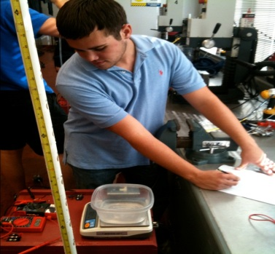
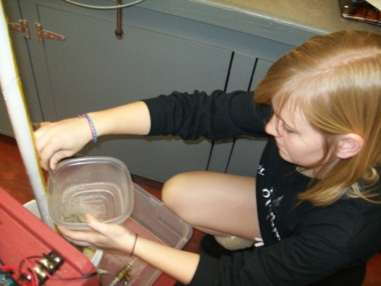
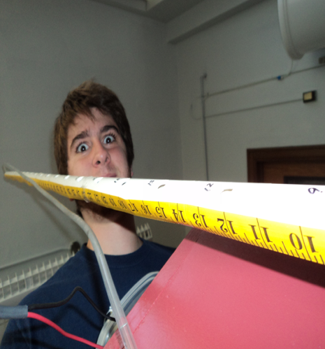
living with the lab
What to turn in
A title page
A concise, well-written executive summary that includes . . .
A couple of introductory sentences describing the project
The maximum pump head (meters)
The peak flow rate (liters per minute)
Typical voltage (V) and current measurements (A)
The peak efficiency (%) and the head (meters) at which the peak efficiency occurs
Photos of you and your partner(s) during pump fabrication and testing
Your Excel spreadsheet containing the raw data and computed values:
A detailed hand calculation using engineering format showing all calculations for a data point in your Excel spreadsheet (include units!!)
A plot of pump head versus (meters) flow rate (liters per minute)
A plot of pump efficiency (%) versus pump head (meters)
Be sure to put the items in the order listed (1, 2, 3, . . . 7) and do a clean job of presenting your work. A good part of your grade will be based on how well your executive summary is written. Don’t forget to use units in your table, calculations and plots.

Slide 8
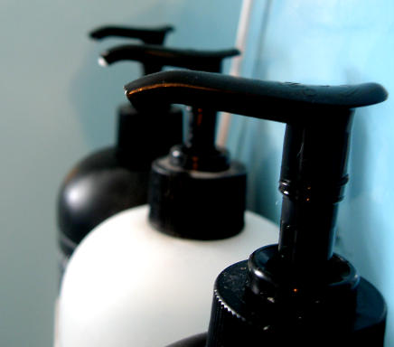
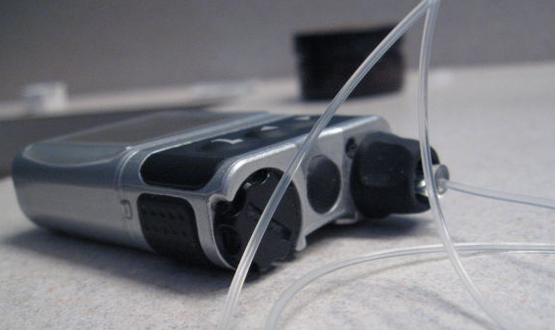
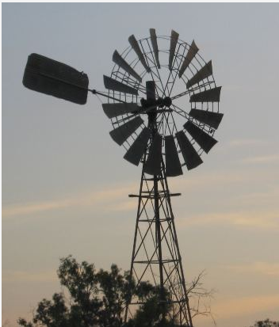
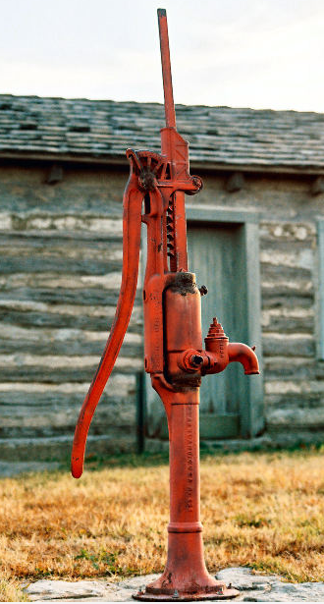
living with the lab
Who uses pumps?
http://mrg.bz/yLmny1
http://mrg.bz/2zyazk
insulin pump
http://mrg.bz/3INZgw
http://mrg.bz/zms9dI
http://mrg.bz/01yW45
http://mrg.bz/SGTyCO
http://mrg.bz/NhrTKC

