Slide 1
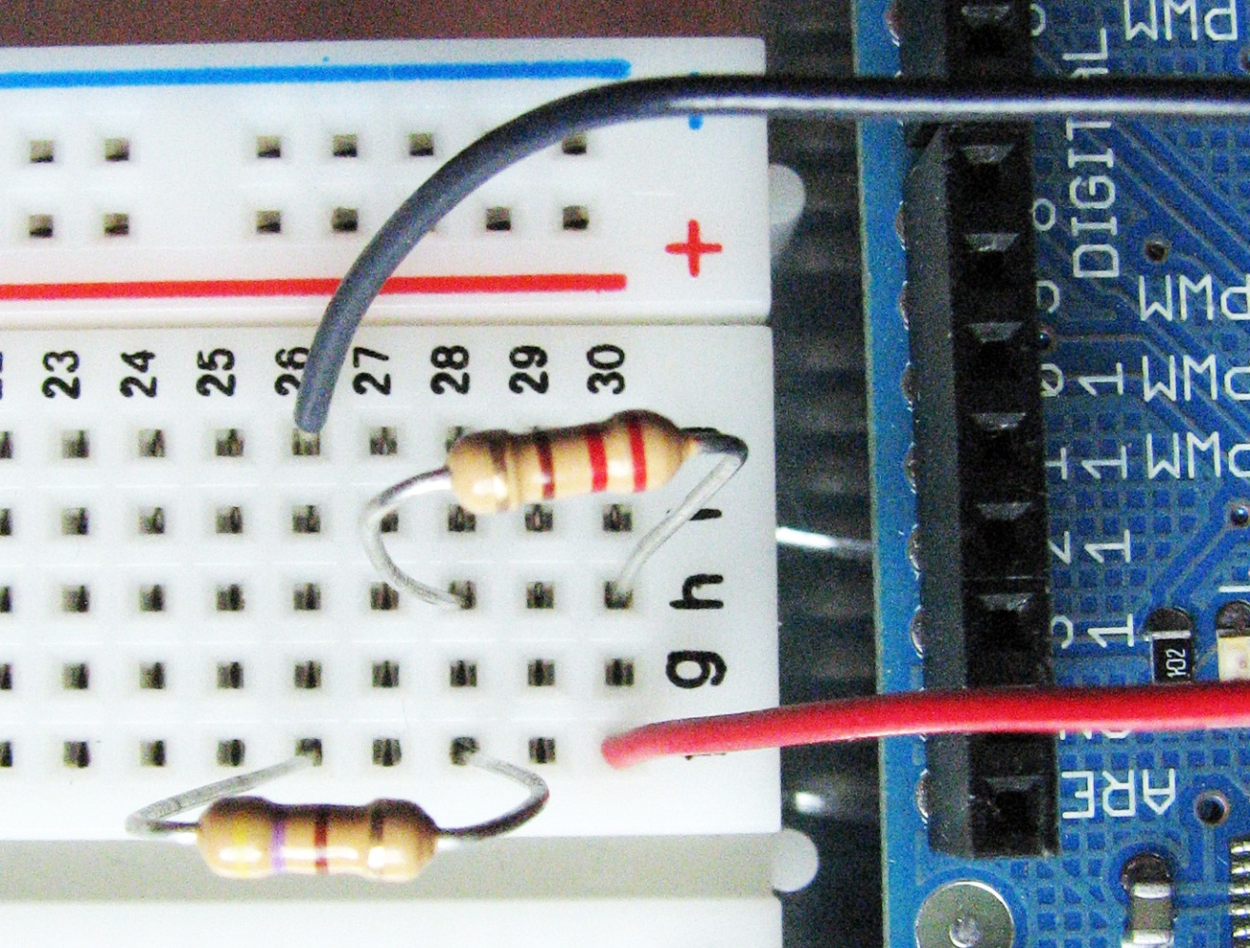
Voltage Drops Around Closed Loops
living with the lab
220Ω
−
220Ω
5V
+
470Ω

Slide 2
living with the lab
Select Resistors
Find the 220Ω and the 470Ω resistors from your parts kit.
color | digit
black | 0
brown | 1
red | 2
orange | 3
yellow | 4
green | 5
blue | 6
violet | 7
gray | 8
white | 9
first
digit
gold = ±5%
silver = ±20%
tolerance
second digit
number
of zeros
Example: 470Ω resistor
4 = yellow
7 = violet
Add 1 zero to 47 to make 470, so 1 = brown
So, 470 = yellow, violet, brown
Now, find the 220Ω resistor.

Slide 3
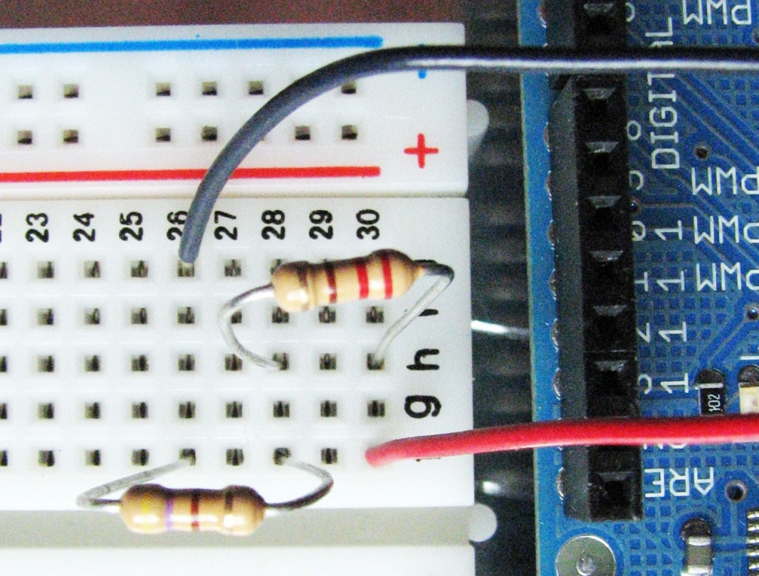
living with the lab
5V
Build the Series Circuit Below
220Ω
220Ω
470Ω
−
5V
+
220Ω
+
-
5V
470Ω
470Ω
All of these circuits are the SAME!!

Slide 4
living with the lab
Compute the Voltage Drops Across the Two Resistors
Use Ohm’s Law: V = I · R
given
R₁ = 220Ω
$$R_{1}=220Ω{ R}_{2}=470Ω{ V}_{1}=5V$$
find the equivalent resistance
+
-
V₁=5V
R₂ = 470Ω
$$R_{eq}=$$
find the current
$$I=$$
find the voltage drop across R₁
Now, add the voltage rise of the power source (+5V) to the voltage drops across the resistors (negative numbers).
$$V_{R_{1}}=$$
find the voltage drop across R₂
$$V_{R_{2}}=$$

Slide 5
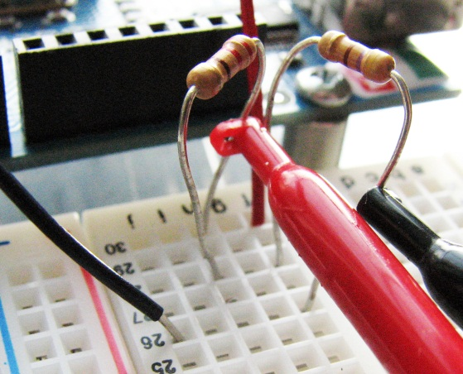
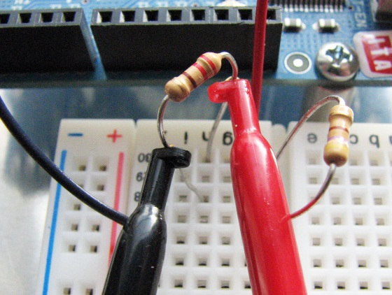
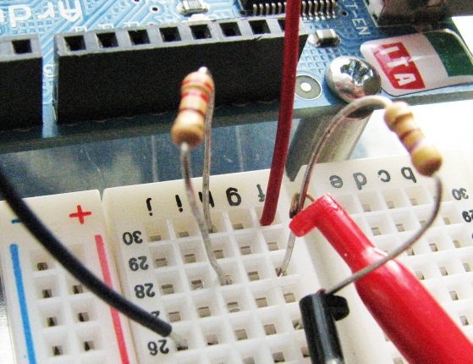
living with the lab
Use Multimeter to Measure Voltages Around Loop
(1) From 5V pin to Gnd
220Ω
ΔV₁ = _____
+
-
5V
470Ω
(2) Across the 220W resistor
ΔV₂ = _____
Remember . . .
a RESISTOR is a voltage DROP and
a POWER SOURCE is a voltage RISE
Δ V₁ − ΔV₂ − ΔV₃ = _____
(3) Across the 470W resistor
ΔV₃ = _____
rises must balance drops!!!!

Slide 6
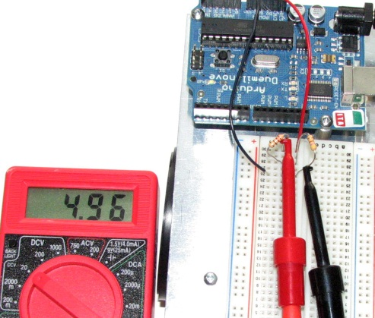
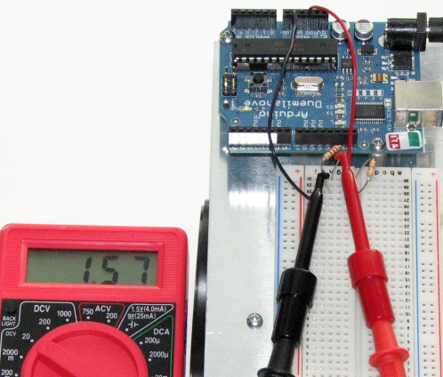
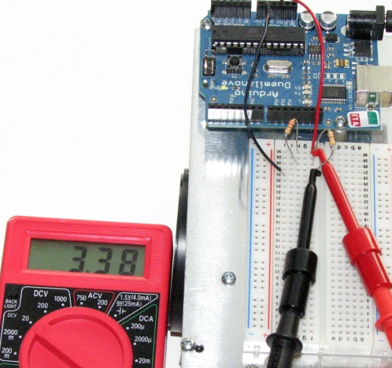
living with the lab
Compare Measurements to Theory
R₁ = 220Ω
ΔV = 1.59V
+
-
V₁=5V
R₂ = 470Ω
ΔV = 3.41V
Pretty close!

Slide 7
living with the lab
Kirchoff’s Voltage Law (KVL)
Kirchoff’s Voltage Law says that the algebraic
sum of voltages around any closed loop in a
circuit is zero – we see that this is true for our
circuit. It is also true for very complex circuits.
R₁ = 220Ω
ΔV = 1.59V
+
-
V₁=5V
R₂ = 470Ω
5V
– 1.59V
– 3.41V
= 0
ΔV = 3.41V
Notice that the 5V is DIVIDED between the two resistors, with the larger voltage drop occurring across the larger resistor.

Slide 8
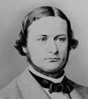
living with the lab
Gustav Kirchoff (1824 – 1887) was a German physicist who made fundamental contributions to the understanding of electrical circuits and to the science of emission spectroscopy. He showed that when elements were heated to incandescence, they produce a characteristic signature allowing them to be identified. He wrote the laws for closed electric circuits in 1845 when he was a 21 year-old student.
Photo: Library of Congress

