Slide 1
Computer Graphics
Prof. Feng Liu
Fall 2021
http://www.cs.pdx.edu/~fliu/courses/cs447/
10/20/2021
Notes:
Computer Graphics

Slide 2
Last time
Compositing
NPR

Slide 3
Today
3D Graphics Toolkits
  Transformations
  3D Transformations
Homework 3 available, due 11/01 (Monday)
Mid-term: in class, 11/03
  Online exam

Slide 4
Where to now…
We are now done with 2D images
We will spend several weeks on the mechanics of 3D graphics
  Coordinate systems and Viewing
  Clipping
  Drawing lines and polygons
  Lighting and shading
Notes:
OK. We are now done with images. We will spend several weeks on 3D graphics, particularly the mechanics of current graphics toolkits.

Slide 5
Graphics Toolkits
Graphics toolkits typically take care of the details of producing images from geometry
Input (via API functions):
  Where the objects are located and what they look like
  Where the camera is and how it behaves
  Parameters for controlling the rendering
Functions (via API):
  Perform well defined operations based on the input environment
Output: Pixel data in a framebuffer – an image in a special part of memory
  Data can be put on the screen
  Data can be read back for processing (part of toolkit)
Notes:
As we might have expected, we do not need to build a complicated 3D graphics application from the scratch. We have graphics toolkits to take care of the details of producing images from 3D geometry. Graphics toolkits provide APIs for us to specify the input environment and geometry information, such as …. Graphics toolkits also provide APIs to perform well defined operations based on the input. Finally, graphics toolkits will store the pixel data in a framebuffer.
A framebuffer is a video output device that drives a video display from a memory buffer containing a complete frame of data.

Slide 6
OpenGL
OpenGL is an open standard graphics toolkit
  Derived from SGI’s GL toolkit
Provides a range of functions for modeling, rendering and manipulating the framebuffer
Alternatives: Direct3D, Java3D - more complex and less well supported
What makes a good toolkit?
Notes:
OpenGL is the most widely used graphics toolkits. It started from SGI’s GL toolkit.

Slide 7
A Good Toolkit…
Everything is a trade-off
Functionality
  Compact: a minimal set of commands
  Orthogonal: commands do different things and can be combined in a consistent way
  Speed
Ease-of-Use and Documentation
Portability
Extensibility
Standards and ownership
Not an exhaustive list …

Slide 8
Coordinate Systems
The use of coordinate systems is fundamental to computer graphics
Coordinate systems are used to describe the locations of points in space, and directions in space
Multiple coordinate systems make graphics algorithms easier to understand and implement
Notes:
Now Let’s look at the basics of graphics toolkits: that is coordinate systems. In a graphics toolkit, there are often multiple coordinate systems.

Slide 9
Coordinate Systems (2)
Different coordinate systems represent the same point in different ways
v
(2,3)
v
(1,2)
y
y
u
u
x
x
Notes:
Different coordinate systems represent the same point in different ways. Here is an example. In the XY coordinate system, the point’s coordinates are (2, 3); while in the uv coordinate system, it is (1,2)

Slide 10
Transformations
Transformations convert points between coordinate systems
v
(2,3)
u=x-1
v=y-1
v
(1,2)
y
y
u
x=u+1
y=v+1
u
x
x
Notes:
We can apply transformations to convert points between coordinate systems. For example, we can convert the xy into uv by subtraction here. We can convert uv to xy in a similar way.

Slide 11
Transformations (Alternate Interpretation)
Transformations modify an object’s shape and location in one coordinate system
The previous interpretation is better for some problems, this one is better for others
(2,3)
x’=x-1
y’=y-1
y
y
(1,2)
x=x’+1
y=y’+1
x
x
Notes:
Transformation can also be considered as a way to modify an object’s location and shape in one coordinate system. Here we can consider the transformation moves a point’s location in the space

Slide 12
2D Translation
Moves an object
y
y
b_{y}
x
b_{x}
x
Notes:
Now let’s see some common transformation. The first is 2D translation.

Slide 13
2D Translation
Moves an object
y
y
b_{y}
x
b_{x}
x

Slide 14
2D Scaling
Resizes an object in each dimension
y
y
y
s_{y}y
x
x
s_{x}x
x

Slide 15
2D Scaling
Resizes an object in each dimension
y
y
y
s_{y}y
x
x
s_{x}x
x

Slide 16
2D Rotation
Rotate counter-clockwise about the origin by an angle θ
y
y
θ
x
x

Slide 17
2D Rotation
Rotate counter-clockwise about the origin by an angle θ
y
y
θ
x
x

Slide 18
X-Axis Shear
Shear along x axis (What is the matrix for y axis shear?)
y
y
x
x

Slide 19
X-Axis Shear
Shear along x axis (What is the matrix for y axis shear?)
y
y
x
x

Slide 20
Reflect About X Axis
y
y
x
x

Slide 21
Reflect About X Axis
y
y
x
x

Slide 22
2D Affine Transformations
An affine transformation is one that can be written in the form:
Notes:
An affine transformation is any transformation that preserves collinearity (i.e., all points lying on a line initially still lie on a line after transformation) and ratios of distances (e.g., the midpoint of a line segment remains the midpoint after transformation)
Parallel lines remain parallel under affine transformations

Slide 23
Composition of Affine Transforms
Any affine transformation can be composed as a sequence of simple transformations:
  Translation
  Scaling (possibly with negative values)
  Rotation

Slide 24
Rotating About An Arbitrary Point
What happens when you rotate an object about an arbitrary point that is not the origin?
y
x
Notes:
Now let’s talk about a more complicated case. That is, rotating about an arbitrary point instead of the origin of the coordinate system.

Slide 25
Rotating About An Arbitrary Point
What happens when you rotate an object about an arbitrary point that is not the origin?
y
y
x
x
Notes:
So what happens when we rotate an object about a point that is not the origin? We find that some point’s position is not changed!

Slide 26
How Do We Compute It?
How do we rotate an about an arbitrary point?
  Hint: we know how to rotate about the origin of a coordinate system
Notes:
So how do we compute the position of a point after rotating around an arbitrary point.
Remember, we know how to rotate around the origin of the coordinate system.

Slide 27
Rotating About An Arbitrary Point
y
y
(a, b)
x
(0, 0)
x
y
y
(a, b)
x
(0, 0)
x
Notes:
We can first translate the coordinate system, so that in the new coordinate system, the point (a, b) will be the origin. Then we rotate the object around the new origin, we know how to do it. Then we translate the coordinate system back.

Slide 28
Rotating About An Arbitrary Point
Say you wish to rotate about the point (a,b)
You know how to rotate about (0,0)
Translate so that (a,b) is at (0,0)
  x’=x–a, y’=y–b
Rotate
  x”=(x-a)cosθ-(y-b)sinθ, y”=(x-a)sinθ+(y-b)cosθ
Translate back again
  x_{f}=x”+a, y_{f}=y”+b
Notes:
Here is the math beside this idea. We translate the coordinate system, so that (a,b) becomes (0,0)

Slide 29
Rotating About An Arbitrary Point
Say R is the rotation matrix to apply, and p is the point about which to rotate
Translation to Origin:
Rotation:
Translate back:
The translation component of the composite transformation involves the rotation matrix. What a mess!
Notes:
OK. Now let’s look at the matrix and vector operation of this method.

Slide 30
Homogeneous Coordinates
Use three numbers to represent a 2D point
(x,y)=(wx,wy,w) for any constant w≠0
  Typically, (x,y) becomes (x,y,1)
  To go backwards, divide by w
Translation can now be done with matrix multiplication!
Notes:
Now let’s introduce the concept of homogeneous coordinates to make the math more elegant.
With homogeneous coordinates, we use three numbers to represent a 2D point;
Now translation can be done with matrix muliplication.

Slide 31
Basic Transformations
Translation: Rotation:
Scaling:

Slide 32
Homogeneous Transform Advantages
Unified view of transformation as matrix multiplication
  Easier in hardware and software
To compose transformations, simply multiply matrices
  Order matters: AB is generally not the same as BA
Allows for non-affine transformations:
  Perspective projections!
Notes:
Using homogeneous coordinates, we can formulate any transformation we mentioned today as matrix muliplication;
To compose transformations, we can simply multiply the transformation matrices together. Here, we need to be careful that when we compose transformations, order matters.
Finally, homogenous coordinates allows for non-affine transformations, such as perspective projections!

Slide 33
Directions vs. Points
We have been talking about transforming points
Directions are also important in graphics
  Viewing directions
  Normal vectors
  Ray directions
Directions are represented by vectors, like points, and can be transformed, but not like points
(1,1)
(-2,-1)
Notes:
So far, we know how to transform a point. So how about directions? Directions are also important in computer graphics.
Directions are represented by vectors too, like points; they can be transformed too, but in a different way than transforming points.

Slide 34
Transforming Directions
Say I define a direction as the difference of two points: d=a–b
  This represents the direction of the line between two points
Now I translate the points by the same amount: a’=a+t, b’=b+t
How should I transform d?
Notes:
We know, we can define a direction as the difference between two points;
If we translate the two points by the same amount, what happens to the direction d?

Slide 35
Homogeneous Directions
Translation does not affect directions!
Homogeneous coordinates give us a very clean way of handling this
The direction (x,y) becomes the homogeneous direction (x,y,0)
The correct thing happens for rotation and scaling also
  Uniform scaling changes the length of the vector, but not the direction
Notes:
D is actually not affected by the translation. Homogenous coordinates give us a very clean way to handle this.
For any direction, its homogenous coordinates is (x,y,0). So when we translate it by multiplying the translation matrix, we find that we get the same out as the input. We can rotate or scale a direction in a similar way.

Slide 36
Today
3D Graphics Toolkits
  Transformations
  3D Transformations

Slide 37
3D Transformations
Homogeneous coordinates: (x,y,z)=(wx,wy,wz,w)
Transformations are now represented as 4x4 matrices
Typical graphics packages allow for specification of translation, rotation, scaling and arbitrary matrices
  OpenGL: glTranslate[fd], glRotate[fd], glScale[fd], glMultMatrix[fd]
Notes:
Now let’s look at 3D transformations.

Slide 38
3D Translation
Notes:
3D translation is similar to 2D translation. It is pretty straight forward.

Slide 39
3D Rotation
Rotation in 3D is about an axis in 3D space passing through the origin
Using a matrix representation, any matrix with an orthonormal top-left 3x3 sub-matrix is a rotation
  Rows are mutually orthogonal (0 dot product)
  Determinant is 1
  Implies columns are also orthogonal, and that the transpose is equal to the inverse
Notes:
3D rotation is more complicated. Rotation in 3D is about an axis in 3D space that passes through the origin. A 3D rotation matrix has the following properities:

Slide 40
3D Rotation

Slide 41
Problems with Rotation Matrices
Specifying a rotation really only requires 3 numbers
  Axis is a unit vector, so requires 2 numbers
  Angle to rotate is third number
Rotation matrix has a large amount of redundancy
  Orthonormal constraints reduce degrees of freedom back down to 3
Rotations are a very complex subject, and a detailed discussion is way beyond the scope of this course
Notes:
Rotation matrix has a few limitations. We actually only need 3 numbers to specify a rotation. An axis is a direction, which can be represented using 3 numbers; but since the axis is a unit vector, so it only requires 2 numbers; we also need another number to encode the angle to rotate.
This means that the rotation matrix has a large amount of redundancy. Rotations are a very complex subject, and a detailed discussion is out of the scope of this course.

Slide 42
Alternative Representations
Specify the axis and the angle (OpenGL method)
Euler angles: Specify how much to rotate about X, then how much about Y, then how much about Z
  Hard to think about, and hard to compose
  Any three axes will do e.g. X,Y,Z
Specify the axis, scaled by the angle
  Only 3 numbers, called the exponential map
Quaternions
Notes:
Today we just briefly describe a few rotation representations besides the rotation matrix. In OpenGL, we can specify the axis and angle;
We can also use Euler angles, where we specify how much to rotate about each coordinate axises. Euler angles looks simple, but it is difficult to use in practice. It is difficult to to think a rotation in an intuitive way; and difficult to compose multiple transformations.
Alternatively, we can also specify the axis and then use the length of the axis to encode the angle.

Slide 43
Quaternions
4-vector related to axis and angle, unit magnitude
  Rotation about axis (n_{x},n_{y},n_{z}) by angle θ:
Reasonably easy to compose
Reasonably easy to go to/from rotation matrix
Only normalized quaternions represent rotations, but you can normalize them just like vectors, so it isn’t a problem
Easy to perform spherical interpolation
Notes:
The most widely used rotation representation in computer graphics, especially in animation, is Quaternions.

Slide 44
Other Rotation Issues
Rotation is about an axis at the origin
  For rotation about an arbitrary axis, use the same trick as in 2D: Translate the axis to the origin, rotate, and translate back again
Rotation is not commutative
  Rotation order matters
  Experiment to convince yourself of this
Notes:
OK. We just talked about that rotation is about an axis that passes the origin. For rotation around an arbitary axis, we can use the same trick as in 2D.

Slide 45
Transformation Leftovers
Scale, shear etc extend naturally from 2D to 3D
Rotation and Translation are the rigid-body transformations:
  Do not change lengths or angles, so a body does not deform when transformed
Notes:
So far, we have talked about the 3D translation and rotation. The extension of scaling and shearing from 2D to 3D is pretty straightforward. Please look into reading materials. Out of these transformations, rotation and translation are the rigid-body transformations; they do not change the lengths or angles of an object.

Slide 46
Modeling 101
For the moment assume that all geometry consists of points, lines and faces
Line: A segment between two endpoints
Face: A planar area bounded by line segments
  Any face can be triangulated (broken into triangles)
Notes:
OK. Now we have finished transformations. Let’s move on to modeling. For the moment, we use three geometry primitives for modeling, points, lines, and faces.

Slide 47
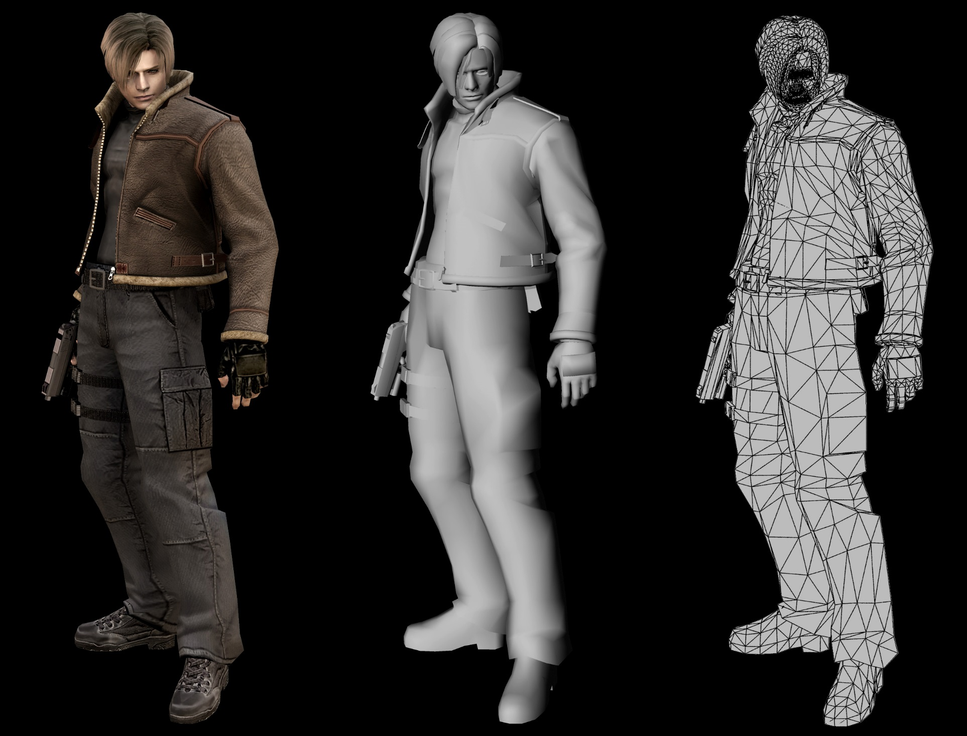
Image url: http://www.capcom-central.com/concept/re4/LeonWireFrame.jpg

Slide 48
Modeling and OpenGL
In OpenGL, all geometry is specified by stating which type of object and then giving the vertices that define it
glBegin() …glEnd()
glVertex[34][fdv]
  Three or four components (regular or homogeneous)
  Float, double or vector (eg float[3])
Chapter 2 of the OpenGL red book
Notes:
In OpenGL, we first specify what type of object we are modeling and then we give the vertices that define it.

Slide 49
Rendering
Generate an image showing the contents of some region of space
  The region is called the view volume, and it is defined by the user
Determine where each object should go in the image
  Viewing, Projection
Determine which pixels should be filled
  Rasterization
Determine which object is in front at each pixel
  Hidden surface elimination, Hidden surface removal, Visibility
Determine what color it is
  Lighting, Shading
Notes:
Once we model an object, we now need to render it. First, we need to specify a region of space that contains objects to be displayed. We call it view volume. Then, we need to determine where each object should go in the final image; then; we need to determine which pixels we need to fill based on the object, we call this procedure rasterization. Since there maybe multiple objects and these objects could occlude others, we need to figure out which object is shown eventually; we will hidden surface elimination methods for this task. Finally, we need to determine the color for each pixel. We will talk about lighting and shading methods for this task.

Slide 50
Graphics Pipeline
Graphics hardware employs a sequence of coordinate systems
  The location of the geometry is expressed in each coordinate system in turn, and modified along the way
  The movement of geometry through these spaces is considered a pipeline
Local Coordinate Space
World Coordinate Space
View Space
Canonical View Volume
Display Space
Notes:
Now let’s look at graphics pipeline that takes geometry as input and generates the final image in a few consecutive stages.
In a graphics pipeline, we use a different coordinate system at a different stage. There are usually five coordinate systems involved in a typical graphics pipeline.

Slide 51
Next Time
The Viewing Pipeline
Perspective Projection
Clipping

Slide 52
Local Coordinate Space
It is easiest to define individual objects in a local coordinate system
  For instance, a cube is easiest to define with faces parallel to the coordinate axes
z
y
o
x
Notes:
The first is local coordinate space. It is easy to define an individual object in its local coordinate system. For example, we can easily define a cube in coordinate system where each face of the cube is parallel to the coordinate axes. One important advantage of using a local coordinate system to define an object is, when we want to use the object multiple times, we can just copy it and transform in into the different locations of the global system. We do not need to figure out the coordinates of the primitives that are used to define an object for each object.

Slide 53
Local Coordinate Space
It is easiest to define individual objects in a local coordinate system
  For instance, a cube is easiest to define with faces parallel to the coordinate axes
Key idea: Object instantiation
  Define an object in a local coordinate system
  Use it multiple times by copying it and transforming it into the global system
  This is the only effective way to have libraries of 3D objects
Notes:
The first is local coordinate space. It is easy to define an individual object in its local coordinate system. For example, we can easily define a cube in coordinate system where each face of the cube is parallel to the coordinate axes. One important advantage of using a local coordinate system to define an object is, when we want to use the object multiple times, we can just copy it and transform in into the different locations of the global system. We do not need to figure out the coordinates of the primitives that are used to define an object for each object.

Slide 54
World Coordinate System
Everything in the world is transformed into one coordinate system - the world coordinate system
  It has an origin, and three coordinate directions, x, y, and z
Lighting is defined in this space
  The locations, brightness’ and types of lights
The camera is defined with respect to this space
Some higher level operations, such as advanced visibility computations, can be done here
Notes:
Everything in a scene will be eventually transformed into one unified coordinate system- we call it the world coordinate system. Not only objects, the lights, the camera are also defined in this world coordinates; Some higher level operations such as visibility computations are also done here.

Slide 55
View Space
Define a coordinate system based on the eye and image plane – the camera
  The eye is the center of projection, like the aperture in a camera
  The image plane is the orientation of the plane on which the image should “appear,” like the film plane of a camera
Some camera parameters are easiest to define in this space
  Focal length, image size
Relative depth is captured by a single number in this space
Notes:
Once we have defined the objects and rendering environment in the world coordinate system, we now need to model the camera that views the world. We define a new coordinate system based on the camera: the eye and the image plane. Here the eye is the center of the projection, like the aperture of a camera. The image plane defines where the image should appear, like the film plane of a camera. Some of the camera parameters are defined in this space, such as the focal length and the image size. In the view space, the relative depth of a vertex is defined by a single number.

Slide 56
Canonical View Volume
Canonical View Space: A cube, with the origin at the center, the viewer looking down –z, x to the right, and y up
  Canonical View Volume is the cube: [-1,1]×[-1,1]×[-1,1]
  Variants (later) with viewer looking down +z and z from 0-1
  Only things that end up inside the canonical volume can appear in the window
Tasks: Parallel sides and unit dimensions make many operations easier
  Clipping – decide what is in the window
  Rasterization - decide which pixels are covered
  Hidden surface removal - decide what is in front
  Shading - decide what color things are
Notes:
Now let’s look at the canonical view space. Canonical view space is defined as a cube with the origin at the center and the viewer looks down –z, and x to the right and y up. Only the objects that are inside the canonical view volume will appear in the final image. Many processes are performed in this canonical view volume.

Slide 57
Window Space
Window Space: Origin in one corner of the “window” on the screen, x and y match screen x and y
Windows appear somewhere on the screen
  Typically you want the thing you are drawing to appear in your window
  But you may have no control over where the window appears
You want to be able to work in a standard coordinate system – your code should not depend on where the window is
You target Window Space, and the windowing system takes care of putting it on the screen
Notes:
Finally, the objects in the canonical volume will be displayed in a window. The window space is defined by its origin and x y axises. The x, y axises match the screen x and y. The things/image we are drawing will eventually appear in the window. We have no control over where the window appears in a screen. The windowing system takes care of putting it on the screen.

Slide 58
Graphics Pipeline
Local Coordinate Space
World Coordinate Space
View Space
Canonical View Volume
Display Space
Notes:
Let’s first look at how we convert from canonical view space to display space/window space.

Slide 59
Canonical → Window Transform
Problem: Transform the Canonical View Volume into Window Space (real screen coordinates)
  Drop the depth coordinate and translate
  The graphics hardware and windowing system typically take care of this – but we’ll do the math to get you warmed up
The windowing system adds one final transformation to get your window on the screen in the right place
Notes:
We know that the canonical view volume is a cube. We want to transform this cube into the window space. So how do we do it?
Basically, we drop the depth coordinate and then translate and possibly scale the cube to show on the screen. We only need to specify the target region in the window space to show the canonical view volume, and the graphics pipeline in our computer, like opengl, will take care of the transformation. But, here, let’s see how opengl works.

Slide 60
Canonical → Window Transform
Typically, windows are specified by a corner, width and height
  Corner expressed in terms of screen location
  This representation can be converted to (x_{min},y_{min}) and (x_{max},y_{max})
We want to map points in Canonical View Space into the window
  Canonical View Space goes from (-1,-1,-1) to (1,1,1)
  Lets say we want to leave z unchanged
What basic transformations will be involved in the total transformation from 3D screen to window coordinates?
Notes:
Typically, a window is specified by a corner, width and height; the corner is expressed in terms of screen location; we can also represent a window by its two corner points;

Slide 61
Canonical → Window Transform
(1,1)
(x_{max},y_{max})
(x_{min},y_{min})
(-1,-1)
Canonical view volume Window space
Notes:
Canonical view volume Window

Slide 62
Canonical → Window Transform
(1,1)
(x_{max},y_{max})
(x_{min},y_{min})
(-1,-1)

Slide 63
Canonical → Window Transform
You almost never have to worry about the canonical to window transform
In OpenGL, you tell it which part of your window to draw in – relative to the window’s coordinates
  That is, you tell it where to put the canonical view volume
  You must do this whenever the window changes size
  Window (not the screen) has origin at bottom left
  glViewport(minx, miny, maxx, maxy)
  Typically: glViewport(0, 0, width, height)fills the entire window with the image
Some textbook derives a different transform, but the same idea
Notes:
In practice, we usually do not need to come up with the matrix by ourselves; OpenGl will take care of it for us.
In OpenGL, you tell it which part of your window to draw in;

Slide 64
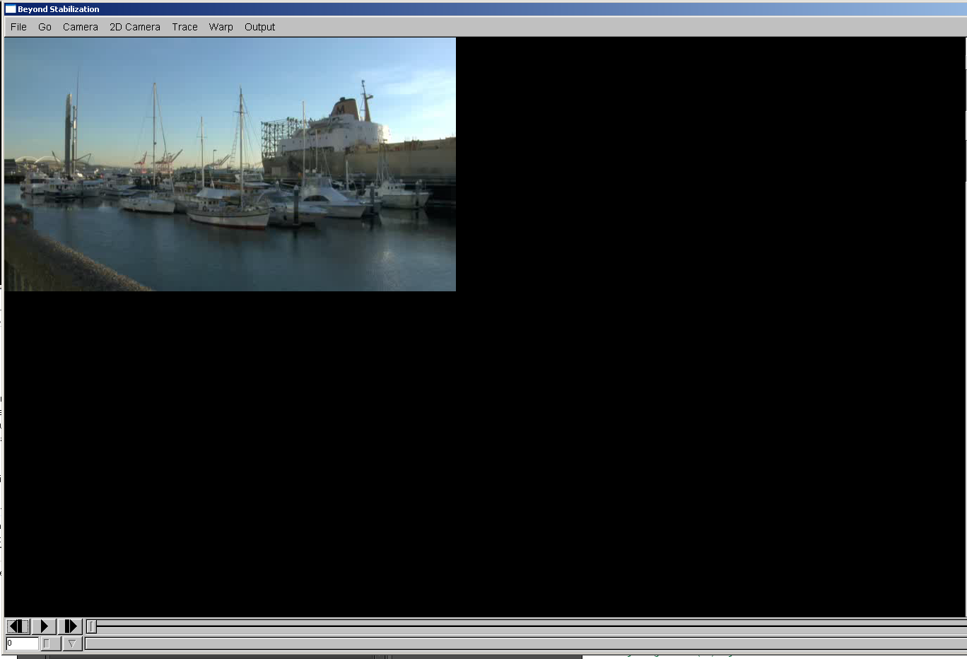
glViewport(0, 0, width, height)

Slide 65
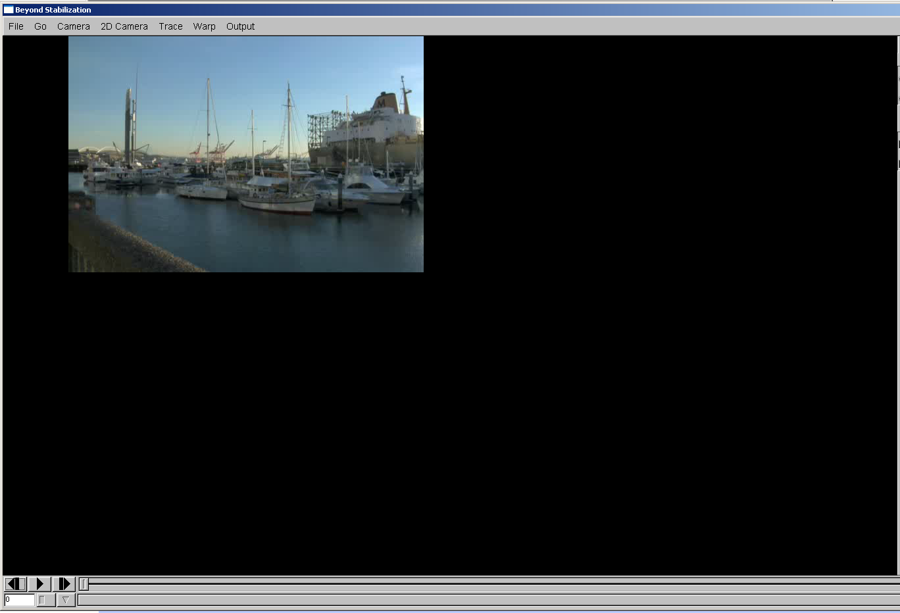
glViewport(100, 0, width, height)

Slide 66
Graphics Pipeline
Local Coordinate Space
World Coordinate Space
View Space
Canonical View Volume
Display Space
Notes:
OK, we have just talked about how to convert from the canonical view volume to the display space. Now let’s talk about how do we convert from the view space to the canonical view volume.

Slide 67
View Volumes
Only stuff inside the Canonical View Volume gets drawn
  Points too close or too far away will not be drawn
  But, it is inconvenient to model the world as a unit box
A view volume is the region of space we wish to transform into the Canonical View Volume for drawing
  Only stuff inside the view volume gets drawn
  Describing the view volume is a major part of defining the view
Notes:
We know that only objects inside the canonical view volume gets drawn. But imagine, when we or a camera view a scene, what we see actually is not a unit box. So it is inconvenient to model the world as a unit box. (The view space is defined from the point of view of a camera that we use to take the picture of the scene.) Again, only stuff inside the view volume gets drawn.
A view volume is the region of space we wish to transform into the canonical view volume for drawing.
Now, let’s describe how we define the view volume.

Slide 68
Orthographic Projection
Orthographic projection projects all the points in the world along parallel lines onto the image plane
  Projection lines are perpendicular to the image plane
  Like a camera with infinite focal length
The result is that parallel lines in the world project to parallel lines in the image, and ratios of lengths are preserved
  This is important in some applications, like medical imaging and some computer aided design tasks
Notes:
In practice, there are two types of view volume based on the camera model. Today, we will first start from an easy one: Orthograhic view volume.
Orthographic view volume is defined based on the orthographic projection camera model. The orthographic projection projects all the points in the world along parallel lines onto the image plane. And the projection lines are perpendicular to the image plane. We can consider such a camera with infinite focal length. Using orthographic projection, parallel lines in the world project to parallel lines in the image; and the ratios of lengths between parallel lines are preserved.

Slide 69
Orthographic View Space
View Space: a coordinate system with the viewer looking in the –z direction, with x horizontal to the right and y up
  A right-handed coordinate system! All ours will be
The view volume is a rectilinear box for orthographic projection
  The view volume has:
  a near plane at z=n
  a far plane at z=f , (f < n)
  a left plane at x=l
  a right plane at x=r, (r>l)
  a top plane at y=t
  and a bottom plane at y=b, (b<t)
y
(l,t,f)
z
x
(r,b,n)
Notes:
Based on this orthographic projection model, the view space is defined as a coordinate system with the viewer looking into the –z…
This is a right-hand system.

Slide 70
Rendering the Volume
To find out where points end up on the screen, we must transform View Space into Canonical View Space
  We know how to draw Canonical View Space on the screen
This transformation is “projection”
The mapping looks similar to the one for Canonical to Window …

Slide 71
Orthographic Projection Matrix
(Orthographic View to Canonical Matrix)

Slide 72
Graphics Pipeline
Local Coordinate Space
World Coordinate Space
View Space
Canonical View Volume
Display Space

Slide 73
Next Time
Perspective Projection
Clipping

