Slide 1
Computer Graphics
Prof. Feng Liu
Fall 2022
http://www.cs.pdx.edu/~fliu/courses/cs447/
10/17/2022
Notes:
Computer Graphics

Slide 2
Last time
Filtering
Resampling

Slide 3
Today
Compositing
NPR

Slide 4

https://www.youtube.com/watch?v=cqczPfWnQMI

Slide 5
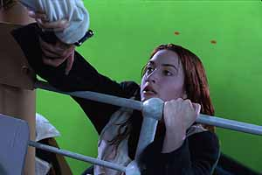

Compositing
Compositing combines components from two or more images to make a new image
  Special effects are easier to control when done in isolation
  Even many all live-action sequences are more safely shot in different layers
Notes:
OK. This is all we need to know about signal processing for this introductory graphics class. Now let’s first take a rest and then talk about a more interesting topic. Image compositing.
Compositing is an operation that combines components from two or more images to make a new image. It is one of the most widely used graphics algorithm in movies and games. For example, the action shown on the right is dangerous. But in practice, this action was shot in a much safer environment. They extract the actress and some objects and merge them into a background scene using compositing.

Slide 6
Historically …
The basis for film special effects
  Create digital imagery and composite it into live action
  It was necessary for films (like Star Wars) where models were used
  It was done with film and masks, and was time consuming and expensive
Important part of animation – even hand animation
  Background change more slowly than foregrounds, so composite foreground elements onto constant background
  It was a major advance in animation – the multiplane camera first used in Snow White (1937)
Notes:
The multiplane camera is a special motion picture camera used in the traditional animation process that moves a number of pieces of artwork past the camera at various speeds and at various distances from one another. This creates a three-dimensional effect, although not actually stereoscopic.
Various parts of the artwork layers are left transparent, to allow other layers to be seen behind them. The movements are calculated and photographed frame-by-frame, with the result being an illusion of depth by having several layers of artwork moving at different speeds - the further away from the camera, the slower the speed. The multiplane effect is sometimes referred to as a parallax process.

Slide 7
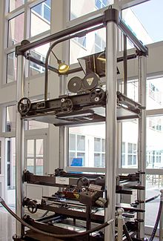

Multiplane camera
https://en.wikipedia.org/wiki/Multiplane_camera
Notes:
Add by Feng

Slide 8
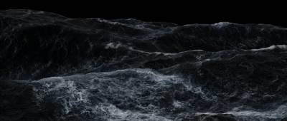
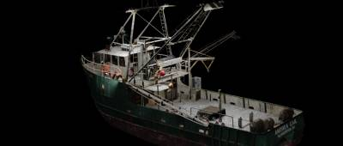




Perfect Storm

Slide 9



Animated Example
=
over

Slide 10
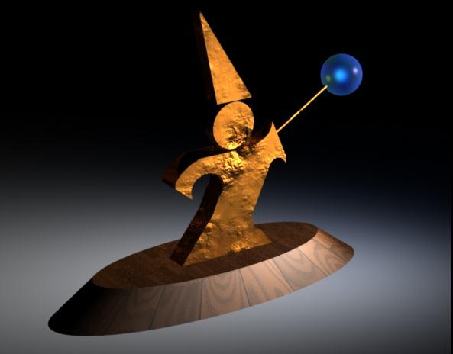

Mattes
A matte is an image that shows which parts of another image are foreground objects
Term dates from film editing and cartoon production
How would I use a matte to insert an object into a background?
How are mattes usually generated for television?
Notes:
Now let’s talk about how the compositing technique works. We first need to obtain a matte image for each source image. Matte is a term from film editing and cartoon production. A matte is an image that shows which parts of the image are foreground objects. We need to figure out two problems: first, how could we generate mattes? Second, how could we make use of them to insert an object into a background?

Slide 11
Working with Mattes
To insert an object into a background
  Call the image of the object the source
  Put the background into the destination
  For all the source pixels, if the matte is white, copy the pixel, otherwise leave it unchanged
To generate mattes:
  Use smart selection tools in Photoshop or similar
    They outline the object and convert the outline to a matte
  Blue Screen: Photograph/film the object in front of a blue background, then consider all the blue pixels in the image to be the background
Notes:
There are many ways for use to generate mattes. We can use the smart selection tools in Photoshop to create the mattes. Or, in cinematography, people actually use blue screen techniques. Basically, an object or person is filmed in front of a blue background; then we can consider all the blue pixels in the image to be the background.
Now let’s talk about how we insert an object into a background using a matte image. We call the image with the object the source, and the background as the destination. For all the source pixels, if the matte is white, we copy the pixel; otherwise we leave it unchanged.

Slide 12
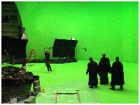
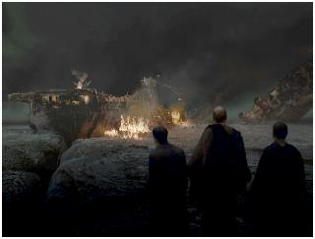
Compositing
Compositing is the term for combining images, one over the other
  Used to put special effects into live action
Notes:
Here is an example of how we make use of the matte to combine two images. The left shows how the action is filmed with a green screen as a background. The right shows that the action is inserted into the background with special effects. This procedure of combining images together as compositing.

Slide 13
Alpha
Basic idea: Encode opacity information in the image
Add an extra channel, the alpha channel, to each image
  For each pixel, store R, G, B and Alpha
  alpha = 1 implies full opacity at a pixel
  alpha = 0 implies completely clear pixels
There are many interpretations of alpha
  Is there anything in the image at that point (web graphics)
  Transparency (real-time OpenGL)
Images are now in RGBA format, and typically 32 bits per pixel (8 bits for alpha)
All images in the project are in this format
Notes:
Now let’s review the algorithms for compositing. We encode opacity information and store it as another channel for a digital image beside RGB. We call it alpha channel. In this way, the pixel format in an image is RGBA, which typically takes 32 bits.
All the images in project 1 are in this format.

Slide 14
Pre-Multiplied Alpha
Instead of storing (R,G,B,α), store (αR,αG,αB,α)
The compositing operations in the next several slides are easier with pre-multiplied alpha
To display and do color conversions, must extract RGB by dividing out α
  α=0 is always black
  Some loss of precision as α gets small, but generally not a big problem
Notes:
A straight-forward way to store a pixel then is to store rgba. But, in practice, we actually store ar, ag,ab, a instead. We call this format pre-multiplied alpha. That is because, the compositing operations as we will talk about in the next few slides are much easier with pre-multiplied alpha.
With pre-multiplied alpha, to display and manipuate color, we must extract rgb by dividing out alpha. Note, when alpha is zero, the color is black.

Slide 15
Compositing Assumptions
We will combine two images, f and g, to get a third composite image
Both images are the same size and use the same color representation
Multiple images can be combined in stages, operating on two at a time
Notes:
Ok. Now let’s talk about compositing algorithms. Before we do, let’s first make some assumptions. We will combine two images, f and g into a third composite image;

Slide 16
Basic Compositing Operation
At each pixel, combine the pixel data from f and the pixel data from g with the equation:
F and G describe how much of each input image survives, and c_{f} and c_{g} are pre-multiplied pixels, and all four channels are calculated
To define a compositing operation, define F and G
Notes:
Any compositing operation can be described by this linear combination formula.

Slide 17

Basic Compositing Operation
F and G are simple functions of the alpha values
F and G are chosen (independently)
Different choices give different operations
To code it, you can write one compositor and give it 6 numbers (3 for F, 3 for G) to say which function
  Constant of 0 or 1
  α_{f} is multiplied by -1, 0 or 1. Similar for α_{g}
$$1α_{f}α_{g}$$
Notes:
F and G are functions of the alpha values of the input images f and g. We can actually code these operations.
… Of course, there are some combination we do not use in practice, such as F=1+af+ag

Slide 18




Sample Images
Images
Alphas
Notes:
OK. Now let’s go over these operations one by one. This slides show two images as well as their alpha values.

Slide 19
Sample Images
Images
0,1,0 | 0,1,0 | 0, 0, 0
0,1,0 | 0,1,0 | 0 ,0, 0
0,1,0 | 0,1,0 | 0, 0 ,0
1,0,0 | 1,0,0 | 1,0,0
1,0,0 | 1,0,0 | 1,0,0
0, 0 ,0 | 0, 0 ,0 | 0, 0 ,0
RGB
Alphas
1 | 0.5 | 0
1 | 0.5 | 0
1 | 0.5 | 0
1 | 1 | 1
0.5 | 0.5 | 0 .5
0 | 0 | 0
Notes:
OK. Now let’s go over these operations one by one. This slides show two images as well as their alpha values.

Slide 20
Sample Images
Images
Pre-multiplied
RGBA
0,1,0 1 | 0,0.5,0 0.5 | 0, 0, 0 0
0,1,0 1 | 0,0.5,0 0.5 | 0 ,0, 0 0
0,1,0 1 | 0,0.5,0 0.5 | 0, 0 ,0 0
1,0,0 1 | 1,0,0 1 | 1,0,0 1
0.5,0,0 0.5 | 0.5,0,0 0.5 | 0.5,0,0 0.5
0, 0 ,0 0 | 0, 0 ,0 0 | 0, 0 ,0 0
Alphas
Notes:
OK. Now let’s go over these operations one by one. This slides show two images as well as their alpha values.

Slide 21
“Over” Operator
Computes composite with the rule that f covers g
Notes:
The first is over operator. Basically, it shows the effect of f covers g.

Slide 22
“Over” Operator
0,1,0 1 | 0,0.5,0 0.5 | 0, 0, 0 0
0,1,0 1 | 0,0.5,0 0.5 | 0 ,0, 0 0
0,1,0 1 | 0,0.5,0 0.5 | 0, 0 ,0 0
1,0,0 1 | 1,0,0 1 | 1,0,0 1
0.5,0,0 0.5 | 0.5,0,0 0.5 | 0.5,0,0 0.5
0, 0 ,0 0 | 0, 0 ,0 0 | 0, 0 ,0 0
0,1,0 1 | 0.5,0.5,0 1 | 1,0,0 1
0,1,0 1 | 0.25,0.5,0 0.75 | 0.5,0,0 0.5
0,1,0 1 | 0, 0.5 ,0 0.5 | 0, 0 ,0 0
Over
f g result
Notes:
The first is over operator. Basically, it shows the effect of f covers g.
Over

Slide 23
“Over” Operator
0,1,0 1 | 0,0.5,0 0.5 | 0, 0, 0 0
0,1,0 1 | 0,0.5,0 0.5 | 0 ,0, 0 0
0,1,0 1 | 0,0.5,0 0.5 | 0, 0 ,0 0
1,0,0 1 | 1,0,0 1 | 1,0,0 1
0.5,0,0 0.5 | 0.5,0,0 0.5 | 0.5,0,0 0.5
0, 0 ,0 0 | 0, 0 ,0 0 | 0, 0 ,0 0
0,1,0 1 | 0.5,0.5,0 1 | 1,0,0 1
0,1,0 1 | 0.25,0.5,0 0.75 | 0.5,0,0 0.5
0,1,0 1 | 0, 0.5 ,0 0.5 | 0, 0 ,0 0
Over
f g result
0, 0.5, 0
0.5
+
(1 - 0.5)
1, 0, 0
0
0.5, 0.5, 0
1
Notes:
The first is over operator. Basically, it shows the effect of f covers g.
Over + (1 - 0.5)

Slide 24
“Over” Operator: Extract RGB Color
0,1,0 | 0.5,0.5,0 | 1,0,0
0,1,0 | 1/3,2/3,0 | 1,0,0
0,1,0 | 0, 1,0 | 0, 0 ,0
0,1,0 1 | 0.5,0.5,0 1 | 1,0,0 1
0,1,0 1 | 0.25,0.5,0 0.75 | 0.5,0,0 0.5
0,1,0 1 | 0, 0.5 ,0 0.5 | 0, 0 ,0 0
RGB
0,1,0 1 | 0.5,0.5,0 1 | 1,0,0 1
0,1,0 1 | 0.25,0.5,0 0.75 | 0.5,0,0 0.5
0,1,0 1 | 0, 0.5 ,0 0.5 | 0, 0 ,0 0
Pre-multiplied RGBA
Alpha
Notes:
The first is over operator. Basically, it shows the effect of f covers g.
Over

Slide 25


“Over” Operator
If there’s some f, get f, otherwise get g
over
=
Notes:
If the alpha values are binary, over is easy; basically, if f exist, we will use f otherwise we use g. For fraction alpha values, we need to do math.
Which is easy for a compute, could be tedious for me. Anyway, let’s do the math.

Slide 26
“Inside” Operator
Computes composite with the rule that only parts of f that are inside g contribute

Slide 27
“Inside” Operator
0,1,0 1 | 0,0.5,0 0.5 | 0, 0, 0 0
0,1,0 1 | 0,0.5,0 0.5 | 0 ,0, 0 0
0,1,0 1 | 0,0.5,0 0.5 | 0, 0 ,0 0
1,0,0 1 | 1,0,0 1 | 1,0,0 1
0.5,0,0 0.5 | 0.5,0,0 0.5 | 0.5,0,0 0.5
0, 0 ,0 0 | 0, 0 ,0 0 | 0, 0 ,0 0
0,1,0 1 | 0,0.5,0 0.5 | 0,0,0 0
0,0.5,0 0.5 | 0,0.25,0 0.25 | 0,0,0 0
0, 0 ,0 0 | 0, 0 ,0 0 | 0, 0 ,0 0
Over
f g result

Slide 28


“Inside” Operator
Get f to the extent that g is there, otherwise nothing
inside
=

Slide 29
“Outside” Operator
Computes composite with the rule that only parts of f that are outside g contribute

Slide 30


“Outside” Operator
Get f to the extent that g is not there, otherwise nothing
outside
=

Slide 31
“Atop” Operator
Computes composite with the over rule but restricted to places where there is some g

Slide 32

“Atop” Operator
Get f to the extent that g is there, otherwise g
atop
=

Slide 33
“Xor” Operator
Computes composite with the rule that f contributes where there is no g, and g contributes where there is no f

Slide 34


“Xor” Operator
Get f to the extent that g is not there, and g to extent of no f
xor
=

Slide 35
“Clear” Operator
Computes a clear composite
Note that (0,0,0,α>0) is a partially opaque black pixel, whereas (0,0,0,0) is fully transparent, and hence has no color
Notes:
Now let’s look at an easy operator, “clear operator”. It basically makes a clear composite. Here we will get (0,0,0,0), which is a fully transparent; and hence no color; Note, (0,0,0,alpha) is a partially opaque black pixel.

Slide 36
“Set” Operator
Computes composite by setting it to equal f
Copies f into the composite
Notes:
The next one is set operator. It basically takes f as the output.

Slide 37
Compositing Operations
F and G describe how much of each input image survives, and c_{f} and c_{g} are pre-multiplied pixels, and all four channels are calculated
Operation | F | G
Over
Inside
Outside
Atop
Xor
Clear
Set

Slide 38
Unary Operators
Darken: Makes an image darker (or lighter) without affecting its opacity
Dissolve: Makes an image transparent without affecting its color
Notes:
There are two interesting unary operators. The first is darkening operator. It makes an image darker or lighter without chaning its opacity;
The second is dissolve. It makes an image transparent without affecting its color.

Slide 39
“PLUS” Operator
Computes composite by simply adding f and g, with no overlap rules
Useful for defining cross-dissolve in terms of compositing:
Notes:
Now let’s look at the final operator; plus. This is useful to create the cross-dissolving effects between two images.

Slide 40
Obtaining α Values
Hand generate (paint a grayscale image)
Automatically create by segmenting an image into foreground background:
  Blue-screening is the analog method
    Remarkably complex to get right
  “Lasso” is the Photoshop operation
With synthetic imagery, use a special background color that does not occur in the foreground
  Brightest blue or green is common

Slide 41
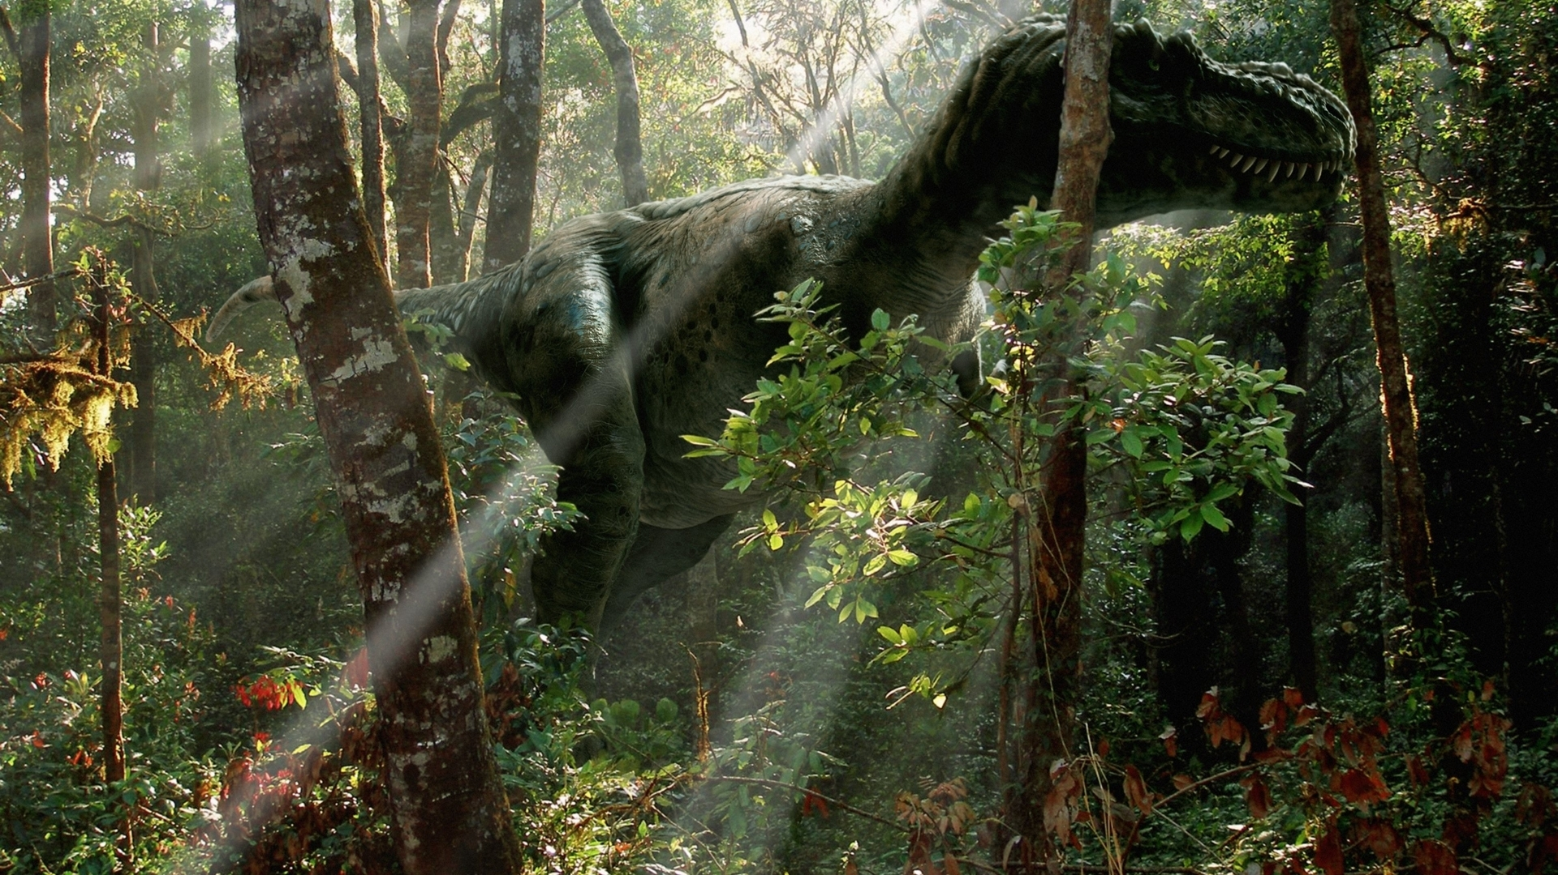
https://wallup.net/dinosaur-trees-forest-sunlight/
Notes:
https://wallup.net/dinosaur-trees-forest-sunlight/

Slide 42
Compositing With Depth
Can store pixel “depth” instead of alpha
Then, compositing can truly take into account foreground and background
Generally only possible with synthetic imagery
  Image Based Rendering is an area that, in part, tries to composite photographs taking into account depth
A photo and its depth map
Notes:
Besides using alpha values for compositing, another popular way is to use depth. This depth-based compositing really takes into account the foreground and background. It is easy to do depth-based compositing using synthetic imagery because we know the depth relationship among layers. Now, the ibr methods in graphics and vision are been developed to composite real images taking into account the depth.
A photo and its depth map

Slide 43
Today
More Compositing
Non-photorealistic Rendering (NPR)
Notes:
OK. Now let’s talk about non-photorealistic rendering. Non-photorealistic rendering (NPR) is an area of computer graphics that focuses on enabling a wide variety of expressive styles for digital art

Slide 44
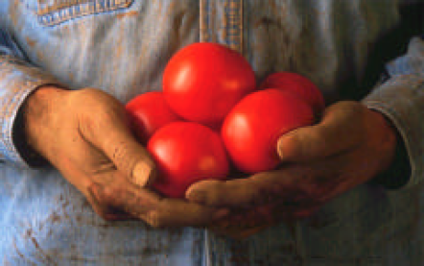
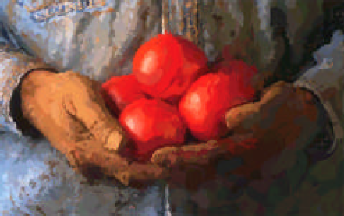
Painterly Filters
Many methods have been proposed to make a photo look like a painting
Today we look at one: Painterly-Rendering with Brushes of Multiple Sizes*
Basic ideas:
  Build painting one layer at a time, from biggest to smallest brushes
  At each layer, add detail missing from previous layer
*Aaron Hertzmann. Painterly rendering with curved brush strokes of multiple sizes, SIGGRAPH 1998
Notes:
An important topic in non-photorealistic rendering is to create an image that look like a painting. Today we look at one: painterly–rendering with Brushes of Multiple Sizes. This algorithm is pretty intuitive, and not very difficult to implement. You can implement this algorithm for project 1.
Basically, it builds painting one layer at a time. At the first, it uses a big brush, and then uses a smaller brush at each step. Big brush can capture the overall feature of an image, and smaller brushes can add details.

Slide 45
Algorithm 1
function paint(sourceImage,R₁ ... R_{n}) // take source and several brush sizes
{
canvas := a new constant color image
// paint the canvas with decreasing sized brushes
for each brush radius R_{i}, from largest to smallest do
{
// Apply Gaussian smoothing with a filter of size const * radius
// Brush is intended to catch features at this scale
referenceImage = sourceImage * G(fs R_{i})
// Paint a layer
paintLayer(canvas, referenceImage, Ri)
}
return canvas
}
Notes:
This is a psudo code for this NPR algorithm

Slide 46
Algorithm 2
procedure paintLayer(canvas,referenceImage, R) // Add a layer of strokes
{
S := a new set of strokes, initially empty
D := difference(canvas,referenceImage) // euclidean distance at every pixel
for x=0 to imageWidth stepsize grid do // step in size that depends on brush radius
for y=0 to imageHeight stepsize grid do {
// sum the error near (x,y)
M := the region (x-grid/2..x+grid/2, y-grid/2..y+grid/2)
areaError := sum(D_{i,j} for i,j in M) / grid²
if (areaError > T) then {
// find the largest error point
(x1,y1) := max D_{i,j} in M
s :=makeStroke(R,x1,y1,referenceImage)
add s to S
}
}
paint all strokes in S on the canvas, in random order
}
Notes:
Each layer is painted with strokes. We first compute the difference between the reference Image and the canvas. Then, for each pixel, we calculate the difference between the canvas and the reference image in its neighborhood. If the difference is too big, which means the canvas is not like the reference image, we put a stroke there to decrease the difference.

Slide 47
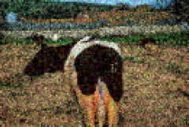
Point Style
Uses round brushes
We provide a routine to “paint” round brush strokes into an image for the project
Notes:
There are a variety of ways to model the stroke. An easy way is to model a stroke as a circle, and use a representative color in the neighborhood as the brush color. We actually provide a routine in the basic project program to help you to paint a stroke.

Slide 48


Results
Original
Biggest brush
Medium brush added
Finest brush added

Slide 49
Next Time
3D Graphics Toolkits
  Transformations
Composing transformations
3D Transformations
Viewing

Slide 50
Where to now…
We are now done with images
We will spend several weeks on the mechanics of 3D graphics
  Coordinate systems and Viewing
  Clipping
  Drawing lines and polygons
  Lighting and shading
Notes:
OK. We are now done with images. We will spend several weeks on 3D graphics, particularly the mechanics of current graphics toolkits.

Slide 51
Graphics Toolkits
Graphics toolkits typically take care of the details of producing images from geometry
Input (via API functions):
  Where the objects are located and what they look like
  Where the camera is and how it behaves
  Parameters for controlling the rendering
Functions (via API):
  Perform well defined operations based on the input environment
Output: Pixel data in a framebuffer – an image in a special part of memory
  Data can be put on the screen
  Data can be read back for processing (part of toolkit)
Notes:
As we might have expected, we do not need to build a complicated 3D graphics application from the scratch. We have graphics toolkits to take care of the details of producing images from 3D geometry. Graphics toolkits provide APIs for us to specify the input environment and geometry information, such as …. Graphics toolkits also provide APIs to perform well defined operations based on the input. Finally, graphics toolkits will store the pixel data in a framebuffer.
A framebuffer is a video output device that drives a video display from a memory buffer containing a complete frame of data.

Slide 52
OpenGL
OpenGL is an open standard graphics toolkit
  Derived from SGI’s GL toolkit
Provides a range of functions for modeling, rendering and manipulating the framebuffer
What makes a good toolkit?
Alternatives: Direct3D, Java3D - more complex and less well supported
Notes:
OpenGL is the most widely used graphics toolkits. It started from SGI’s GL toolkit.

Slide 53
A Good Toolkit…
Everything is a trade-off
Functionality
  Compact: a minimal set of commands
  Orthogonal: commands do different things and can be combined in a consistent way
  Speed
Ease-of-Use and Documentation
Portability
Extensibility
Standards and ownership
Not an exhaustive list …

Slide 54
Coordinate Systems
The use of coordinate systems is fundamental to computer graphics
Coordinate systems are used to describe the locations of points in space, and directions in space
Multiple coordinate systems make graphics algorithms easier to understand and implement
Notes:
Now Let’s look at the basics of graphics toolkits: that is coordinate systems. In a graphics toolkit, there are often multiple coordinate systems.

Slide 55
Coordinate Systems (2)
Different coordinate systems represent the same point in different ways
v
(2,3)
v
(1,2)
y
y
u
u
x
x
Notes:
Different coordinate systems represent the same point in different ways. Here is an example. In the XY coordinate system, the point’s coordinates are (2, 3); while in the uv coordinate system, it is (1,2)

Slide 56
Transformations
Transformations convert points between coordinate systems
v
(2,3)
u=x-1
v=y-1
v
(1,2)
y
y
u
x=u+1
y=v+1
u
x
x
Notes:
We can apply transformations to convert points between coordinate systems. For example, we can convert the xy into uv by subtraction here. We can convert uv to xy in a similar way.

Slide 57
Transformations (Alternate Interpretation)
Transformations modify an object’s shape and location in one coordinate system
The previous interpretation is better for some problems, this one is better for others
(2,3)
x’=x-1
y’=y-1
y
y
(1,2)
x=x’+1
y=y’+1
x
x
Notes:
Transformation can also be considered as a way to modify an object’s location and shape in one coordinate system. Here we can consider the transformation moves a point’s location in the space

Slide 58
2D Translation
Moves an object
y
y
b_{y}
x
b_{x}
x
Notes:
Now let’s see some common transformation. The first is 2D translation.

Slide 59
2D Translation
Moves an object
y
y
b_{y}
x
b_{x}
x

Slide 60
2D Scaling
Resizes an object in each dimension
y
y
y
s_{y}y
x
x
s_{x}x
x

Slide 61
2D Scaling
Resizes an object in each dimension
y
y
y
s_{y}y
x
x
s_{x}x
x

Slide 62
2D Rotation
Rotate counter-clockwise about the origin by an angle θ
y
y
θ
x
x

Slide 63
2D Rotation
Rotate counter-clockwise about the origin by an angle θ
y
y
θ
x
x

Slide 64
X-Axis Shear
Shear along x axis (What is the matrix for y axis shear?)
y
y
x
x

Slide 65
X-Axis Shear
Shear along x axis (What is the matrix for y axis shear?)
y
y
x
x

Slide 66
Reflect About X Axis
y
y
x
x

Slide 67
Reflect About X Axis
y
y
x
x

Slide 68
2D Affine Transformations
An affine transformation is one that can be written in the form:
Notes:
An affine transformation is any transformation that preserves collinearity (i.e., all points lying on a line initially still lie on a line after transformation) and ratios of distances (e.g., the midpoint of a line segment remains the midpoint after transformation)
Parallel lines remain parallel under affine transformations

Slide 69
Composition of Affine Transforms
Any affine transformation can be composed as a sequence of simple transformations:
  Translation
  Scaling (possibly with negative values)
  Rotation

Slide 70
Rotating About An Arbitrary Point
What happens when you rotate an object about an arbitrary point that is not the origin?
y
x
Notes:
Now let’s talk about a more complicated case. That is, rotating about an arbitrary point instead of the origin of the coordinate system.

Slide 71
Rotating About An Arbitrary Point
What happens when you rotate an object about an arbitrary point that is not the origin?
y
y
x
x
Notes:
So what happens when we rotate an object about a point that is not the origin? We find that some point’s position is not changed!

Slide 72
How Do We Compute It?
How do we rotate an about an arbitrary point?
  Hint: we know how to rotate about the origin of a coordinate system
Notes:
So how do we compute the position of a point after rotating around an arbitrary point.
Remember, we know how to rotate around the origin of the coordinate system.

Slide 73
Rotating About An Arbitrary Point
y
y
(a, b)
x
(0, 0)
x
y
y
(a, b)
x
(0, 0)
x
Notes:
We can first translate the coordinate system, so that in the new coordinate system, the point (a, b) will be the origin. Then we rotate the object around the new origin, we know how to do it. Then we translate the coordinate system back.

Slide 74
Rotating About An Arbitrary Point
Say you wish to rotate about the point (a,b)
You know how to rotate about (0,0)
Translate so that (a,b) is at (0,0)
  x’=x–a, y’=y–b
Rotate
  x”=(x-a)cosθ-(y-b)sinθ, y”=(x-a)sinθ+(y-b)cosθ
Translate back again
  x_{f}=x”+a, y_{f}=y”+b
Notes:
Here is the math beside this idea. We translate the coordinate system, so that (a,b) becomes (0,0)

Slide 75
Rotating About An Arbitrary Point
Say R is the rotation matrix to apply, and p is the point about which to rotate
Translation to Origin:
Rotation:
Translate back:
The translation component of the composite transformation involves the rotation matrix. What a mess!
Notes:
OK. Now let’s look at the matrix and vector operation of this method.

Slide 76
Next Time
Composing transformations
3D Transformations
Viewing

