Slide 1
Computer Graphics
Prof. Feng Liu
Fall 2021
http://www.cs.pdx.edu/~fliu/courses/cs447/
10/04/2021
Notes:
Computer Graphics

Slide 2
Announcements
Free Textbook: Linear Algebra, by Jim Hefferon
  http://joshua.smcvt.edu/linalg.html/
Homework 1 due on Oct. 5
FAQ for tutorials available
Project 1 is available on course website
In-class lab session on Oct. 05
  Have a computer with VS 19 installed ready

Slide 3
Last Time
Digital images
  Raster vs. Vector
  Digital images as discrete representations of reality
  Human perception in deciding resolution and image depth
Color
Tri-Chromacy
Digital Color

Slide 4
Today
Color spaces
Ink
Image file formats
Color quantization

Slide 5
The Math of Trichromacy
Write primaries as R, G and B
  We won’t precisely define them yet
Many colors can be represented as a mixture of R, G, B: M=rR + gG + bB (Additive matching)
Gives a color description system - two people who agree on R, G, B need only supply (r, g, b) to describe a color
Some colors can’t be matched like this, instead, write: M+rR=gG+bB (Subtractive matching)
  Interpret this as (-r, g, b)
  Problem for reproducing colors – you can’t subtract light using a monitor, or add it using ink

Slide 6
James Maxwell’s color-matching experiment
Slide Credit: Jonathan Pillow
Notes:
Slide Credit: Jonathan Pillow

Slide 7
Color Matching
Given a spectrum, how do we determine how much each of R, G and B to use to match it?
First step:
  For a light of unit intensity at each wavelength, ask people to match it using some combination of R, G and B primaries
  Gives you, r(λ), g(λ) and b(λ), the amount of each primary used for wavelength λ
  Defined for all visible wavelengths, r(λ), g(λ) and b(λ) are the RGB color matching functions

Slide 8
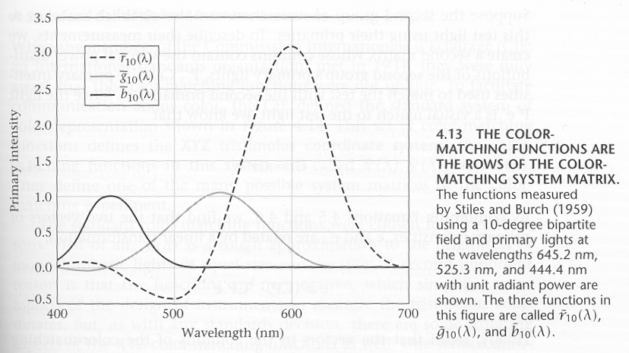
The RGB Color Matching Functions
Notes:
There is no such thing as negative light; so we add the same amount of light to the color the is being matched

Slide 9
Computing the Matching
Given a spectrum, how do we determine how much each of R, G and B to use to match it?
The spectrum function that we are trying to match, E(λ), gives the amount of energy at each wavelength
The RGB matching functions describe how much of each primary is needed to give one energy unit’s worth of response at each wavelength

Slide 10
Color Spaces
The principle of trichromacy means that the colors displayable are all the linear combination of primaries
Taking linear combinations of R, G and B defines the RGB color space
  the range of perceptible colors generated by adding some part of each of R, G and B
If R, G and B correspond to a monitor’s phosphors (monitor RGB), then the space is the range of colors displayable on the monitor
Notes:
Now let’s talk about color spaces. The principle of trichromacy states that the colors displayable are all the …
For example, we can take linear comibinations of rgb to define the RGB color space. As far as a moniotr is concerned, we can consider R,G,B correspond to a monitor’s phosphors, then monitor RGB space is the range of color that can be displayed on this monitor.

Slide 11
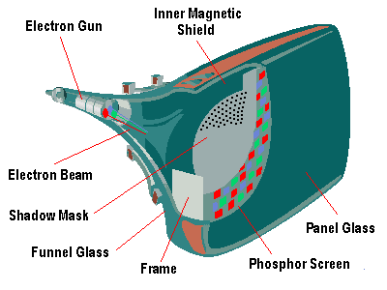
CRT’s Color Space
Image credit:
Left: https://depts.washington.edu/matseed/mse_resources/Webpage/Computer/Links/Monitor/desktop_monitors.htm
Right: Woods and Tan, Characterising Sources of Ghosting in Time-Sequential Stereoscopic Video Displays, SPIE 4660
Notes:
Slides prepared by F. Liu
Image credit:
Left: https://depts.washington.edu/matseed/mse_resources/Webpage/Computer/Links/Monitor/desktop_monitors.htm
Right: Woods and Tan, Characterising Sources of Ghosting in Time-Sequential Stereoscopic Video Displays, SPIE 4660

Slide 12
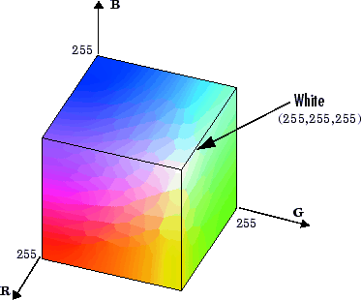
RGB Color Space
Demo

Slide 13
Problems with RGB
Can only represent a small range of all the colors humans are capable of perceiving (particularly for monitor RGB)
It isn’t easy for humans to say how much of RGB to use to make a given color
  How much R, G and B is there in “brown”? (Answer: .64,.16, .16)
Perceptually non-linear
Notes:
A B C 3 points in the color space; B and C are of the same distance away from A. But the difference between A and B and the difference between A and C are perceptually different!

Slide 14
CIE XYZ Color Space
  Imaginary primaries
  X, Y, Z
  Y component intended to correspond to intensity
  Cannot produce the primaries – need negative light!
Defined in 1931 to describe the full space of perceptible colors
  Revisions now used by color professionals
Color matching functions are everywhere positive
Most frequently set x=X/(X+Y+Z) and y=Y/(X+Y+Z)
  x,y are coordinates on a constant brightness slice
Notes:
To solve the first problem of RGB, color scientists defined another space.

Slide 15
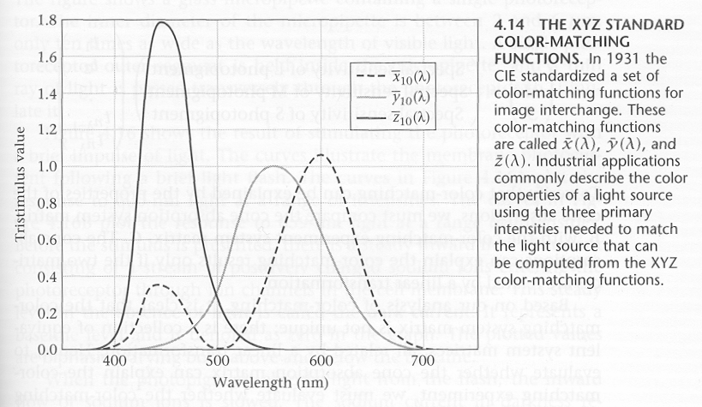
CIE Matching Functions

Slide 16
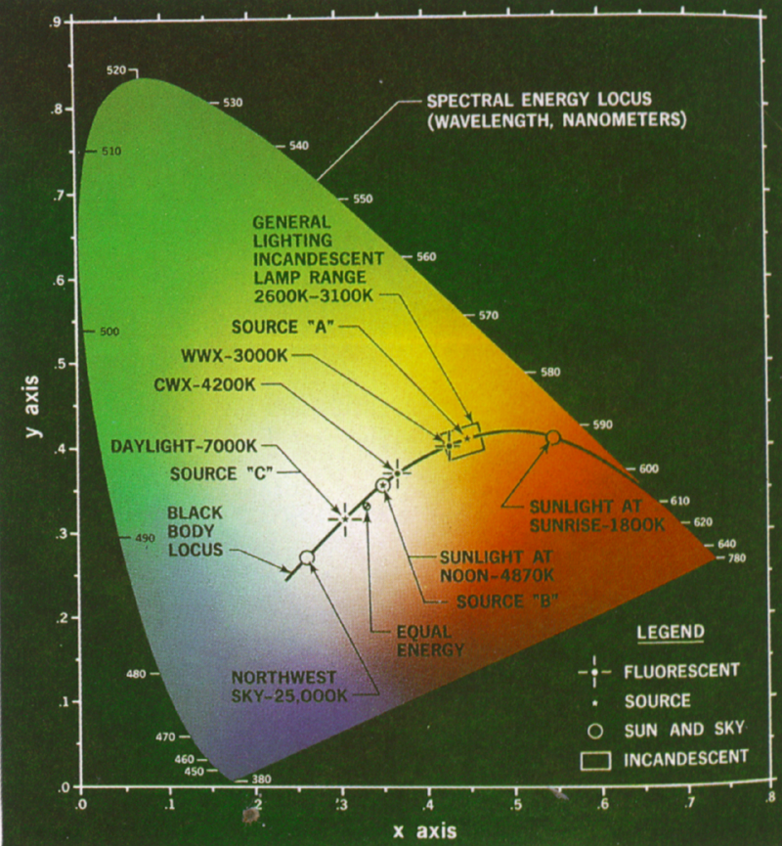
CIE x, y
Note: This is a representation on a projector with limited range, so the correct colors are not being displayed

Slide 17
Standard RGB↔XYZ
Note that each matrix is the inverse of the other
Recall, Y encodes brightness, so the matrix tells us how to go from RGB to grey

Slide 18
Determining Gamuts
XYZ Gamut
Gamut: The range of colors that can be represented or reproduced
Plot the matching coordinates for each primary. eg R, G, B
Region contained in triangle (3 primaries) is gamut
Really, it’s a 3D thing, with the color cube distorted and embedded in the XYZ gamut
y
RGB Gamut
G
R
B
x

Slide 19
Accurate Color Reproduction
Device dependent RGB space
High quality graphic design applications, and even some monitor software, offers accurate color reproduction
A color calibration phase is required:
  Fix the lighting conditions under which you will use the monitor
  Fix the brightness and contrast on the monitor
  Determine the monitor’s γ
  Using a standard color card, match colors on your monitor to colors on the card: This gives you the matrix to convert your monitor’s RGB to XYZ
  Together, this information allows you to accurately reproduce a color specified in XYZ format

Slide 20
More Linear Color Spaces
Monitor RGB: primaries are monitor phosphor colors, primaries and color matching functions vary from monitor to monitor
sRGB: A new color space designed for web graphics
YIQ: mainly used in television
  Y is (approximately) intensity, I, Q are chromatic properties
  Linear color space; hence there is a matrix that transforms XYZ coords to YIQ coords, and another to take RGB to YIQ
Notes:
Monitor manufactures try to select an optimal set of phosphor colors to get a color space that is closer to be linear as possible.

Slide 21
HSV Color Space (Alvy Ray Smith, 1978)
Hue: the color family: red, yellow, blue…
Saturation: The purity of a color: white is totally unsaturated
Value: The intensity of a color: white is intense, black isn’t
Space looks like a cone
  Parts of the cone can be mapped to RGB space
Not a linear space, so no linear transform to take RGB to HSV
  But there is an algorithmic transform
Notes:
Co-founder of LucasFilm’s Computer Division and Pixar. Oscar awards twice for image composition and digital painter system

Slide 22
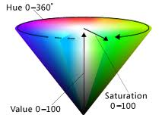
HSV Color Space

Slide 23
Linear Space vs. Perceptually Linear (Uniform)
Linear Space: RGB, CIE XYZ
  The principle of trichromacy means that the colors displayable are all the linear combination of primaries
    HSV is not a linear space
  Matrix multiplication
  Easy to convert between colors
  Not perceptually linear
Perceptually Linear space
  Computational consuming
  Make color distance meaningful
  CIE u’v’: a good approximation
Notes:
Here, I’d like to emphasize that Linear space and perceptually linear space are not the same concept. Linear space is defined based on the trichromacy principle. It states that the colors are all the linear combination of primaries.
Last time, we talked about HSV; HSV is still criticized that it is not perceptually linear enough. So the CIE defines a better approximation. Again, I have to emphasize that CIE u’v’ is still an approximation

Slide 24
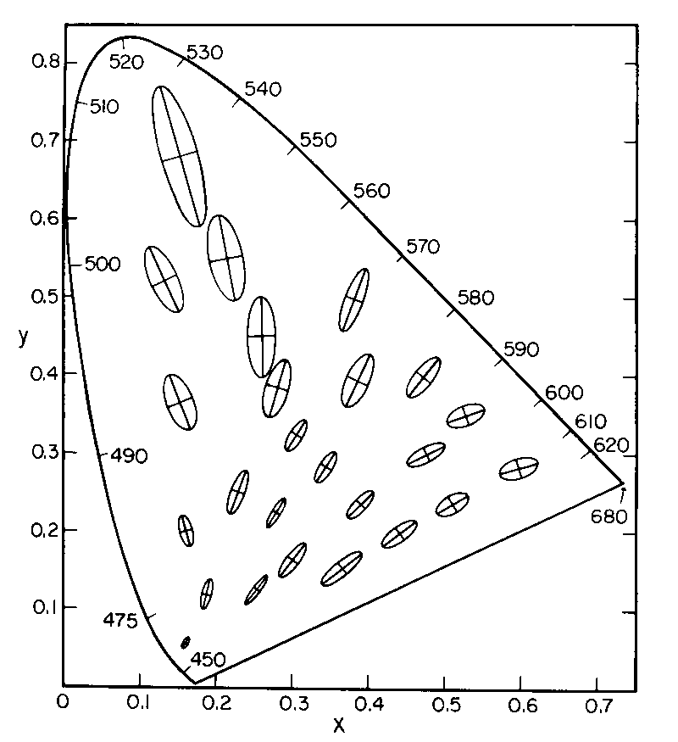
MacAdam Ellipses
Refer to the region which contains all colors which are indistinguishable
Scaled by a factor of 10 and shown on CIE xy color space
If you are shown two colors, one at the center of the ellipse and the other inside it, you cannot tell them apart
Only a few ellipses are shown, but one can be defined for every point
Notes:
MacAdam ellipses refer to the region on a chromaticity diagram which contains all colors which are indistinguishable,

Slide 25
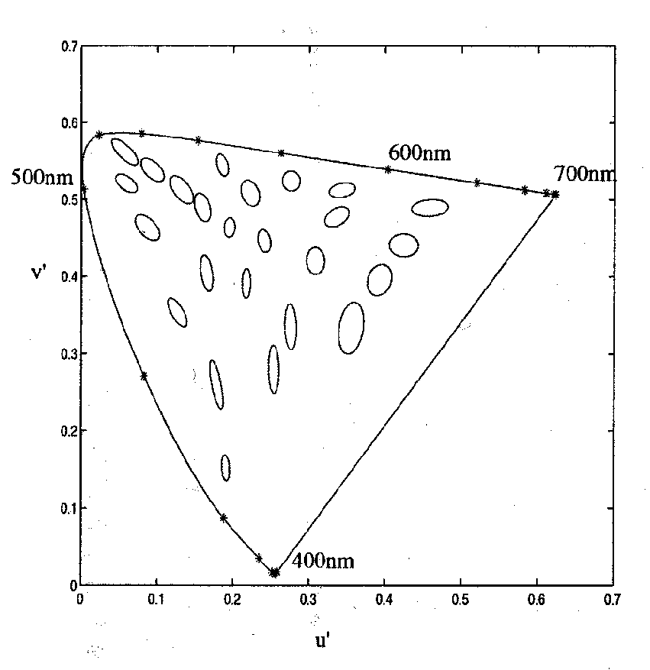
CIE u’v’ Space
CIE u’v’ is a non-linear color space where color differences are more uniform
Note that now ellipses look more like circles
The third coordinate is the original Z from XYZ
Violet

Slide 26
Today
Color spaces
Ink
Image file formats
Color quantization

Slide 27
Ink
Ink is thought of as adsorbing particles
  You see the color of the paper, filtered by the ink
  Combining inks adsorbs more color, so subtractive color
    White paper – red – blue = green
  The color and texture of the paper affects the color of the image
Notes:
From our previous lectures, we know that compared with monitors, ink absorbs the light.
Now let’s look at the ink. We can consider Ink as a filter.

Slide 28
Subtractive mixing
Common inks: Cyan=White−Red; Magenta=White−Green; Yellow=White−Blue
  cyan, magenta, yellow, are how the inks look when printed
For good inks, matching is linear:
  C+M+Y=White-White=Black
  C+M=White-Red-Green=Blue
  How to make a red mark?
Notes:
put down magenta and yellow

Slide 29
Subtractive mixing
Common inks: Cyan=White−Red; Magenta=White−Green; Yellow=White−Blue
  cyan, magenta, yellow, are how the inks look when printed
For good inks, matching is linear:
  C+M+Y=White-White=Black
  C+M=White-Red-Green=Blue
  How to make a red mark?
Usually require CMY and Black, because colored inks are more expensive, and registration is hard
  Registration is the problem of making drops of ink line up
Notes:
put down magenta and yellow

Slide 30
Calibrating a Printer
If the inks (think of them as primaries) are linear, there exists a 3x3 matrix and an offset to take RGB to CMY
  For example, if an RGB of (1,0,0) goes to CMY of (0,1,1); (0,1,0)→(1,0,1); and (0,0,1)→(1,1,0), then the matrix is
To calibrate your printer, you find out exactly what the numbers in the matrix should be
  Print with cyan ink only and match the color with RGB, repeat with magenta and yellow, use the results to determine the matrix
Notes:
If we assume the inks are linear, there exist a matrix to convert the ink color space to rgb;
This is a simple conversion formula. We can see here that cyan is white minus red; yellow is white minus blue;
As we talked in the last lecture, RGB color space is device dependent, and there exist many different RGB space; likely wise, the ink color space is also not unique; so we need to calibrate the printer. The calibration is straight forward. For example, we can print cyan ink and match the color with RGB.

Slide 31
Today
Color spaces
Ink
Image file formats
Color quantization

Slide 32
Image File Formats
How big is the image?
  All files in some way store width and height
How is the image data formatted?
  Is it a black and white image, a grayscale image, a color image, an indexed color image?
  How many bits per pixel?
What other information?
  Color tables, compression codebooks, creator information…
All image formats are a trade-off between ease of use, size of file, and quality of reproduction
Notes:
So far, we have talked about color. Now we are ready to talk about the digital image formats.
So what information about an image that we need to store? First, is the dimension of the image; Second, we need to figure out how to store the image content; depending on how we store image content, we need to store the information that is used to retrieve the image content;
Last time, we mentioned that there are hundreds of different image format. All these image formats are a trade-off between ease of use, size of file, and quality of reproduction.

Slide 33
The Simplest File
0_{r,g,b}
1_{r,g,b}
2_{r,g,b}
Assumes that the color depth is known and agreed on
Store width, height, and data for every pixel in sequence
This is how you normally store an image in memory
Unsigned because width and height are positive, and unsigned char because it is the best type for raw 8 bit data
Note that you require some implicit scheme for laying out a rectangular array into a linear one
3_{r,g,b}
4_{r,g,b}
5_{r,g,b}
class Image {
unsigned int width;
unsigned int height;
unsigned char *data;
}
6_{r,g,b}
7_{r,g,b}
8_{r,g,b}
0_{r}
0_{g}
0_{b}
1_{r}
1_{g}
1_{b}
2_{r}
2_{g}
2_{b}
3_{r}
3_{g}
Notes:
Let’s start from the simplest file format. Assume we use RGB color space; each color channel uses 1 byte (8bits). Then to store an image, we can first store the width and height of the image; and follows with the RGB pixel sequence.

Slide 34
Indexed Color
24 bits per pixel (8-red, 8-green, 8-blue) are expensive to transmit and store
It must be possible to represent all those colors, but not in the same image
Solution: Indexed color
  Assume k bits per pixel (typically 8)
  Define a color table containing 2^{k} colors (24 bits per color)
  Store the index into the table for each pixel (so store k bits for each pixel, instead of 24 bits)
  Once common in hardware, now an artifact (256 color displays)
Notes:
In the above example, we use 24 bits to encode the color at each pixel, which could be expensive to transmit and store.
24 bits per color is necessary since we need a color representation that can contain a big enough color space.
However, for a single image, there usually won’t be a lot colors. So what we can do? We can build a color table and use the color index to the table to encode the color
What if the image is so unusual, it contains all the color? How many k we need?

Slide 35
Indexed Color
Color Table
Pixel Data
Image
0
4
3
0
2
1
1
7
4
5
2
3
7
6
5
3
2
2
1
1
4
5
6
Only makes sense if you have lots of pixels and not many colors
7
Notes:
How many bits needed for this indexed color format?

Slide 36
Image Compression
Indexed color is one form of image compression
  Special case of vector quantization – in color space, reducing the range of available colors
Alternative 1: Store the image in a simple format and then compress with your favorite compressor
  Doesn’t exploit image specific information
  Doesn’t exploit perceptual shortcuts
Two historically common compressed file formats: GIF and JPEG
  GIF was replaced with PNG for many applications, as it was patented and the owner started enforcing the patent
    Patent expired recently?
    GIF is popular now for its support of short animation. Check Giphy and Tenor
Notes:
The basic GIF format is almost free now

Slide 37
GIF
Header – Color Table – Image Data – Extensions
Header gives basic information such as size of image and size of color table
Color table gives the colors found in the image
  Biggest it can be is 256 colors, smallest is 2
Image data is LZW compressed color indices
To create a GIF:
  Choose colors
  Create an array of color indices
  Compress it with LZW

Slide 38
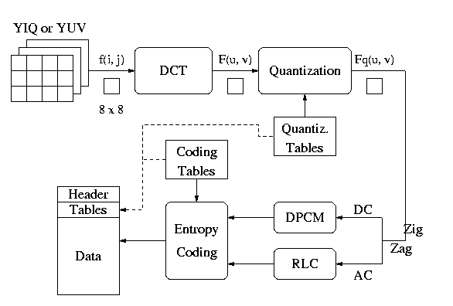
JPEG
Multi-stage process intended to get very high compression with controllable quality degradation
Start with YIQ color
Notes:
Dc and ac are DCT transformation results

Slide 39
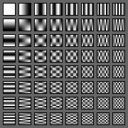
Discrete Cosine Transform
A transformation to convert from the spatial to frequency domain – done on 8x8 blocks
Why? Humans have varying sensitivity to different frequencies, so it is safe to throw some of them away
Basis functions:

Slide 40
Quantization
Reduce the number of bits used to store each coefficient by dividing by a given value
  If you have an 8 bit number (0-255) and divide it by 8, you get a number between 0-31 (5 bits = 8 bits – 3 bits)
  Different coefficients are divided by different amounts
  Perceptual issues come in here
Achieves the greatest compression, but also quality loss
“Quality” knob controls how much quantization is done

Slide 41
Entropy Coding
Standard lossless compression on quantized coefficients
  Delta encode the DC components
  Run length encode the AC components
    Lots of zeros, so store number of zeros then next value
  Huffman code the encodings

Slide 42
Lossless JPEG With Prediction
Predict what the value of the pixel will be based on neighbors
Record error from prediction
  Mostly error will be near zero
Huffman encode the error stream
Variation works really well for fax messages

Slide 43
Today
Color spaces
Ink
Image file formats
Color quantization

Slide 44
Color Quantization
The problem of reducing the number of colors in an image with minimal impact on appearance
  Extreme case: 24 bit color to black and white
  Less extreme: 24 bit color to 256 colors, or 256 grays
Sub problems:
  Decide which colors to use in the output (if there is a choice)
  Decide which of those colors should be used for each input pixel
Notes:
An important component of image compression is color quantization. Color quantization aims to reduce the number of colors with minimal impact on its appearance. In color quantization, we need to answer two problems: we need to decide which colors to use in the input; we also need to decide how to assign which of the colors to each input pixel?

Slide 45
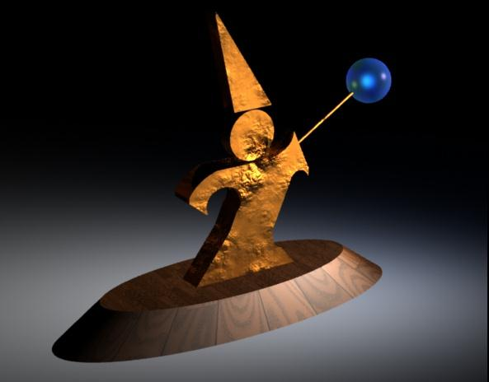
Example (24 bit color)
Notes:
This is an image with 24 bit color (8 bits for each of the r,g,b channel)

Slide 46
Uniform Quantization
Break the color space into uniform cells
Find the cell that each color is in, and map it to the center
Equivalent to dividing each color by some number and taking the integer part
  Say your original image is 24 bits color (8 red, 8 green, 8 blue)
  Say you have 256 colors available, and you choose to use 8 reds, 8 greens and 4 blues (8 × 8 × 4 = 256 )
  Divide original red by 32, green by 32, and blue by 64
  Some annoying details
Generally does poorly because it fails to capture the distribution of colors
  Some cells may be empty, and are wasted
Notes:
A simple method is to uniform quantization. That is,

Slide 47
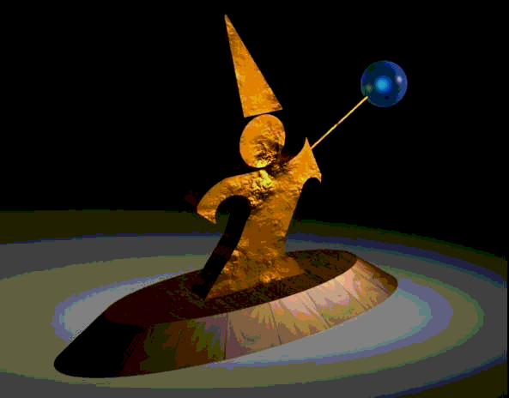
Uniform Quantization
8 bits per pixel in this image
Note that it does very poorly on smooth gradients
Normally the hardest part to get right, because lots of similar colors appear very close together
Does this scheme use information from the image?
Notes:
One reason why this uniform quantization does not work is that it does not make use of the image content information.

Slide 48
Populosity Algorithm
Build a color histogram: count the number of times each color appears
Choose the n most commonly occurring colors
  Typically group colors into small cells first using uniform quantization
Map other colors to the closest chosen color
Problem?
Notes:
Now let’s look at how we can make use of the image content information to improve the performance of quantization.
We can build a color histogram. Basically, a histogram describes the color distribution in the color space. Each bin of a histogram counts the number of times each color appears. Once we have the color histogram, we can choose the most common colors and map other colors to the closest chosen color.

Slide 49
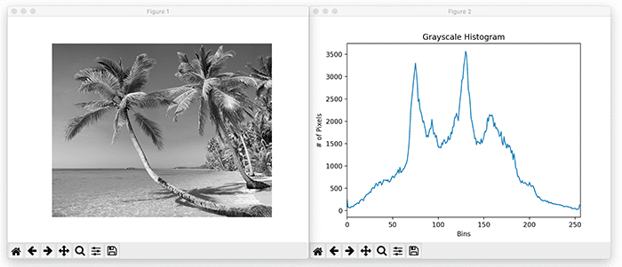
Histogram
Image credit: https://www.pyimagesearch.com/2021/04/28/opencv-image-histograms-cv2-calchist/
Notes:
Image credit: https://www.pyimagesearch.com/2021/04/28/opencv-image-histograms-cv2-calchist/

Slide 50
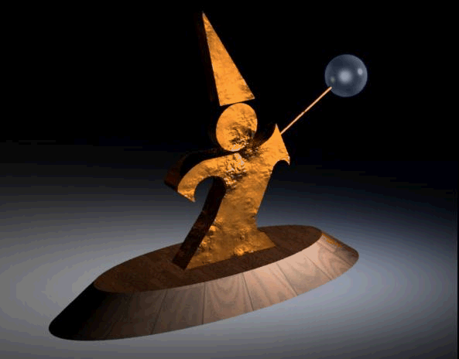
Populosity Algorithm
8 bit image, so the most popular 256 colors
Notes:
We can see that using the most popular colors really improves the result over the uniform quantization method. However, we find that this algorithm has one big problem: that is, it ignores the rare but important colors.

Slide 51
Populosity Algorithm
8 bit image, so the most popular 256 colors
Note that blue wasn’t very popular, so the crystal ball is now the same color as the floor
Populosity ignores rare but important colors!
Notes:
We can see that using the most popular colors really improves the result over the uniform quantization method. However, we find that this algorithm has one big problem: that is, it ignores the rare but important colors.

Slide 52
Median Cut (Clustering)
View the problem as a clustering problem
  Find groups of colors that are similar (a cluster)
  Replace each input color with one representative of its cluster
Many algorithms for clustering
Median Cut is one: recursively
  Find the “longest” dimension (r, g, b are dimensions)
  Choose the median of the long dimension as a color to use
  Split into two sub-clusters along the median plane, and recurse on both halves
Works very well in practice
Notes:
Clustering-based methods are designed to address this problem. A clustering method find groups of colors that are similar to each other; and replace each input color with one representative of its cluster. There are many clustering algorithms available. Today we talk about the Median cut algorithm. Here is how the median cut algorithm works. It first finds the longest dimension of R,G,B. And then it chooses the median of the long dimension and split the color space into two sub-clusters; and then run the same procedure on each halves recursively.

Slide 53
Median Cut (Clustering)
0
255
Notes:
0

Slide 54
Median Cut (Clustering)
0
255
Notes:
0

Slide 55
Median Cut (Clustering)
0
255
Notes:
0

Slide 56
Median Cut (Clustering)
0
255
Notes:
0

Slide 57

Median Cut
8 bit image, so 256 colors
Now we get the blue
Median cut works so well because it divides up the color space in the “most useful” way

Slide 58
Optimization Algorithms
The quantization problem can be phrased as optimization
  Find the set of colors and map that result in the lowest quantization error
Several methods to solve the problem, but of limited use unless the number of colors to be chosen is small
  It’s expensive to compute the optimum
  It’s also a poorly behaved optimization
Notes:
Mathematically, we can consider the color quantization as an optimization problem. It aims to find a set of colors and mapping that result in the lowest quantization error. However, this optimization problem is very difficult to solve.

Slide 59
Perceptual Problems
While a good quantization may get close colors, humans still perceive the quantization
Biggest problem: Mach bands
  The difference between two colors is more pronounced when they are side by side and the boundary is smooth
  This emphasizes boundaries between colors, even if the color difference is small
  Rough boundaries are “averaged” by our vision system to give smooth variation
Notes:
Color quantization will necessarily loose color information. While there have been many methods that try to reduce the quantizatin error, we, humans, are so good that we can still perceive the quantization artifacts. The biggest problem for quantization is mach bands.

Slide 60
Mach Bands in Reality
The floor appears banded
Notes:
Basically, the difference between colors manifests more along smooth boundaries. The difference between colors side by side really emphasizes the boundary.

Slide 61
Mach Bands in Reality
Still some banding even in this 24 bit image (the floor in the background)
Notes:
We can still sense this banding problem even in this original image without any color quantization. This mach bands problem can be relieved by adding noise along the smooth boundary because our vision system will average the rough boundaries to give smooth variation

Slide 62
Dithering (Digital Halftoning)
Mach bands can be removed by adding noise along the boundary lines
General perceptive principle: replaced structured errors with noisy ones and people complain less
Old industry dating to the late 1800’s
  Methods for producing grayscale images in newspapers and books
Notes:
This mach bands problem can be relieved by adding noise along the smooth boundary because our vision system will average the rough boundaries to give smooth variation. This method is called dithering. Dithering is also widely used to produce grayscale images in newspapers using only black inks.

Slide 63
Next Time
Dithering
Sampling
Signal Processing

Slide 64
Announcements
If you use C++ 11, update Tutorial code.
  Problem
  'MyWindow::MyWIndow(const MyWindow &)': cannot convert argument 3 from 'const char [15]' to 'char*‘
  Fix myWindow.h,
  MyWindow(int width, int height, char title) ➔
  MyWindow(int width, int height, const char * title);
  Fix similar problems in other files
Notes:
'MyWindow::MyWIndow(const MyWindow &)': cannot convert argument 3 from 'const char [15]' to 'char*'
* * *So in Step 1, MyWindow.h should be changed to:
public:
MyWindow(int width, int height, char const* title);
* * *
And MyWIndow.cpp should be changed to:
* * *
MyWindow::MyWindow(int width, int height, char const* title) : Fl_Window(width, height, title)

