Slide 1
Computer Graphics
Prof. Feng Liu
Fall 2022
http://www.cs.pdx.edu/~fliu/courses/cs447/
09/28/2022
Notes:
Computer Graphics

Slide 2
Announcement
  Read Programming Tutorial 1 before trying compiling Project 1 code
Homework 1 – due Oct. 05 before class
  Email your submission to lizhan@pdx.edu

Slide 3
Last Time
Course introduction
Digital images
  The difference between an image and a display
  Ways to get them
  Raster vs. Vector

Slide 4
Today
Digital images
  Raster vs. Vector
  Digital images as discrete representations of reality
  Human perception in deciding resolution and image depth
Color
Tri-Chromacy
Digital Color

Slide 5
Obtaining Digital Images
What are some methods for obtaining a digital image?
  Digital camera
  Scanning another image
  Other forms of scanning (e.g. medical)
  Editing existing digital images
  Paint or drawing programs
  Created from abstract data (e.g. math function plot)
  Rendered from a scene description
  …
Notes:
Is the image obtained equivalent to the image we see with our eyes?

Slide 6
Ideal Images
The information stored in images is often continuous in nature
For example, consider the ideal photograph:
  It captures the intensity of light at a particular set of points coming from a particular set of directions (it’s called irradiance)
  The intensity of light arriving at the camera can be any positive real number, and it mostly varies smoothly over space
  The world we see is not pixelated
    Where do you see spatial discontinuities in a photograph?
Film
Focal point
Notes:
Edge!

Slide 7
Digital Images
Computers work with discrete pieces of information
How do we digitize a continuous image?
  Break the continuous space into small areas, pixels
  Use a single value for each pixel - the pixel value (no color, yet)
  No longer continuous in space or intensity
This process is fraught with danger, as we shall see
Continuous
Discrete
Pixels: Picture Elements

Slide 8
Discretization Issues
Can only store a finite number of pixels
  Choose your target physical image size, choose your resolution (pixels per inch, or dots per inch, dpi), determine width/height in pixels necessary
  Storage space goes up with square of resolution
    600dpi has 4× more pixels than 300dpi
Can only store a finite range of intensity values
  Typically referred to as depth - number of bits per pixel
    Directly related to the number of colors available and typically little choice
    Most common depth is 8, but also sometimes see 16 for grey
  Also concerned with the minimum and maximum intensity – dynamic range
What is enough resolution and enough depth?
Notes:
When we digitize an image, we need to consider two parameters. First, how many pixels we can get. This is determined by two factors. One is the physical image size. The other is resolution. (pixels in inch)
A second problem is that a computer only stores a finite range of intensity values. Specifically, a computer only uses a certain amount of bits to encode the color or intensity for each pixel. Most common depth is 8, which means we use 8 bits to encode the intensity. So totally how many intensities we have for a 8-bit image?

Slide 9
Perceptual Issues
Spatially, humans can discriminate about ½ a minute of arc
  At fovea, so only in center of view
  At 0.5m, about 0.1mm (“Dot pitch” of monitors)
  Sometimes limits the required number of pixels
Humans can discriminate about 8 bits of intensity
  “Just Noticeable Difference” experiments
  Limits the required depth for typical dynamic ranges
  Actually, it’s 9-10 bits, but 8 is far more convenient
BUT, when manipulating images much higher resolution may be required
129 128 125

Slide 10
Intensity Perception
Humans are actually tuned to the ratio of intensities, not their absolute difference
  So going from a 50 to 100 Watt light bulb looks the same as going from 100 to 200
Most computer graphics ignores this, giving poorer perceptible intensity resolution at low light levels, and better resolution at high light levels
Notes:
Example: l1=1 l2=? L3=?
l4= 8

Slide 11
Intensity Perception
Humans are actually tuned to the ratio of intensities, not their absolute difference
  So going from a 50 to 100 Watt light bulb looks the same as going from 100 to 200
Most computer graphics ignores this, giving poorer perceptible intensity resolution at low light levels, and better resolution at high light levels
Test: if we want to design a perceptually uniform intensity system with four levels and l1 = 1, l4 = 8
  What should be the intensity levels for l2 and l3?
Notes:
Example: l1=1 l2=? L3=?
l4= 8

Slide 12

DeepFovea: Neural Reconstruction for Foveated Rendering (Meta Reality Lab)
https://www.youtube.com/watch?v=eTUmmW4ispA
Notes:
https://www.youtube.com/watch?v=eTUmmW4ispA

Slide 13
Dynamic Range
Image depth refers to the number of bits available, but not how those bits map onto intensities
We can use those bits to represent a large range at low resolution, or a small range at high resolution
Common display devices can only show a limited dynamic range, so typically we fix the range at that of the display device and choose high resolution
Low range, high res
High range, low res
All possible
intensities

Slide 14
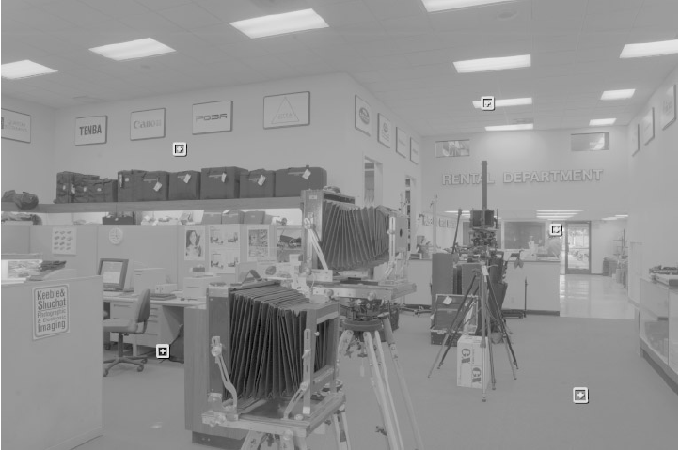
More Dynamic Range
Real scenes have very high and very low intensities
Humans can see contrast at very low and very high light levels
  Can’t see all levels all the time – use adaptation to adjust
  Still, high range even at one adaptation level
Film has low dynamic range around 100:1
Monitors are even worse
Many ways to deal with the problem
  Way beyond the scope of this course

Slide 15
Display on a Monitor
When images are created, a linear mapping between pixels and intensity is assumed
  For example, if you double the pixel value, the displayed intensity should double
Monitors, however, do not work that way
  For analog monitors, the pixel value is converted to a voltage
  The voltage is used to control the intensity of the monitor pixels
  But the voltage to display intensity is not linear
  Similar problem with other monitors, different causes
The outcome: A linear intensity scale in memory does not look linear on a monitor
Even worse, different monitors do different things

Slide 16


Display on a Monitor
Image intensity Voltage to monitor Display intensity

Slide 17
Display on a Monitor
Image intensity Voltage to monitor Display intensity

Slide 18

Display on a Monitor
Image intensity Voltage to monitor Display intensity
$$I_{display}∝I_{image}^{}$$

Slide 19
Gamma Control
The mapping from voltage to display is usually an exponential function:
To correct the problem, we pass the pixel values through a gamma function before converting them to the monitor
This process is called gamma correction
The parameter, γ, is controlled by the user
  It should be matched to a particular monitor
  Typical values are between 2.2 and 2.5
The mapping can be done in hardware or software
Notes:
Image (pixel)->voltage-> display
I_im->I_moni->I_display

Slide 20
Today
Digital images
  Raster vs. Vector
  Digital images as discrete representations of reality
  Human perception in deciding resolution and image depth
Color
Tri-Chromacy
Digital Color

Slide 21
About Color
So far, we have only discussed intensities, so called achromatic light (shades of gray)
On the order of 10 color names are widely recognized by English speakers - other languages have fewer/more, but not much more
Notes:
What is color; Color name?

Slide 22
About Color
So far, we have only discussed intensities, so called achromatic light (shades of gray)
On the order of 10 color names are widely recognized by English speakers - other languages have fewer/more, but not much more
Accurate color reproduction is commercially valuable - e.g. painting a house, producing artwork
E-commerce has accentuated color reproduction issues, as has the creation of digital libraries
Color consistency is also important in user interfaces, e.g.: what you see on the monitor should match the printed version
Notes:
What is color; Color name?

Slide 23
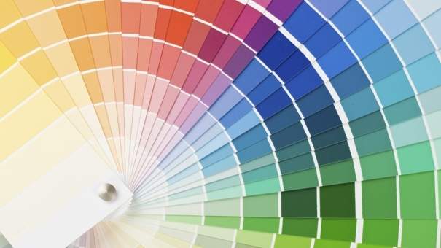
Color Cards
https://www.wisebread.com/25-beautiful-things-you-can-make-with-paint-sample-cards

Slide 24
Light and Color
The frequency, ω, of light determines its “color”
  Wavelength, λ, is related
  Energy also related
Describe incoming light by a spectrum
  Intensity of light at each frequency
  A graph of intensity vs. frequency
We care about wavelengths in the visible spectrum: between the infra-red (700nm) and the ultra-violet (400nm)
Notes:
Color definition
Wavelength is inversely proportional to the frequency;
Energy is linear with the frequency
The greater the energy, the larger the frequency and the shorter (smaller) the wavelength

Slide 25
Normal Daylight
# Photons
Wavelength (nm)
400
500
600
700
Note the hump at short wavelengths - the sky is blue

Slide 26
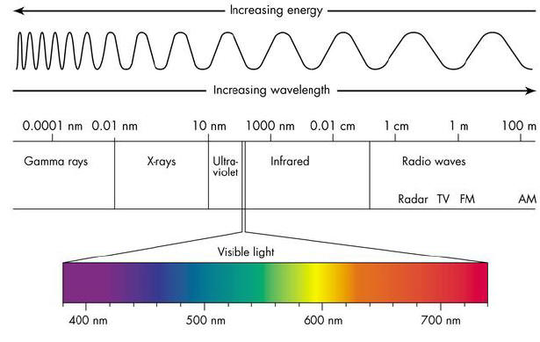
Color and Wavelength

Slide 27
Normal Daylight
# Photons
Wavelength (nm)
400
500
600
700
Note the hump at short wavelengths - the sky is blue

Slide 28
White
White
# Photons
Less Intense White (grey)
Wavelength (nm)
400
500
600
700
Note that color and intensity are technically two different things
However, in common usage we use color to refer to both
  White = grey = black in terms of color
You will have to use context to extract the meaning
Notes:
The white color has a uniform intensity distribution over different wavelength

Slide 29
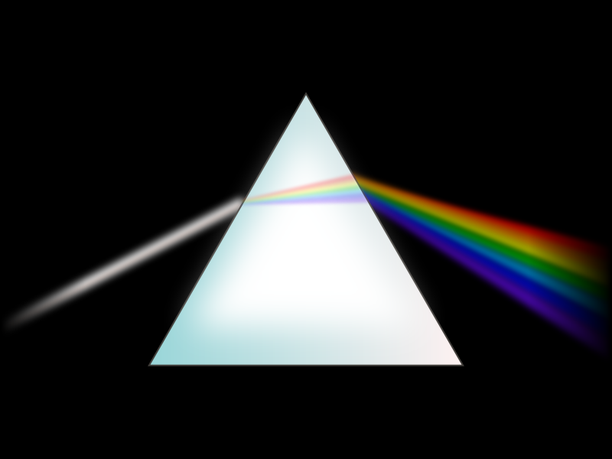
https://commons.wikimedia.org/wiki/File:Prism-rainbow-black.svg

Slide 30
Helium Neon Laser
# Photons
Wavelength (nm)
400
500
600
700
Lasers emit light at a single wavelength, hence they appear colored in a very “pure” way

Slide 31
Tungsten Lightbulb
# Photons
Wavelength (nm)
400
500
600
700
Most light sources are not anywhere near white
It is a major research effort to develop light sources with particular properties
Notes:
Yellowish

Slide 32
Emission vs. Adsorption
Emission is what light sources do
Adsorption is what paints, inks, dyes etc. do
Emission produces light, adsorption removes light
We still talk about spectra, but now is it the proportion of light that is removed at each frequency
  Note that adsorption depends on such things as the surface finish (glossy, matte) and the substrate (e.g. paper quality)
  The following examples are qualitative at best

Slide 33
Adsorption Spectra
Wavelength (nm)
400
500
600
700

Slide 34

Adsorption Spectra: Red Paint
Wavelength (nm)
400
500
600
700
Red paint absorbs green and blue wavelengths, and reflects red wavelengths, resulting in you seeing a red appearance

Slide 35
Representing Color
Our task with digital images is to represent color
You probably know that we use three channels: R, G and B
We will see why this is perceptually sufficient for display and why it is computationally an approximation
First, how we measure color
Notes:
We just talked about the physics behind color. The next question is, how do we represent color in an image. You probably know that we can use R,G,B three channel to represent a color. Today we will discuss why RGB three channel can be used to present color for display and why it is just an approximation. Before we talk about color representation, let’s first discuss how we can measure color.

Slide 36
Sensors
Any sensor is defined by its response to a frequency distribution
Expressed as a graph of sensitivity vs. wavelength, ρ(λ)
  For each unit of energy at the given wavelength, how much voltage/impulses/whatever the sensor provides
To compute the response, take the integral
  E(λ) is the incoming energy at the particular wavelength
  The integral multiplies the amount of energy at each wavelength by the sensitivity at that wavelength, and sums them all up
Notes:
We can use sensor to measure color. Our eyes are a special type of color sensor. Any sensor can be defined by its response to a frequency distribution. In practice, a sensor is described by a sensitivity graph. Specifically, given each unit of energy at a given wave length, how much impulse the sensor will provide. Once we have this sensitivity graph, we can compute the response of a sensor to a light by taking integral. Basically, the integral multiples the amount of energy at each wavelength by the sensitivity at that wavelength and sums them up.

Slide 37
A “Red” Sensor
Sensitivity
Wavelength (nm)
400
500
600
700
This sensor will respond to red light, but not to blue light, and a little to green light

Slide 38
The “Red” Sensor Response
Sensor
Sensitivity, ρ
Sensitivity, ρ
400
500
600
700
400
500
600
700
Color
#photons, E
#photons, E
400
500
600
700
400
500
600
700
Notes:
Ok. Here we show two color’s spectrum. Do you know to which color the sensor responses more?

Slide 39
The “Red” Sensor Response
Sensor
Sensitivity, ρ
Sensitivity, ρ
400
500
600
700
400
500
600
700
Color
#photons, E
#photons, E
Red
Blue
400
500
600
700
400
500
600
700
High response
Low response

Slide 40
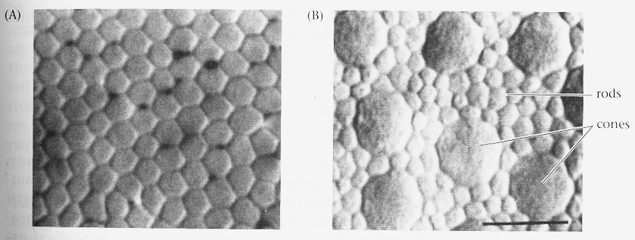
Seeing in Color
The eye contains rods and cones
  Rods work at low light levels and do not see color
    That is, their response depends only on how many photons, not their wavelength
  Cones come in three types (experimentally and genetically proven), each responds in a different way to frequency distributions
Notes:
Our eye

Slide 41
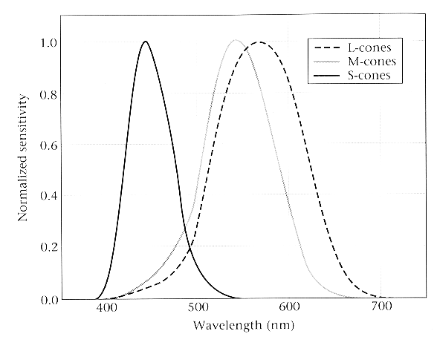
Color receptors
Each cone type has a different sensitivity curve
  Experimentally determined in a variety of ways
For instance, the L-cone responds most strongly to red light
“Response” in your eye means nerve cell firings
How you interpret those firings is not so simple …

Slide 42
Color Perception
How your brain interprets nerve impulses from your cones is an open area of study, and deeply mysterious
Colors may be perceived differently:
  Affected by other nearby colors
  Affected by adaptation to previous views
  Affected by “state of mind”
Experiment:
  Subject views a colored surface through a hole in a sheet, so that the color looks like a film in space
  Investigator controls for nearby colors, and state of mind

Slide 43
The Same Color?

Slide 44
The Same Color?
Notes:
In fact, the color on the left and right is different. When we can put them side by side, we can perceive the difference although they are similiar

Slide 45
Color Deficiency
Some people are missing one type of receptor
  Most common is red-green color blindness in men
  Red and green receptor genes are carried on the X chromosome - most red-green color blind men have two red genes or two green genes
Other color deficiencies
  Anomalous trichromacy, Achromatopsia, Macular degeneration
  Deficiency can be caused by the central nervous system, by optical problems in the eye, injury, or by absent receptors

Slide 46
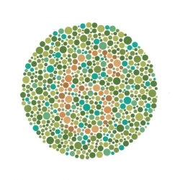
Color Deficiency

Slide 47
Today
Digital images
  Raster vs. Vector
  Digital images as discrete representations of reality
  Human perception in deciding resolution and image depth
Color
Tri-Chromacy
Digital Color

Slide 48
Recall
We’re working toward a representation for digital color
We have seen that humans have three sensors for color vision
Now, the implications …
Notes:
Can we represent a color with 3 channels or primary sources? We call such a color representation trichromacy

Slide 49
Trichromacy
Experiment:
  Show a target color spectrum beside a user-controlled color
  User has knobs that adjust primary sources to set their color
    Primary sources are just lights with a fixed spectrum and variable intensity
  Ask the user to match the colors – make their light look the same as the target
Experiments show that it is possible to match almost all colors using only three primary sources - the principle of trichromacy
Sometimes, have to add light to the target
In practical terms, this means that if you show someone the right amount of each primary, they will perceive the right color
This was how experimentalists knew there were 3 types of cones
Notes:
For trichromacy, color scientist designed the following experiment:

Slide 50
James Maxwell’s color-matching experiment
Slide Credit: Jonathan Pillow
Notes:
Slide Credit: Jonathan Pillow

Slide 51
Trichromacy Means…
Color Matching:
People think these two spectra look the same (monomers)
Representing color:
If you want people to “see” the continuous spectrum, you can just show the three primaries
(with varying intensities)
400
500
600
700
3 Primaries

Slide 52
The Math of Trichromacy
Write primaries as R, G and B
  We won’t precisely define them yet
Many colors can be represented as a mixture of R, G, B: M=rR + gG + bB (Additive matching)
Gives a color description system - two people who agree on R, G, B need only supply (r, g, b) to describe a color
Some colors can’t be matched like this, instead, write: M+rR=gG+bB (Subtractive matching)
  Interpret this as (-r, g, b)
  Problem for reproducing colors – you can’t subtract light using a monitor, or add it using ink

Slide 53
Primaries are Spectra Too
A primary can be a spectrum
  Single wavelengths are just a special case
3 Primaries
3 Primaries
or
400
500
600
700
400
500
600
700

Slide 54
Color Matching
Given a spectrum, how do we determine how much each of R, G and B to use to match it?
First step:
  For a light of unit intensity at each wavelength, ask people to match it using some combination of R, G and B primaries
  Gives you, r(λ), g(λ) and b(λ), the amount of each primary used for wavelength λ
  Defined for all visible wavelengths, r(λ), g(λ) and b(λ) are the RGB color matching functions

Slide 55
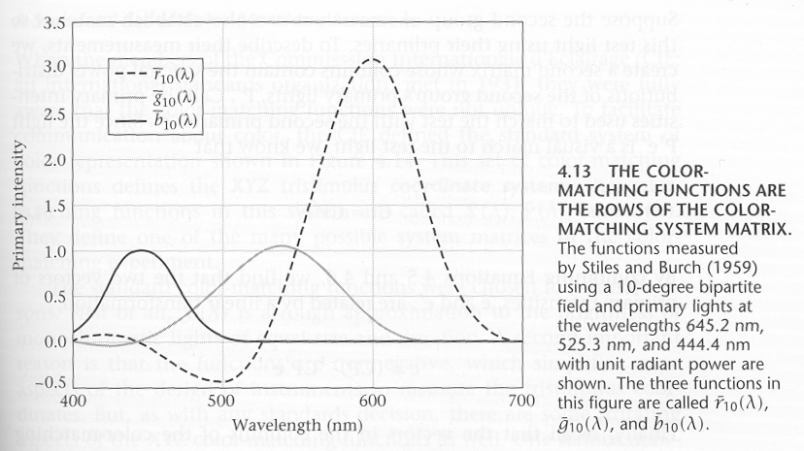
The RGB Color Matching Functions
Notes:
There is no such thing as negative light; so we add the same amount of light to the color the is being matched

Slide 56
Computing the Matching
Given a spectrum, how do we determine how much each of R, G and B to use to match it?
The spectrum function that we are trying to match, E(λ), gives the amount of energy at each wavelength
The RGB matching functions describe how much of each primary is needed to give one energy unit’s worth of response at each wavelength

Slide 57
Next Time
Color Spaces
Color Quantization
Dithering

Slide 58
Color Spaces
The principle of trichromacy means that the colors displayable are all the linear combination of primaries
Taking linear combinations of R, G and B defines the RGB color space
  the range of perceptible colors generated by adding some part of each of R, G and B
If R, G and B correspond to a monitor’s phosphors (monitor RGB), then the space is the range of colors displayable on the monitor
Notes:
Now let’s talk about color spaces. The principle of trichromacy states that the colors displayable are all the …
For example, we can take linear comibinations of rgb to define the RGB color space. As far as a moniotr is concerned, we can consider R,G,B correspond to a monitor’s phosphors, then monitor RGB space is the range of color that can be displayed on this monitor.

Slide 59
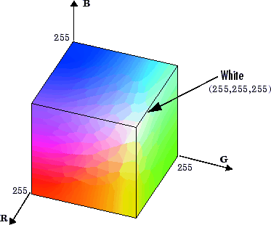
RGB Color Space
Demo

Slide 60
Problems with RGB
Can only represent a small range of all the colors humans are capable of perceiving (particularly for monitor RGB)
It isn’t easy for humans to say how much of RGB to use to make a given color
  How much R, G and B is there in “brown”? (Answer: .64,.16, .16)
Perceptually non-linear
Notes:
A B C 3 points in the color space; B and C are of the same distance away from A. But the difference between A and B and the difference between A and C are perceptually different!

Slide 61
CIE XYZ Color Space
  Imaginary primaries
  X, Y, Z
  Y component intended to correspond to intensity
  Cannot produce the primaries – need negative light!
Defined in 1931 to describe the full space of perceptible colors
  Revisions now used by color professionals
Color matching functions are everywhere positive
Most frequently set x=X/(X+Y+Z) and y=Y/(X+Y+Z)
  x,y are coordinates on a constant brightness slice
Notes:
To solve the first problem of RGB, color scientists defined another space.

Slide 62
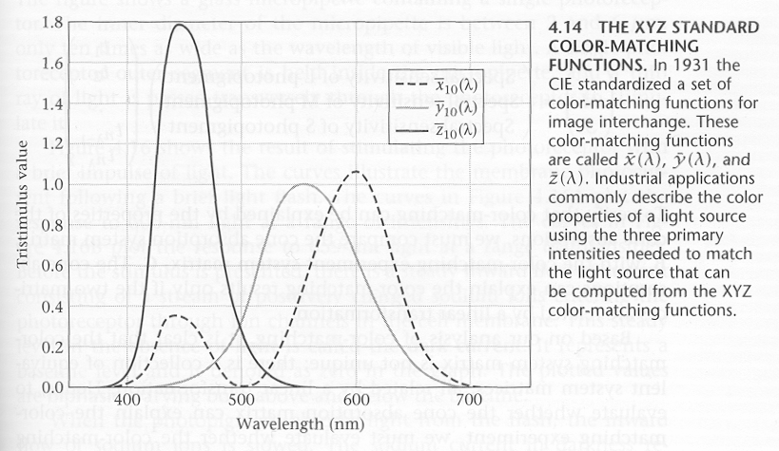
CIE Matching Functions

Slide 63
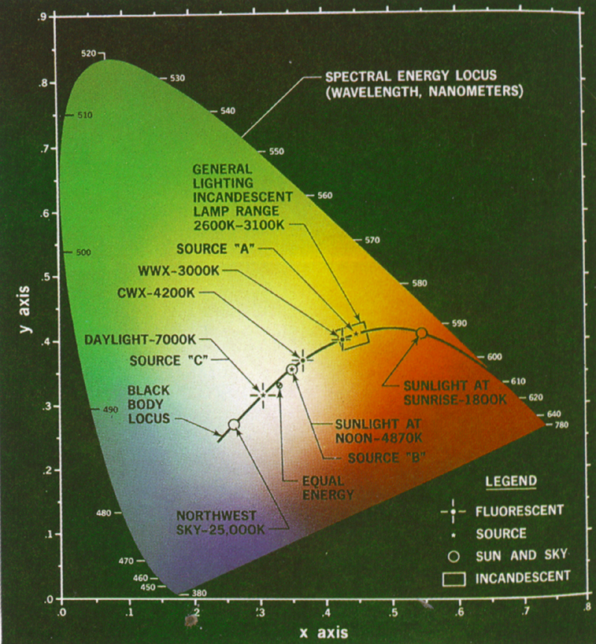
CIE x, y
Note: This is a representation on a projector with limited range, so the correct colors are not being displayed

Slide 64
Standard RGB↔XYZ
Note that each matrix is the inverse of the other
Recall, Y encodes brightness, so the matrix tells us how to go from RGB to grey

Slide 65
Determining Gamuts
XYZ Gamut
Gamut: The range of colors that can be represented or reproduced
Plot the matching coordinates for each primary. eg R, G, B
Region contained in triangle (3 primaries) is gamut
Really, it’s a 3D thing, with the color cube distorted and embedded in the XYZ gamut
y
RGB Gamut
G
R
B
x

Slide 66
Accurate Color Reproduction
Device dependent RGB space
High quality graphic design applications, and even some monitor software, offers accurate color reproduction
A color calibration phase is required:
  Fix the lighting conditions under which you will use the monitor
  Fix the brightness and contrast on the monitor
  Determine the monitor’s γ
  Using a standard color card, match colors on your monitor to colors on the card: This gives you the matrix to convert your monitor’s RGB to XYZ
  Together, this information allows you to accurately reproduce a color specified in XYZ format

Slide 67
More Linear Color Spaces
Monitor RGB: primaries are monitor phosphor colors, primaries and color matching functions vary from monitor to monitor
sRGB: A new color space designed for web graphics
YIQ: mainly used in television
  Y is (approximately) intensity, I, Q are chromatic properties
  Linear color space; hence there is a matrix that transforms XYZ coords to YIQ coords, and another to take RGB to YIQ
Notes:
Monitor manufactures try to select an optimal set of phosphor colors to get a color space that is closer to be linear as possible.

Slide 68
HSV Color Space (Alvy Ray Smith, 1978)
Hue: the color family: red, yellow, blue…
Saturation: The purity of a color: white is totally unsaturated
Value: The intensity of a color: white is intense, black isn’t
Space looks like a cone
  Parts of the cone can be mapped to RGB space
Not a linear space, so no linear transform to take RGB to HSV
  But there is an algorithmic transform

Slide 69
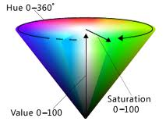
HSV Color Space

Slide 70
Qualitative Response
Sensitivity, ρ
ρE
Multiply
400
500
600
700
400
500
600
700
Sensor
Area under curve?
#photons, E
Red
Big response!
400
500
600
700
Light source
Notes:
Light source

Slide 71
Qualitative Response
Sensitivity, ρ
ρE
Multiply
400
500
600
700
400
500
600
700
Sensor
Area under curve?
#photons, E
Blue
Tiny response!
400
500
600
700
Light source

