Slide 1
Computer Graphics
Prof. Feng Liu
Fall 2022
http://www.cs.pdx.edu/~fliu/courses/cs447/
11/30/2022

Slide 2
Last time
Ray tracing

Slide 3
Today
Animation
Final Exam
  To-know list available
  December 05 (Monday) 17:30-19:00

Slide 4
Animation
Animation is about bringing things to life
Technically:
  Generate a sequence of images that, when played one after the other, make things move
  One image is called a frame
    24 frames per second for film, resolution approx 1600x1200, good anti-aliasing
    30 frames per second for NTSC video, resolution less than 640x480
    60+ frames per second for “twitch” computer games, 640x480 up to 4k or higher resolution
    120 frames per second, 8k for exciting VR experience
  Interlacing: Display every second row for one frame, every other row for the next. Used in NTSC TV and older monitors
Notes:
Animation is about bringing things to life. Technically, to make an animation, we need to generate a sequence of images that are played one after the other to make things move. Here, each image is called a frame. For some film, each frame is about 1600 x 1200; For NTSC video, it has 30 frames per second with resolution like 640 x 480. For some computer games, they use 60+ frames. For some videos, they are actually interlaced. Basically, interlacing display every second row for one frame; every other row for the next. Some camera that claims to have 60i, actually they only have 30 frames each second.

Slide 5
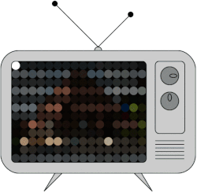
Interlaced Anmation
https://en.wikipedia.org/wiki/Interlaced_video

Slide 6
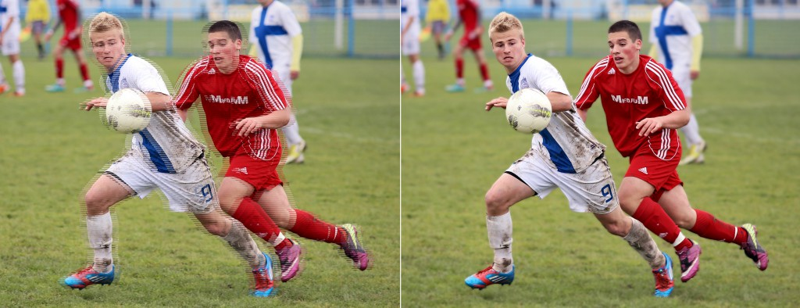
Deinterlacing
Interlaced video shown in a progressive format Deinterlaced video
https://blog.video.ibm.com/streaming-video-tips/interlaced-video-deinterlacing-for-streaming/

Slide 7
Perceptual Issues
We perceive many still images in rapid succession as continuous motion
  Even if there is a transition period between the images
  Can even put distracters in and motion is still perceived
You can be fooled, however, if the flicker rate is incorrect
The frame rate for film was perceptually chosen
Notes:
Animation and video makes use of our human motion perception. That is, No matter we have 60 fps or 30fps, there is a transition period between images when we display the animation or video. However, we, human, can easily sense the continuous motion from watching the display of the image sequence. According to the motion perception, our brain can automatically interpret the image seqence as a continuous motion.

Slide 8
Animation Issues
When evaluating an animation technique or application, the following things should be considered:
  How fast can the images be generated?
  How easy is it to control the appearance of the animation?
  How much human expertise is required to generate the animation?
  Can the animation be generated in response to a user’s action (interactive animation)?
Application driven: Different applications have different requirements:
  Feature film animation is different from interactive gaming animation
Notes:
OK. Before we talk about individual animation techniques, now let’s first look at what are the important aspects of an animation technique.

Slide 9
The 11 Principles
Developed at Disney over the 1920s and 1930s
Described by John Lasseter (Pixar) 1987
Squash-and-Stretch, Timing, Anticipation, Follow Through and Overlapping Action, Straight Ahead Action and Pose-to-Pose Action, Slow In and Out, Arcs, Exaggeration, Secondary Action, Appeal
Basically, principles are driven by:
  Perceptual factors, such as directing the viewer’s attention and smoothing the motion for easier perception
  Conveying emotion through motion
Notes:
Like film, animation has been creating for 100 years. In the practice of animation production, people, especially at Disney, develop a few principles for making good animation. John Lasseter at Pixar formally summarized these rules into 11 principles: many of them talk about how to direct viewer’s attention for easier animation perception and how to convey emotion through motion.
Pixar lamp animation

Slide 10

Pixar Lamp
https://www.youtube.com/watch?v=PGKmexNTHNE

Slide 11
Basic Animation Techniques
Keyframe animation
  Animator specifies important positions throughout the animation – the keyframes
  Someone or something fills in the intermediate frames – inbetweening, or just ’tweening
Motion capture
  System captures motion data from a real enactment of the animation
  The data then drives a virtual character or object
Procedural animation
  A set of equations or rules are evaluated to determine how the animation behaves
Notes:
For these who are interested in these 11 principles, please read the paper by John Lesseter which is available on our class website. In our class, today, we will focus on overviewing basic animation techniques.

Slide 12
Keyframing
The original way to animate, and still the most common form for feature animation
  Process has shifted to computers, but basic approach is the same
Underlying technique is interpolation
  The in-between frames are interpolated from the keyframes
  Originally done by armies of underpaid animators
  Now done with computers
  Which of the techniques that we have learned about is used extensively for keyframe animation?

Slide 13
Interpolation
Interpolating splines are smooth curves that interpolate their control points
  For example, Cardinal cubics ( Shirley book ch. 15.5.3)
Perfect for keyframe animation
Typically, time is directly associated with the parameter value, controlling speed
2
3
1
Keyframes
Animation

Slide 14
More Interpolation
Anything can be keyframed and interpolated
  Position, Orientation, Scale, Deformation, Patch Control Points (facial animation), Color, Surface normals…
Special interpolation schemes for things like rotations
  Use quaternions to represent rotation and do spherical interpolation
Control of parameterization controls speed of animation

Slide 15
Motion Capture
Extract data from real-world people acting out a scene
Many techniques for getting the data:
  Optical – take video and extract motion
  Magnetic/Radio – attach magnets, transponders and use sensors to get location
  Mechanical methods of extracting motion (for small motions)
Most methods have some problems, all are limited in the complexity of the scenes they can capture
  Solution: Break scenes into smaller pieces and re-construct later

Slide 16
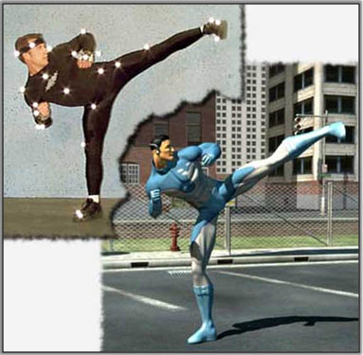
Motion Capture Example
From http://www.batou.fr/wp-content/uploads/motion_capture_1.jpg

Slide 17
Motion Capture in Use
Motion capture is one of the primary animation techniques for computer games
  Gather lots of snippets of motion capture
    e.g.: Several ways to dunk, dribble, pass
  Arrange them so that they can be pieced together smoothly
  At run time, figure out which pieces to play to have the character do the desired thing
Problems: Once the data is captured, it’s hard to modify for a different purpose

Slide 18
Face animation
https://www.youtube.com/watch?v=ohmajJTcpNk
Thies, etc. Face2Face: Real-time Face Capture and Reenactment of RGB Videos. CVPR 2016
Notes:
Face2Face: Real-time Face Capture and Reenactment of RGB Videos

Slide 19
Procedural Animation
Animation is generated by writing a program that outputs the position/shape/whatever of the scene over time
Generally:
  Program some rules for how the system will behave
  Choose some initial conditions for the world
  Run the program, maybe with user input to guide what happens
Advantage: Once you have the program, you can get lots of motion
Disadvantage: The animation is generally hard to control, which makes it hard to tell a story with purely procedural means

Slide 20
Particle Systems
A particle has:
  A position in the world
  Rules for how it moves over time
  Rules for how it is drawn
A particle system:
  Controls when particles are created and destroyed
  Makes sure that all the particles are updated

Slide 21
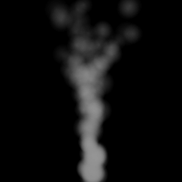
Smoke Particle System
Constantly create particles
Particles move upwards, with turbulence added
  Ken Perlin: An academy award
Draw them as partially transparent circles that fade over time

Slide 22
Movie Particle Systems
Particle systems are the standard way of doing smoke and water spray
Examples from Perfect Storm (lots of water)
  All images from Industrial Light and Magic (ILM)

Slide 23
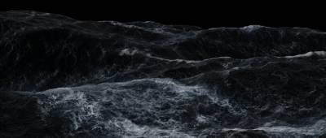
Basic Ocean
Ocean created with Computational Fluid Dynamics

Slide 24

Flowing Water
Water from previous frame flowing over boat

Slide 25

Boat’s Spray
Particles are created where the boat meets the ocean

Slide 26

Impact Spray
Particles created where boat and ocean hit hard

Slide 27


Perfect Storm – Composite

Slide 28
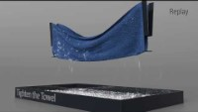
Fei et al. https://www.youtube.com/watch?v=xvyGpBKevLM

Slide 29
Spring-Mass Systems
Model objects as systems of springs and masses
The springs exert forces, and you control them by changing their rest length
A reasonable, but simple, physical model for muscles
Advantage: Good looking motion when it works
Disadvantage: Expensive and hard to control

Slide 30
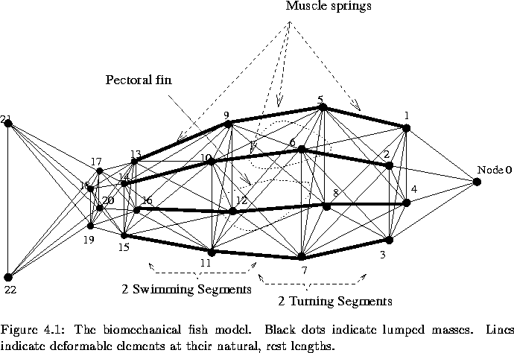
Spring mass fish
Due to Xiaoyuan Tu, http://www.dgp.toronto.edu/people/tu

Slide 31
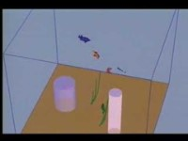
Spring mass fish
http://www.dgp.toronto.edu/~tu/animations.html
https://www.youtube.com/watch?v=aP1_XkCdAaE

Slide 32
Physically-Based Models
Create a model based on the physics of a situation, and just solve for what happens
Has been applied to:
  Colliding rigid objects
  Cloth
    An example: http://www.youtube.com/watch?v=04nXlhdPxB4&noredirect=1
  Water
  Smoke
    https://www.youtube.com/watch?v=7cC-_-aqx18
  Squishy objects
  Humans
  New ones every year
Problem: Expensive, hard to control, and not necessarily realistic

Slide 33
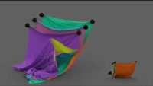
Cloth Simulation
Jiang et al. https://www.youtube.com/watch?v=eGtB0VXJsuI

Slide 34
Mixing Techniques
Techniques can be mixed and matched in the same animation
For example, apply physical secondary motion on top of key-framed primary motion
  Particularly appropriate for cloth
Mix motion capture and physics:
  Motion captured person kicks a ball which is then physically simulated to find out where it goes

Slide 35
Animation Summary (brief)
Technique | Control | Time to Create | Computation Cost | Interactivity
Key-Framed | Excellent | Poor | Low | Low
Motion Capture | Good at time of creation, after that poor | Medium | Medium | Medium
Procedural | Poor | Poor to create program | High | High

Slide 36

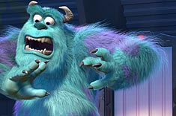
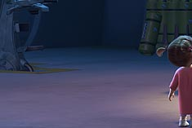
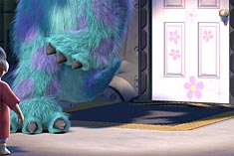
Current Challenges
Human characteristics
  Hair animation and rendering
  Skin rendering
  Facial animation
  Realistic subtle motion
High quality real time
  Fluids, hair, physics
  Realistic lighting and shading
Control with quality
  Making it easier for artists and directors to get the results they want

Slide 37
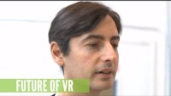
https://www.youtube.com/watch?v=Q-gse_hFkJM

Slide 38
Next Time
Final Exam

