Slide 1
Computer Graphics
Prof. Feng Liu
Fall 2022
http://www.cs.pdx.edu/~fliu/courses/cs447/
11/21/2022

Slide 2
Last time
Polygon Mesh and Modeling

Slide 3
Today
Final Exam
  December 05 (Monday) 17:30-19:00
  To know list available on our class website
Modeling Technologies

Slide 4
Modeling Techniques
Obtaining polygonal meshes
Hierarchical modeling
Instancing and Parametric Instancing
Constructive Solid Geometry
Sweep Objects
Subdivision

Slide 5
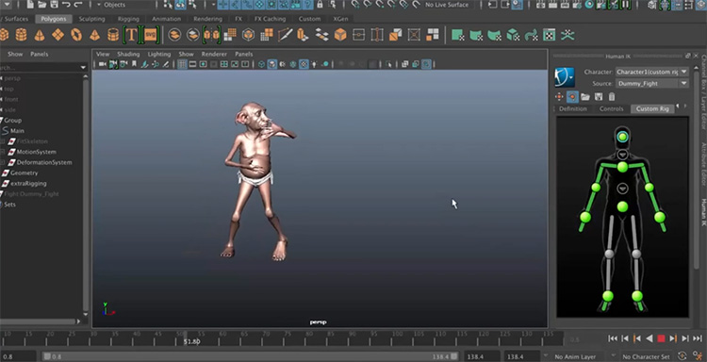
Animating a character
https://www.youtube.com/watch?v=TOMEtLJUyXY
Notes:
Added by Feng

Slide 6
Hierarchical Modeling
Hierarchical model: Group of meshes related by a tree (or graph) structure
  Properties of children are derived from their parents
  Most useful for animating polygonal meshes
Consider a walking (humanoid, classic) robot:
  How would you move the robot around?
  Does the entire robot move in the same way?
  Does the position of one part of the robot depend on other parts?
Notes:
Let’s start with hierarchical modeling. Hierarchical modeling is very useful for animating polygon meshes. Let’s look at one example here.
Consider we want to model and animate a walking robot. So, how would we move this robot around? We know that each part of the robot does not move in the same way. But they do not move independently. The position of one part depends on others. For example, if I lift my up arm, my low arm moves with it. Based on this observation, we can build a tree to model this robot. Basically, we group meshes according to a tree structure. The properties of children in this tree are derived from their parents.

Slide 7
Hierarchical Model Example
Move body
Draw body
Important Point:
Every node has its own local coordinate system.
This makes specifying transformations much much easier.
l
left arm
Rotate about shoulder
Draw upper arm
Translate (l,0,0)
Rotate about origin of lower arm
Draw lower arm
Notes:
For the case of the robot, we can build a tree like this. The root is the body. The arm positions depend on the body; so we make them the children of the body. Again, the lower arm depends on the upper arm, so we make the lower arm a child of the upper arm. So, when we draw the robot, we first move the body and draw it; then we rotate the upper arm, draw it; then we translate the low arm, and rotate it and draw it. Here, each node has its own local coordinate system;

Slide 8
Hierarchical Details
Generally represented as a tree, with transformations and instances at any node
  Can use a general graph, but resolving inheritance conflicts is a problem
Rendered by traversing the tree, applying the transformations, and rendering the instances
Particularly useful for animation
  Human is a hierarchy of body, head, upper arm, lower arm, etc…
  Animate by changing the transformations at the nodes
Other things can be inherited (colors, surface properties)
Notes:
Now let’s look at the detail of hierarchical modeling. A hierarchical model, is represented as a tree; each of its nodes is a transformation and instance (object). When we render the tree, we just need to traverse the tree, applying the transformation at each node and render the instances.

Slide 9
OpenGL Support
OpenGL defines
glPushMatrix()and glPopMatrix()
  Takes the current matrix and pushes it onto a stack, or pops the matrix off the top of the stack and makes it the current matrix
  Note: Pushing does not change the current matrix
Rendering a hierarchy (recursive):
RenderNode(tree)
glPushMatrix()
Apply node transformation
Draw node contents
RenderNode(children)
glPopMatrix()
Notes:
OpenGL actually supports rendering of a hierarchical model. OpenGL provides two functions, push takes the current matrix and pushes it onto an internal stack; and pop pops the matrix of the stack and makes it the current matrix. With these two functions, we can easily render a hierarchical object recursively.

Slide 10
Instancing
Sometimes you need many copies of the “same” object
  Like chairs in a room
Define one chair, the base or the prototype
Create many instances (copies) of it, and apply a different transformation to each
Appears in scene description languages (Renderman, Inventor) as “defining” a label for an object
Advantages?
Notes:
Now let’s talk about a popular modeling technique, instancing. Often, we need to have many copies of the same object, just like the chairs in a room. We can define one chair, and create multiple copies of it; and then apply a different transformation to each.

Slide 11
OpenGL Support
OpenGL defines display lists for encapsulating commands that are executed frequently
list_id = glGenLists(1);
glNewList(list_id, GL_COMPILE);
glBegin(GL_TRIANGLES);
draw some stuff
glEnd();
glEndList();
And later
glCallList(list_id);

Slide 12
More Display Lists
Almost any command can go in a display list
  Viewing transformation set-up
  Lighting set-up
  Surface property set-up
But some things can’t
  Causes strange bugs – always check that a command can go in a display list
The list can be:
  GL_COMPILE: things don’t get drawn, just stored
  GL_COMPILE_AND_EXECUTE: things are drawn, and also stored

Slide 13
Display Lists Good/Bad
You should use display lists when:
  You do the same thing over and over again
  The commands are supported
  Nothing changes about the way you do it
Advantages:
  Can’t be much slower than the original way
  Can be much faster
Disadvantages:
  Can’t use various commands that would offer other speedups
    For example, can’t use glVertexPointer()

Slide 14
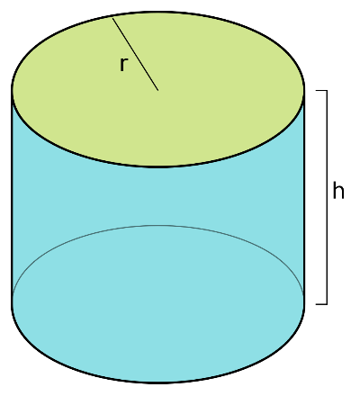
Parametric Instancing
Many things, called primitives, are conveniently described by a label and a few parameters
  Cylinder: radius, height, does it have end-caps, …
  Bolts: length, diameter, thread pitch, …
  Other examples?
This is a modeling format:
  Provide software that knows how to draw the object given the parameters, or knows how to produce a polygonal mesh
  How you manage the model depends on the rendering style
  Can be an exact representation
https://en.wikipedia.org/wiki/Cylinder#/media/File:Circular_cylinder_rh.svg
Notes:
Now let’s talk about a special instancing technique, parametric instancing. Some geometry primitives can be conveniently controlled by a few parameters. Such as cylinder; we can create different versions of cylinders by just changing the parameters. One particular advantage of parametric instancing is, it can often serve as an exact representation; rather than an approximation.

Slide 15
Rendering Instances
Generally, provide a routine that takes the parameters and produces a polygonal representation
  Conveniently brings parametric instancing into the rendering pipeline
  May include texture maps, normal vectors, colors, etc
  OpenGL utility library (glu) defines routines for cubes, cylinders, disks, and other common shapes
  Renderman does similar things, so does POVray, …
The procedure may be dynamic
  For example, adjust the polygon resolution according to distance from the viewer
Notes:
OpenGl actually supports parametric instancing too; most of then are supported by opengl utility library.
(OpenGL supports customized polygon resolutions)

Slide 16
Constructive Solid Geometry (CSG)
Based on a tree structure, like hierarchical modeling, but now:
  The internal nodes are set operations: union, intersection or difference (sometimes complement)
  The edges of the tree have transformations associated with them
  The leaves contain only geometry
Allows complex shapes with only a few primitives
  Common primitives are cylinders, cubes, etc, or quadric surfaces
Motivated by computer aided design and manufacture
  Difference is like drilling or milling
  A common format in CAD products
Notes:
OK. Now let’s talk about constructive solid geometry. We often call it CSG. CSG is also based on a tree structure. Here the internal nodes are set operations, like union, intersection or difference. The edges of the tree have transformation associated with them.

Slide 17
CSG Example
-
scale
translate
-
cube
∪
scale
translate
scale
translate
∪
cylinder
cylinder

Slide 18
Sweep Objects
Define a polygon by its edges
Sweep it along a path
The path taken by the edges form a surface - the sweep surface
Special cases
  Surface of revolution: Rotate edges about an axis
  Extrusion: Sweep along a straight line
Notes:
Now let’s talk about sweep objects. For this technique, we first define a polygon by its edges. Then, we define a path, and finally sweep the polygon a long a path, and create a surface finally. Let’s show two examples here.

Slide 19
Rendering Sweeps
Convert to polygons
  Break path into short segments
  Create a copy of the sweep polygon at each segment
  Join the corresponding vertices between the polygons
  May need things like end-caps on surfaces of revolution and extrusions
Normals come from sweep polygon and path orientation
Sweep polygon defines one texture parameter, sweep path defines the other
Notes:
Then, how do we render a sweep object? A common way is, we convert the object into polygons. Basically, we break the path into short segments; create a copy of sweep polygon at each segment, join the corresponding vertices between the polygons.
If you want to texture the object, the sweep polygon defines one texture parameter; and the path defines the other.

Slide 20
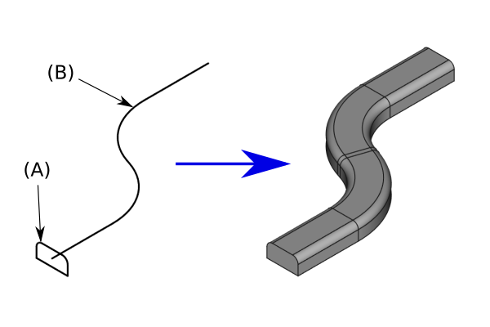
Rendering Sweeps
https://wiki.freecadweb.org/File:Part_Sweep_simple.png

Slide 21
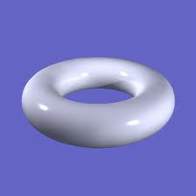
A Circular Tube (A torus)
What do we sweep, along what path?
Notes:
Now let’s show one example how to draw a sweep object, a circular tube.

Slide 22
A Circular Tube (A torus)
What do we sweep, along what path?
Geometry Path

Slide 23
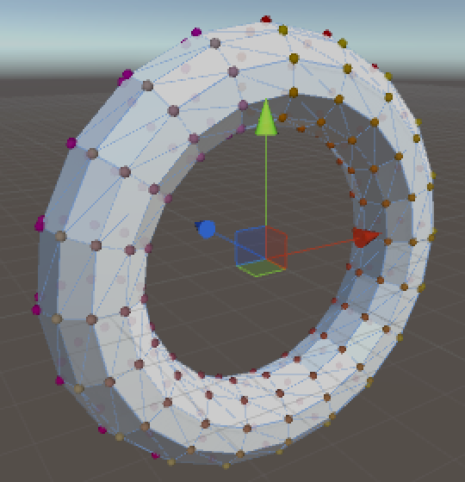
A Circular Tube (A torus)
N
What do we sweep, along what path?
Vector3 points[2][N];
int start_i = 0;
int end_i = 1;
for ( int i = 0 ; i < N ; i++ )
points[start_i][i] = TorusPoint(M-1,i);
for ( int j = 0 ; j < M ; j++ ) {
glBegin(GL_TRIANGLE_STRIP);
    for ( int i = 0 ; i < N ; i++ ) {
    glVertex3fv(points[start_i][i]);
    points[end_i][i] = TorusPoint(j, i);
    glVertex3fv(points[end_i][i]);
    }
    glVertex3fv(points[start_i][0]); //close the loop
    glVertex3fv(points[end_i][0]);
glEnd();
int temp = start_i; start_i = end_i; end_i = temp;
}
M
https://catlikecoding.com/unity/tutorials/swirly-pipe/
Notes:
Now let’s show one example how to draw a sweep object, a circular tube.

Slide 24
General Sweeps
The path maybe any curve
The polygon that is swept may be transformed as it is moved along the path
  Scale, rotate with respect to path orientation, …
One common way to specify is:
  Give a poly-line (sequence of line segments) as the path
  Give a poly-line as the shape to sweep
  Give a transformation to apply at the vertex of each path segment
Difficult to avoid self-intersection

Slide 25
Smooth versus General
Polygon meshes are very general, but hard to model with
  In a production context (film, game), creating a dense, accurate mesh requires lots of work
  Biggest problem is smoothness
We desire a way to “smooth out” a polygonal mesh
  We can model at a coarse level, and automatically fill in the smooth parts
Subdivision surfaces are part of the answer
Notes:
We can model everything using polygon meshes; but in order to create a good polygon mesh, it is difficult; it requires a lot of effort to create a good polygon mesh. One problem is to achieve smoothness. One of the solutions is subdivision.

Slide 26
Subdivision Schemes
Basic idea: Start with something coarse, and refine it into smaller pieces, smoothing along the way
  We will see how it can be used for modeling specific objects, and as a modeling scheme in itself
In this lecture:
  Subdivision for tessellating a sphere
  Subdivision for fractal surfaces
Notes:
The basic idea of subdivision is, we start with something coarse, and refine it into smaller pieces. In this lecture, we will talk about two subdivision examples.

Slide 27
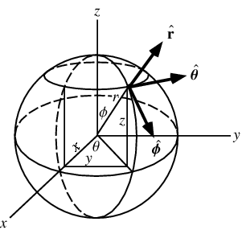
Tessellating a Sphere
Spheres are frequently parameterized in polar coordinates:
Image source: http://mathworld.wolfram.com/SphericalCoordinates.html
Notes:
Now let’s look at how to tessellate a sphere. Tessellation is the process of approximating a surface with a polygon mesh. For example, we want to tessellate a sphere.
Vertical: longitude theta
Horizontal: latitude, phi

Slide 28
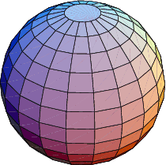
Tessellating a Sphere
Spheres are frequently parameterized in polar coordinates:
Tessellation: The process of approximating a surface with a polygon mesh
One option for tessellating a sphere:
  Step around and up the sphere in
  constant steps of θ and φ
  Problem: Polygons are of wildly different sizes,
  and some vertices have very high degree
Notes:
Now let’s look at how to tessellate a sphere. Tessellation is the process of approximating a surface with a polygon mesh. For example, we want to tessellate a sphere.
Vertical: longitude theta
Horizontal: latitude, phi

Slide 29
Subdivision Method
Begin with a coarse approximation to the sphere, that uses only triangles
  Two good candidates are platonic solids with triangular faces: Octahedron, Isosahedron
  They have uniformly sized faces and uniform vertex degree
Repeat the following process:
  Insert a new vertex in the middle of each edge
  Push the vertices out to the surface of the sphere
  Break each triangular face into 4 triangles using the new vertices
Octahedron
Isosahedron
Notes:
Now let’s see how subdivision method can solve this problem. We start with 8 triangles

Slide 30
The First Stage
Each new vertex is degree 6, original vertices are degree 4
Each face gets split into 4:

Slide 31
Sphere Subdivision Advantages
All the triangles at any given level are the same size
  Relies on the initial mesh having equal sized faces, and properties of the sphere
The new vertices all have the same degree
  Mesh is regular (or uniform) in newly generated areas
  Makes it easier to analyze what happens to the surface
The location and degree of existing vertices does not change

Slide 32
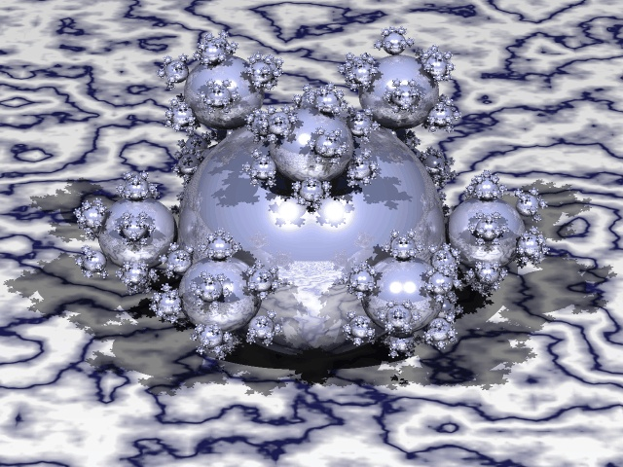
Fractal Surfaces
Fractals are objects that show self similarity
  The word is overloaded – it can also mean other things
Landscapes and coastlines are considered
fractal in nature
  Mountains have hills on them that have rocks
  on them and so on
  Continents have gulfs that have harbors
  that have bays and so on
Notes:
Fractals are objects that show self-simiarlity at different scales.

Slide 33
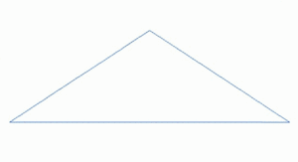
Fractal
https://en.wikipedia.org/wiki/Fractal_landscape

Slide 34
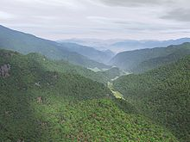
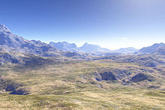
Fractal
https://en.wikipedia.org/wiki/Fractal_landscape

Slide 35
Fractal Surfaces
Fractals are objects that show self similarity
  The word is overloaded – it can also mean other things
Landscapes and coastlines are considered fractal in nature
  Mountains have hills on them that have rocks on them and so on
  Continents have gulfs that have harbors that have bays and so on
Subdivision is the natural way of building fractal surfaces
  Start with coarse features, subdivide to finer features
  Different types of fractals come from different subdivision schemes and different parameters to those schemes
Notes:
Fractals are objects that show self-simiarlity at different scales.

Slide 36
Fractal Terrain (1)
Start with a coarse mesh
  Vertices on this mesh won’t move, so they can be used to set mountain peaks and valleys
  Also defines the boundary
  Mesh must not have dangling edges or vertices
    Every edge and every vertex must be part of a face
Also define an “up” direction
Then repeatedly:
  Add new vertices at the midpoint of each edge, and randomly push them up or down
  Split each face into four, as for the sphere

Slide 37
Fractal Terrain Example
A mountainside

Slide 38
Fractal Terrain Details
There are options for choosing where to move the new vertices
  Uniform random offset
  Normally distributed offset – small motions more likely
  Procedural rule – eg Perlin noise
Reducing the offset of new points according to the subdivision level is essential
  Define a scale, s, and a ratio, k, and at each level: s_{i+1}=ks_{i}
Colors are frequently chosen based on “altitude”
Notes:
K<1

Slide 39
Fractal Terrain Algorithm
The hard part is keeping track of all the indices and other data
Same algorithm works for subdividing sphere
Split_One_Level(struct Mesh terrain)
Copy old vertices
for all edges
Create and store new vertex
Create and store new edges
for all faces
Create new edges interior to face
Create new faces
Replace old vertices, edges and faces

Slide 40
Subdivision Operations
Split an edge, create a new vertex and two new edges
  Each edge must be split exactly once
  Need to know endpoints of edge to create new vertex
Split a face, creating new edges and new faces based on the old edges and the old and new vertices
  Require knowledge of which new edges to use
  Require knowledge of new vertex locations

Slide 41
Data Structure Issues
We must represent a polygon mesh so that the subdivision operations are easy to perform
Questions influencing the data structures:
  What information about faces, edges and vertices must we have, and how do we get at it?
  Should we store edges explicitly?
  Should faces know about their edges?

Slide 42
Next Time
Implicit Surfaces

Slide 43
General Subdivision Schemes
Subdivision schemes can also be used where there is no “target” surface
They aim to replace a polygonal mesh with a smooth surface that approximates the coarse mesh
There are many schemes:
  Butterfly scheme (for triangular meshes)
  Catmull-Clark subdivision (for mostly rectangular meshes)
  Loop’s scheme (for triangular meshes)
  Modified butterfly scheme (for triangular meshes)
  Many more…

Slide 44
Modified Butterfly Scheme
Subdivides the same way we have been discussing
  Each edge is split
  Each face is split into four
Rules are defined for computing the splitting vertex of each edge
Basic rule for a uniform region
  Splitting an edge with endpoints that have degree 6
  As before, all new interior vertices will have degree 6
  Take a weighted sum of the neighboring vertices
  Weights define rules
http://www.gamasutra.com/features/20000411/sharp_01.htm

Slide 45
Modified Butterfly Scheme
c
b
c
a
a
d
d
c
b
c
Multiply each vertex by its weight and sum them up
w is a control parameter – determines how closely the shape conforms to the original mesh

Slide 46
Data Structures
Given an edge, how do we find a’s, b’s, c’s, and d’s?
What do we know about the number of edges out of a?
Key idea: Store the edges out of each vertex in an ordered list
c
b
c
a
a
d
d
c
b
c

Slide 47
Modified Butterfly Scheme
The butterfly scheme must be modified to deal with edges with an endpoint of degree ≠ 6
In that case, compute new vertex based on only the neighbors of the extraordinary vertex
If an edge has two extraordinary endpoints, average the results from each endpoint to get the new endpoint
The modified butterfly scheme is provably continuous about extraordinary vertices
  Proof formulates subdivision as a matrix operator and does eigen-analysis of subdivision matrix

Slide 48
Modified Butterfly Scheme
e₃
e₂
e₁
v is the extraordinary vertex
v
e₀
e_{N-1}
e_{N-3}
e_{N-2}

Slide 49
Boundaries
Meshes with boundaries, or sharp edges, pose problems
Boundaries are simpler: split edges on the boundary, but do not move the new vertex – place it at the edge midpoint
  Vertices on the boundary will probably be extraordinary
Sharp corners need special rules – beyond our scope

Slide 50
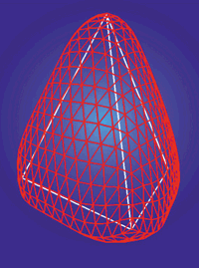
Modified Butterfly Example
Notes:
  The mesh is uniform everywhere except the original vertices
  It interpolates the original vertices
  It has smoothed out the underlying mesh

