Slide 1
Ultraviolet (UV) Disinfection

Slide 2
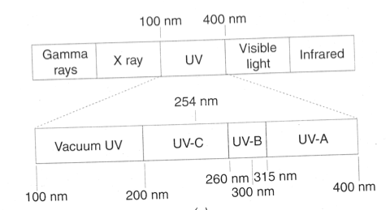
Ultraviolet Spectrum

Slide 3
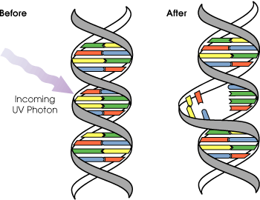
UV Radiation Induces Pyrimidine Dimers
Disrupts DNA Replication
Pyrimidine Bases =
Thymine & Cytosine

Slide 4
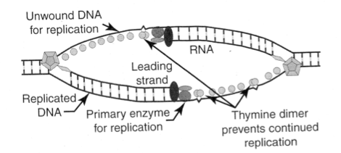
UV Radiation Induces Pyrimidine Dimers
Disrupts DNA Replication

Slide 5
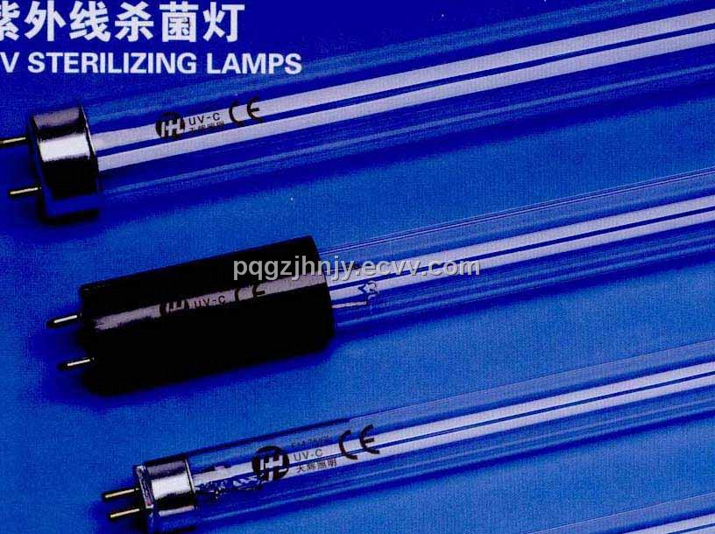
UV Lamps

Slide 6
UV Lamp Types
Low Pressure Hg Vapor (Amalgam)
  Higher biocide efficiency
  Lower power, lower temperature
  Longer lamp life
  Lots of lamps needed for large flows
  Hence mostly in smaller plants

Slide 7
UV Lamp Types
Medium Pressure Hg Vapor
  Broader UV spectrum
  Penetrate water better
  Higher power use per tube, higher temp
  Hotter tubes tend to foul more easily
  Fewer tubes needed
  Hence more efficient per watt for large flows

Slide 8
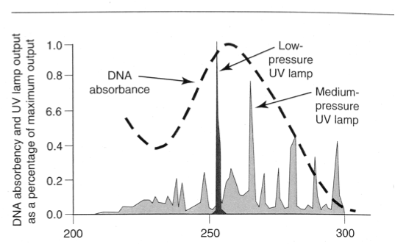
Comparative Spectra:
Low and Medium Pressure UV Lamps
Wavelength, nm

Slide 9
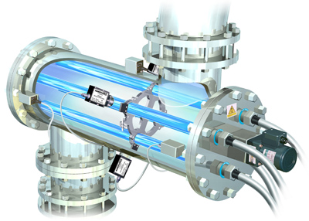
UV Disinfection Equipment

Slide 10
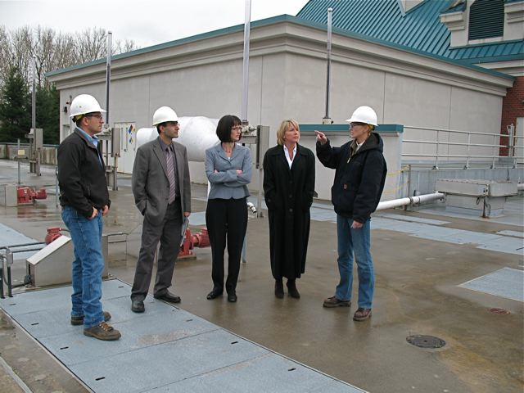
Marine Park WWTP, Vancouver WA

Slide 11
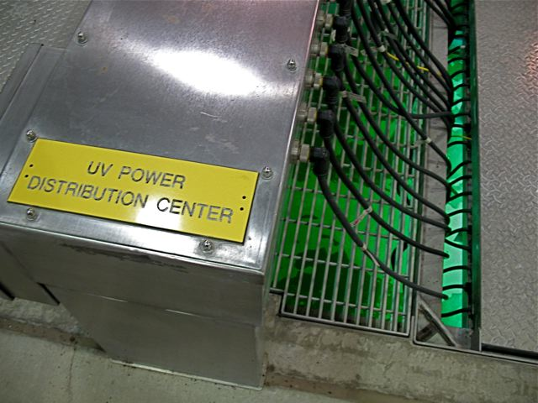

Slide 12
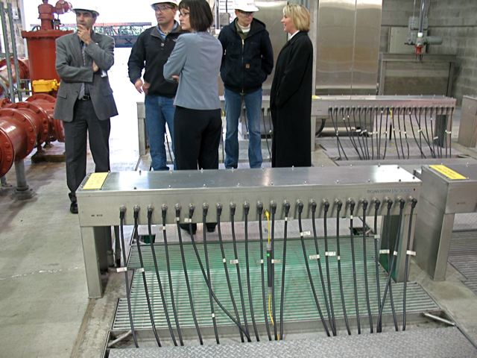

Slide 13
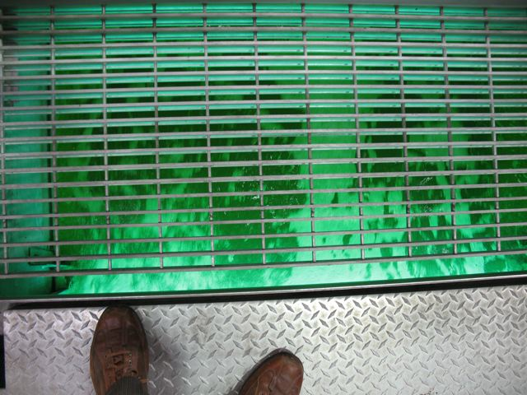
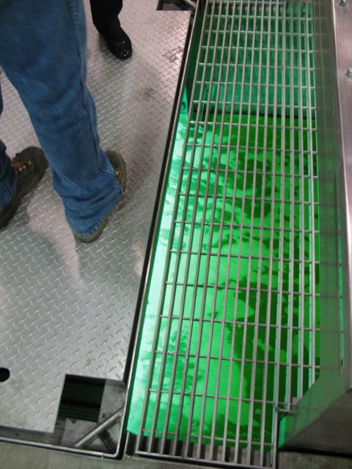

Slide 14
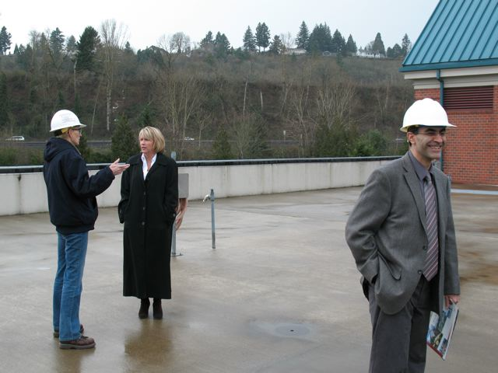
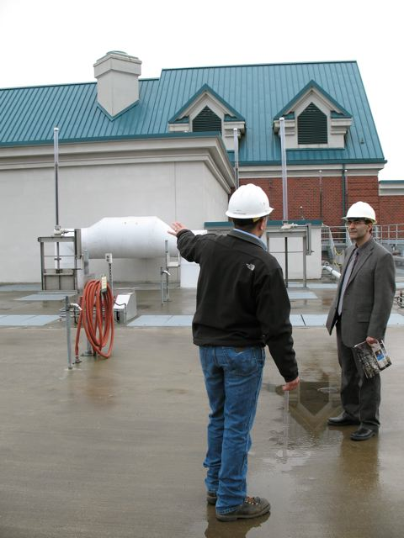
Aesthetics at Marine Park WWTP

Slide 15
