Slide 1
Bioreactor Fluid
Perfusion System
Mechanical Engineering Capstone - 2010

Slide 2

Project Sponsors
Dr. Sean S. Kohles
PSU Reparative Bioengineering Lab
In collaboration with the National Institute of Standards and Technology (NIST), with grants from the National Institutes of Health (NIH).

Slide 3
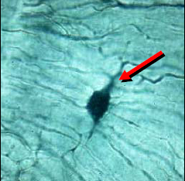
Background
Millions suffer joint tissue damage annually
  Bone
  Tendons
  Cartilage
If the damaged area is too large, it won’t heal

Slide 4
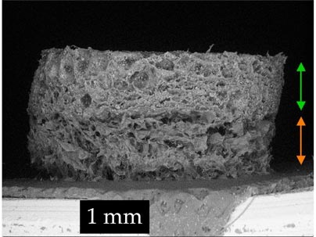
Background
Synthetic scaffold materials
Support cells
Allow applied loads to stress cells

Slide 5
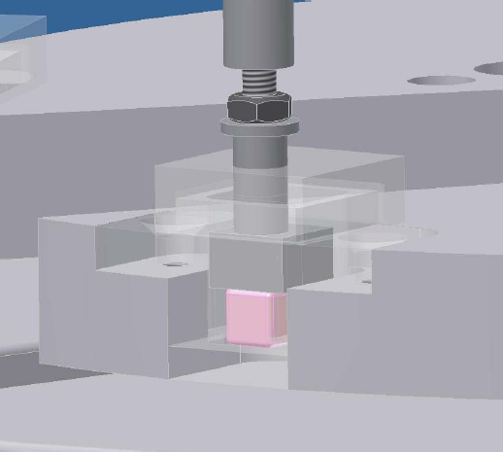
Background

Slide 6
Interfacing Equipment
High Precision Linear Actuator
Displacement Guide “Hat”
Force Application Pistons with Load Cells (5)
Camera
Ultrasonic Transducer

Slide 7
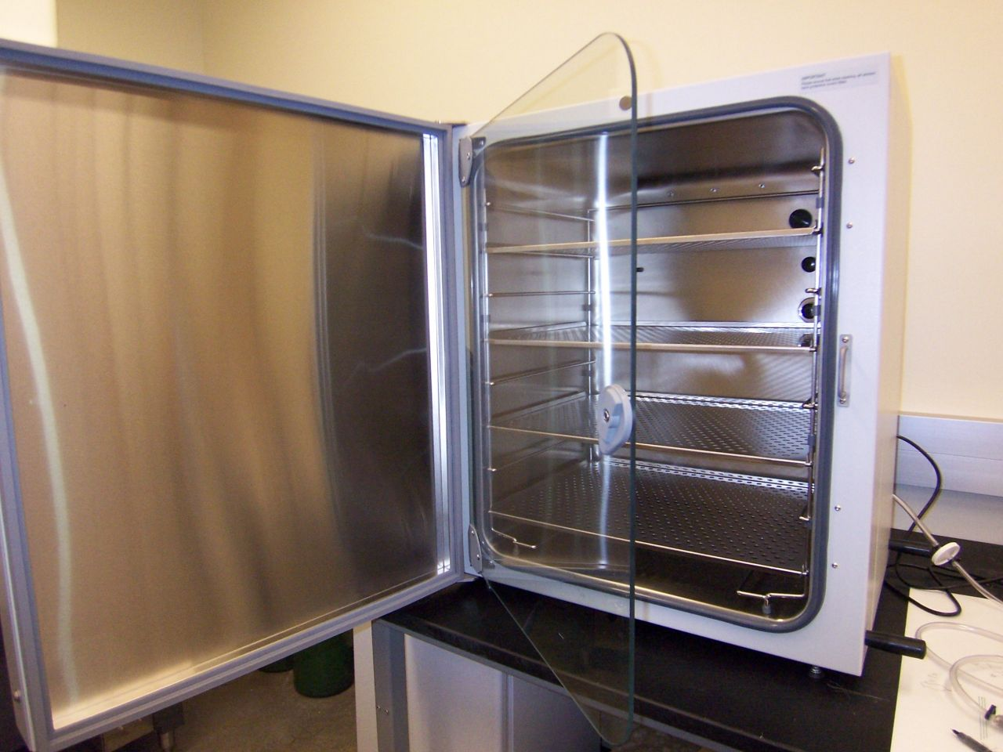
Interfacing Equipment
Incubator – Used to maintain temperature, humidity, O2 and CO2 levels.
Limits size of bioreactor equipment to inner chamber envelope (21”w x 17”d x 27”h)

Slide 8
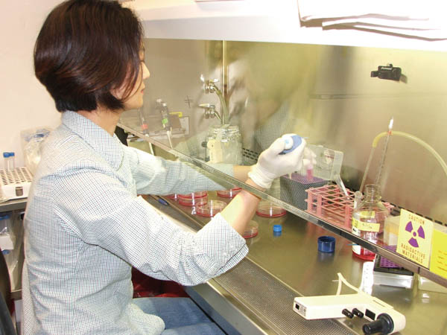
What’s the Need?
Manual Refresh of Solution
  Time consuming
  Requires disassembly of the apparatus
  Disrupts the equilibrium of the cell environment
  Requires lab workers to be available at all hours

Slide 9
What’s the Need?
Automated Fluid Perfusion System
  Circulate nutrient solution
  Interfaces with the existing system
  Works within the fully assembled system
  Adjustable timing to allow it to run unattended for extended periods, “set it and forget it”

Slide 10
Design – Requirements
Environment
  Temperatures up to 50°C
  Relative humidity up to 95%
  O2 and CO2 levels up to 20%
Function
  Up to 7 days unattended run time
  Run intervals adjustable from continuous to 72 hours
  Mininum of 4 mL/min flow rate

Slide 11
Design – Requirements
Users
  Easy setup and takedown
  Fast replacement of parts to minimize disruption to tissue samples
Fabrication
  Total budget of $1k
  Must be manufactured with PSU’s machine shop

Slide 12
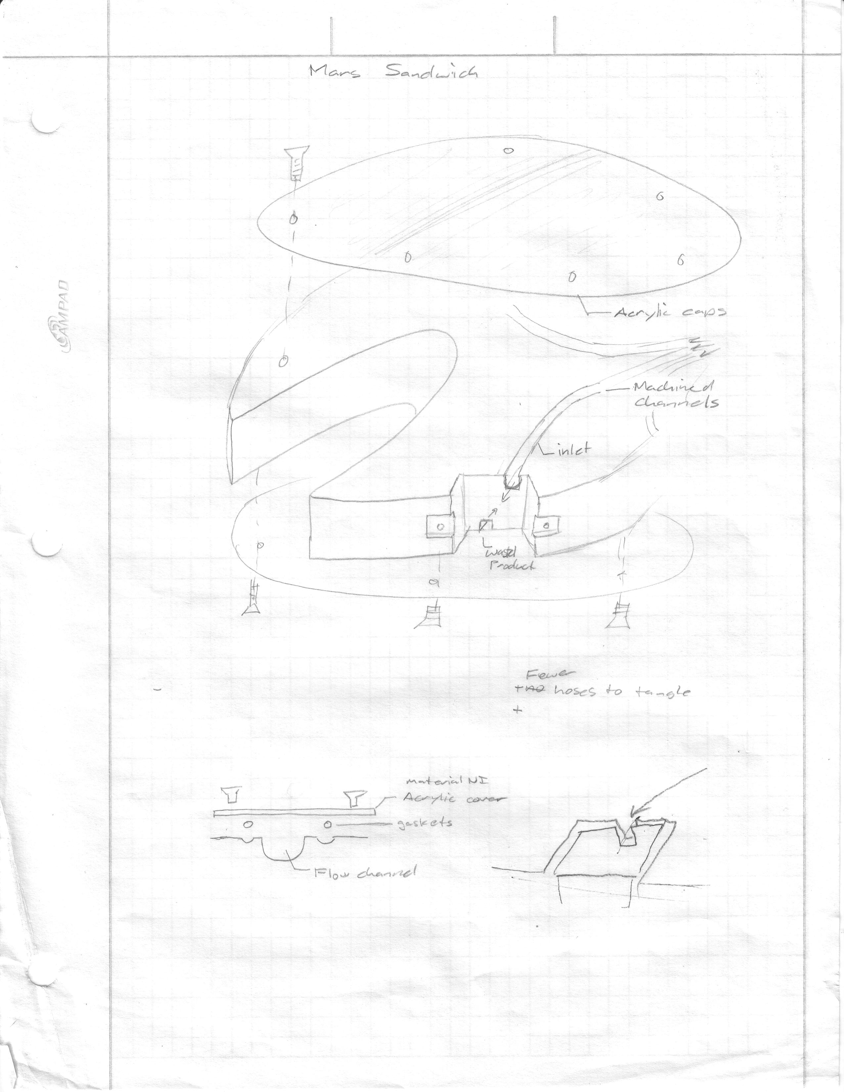
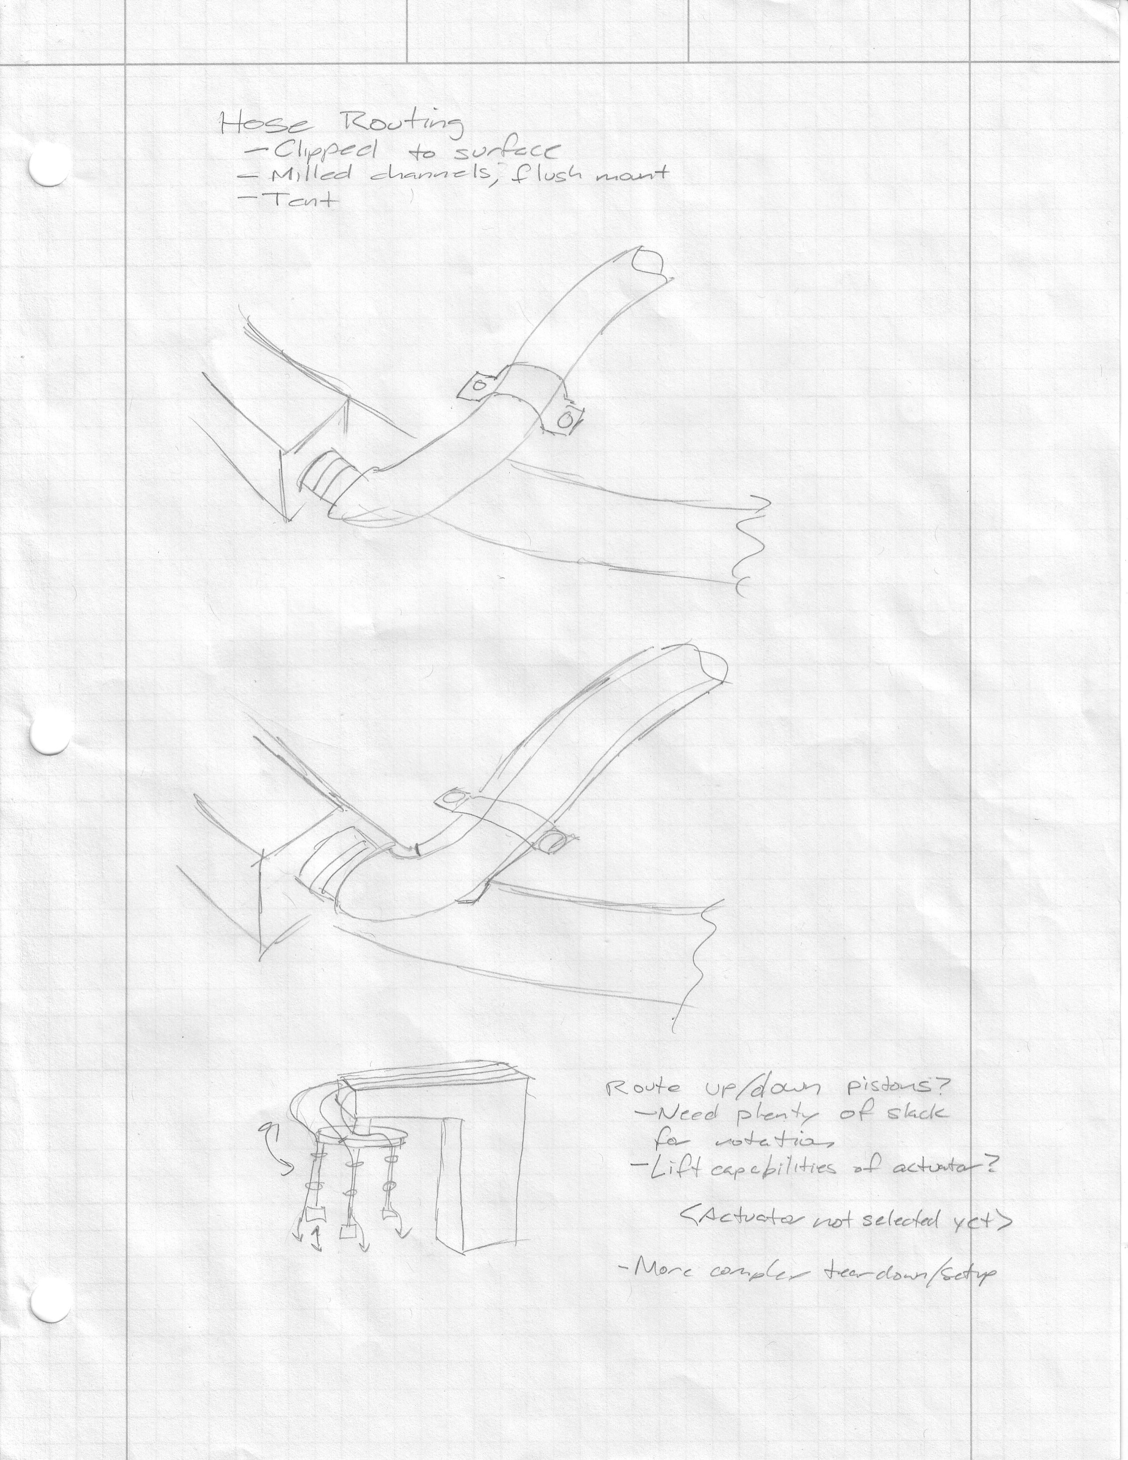
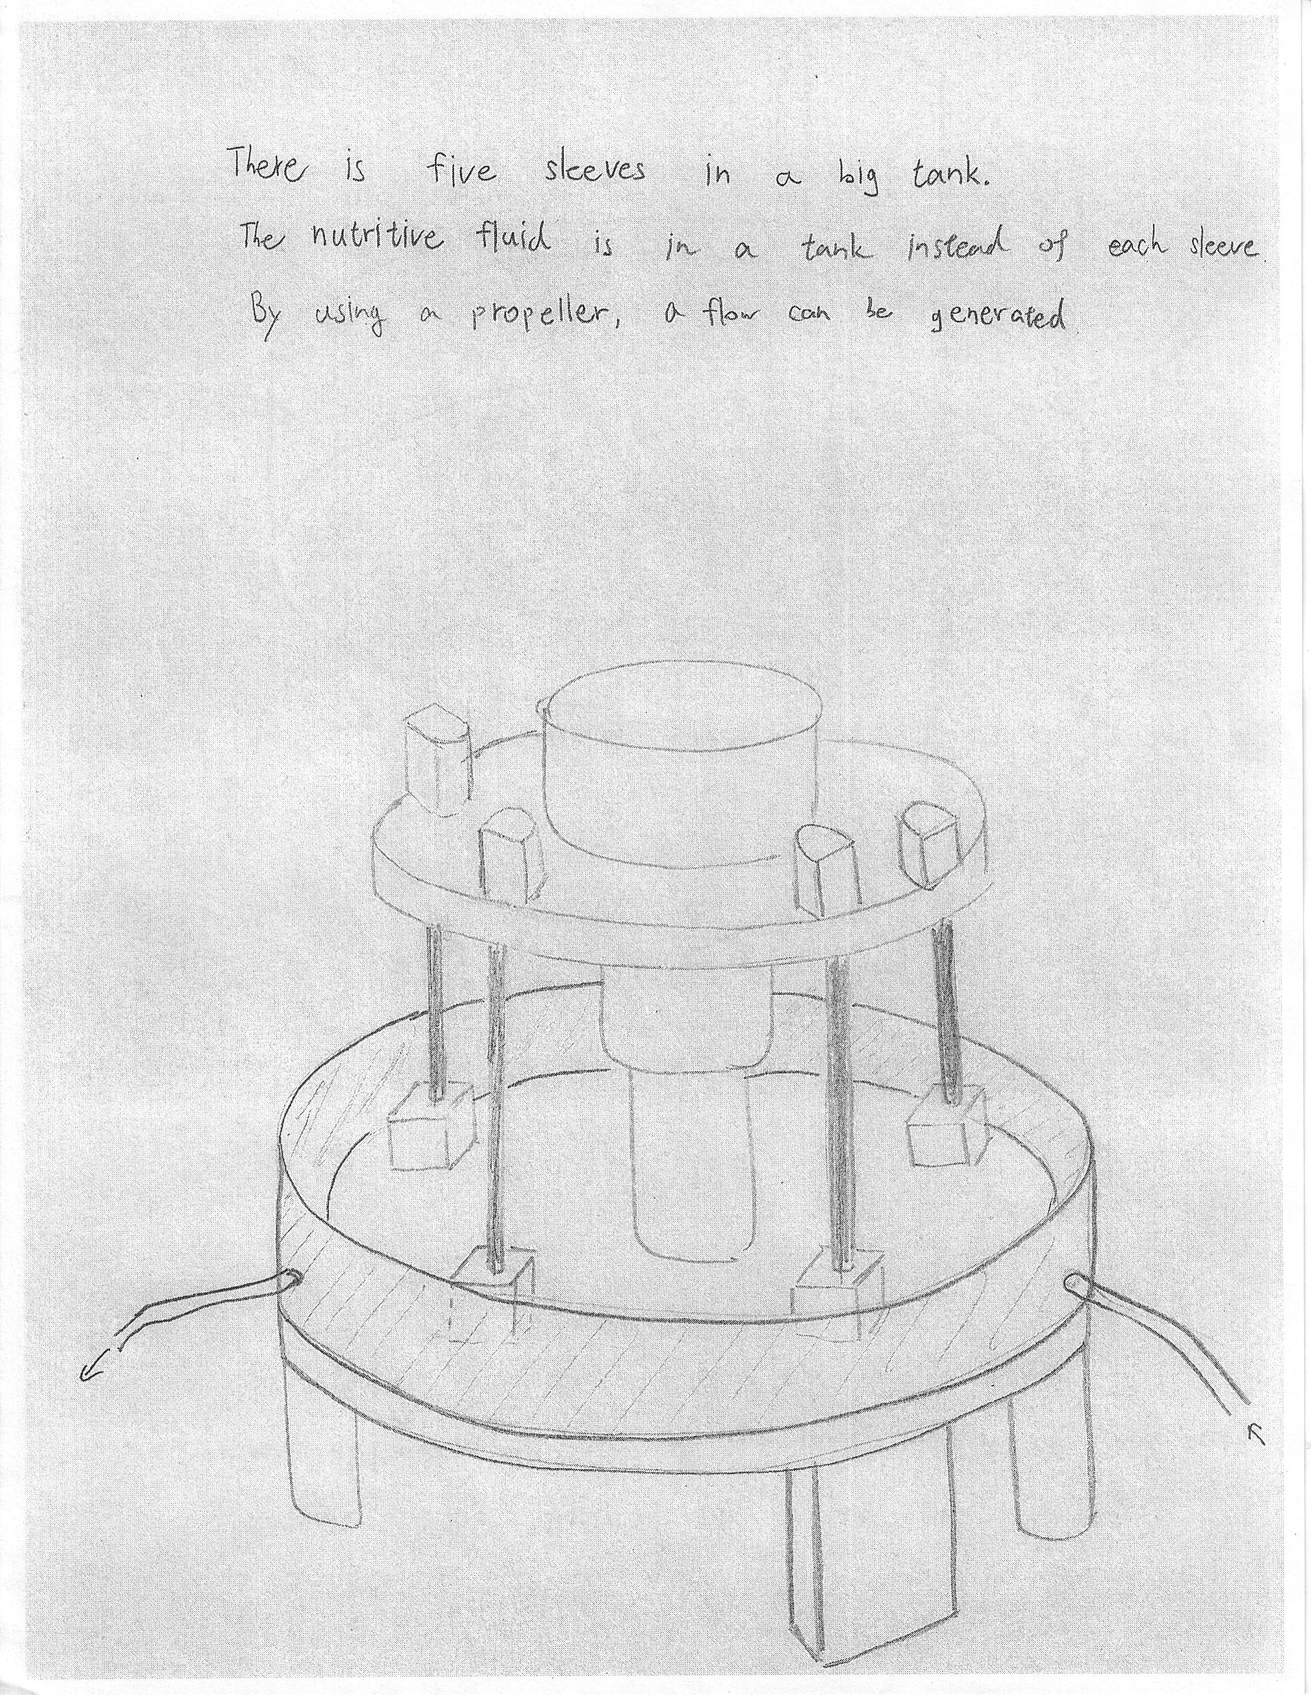
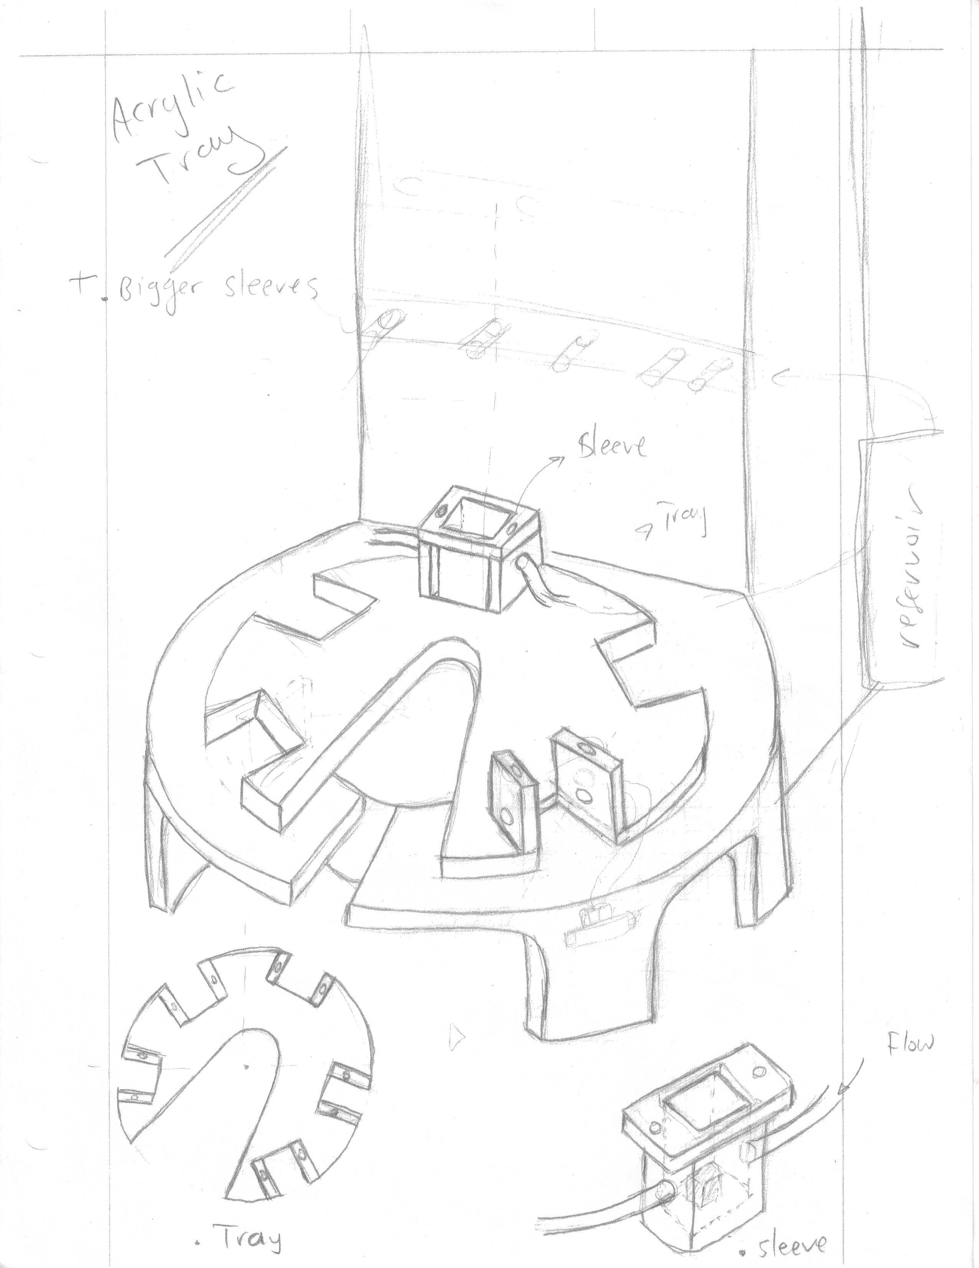
Design – Conception

Slide 13
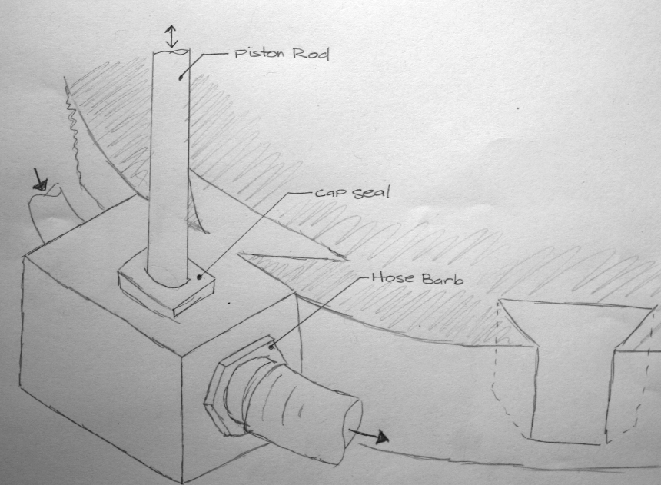
Design – Conception
“Dovetail” Advantages
  Tool free assembly and disassembly
  Simplified design to minimize manufacturing time and costs
  Reduction in material usage
  Allows future use of different size/shape sleeves with same mounting clip

Slide 14
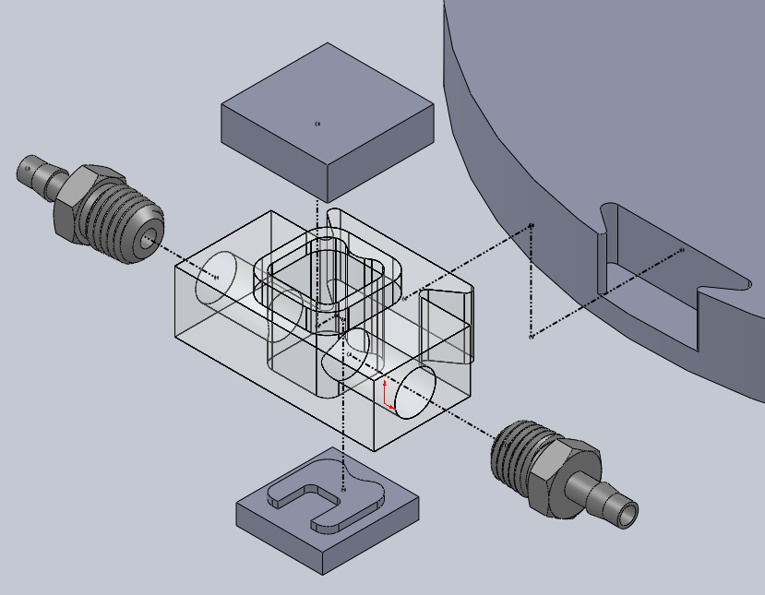
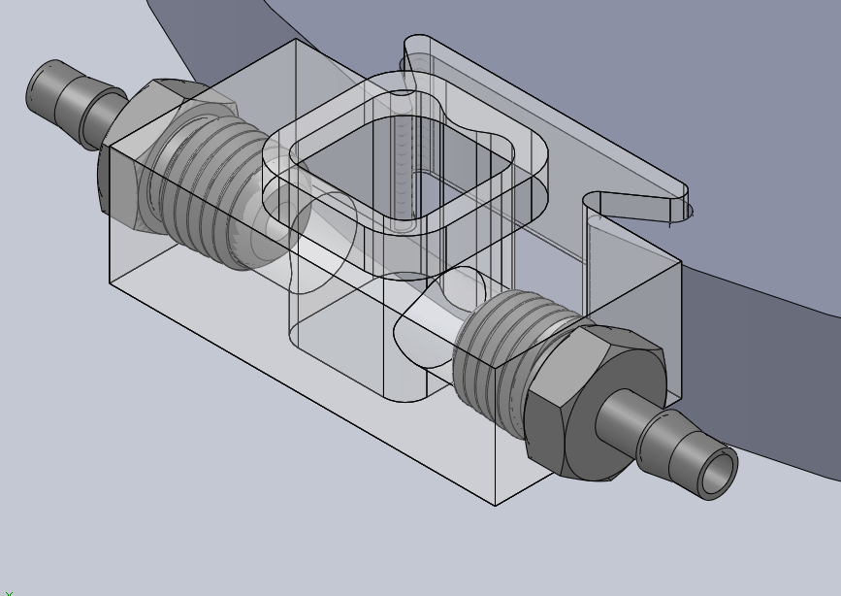
Design – Conception

Slide 15
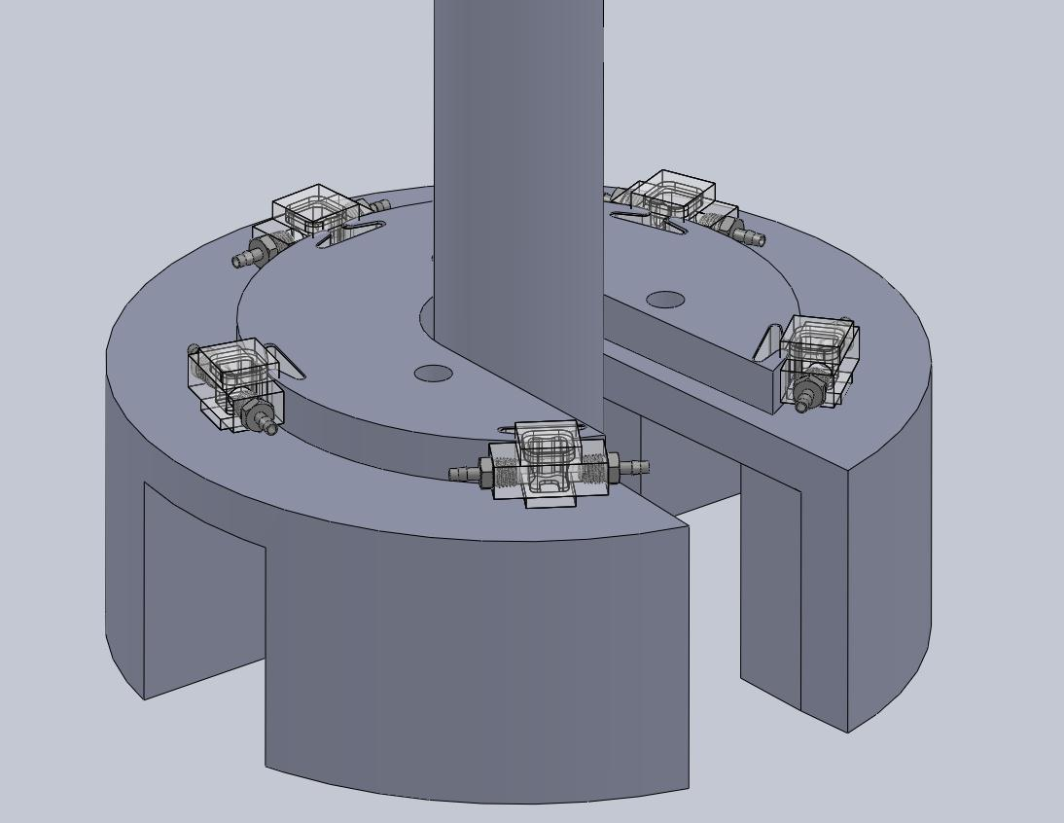
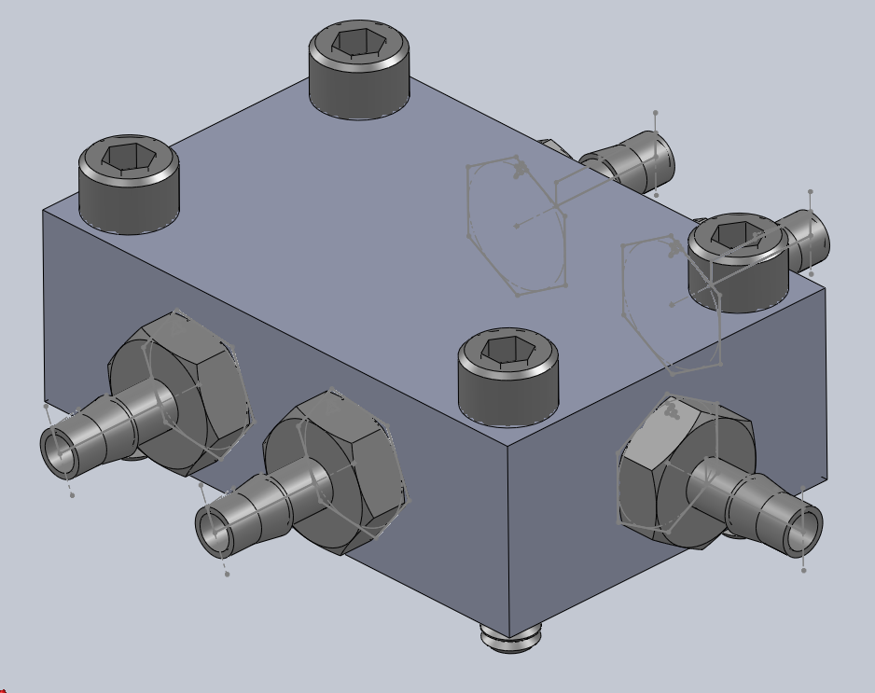
Design – Conception

Slide 16
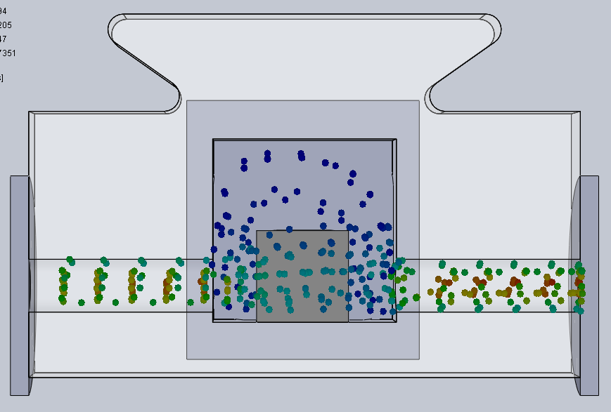
Design – Refinement
Solution provides nutrients, removes waste
Must not be allowed to stagnate
Initial design suffered from recirculation problems.

Slide 17
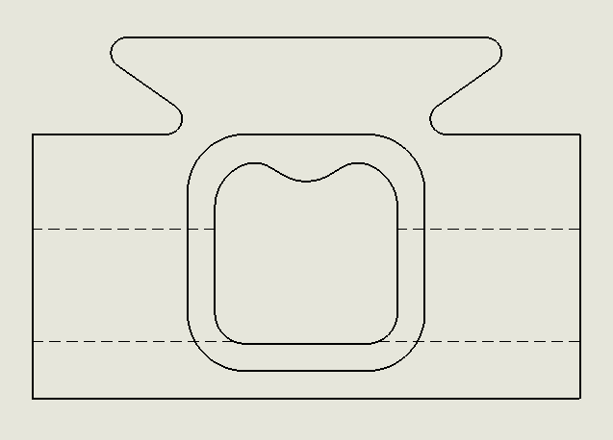
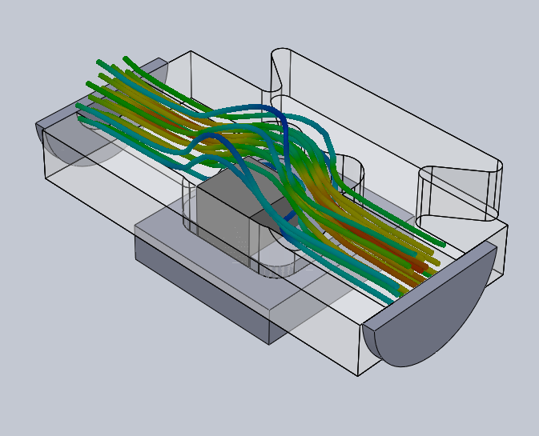
Design – Refinement

Slide 18
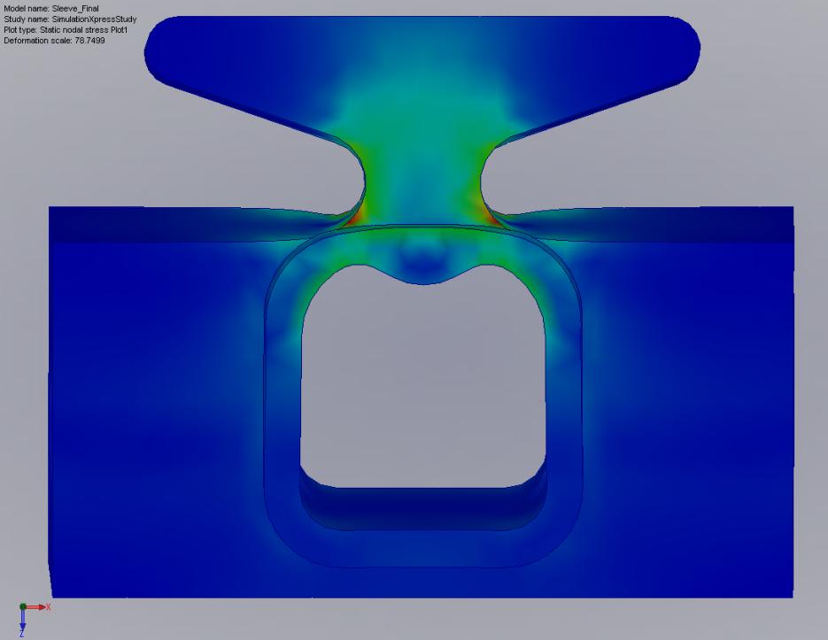
Design – Refinement
Stress Analysis
  Stress concentration points at neck
  FEA Modeling of sample sleeve and tray

Slide 19
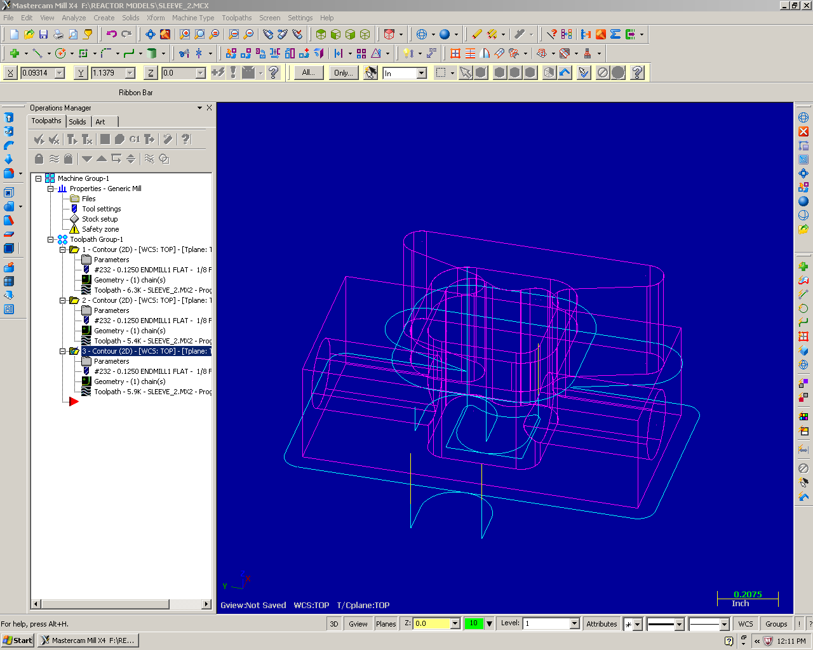
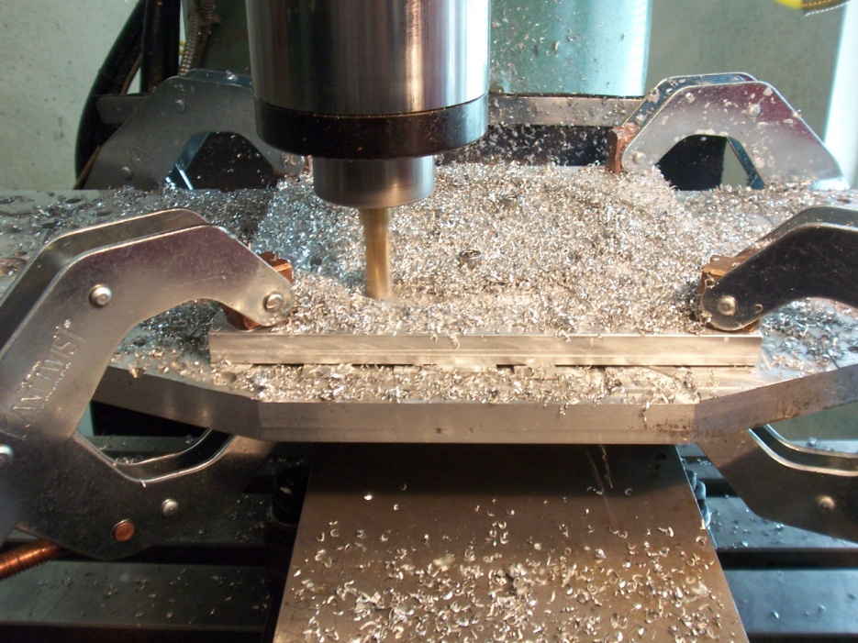
Design – Realization

Slide 20
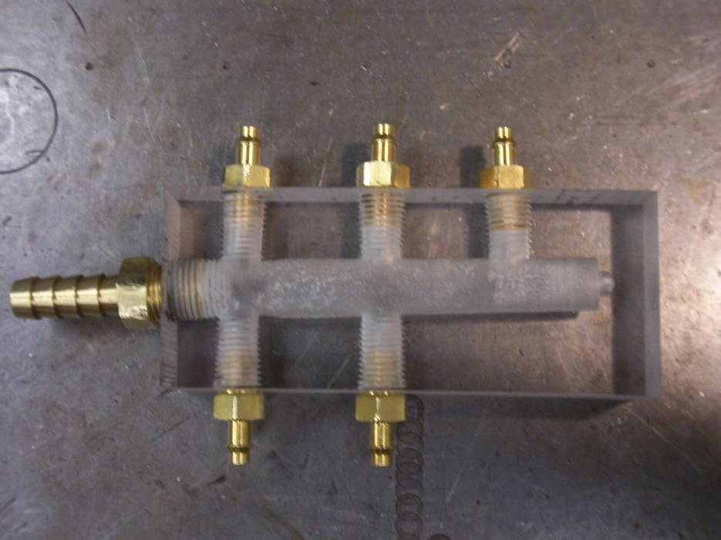
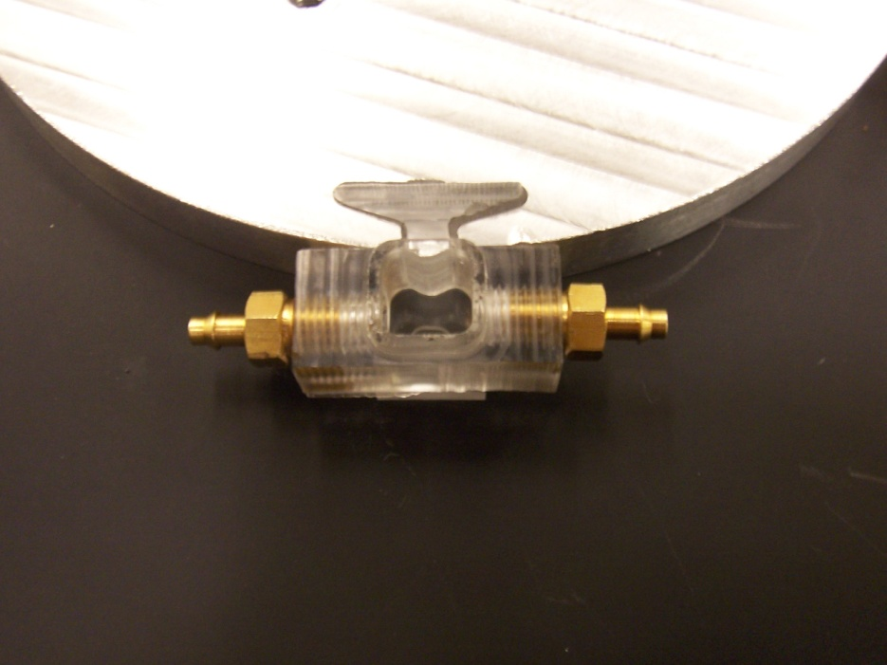
Design – Realization

Slide 21
Challenges
What didn’t go as expected
What was learned from those challenges?

Slide 22
Any Questions?

