Slide 1
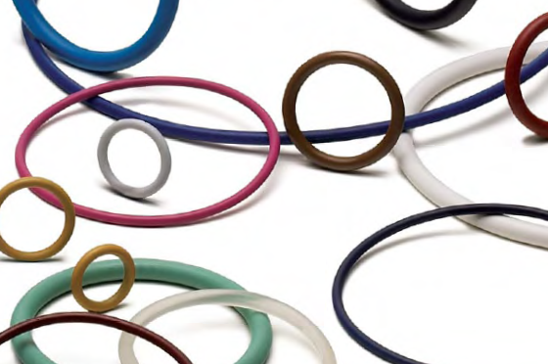
Design of O-Ring Seals

Slide 2
Design of O-Ring Seals
Primary Source of information

Slide 3
Why O-Rings?
Can be used for static and dynamic applications
Compact – need very little space - light weight
Easy to incorporate into design
Do not require high accuracy
Simple design rules
Easy to install or remove
Easy to service
Available in many standard sizes, materials

Slide 4
Why O-Rings?
Wide range of operating temperatures
Wide range of operating pressures
Good durability and abrasion resistance
O-ring materials for a wide range of chemicals
Their failure or deterioration is gradual
Inexpensive

Slide 5
Limitations of O-rings
Temperature (typically between -40 and 400 degrees F)
Rotary speeds ( not to exceeding 1500 feet per minute)
For a 2 inch shaft, it is 3000 rpm
Vulnerable to sharp edges
Require small clearances

Slide 6
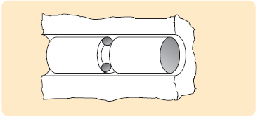
O-Rings

Slide 7
Popular O-ring materials
Nitrile (Buna-N)
Variety of trade names
Copolymer of butadiene and acrylonitrile
Most widely used and economical elastomer
Temperature Range: Standard Compound: -40° to +257°F
Hardness (Shore A): 40 to 90

Slide 8
Popular O-ring materials Nitrile (Buna-N)
Excellent resistance to
petroleum-based oils and fuels
silicone greases
hydraulic fluids
water and alcohol
High tensile strength
High abrasion resistance

Slide 9
Popular O-ring materials Nitrile (Buna-N)
Applications
Oil resistant applications
Low temperature uses
Off-road equipment
Automotive, marine, aircraft fuel systems

Slide 10
Other O-ring Materials
Viton® / FKM: Fluorocarbon (Viton®) exceptional resistance to chemicals, oils, temperature extremes (-13°F to +446°F), low compression set. Applications include: aircraft engines, automotive fuel handling systems, and chemical processing industries.
Ethylene-Propylene / EPDM: EPDM has excellent resistance to heat, water and steam, alkali, mild acidic and solvents, ozone, and sunlight with a temperature range of (-40ºF to +275ºF); but it is not recommended for gasoline, petroleum oil and grease, and hydrocarbon environments.

Slide 11
Other O-ring Materials
Fluorosilicone / FVMQ: Fluorosilicone (-75º to +400ºF) combines the good high and low temperature stability of silicones with the fuel, oil, and solvent resistance of fluorocarbons. FVMQ is used for aerospace fuel systems, auto fuel emission control systems. However, due to relatively low tear strength, high friction and limited abrasion resistance of these materials, they are generally not used in dynamic applications.

Slide 12
Other O-ring Materials
Silicone / VMQ: Superior as static seals in extreme temperature conditions. Standard compounds handle operating temperatures -85º to +400ºF. Silicone compounds are popular in food and medical applications because they are clean and do not impart odor or taste. Special Phenyl silicones can be used down to -148°F.

Slide 13
Other O-ring Materials
Neoprene® / CR: Neoprene (-40º to +250ºF) features good resistance to petroleum oils, ozone, sunlight, relatively low compression set, good resilience and physical toughness. It is the preferred sealing material for the refrigeration industry because of its resistance to ammonia and Freon

Slide 17
O-Ring Seal Design
The O-ring Specifications
Size (inside diameter)
1/32 to 26 inches
CS (Cross-Section)
1/32 to ¼ inch
Rigidity (Hardness)
Material

Slide 18
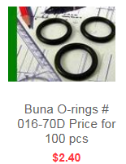
O-ring Standards
Standard
AS568
ISO 3601
Example
AS016-70N Nitrile O-ring
(AS568-016 Size 0.070 CS x 0.614 ID)

Slide 19
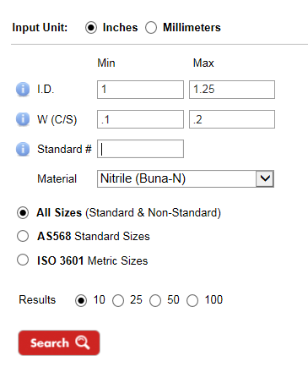
O-ring Search Tools

Slide 20
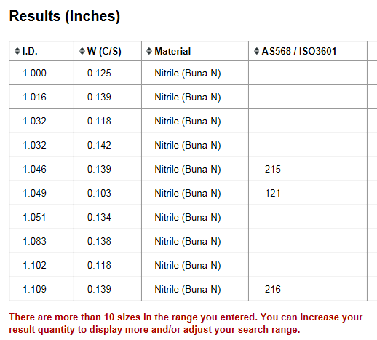

Slide 21
O-Ring Hardness
Measured on Shore-A hardness index
Shore 20A = Rubber Band
Shore 40A = Pencil Eraser
Shore 60A = Car Tire Tread
Shore 70A* = Running Shoe Sole
Shore 80A = Leather Belt
Shore 100A = Shopping Cart Wheel

Slide 22
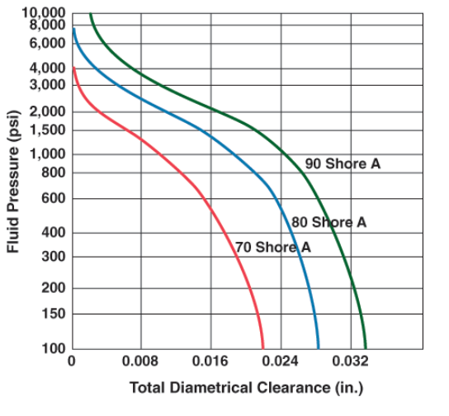

Slide 23
O-Ring Properties
Fluid resistance
Hardness
Toughness
Volume change (swell / shrinkage)
Compression set
Thermal effects
Resilience
Deterioration
Corrosion
Permeability
Coefficient of friction
Coefficient of thermal expansion
Compression set relaxation
Tensile strength
Elongation
Tear resistance / Abrasion resistance

Slide 24
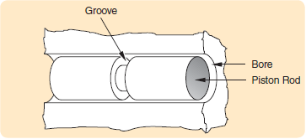
O-ring Seal Design
The Gland (Groove + Spacing)
Depth of groove
Width of groove
Diameter of bore and piston
Surface finish
Tolerances

Slide 25
Static Seals
Static Axial Seal
(Face Seal)

Slide 26
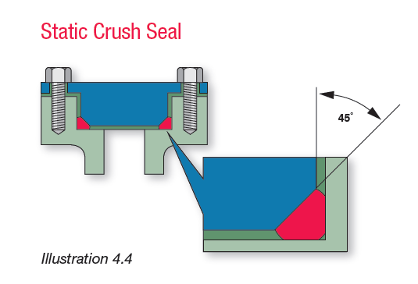
Static Seals
Static Crush Seal

Slide 27
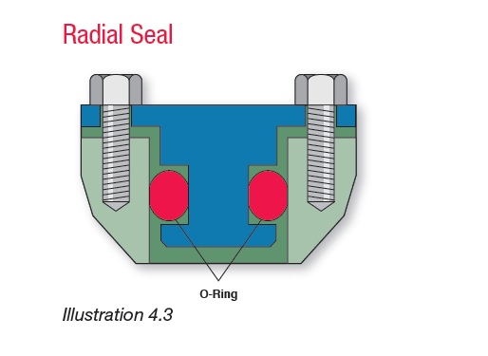
Static Seals
Static Radial Seal
(Piston Seal)

Slide 28
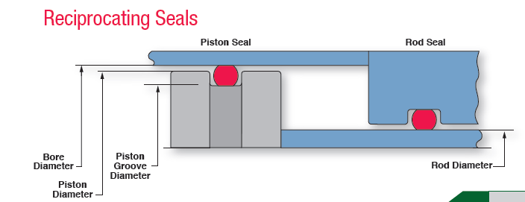
Dynamic Seals
Reciprocating Seals

Slide 29
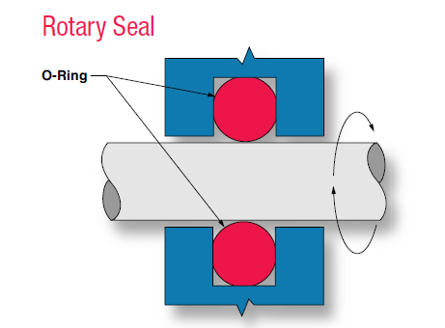
Dynamic Seals
Rotary Seals

Slide 30
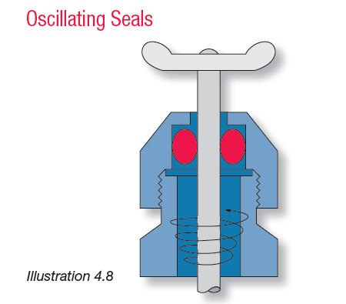
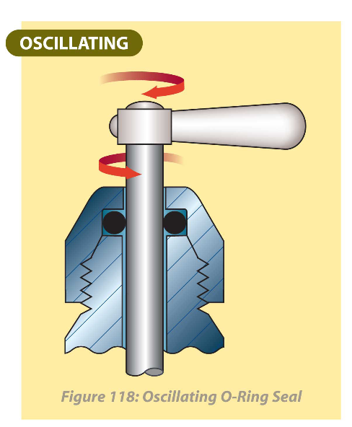
Dynamic Seals

Slide 31
General Design Guidelines
Stretch should be less than 5% on the O-ring I.D.
Groove depth must be smaller than the O-ring CS
O-ring should not completely fill the gland
Between 75% and 90%
Static seal CS should be compressed from 10% to 40%
Dynamic seals should be compressed from 10% to 30%

Slide 32
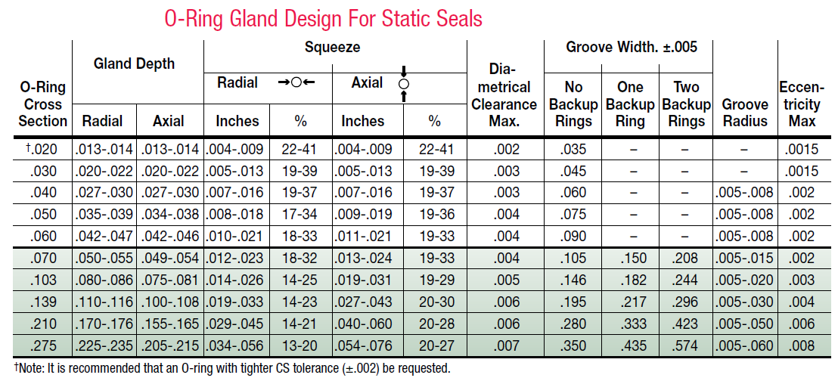

Slide 33
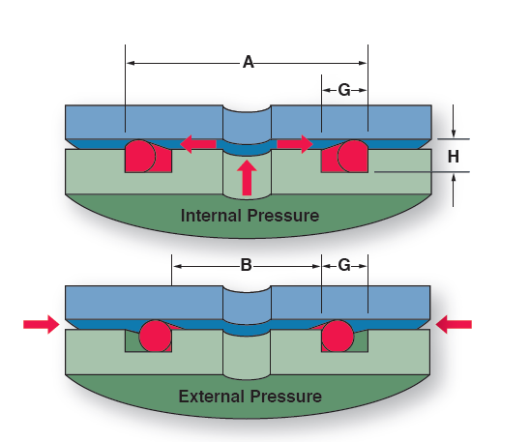
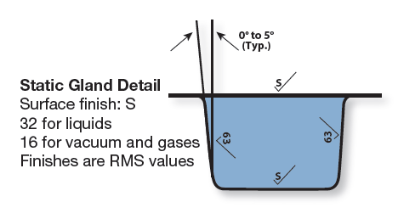
Design of Axial Seal
Axial Seal

Slide 34
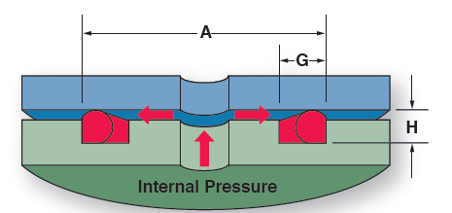
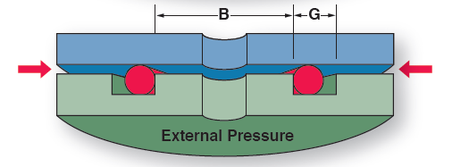

Slide 35
Example Design
Design a groove for a 1.5 inch diameter Internal pressure O-ring
O-ring : -029 (ID: 1.489 +/- .013) (W: .07 +/- .003)
Material: Buna-N
Hardness: 70 Shore-A
A: 1.624 (-0 , + .005)
G: .125 (-0, + .01)
H: .049 (-0,+.005)

Slide 36
Example Design
Checking resulting compression
Compression (squeeze) = W - H
Min. Comp. = W_{min} - H_{max}
Min. Comp. = 0.013 in (18.5%)
Max. Comp. = W_{max} - H_{min}
Max. Comp. = 0.024 in (34.3%)

Slide 37
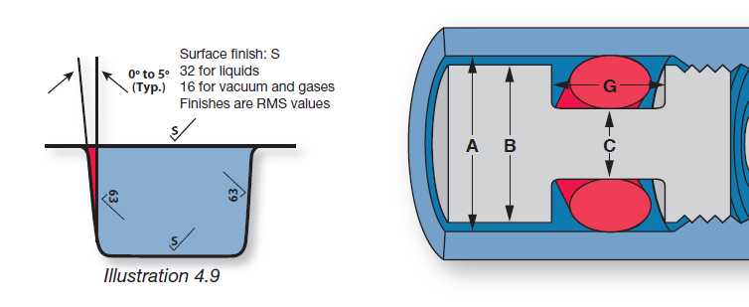
Radial Seal
Radial Static
Piston Seal

Slide 38
Example Design
Design a groove for a 0.7 inch diameter piston ring
O-ring : -029 (ID: .614 +/- .009) (W: .07 +/- .003)
Material: Buna-N
Hardness: 70 Shore-A
A: .746 (-0 , + .002)
B: .745 (-.001, + 0)
C: .638 (-.001,+ 0)

Slide 39
Example Design
Checking compression
Comp = W – 0.5(A - C)
Min. Comp = W_{min} – 0.5(A_{max} – C_{min})
Min. Comp. = 0.0115 in (17.1%)
Max. Comp. = 0.024 in (26.0%)
Also check
Extrusion gap
Stretch
Squeeze

Slide 41
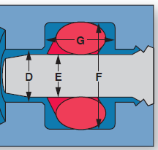
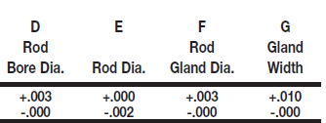
Radial Static
Rod Seal

Slide 42
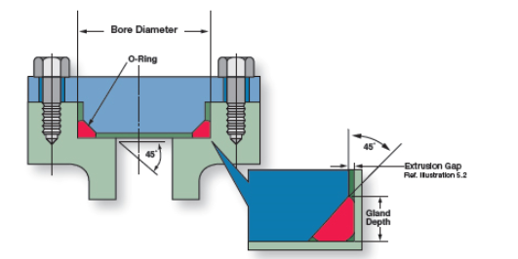
Static Crush Seal

Slide 43
Static Crush Seal

Slide 44
Dynamic Seals

Slide 45
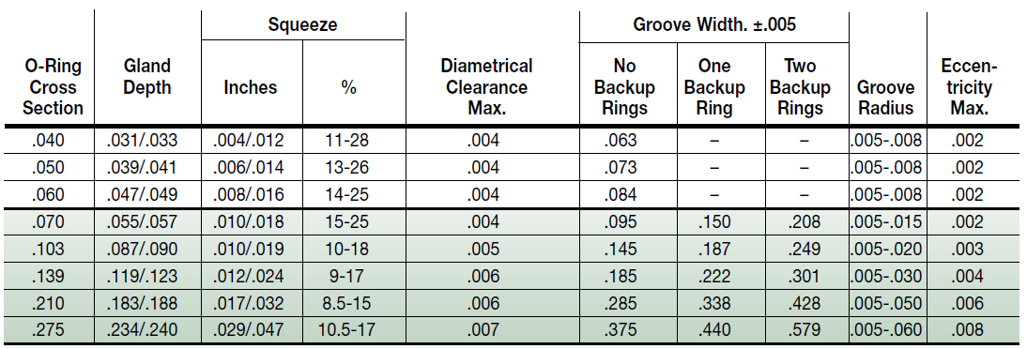
Gland Design For Dynamic O-ring Seals

Slide 46
Reciprocating Motion

Slide 47
The O-ring’s O.D. is larger than the cylinder bore diameter. Peripheral squeeze is applied to the O.D. as the O-ring is installed into the bore. Incoming air pressure forces the O-ring against the walls sealing

Slide 48
Floating O-Rings
Advantage
Greatly reduced breakout friction
Longer seal life
Limitations
Air pressure less than 200 psi in pneumatic cylinders
In hydraulic systems small amount of leakage must be permissible
Floating O-rings are NOT suitable as rod seals

Slide 49
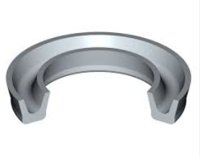
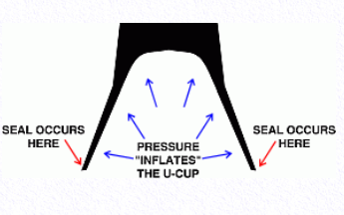
Alternatives to O-Rings U-cup Seals
O-rings have a tendency to roll and move in reciprocating motions
U-cups create more sealing as the pressure increases
U-cups require less precision for the associated hardware

Slide 50
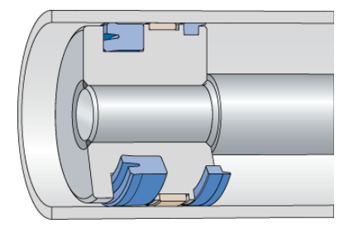
Alternatives to O-Rings U-cup Seals

Slide 51
Typical Applications

Slide 52
Buffer Seal
Buffer seals are one-way seals that protect rod seals from pressure spikes yet allow fluid (lubricant) to reach the main seal

Slide 53
Rotary Seals

Slide 54
Due to centrifugal force and Gough-Joule effect rotary O-rings are only installed in the housing not on the shaft

Slide 55
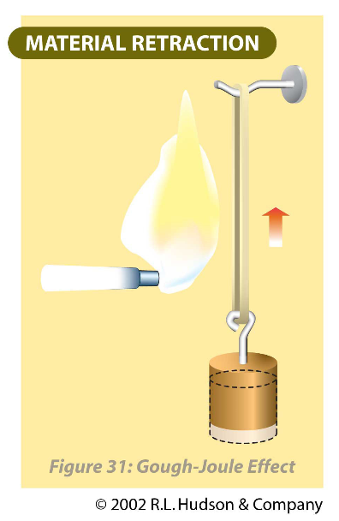
Gough-Joule effect
When an elastomer is stretched and heated, it will contract.

Slide 56
Rotary O-Ring Limitations
O-ring seals are NOT recommended for rotary applications under the following conditions:
Pressures exceeding 900 psi
Temperatures lower than -40° F or higher than 225° F
Surface speeds exceeding 600 feet per minute (fpm).
2300 rpm for 1 inch diameter shaft
1150 rpm for 2 inch diameter shaft

Slide 57
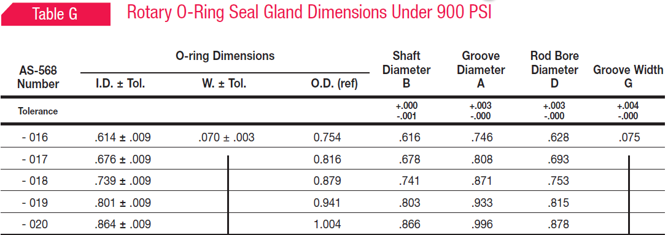
Rotary Seals

Slide 58
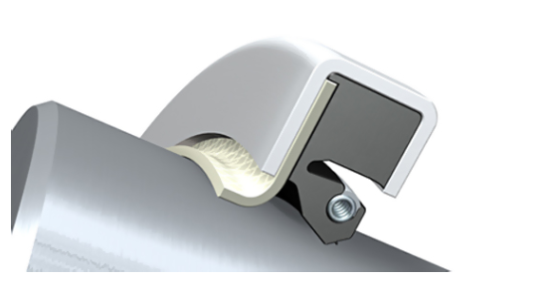
Lip Seals
Lip seals work well in high speed low pressure rotating shafts

Slide 59
Main Application of Lip Seals
Ball and roller bearing protection
As little as 0.002% water in lubrication oil can reduce ball bearing life by 50%
Solid particles cause rapid damage to the bearing races.

Slide 62
The purpose of the spring is to provide a uniform load on the lip
The spring keeps the seal lip in contact with the shaft during higher speeds and also overcomes compression set and wear of the lip material.

Slide 63
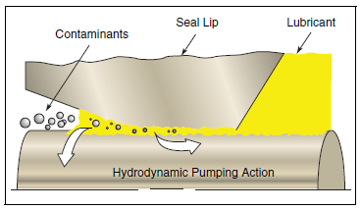
There is a tendency for liquids to be pumped from the low angle side towards the high angle side. Underneath the flattened area a thin fluid film is formed. Its thickness must be between 1 and 3 µm to avoid leakage

Slide 65
Primary function is retention
Primary function is exclusion

Slide 66
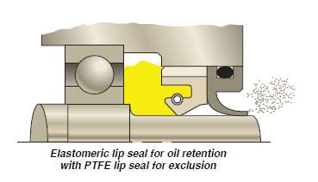

Slide 67
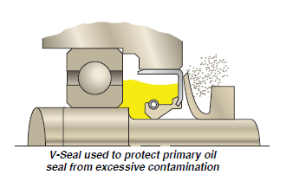

Slide 68
Lip Seals
To minimize wear
The contact pressure should be as low as possible.
Shaft surface should be smooth to 0.25- 0.5µm.
There must be enough fluid to form a hydrodynamic film
Fluid pressure must be low (0-3 psi )

Slide 69
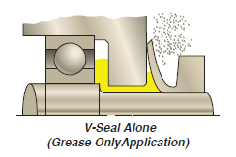
V-Seals

Slide 70
Flexi-Lip Rotary Seals
Speeds up to 5000 fps
Pressures up to 150 psi
Material: PTFE, graphite

Slide 71
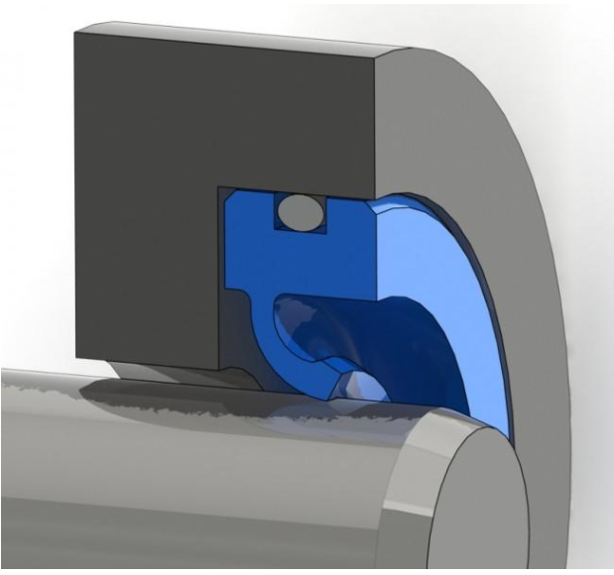

Slide 72
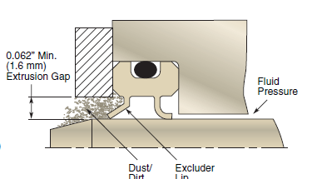

Slide 73
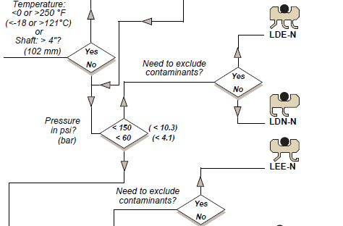

Slide 74
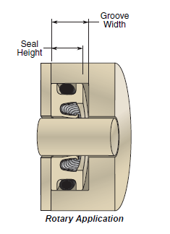
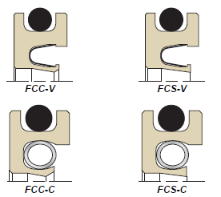

Slide 75
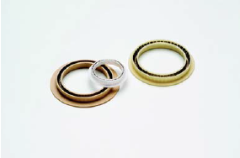
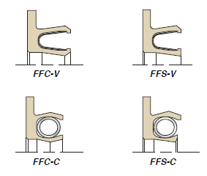

Slide 76
Metallic Seals
Metallic seals go where polymers cannot
High temperatures (Above 400 to 1800 Degree F)
Cryogenic temperatures (below −238 °F)
High pressures (3000 psi to 60000 psi)
High speeds

Slide 77
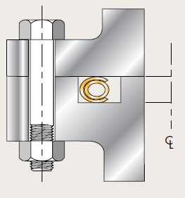
Metal Seals

Slide 78
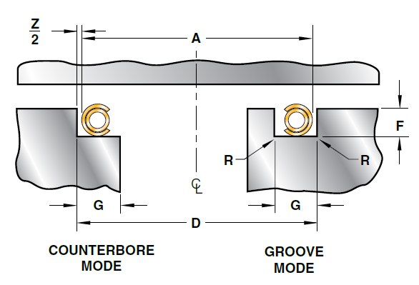
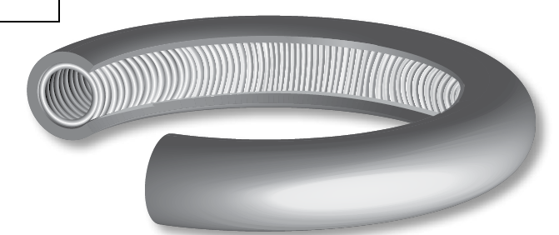
C-Ring and Energized C-Ring

Slide 79
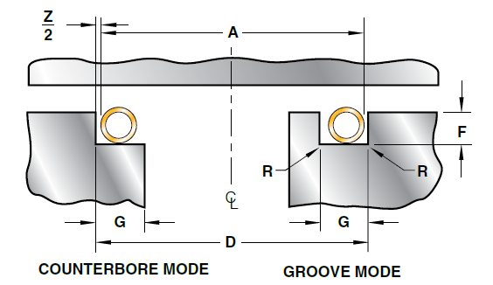
E-Ring and O-Ring

Slide 80
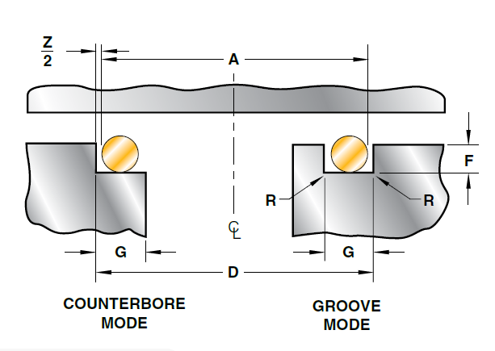
U-Ring and Metal Wire

Slide 81
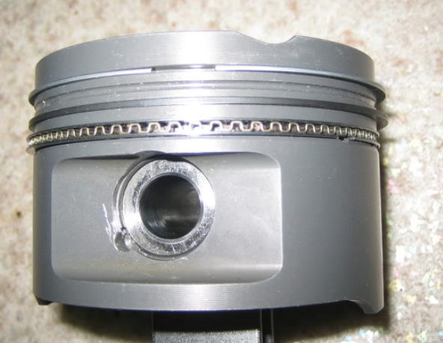
Combustion Engine Piston Rings
First compression ring (1)
Second compression ring (2)
Oil scraper ring (3)

Slide 82
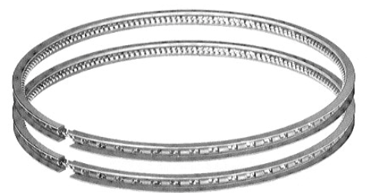
Piston Rings
Compression ring
Seals the gases in the cylinder
Gas pressure forces the ring against the cylinder wall
Wiper ring (secondary compression ring)
Seals the gases that escape the compression ring
Wipes excess oil from cylinder wall
Oil ring
Made of two thin rails with slots
Wipes excess oil from cylinder walls through port holes

Slide 83
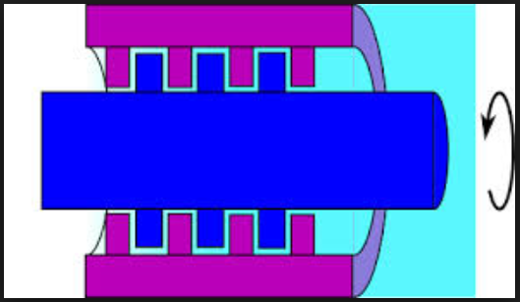
Labyrinth Seals

Slide 84
Labyrinth Seal

Slide 85
Labyrinth Seal

Slide 86
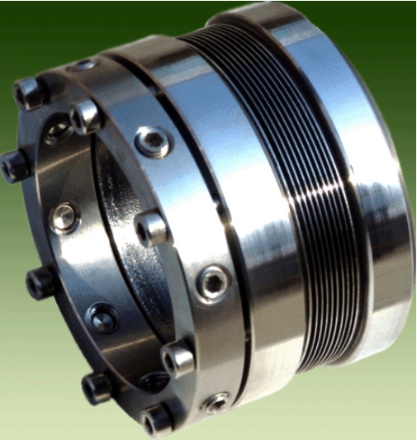
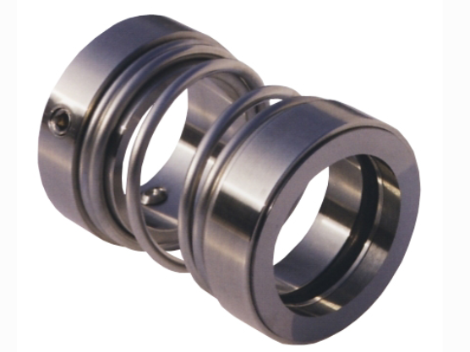
Mechanical Seals
Rotating Elements

