Slide 1
FSAE Cooling Progress Report
Craig McLain
Reuben Ness
Riki Hopkins
Advisor: Lemmy Meekisho

Slide 2
Content
What We Have Done So Far
Research
Calculation
Design
Manufacture
What We Are Doing
Manufacture
Experiments
What’s Next
Finish Design/Manufacture
Assembly & Real-World Testing

Slide 3
What We Have Done So Far
PDS
210°F Top Tank Temperature
Reliability
Research
Internal/External
Single Radiator
No Oil Cooler

Slide 4
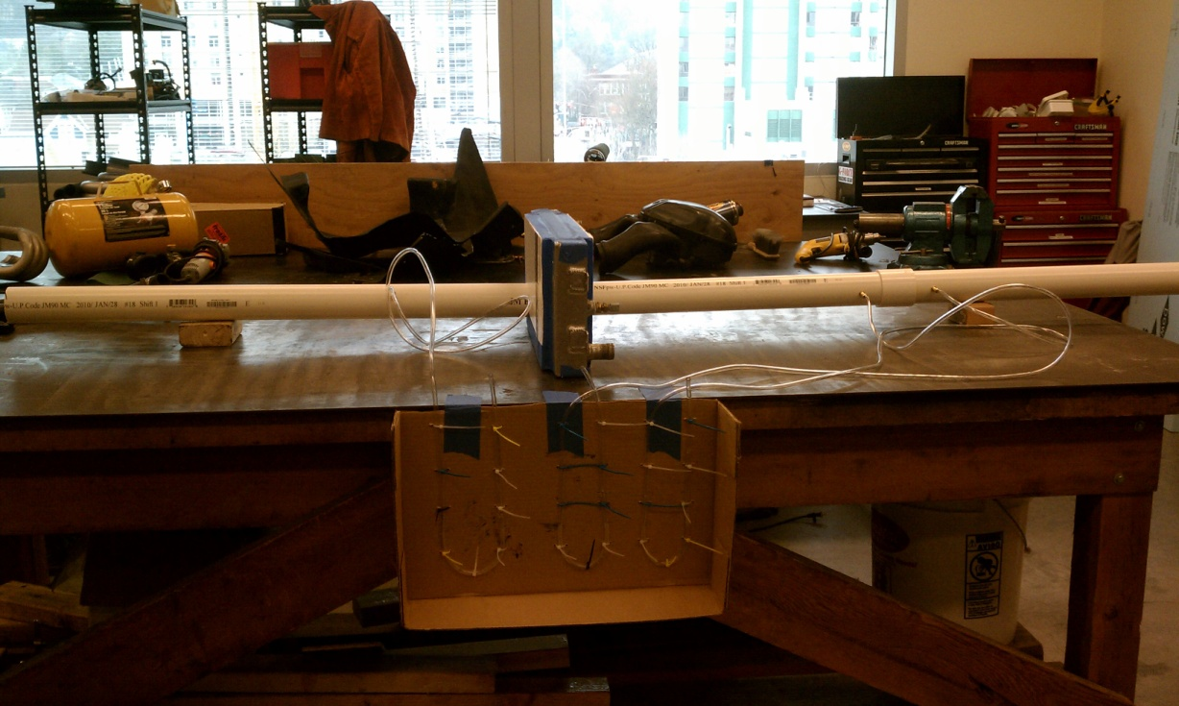
What We Have Done So Far
Calculation
Assumptions Based on Research
Calculations
Heat Transfer/Fluids
Factor of Safety
Experiments

Slide 5
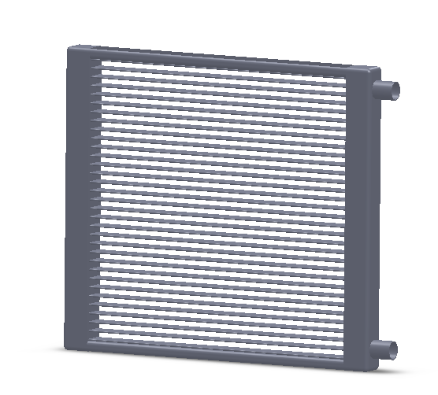
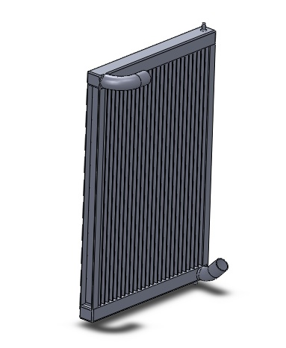
What We Have Done So Far
Design
Radiator Sizing
Fan Size
House Routing
Mounts

Slide 6
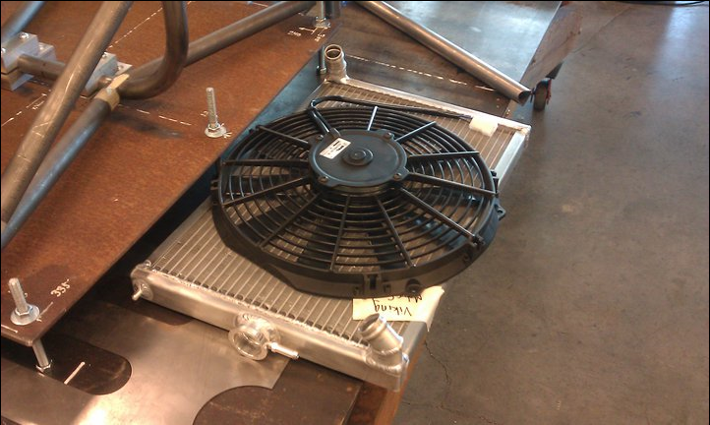
What We Have Done So Far
Manufacture
Radiator Custom Made by Mac’s Radiator

Slide 7
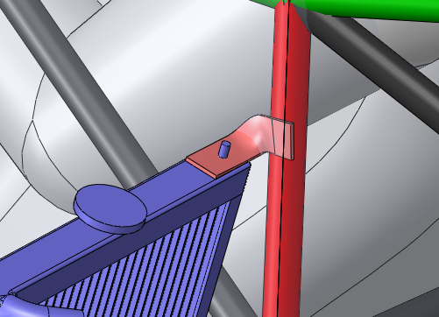
What We Are Doing
Design
Radiator Mounts

Slide 8
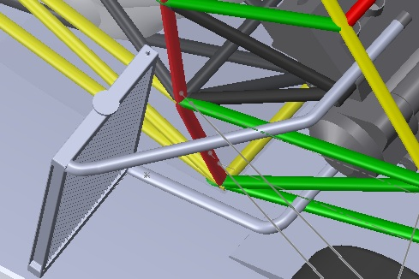
What We Are Doing
Manufacture
Solid Hoses
Aluminum Tubing

Slide 9
What We Are Doing
Experiments
To Confirm Our Calculations
Define Core Characteristics
Heat Rejection per Unit Area

Slide 10
What’s Next
Finish Design of Mounts
Manufacture Mounts
Solid Hose Routing
Assembly & Real-World Testing

Slide 11
Questions?

