Slide 1
Personal Comfort Unit
Capstone Project Proposal
October 2015
Presented by
David Small & Richard Small

Slide 2
Growing Old Ain’t Easy
Richard’s experience (last several years)
Lower leg circulation issues (cold feet)
Foot cramps and leg cramps
Restless Leg Syndrome (feet tops burn as rub sheets)
Sleep Apnea and C-PAP breathing issues

Slide 3
My Initial Solution
Purchased a hair dryer to warm sheets
Too loud (woke my wife each time I used it)
Shut itself off if got too hot
Hard to use at night
Framework made of pipes to hook on to hair dryer
Hurt my feet when accidently kicked pipes
Almost no heat output
Noise and pipes now made my wife mad
Got smart and approached my brother David
Master furniture refinisher
Has woodworking shop

Slide 4
Current Prototype $28.49
$ 0.00 Built from lumber laying around his shop
$ 9.99 used heater from Amazon
$ 9.00 shipping
$ 1.95 on/off switch
$ 3.55 extension cord
$ 4.00 plastic 1” pipe
$28.49 total cost

Slide 5
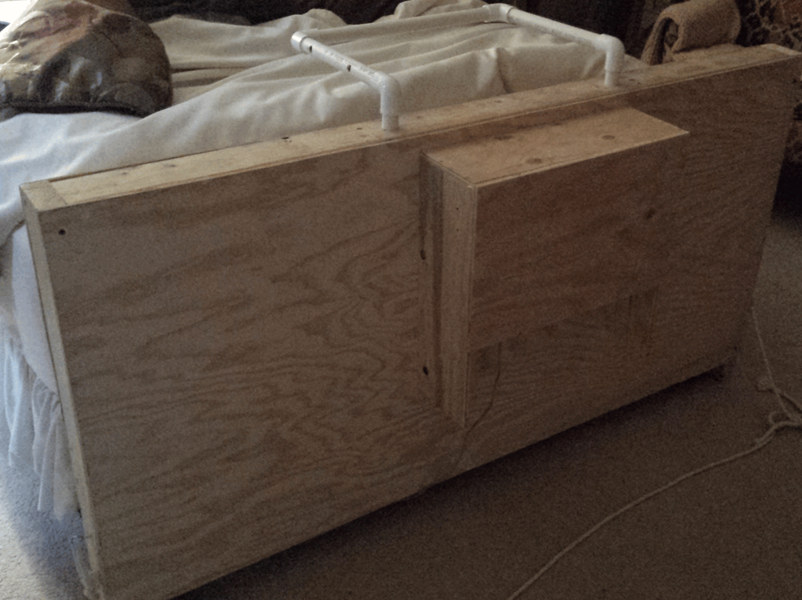

Slide 6
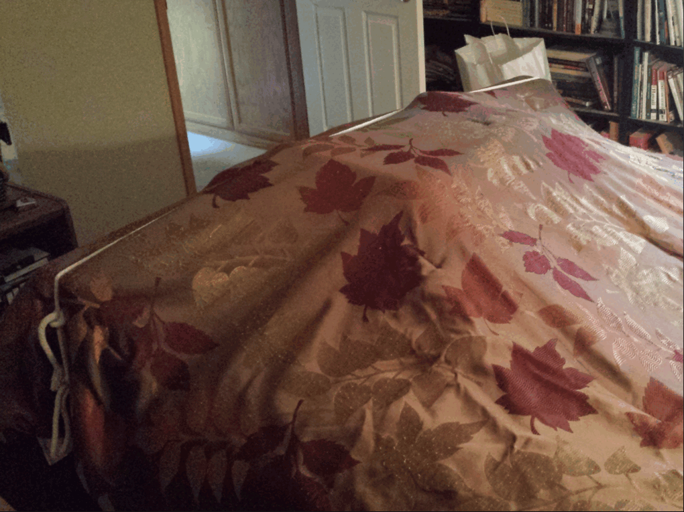

Slide 7
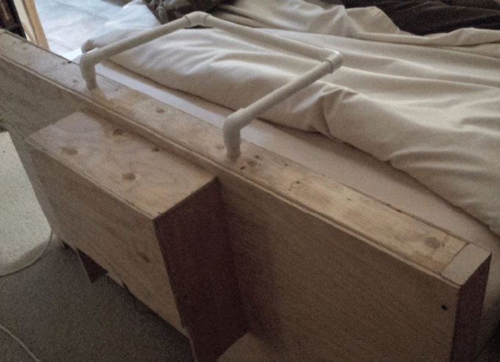

Slide 8
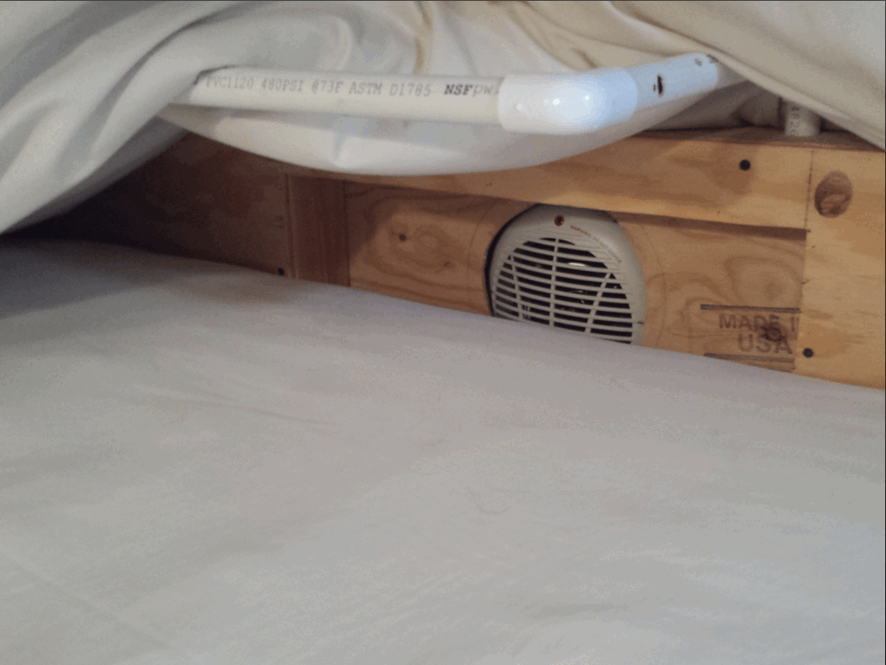

Slide 9
The Bad News about Prototype
It’s wooden (fire hazard)
Heating element is too hot
One temperature setting
No automatic shutoff if it overheats
I have to be awake every time I use it
I have to be sure to switch it off

Slide 10
The Good News about Prototype
Cold to warm cavity in 10 seconds
Toasty warm sheets in 30 seconds
Very quiet fan (cannot hear it)
Good fan volume
Best sleep I’ve had in five years
Which means the idea is a good one

Slide 11
Capstone Project Proposal Personal Comfort Unit
Split the design into three elements
BASE
Single Bed *
Double Bed
Recliner Chair
Office Chair
UNIVERSAL CONTROLLER *
Controls the core
CORE * (same core fits all bases)
Actual heating/cooling unit
* Primary Focus of the project

Slide 12
Base
Easy attachment to bed frame rails
Height adjusters to adapt to any bed
Permanent 110 VAC connection to wall plug
Power adapter for operating core
Adjustable height thermal chamber
Easy attach/release clasp to hold core
Adjustable seal between mattress and base
Way to hold top sheet and blanket
Non-flammable, light weight & rugged material
Meets all safety requirements

Slide 13
Universal Controller
Fits all bases
Easy to operate
Paired with core (controller matched to core)
On/Off switch
Comfort level system
Maintains temperature in user defined range
Programmable
High Temp/Low Temp
Stop Time
Override heat button
Override cool button
Meets all safety requirements

Slide 14
Core
Power adapter that matches base adapter
Quiet fan motor (similar to prototype)
Capable of heating thermal chamber to 78˚ F
Has some way of measuring chamber temperature
Automatic shutoff in case of overheating
Exhaust vent
Idle airway block (prevent cold air entering chamber)
Washable dust filter
Rugged construction that can take abuse
Meets all safety requirements

Slide 15
Advantages of Doing Project
There’s meat in the project (plenty to think about)
No time constraints and no deadline
Can use any current technology
No existing design that has to be followed
Nobody else is working on it
Low prototyping costs
It’s a real world issue
With the potential to help a lot of people

Slide 16
Our Next Step if Project Done
Patent the design(s)
Start another company with my brother
Try to produce an inexpensive unit
Sell to the masses
Assisted Living Facilities
People in recliner chairs in living rooms (my mom)
Anybody that is ill and needs personal heating/cooling
Anybody who wants to save on their heating bills
Anybody with children

Slide 17
Contact information
Richard Small
503-330-2260
richard@wwfc.biz

