Slide 1
INN AT OTTER CREST
TEAM MEMBERS:
LEE HAN OSMAN KUCUK KEVIN MURRAY ANDREY VOLODKIN NATALIE SHERWOOd ABDULAZIZ ALNASSAR
HUY TRAN FACULTY ADVISOR : DR. HUAFEN HU

Slide 2
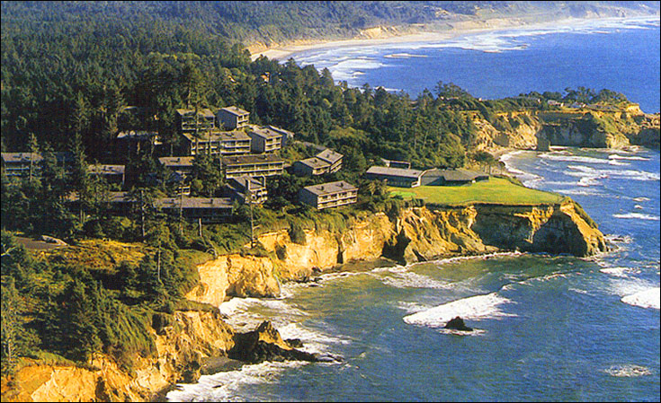
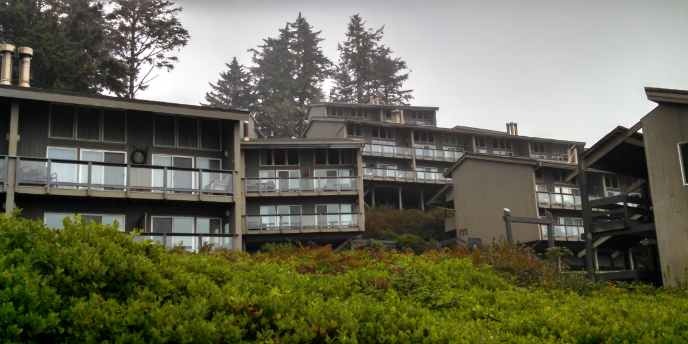
OBJECTIVE
Background
Mission/Goal
Analysis background
PDS/Design Narrative
Conclusion

Slide 3
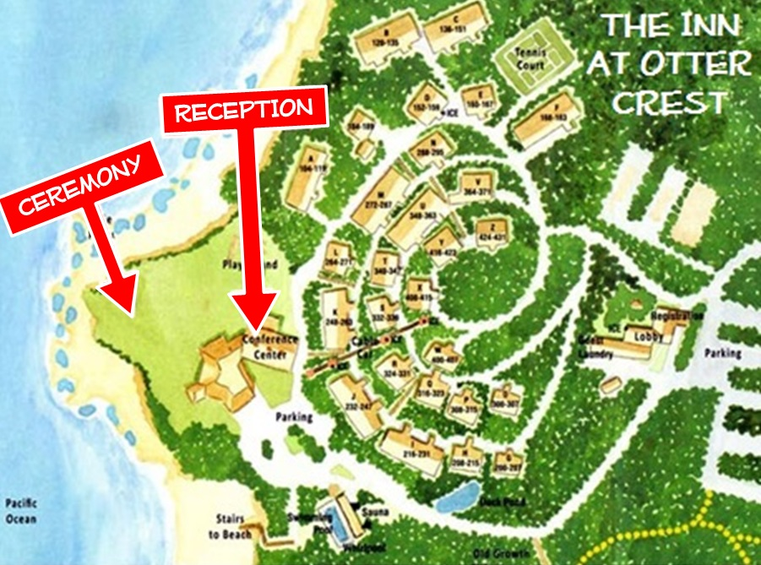
PROPERTY BACKGROUND
Property was built in 1972
35 Acres
27 Building
4 or 8 condo
144 units
Timeshare ownership or hotel

Slide 4
Mission/Goals
Our capstone mission is to perform an energy audit
Save annual cost for the owners
Deliverables:
Reduce Annual Heating Cost by 20%
Current cost $150,000
Improve Building Performance
6 year back for any upgrades

Slide 5
Customer Identification
Primary External Customer
Owners at IOC
Secondary External Customer
Visitor/Guest at IOC
Internal Customer
Capstone class requirements

Slide 6
Research
Internal Research
Brainstorming
Envelope analysis
Blower door test
Window glaze
Submetering – individual electical load
External Research
LED light
Heat Pump
Solar water heater
Low flow devices – Hot water

Slide 7
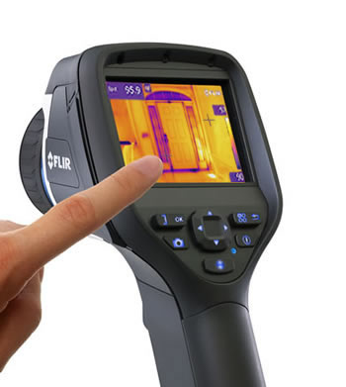
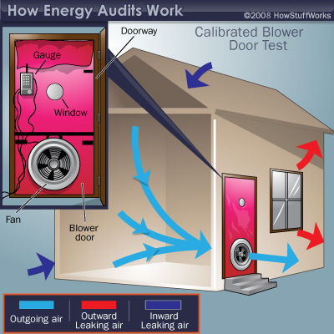
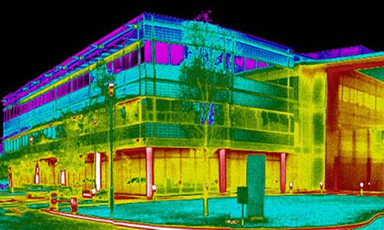
ANALYSIS BACKGROUND
Baseline Energy Analysis
Building Envolpe
HVAC System
Energy Modeling

Slide 8
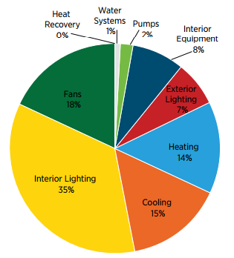
ENERGY ANALYSIS
Electrical usage
Baseline model – compare savings
Help with target reto-improvements
Better ideas for equipment selections/upgrades
Understanding of behavior usage
When/what to turn off
Automate systems to reduce power

Slide 9
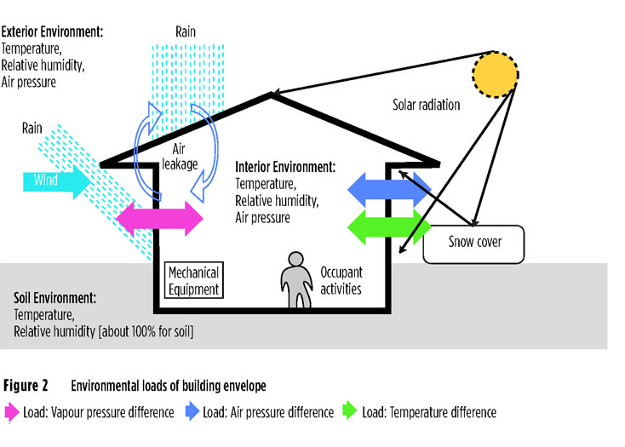
BUILDING ENVELOPE
What effect the building envelop
Walls insulation (R-values)
Windows (U-values)
Roof/Floor
System sizing

Slide 10
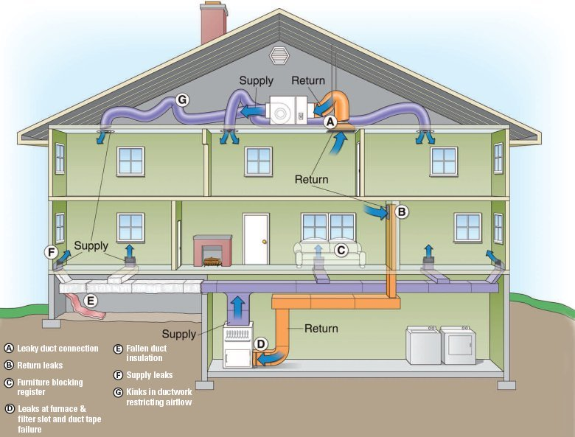
HVAC SYSTEM
Current System
Baseboard heating
Electrical hot water heater
No cental ventlation – A/C Units
Possible Upgrades
Heat pump
Boiler
Solar Panel/Solar water heater

Slide 11
ENERGY MODELING
Powerful Tool in building science
Modeling before and after building changes
Account for weather patterns
Check System
Modeling can verify assumptions
Can validate final solution for customer

Slide 12
OBSTACLES
Owners rights !
The cost of upgrades
Large property
Weather
Effects equipment selection and installation
High salt corrosion
Time constant – Distance

Slide 13
PDS/DESIGN NARRATIVE
Baseline Energy Usage
Light
Heating
Water
Wall Insulation
Windows
Building Usage

Slide 14
CONCLUSION
Big property
Difference usages, Space to space varenice
Our mission/goals
Annual Cost Reduction
Analysing the property systems
PDS/Design Narrative

Slide 15
QUESTIONS

