Slide 1
INN AT OTTER CREST
TEAM MEMBERS:
LEE HAN OSMAN KUCUK KEVIN MURRAY ANDREY VOLODKIN NATALIE SHERWOOd ABDULAZIZ ALNASSAR
HUY TRAN FACULTY ADVISOR : DR. HUAFEN HU

Slide 2
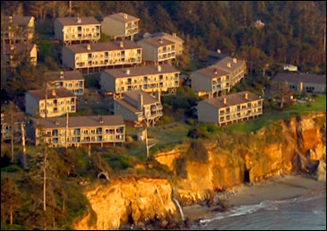
Summary
The Inn at Otter Crest is a resort hotel with privately owned condo units on the Oregon coast. It was constructed 1974.
27 builings, 4 to 8 condo units per building, 144 condo units total. Each condo can be split into 2 hotel units
71 domestic water heaters
454 exterior light fixtures
Natural gas is not available

Slide 3
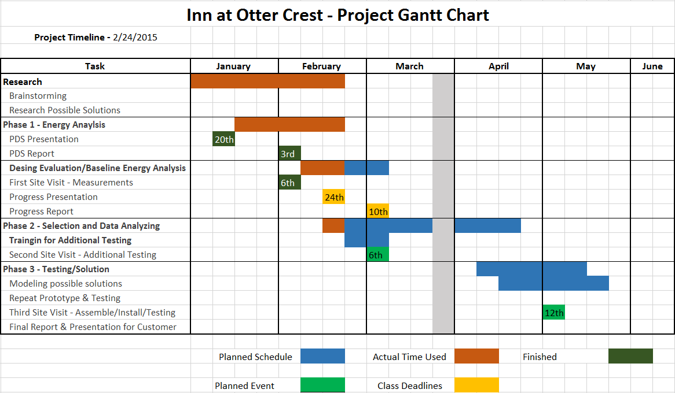
Timeline

Slide 4
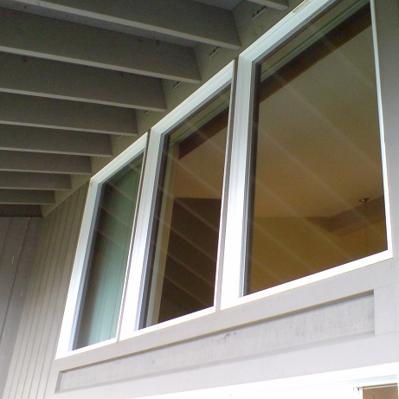
Current Energy Saving Measures
- Water heaters are being replaced at a rate of 4 per year.
32 out of 71 water heaters have been replaced thus far.
- Removed 3 of 4 heating element
fuses from each water heater.
- Windows replaced in 2009
- All exterior lights are CFL

Slide 5
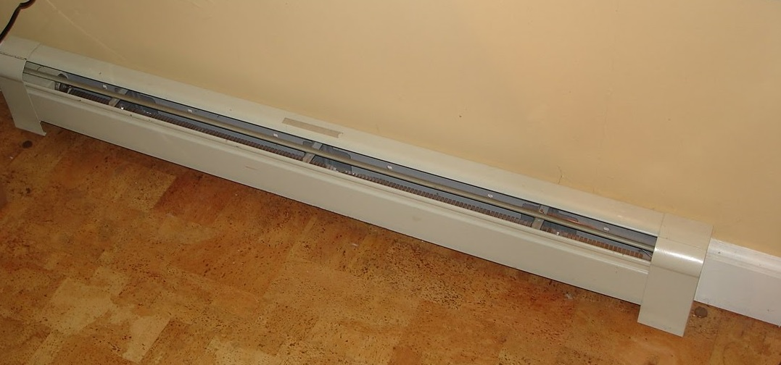
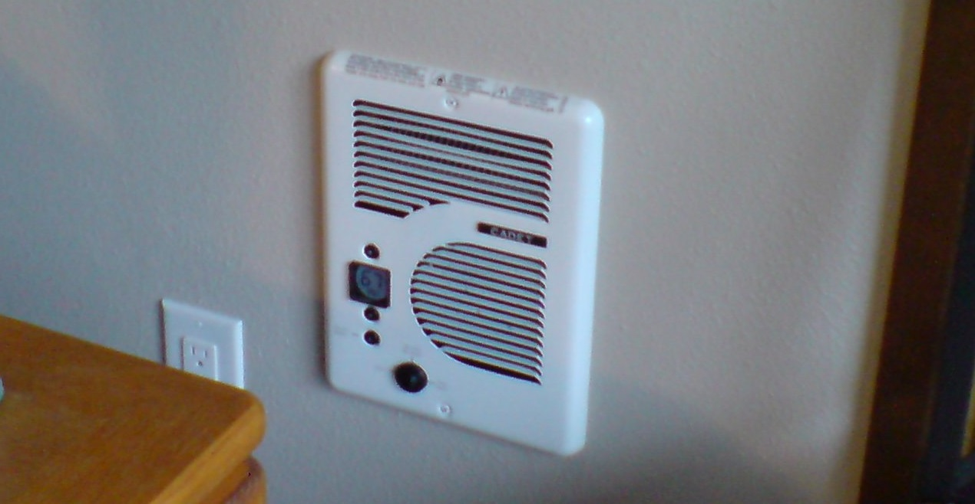
Heating System
Natural gas is not available to the property
- Curretly use baseboard and in-wall resistance convection heaters.
- Baseboard heaters are thermostat
controlled and the in-wall heaters
are locally controlled.
- No central HVAC system.
Baseboard heater
In-wall heater

Slide 6
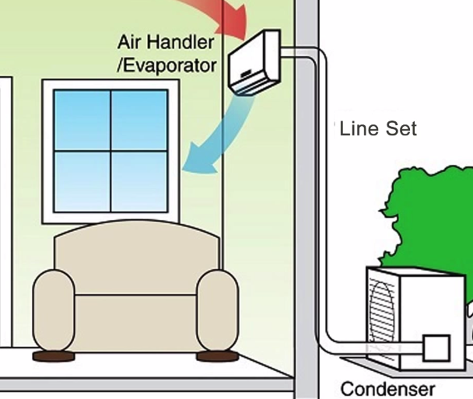
Heating System
Potential future replacement: air source,
multi-zone heat pump
- Vapor compression refridgeration cycle
operating in reverse, moves low grade heat
from outdoors to indoors
- Potential to reduce electrical energy
used for space heating by half.
- Most efficient in mild climates, such as the Oregon coast.

Slide 7
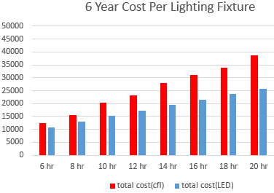
Exterior lighting Replacement
- 454 exterior pathway and
building light fixtures
- Currently using CFL and
replacing 3 lights/week. CFLs
have a ~6 to10 x10^3 hour life.
- Manufacturing technologies
are lowering LED bulb prices
- LED bulbs have a 50 x10^3 hour life and use slightly less energy.

Slide 8
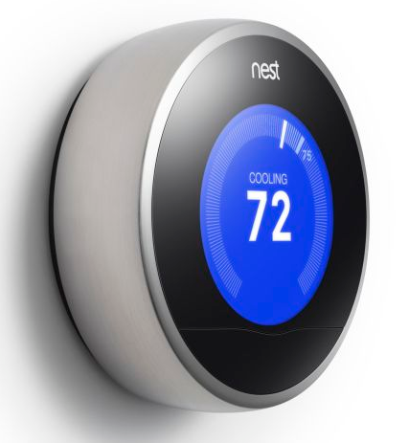
Automation and Controls
- Research potential web based thermostat controls to be used when a condo unit is functioning as a resort hotel room.
- Challenge would be getting private
owners of each unit to pay into new
thermostat controls.
- One possible solution is to incentivize
the purchase and installation of each
web based thermostat

Slide 9
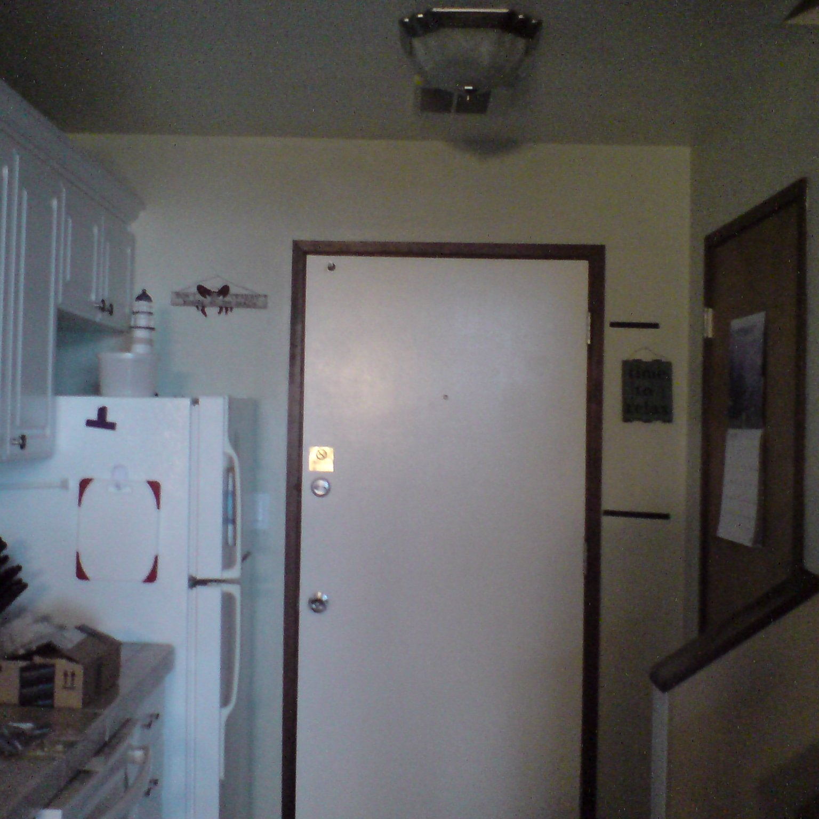
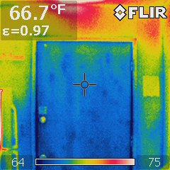
Wall insultation Test
Stud section
Insulation section

Slide 10
Behavior schedule
Highly diversified
Divided into 3 submodels based on hotel / resident ratio
25% or less
Between 25% and 50%
75% or more
Different occupancy schedules for each submodel
Same occupancy schedule for buildings within a submodel

Slide 11
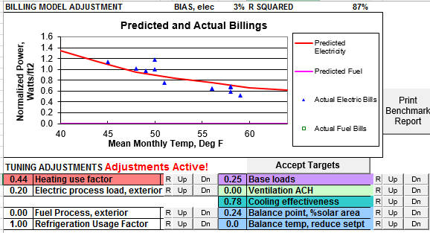
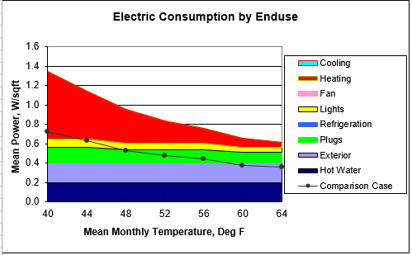
ENERGY ANALYSIS
Inverse Modeling
Monthly Temp. vs Kwh billed
EZ Sim
Best R-squared value
Match Predicted electricity to actual
Manually adjusting factors.
Not recommended by our advisor
First View
Automatically adjusted

Slide 12
Electricity Rate
Current: PUD rate schedule 200
Charge demand (KW) and consumption (KWH)
Thresh hold 31 KW
Target: Schedule 190
No demand charge
Lower KWH charge for the 1st 5,000 KWH

Slide 13
QUESTIONS

