Slide 1

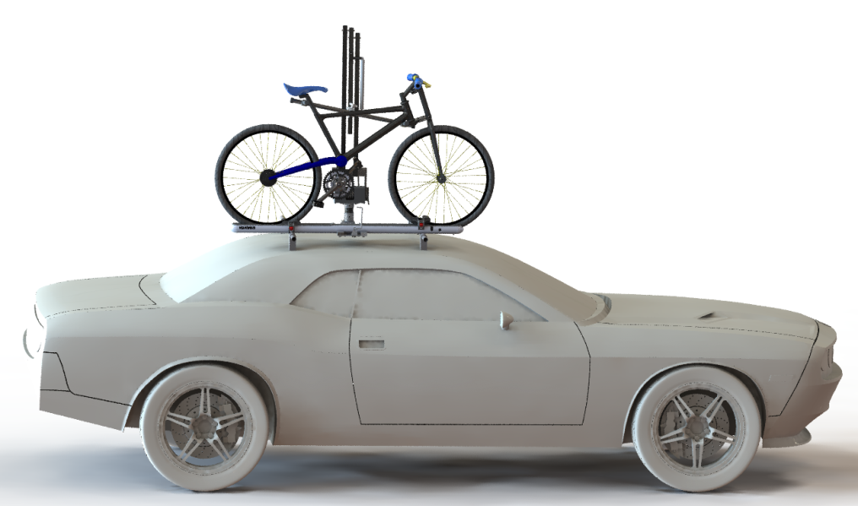
Mechanical Engineering Design Team
John Branum
Alex Grill
Ross Notebaart
John Robinson
Tyler Robinson
PSU Faculty Advisor
Chen Wern, PhD
Yakima Advisor
Dave Condon
Top of Car Load Assisting Bike Lift

Slide 2
Overview
Summary & Objectives
Mission Statement
Key Product Design Specifications
Top Level Design Options
Final Design
Design Evaluation

Slide 3
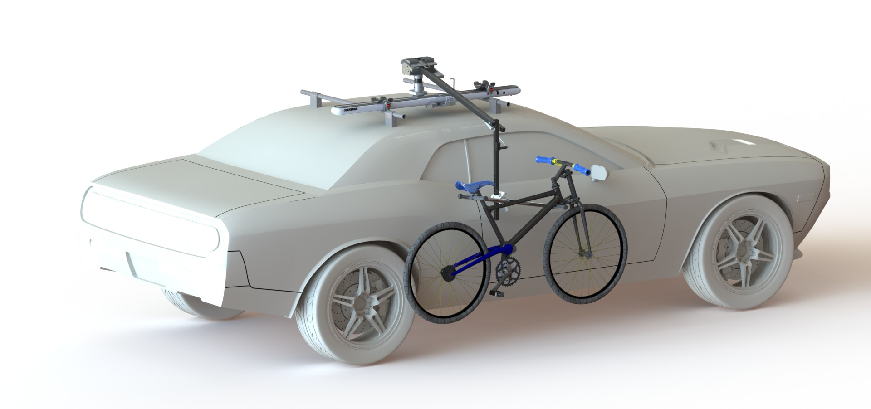
Summary & Objectives
Load Assisting Bike Lift for top of car roof rack system
Mounts to Yakima HighRoller
Standard Bike Types
  Exclusions: Tandem, motorized

Slide 4
Mission Statement
The team will design and manufacture a load-assisting bicycle lift prototype for a Yakima roof rack system. The device will provide at least 30 pounds of load assistance over a 40-inch vertical lift for a variety of bicycle types, and will be compatible with existing Yakima products.

Slide 5
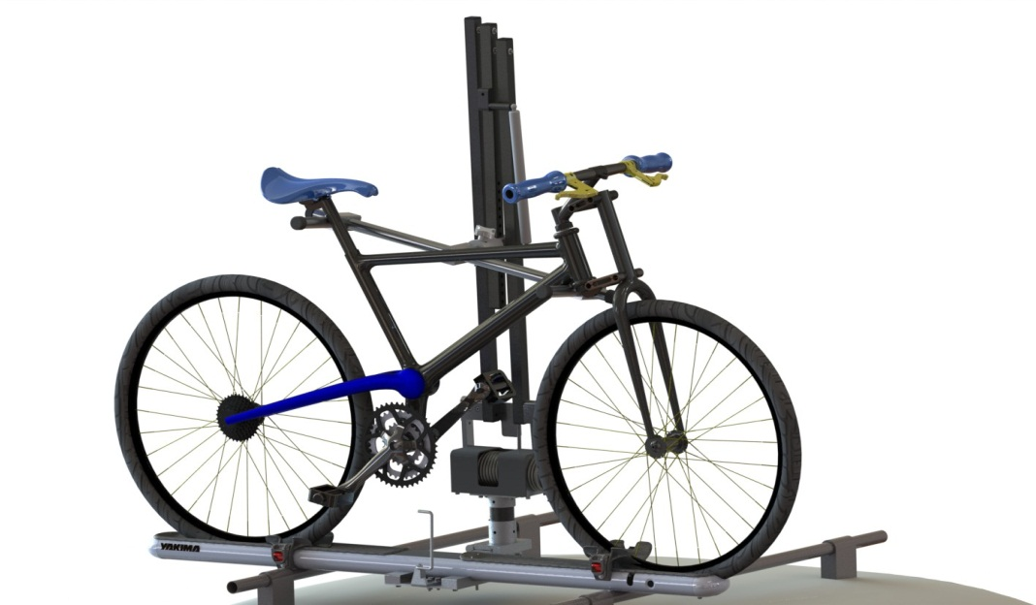
Key Product Requirements
30 lbs. of Load Assistance
40” of Vertical Lift
Collapsible
Transportation & Lift
Fits Conventional Style Bikes

Slide 6

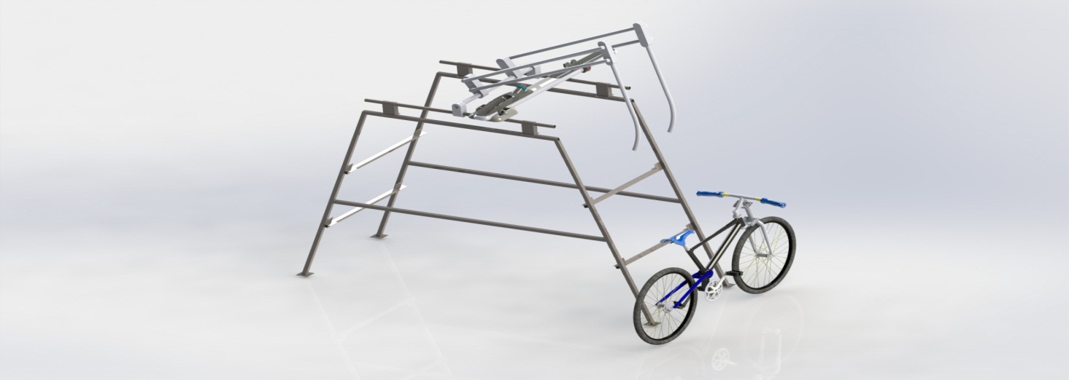
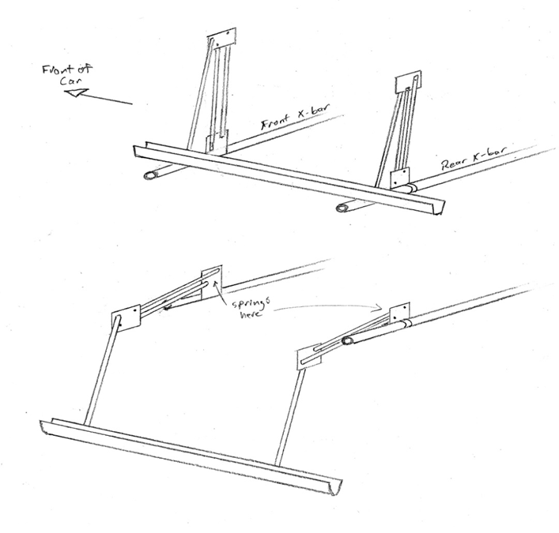
Top Level Design Options
Single Arm Double Arm Tray Drop

Slide 7
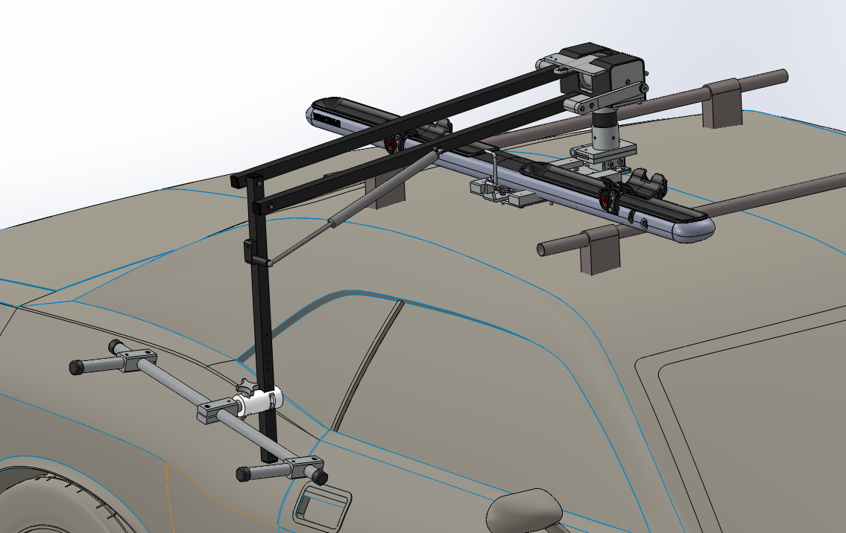
Final Design
5 Major Design Components:
Bike Holder, Linkages, Baseplate, Spring Box, Collapsibility

Slide 8
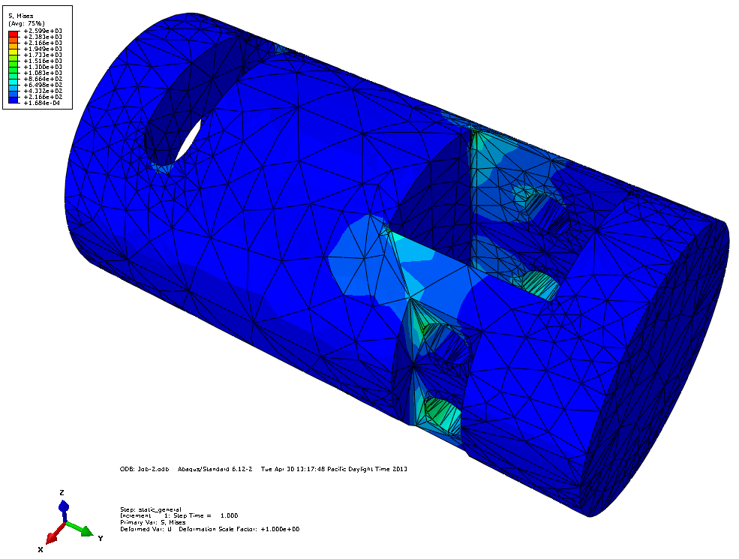
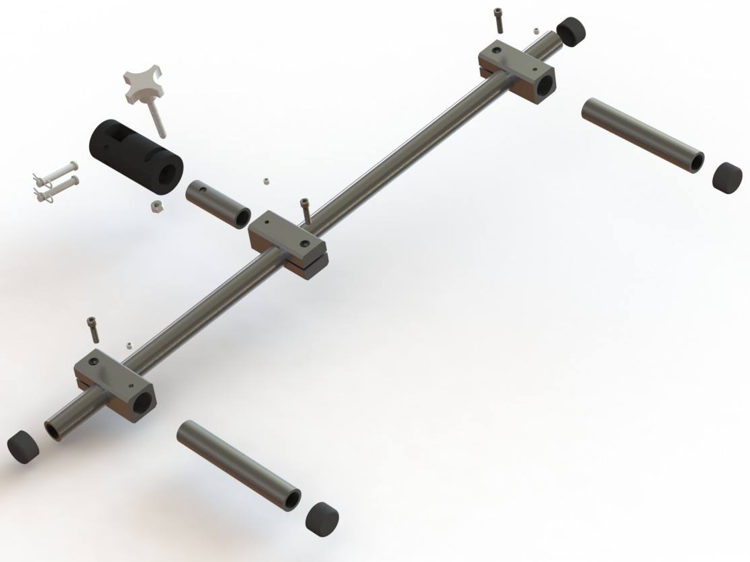
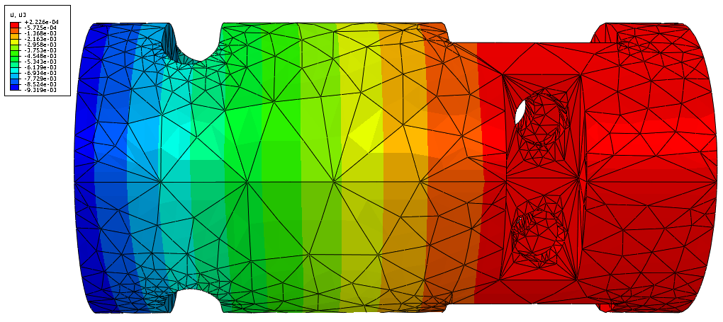
Bike Holder
Max Stress
Max Displacement

Slide 9
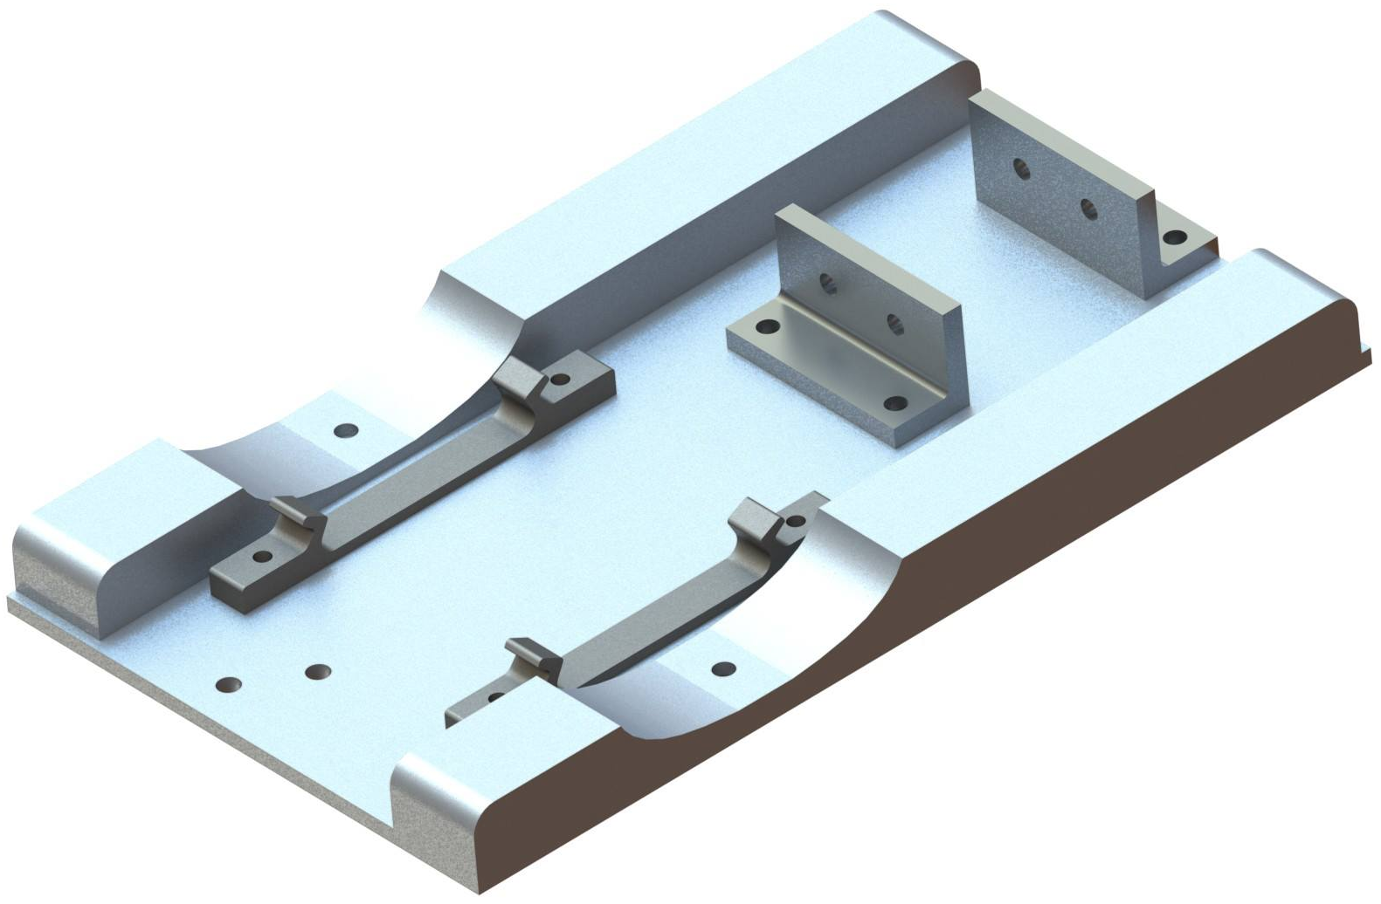
Baseplate

Slide 10
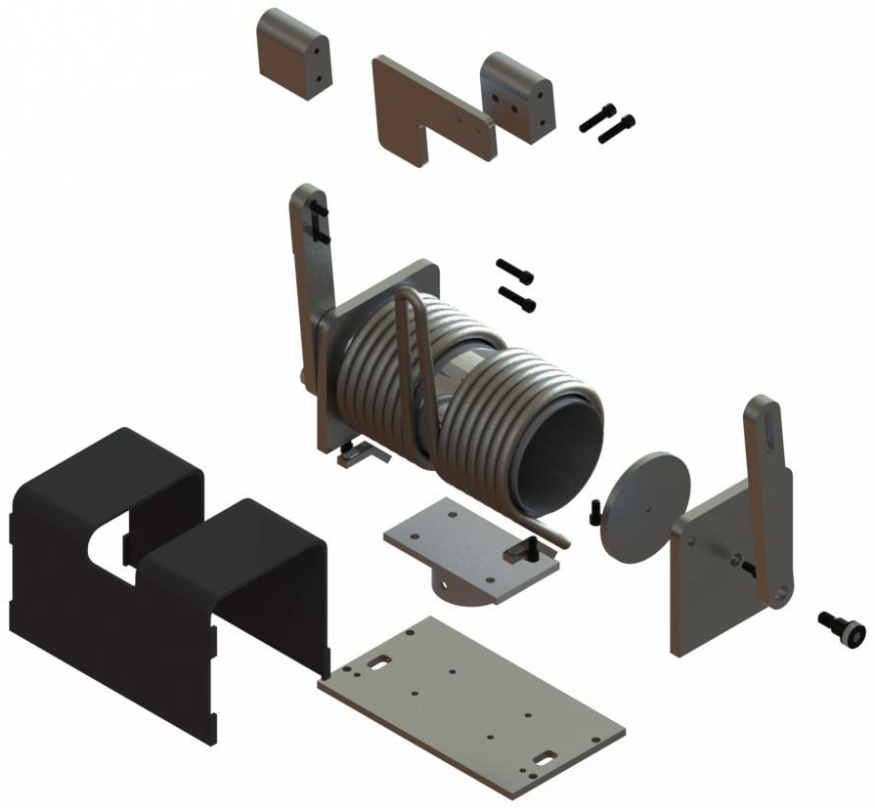
Spring Box

Slide 11
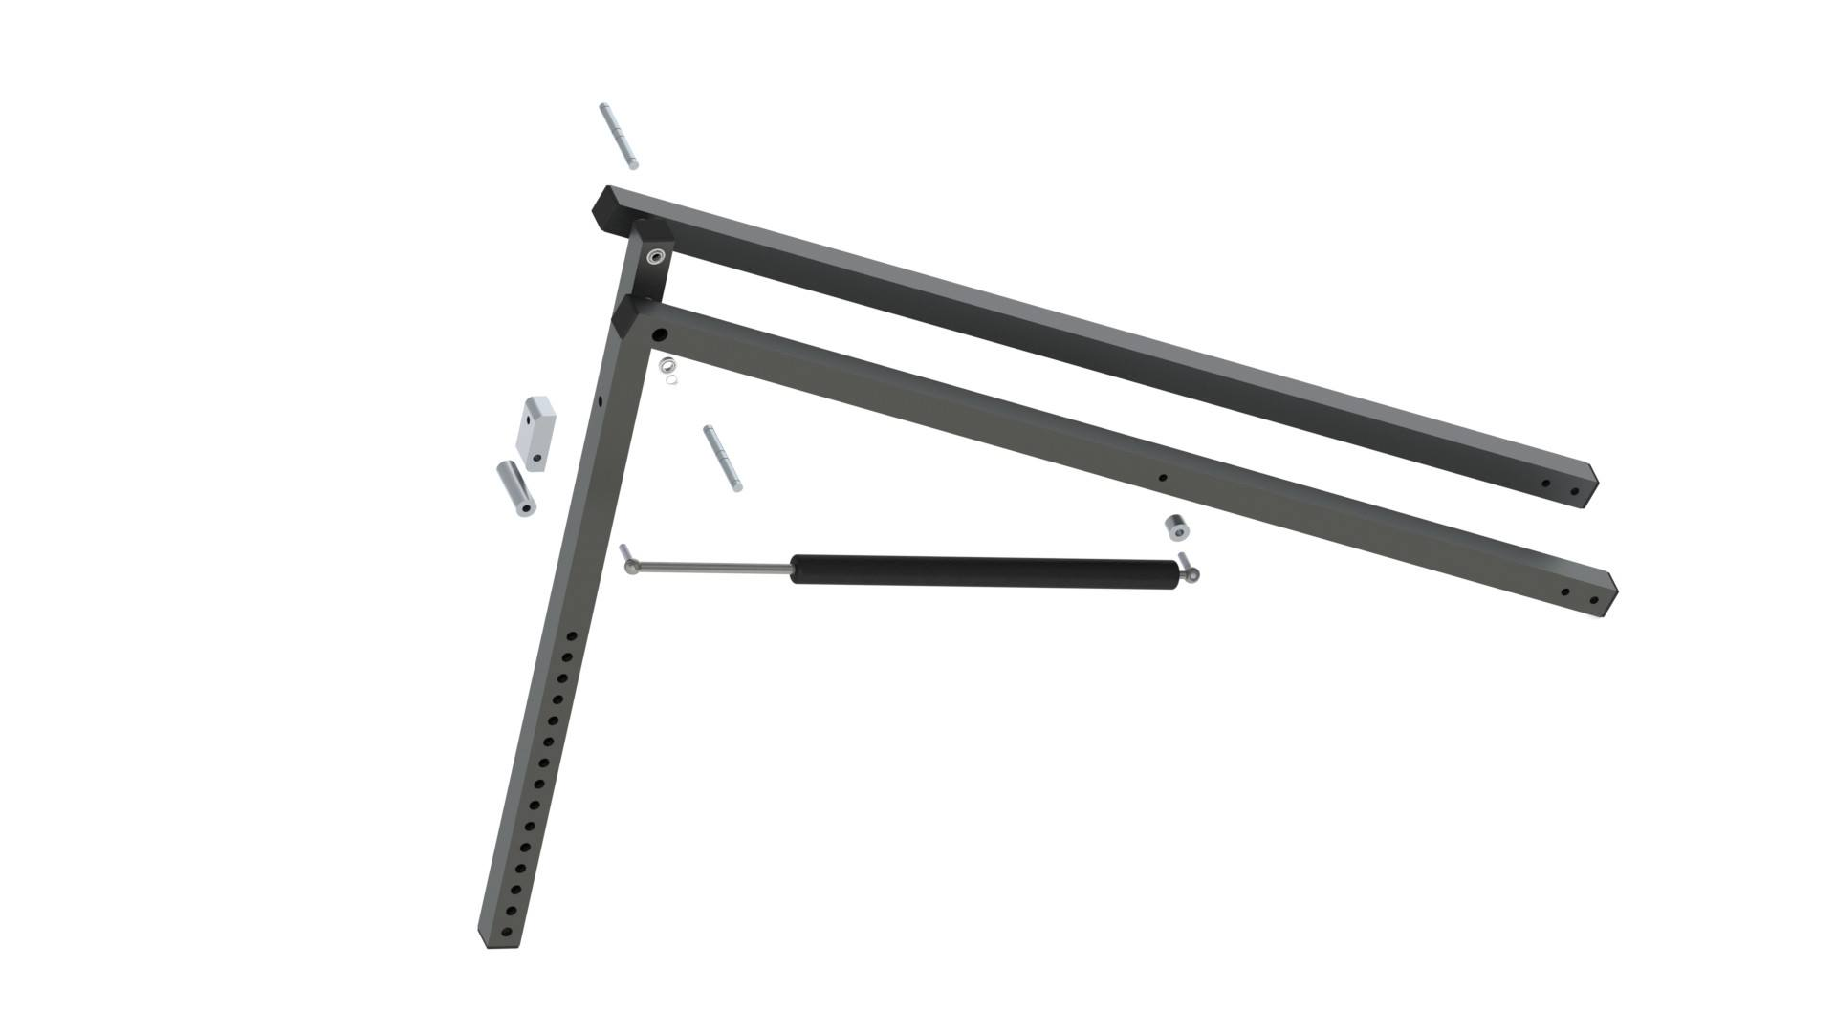
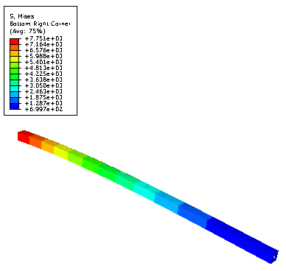
Linkages
Max Stress
Max Strain

Slide 12
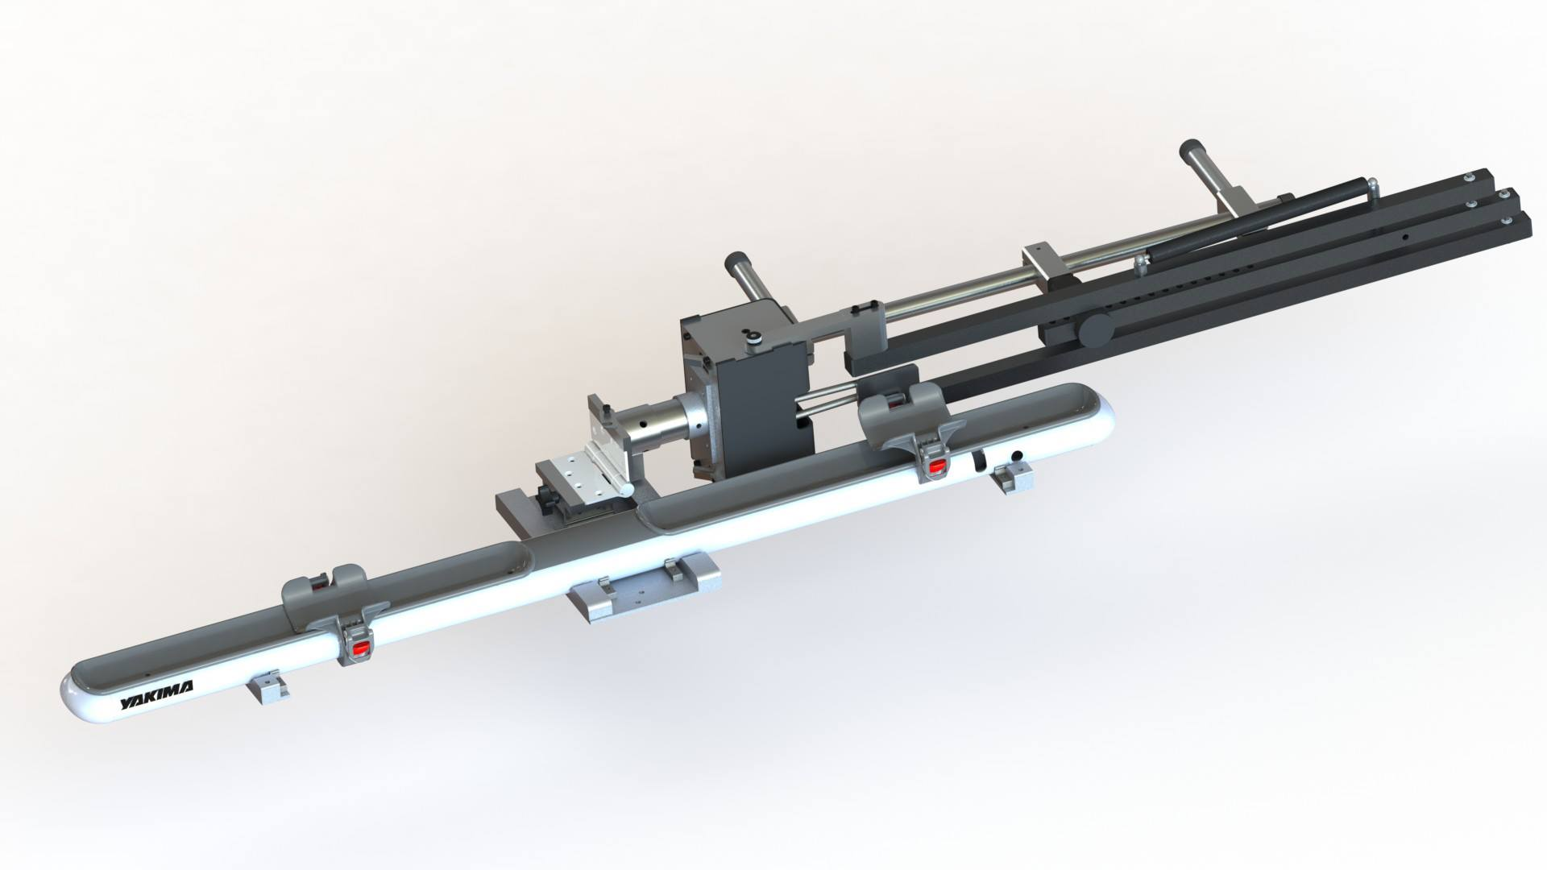
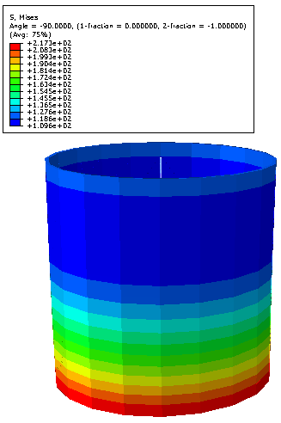
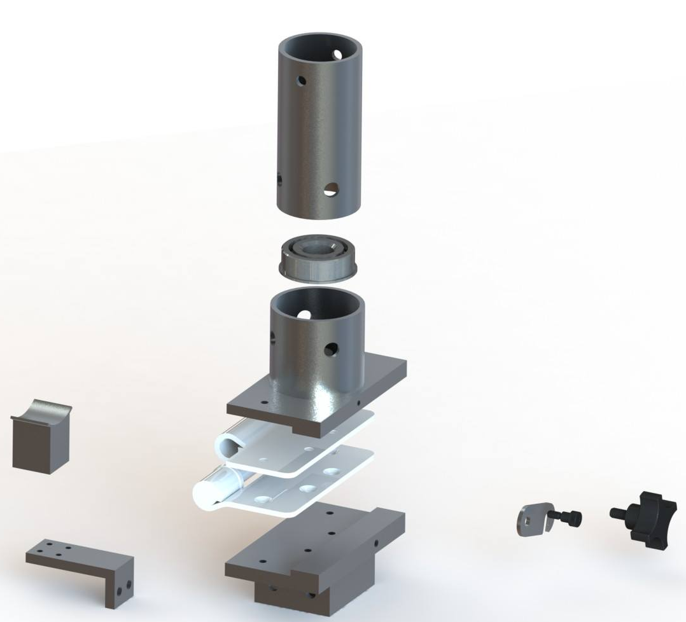
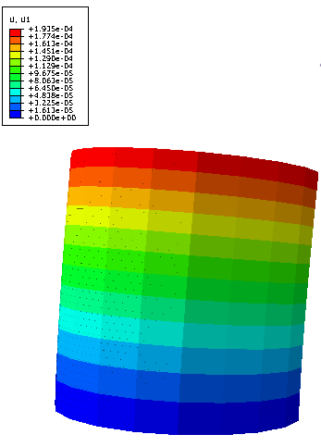
Collapsibility
Max Stress
Max Displacement

Slide 13
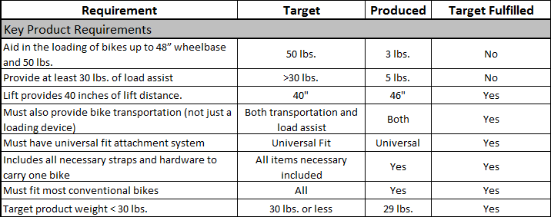
Final Product Evaluation
*7/8 Key Product Requirements Met*

Slide 14
Conclusion
*7/8 Key Product Requirements Met*
*250 Hours Machining Parts
*Learning Experience*
*Leadership and Team Building Skills*

