Slide 1
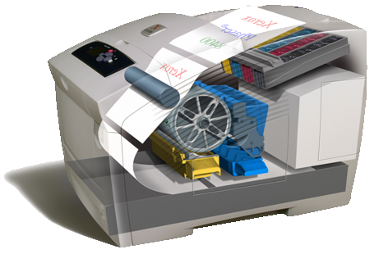
Xerox Advanced Development Test Printing Platform
Group Members:
Andras Resch
Keaton Snyder
Robbie Carpenter
Daniel McCall
Hussain Qasem
Academic Advisor :
David Turcic, PhD
Industry Advisor :
Trevor Snyder, PhD
Notes:
Regain Color leadership
Thought leader with innovative technology and flexible pricing options:
Color for the Price of B & W
Breakthrough TCO - Metered plans
“Heat shield” to protect laser post-sale pricing
Opportunity to go head to head with HP heartland printer business
Enable channel expansion and
OEM/partner opportunities
Diversification, competency and capability in direct marking technology
Contribute to Xerox’ Environmental Sustainability Goals

Slide 2
Topics Covered
Intro: What are we designing?
Overview: Why are we designing this?
Customers: Who are we designing this for?
Development of PDS: Interviews-> Paired Comparison->HOQ1->Kano Model
Product Design Specifications
Project Plan

Slide 3
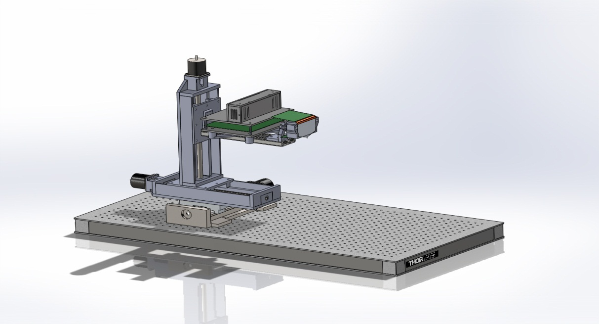
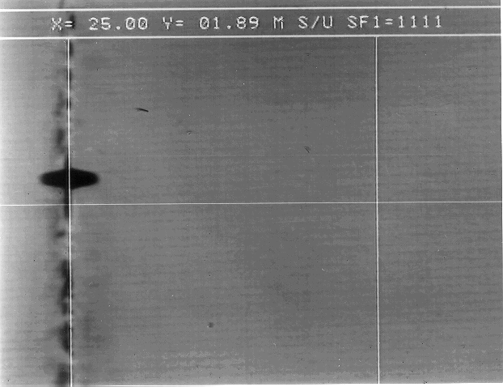
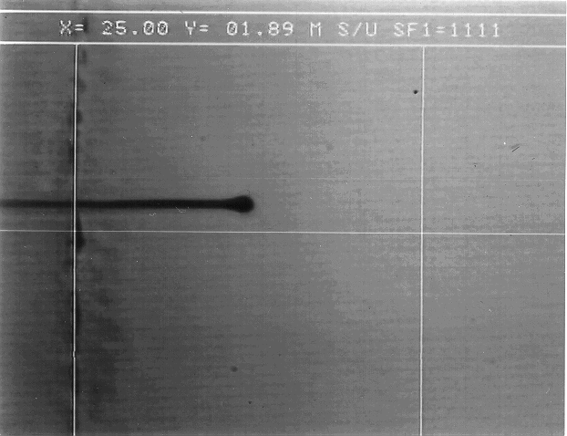
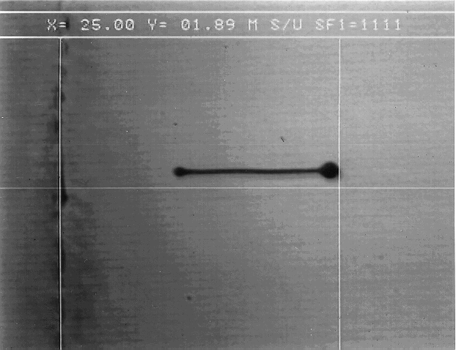
Introduction: What are we designing?
General purpose fixture that will be used for advanced print development at Xerox
Picking up where last years team left off
Three modes
  Paper printing mode
  Rigid Media Mode
  Strobe Mode

Slide 4
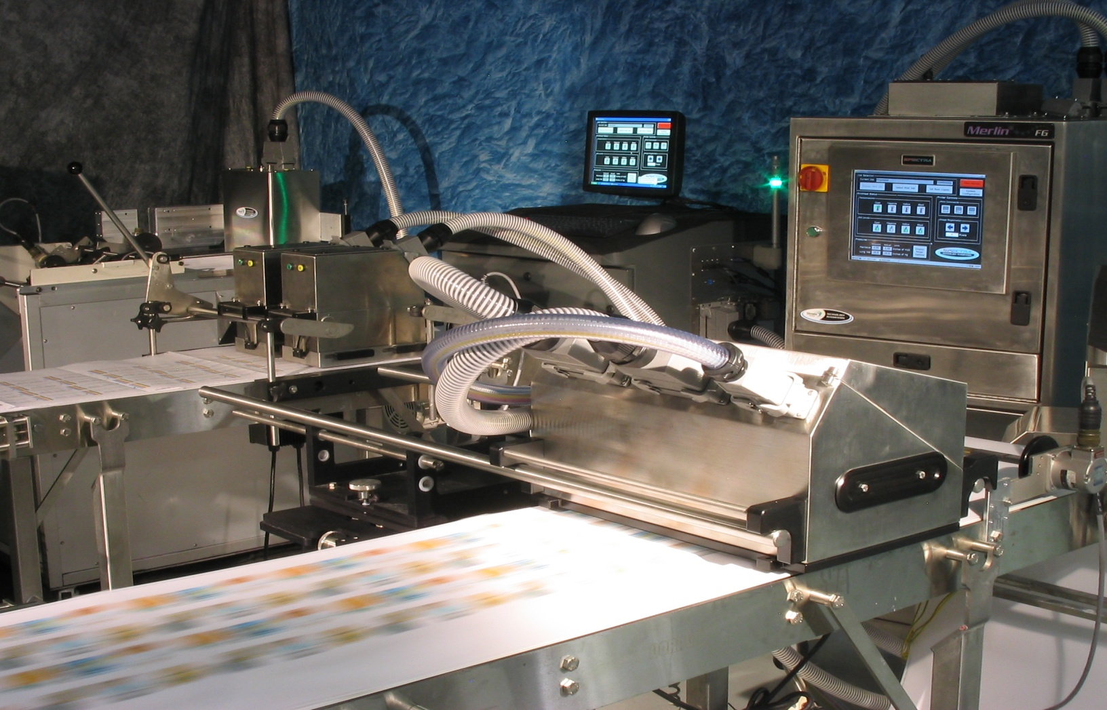
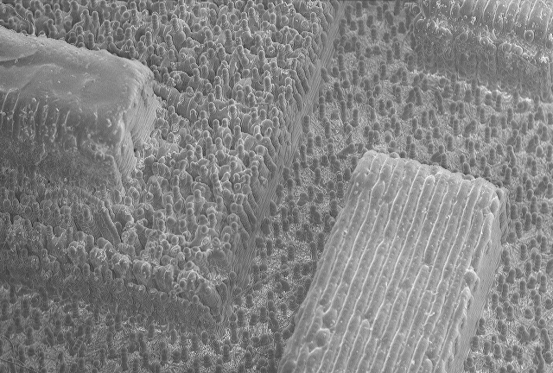
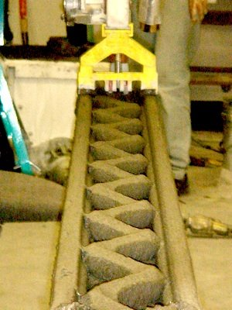
Overview: Why are we designing this?
3D Printing business is expected to grow from a 1.3 billion dollar market to a 50 billion dollar market in the next 3 years!
Current fixtures and printers are unsuitable for testing purposes, only implement ink on drum.
Need fixture for ink on paper
Variety of OEM markets for Xerox’s print head
Markets include chip fab, solid modeling, photovoltaics, MEM’s, etc…

Slide 5
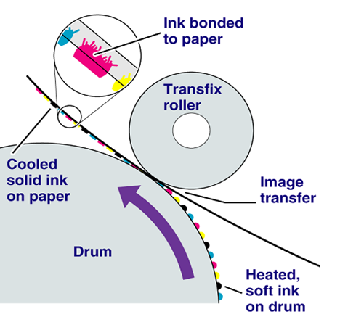
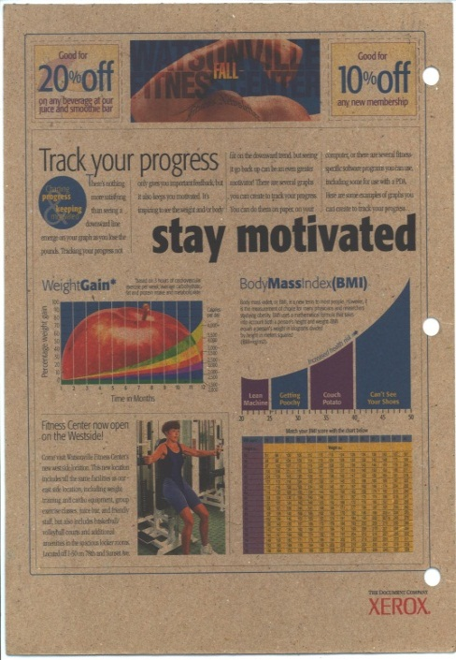
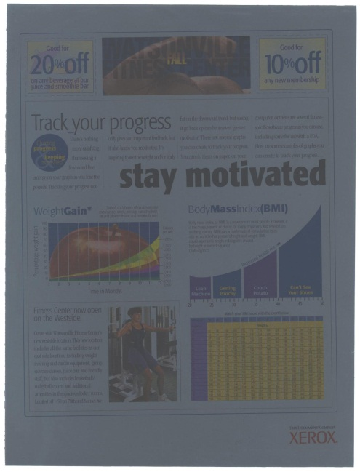
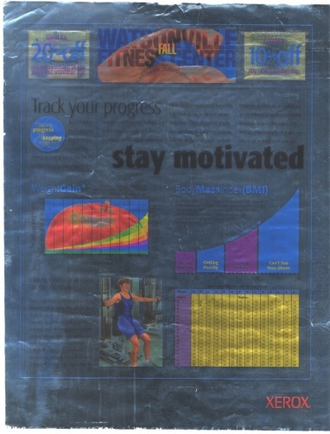
Current Xerox Print Process
Uses a large drum and transfix roller to press ink into paper
Robust, but limited to flexible materials up to card board, sand paper, mica board, aluminum foil.

Slide 6
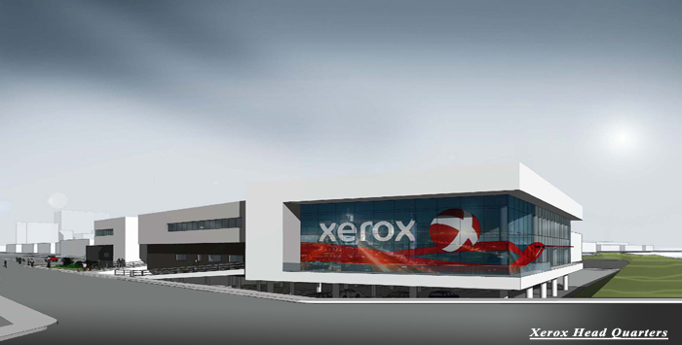
Customers
External
  Trevor Snyder Our Sponsor
  Engineers at Xerox
  Xerox
Internal
  The PSU Capstone Program
  Dr. Etesami
  Capstone Team Members

Slide 7
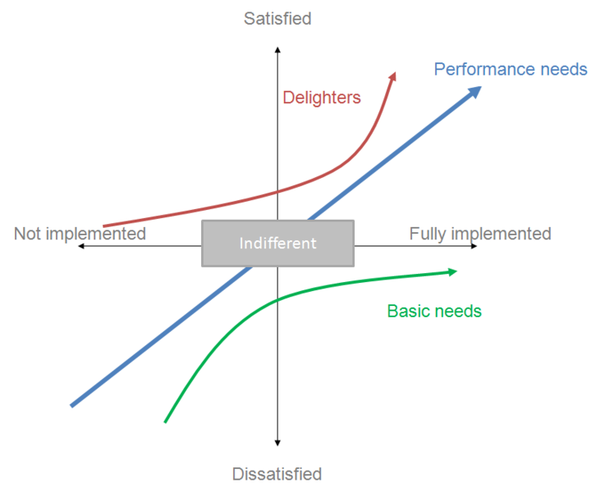
Kano’s Model
Three types of Quality
Expected Quality – Needs
      Not requested but assumed
      If absent customer very dissatisfied
      If present, indifferent
One dimensional Quality – Wants
      Specifically Requested, gathered from survey or other,
      If present, customer Satisfied
      If absent, customer dissatisfied
Exciting Quality – Delighters
      Unknown to customer
      If present, very satisfied
      If absent, indifferent

Slide 8
1st Interview: Paired comparison
Development of PDS
 |  | A | B | C | D | E | F | G | H | I | J | K
 |  | Safe | Simple Design | Maintenance | Reliability | Usability | Manufacturability | Cost | Portability | Aesthetics | Performance | Installation
A | Safe
B | Simple Design | A
C | Maintenance | A | B
D | Reliability | A | D | D
E | Usability | A | B | E | E
F | Manufacturability | A | F | F | D | E
G | Cost | A | G | G | D | E | G
H | Portability | A | H | H | H | H | H | H
I | Aesthetics | A | B | C | D | E | F | G | H
J | Performance | A | J | J | J | J | J | J | H | J
K | Installation | A | B | K | K | K | K | K | H | K | J

Slide 9
Pareto

Slide 10
2nd Interview: HOQ 1, Part 1
 | HOQ 1
 | Measurable CTC (critical to customer) | GFI (Ground Force interference) | Isolation Transformer | Care with Heated parts above 50C | No picnch points (finger gaurds etc…) | No Sharp Edges | All power supplies Fused | Weight | System Width with table (fits through door) | Hand holds | No unmounted assemblies | Physical Paper Size (media sizes) | Image on paper size (wide) | Physical Paper Thickness | Paper Speed | Physical Rigid Media Size* | Image on Rigid Media Size | Physical Rigid media Thickness | Rigid Media Heating Temp (25-100C) | Multi passability (paper) | Heated Plate for Strobe Stand (25-140C) | Paper Heating (pre-heating and jetting zone) | Camera Focus Clear Picture | Dot Position accuracy (vibration, paper movement/rigid accuracy) | Manual paper feed | Jam Detection | Print Head Communication | Functional Jetting*
A | Safe | 9 |  |  |  |  |  | 3 | 3 |  |  | 0 | 0 |  | 0 | 0 | 0 |  | 3 | 0 | 3 | 3 | 0 | 0 | 1
H | Portability (movement and modularity) | 3 |  |  |  |  |  | 9 | 9 |  |  | 0 | 0 |  | 0 | 0 | 0 |  | 0 | 0 | 0 | 0 | 3 | 0 | 0
J | Performance | 0 |  |  |  |  |  | 0 | 0 |  |  | 3 | 3 |  | 3 | 3 | 3 |  | 3 | 3 | 3 | 3 | 3 | 3 | 3
K | Installation | 0 |  |  |  |  |  | 3 | 0 |  |  | 0 | 0 |  | 0 | 0 | 0 |  | 0 | 0 | 0 | 0 | 0 | 0 | 0
D | Reliability | 0 |  |  |  |  |  | 0 | 0 |  |  | 0 | 0 |  | 3 | 0 | 0 |  | 3 | 0 | 3 | 3 | 3 | 9 | 9
E | Usability | 0 |  |  |  |  |  | 0 | 0 |  |  | 0 | 0 |  | 0 | 0 | 0 |  | 0 | 0 | 0 | 0 | 3 | 1 | 9
B | Simple Design | 0 |  |  |  |  |  | 0 | 0 |  |  | 0 | 0 |  | 0 | 0 | 0 |  | 0 | 0 | 0 | 0 | 3 | 0 | 1
G | Cost | 0 |  |  |  |  |  | 0 | 0 |  |  | 0 | 0 |  | 0 | 0 | 0 |  | 1 | 0 | 1 | 1 | 1 | 1 | 1
F | Ease of reproduction | 0 |  |  |  |  |  | 0 | 0 |  |  | 0 | 0 |  | 1 | 0 | 0 |  | 0 | 0 | 0 | 0 | 1 | 0 | 0
C | Maintenance | 0 |  |  |  |  |  | 0 | 0 |  |  | 0 | 0 |  | 0 | 0 | 0 |  | 0 | 0 | 0 | 0 | 0 | 0 | 0
I | Aesthetics | 0 |  |  |  |  |  | 0 | 0 |  |  | 0 | 0 |  | 0 | 0 | 0 |  | 0 | 0 | 0 | 0 | 1 | 0 | 0
* | * Delighter
 |  | 117 |  |  |  |  |  | 129 | 111 |  |  | 24 | 24 |  | 42 | 24 | ### |  | 73 | 24 | 73 | 73 | 100 | 78 | 132

Slide 11
2nd Interview: HOQ 1, Part 2

Slide 12
Conclusion of Kano Model
Customer will not be satisfied unless all mechanical systems are functioning (mechanically) and robust.
Customer will be Dissatisfied if Safety, Portability and Performance goals are not met.
Several Delighters Identified
    Automatic Paper Feed
    Multiple Size Rigid Media
    Functional Jetting
    Clean, Usable G.U.I.

Slide 13
Product Design Specifications
Performance | Primary Customer | Metric & Targets | Metric | Target | Target Basis | Verification
Requirements
Vibration resistance | Xerox | Prevent Vibration Interferences | Hertz | N/A | Group Decision | Experimentation
Paper Speed | Xerox | Paper Speed | in/sec | 30 | Customer Defined | Prototyping
Position Location | Xerox/Operator | Printer vs Camera | Inches | N/A | Group Decision | Prototyping
Adjustability | Xerox | Ease of Adjusting Camera | N/A | N/A | Customer Defined | Prototyping
Paper Heating | Xerox | Temperature Range | Celsius | 25-100 | Customer Defined | Prototyping
Media Capability | Xerox | Paper Size | Inches | 8.5 x 11 | Customer Defined | Prototyping
Imaging Zone | Xerox | Movements Up & Down | # movements | 20 | Customer Defined | Prototyping
Image Size | Xerox | Width | Inches | 6 | Customer Defined | Prototyping
Safety | Primary Customer | Metric & Targets | Metric | Target | Target Basis | Verification
Requirements
Finger Guard | Xerox Legal Dept. | Guard from Moving Platform | N/A | Shroud | Group Decision | Prototyping
Ergonomics | Primary Customer | Metric & Targets | Metric | Target | Target Basis | Verification
Requirements
Withstand Operation | Xerox | Reliability | # Operations | 10 | Customer Defined | Time
Aesthetics | Operator | Clean, Stream-lined Look | N/A | N/A | Group Decision | Post Interview
Portability | Xerox | Weight | Lbs | 100 | Group Decision | Prototyping
Ease of Use | Xerox/Operator | Setup & Instruction | Minutes | 15 | Customer Defined | Prototyping

Slide 14
Product Design Specifications
Maintenance & Parts | Primary Customer | Metric & Targets | Metric | Target | Target Basis | Verification
Requirements
Part Replacement | Xerox | Off Shelf Parts | N/A | Availability | Group Decision | Market Research
Fasteners | Xerox | Assembly using Standard parts | Inches or mm | Standard Tools | Group Decision | Prototyping
Manufacture Parts | Xerox Prototype Shop | Standard Materials | N/A | In Stock | Group Decision | Stock List
Installation | Primary Customer | Metric & Targets | Metric | Target | Target Basis | Verification
Requirements
Withstand Relocation | Xerox | Ease of Assembly/Disassembly | Minutes | 45 | Customer Defined | Experiment
Electricity Source | Xerox | Power Source | Volts | 110-120 | Customer Defined | Prototyping
Cost | Primary Customer | Metric & Targets | Metric | Target | Target Basis | Verification
Requirements
Low production cost | Xerox | Project Cost | Dollars | 5,000 | Customer Defined | Invoices
Additional | Primary Customer | Metric & Targets | Metric | Target | Target Basis | Verification
Requirements
Output Tray | Xerox | Holding Weight | Lbs | 20 | Customer Defined | Prototyping
Output Tray Capacity | Xerox | Sheets in Output Tray | # sheets | 25 | Customer Defined | Prototyping
Rigid Media Heating | Xerox | Temperature Range | Celsius | 25 - 140 | Customer Defined | Prototyping

Slide 15
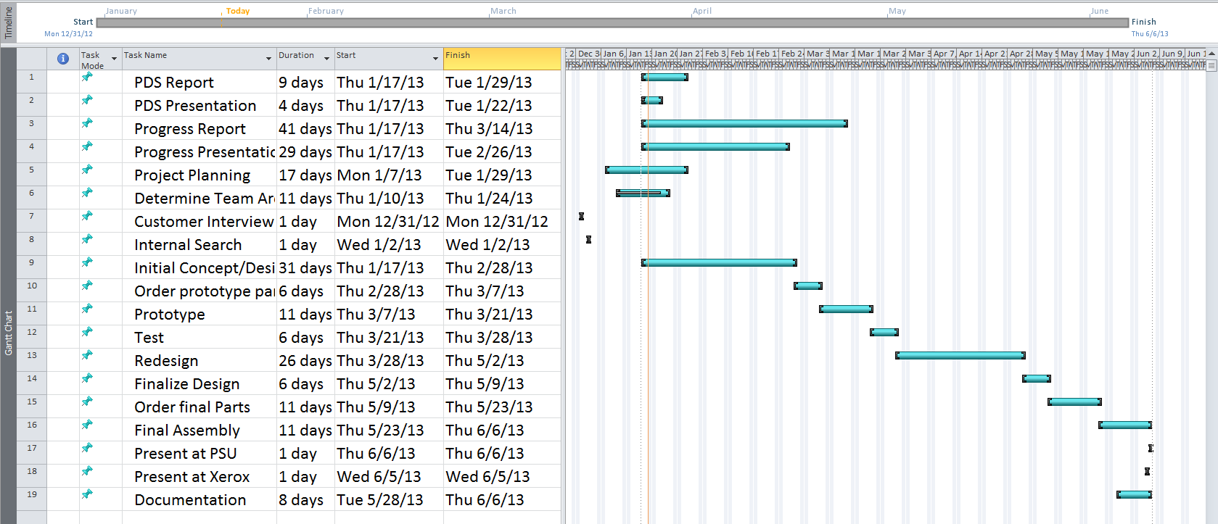
Project Plan
Ambitious Project, Our team needs two design iterations ->
  30 Days to design a Prototype
  Three weeks for ordering/manufacturing prototype
  Additional 30 days for a redesign

Slide 16
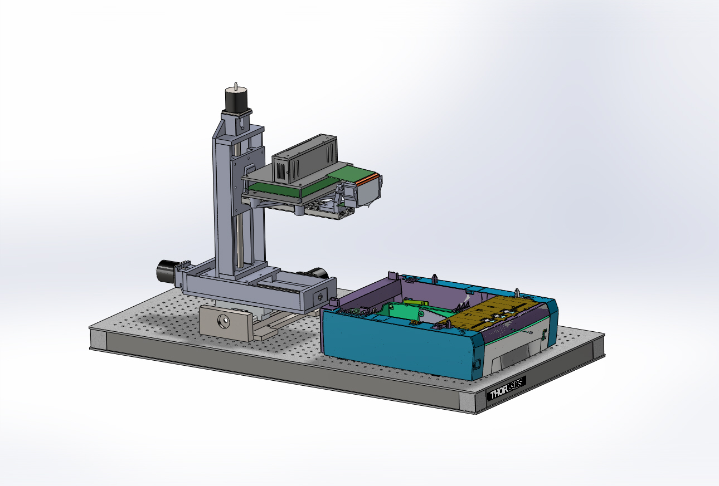
Conclusion

Slide 17
Questions?

