Slide 1
Wind Tunnel Wave Tank
Team members:
Kirk Hansen
Devin Knowles
Corey Rosenfeld
Matthew Schultheis
Mondell Wells
Faculty Adviser/Industry Sponsor
Dr. Raul Cal

Slide 2
Agenda
Overview of Project
Motivation for design
Current wind tunnel layout
Plan for wave tank installation
Major design elements
Question and answer

Slide 3
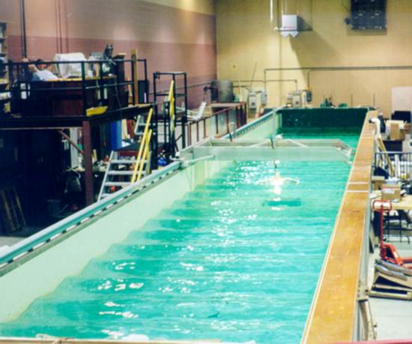
Overview of Project
Objective: Design a wave tank which can be installed in the floor of the wind tunnel at Portland State University
Source: http://en.wikipedia.org/wiki/File:JACOEL-Wave_Tow_Tank-Image16.png

Slide 4
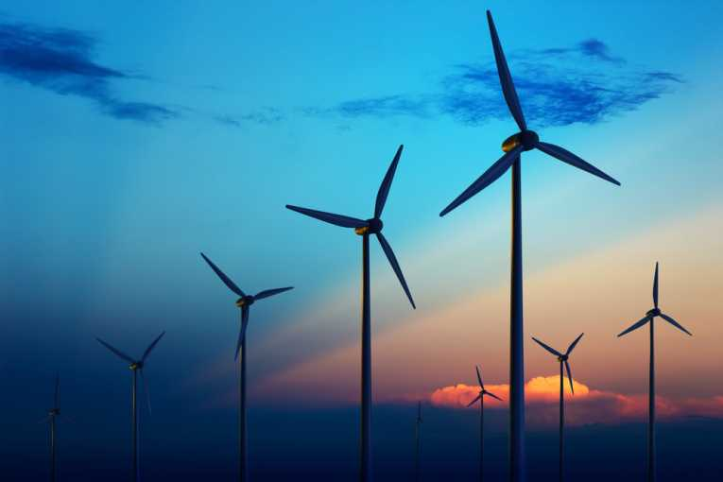
Motivation for Design
Why build a wave tank?
Major motivation is the study of wind energy
Source: http://www.earthtimes.org/newsimage/wwf-backs-scottish-wind-farms_9312.jpg

Slide 5
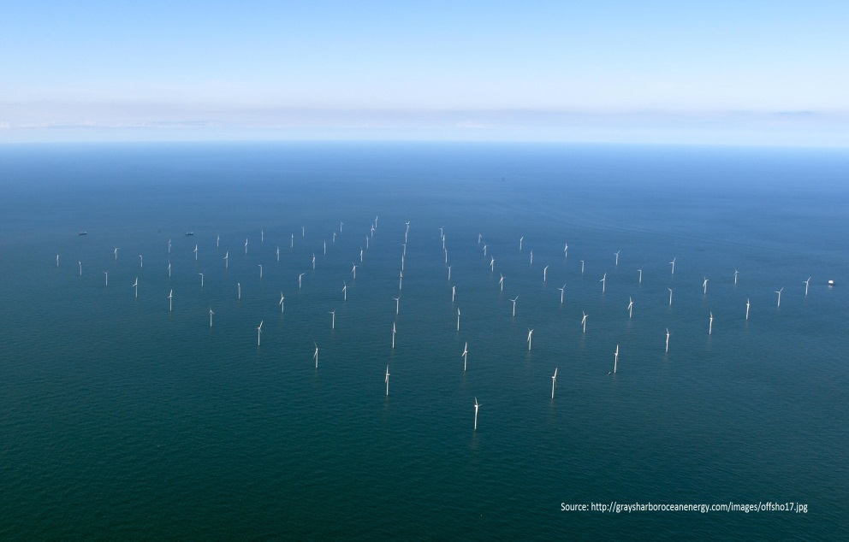
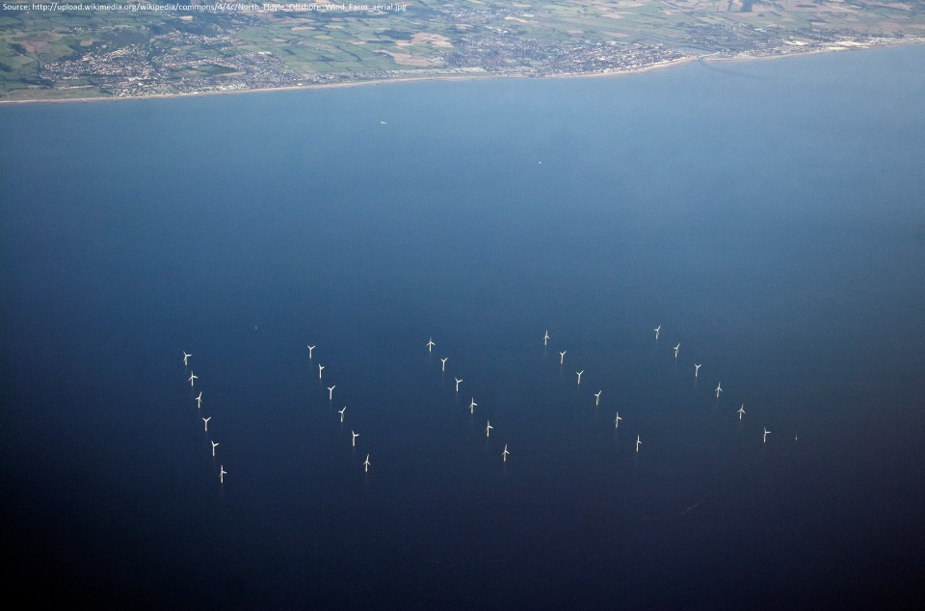
Motivation for Design
Tunnel currently configured for studying land based wind farms
Increased interest in offshore wind farms -> need to understand fluid dynamics of the system
Notes:
There has been an increase in the use of offshore wind farms world wide.
These images show the arrangement of the wind turbines near the shore as well as far out in the ocean.
Are these arrangements optimal?

Slide 6
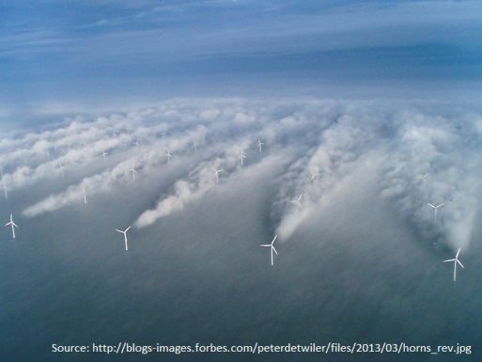
Motivation for Design
Why we need to study offshore wind farms
Notes:
In answering the question ‘are these arrangements optimal’ we can assume from this image that perhaps they are not.

Slide 7
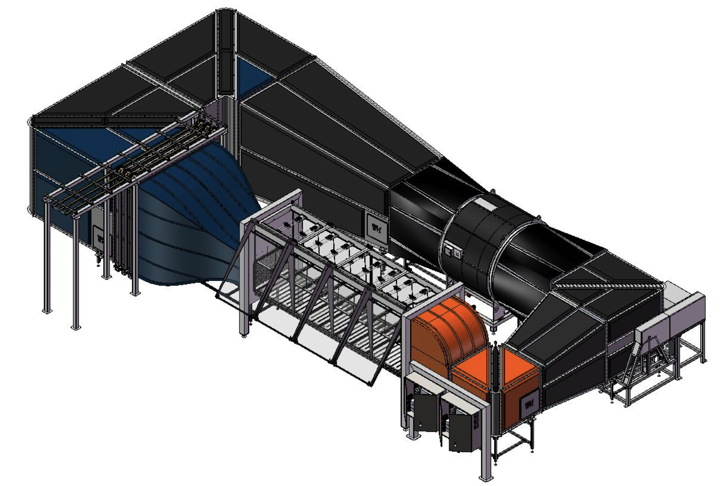
Current Wind Tunnel Layout
Notes:
This is the entire closed loop wind tunnel, jammed into laboratory space on the ground floor of this building.

Slide 8
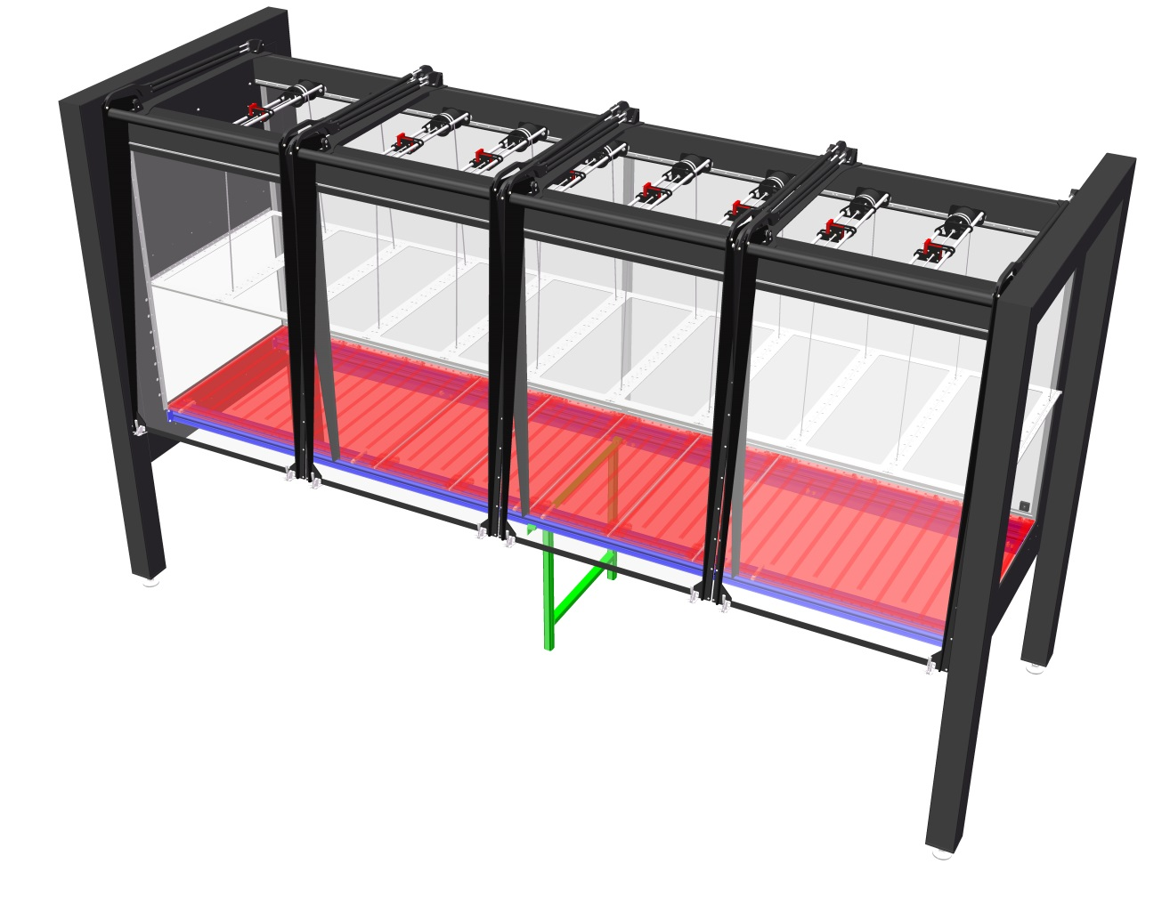
Current Wind Tunnel Layout
Test section
Goal to replace highlighted portion with wave tank
4 ft
15 ft

Slide 9
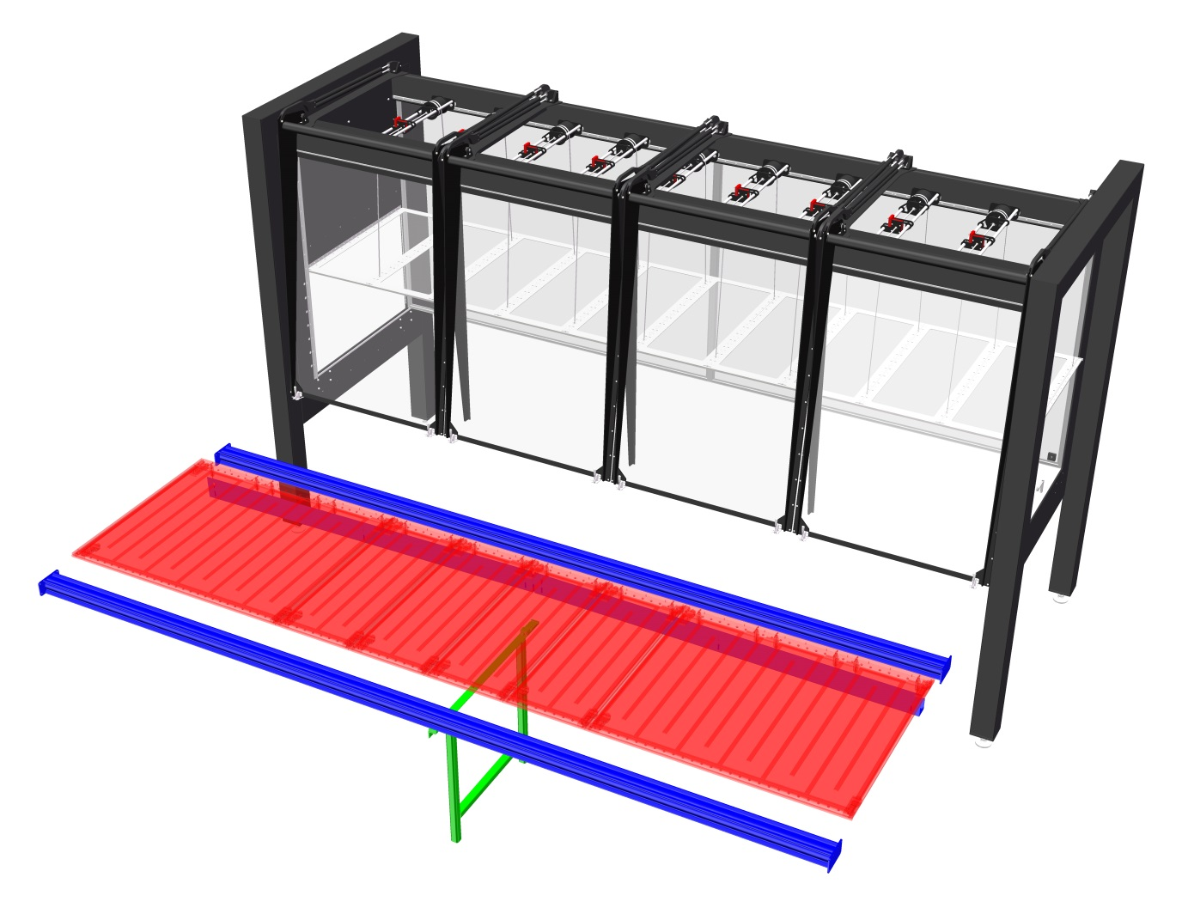
Plan for Wave Tank Installation
Solid floor removed for wave tank
Wave tank must be removable – a modular design

Slide 10
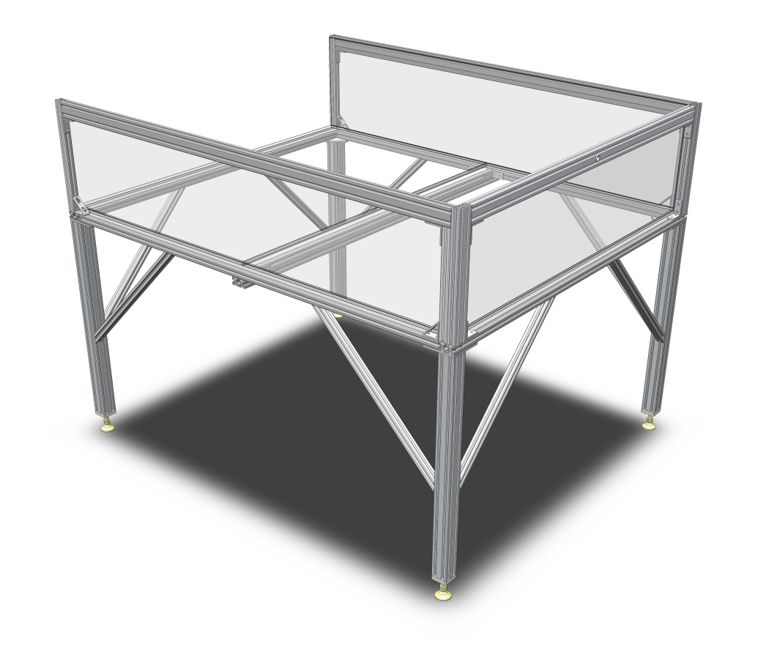
Major Design Elements
Composed of three interlocking sections
Glass tank with aluminum frame
Water depth 25 cm

Slide 11
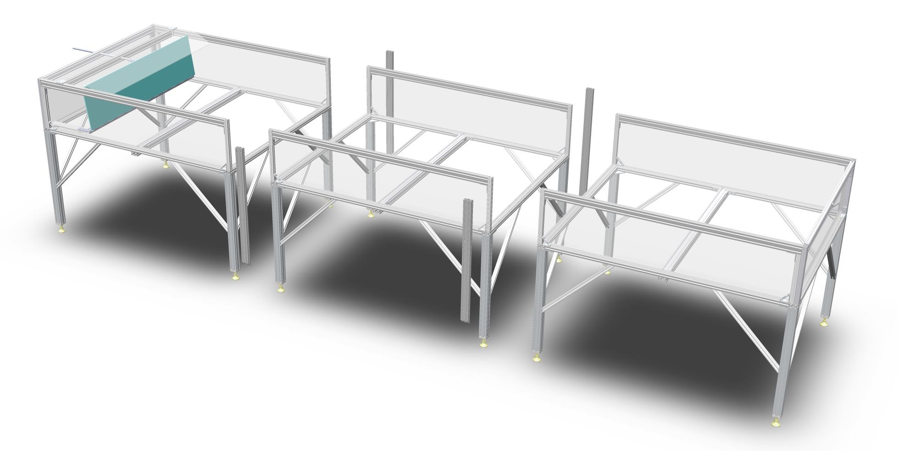
Major Design Elements

Slide 12
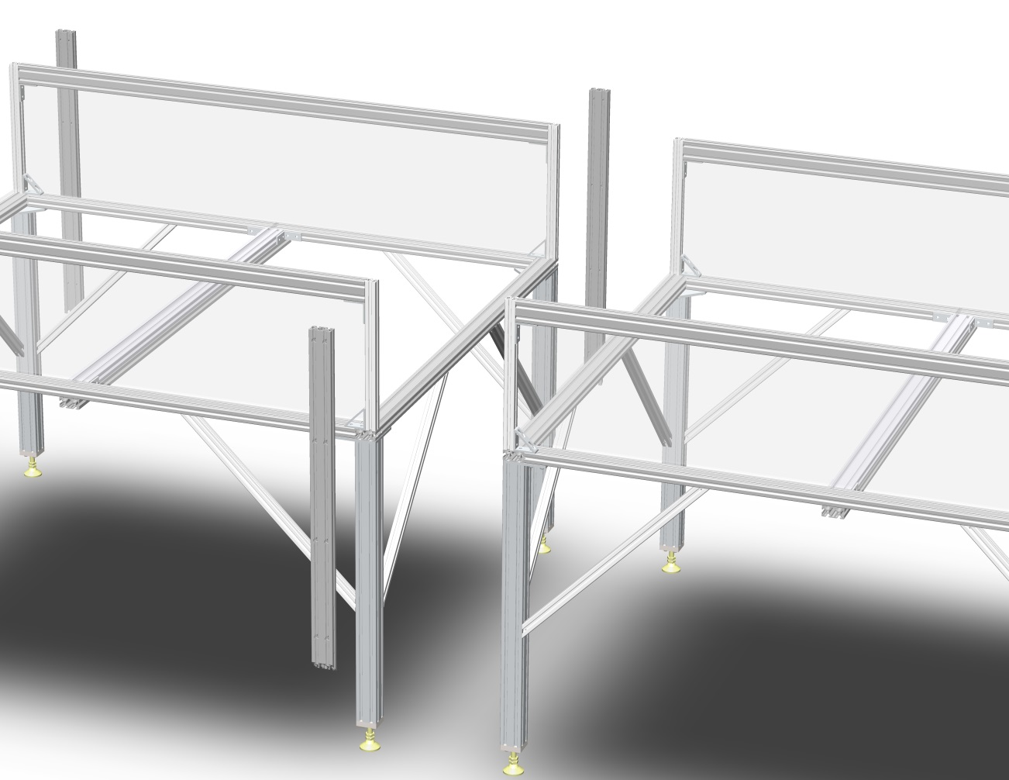
Major Design Elements
Waterproofing: RTV Silicone

Slide 13
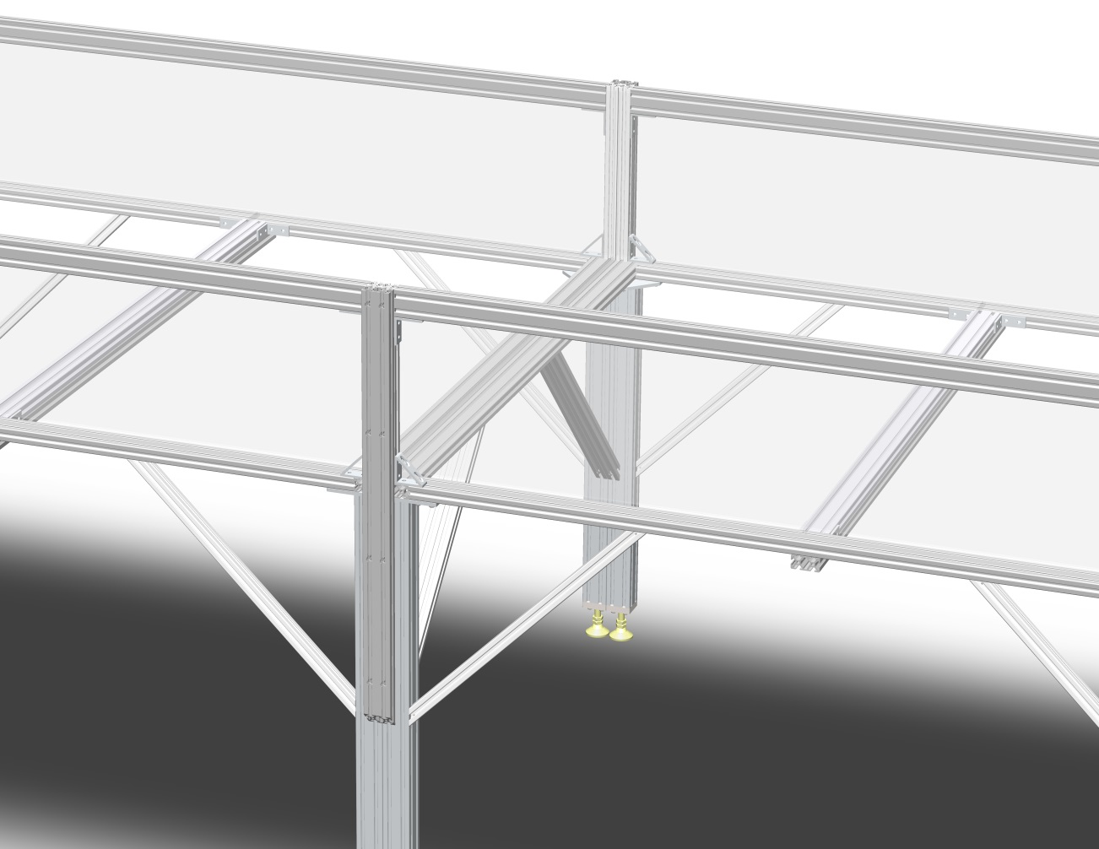
Major Design Elements
Waterproofing: RTV Silicone

Slide 14
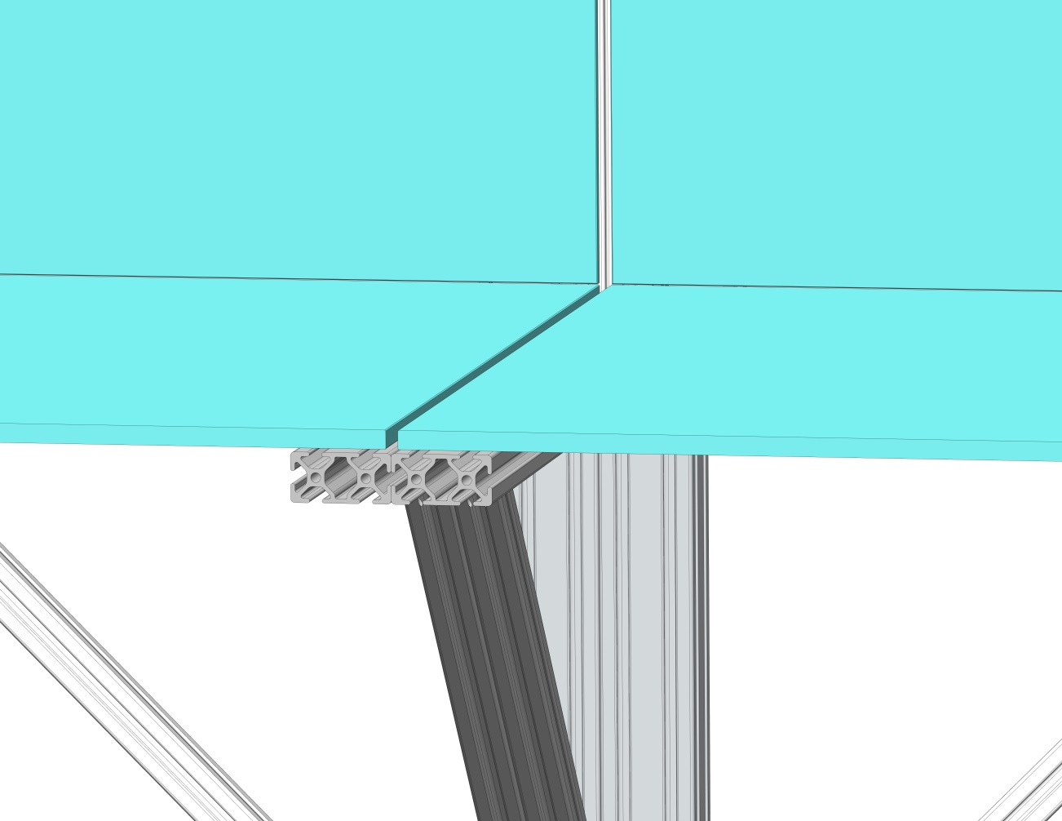
Major Design Elements
Waterproofing: RTV Silicone

Slide 15
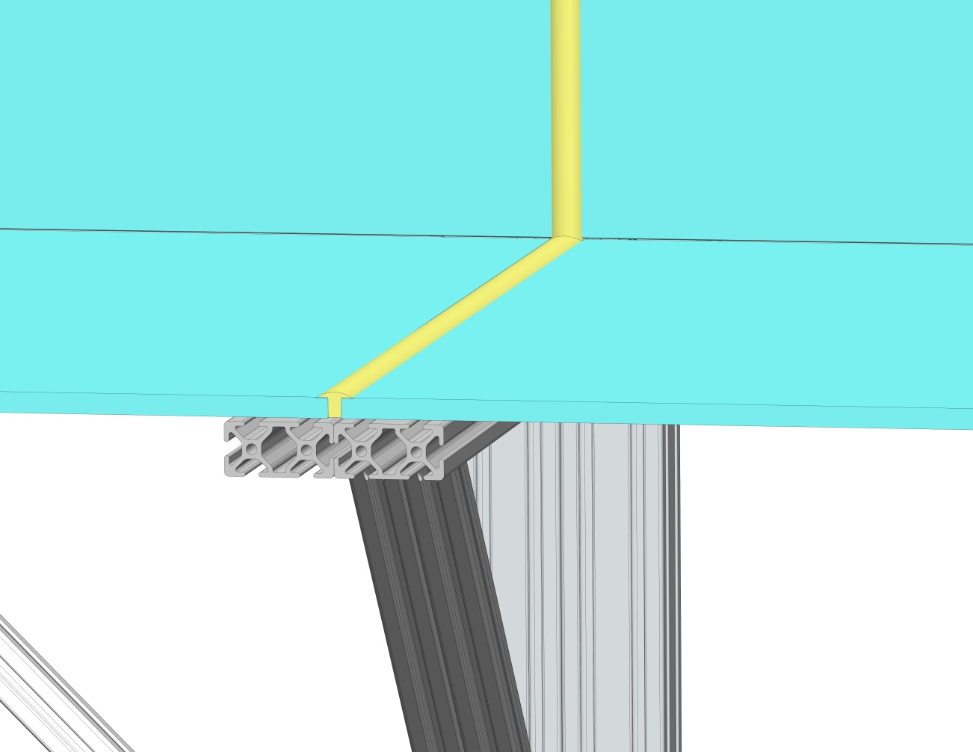
Major Design Elements
Waterproofing: RTV Silicone

Slide 16
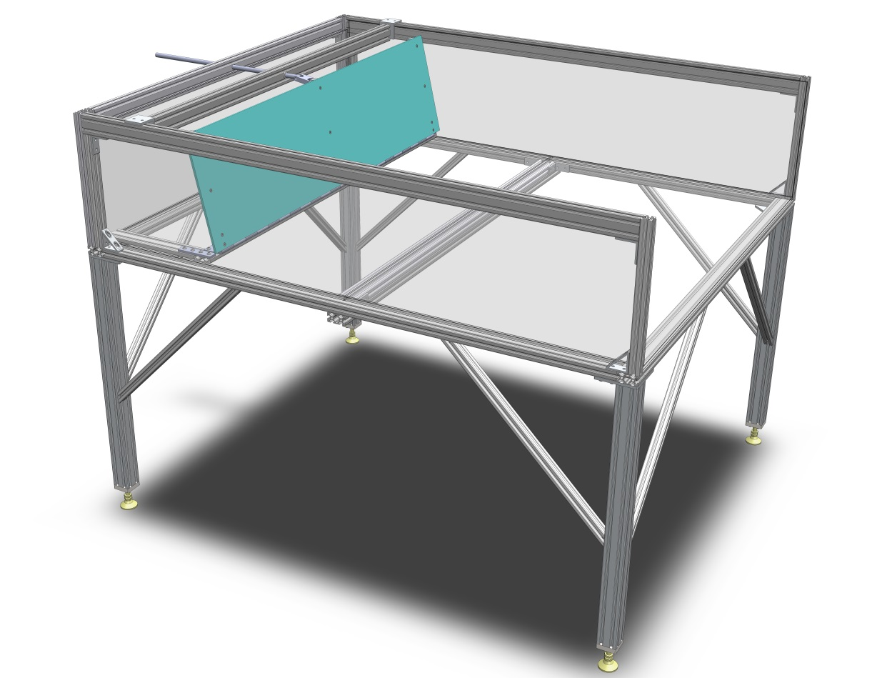
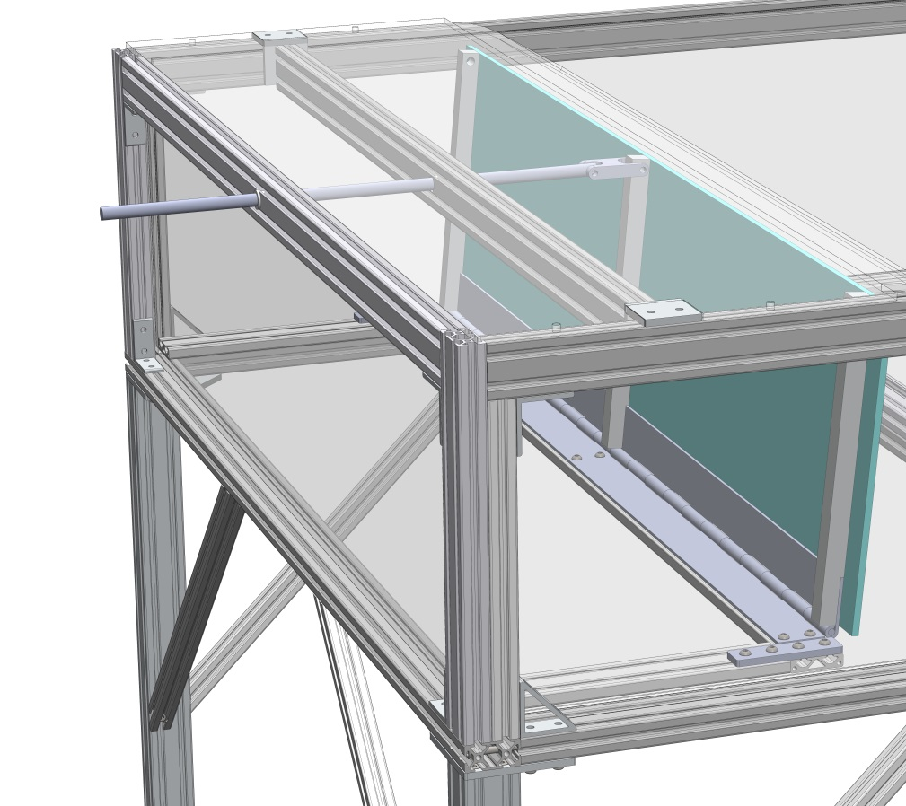
Major Design Elements
Mechanically driven waves

Slide 17
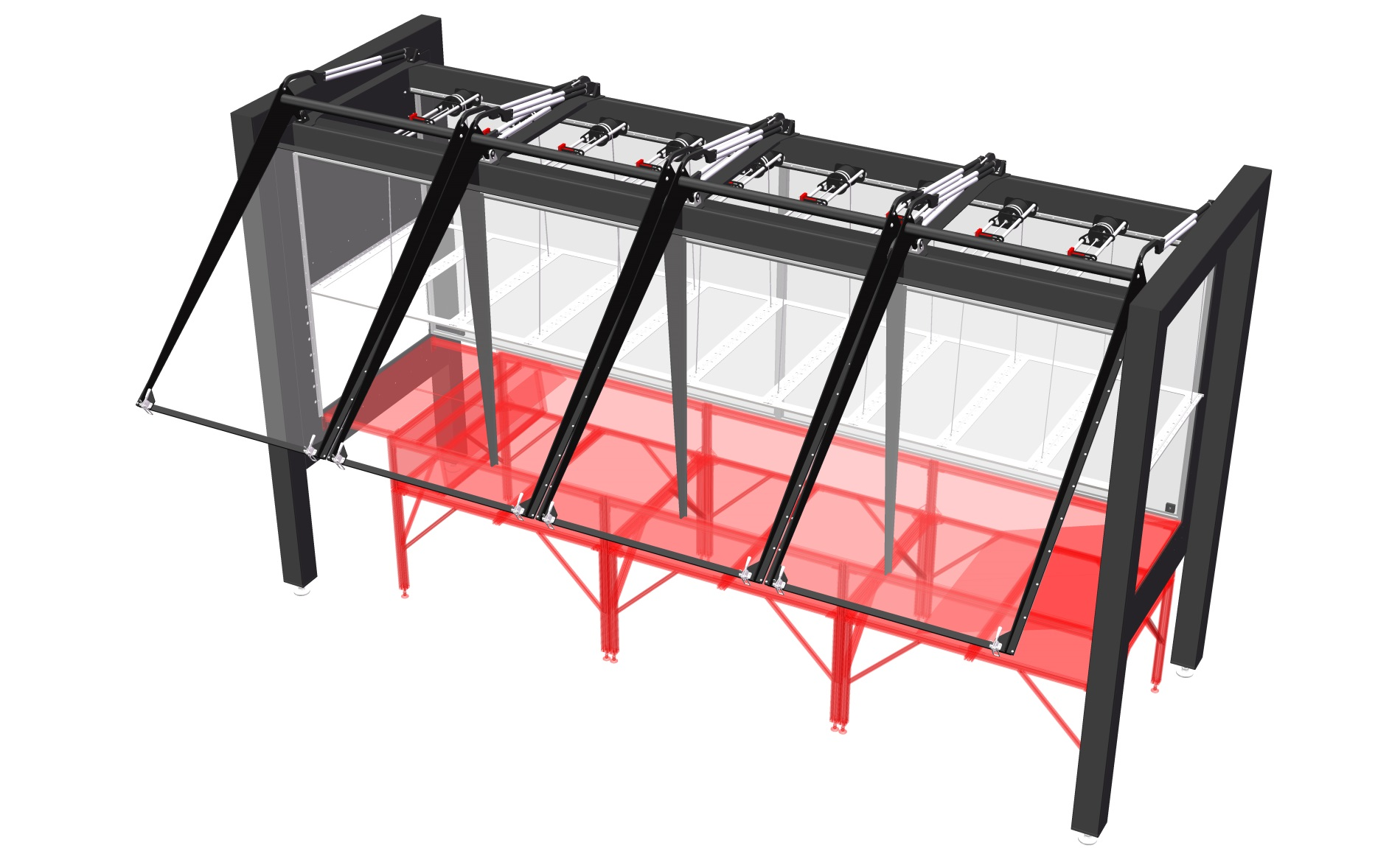
Major Design Elements
Installation

Slide 18
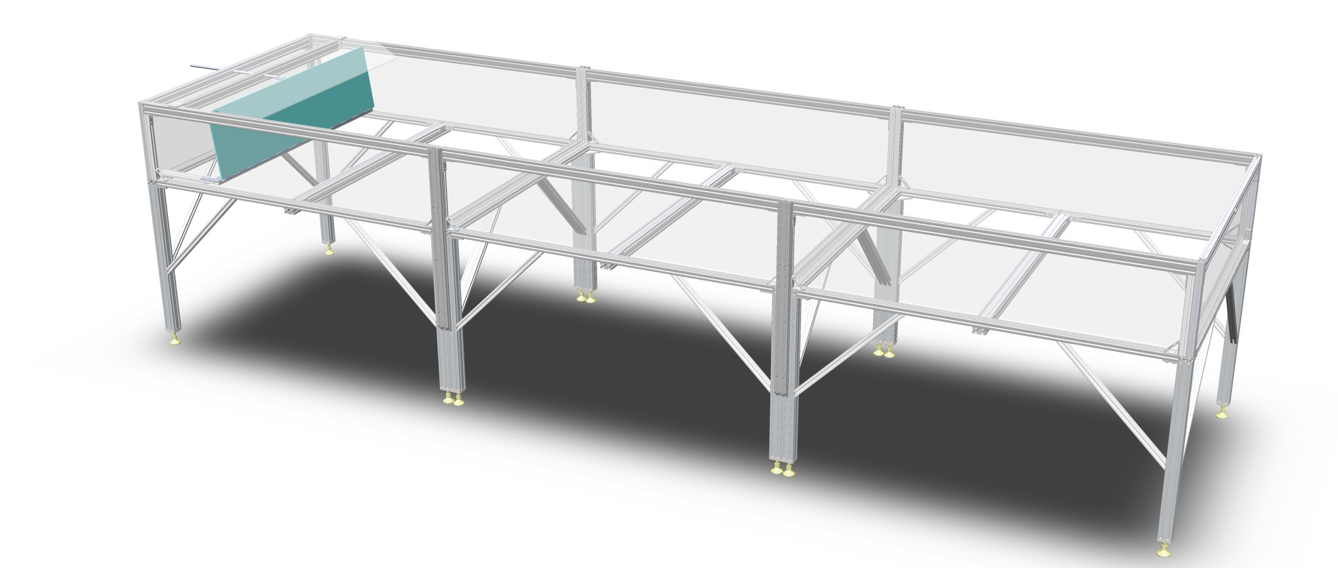
Questions

Slide 19
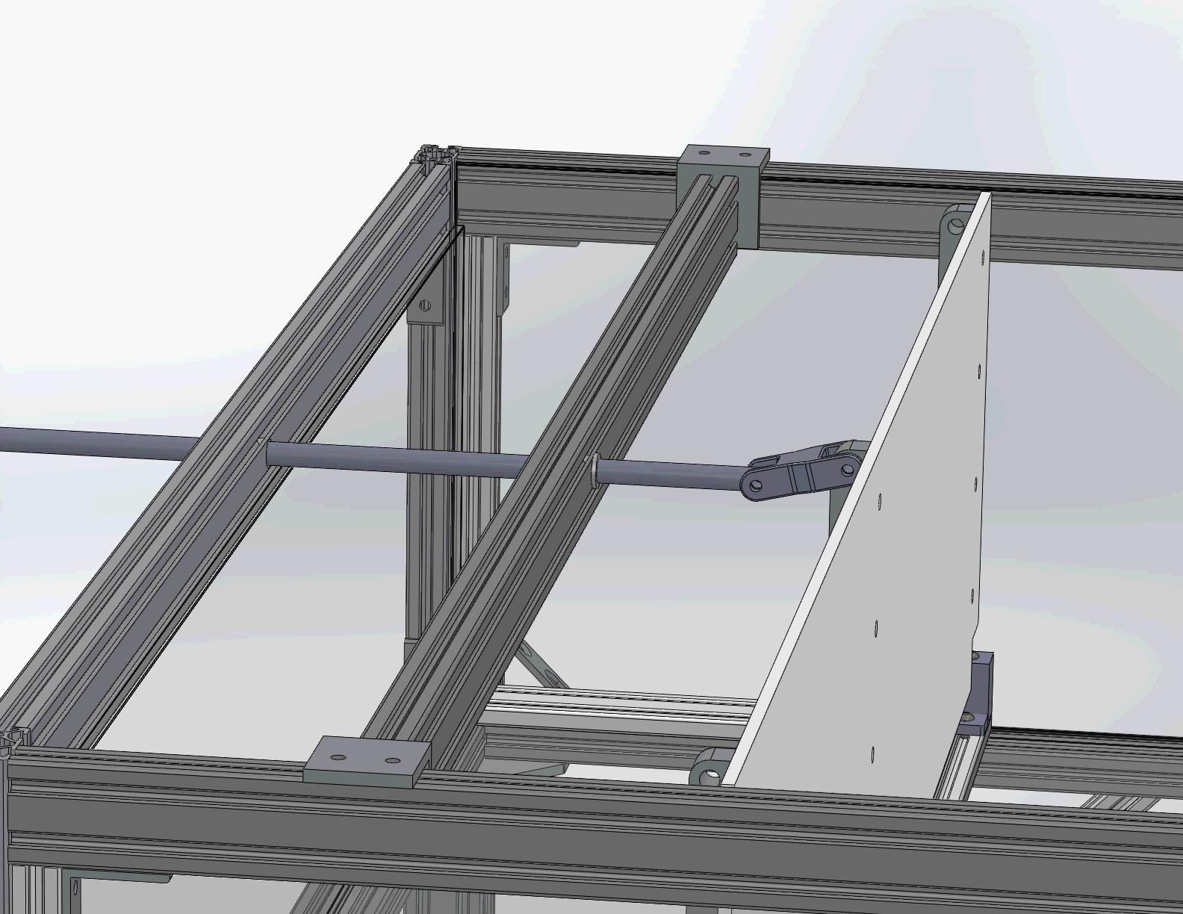
Paddle Wavemaker

