Slide 1
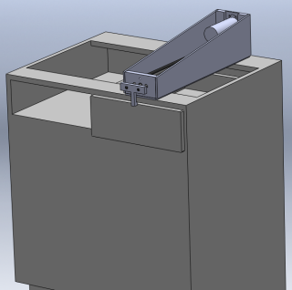

VGO CABINET CYCLE TESTER
HANNY SELBAK
AMMAR AL SALMAN
DRAGAN ULEMEK
JOHN GEILE

Slide 2
PDS
Be able to run a 25000 cycle test
Adjustable length settings for varying drawer/cabinet set-ups
Able to support a load of 15 lbs/sq ft drawer area
3-5 year life-time (depending on frequency of usage)
3 second cycle time
Smooth open and close motion

Slide 3
MOTION DEVICE SELECTION
The criteria for motor selection was organized as shown below. VGO currently uses a pneumatic actuator. We have chosen to go with a
DC MOTOR.

Slide 4
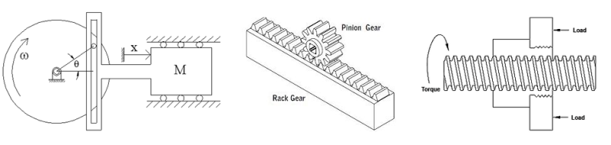
POSSIBLE DESIGNS
Need to translate rotational motion (DC Motor) to linear motion.
Left to Right: scotch yoke, rack and pinion, worm drive

Slide 5
LINEAR DRIVER SELECTION
The criteria for driver selection was organized as shown below. VGO currently uses a piston in conjunction with the pneumatic actuator. We have chosen to go with a WORM GEAR.

Slide 6
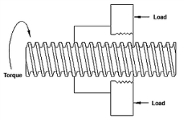
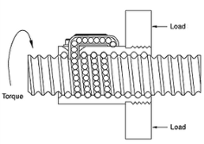
WORM DRIVE SELECTION
POWER SCREW
Higher friction
Lower max speeds
Lifetime is inconsistent
BALL SCREW
Quiet motion
High speeds
Very low friction
Not self-locking

Slide 7
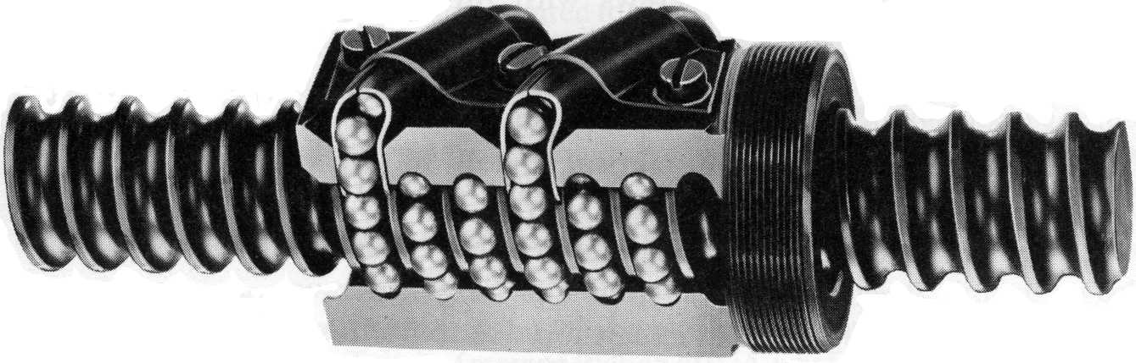
WORM GEAR WITH BALL SCREW

Slide 8
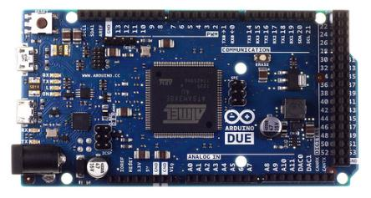
SYSTEM CONTROLLER
An Arduino Due was chosen to control the system. It is easily programmable, low-cost ($40-$50), and can support multiple inputs/outputs.
32-bit, 84 MHz processor, 54 digital input/output pins

Slide 9
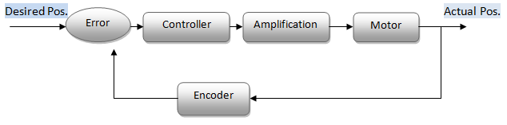
CONTROL SYSTEM
Used a proportional controller
Feedback is from rotary encoder on worm screw
  400 pulses per rev
Encoder senses any outside interaction
Motor voltage is varied to match desired position

Slide 10
DERIVED MOTION
Maximum displacement, velocity, acceleration, and force of the system.
Rotary motion of the worm drive with respect to the linear position of the drawer.

Slide 11
SYSTEM PROPERTIES
1 Test = 1.8 million revolutions maximum
40 Tests/year for 5 years = 360 million revolutions
Maximum torque required to open drawer = 15 oz-in
Maximum axial force = 10 lb
The system design is meant to outlast this with minimal maintenance/replacement parts

Slide 12
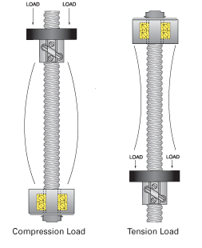

ENGINEERING THEORETICAL DESIGN
FS MAX TOURQE 7
  $T_{R}=\frac{Fd_{m}}{2}\left(\frac{l+πfd_{m}}{πd_{m }−fl}\right)$
FS BUCKLING 32
$P=\frac{Cπ^{2}EI}{L^{2}}$
FS FATIGUE LIFE 411

Slide 13
CURRENT STATUS
DESIGN COMPLETED
CONSTRUCTION COMPLETED
FINAL TESTING
FUTURE ACTIONS
          DELIVER TO CUSTOMER

Slide 14
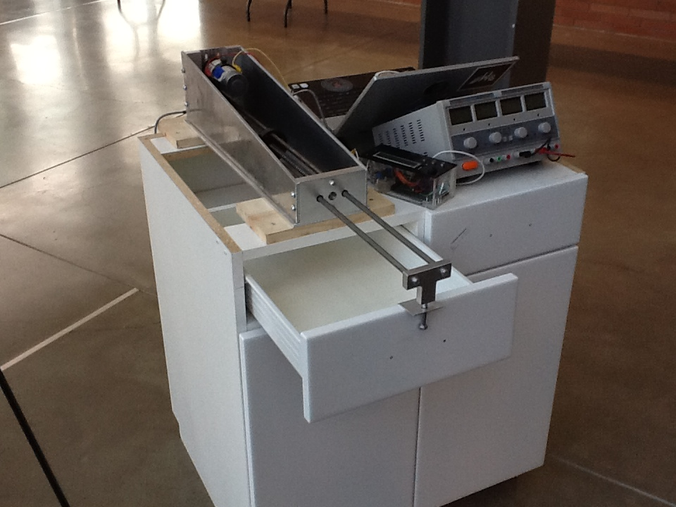
THANK YOU!
QUESTIONS?

