Slide 1
Spa Lift Project
Notes:
Title page
Project title Spa Lift
Group members Dale Calnek, Jerel Hutapea, Chang Park, and Casey Radtke
Academic Advisor Dr. Sung Yi
Industry advisor Jennifer Armbruster
Sponsoring company Adaptive Recreation Center
Date 5 March 2013
and “Progress Report – Winter 2012”.

Slide 2
Team Adaptive Rec
Members
Advisors
Dale Calnek
Jerel Hutapea
Chang-Won Park
Casey Radtke
Academic:
  Dr. Sung Yi
Industry:
  Jennifer Armbruster
  Todd Bauch
  Jennifer Sharp
  Jeff Stein
  Jesse Belter
Sponsoring Company
PSU Student Recreation Center
  -Adaptive Recreation and
  Community Services

Slide 3
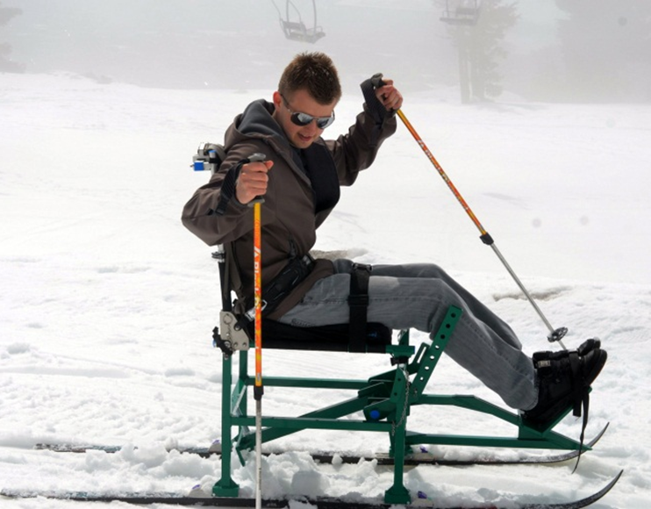
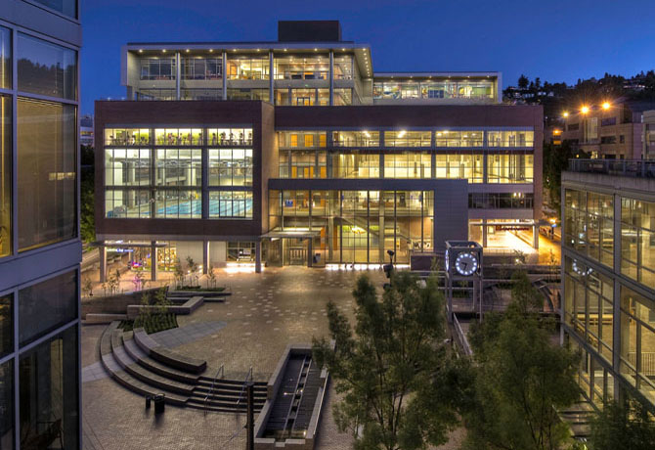
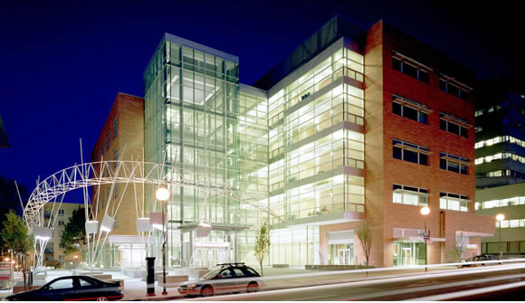
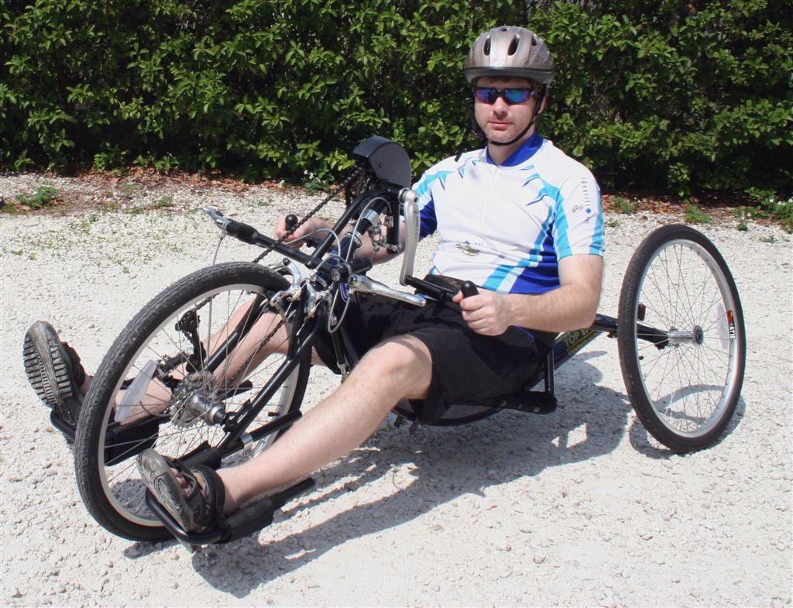
Notes:
Introduction and background information.

Slide 4
Mission Statement
Our team will design, fabricate, and install a lift that will allow a paraplegic person unassisted access to the spa in the student recreation center. This spa lift will provide simple push button control for the user, will address any aesthetic issues requested by the Inclusive Recreation Department, and their intended customers.
Notes:
Mission statement

Slide 5
PDS: Adaptive Rec Requirements
Major
Minor
Safety
  300#/450#
Portability
  Tub Aesthetics
Documentation
Aesthetics
Budget

Slide 6
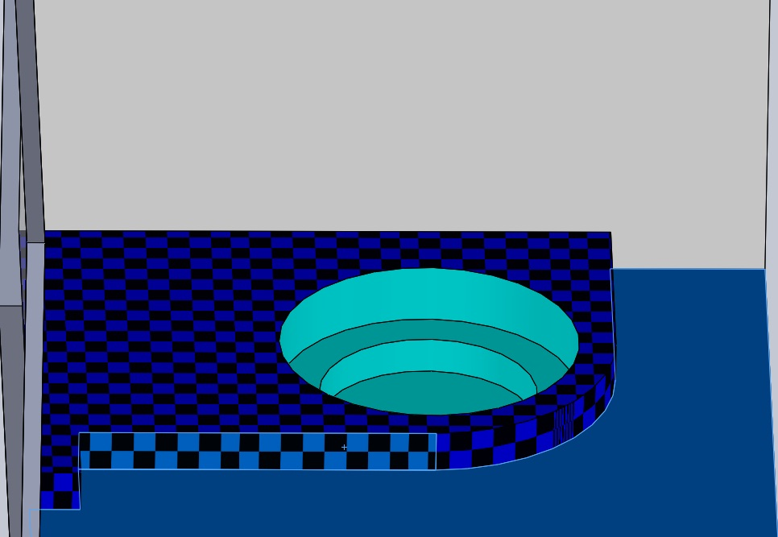
Spa Environment
Curb Width = 16”
Curb Height = 19”
Depth to Spa Seat = 26”

Slide 7
PDS: Adaptive Rec Requirements
Major
Minor
Safety
  300#/450#
Portability
  Tub Aesthetics
Documentation
Aesthetics
Budget

Slide 8
PDS: Spa Lift Team Requirements
Major
Minor
Engineering Simplicity
  Design
  Product Acquisition
Cost
Power

Slide 9
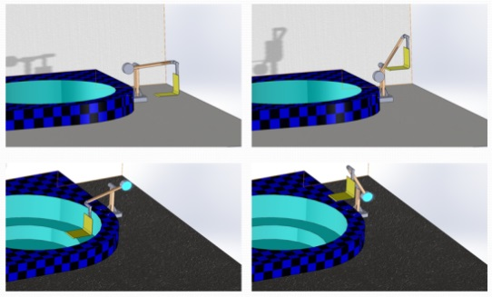
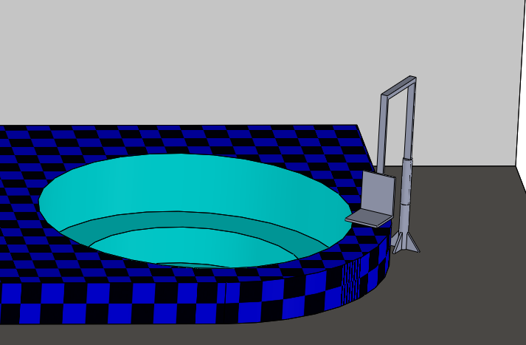
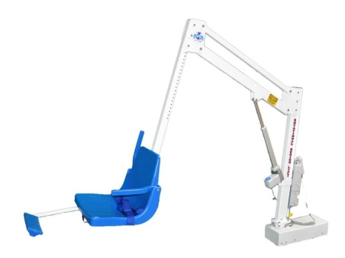

Slide 10
Design Selection
Selection Topic | Excavator | Man on a Clock | Z-Rotator
Safety | 5 | 4 | 9
Maintenance | 12 | 12 | 9
Mobility | 8 | 11 | 9
Budget | 8 | 4 | 8
Engineering Simplicity | 7 | 4 | 10
Totals | 40 | 35 | 45
Notes:
Top-level final design evaluation and Selection

Slide 11
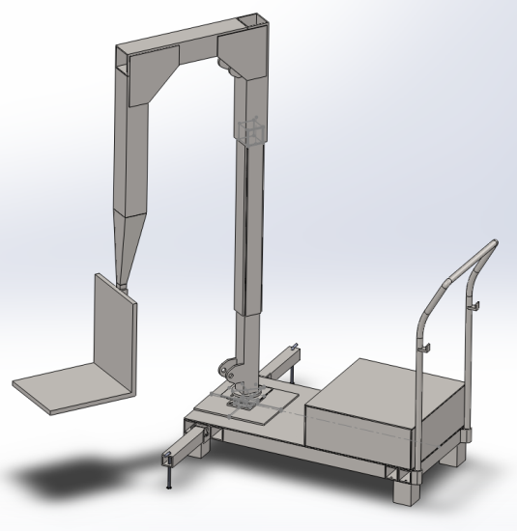
Final Design Model

Slide 12
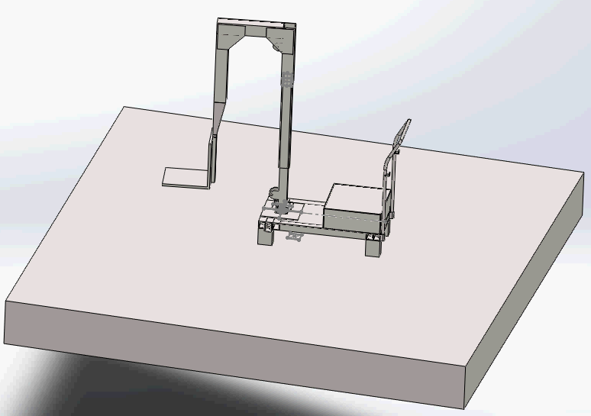
Tipping

Slide 13
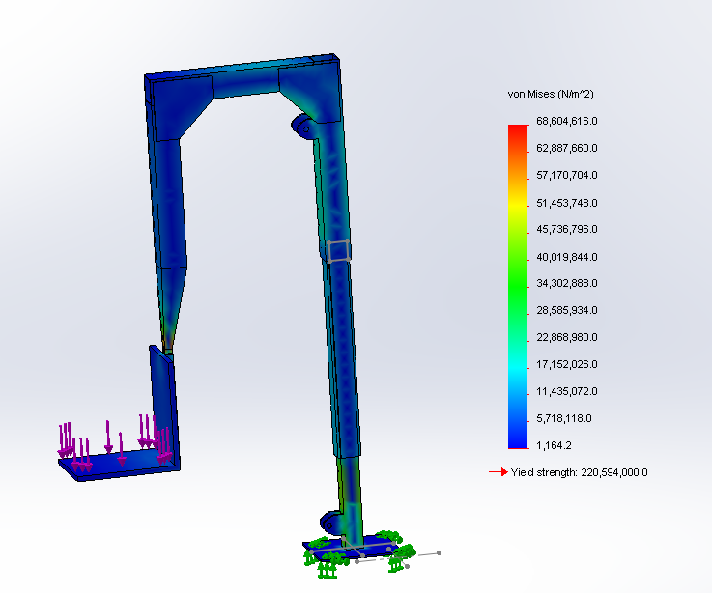
FEA

Slide 14
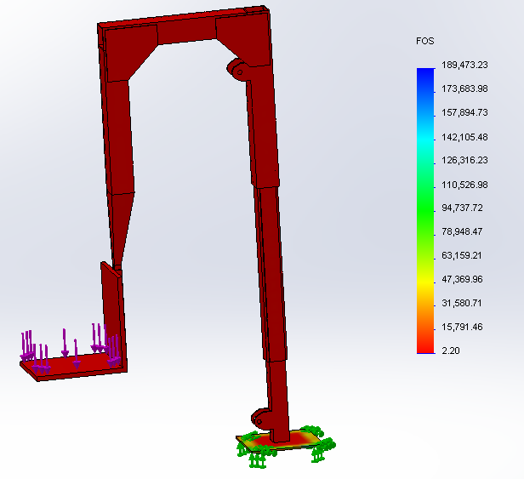
FEA

Slide 15
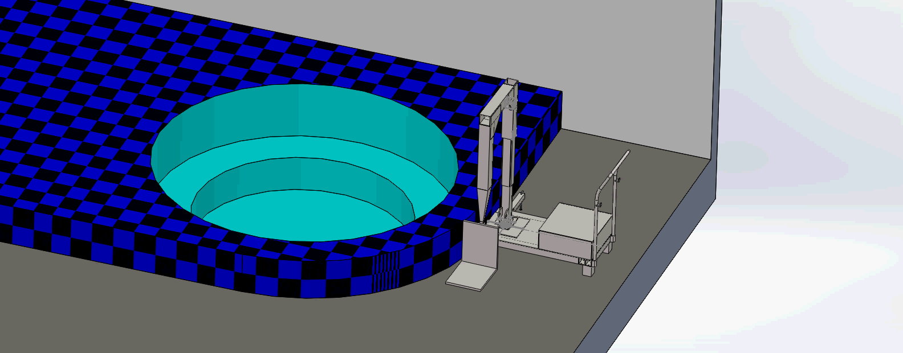
Final Design Simulation

Slide 16
Final Design
Evaluation of PDS requirement
Requirements | Goal met
Clearance of Spa Curb
Maintenance Plan Documentation
Spa Lift Mobility
Unassisted Operation
Must Fit Current Visual Aesthetics

Slide 17
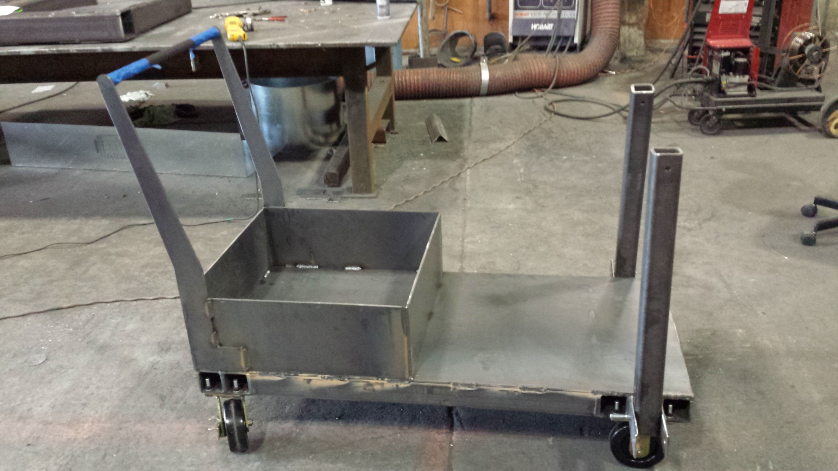

Slide 18
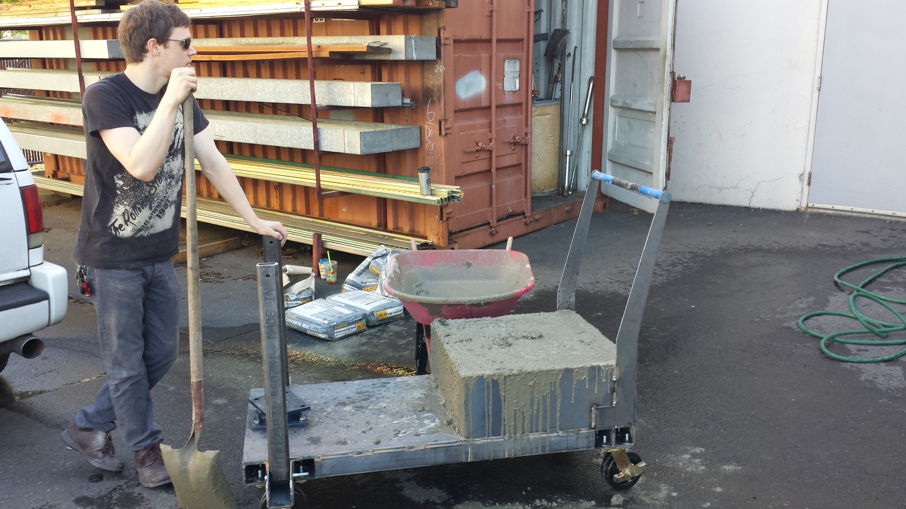

Slide 19
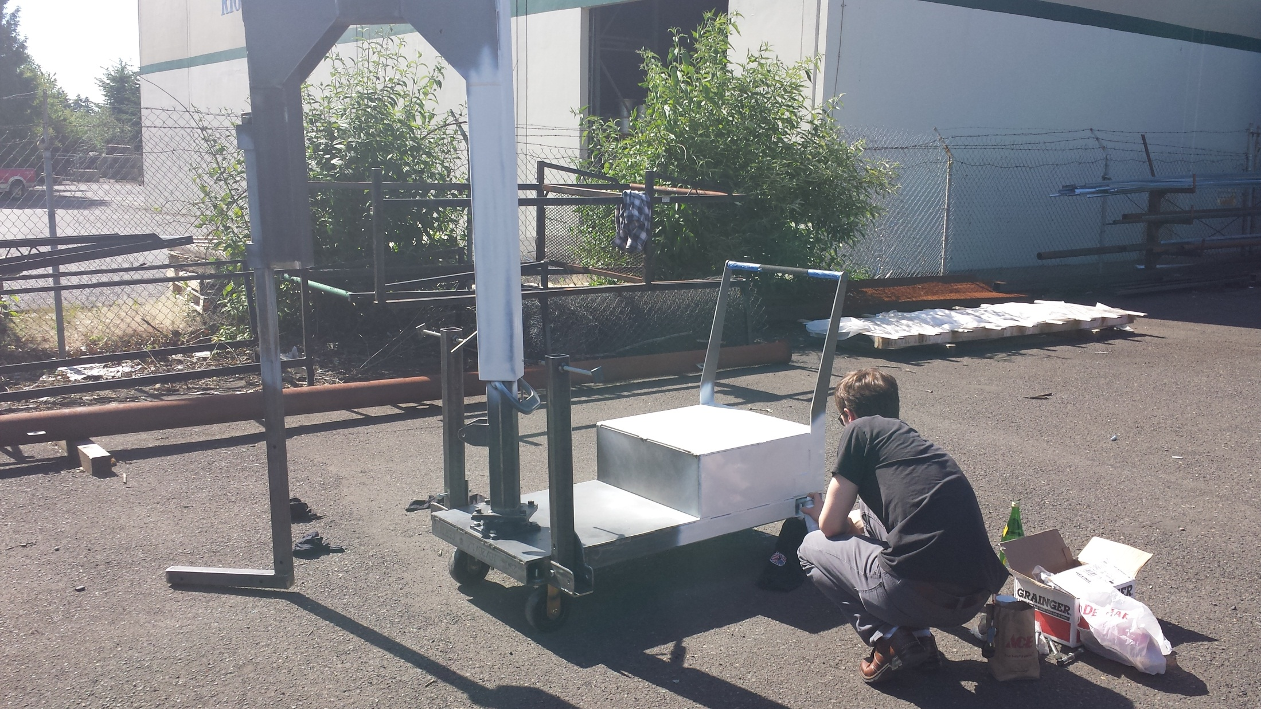

Slide 20
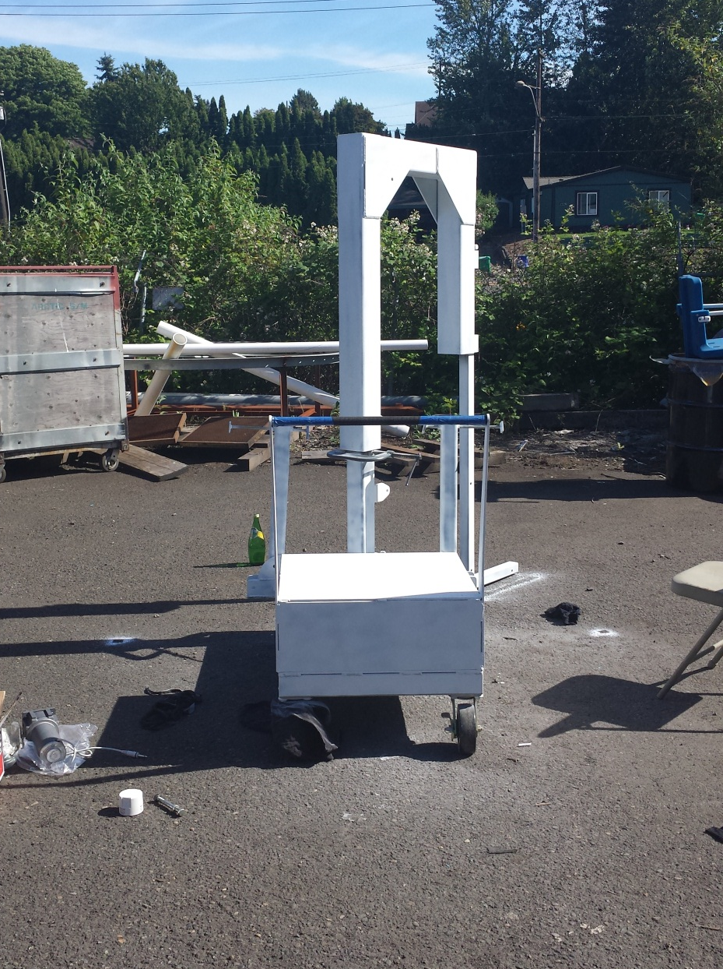
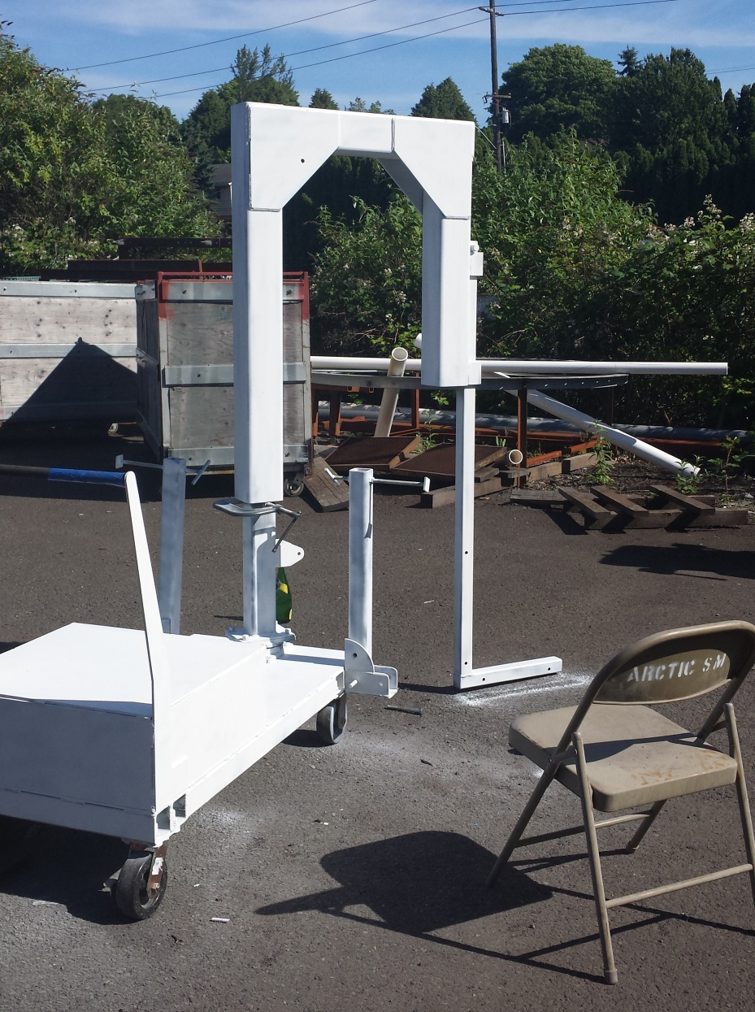

Slide 21
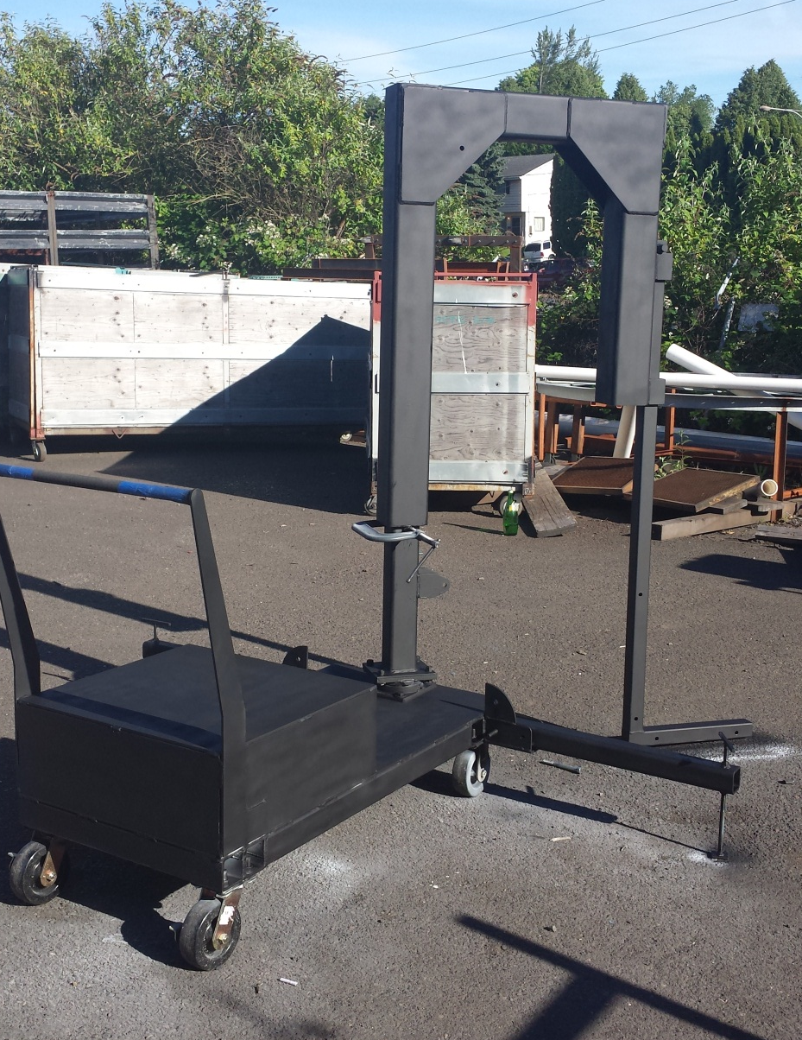
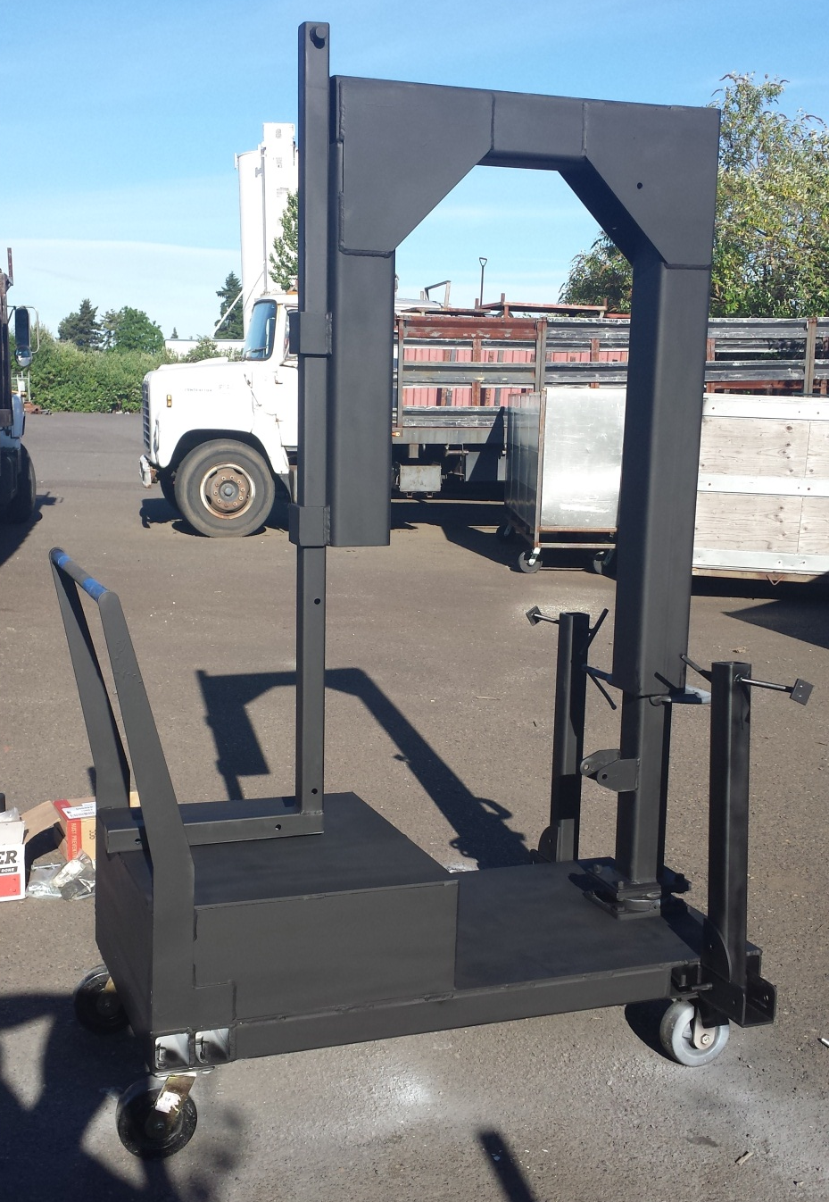

Slide 22
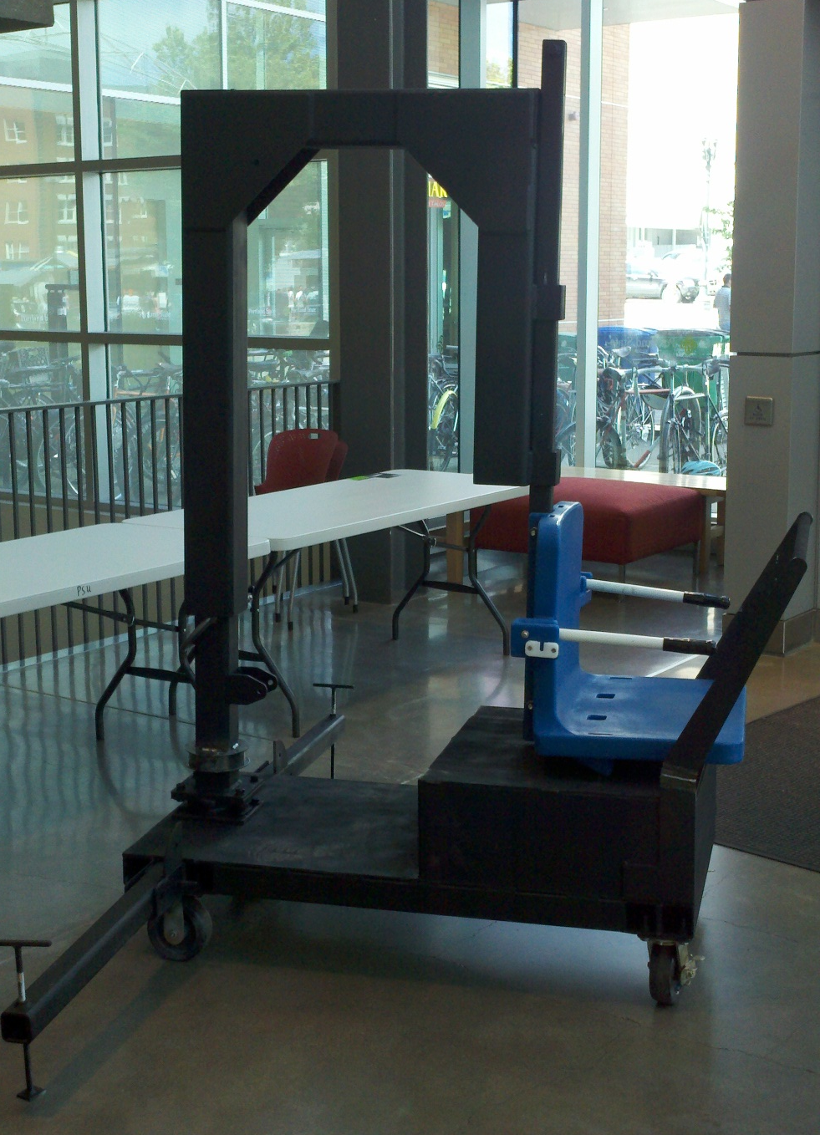
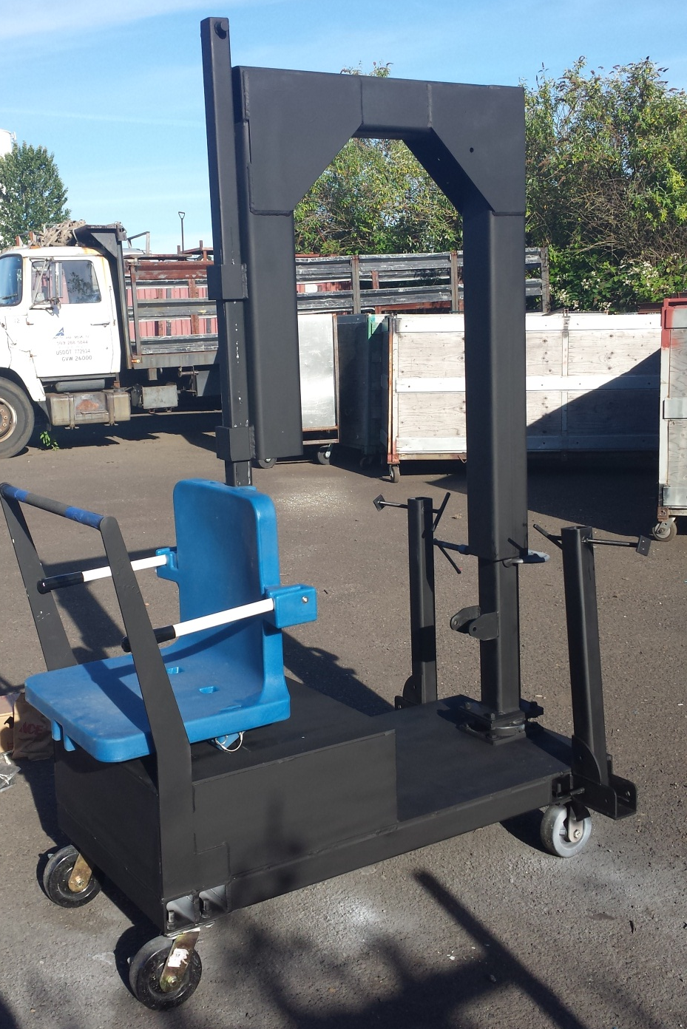

Slide 23
Team Adaptive Rec
Helping paraplegic Students and Faculty
ADA Compliance in the Student Recreation Center
“We are proud to provide equipment and programming that creates an inclusive environment and makes every effort to be accessible to all abilities. ”
–Inclusive Rec
Notes:
Conclusion and recommendations

Slide 24
Spa Lift Project
Team Adaptive Rec
Notes:
Title page
Project title Spa Lift
Group members Dale Calnek, Jerel Hutapea, Chang Park, and Casey Radtke
Academic Advisor Dr. Sung Yi
Industry advisor Jennifer Armbruster
Sponsoring company Adaptive Recreation Center
Date 5 March 2013
and “Progress Report – Winter 2012”.

