Slide 1
CPU Waste Heat Recovery Device
Faculty Advisor
Huafen Hu
Industry Advisor
Jered Wikander
Capstone Team
Chad Miller
Andrew Louie
Thomas Miesen
Geoff Jenks

Slide 2
Presentation Outline
Mission Statement
Heat and Modern Computing
Basic Problem and Solution
Key PDS Requirements
Thermal Electric Devices
Final Design
Design Implementation
Further Improvements
Questions

Slide 3
Mission Statement
A CPU waste heat recovery device is to be designed for use in laptop computers. The device is to output 2 watts of non-thermal energy from a 40 watt input with a total volume no larger than 27,000 mm³ (Suggested: 60 mm x 60 mm x 7.5 mm)

Slide 4
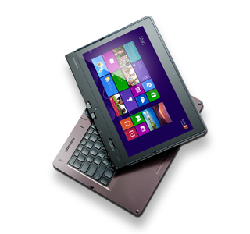
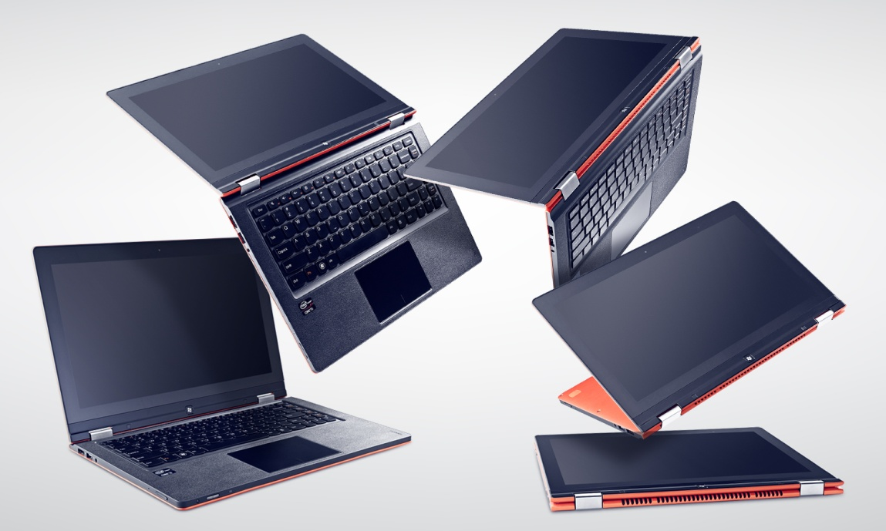
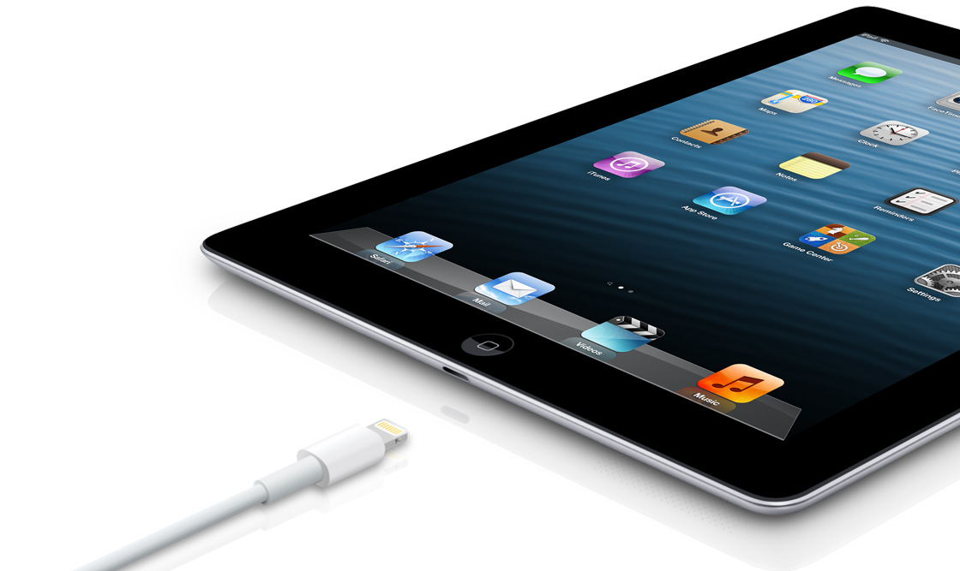
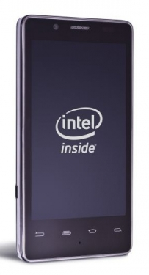
Heat and Modern Computing
Thin, Fast, and Portable
Increasing Level of Personal Integration

Slide 5
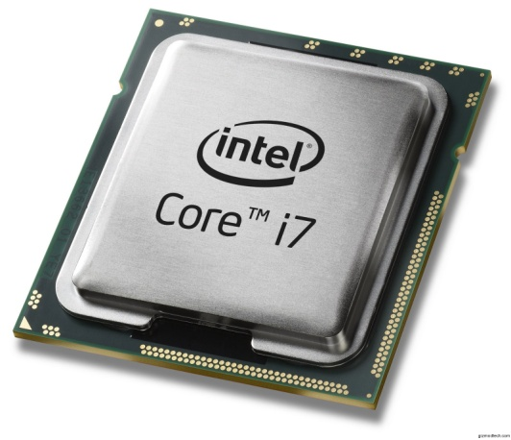
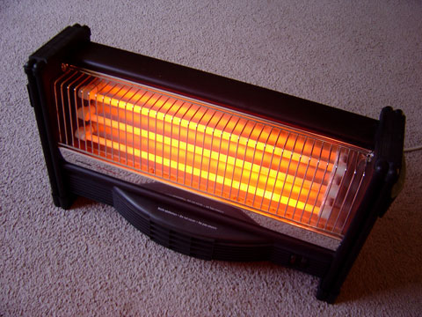
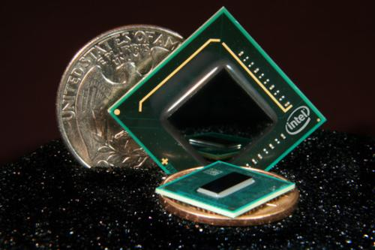
Heat and Modern Computing
Speeds
Shapes
and Sizes
Processors Handle Data Computation
Defines a Computing Device’s Speed
Come in a variety of…
http://www.google.com/imgres?um=1&hl=en&tbo=d&authuser=0&biw=1366&bih=620&tbm=isch&tbnid=5jmbDCyRJr52GM:&imgrefurl=http://www.lowerelectricbilltoday.com/home-heating/space-heater.html&docid=EmIksj9m6yHjlM&imgurl=http://www.lowerelectricbilltoday.com/useruploads/images/space-heater.jpg&w=480&h=360&ei=BDz_UM-UGYqcrAH9iIG4DA&zoom=1&iact=rc&dur=305&sig=108145729007402177137&page=1&tbnh=138&tbnw=211&start=0&ndsp=25&ved=1t:429,r:1,s:0,i:151&tx=193&ty=56

Slide 6
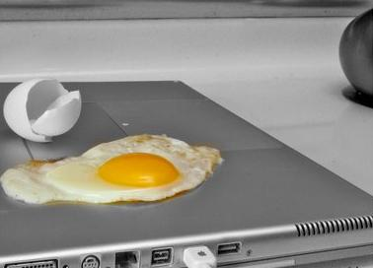
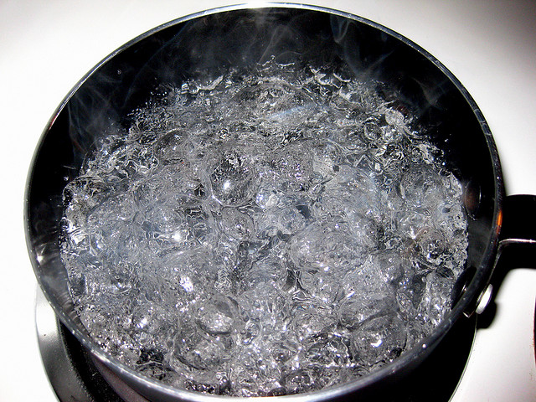
Heat and Modern Computing
Computers Produce a Lot of Heat
Capable of upwards of 100-110C
http://www.google.com/imgres?um=1&hl=en&tbo=d&authuser=0&biw=1366&bih=620&tbm=isch&tbnid=J8lzaQBAJbVwVM:&imgrefurl=http://mix931fm.com/boil-water-notification/&docid=A7NL9kpg6mHpRM&imgurl=http://wac.450f.edgecastcdn.net/80450F/knue.com/files/2011/11/Boiling-Water.jpg&w=640&h=480&ei=uj7_UKuJOM36qAHy4IDoCw&zoom=1&iact=hc&vpx=4&vpy=233&dur=314&hovh=194&hovw=259&tx=196&ty=100&sig=108145729007402177137&page=2&tbnh=149&tbnw=200&start=20&ndsp=26&ved=1t:429,r:26,s:0,i:232
Heat is Proportional to Processor Speed
Must throttle processor speed
Ergonomic window ~50-60C
http://i.telegraph.co.uk/multimedia/archive/01392/PF-laptop-1_1392700c.jpg

Slide 7
Basic Problem and Solution
System Generating Waste Heat
Need for Device to Reduce Total Heat Output
Waste Heat
Electrical Power
Waste Heat
Reduction Device
Heat Source

Slide 8
Key PDS Requirements
Minimum 2 Watt Output
Maximum Volume of 27,000 mm³
Recommended Dimensions of 60x60x7.5 mm
Self-Sustained Operation
Operating Temperature ≤100°C
Uses Non-Hazardous Materials by ROHS Standards
Notes:
RoHS regulations restrict:
Lead, cadmium, mercury, hexavalent chromium, polybrominated biphenyl (PBB) and polybrominated diphenyl ether (PBDE) flame retardants.

Slide 9
Thermal Electric Device
Hot Side Temp
Power Output
Cold Side Temp

Slide 10
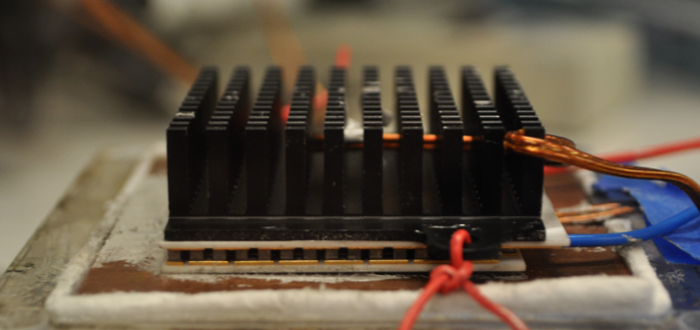
Thermal Electric Device
Power Output Dependent on:
Temperature Difference
Number of Node Pairs
Node Material
Node Dimensions
Calculated vs. Experimental Output
Experimental / Theoretical = 71%
Applied to Theoretical Design Output
T_{H}
P
N
Node Pair
T_{C}

Slide 11
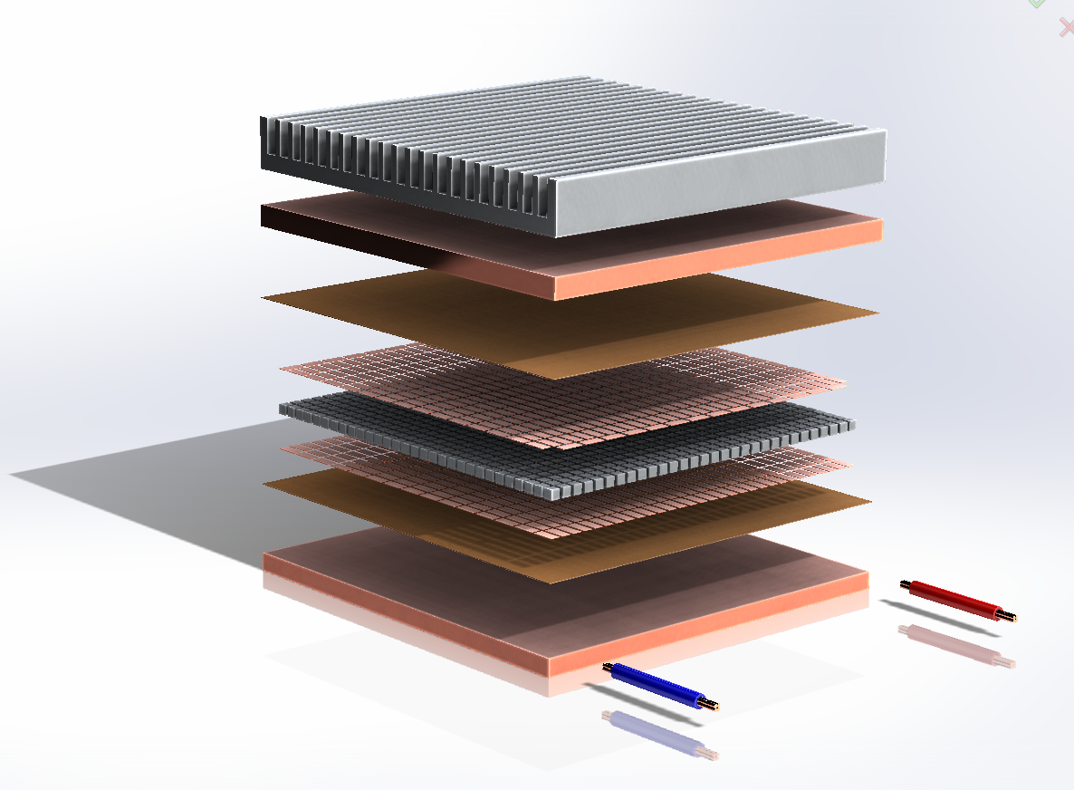
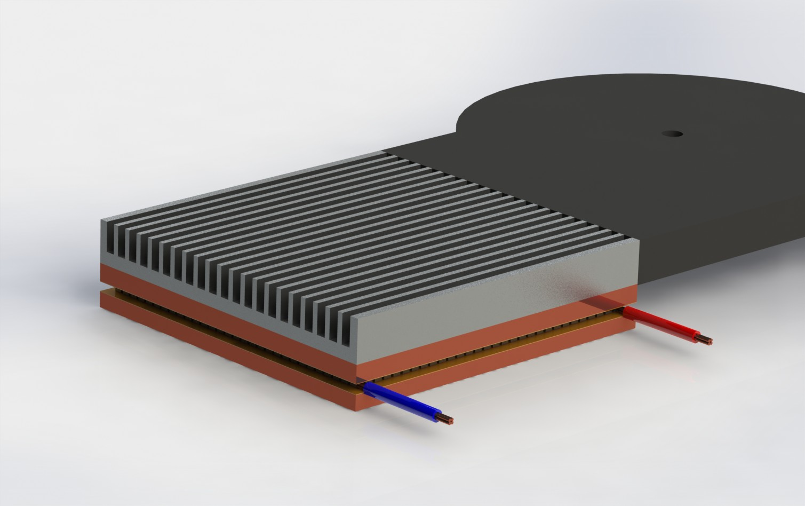
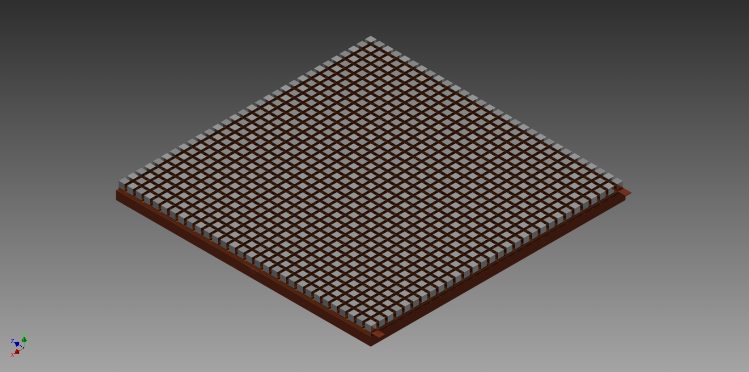
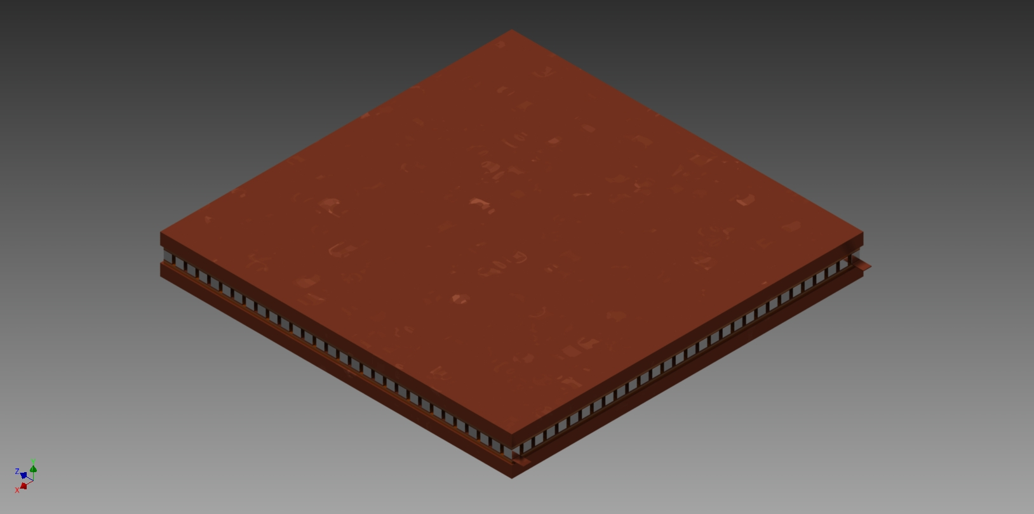
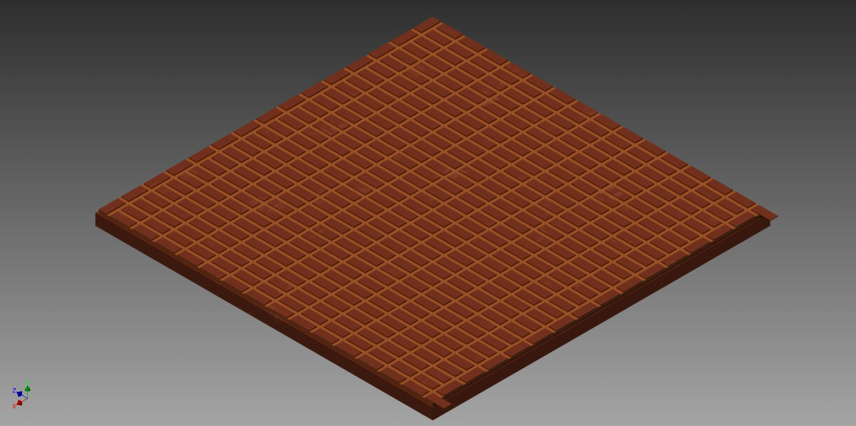
Final Design

Slide 12
Final Design 1
Calculated Output: 1.78 Watts
Dimensions: 60x60x7.5 ± 0.1 mm
Materials: Copper, Kapton Tape, Bismuth Telluride (P and N Type).
Operating Temp: 100°C ± 5°C

Slide 13
Final Design 2
Calculated Output: 2.42 Watts
Dimensions: 70x70x5.5 ± 0.1 mm
Materials: Copper, Kapton Tape, Bismuth Telluride (P and N Type).
Operating Temp: 100°C ± 5°C

Slide 14
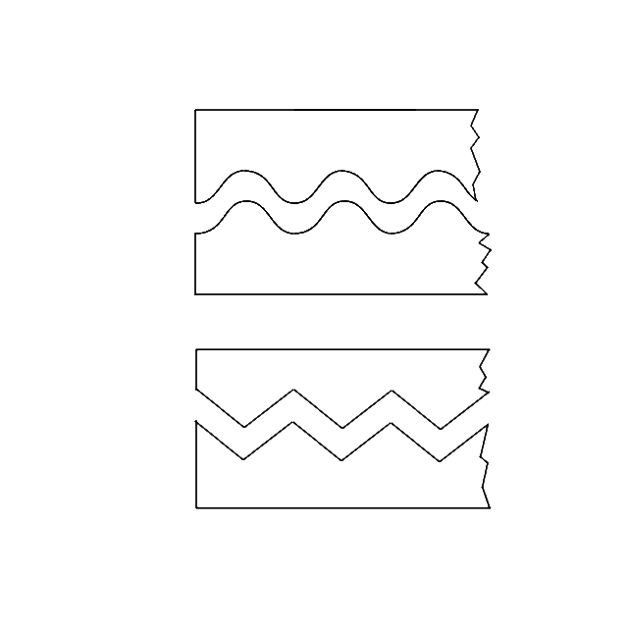
Further Improvements
Use of Different Heat Sink
Lower Cold-Side Temp
Different Plate Meshing Patterns
Further Reduction of Copper Plate Thickness
Modified Sinusoidal
Saw Tooth

Slide 15
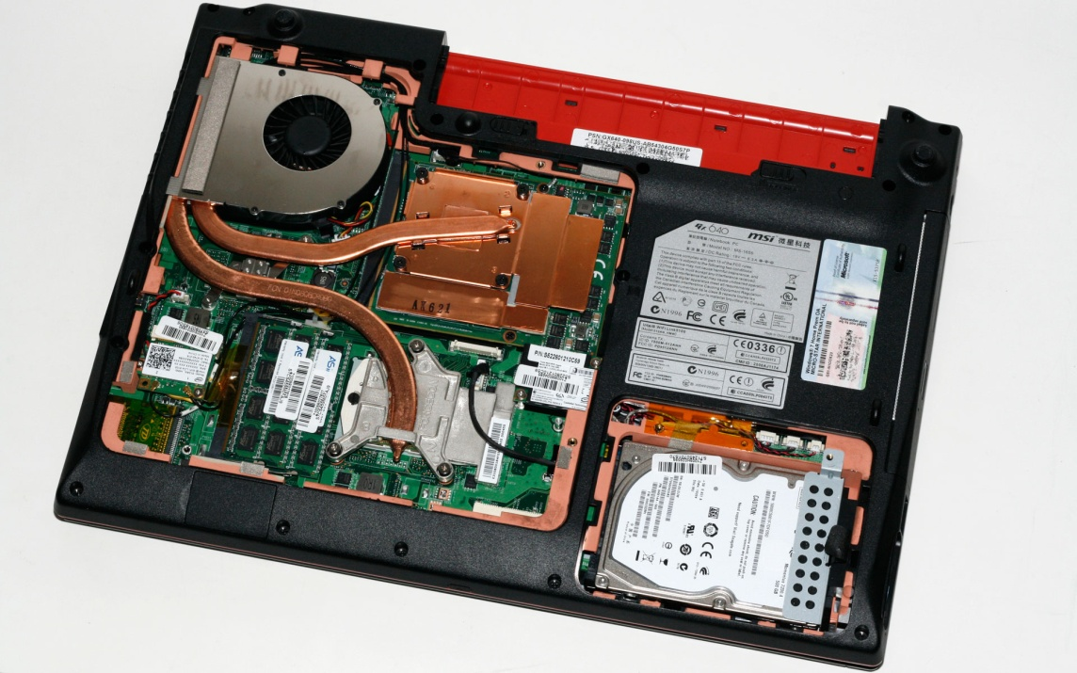
Design Implementation
CPU
Location Inside Computer
Processor
Fan Heat Exchanger
Thermal Connections
Use of Thermal Grease at Interfaces
Fan Heat Exchanger
http://images.anandtech.com/galleries/703/msi-gx640-22-inside-3d.jpg

Slide 16
Special Thanks
Friends and Families
Industry
Jered Wikander (Industry Advisor)
Intel (Sponsor)
Faculty
Huafen Hu, PhD (Faculty Advisor)
Faryar Etesami, PhD (Capstone Director)

Slide 17
Questions

