Slide 1
Bamboo Bike Capstone
Team Members
Camrun Arkills
Kyle Heitmeyer
Fay Gibson
Matt Brown
Faculty Advisor
Hormoz Zareh , PhD
Associate Professor of Mechanical Engineering
Industry Advisor
Alexi Lamadrid
Owner, Bamboo’d Gear

Slide 2
Outline
Mission Statement
Product Design Specification
Final Design
Design Evaluation
PDS Evaluation
Q & A

Slide 3
Mission Statement
To design and construct a low cost, reliable, and desirable bike frame compatible with off the shelf components made from bamboo stalks.

Slide 4
PDS Summary
Build frame and assemble components in 25 man hours or less
Stay within a $155 budget for frame parts and materials
Assure the bike can support riders of various sizes
The bike must be aesthetically pleasing to the eye

Slide 5
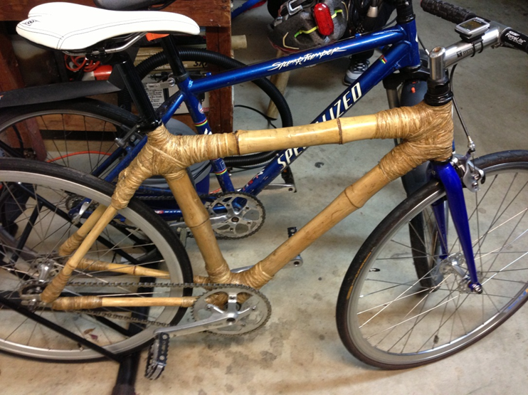
Current Design
Bamboo tubing
Joints wrapped with hemp strands soaked in an epoxy resin
Metal inserts for seat tube, bottom bracket, dropouts and headset.
~50 hrs build time
Single Gear Drive Train
Parts Cost ?????

Slide 6
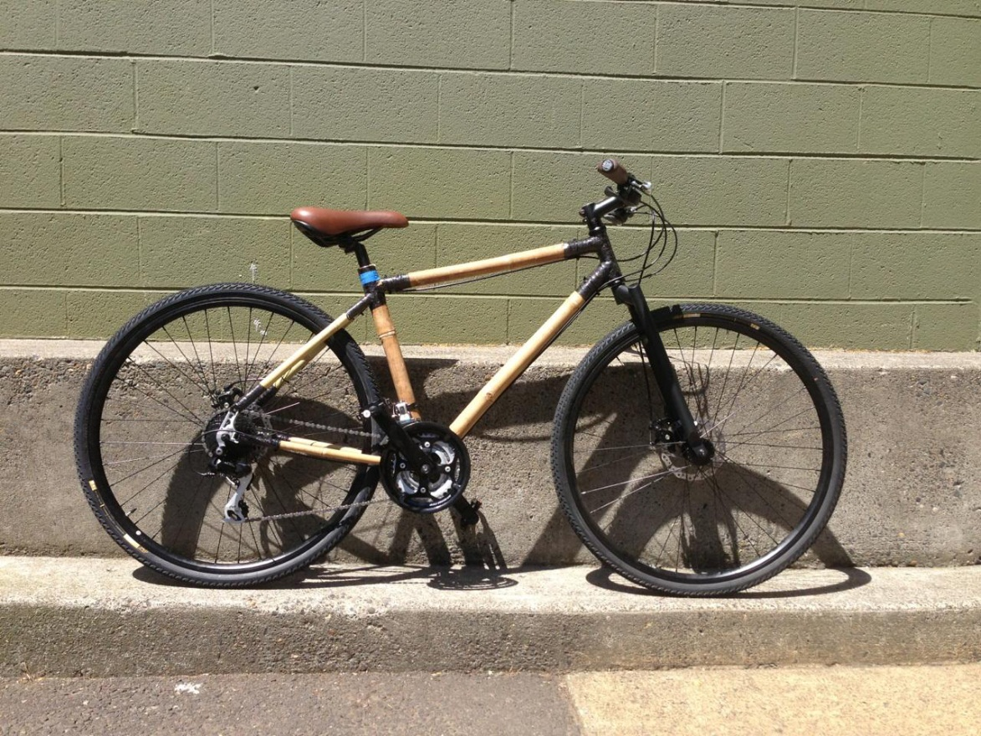
Final Design
Bamboo tubing
Joints wrapped in carbon fiber strips coated in an epoxy/hardener resin
Metal inserts for seat tube, bottom bracket, dropouts and headset.
~10 hr build time
Gear Drive Train ????
Parts Cost $139

Slide 7
Design Evaluation
Bamboo
Pros
  Highly sustainable
  Produces 35% more oxygen and absorbs 4x the CO2 than hardwood trees
  High Strength
    ~30,000 psi in tension
    ~14,000 psi in compression
Cons
  Heavier frame weight compared to its aluminum counterpart
  Mechanical properties vary between species

Slide 8
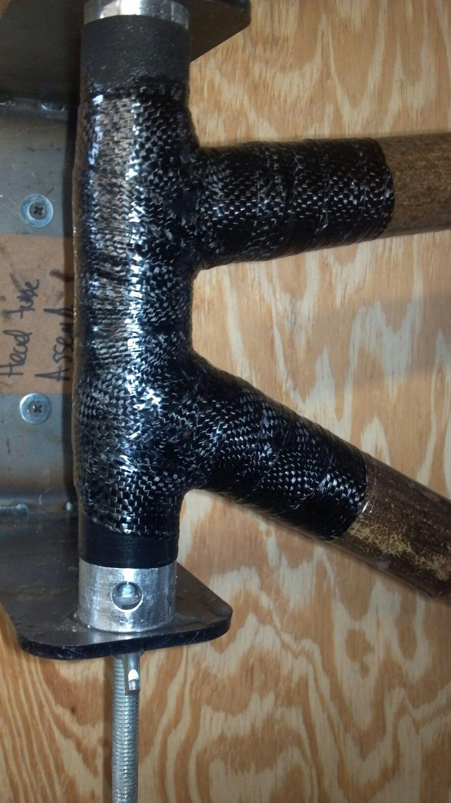
Carbon Fiber Webbing
Pros:
  High Strength
  Low Weight
  Wider strands allow quicker wrapping time
Cons:
  Not readily available in small quantities
  Expensive

Slide 9
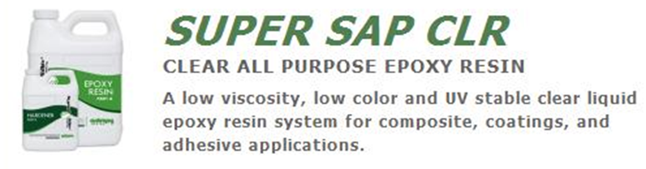
Super Sap CLR Epoxy w/FAST Hardener
Pros
  Made from biobased renewable materials
  UV Stability
  High Tensile and Compression Strength
Cons
  7 day recommended cure time
  Can be hazardous if proper safety precautions are not met
  48 oz Kit - $47.95

Slide 10
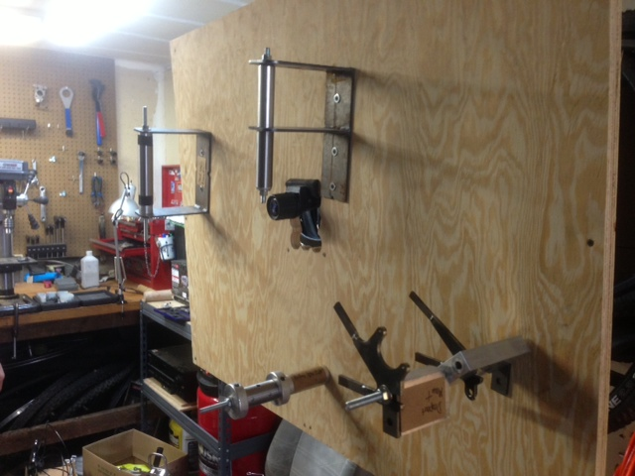
Jig Assembly
Pros
  Upright position allows for easier access to entire frame
Cons
  Wood support board is less sturdy and requires holes to be drilled manually to attach jig components

Slide 11
PDS Evaluation
Requirements | Goal | Actual
Assembly Time | < 25 hours | 10 hours
Budget | < $155 | $139
Rider Capacity | ??????? | ?????
Aesthetics | Easy on the eyes | You be the judge!

Slide 12
Questions??

