Slide 1
PECO Capstone Project
Ryan Ernst
Jeff Bennett
Kiehl McIntyre
Jonathan boschiero
Faculty Advisor:
David Turcic
Contact Engineer:
David Cifuni
Portland State university
Me 493 2008

Slide 2
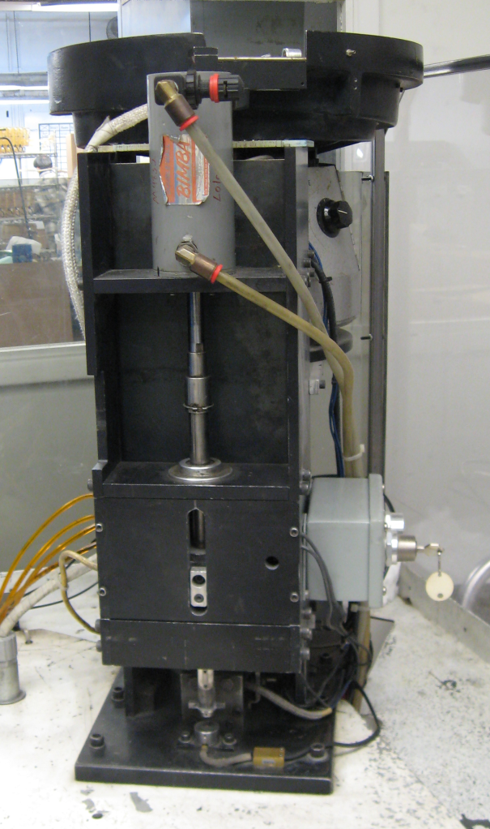
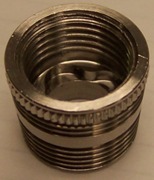
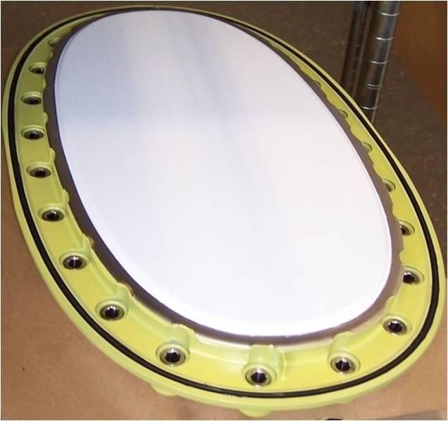
Introduction
Lola is a manufacturing device that presses metal inserts into nylon doors.

Slide 3
Existing Problems
Two types of inserts are used and Lola cannot tell them apart.
The inserts are not consistently heated to the target temperature.
Removing inserts from the heating tube is time-consuming and unsafe.
Inserts are oftentimes not pressed to a sufficient depth.

Slide 4
Design Solutions
A solution for each problem.

Slide 5
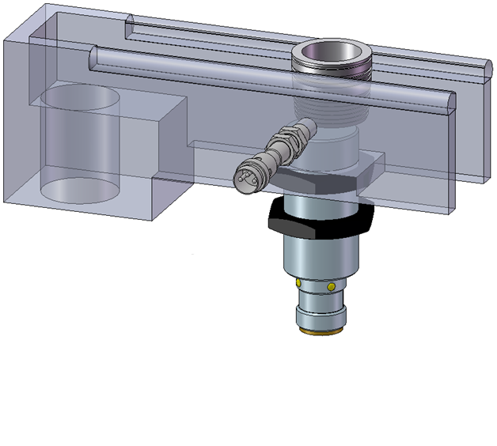
Insert Identification
Proximity sensor detects presence of insert
Aluminum selective proximity sensor detects presence of aluminum
If insert type is incorrect alarm is triggered and feeding haulted
Proximity Sensor
Aluminum Selective
Proximity Sensor

Slide 6
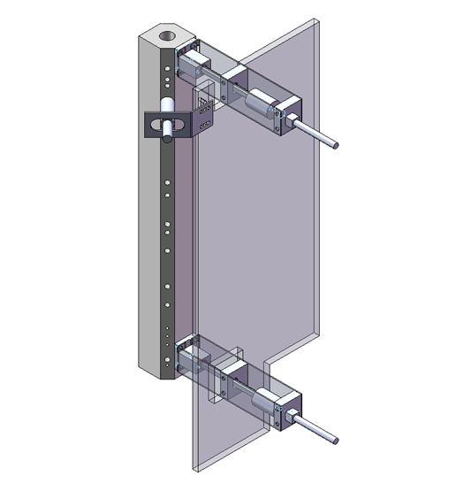
Heating Tube Improvements
Significant heat loss due to free convection
Inserts at the bottom are actually cooling off
Two doors prevent air flow through the tube
Photoelectric sensor controls feeding of inserts
Photoelectric
Sensor
Door
Assemblies

Slide 7
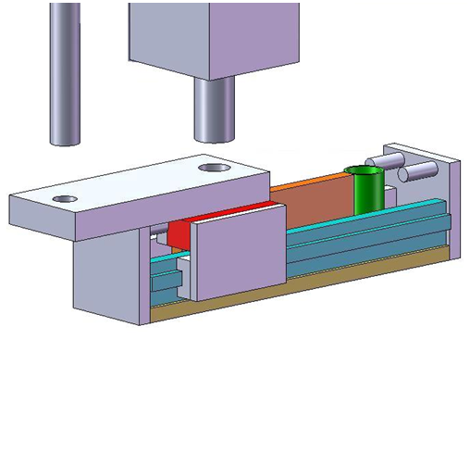
Heating Tube Evacuation
Existing system has stop rail and rear hole in shuttle
Widen rails supporting shuttle
Install tube allowing inserts to fall through
Redesign stop rail to extend to evacuation tube
Heating Tube
Shuttle
Evacuation Tube

Slide 8
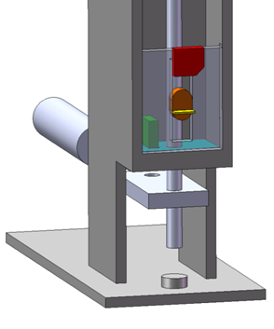
Pressing Depth Monitoring
Install pair of displacement sensors
Measure piston travel relative to door surface
Control system alerts when piston travel is insufficient
Displacement
Sensors

Slide 9
Concept Verification
Installation could not be completed before the project deadline so alternate verification methods were used.

Slide 10
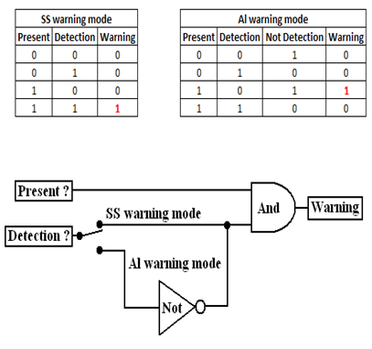
Verification of Insert Identification
Truth tables formulated
Prototype constructed and tested
Performance was consistent with expectations

Slide 11
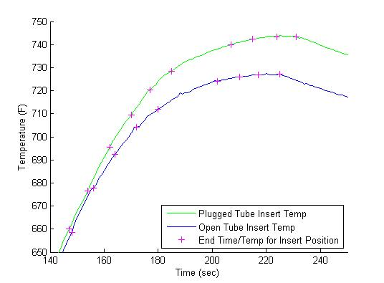
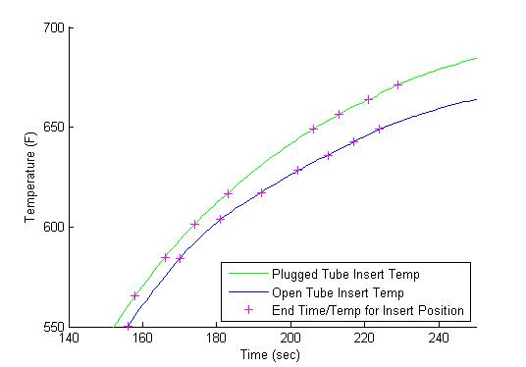
Verification of Heating Tube Improvements
Aluminum Trial
Steel Trial
22 °F
Gain
16°F
Gain
Experimental data was analyzed
Heating tube performance improved

Slide 12
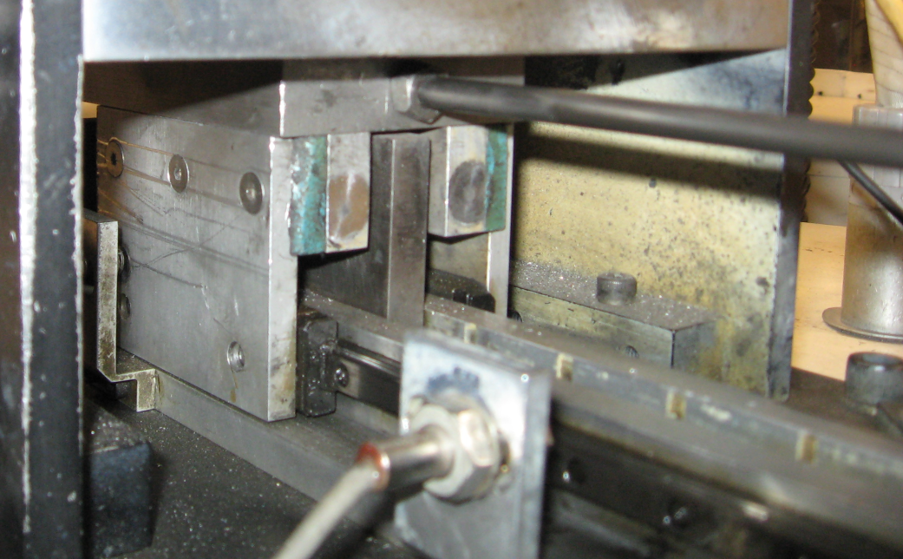
Verification of Heating Tube Evacuation
Redesign compared with existing system
Shuttle slides inserts along stop rail currently
No foreseeable reason for failure of new system
Shuttle
Stop Rail

Slide 13
Accomplishments
Our team performed numerous experiments to gather relevant data.
We feel that we correctly diagnosed the cause of the inconsistent insert temperatures.
We designed effective solutions to satisfy our customer’s desires.

Slide 14
Lessons Learned
Real world problems are not necessarily well defined.
Experiments should be well prepared and documented to avoid unnecessary repetition.
Sometimes a solution costs more than the problem.
Collaborating with a second party entails not only benefits but also many complications.

Slide 15
Summary
Our group undertook a project to address certain inadequacies in Lola’s current design.
We conducted experiments to characterize the heating tube performance.
Three major improvements to Lola’s system were designed and we feel confident that they will work.
Every member of our team gained valuable experience in real-world engineering.

Slide 16
Thank you.
We will be happy to answer any questions.

