Slide 1

2008 NASA team
Team members:
Alex Baker
Ryan Bailey
Donald Bell
Nathan Wenk
Faculty Advisor: Jim Van Winkle, PhD
http://web.cecs.pdx.edu/~micro-g/microg2008/SEED/

Slide 2
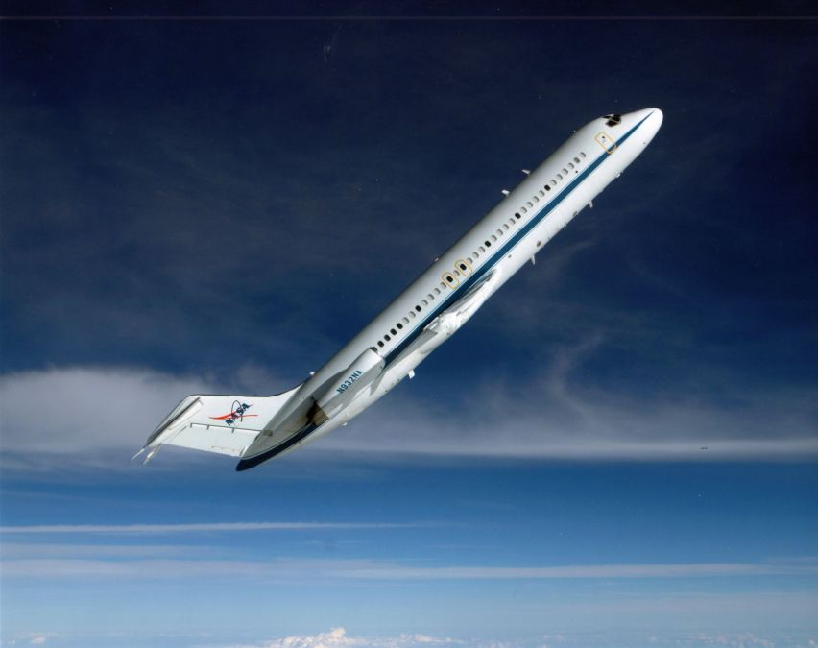
NASA SEED Program
Introduction/ Background | Design | Fabrication/ Assembly | Conclusion/ Results
Angle of Repose of Lunar Regolith Simulant JSC-1A in 1/6 g
Application of developing world terrestrial water treatment to the lunar outpost
CEV EVA Umbilical Behavior and Management
Characterization of a Commercial Off-The-Shelf Treadmill
COTS Tools/Hardware for EVA use
Droplet Coalescence
Effects of 0G or 1/6G on Radio Frequency Identification (RFID) Data Accuracy
Impact ground reaction force on different surface types in a lunar gravitational environment

Slide 3
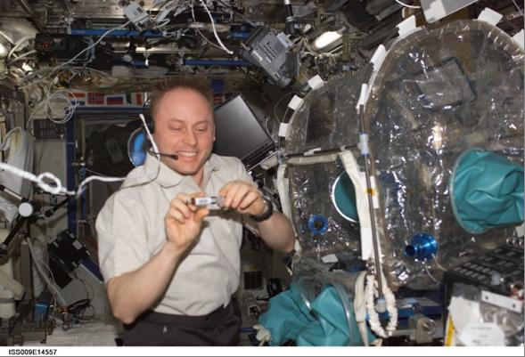
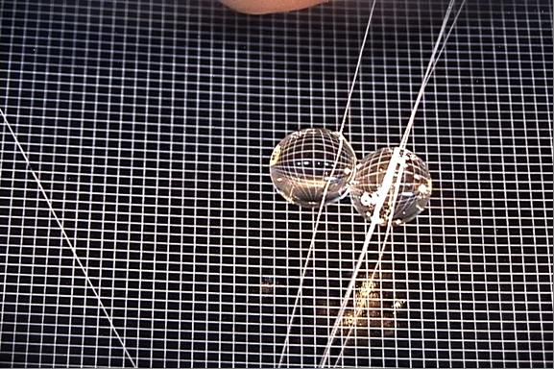
FMVM
Introduction/ Background | Design | Fabrication/ Assembly | Conclusion/ Results
Fluid Merging Viscosity Measurement.

Slide 4
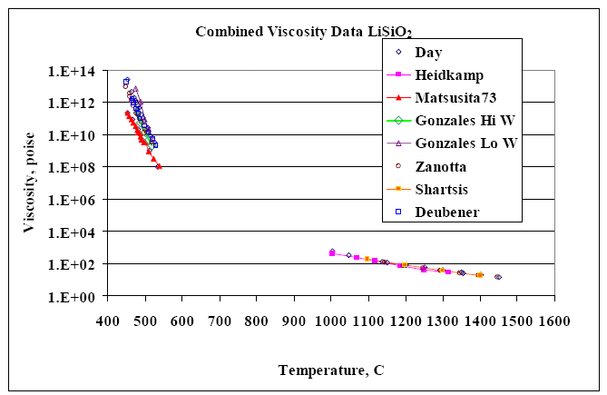
FMVM
Introduction/ Background | Design | Fabrication/ Assembly | Conclusion/ Results

Slide 5
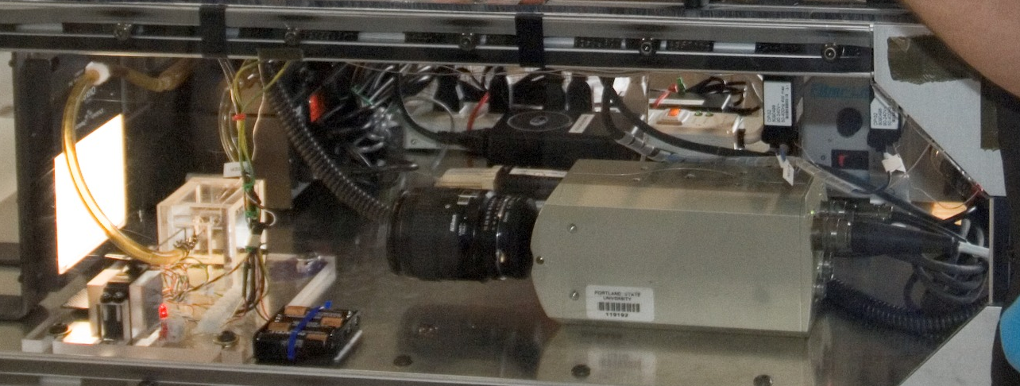
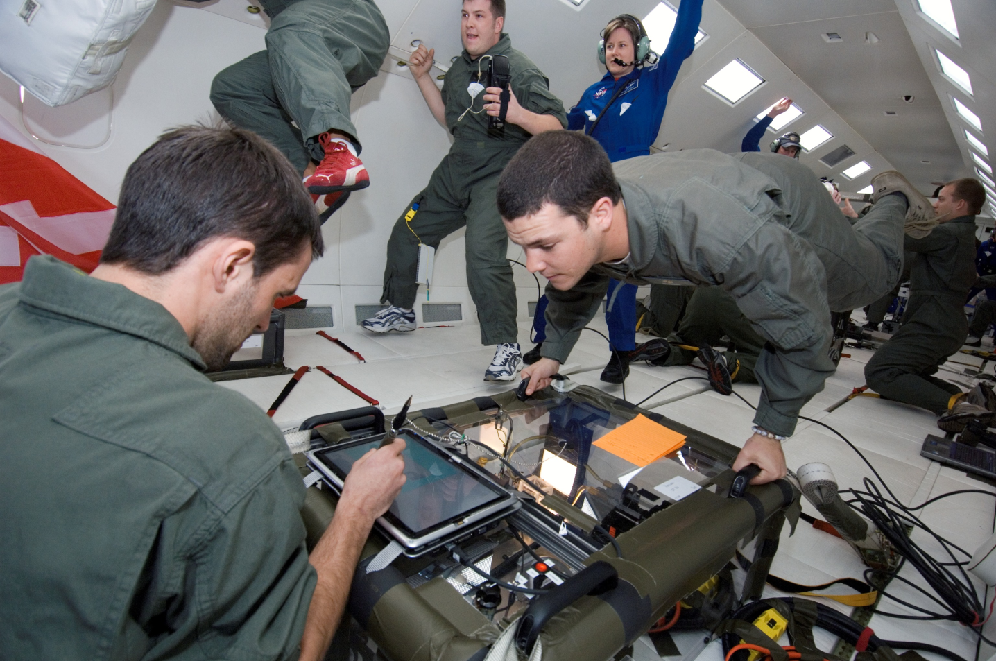
DCMG
Introduction/ Background | Design | Fabrication/ Assembly | Conclusion/ Results

Slide 6
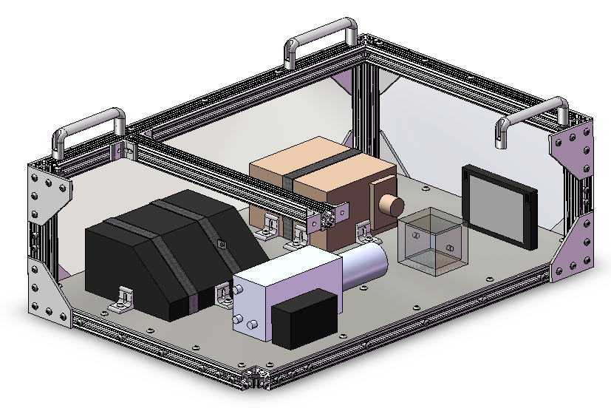
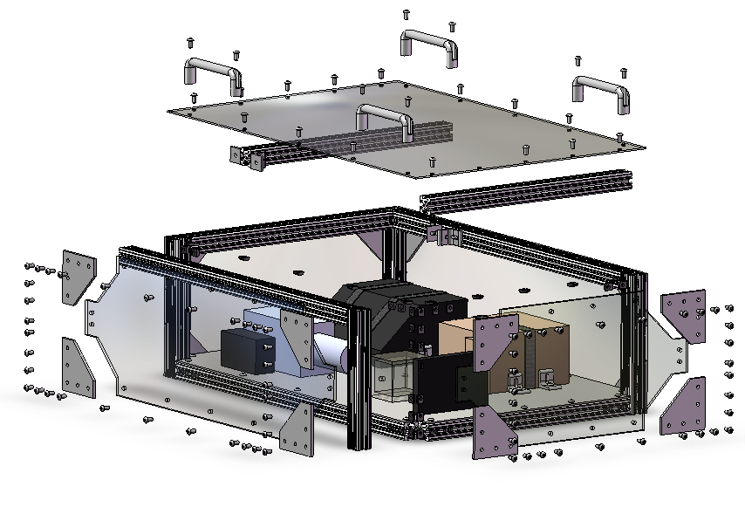
Final Design
Background/ Introduction | Design | Fabrication/ Assembly | Conclusion/ Results
Overall Assembly Weight (lbs.): | 111 lbs
Assembly Dimensions (L x W x H): | 12” x 24” x 36”
Power Requirement: | 115 V AC 5.5 Amps

Slide 7
Structural Verification
Background/ Introduction | Design | Fabrication/ Assembly | Conclusion/ Results
Direction | Required G Force Load
Forward (+Y) | 9
Aft (-Y) | 3
Lateral (+/-X) | 2
Up (+Z) | 2
Down (-Z) | 6
Full structural analysis with worst
case scenario loading.
Design Calculations including:
    Attachment of components to frame
    Full assembly analysis under g loads
    Aircraft floor attachment
    External/internal impact analysis
    Floor load
Factor of Safety Table

Slide 8
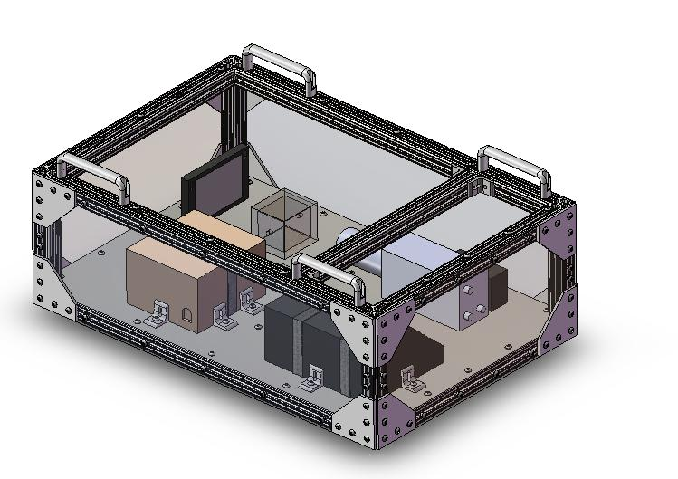
Top Level Design Decisions
Background/ Introduction | Design | Fabrication/ Assembly | Conclusion/ Results
Double enclosure of test fluids- sealed test cell and protective paneling surrounding the frame
Test cell geometry
Single level equipment configuration
Reinforcing cross beams
Aluminum mounting plate
Open fluid circuit
Actuated fluid delivery needle
Fiber optic light panel

Slide 9
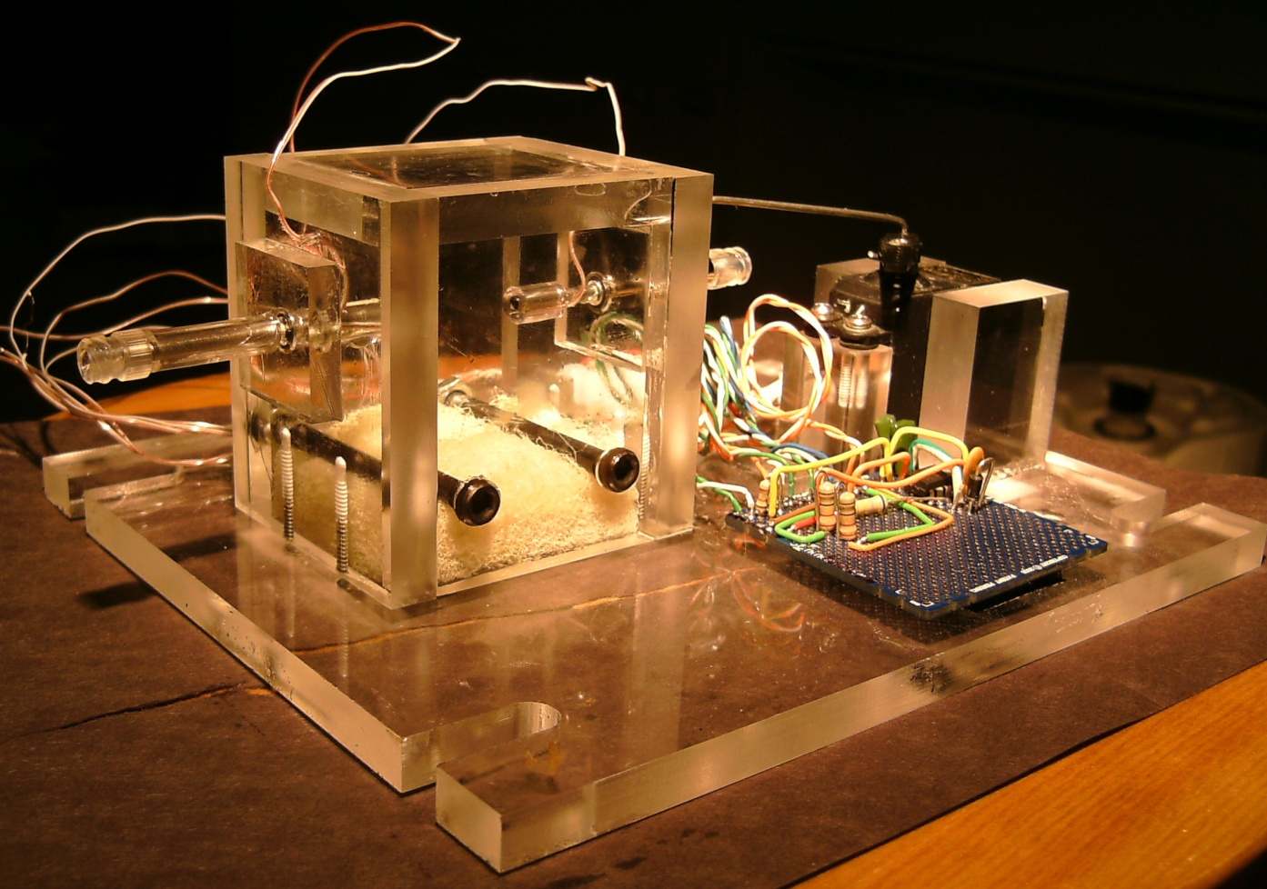
Fabrication
Background/ Introduction | Design | Fabrication/ Assembly | Conclusion/ Results
Test Cell – Structure – Components - Electrical

Slide 10
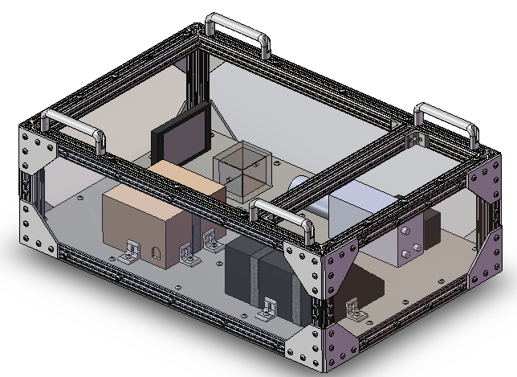
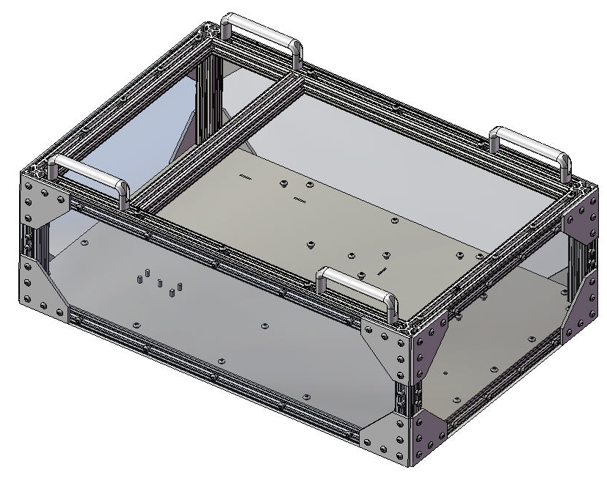
Fabrication
Background/ Introduction | Design | Fabrication/ Assembly | Conclusion/ Results
Test Cell – Structure – Components - Electrical
Insert Picture of Structure Here

Slide 11
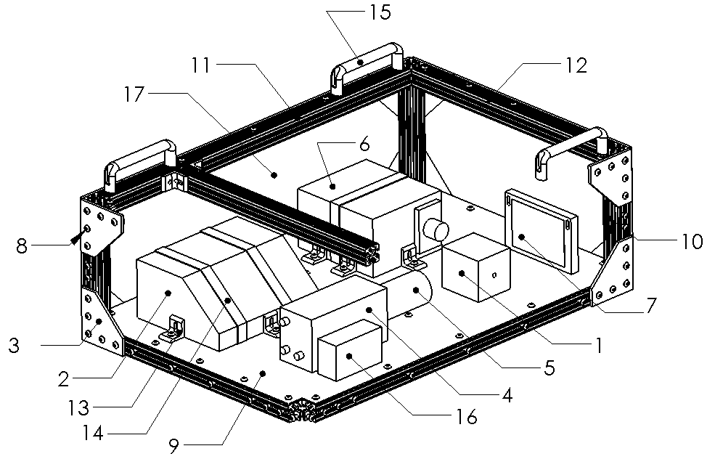
Fabrication
Background/ Introduction | Design | Fabrication/ Assembly | Conclusion/ Results
Test Cell – Structure – Components - Electrical
Insert Picture of Components Here

Slide 12
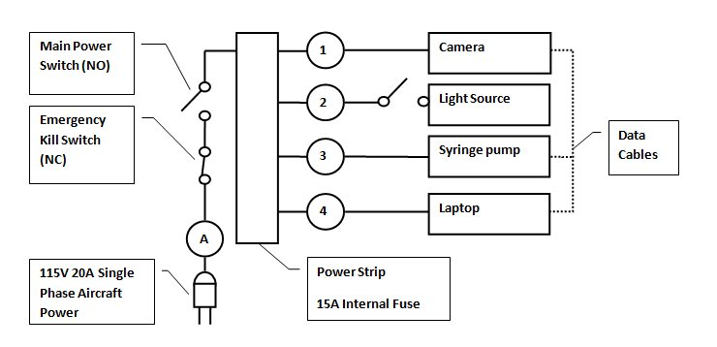
Fabrication
Background/ Introduction | Design | Fabrication/ Assembly | Conclusion/ Results
Test Cell – Structure – Components - Electrical
Insert Picture of Electrical Here

Slide 13
Experiment Testing
Background/ Introduction | Design | Fabrication/ Assembly | Conclusion/ Results
Individual Components Tested
Fluid flow rate
Video capture system
User interface
System Tested Before Flight
No fluid
Procedure practiced to set experiment routine
Looked for potential issues

Slide 14
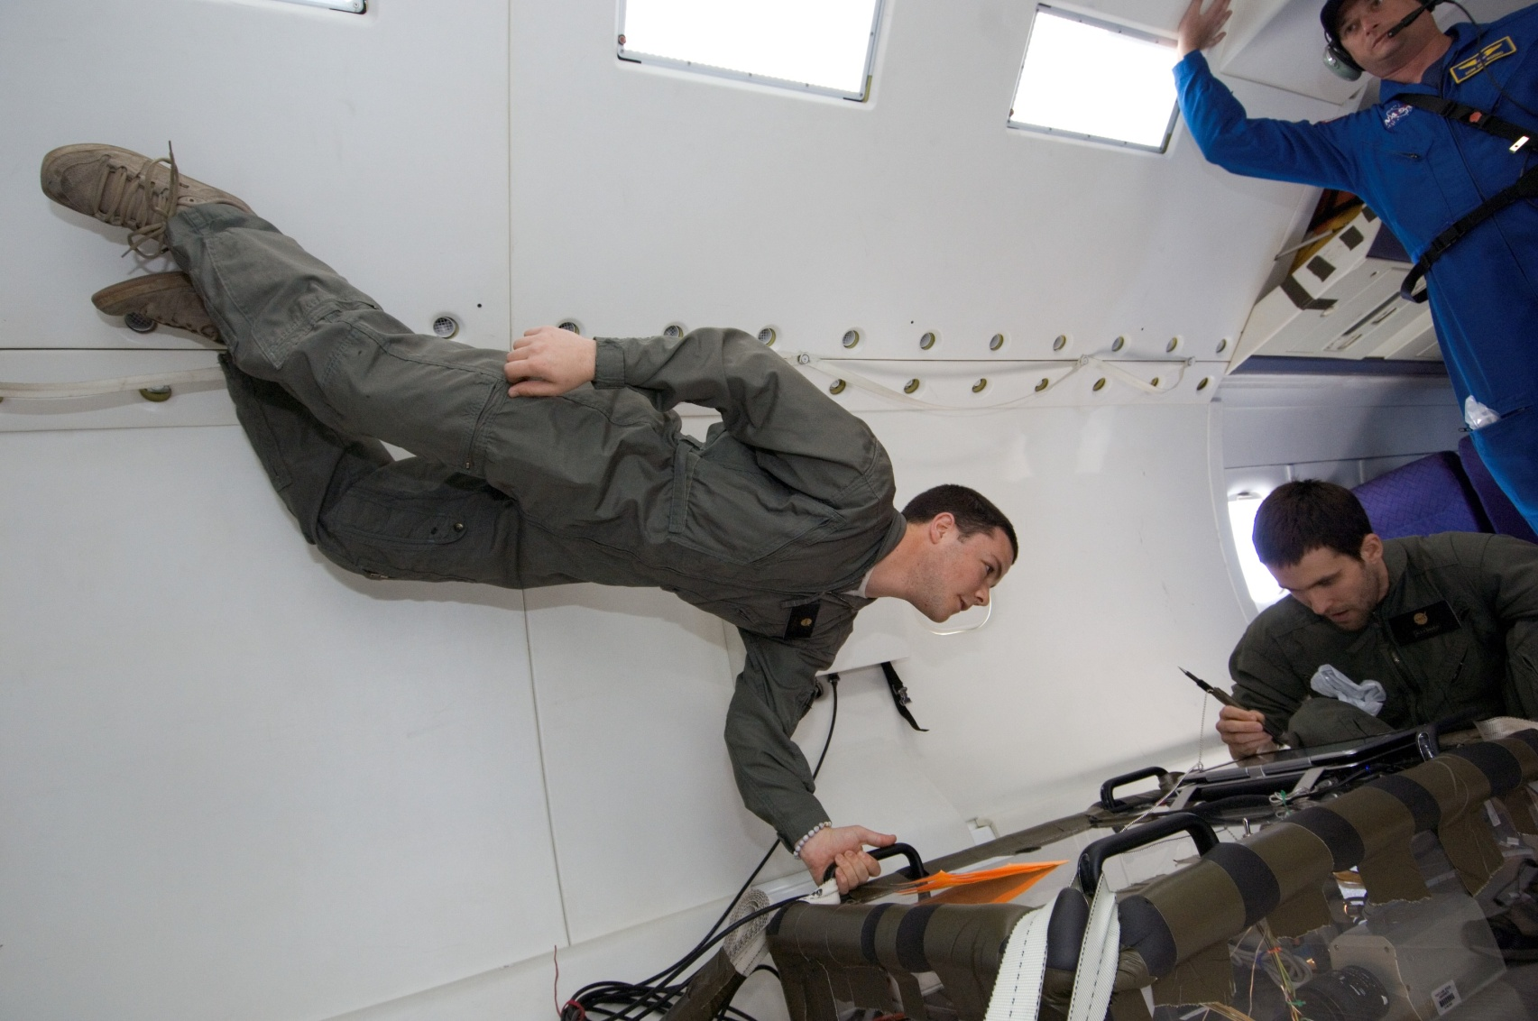
System Tested In-Flight
Background/ Introduction | Design | Fabrication/ Assembly | Conclusion/ Results

Slide 15
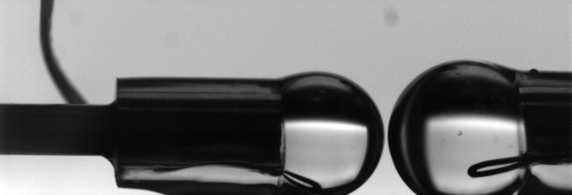
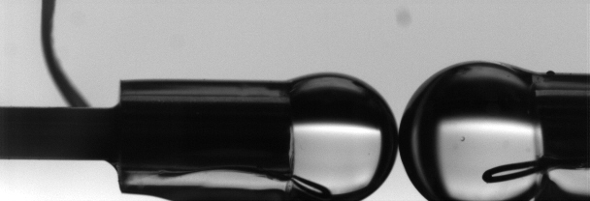
Video Results
Background/ Introduction | Design | Fabrication/ Assembly | Conclusion/ Results
Drops before contact
Drops at contact
16 videos from 60 parabolas
SUCCESS!

Slide 16
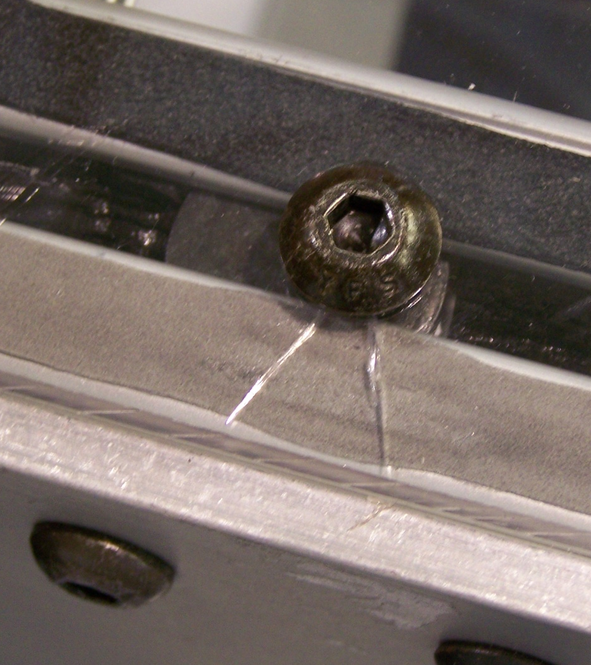
What Could Be Improved
Background/ Introduction | Design | Fabrication/ Assembly | Conclusion/ Results
Easier access to experiment
Easier access to test cell
Force distributing strip
Streamlined control interface

Slide 17
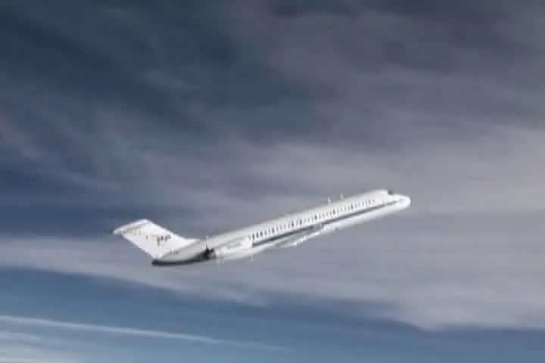
Background/ Introduction | Design | Fabrication/ Assembly | Conclusion/ Results
Thank you
Questions?

