Slide 1

Cross-Country Sit Ski
Cody Barnett
Betsy Camp
Josh Metzler
Robbie Quesada
Mark Scheel
Alex Triplett
Academic Advisor: Dr. Hormoz Zareh
Industry Advisor: Jennifer Armbruster
Sponsor: PSU Inclusive Recreation

Slide 2

Agenda
Project Background
Key Design Requirements
External Search
Final Design
Design Analysis
Product Testing
Notes:
Agenda
What we are going to talk about
Take you through what our customer needs, our design process, and talk about our final product

Slide 3
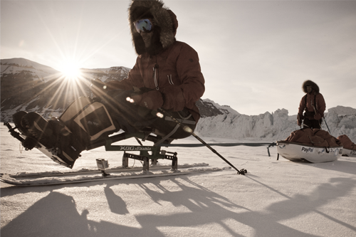
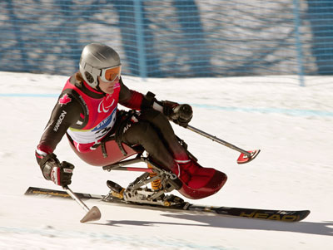
Project Background
What is a sit ski?
  Enables user to ski from a seated position
  Cross country and downhill models
Notes:
Project Background
What is a sit ski? A device that allows user to ski from a seated position
Used by people in wheelchairs
Quadriplegics, paraplegics, amputees, and people with MS

Slide 4
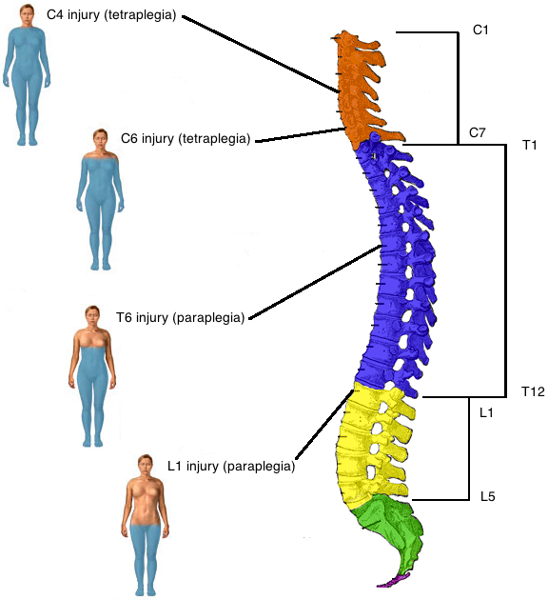
Project Background
Sponsored by the Inclusive Rec Department at PSU
  Want a versatile sit ski that can accommodate a wide range of user injuries
Notes:
Primary Customer
Inclusive Rec Department at PSU
Dept wants a sit ski available to users who are interested in trying the sport
Most sit skis custom built to a specific injury
Dept funding for equipment is limited, so Inclusive Rec tasked our team to design and build a single sit ski that could be used by the widest possible range of users
Sit ski had to accommodate spinal injuries from the T12 to C5 vertrabrae (explain photo)
Main difference is the amount of abdominal functionality a person has – as spinal injury goes higher, upper body function decreases
Amount of arm hand hand functionality decreases with higher level spinal injuries too
Sit skiers with high level injuries don’t have much abdominal strength and will likely need to be secured to seat back
Sit skiers with lower level injuries will probably choose to be free of the seat back so they can lean forward and put core strength into propulsion

Slide 5
Mission Statement
  The objective of the PSU Sit Ski Team is to design and build a cross-country sit ski for the PSU Inclusive Rec Department. The sit ski must accommodate varying user size, weight, and injury type. The product and supporting documentation will be delivered to Inclusive Rec in June of 2012.

Slide 6
Key Design Requirements
Seat back height adjusts from 20” to 25”
Seat back reclines from 90° to 100°
Bottom of seat adjusts from 0° to 10°
Footrest adjustable
Restraints for T12 to C5 injuries
Cost less than $1500
Notes:
Key Product Design Specifications
Adjustability and versatility take precedence over performance
Took input from Inclusive Rec and made quantifiable design requirements:
Seat back adjusts from 20” to 25”
Seat bottom adjusts from 0deg to 10deg
Seat back reclines from 90deg to 100deg
Footrest adjustable
Restraints for T12 to C5 injuries
Lap and foot belts w/ optional torso restraints
Cost less than $1500
Weigh less than 20lb
Not a key requirement…

Slide 7
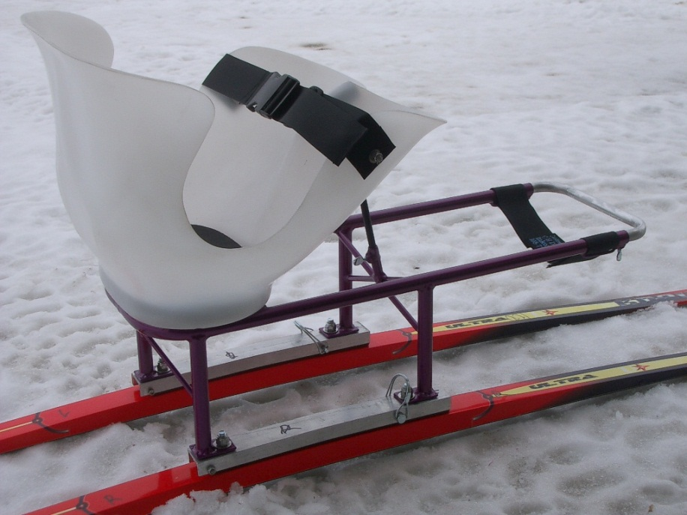
External Search
Teton Nordic Sit Ski
  Telescoping footrest
  Molded seat is fitted to specific user
  Frame is custom-built

Slide 8
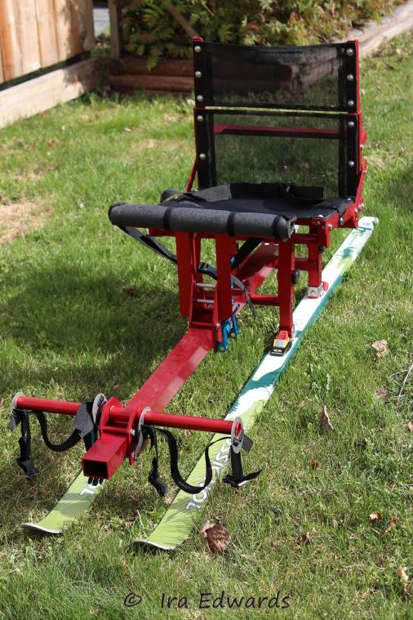
External Search
Central Cross Country Ski
  Footrest inadequate
  Restraints do not accommodate higher-level injuries
  Users have noted rubbing issues with seat material

Slide 9
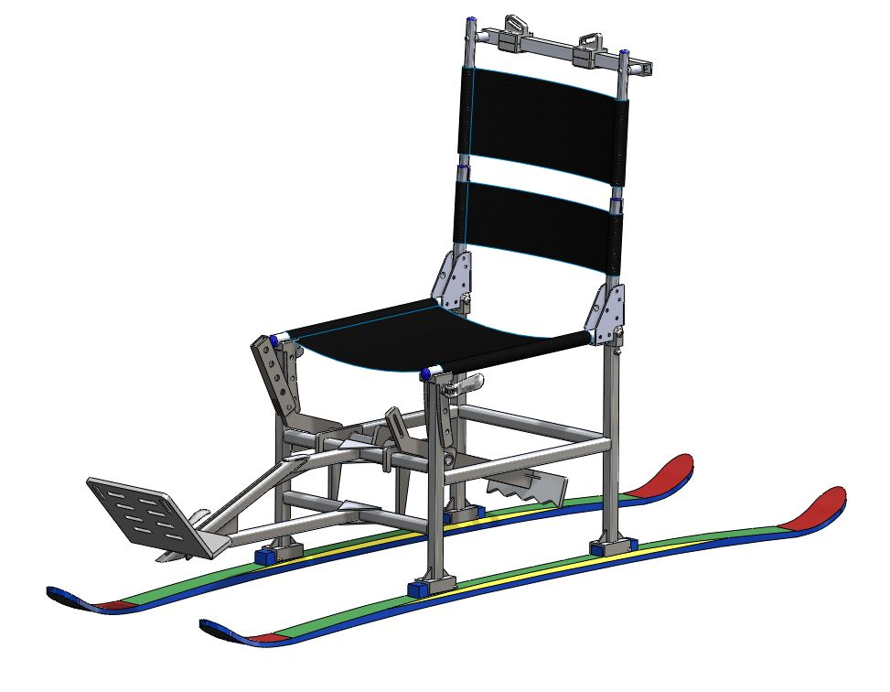
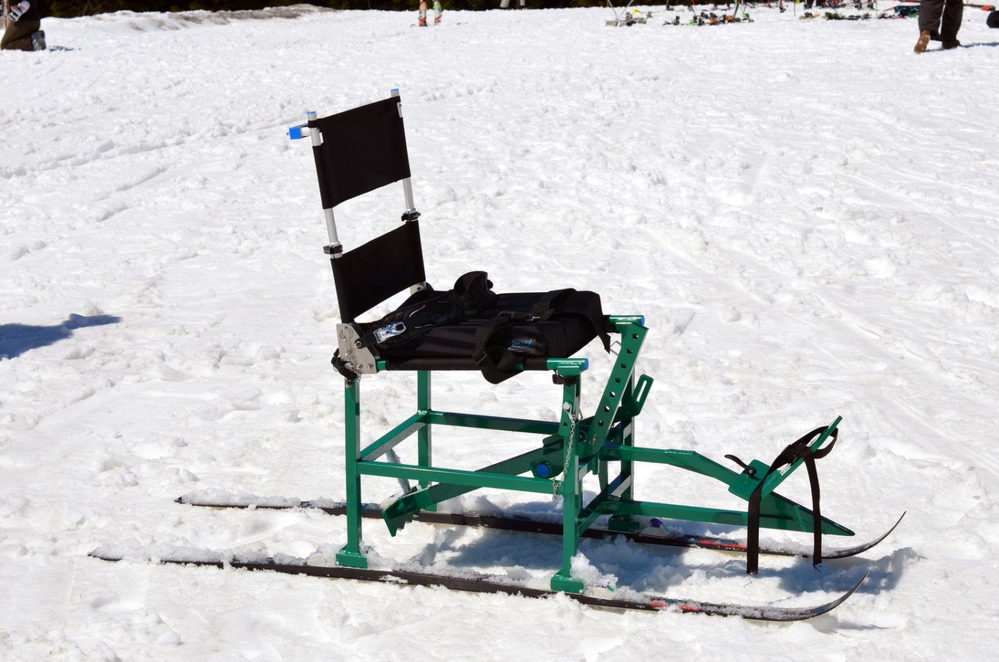
Final Design
Notes:
Final Design
(Show CAD model and actual model on same slide)
Details about construction
A welded aluminum frame (6061 T6 Al)
Gussets for reinforcement
Avoided tube bending in the design to save on cost and specialized manufacturing
Used welded bushings in tubes that would be bolted or pinned
Thanks to Evan Waymire and staff at Treske Precision for reviewing our design
Pinned connections help to make adjustability
Determined ideal frame dimensions, making compromises on conflicting design requirements:
Seat height should be fairly close to the same as a wheelchair to facilitate easy transfer
Get a more efficient pole stroke when user is higher off the ground
Too high of a seat starts to present a tipping hazard
Seat width also must make compromises between ergonomics and safety
Survey of users indicated a narrower sit ski made it eaiser to use poles effectively
Wider ski was better for stability
Delrin bushings aid in telescoping feature of the seat back
Reduce slop
Hand brake was not initially requested by the customer, but team determined it to be an important safety feature – inlusive rec agreed
Powder coated frame
Seat back tubes were anodized because of the moving parts

Slide 10
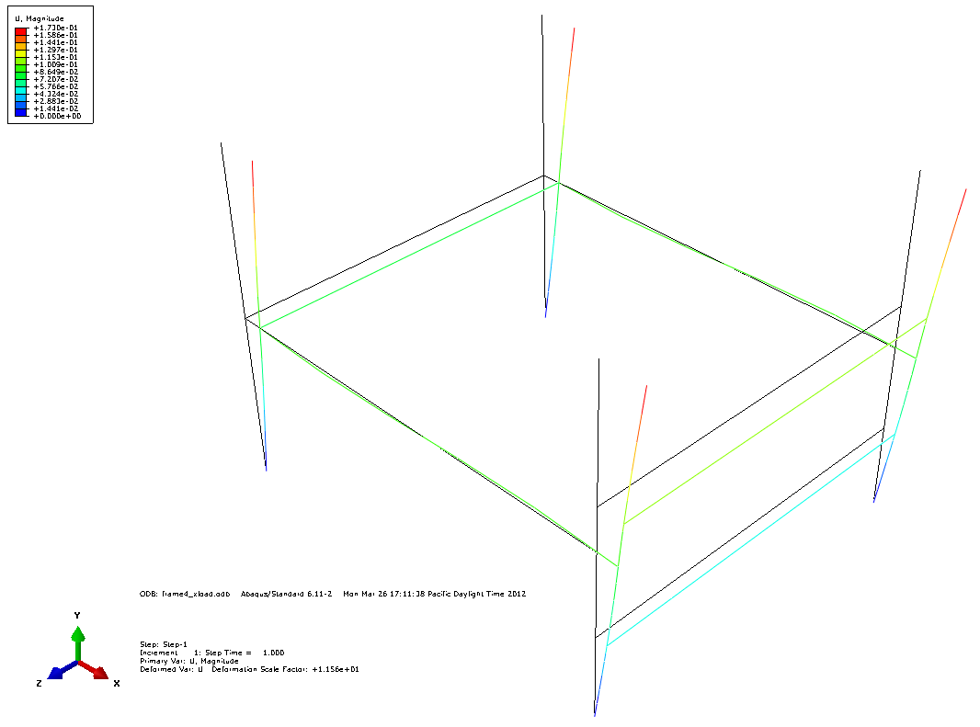
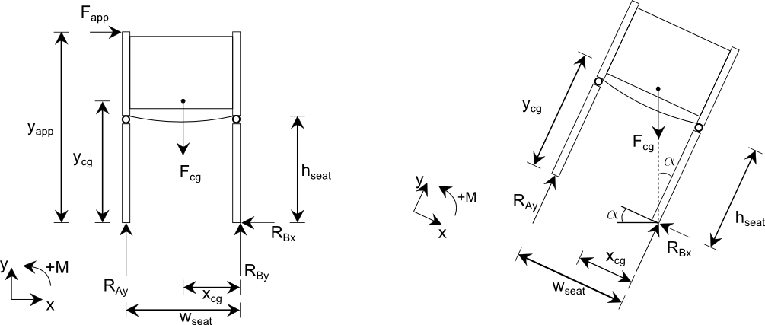
Theoretical Analysis
Types of engineering analysis leading to final design
  Finite Element Analysis
  Tip analysis
  Ergonomic analysis
  Weld analysis
  Tube bending analysis
  Tube buckling analysis
Notes:
Details about theoretical analysis (show figures and FEA pictures)
Stability analysis to determine ideal frame dimensions
Max stresses in the seat back – seat back will likely be used to push the sit ski; team determined the safety factor wrt max loads the seat will be subjected to
Looked at stresses in the seat bottom given the max user wt
Used finite element software to test support member configurations in the frame; determined maximum deflection and internal stresses
Examined the frames suceptibilty to bucking
Determined FS wrt shear in key load bearing adjustability pins
Determined stresses in the welds of the hand brake when put to use

Slide 11
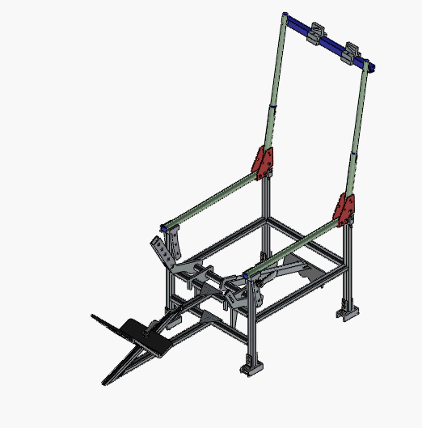
Adjustability
Seat back adjusts from 20” to 25”

Slide 12
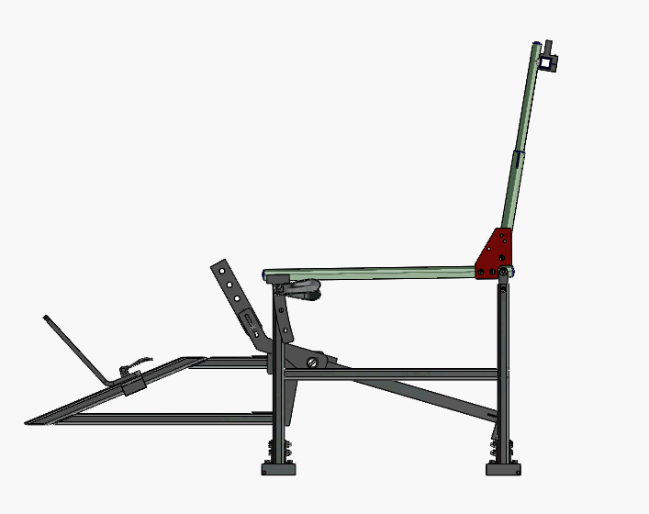
Adjustability
Seat back reclines from 90° to 100°

Slide 13
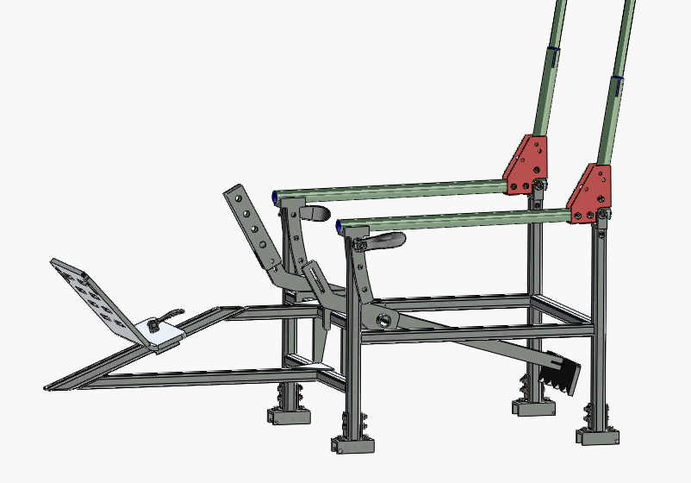
Adjustability
Bottom of seat adjusts to 10°

Slide 14
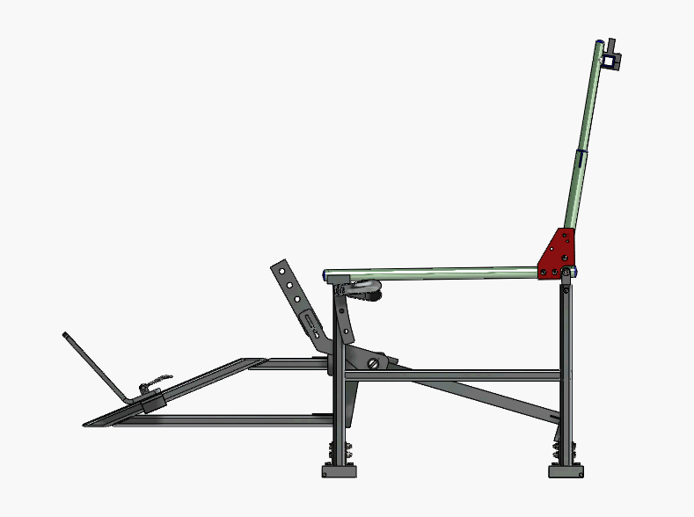
Adjustability
Footrest adjustable

Slide 15
Product Evaluation
Specified adjustability
Pass
Restraints for T12 to C5 injuries
Pass
Total cost less than $1500
Pass
Weight less than 20lb
Fail
Notes:
Specified Adjustability
Restraints for T12 – C5
Cost less than $1500
Less than 20lb
Fails, but we knew or design was sacrificing performance for the sake of comfort and adjustability. We can live with this failure.

Slide 16
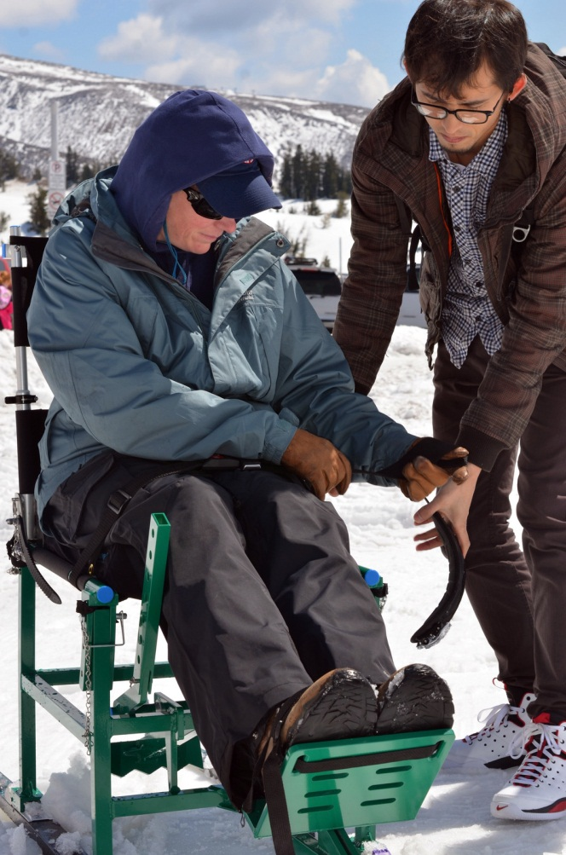
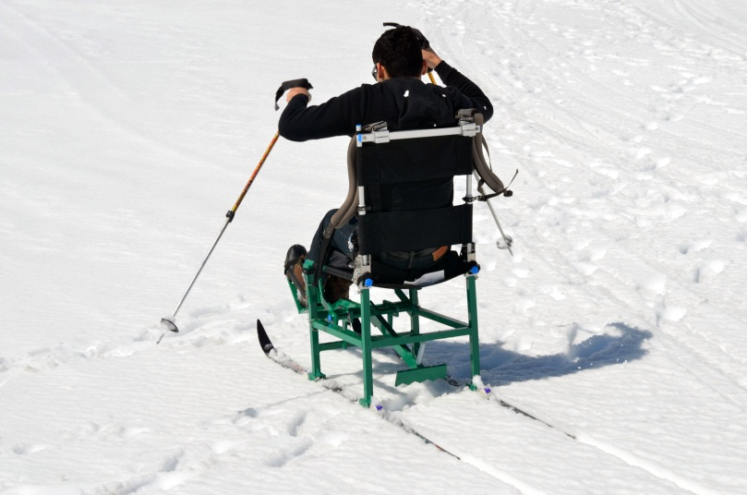
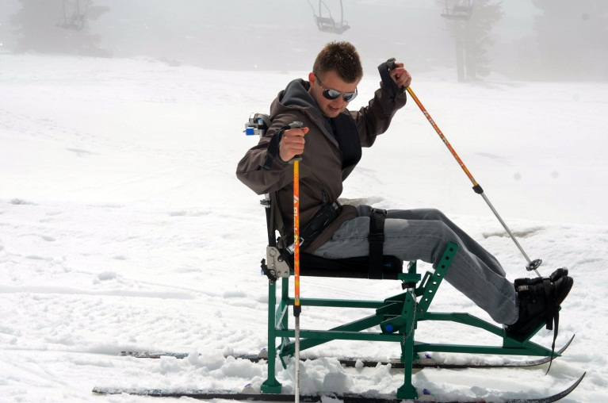
Field Testing
Field testing at Mt Hood…

Slide 17
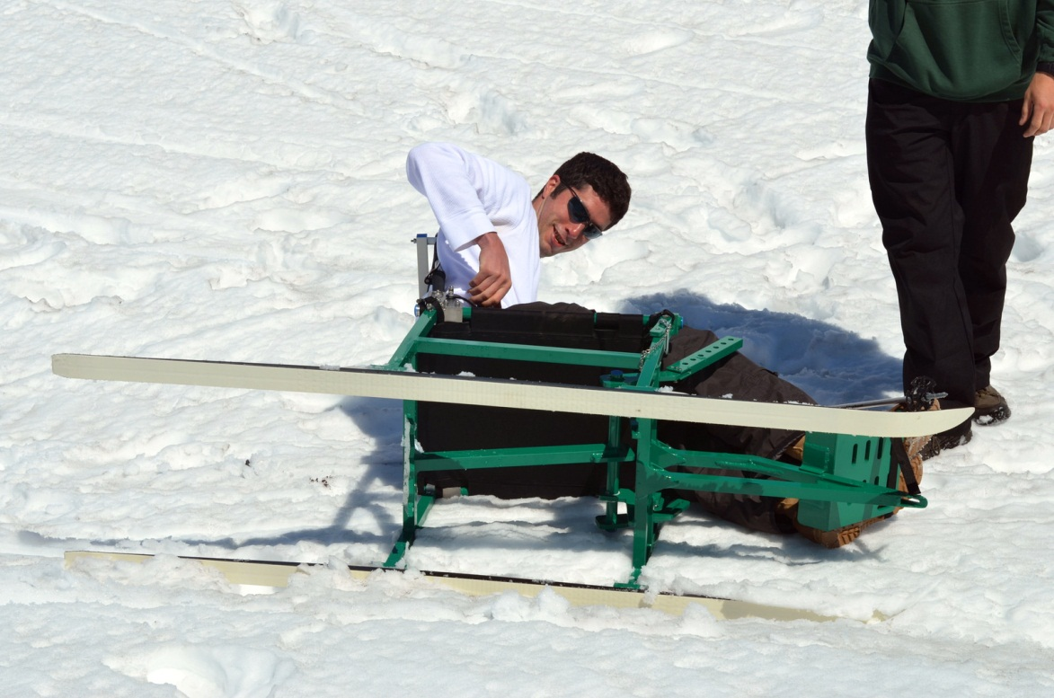
Field Testing
Verified tipping angle of the sit ski

Slide 18
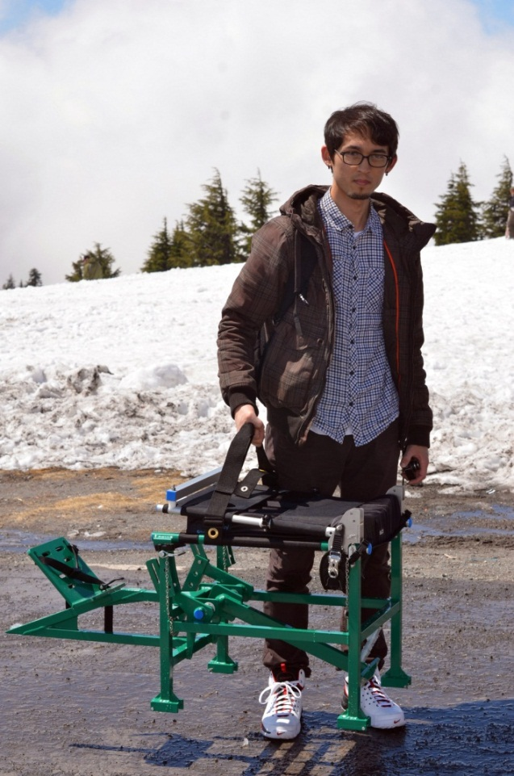
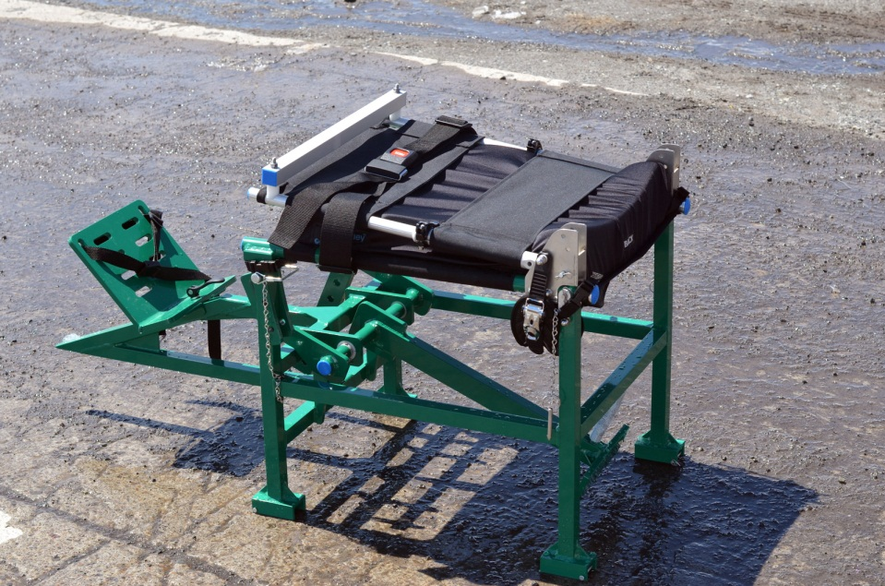
Field Testing
Collapsed for storage and transport

Slide 19



Sponsors
Treske Precision Machining
  Donated fabrication labor
Finish Line Industries
  Donated powder coating and other material finishes
Keen
  Restraints
  Head rest
  Seat Cushion
Next Adventure
  Discounted skis and bindings

Slide 20
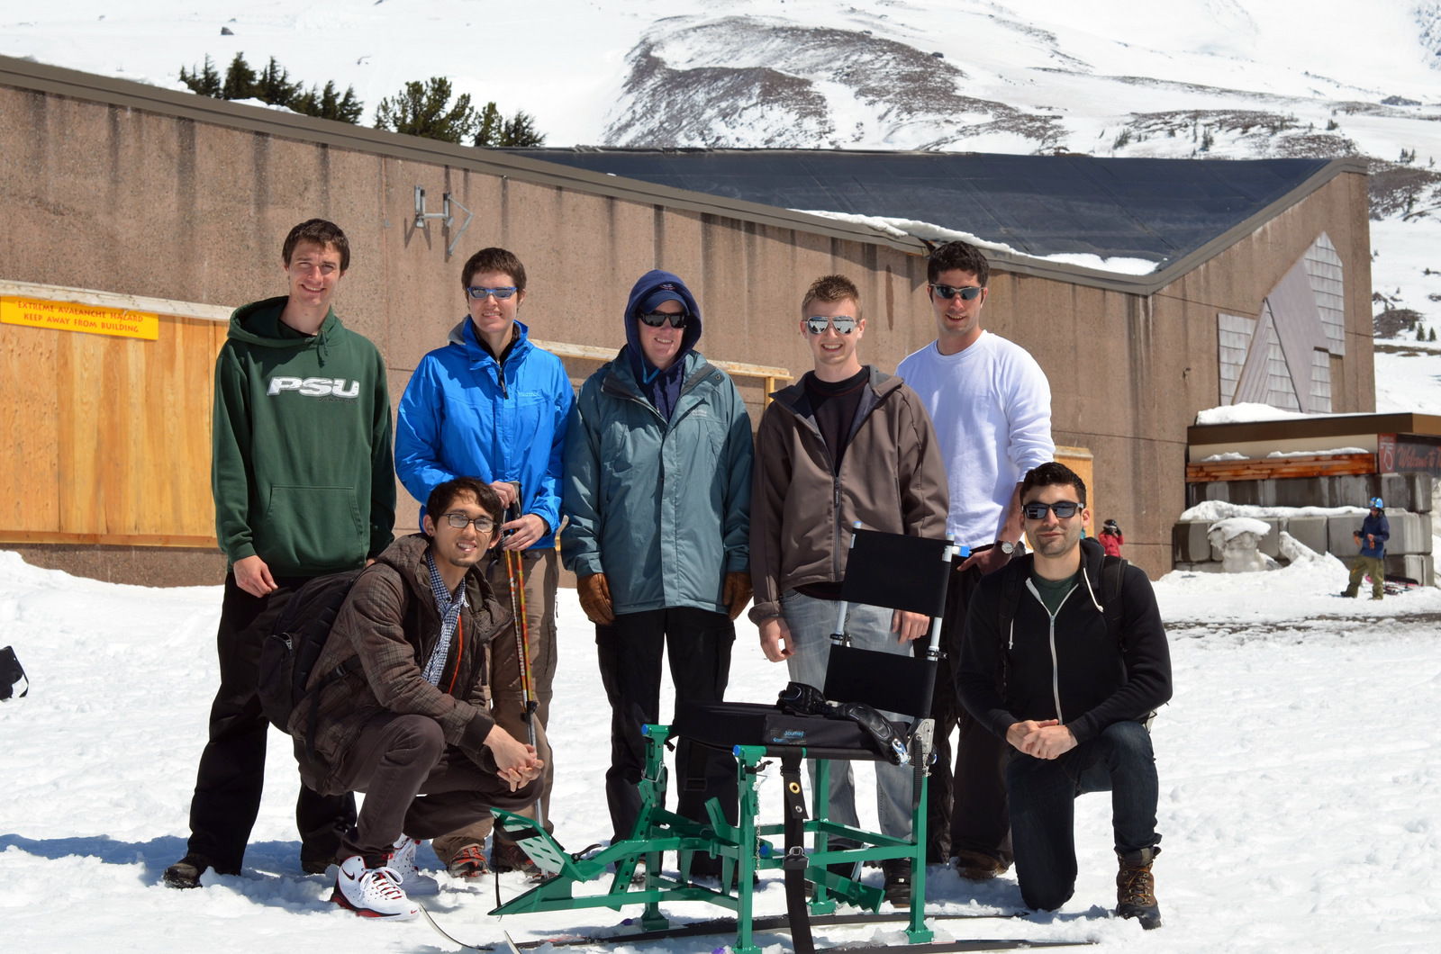
Questions?

