Slide 1

Mt. Angel Abbey Library
HVAC
June – 6th – 2012

Slide 2

Team “M.A.C.H.V.A.C.”
Design Team
Ras Wickramaratne
Santiago Rodriguez
John Slate
Ghassan Mustafa
Ali Alsahaf
Support Team
Client: Victoria Ertelt
PSU Advisor: Dr. David Sailor
Design Advisor: Evan Waymire
Industry Advisor: Ruwan Jayaweera

Slide 3
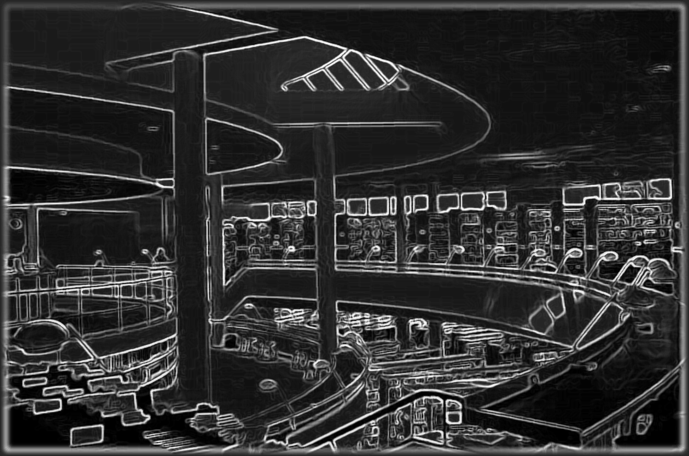
Background
  Designed by modernist Finnish architect Alvar Aalto
  Completed in 1970
  46,000 sq ft., three-story
  Collection of over 5000 rare books and antiquities
  Under-performing HVAC system

Slide 4
Mission Statement
Model an efficient HVAC system for the Mt Angel Library
Maintain a desired temperature and humidity for thermal comfort
Ensure the safe storage of the valuable collection of books in the library
Utilize computer-aided simulations
Calibrate the model using onsite measurements

Slide 5
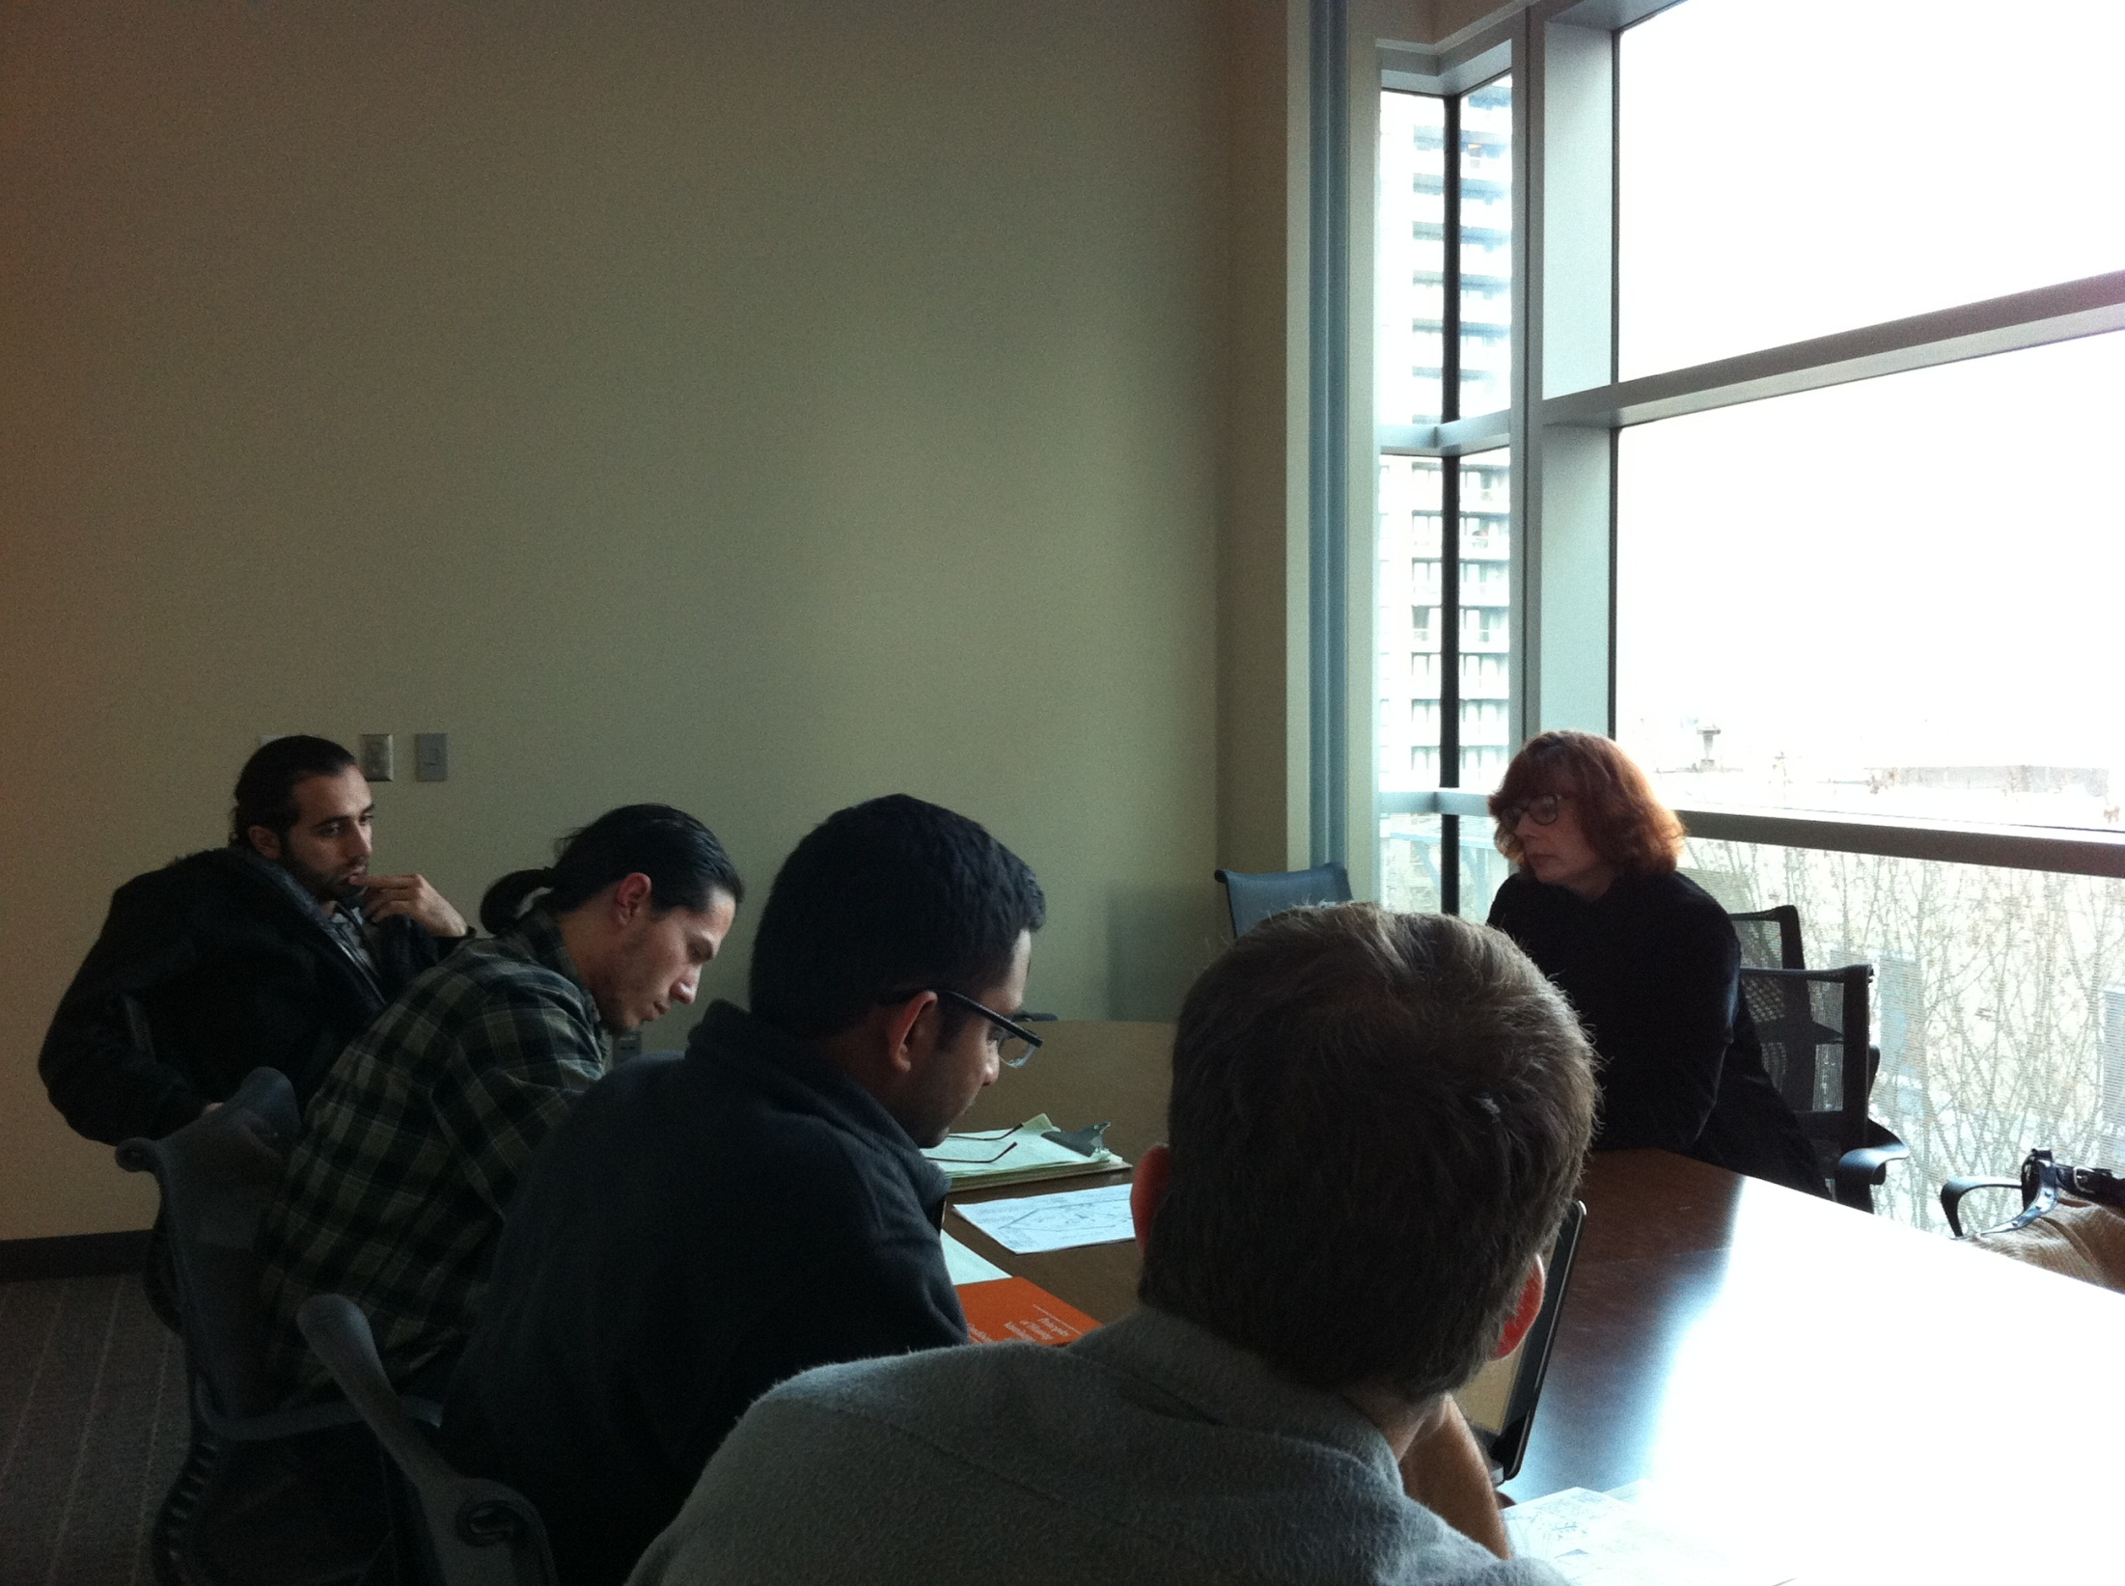

Slide 6
Project Plan
Brainstorm & Research
Data collection
Model Design
Calculate Heating and Cooling Loads
Component selection
Model Refinement
Recommendations

Slide 7
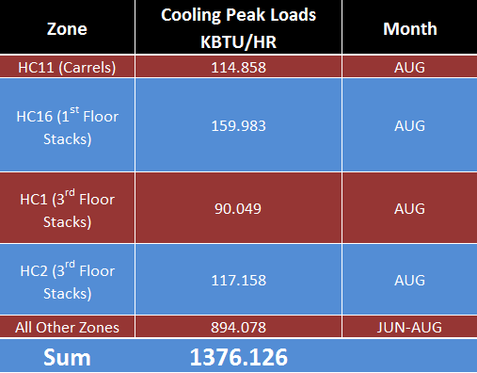
Model Peak Loads

Slide 8
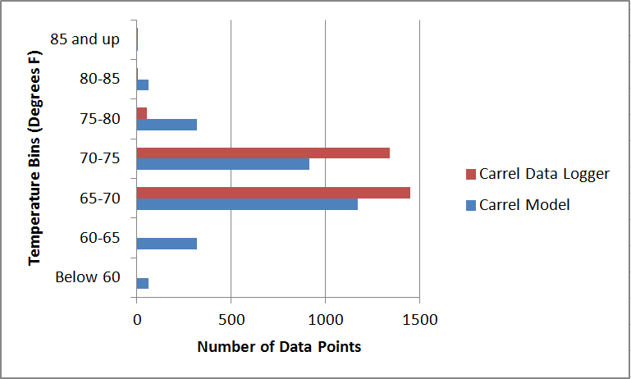
Model Validation

Slide 9


Slide 10
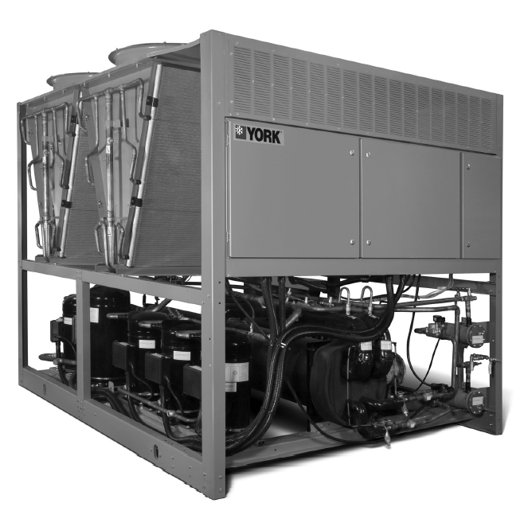
Component Selection
Air-cooled Chiller

Slide 11
Component Selection
Air-cooled Chiller

Slide 12
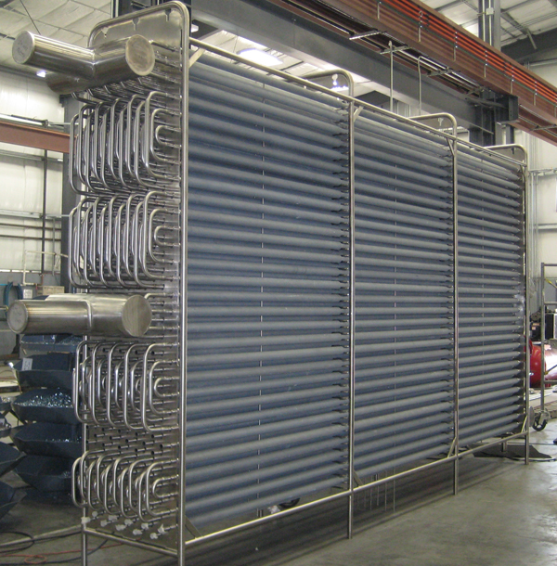
Component Selection
Central Cooling Coil (finned tube)

Slide 13
Component Selection
Central Cooling Coil (finned tube)

Slide 14
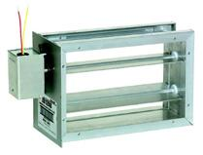
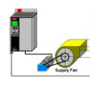
Component Selection
Zone Control Dampers
Variable Frequency Drive

Slide 15
Component Selection
Zone Control Dampers
Variable Frequency Drive

Slide 16
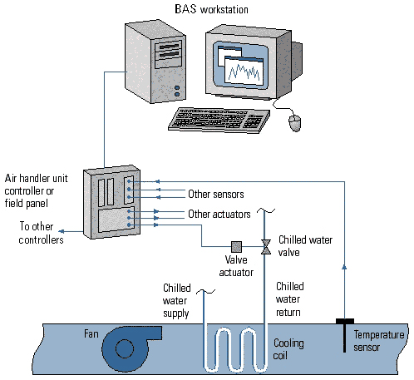
Component Selection
DDC (digital controls)

Slide 17
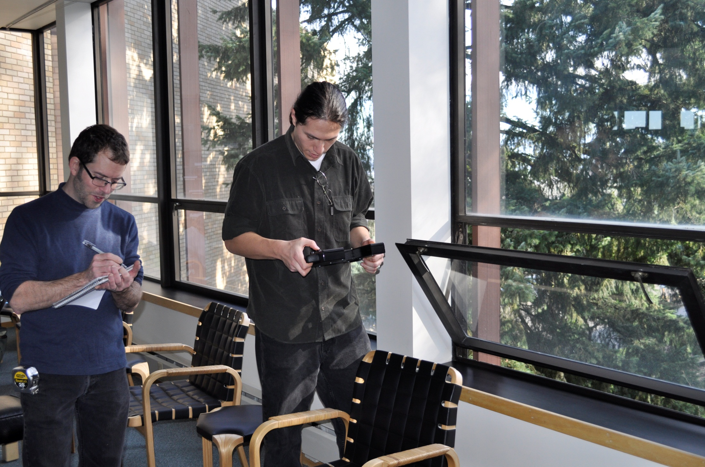
EUI=
144 kBtu/ft²

Slide 18

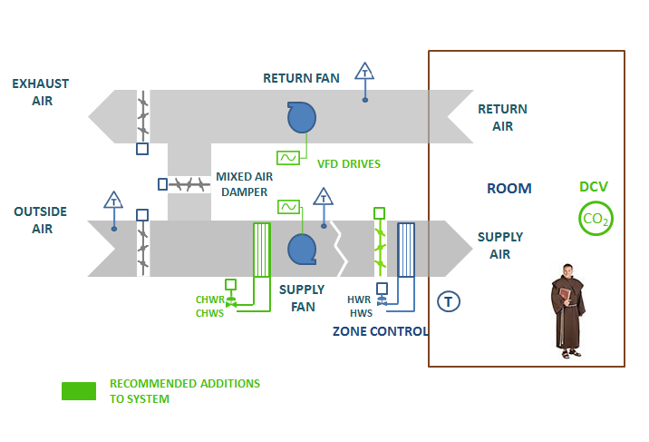
Recommendations

Slide 19
Recommendations
COMPLETE NEW SYSTEM:
120 TON CHILLER
CENTRAL COILING COIL
ZONE CONTROL DAMPERS
SUPPLY/ RETURN FAN VFD
DDC CONTROLS
ECONOMIZER REPAIR

Slide 20
Recommendations
PHASE I
SYSTEM REPAIR:
ECONOMIZER
PNEUMATIC CONTROLS
BALANCE MANUAL DAMPERS
ADD INSULATION
PHASE II
HYBRID DDC CONTROLS:
NEW DIGITAL HEADEND
EPT SWITCHES ON ACTUATORS
UTILIZE PNEUMATIC POWER
COMPLETE NEW SYSTEM:
120 TON CHILLER
CENTRAL COOLING COIL
ZONE CONTROL DAMPERS
SUPPLY/ RETURN FAN VFD
DDC CONTROLS
ECONOMIZER REPAIR
PHASE III
120 TON CHILLER
CENTRAL COOLING COIL
ZONE CONTROL DAMPERS
SUPPLY/ RETURN FAN VFD
PHASE IV
FULL DDC CONTROLS:
REMOVE PNEUMATIC SYSTEM
INSTALL ELECTRONIC ACTUATORS
DCV CO2 SENSORS
HUMIDISTATS IN WORST ZONES

Slide 21
Recommendations

Slide 22
Recommendations

Slide 23
Conclusion

Slide 24
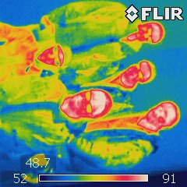
 Questions 
Ali Alsahaf
Ghassan Mustafa
John Slate
Santiago Rodriguez
Ras Wickramaratne

